Slide 1
CouchDB
MEMBERS:
DEEPAK JAISWAR(37)
ANILKUMAR YADAV(74)
RAMZAN KHAN(75)

Slide 2

CouchDB feature
First released in 2005 and later became Apache project in 2008
CouchDB is written in Erlang, a functional programming language with a focus on writing robust, fault tolerant and highly concurrent applications
A document oriented NoSQL database
Store data with JSON documents
HTTP for its API
Eventual consistency
Replication It follows ACID properties
CouchDB supports Browser Based GUI console(fauxton) for easier in interaction between user and application

Slide 3
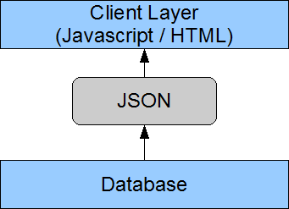
Architecture of CouchDB
It is a 2-tier architecture
CouchDB uses HTTP as its main programming interface and JSON for data storage.
As we have JavaScript on Client side, performance will increase due to compatibility of JSON with JavaScript
CouchDB is compatible to platforms such as Windows, Linux, Mac-iOS, Android mobiles.
CouchDB is more suitable for Client app such as web applications.

Slide 4
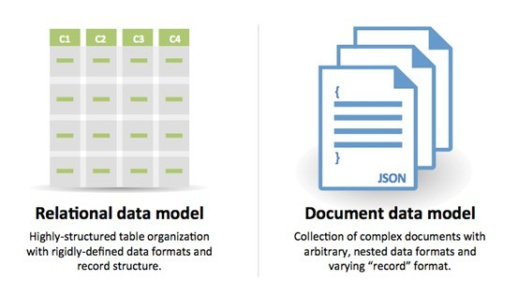
Document oriented database

Slide 5
HTTP for API
HTTP is most widely deployed end-user visible protocol in existence. It handles everything from serving, routing, proxying, monitoring, measuring and debugging.
The main way to do anything with CouchDB is via HTTP. Create a database: make an HTTP request; create some data: make an HTTP request; query your data: make an HTTP request; set up replication: make an HTTP request; configure the database: make an HTTP request. You get the idea.

Slide 6
Pros and Cons of CouchDB
Pros:
We don't need to fit our data into one of those higher-order normal forms
We can change the "schema" of our data at any time
Our data will be indexed exactly for our queries, so we will get results in constant time.
We don’t require plugins such as Adobe Flash player or any.
Cons:
We need to create views for each and every query, i.e. ad-hoc like queries (such as concatenating dynamic WHERE's and SORT's in an SQL),queries are not available.
We will either have redundant data, or we will end up implementing join and sort logic on "client-side"

Slide 7
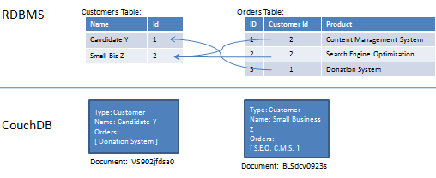
Example

Slide 8
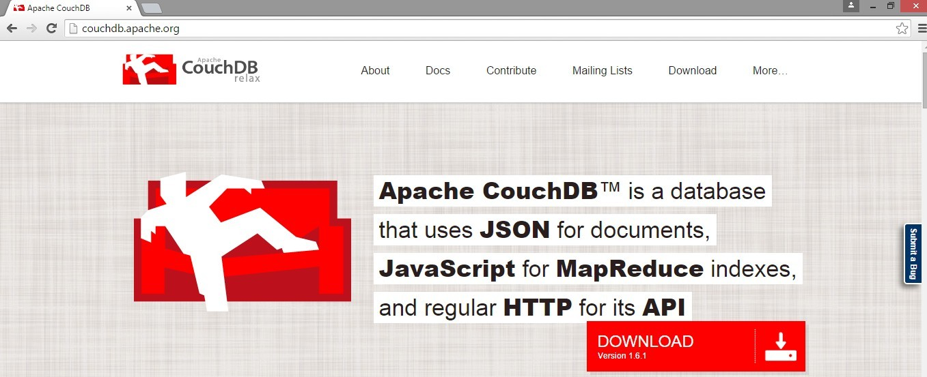
SQL vs NoSQL

Slide 9
THANK YOU

