Slide 1


SRI KRISHNA COLLEGE OF ENGINEERING AND TECHNOLOGY (AN AUTONOMOUS INSTITUTION | AFFILIATED TO ANNA UNIVERSITY | ACCREDITED BY NAAC WITH “A” GRADE) ACCREDITED BY NBA(CSE, IT, ECE, EEE, MECH, MCT & CIVIL) KUNIAMUTHUR, COIMBATORE, TAMILNADU, INDIA
SKCET STUDY MATERIAL
Subject Name : PHYSICS - 23PHI101
Module : I – WAVE OPTICS
TOPIC : NICOL PRISM
BRANCH : I M.TECH.CSE
Dr. I. Pradeep
Associate Professors in Physics
Department of Science and Humanities

Slide 2
NICOL PRISM
Nicol prism is an optical device fabricated from calcite crystal for producing and analyzing plane polarized light named after its inventor William Nicol who designed it in 1820.
Its action is based on phenomenon of double refraction.
It's constructed in such a way that O-ray is eliminated by total internal reflection and we get only the plane polarized E-ray coming out of the Nicol.

Slide 3
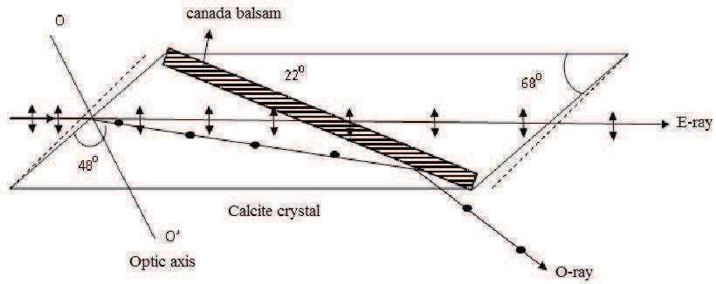

Slide 4
Construction
A rhomb of calcite crystal with length AB three times as long as its breadth CD is obtained by cleavage from the original crystal.
The ends faces are grounded until they make an angle of 68⁰ instead of 71⁰ in natural crystal.
Then the crystal is cut into two parts along a plane perpendicular to the principal axis as well as to the new end surfaces AB and CD (figure)

Slide 5
Thus the two parts are grounded and polished optically flat than again cemented together with a layer of Canada balsam.
Canada balsam is a clear transparent material whose refractive index (µ_{cb} = 1.55) lies between the refractive index for calcite for the O-ray (µ_{o} = 1.66) and E-ray (µ_{e} = 1.486) for sodium yellow light of mean wavelength λ = 5893 Å.

Slide 6
Action of Nicol Prism
When un polarized light is incident on the prism parallel to AB.
it suffers double refraction and splits into O-ray and E-ray as shown in figure. When these ray strikes at Canada balsam layer (which is denser than calcite for E-ray and less dense for O-ray) O-ray travels from an optically denser to a rarer medium it is totally reflected in case the angle of incidence is greater than a certain critical value (critical angle).

Slide 7
This reflected ray is completely absorbed as the tube containing the crystal is coated black.
E–ray is not reflected as it travels from an optically rarer to a denser medium hence E-ray is transmitted through the prism.
Thus Nicol prism acts as a polarizer.
Now the reason behind natural angle 71⁰ is reduced to 68⁰ and choosing length three times to its width enables the O-ray to fall at the Canada balsam layer at an angle greater the critical angle.

Slide 8




Let θ is the critical angle for the O-ray. Than refractive index of O-ray with respect to Canada balsam layer is
The condition for total internal reflection is
Thus, if the angle of incidence for the O-ray is greater than 69⁰ it is totally internal reflected and absorbed by blackened wall.

Slide 9
Nicol Prism as Polarizer and Analyzer
When two Nicol prisms P and A are arranged coaxially adjacent to each other.
First Nicol P acts as a polarizer and other acts as analyzer. Such a combination of polarizer and analyzer is called polariscope.
If unpolarized ray of light is incident on the first Nicol P, E-ray is transmitted with its vibration directly lying in the principal section of P.

Slide 10
The state of the polarization of the light can be analyzed by another Nicol called analyzer.
If principal section of analyzer A is parallel to principal section of polarizer P, E-ray is transmitted through analyzer A without any hindrance.
In the case of Parallel Nicols the intensity of emergent E-ray is maximum (figure).
If the analyzer A is gradually rotated the intensity of E-ray decreases in accordance with Malus law.

Slide 11
In case the angle between principal sections of two Nicol is 90⁰ they are called crossed Nicol.
In the case E-ray when it enters the analyzer acts as O-ray inside the prism hence totally reflected at balsam layer hence no light comes out of the analyzer A (figure).
If A is further rotated the intensity of emergent light from A will go on increasing and is becomes maximum when its principal section is again parallel to that of P

Slide 12
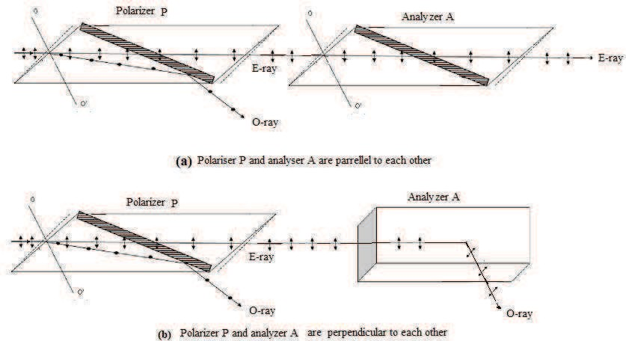

Slide 13
In this way the Nicol prism A is used to analyze the plane polarized light produced by Nicol prism P hence named Analyzer and polarizer respectively.
Limitation of Nicol Prism
A Nicol prism cannot be used for highly convergent and divergent beams.
It is found that the angle of incidence is limited for14⁰ above which the O ray is also transmitted.

Slide 14
It is also found that E- ray also totally reflected if the angle is greater than 14⁰
Thus to avoid the transmission of O-ray and total internal reflection of E-ray the angle between the extreme rays of the incoming beam is limited to 2x14 = 28⁰.

