Slide 1

Branching Strategies
Notes:
Be sure to fill out location and date

Slide 2
Complex Development Workflows
and the constraints that necessitate them
Notes:
Be sure to fill out location and date

Slide 3
Aziz Shamim

Manager, Solutions Engineering
Notes:
Hi!

Slide 4
https://xkcd.com/1597/
Notes:
Humor. The goal is to not do this :-P

Slide 5
What are we seeing?
Software are agglutinative: Build business systems by composing software components.
Software are legacy: Very rarely do older software get replaced. Most get built on-top-of or side-by-side
Notes:
For the most part, software is composed from other software.
For the most part, new software operates in a context that old software creates, it might *change* the context, but rarely replaces it.
In the industry, we see that “composition” for the vast majority of software “creation” includes open source software. That creates some security risks.

Slide 6
What are we seeing?
Conway’s Law is still real: It helps to understand the contexts in which software are developed and deployed.
Best Practices are not universal or fixed: Practices and tools change frequently as software matures.
Notes:
Conway’s Law: organizations which design systems ... are constrained to produce designs which are copies of the communication structures of these organizations.
* No single best practice
I prefer “good practice”
Takes context into consideration
Idea is to avoid waste
How to determine which approach for your repo/app? Start with some questions.

Slide 7
What are we talking about today?
How do we make decisions about the pipelines we use?
What are some templates we can use to think about them?
Can we reuse / augment case studies?
Notes:
How to determine which approach for your repo/app? Start with some questions.
DEFINITION: Pipeline is a type of out-of-order execution, performed by the compiler instead of processor
DEFINITION: Deployment pipeline is similar in that a push might serially yield a build that triggers a parallel code analysis, unit test, integration/API test, etc…

Slide 8
Questions Needing Answers
Release cadence?
Release method?
How many maintained versions?
How is QA performed? Lots of automation or lots of humans?
Preferred level of complexity and control?
Notes:
* No single best practice
I prefer “good practice”
Takes context into consideration
How to determine which approach for your repo/app? Start with some questions.

Slide 9
Constraints
 | Website/SaaS | Delivered Software | Embedded Software | Legacy/Closed systems
Cycle time | ~minutes | ~days | ~weeks | ?
Delivery | push | push/pull | pull, push is complex (tied to hardware) | ?
Tool chain | pipeline supported by platforms | pipelines supported by platforms | bespoke | Proprietary
Notes:
Website/SaaS - aka live running software, Speed to deploy, Small iterative changes delivered quickly, Zero-change scale OOM - minutes, API and F-E changes aren’t strictly coordinated, i.e independent cycles
Delivered software - old-model CD, packaged binaries w/ customer controlled updates, Stability is important, Delivery is harder - pull vs push, Zero-change scale OOM - hours - weeks
Embedded software - Correctness is most important, Often software version tied to hardware version - might be brittle, Hardware versions are hardest to update, software follows
Legacy Applications - Proprietary IDE, Application Platform deployment

Slide 10
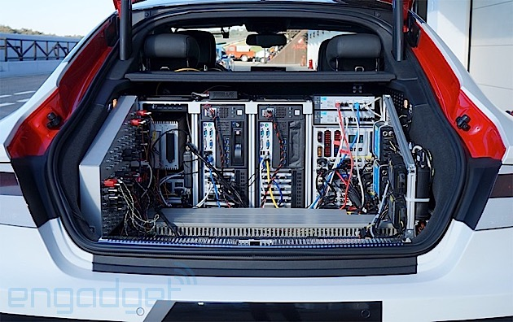
Trunk Based Development

Slide 11

Trunk-based
Linear history - easy to read
Good to have detailed commit messages
Hard to have workflow automation & review
Notes:
Purely serial development likely defeats the value of parallel development. Simple workflows work for very small numbers of developers. Can also be used for very small development teams working on low-complexity, low-novelty applications.

Slide 12
Trunk-based
Scales to 1 developer working on master (or short-lived branches)
More people and longer-lived branches require adding complexity

Slide 13
Trunk-based
Differing opinions on what TBD is:
Feature branching?
Commit to master?
Principles
Dev as close to trunk/master as possible
Feature branches live as short a time as possible
Master is deployable
Feature toggles

Slide 14
SaaS - style application

It’s always running the most current version

Slide 15
SaaS-style application
New Development | Feature branches off master
Patches/Fixes | Feature branches off master
Releases | Every push to prod is a release (no formal)
Backports | N/A
Example | GitHub.com
Notes:
Backporting is the action of taking parts from a newer version of a software system or software component and porting them to an older version of the same software. (ie. Merging newer, possibly less stable, versions into the current master or feature branch.

Slide 16
SaaS-style
master

Slide 17
SaaS-style
featureA
master

Slide 18
SaaS-style
featureA
master
featureB

Slide 19
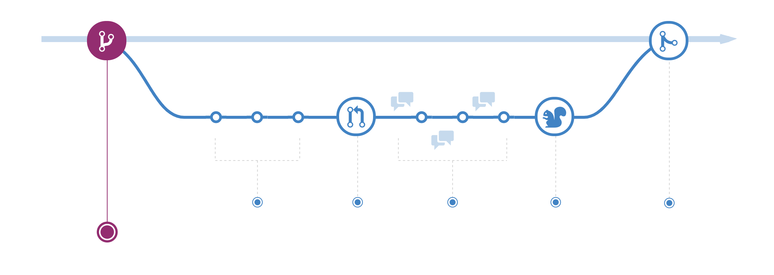
GitHub Flow
master/trunk
feature/fix

Slide 20

GitHub Flow: Rules
http://scottchacon.com/2011/08/31/github-flow.html
Master is always deployable
Create descriptive branches off of master
Push to named branches constantly
Open a Pull Request at any time
Merge only after Pull Request review
Master is always deployable, so deploy it

Slide 21
GitHub Flow: Implementation Techniques
branch protection on master branch
Require feature branches to stay up-to-date with master
Code owners and required reviews
Automated CI: honoring “skip ci” commit messages
Chat-based deployment workflows, with deployment queues
Release Trains with rules
Notes:
GitHub allows you to limit privileges to branches as well as require reviews prior to merging pull requests.
Use “skip ci” to avoid long-running builds for minor commits
ChatOps allow for bots to perform common build/deployment related tasks. Essentially, they become a platform for conversation-driven collaboration allowing people to work better together.
Like locomotives, software release trains run on schedules. Rules drive those schedules. Essentially, they become the sequence of activities that yields a result of observable value.

Slide 22
Single maintained version


Slide 23
Single maintained version
New Development | Feature branches off master
Patches/Fixes | Feature branches off master
Releases | Versions tagged along master
Backports | N/A
Example | atom/atom
Notes:
Example: atom/atom
(Atom also utilizes Fork and Pull…)

Slide 24
Single maintained version
master

Slide 25
Single maintained version
featureA
master

Slide 26

Single maintained version
featureA
v1.1.0
v1.2.0
master
featureB

Slide 27
Git Tags & GitHub Releases
Any commit in Git can be tagged
git tag v1.1.0
Any commit can become a release in GitHub
Programmatically obtain specific releases
View releases (and associated binaries and notes) on a web page
Tags can be lightweight (above) or annotated
git tag -a v1.1.0 -m ‘version 1.1.0 of app’
Annotated tags are full objects (tagger name, e-mail, date, message)
Can be signed via GPG
Notes:
GPG = GNU Privacy Guard (open-source replacement to PGP)

Slide 28
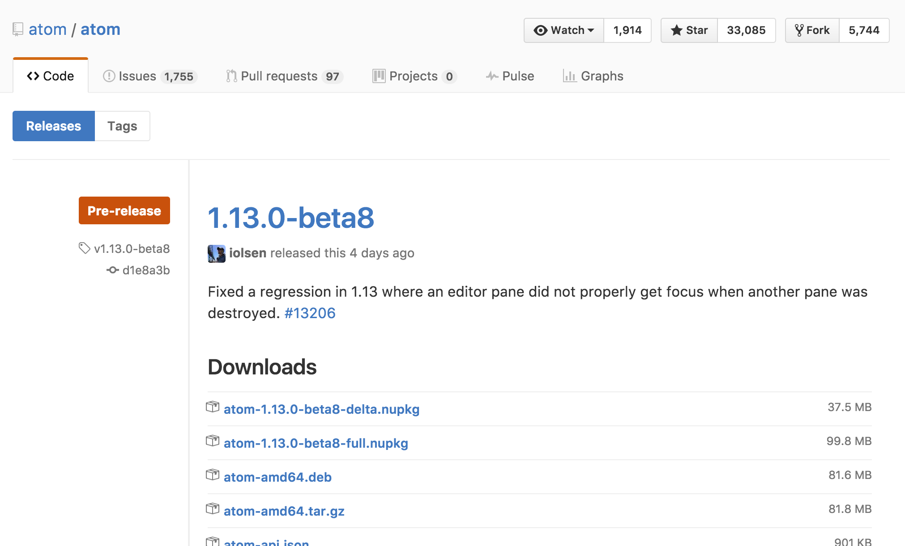
Notes:
Example of a release page. Click the picture to go to the releases page for atom/atom.

Slide 29
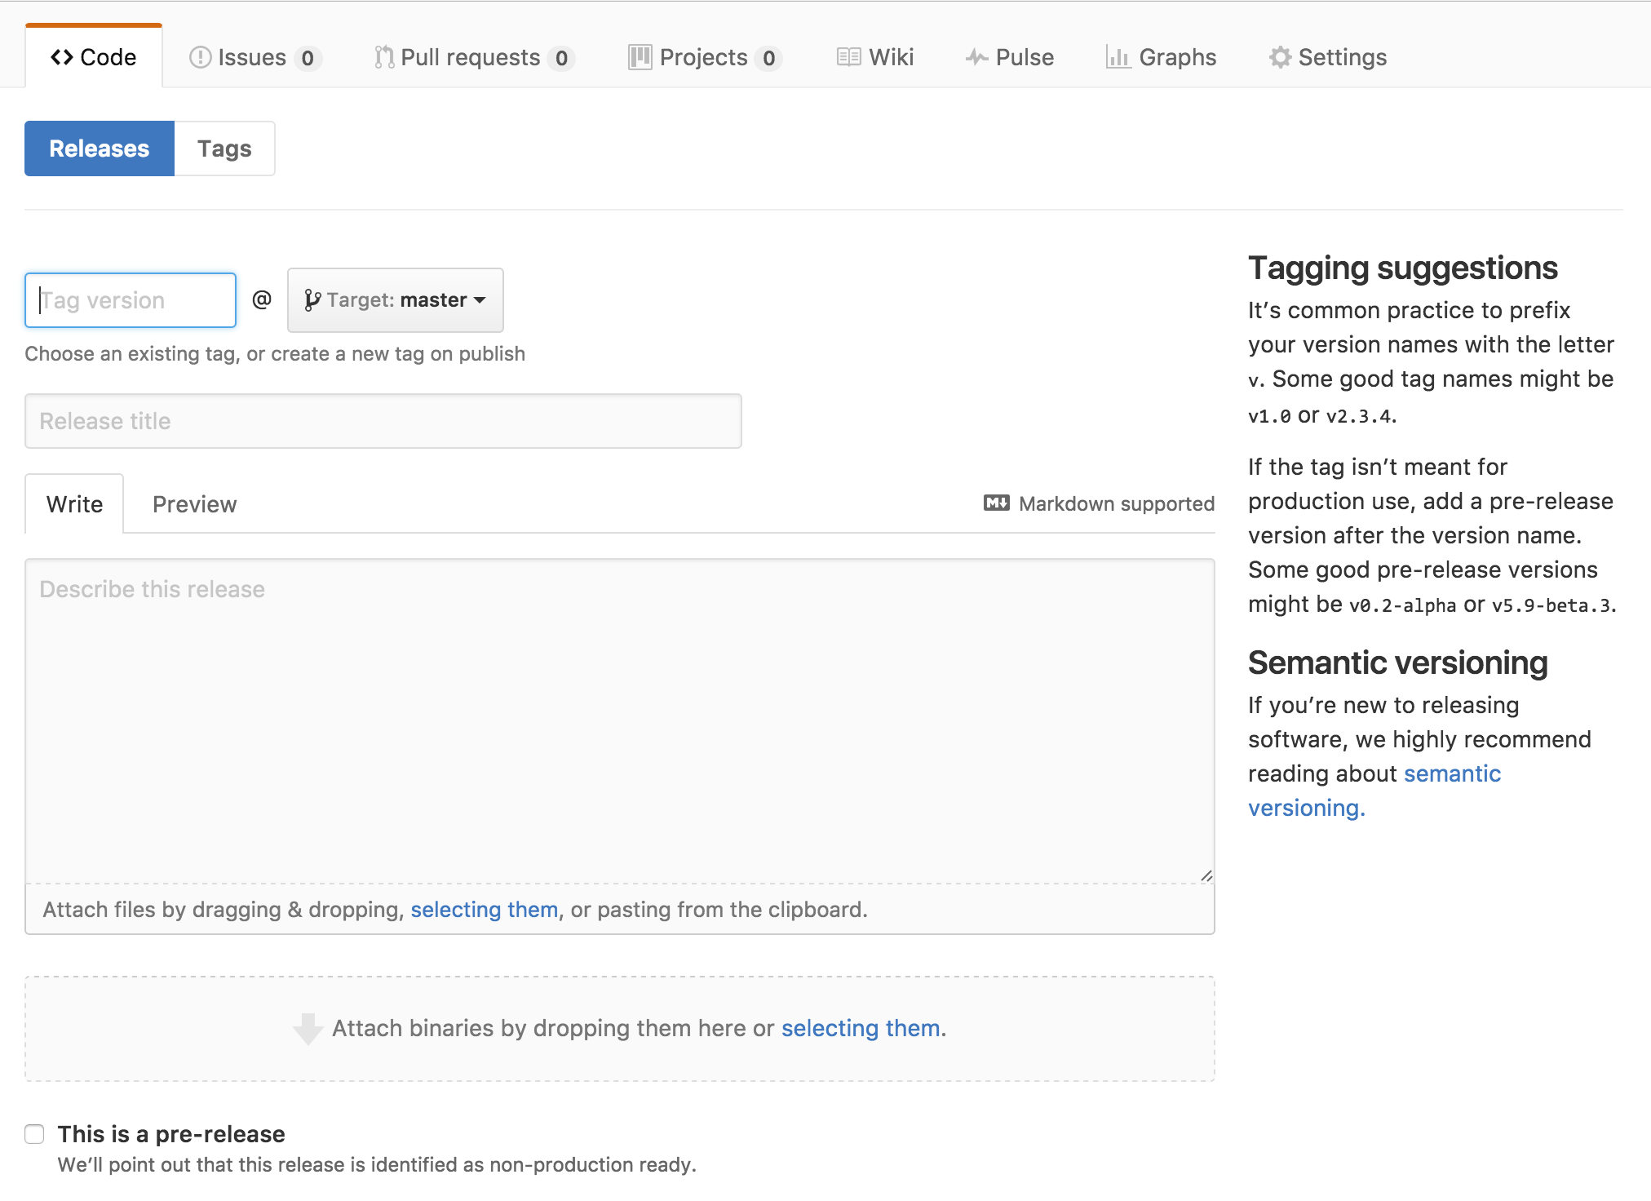
Notes:
How to create a release in the GitHub GUI
Note that this can be done via the API as well

Slide 30
Many maintained versions

Supported versions! So many supported versions!

Slide 31
Notes:
Humor! Also a time to talk about best processes for semantic versioning.
SemVer = semantic versioning
Current Ubuntu = 19.04 Disco Dingo

Slide 32
Multiple maintained versions
New Development | Feature branches off master
Patches/Fixes | Generally feature branches off master
Releases | Each minor version is a long-lived branch Patch releases tagged along these branches
Backports | Patches/fixes to master must be back ported to supported versions
Example | GitHub Enterprise
Notes:
Mention another use for long-lived branches includes is for QA - especially in cases where some to most of the QA is manual

Slide 33
Many maintained versions
featureA
master
v1.2.0
v1.2-release
v1.1.0
v1.1-release
Notes:
* Release branches were created for v1.1 and v1.2
* Work committed to `master` will become part of 1.3.0

Slide 34
Backporting process
Merge PR into master
Branch off release branch(es)
Cherry pick commits from PR onto branch & create new PR
Collaborate
Merge new PR
Tag new version

Slide 35
Many maintained versions
featureA
master
v1.2.0
v1.2.1
v1.2-release
v1.2-release-backport-featureA
v1.1.0
v1.1.1
v1.1-release
v1.1-release-backport-featureA
Notes:
featureA needs to be back ported to v1.1 and v1.2

Slide 36
git cherry-pick
Applies change(s) introduced by existing commit(s)
git checkout applyToThisBranch
git cherry-pick <existingCommit> <existingCommit2>
Creates new commit objects
Use git-cherry to determine if commits have been applied upstream

Slide 37
GitHub Enterprise: Automating backports
We use ChatOps to automate backport process
Saves time
Mitigates tedium
Reduces potential human error

Slide 38

GitHub Enterprise: Automating backports
Merge PR into master
Apply backport label(s) to PR
Run chatOps command
.ghe-backports
Let Hubot do the work

Slide 39
GitHub Enterprise: Automating backports
Hubot looks in configured repo for backport labels
For each PR with a backport label, Hubot:
Creates backport branch(es) off release branch(es)
Cherry picks commits from the PR onto the new branch(es)
Opens up new PR(s) for the new branch(es)
References source PR
CCs users whose commits are cherry-picked
CCs the release team
Removes the backport labels from original PR

Slide 40
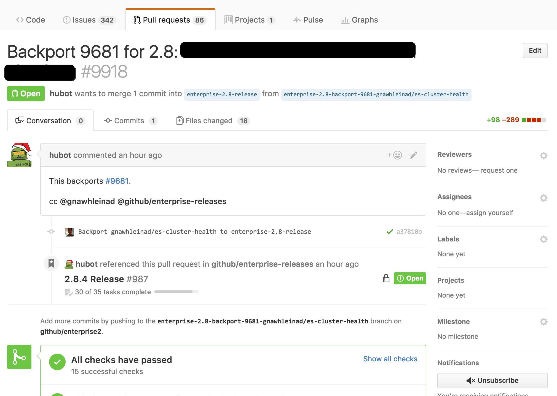
GitHub Enterprise: Automating backports

Slide 41
Fork & Pull

Separate repositories for development and publication

Slide 42
Fork & Pull
How
Developer forks repo into different namespace (personal or different org)
Development occurs on branches in forked repo(s)
Branches from forked repo PRed into parent repo
Common Open Source workflow

Slide 43
Fork & Pull
Benefits
Enable wide participation while limiting write access
Keeps parent repo tidy when many contributors (open source)
Challenges
Proliferation of forks reduces visibility
Multiple contributors to a fork = more overhead (permissions)
Working with collaborator on PR prior to approval

Slide 44
Fork & Pull
In the Enterprise…
Contributors have a managed identity
Branch protections on a single repo = oversight
Branching off a single repo = more straight-forward collaboration
A single repo is indexed and easily searchable by all
While some edge cases exist for Fork & Pull within the Enterprise, a single repo strategy is usually best

Slide 45
Merging Strategies

Bringing it all together

Slide 46
Merging choices
Options
Merge commit
Rebase
Squash
All about representation of history … for humans

Slide 47
Merge Commit
featureA
B
C
D
master
A

Slide 48
Merge Commit
featureA
B
C
D
master
A
E
E is a new merge commit, which adds all the commits from featureA

Slide 49
Squash and Merge
featureA
B
C
D
master
A
E

Slide 50

Squash and Merge
featureA
B
C
D
master
A
E
E is a new commit, which squashes all commits from featureA

Slide 51
Squash and Merge
master
A
E
E is a new commit, which squashes/combines all commits from featureA
Individual commits not preserved

Slide 52
Rebase and Merge
featureA
B
C
D
master
A

Slide 53
Rebase and Merge
featureA
master
A
B
C
D
Commits are replayed on the base branch featureA
Merge points master to ‘D’

Slide 54
Merging choices
Want the complete history of everything?
Use default Merge Commits
Want to reduce the history of a branch to a single commit?
Use Squash & Merge
Want a linear commit history as if always on a single branch?
Use Rebase & Merge
Not sure what any of this means?
Use default Merge Commits

Slide 55
Promote adherence

To chosen branch strategy

Slide 56
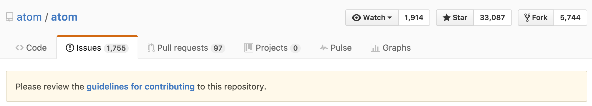
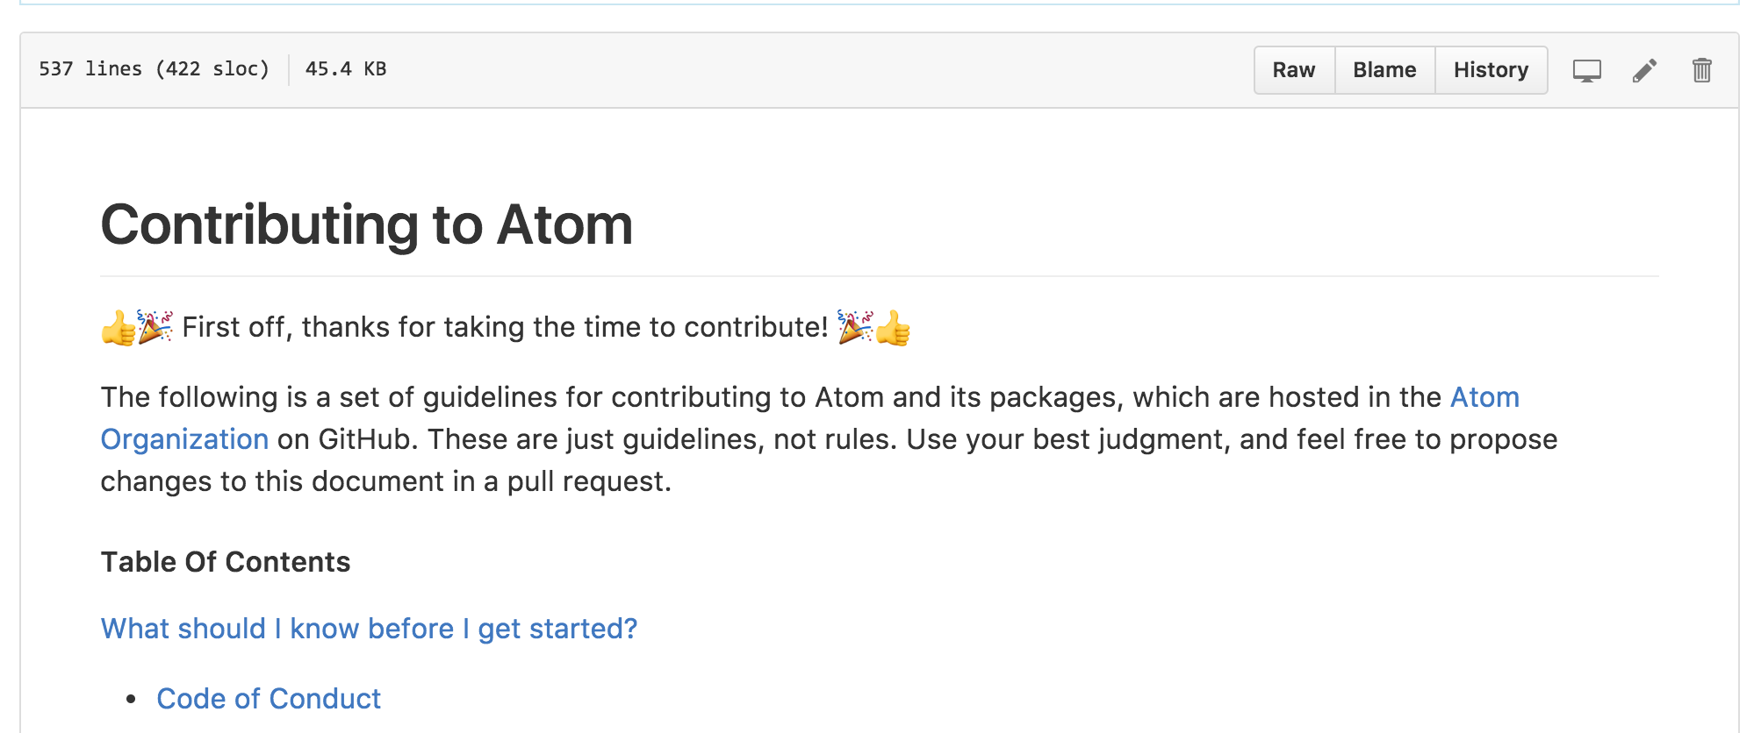
Documentation: CONTRIBUTING.md
Notes:
Use a Contributing.MD file! Then, use it to discuss (among other things) how the code is managed (branching).
Click on the bottom image to go to the contributing.md for atom/atom

Slide 57
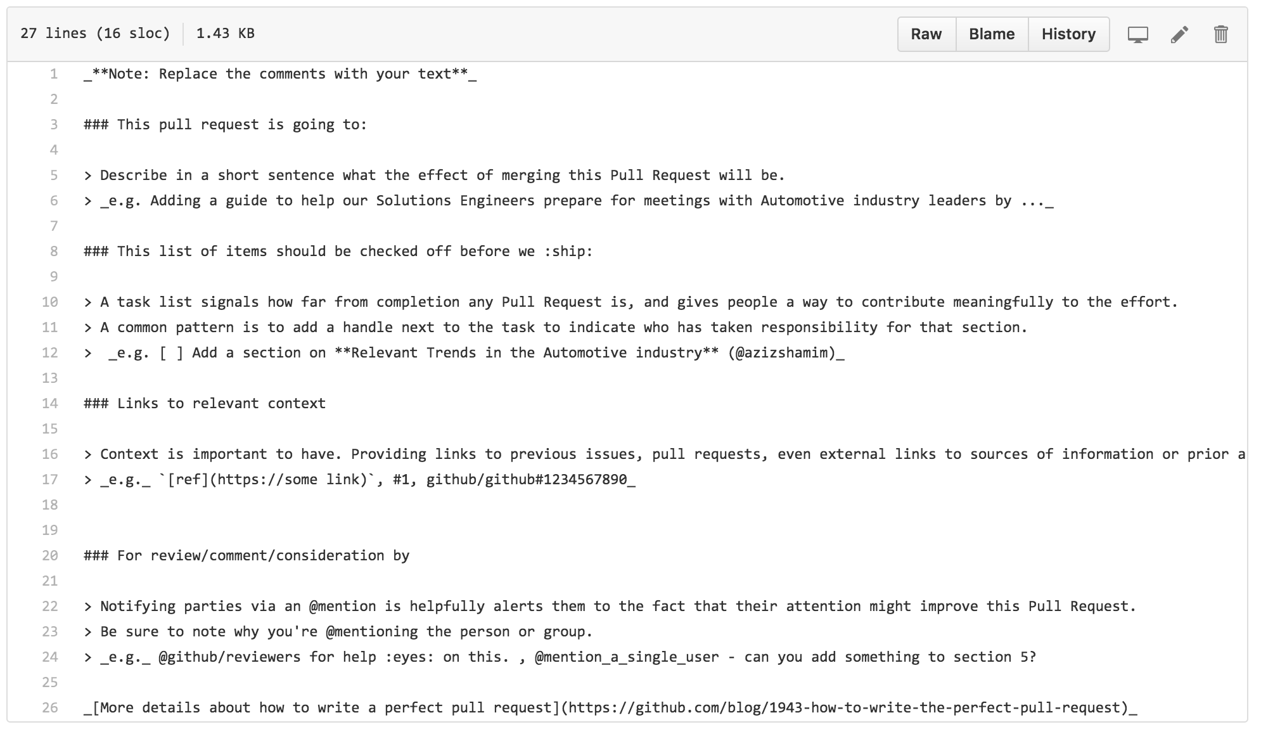
Documentation: PULL_REQUEST_TEMPLATE.md
Notes:
We need a better PR template example from Open Source (there aren’t a ton)

Slide 58
Branch protections
Notes:
Limit who can push into protected branches (as a check on proper branch strategy)

Slide 59
Branch protections
Notes:
Limit who can push into protected branches (as a check on proper branch strategy)

Slide 60
Base branch switcher
Notes:
People will make mistakes. They, or you, can change to the appropriate base.

Slide 61
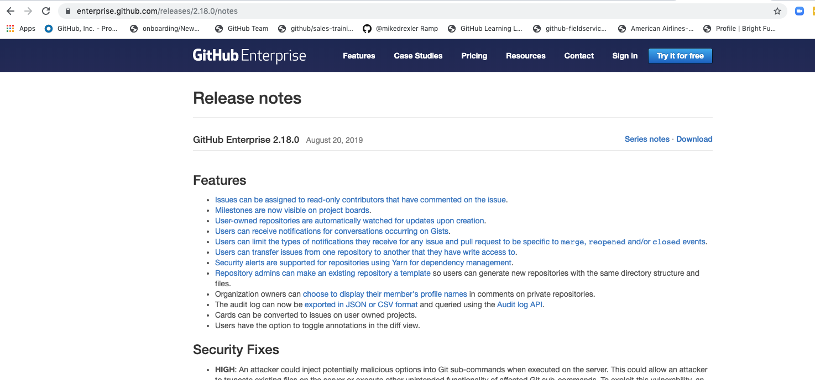
New to v2.18.2
Title Text
In the Enterprise…
Issues can be assigned to read-only contributors that have commented on the issue.
Milestones are now visible on project boards.
Users can transfer issues from one repository to another that they have write access to.
Repository admins can make an existing repository a template
Organization owners can choose to display their member's profile names in comments on private repositories.
The audit log can now be exported in JSON or CSV format and queried using the Audit log API.

Slide 62
Thank you!
please send feedback to aziz@github.com

