Slide 1
ಕ
Kannada Saathi
ಕನ್ನಡ ಸಾಥಿ · your Kannada companion for everyday Karnataka
Speak Kannada. Navigate Karnataka with confidence.
A working, offline-first communication companion — not another vocabulary quiz.
Kannada Digital Innovation Hackathon 2026 · HackerRank Campus Crew × NIE Mysuru
Problem statement #3 — Kannada in Everyday Life (supporting capability: #2 Voice of Kannada) · Individual submission
111
reviewed phrases
8
everyday situations
6
role-play scenes
0
API keys needed
React 18 · TypeScript strict · Vite 8 · Tailwind · 290 bundled Kannada recordings · 83 passing tests
1

Slide 2
PROBLEM STATEMENT · KANNADA IN EVERYDAY LIFE
Public life in Karnataka runs on spoken Kannada
Students, professionals, patients, workers and visitors need sentences, sounds and tone — not word lists
• Signage and counters are Kannada-first — shops, hospitals, rail and bus infrastructure, government offices
• Translation tools stop at the word — they do not give a beginner a polite, complete sentence
• The cost is access, not embarrassment — missed stop · overpaid fare · wrong dosage timing · a visit conducted through a third person
• The barrier is social — people stay silent because a mistake feels rude, and no tool rehearses the moment
Six moments the app is built around
ಬಸ್ ನಿಲ್ದಾಣ ಎಲ್ಲಿದೆ? Where is the bus station?
ಇದರ ಬೆಲೆ ಎಷ್ಟು? How much is this?
ಎರಡು ದಿನಗಳಿಂದ ಜ್ವರ ಇದೆ. Fever for two days.
ಈ ಮಾತ್ರೆ ಖಾಲಿ ಹೊಟ್ಟೆಯಲ್ಲಿಯೇ? Tablet on an empty stomach?
ಮೀಟರ್ ಹಾಕಿ, ಸಾರ್. Use the meter, sir.
ಒಂದು ಕೋಣೆ ಖಾಲಿ ಇದೆಯೇ? Is a room free?
Requirement read-back: help people learn and use Kannada in travel, shopping, education, healthcare, transportation and workplaces.
2

Slide 3
WHO IS AFFECTED · AND WHAT THEY LOSE
Same city, different silence
Group | The moment they cannot handle | Today's workaround
First-year students (Mysuru, Manipal, Bengaluru) | classroom office, hostel mess, asking a question in class | English, or a Kannada-speaking friend
Transferred professionals & site staff | auto fare, shop bargaining, small talk with colleagues | translation app, one word at a time
Patients and caregivers from other states | describe pain, confirm dosage timing, follow-up date | gesture, third-party interpreting
Market, domestic and gig workers | employer instructions, pharmacy, bus conductor | pidgin Kannada, repeated mistakes
Tourists at Hampi, Coorg, Gokarna, Mysuru | entry fee, photo permission, guide, hotel basics | phone maps, cash-only confusion
Impact goal: after eight minutes in the app, a learner completes one real transaction in the situation they just rehearsed — without switching to English or waving a phone.
Target users: anyone literate in English who is functionally silent in Kannada.
3

Slide 4
EXISTING SYSTEM
Today's tools translate words. They do not survive a counter.
Existing option | What it does well | Where it fails at the moment of need
Google Translate | fast word/sentence pairs | no situation, no tone, no practice, no polite-vs-blunt choice, useless offline on venue Wi-Fi
Duolingo-style apps | habit, gamification | weeks of lessons before one usable sentence; topic lists, not bus stands
YouTube basic-Kannada videos | listening exposure | passive; nothing retrievable when you are already standing at the counter
PDF phrasebooks | dense content | script without sound or transliteration; no meaning of *when* to say it
Asking a local friend | accurate, warm | not available at 6 a.m. at a bus stand; no repetition for the learner
The real gap: a sentence you can say, the sound of it, the tone that makes it polite, and a rehearsal of the reply you will actually get.
A gap in workflow, not in vocabulary data — so the fix is product shape, not a bigger word list.
4

Slide 5
THE SOLUTION
Kannada Saathi: organised by the moment you are in
A · Situations
8 situation cards → 111 reviewed phrases. Script + transliteration + meaning + when-to-use + bundled Kannada audio + copy + bookmark.
B · Voice practice
Bundled Kannada recording for every target, kn-IN recognition where supported, typed fallback, capability dashboard. Text-similarity feedback — never a fake accent score.
C · Role-play
6 branching scenes. The other person replies; every choice gets a coaching note; risky-but-understood replies are explained, not failed.
D · Phrasebook
Ranked search across all four fields, situation filter, sort modes, recently viewed; favourites persist on-device and export as .txt from /favorites.
E · Quiz
12 curated judgement questions + a generator over the same data, 4 question types, matching round, best score kept, misses returned as review cards.
F · Culture
10 context notes (namaskāra gesture, -ರು respect, akka/appa/mama, temple etiquette) + regional variants, each badged for native review.
Bonus: “What do I say?” — describe the problem in English, get ranked Kannada lines. Retrieval over the reviewed dataset; works with zero network.
Every feature above is implemented and reachable in the live build — no mock screens.
5

Slide 6
HOW THIS IS DIFFERENT
Four decisions nobody else in this category is making
Situation-first, not word-first
Content is indexed by the pressure you are under, so retrieval at a counter takes one tap instead of a dictionary search.
Honest capability reporting
The app plays a real bundled Kannada recording even when the browser has no kn-IN voice, reports recognition gaps honestly, and refuses to display a pronunciation score it cannot compute.
Role-play that explains
A polite-but-wrong reply is answered and annotated, because that is what happens in real speech — the lesson is in the tone, not the vocabulary.
Local-first, reviewable data
No backend, no key, no third-party/API fetch (audio is bundled). Every phrase carries a review status, so a native speaker can audit and fix the dataset in one file.
Judged on innovation? The innovation is the trust model: 107 standard lines, 4 visibly badged for review, 0 invented dialects, 80 automated tests that police the data itself.
Existing system: words. This: sentences, sound, tone, rehearsal, and knowing what it does not know.
6

Slide 7
APPROACH
How it is built, and why each choice
1. Model the data first — Phrase / Category / ConversationScenario / QuizQuestion / ProgressState as TypeScript types in src/types. 111 phrases and 6 scenes as typed modules compiled into the bundle → content on first paint, no fetch, no key.
2. One state owner — ProgressProvider context exposes favourites, recent, practice log, scenes, quiz best. services/storage.ts writes one versioned localStorage key with defensive hydration → refresh-safe, multi-tab safe, quota-safe.
3. Capability layer for voice — detectCapabilities() reads speechSynthesis voices, SpeechRecognition and secure context. Every entry point returns a typed reason (no-tts / no-voices / permission-denied / no-speech / network) instead of throwing.
4. One normalisation layer — utils/text.ts (NFKD, diacritic- and ZWNJ-tolerant) is shared by search, the assistant and the similarity comparison, so transliteration quirks never split the results.
5. Role-play as a graph — Nodes + options with a mandatory `next` (node id or end). Tests walk every edge, so no scene can dead-end; free text resolves through the same search ranking.
6. Optional AI, fenced off — assistant.ts is offline retrieval by default. VITE_AI_PROXY_URL points at your own proxy — the provider key never ships, because VITE_* is inlined into public JS.
Key design decision: reliability beats feature count. Nothing in the core flow can fail because a service is down.
7

Slide 8
FEATURE WALKTHROUGH
One user, one morning, six screens
1
Open → Situations
eight cards, each showing how many phrases you have opened
2
Hospital & pharmacy
tap a card: script, transliteration, meaning, when-to-use, play, copy, save
3
What do I say?
type “I have fever since two days” → ranked Kannada lines, offline
4
Role-play: bus
choose a reply → the conductor answers → coaching note + alternatives
5
Voice practice
mic in kn-IN, or type it → text-match score + capability truth panel
6
Quiz & refresh
answer → matching round → best score kept; favourites survive F5
Live demo in the submission video covers exactly this path. Functional requirements met: browse a scenario · search · save/remove favourites · favourites persist after refresh · play or an explicit unsupported fallback · complete a conversation · complete a quiz with a score · progress from real interactions only · desktop + mobile · README-run local start.
Nothing above is a design comp: each screen is implemented and reachable in the running build — the next slide shows them as captured.
8

Slide 9
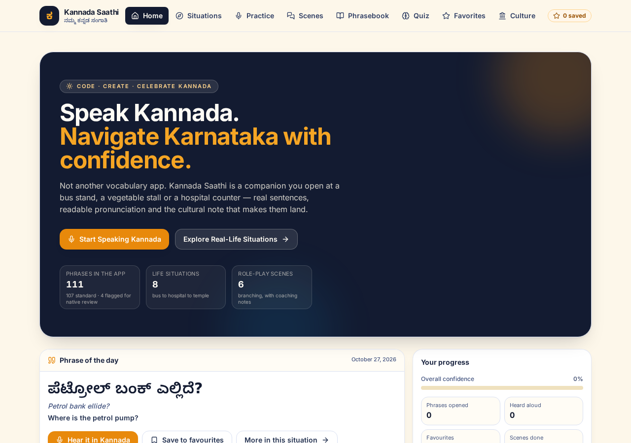
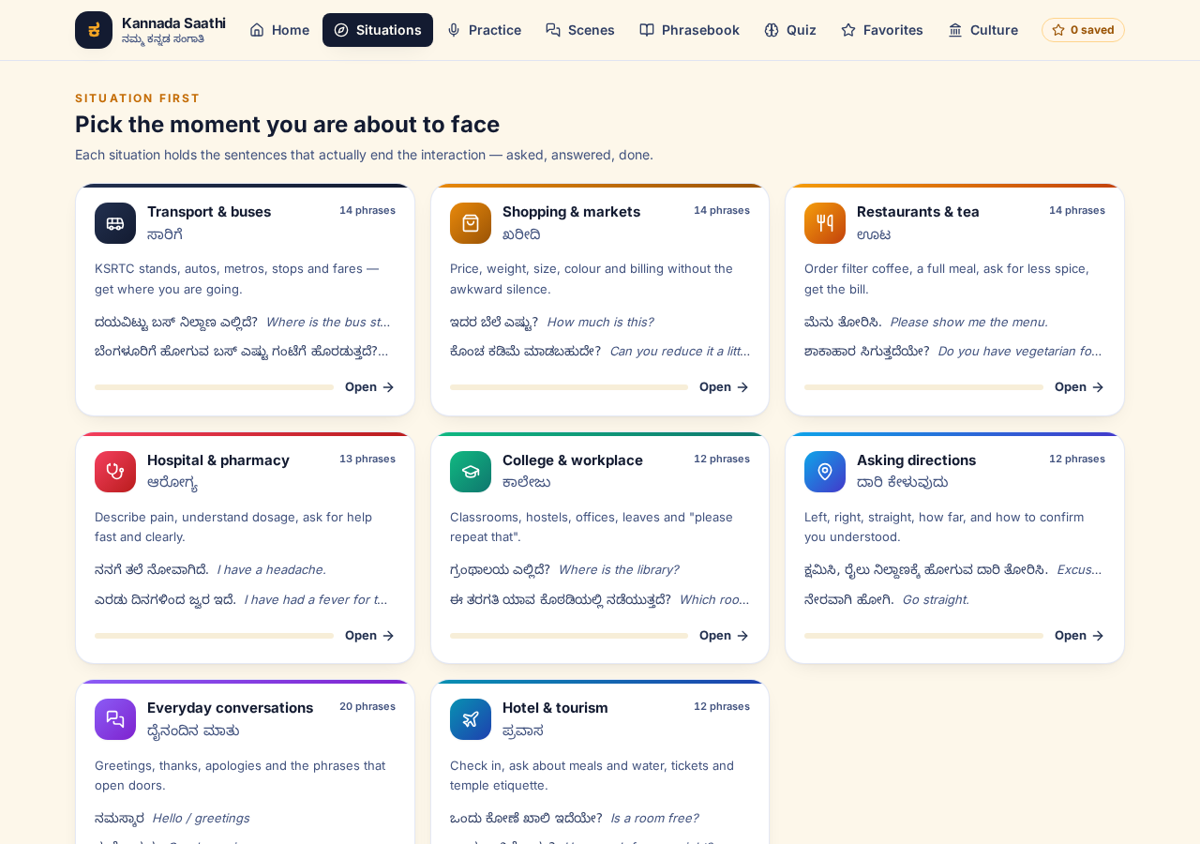
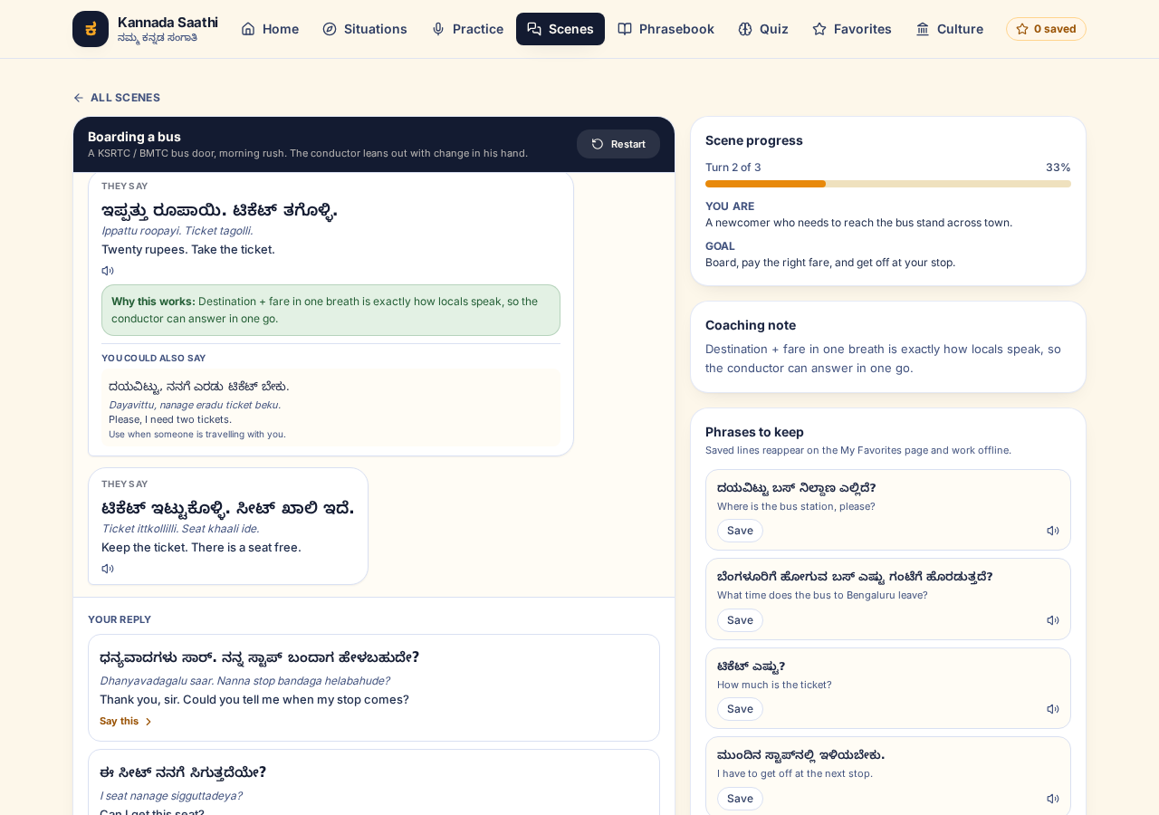
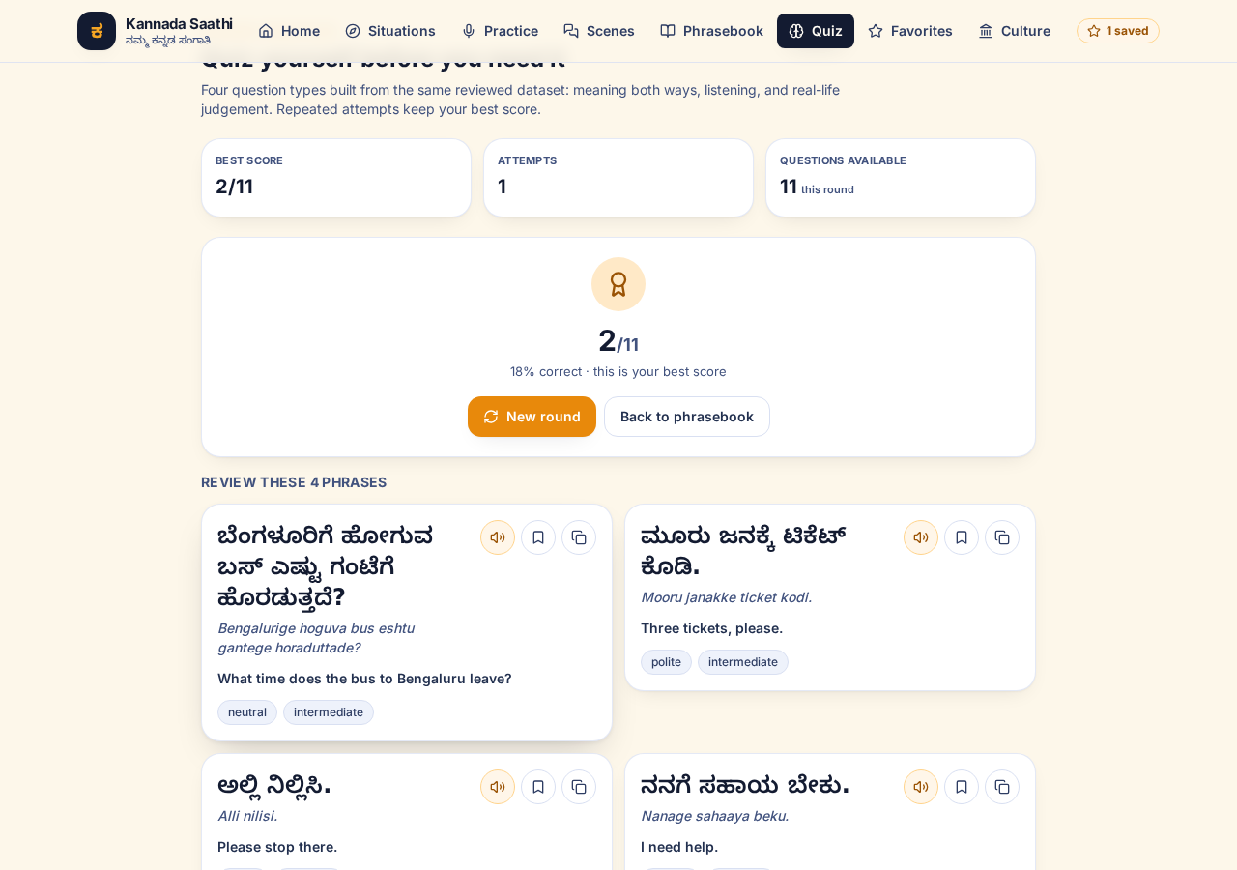
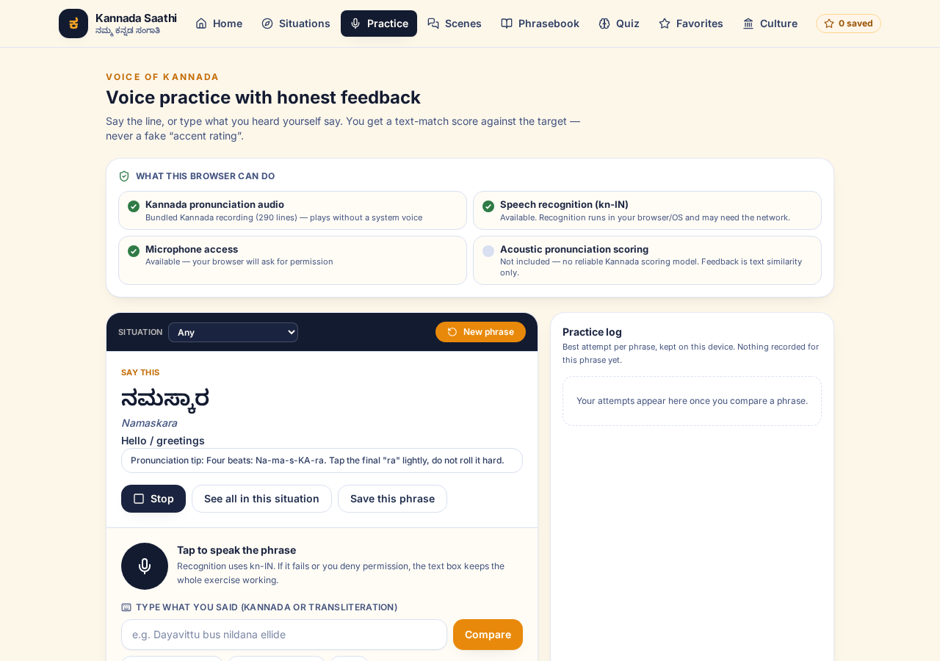
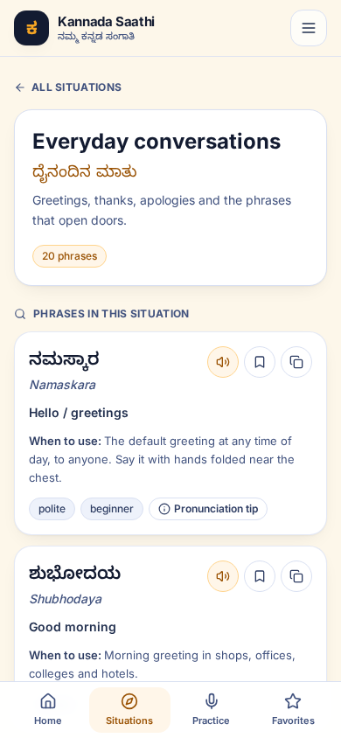
PROOF IN THE BROWSER
Captured from the running build
Chromium at 1280 px and 390 px · 0 console errors · files in docs/screenshots/
Home · progress, streak, phrase of the day
Situations · 8 cards with per-card progress
Role-play · reply, coaching note, alternatives
Quiz · score, best kept, misses as review cards
Voice practice · capability + typed fallback
390 px · situation detail, one-thumb use
Same build the judges get: npm install && npm run dev → localhost:5173 · tsc and 83 tests green on this commit.
9

Slide 10
TECH STACK & ARCHITECTURE
Local-first: 100 % static, optional proxy
Frontend — React 18 · TypeScript 5.6 strict · Vite 8.3.5 · Tailwind CSS 3 · lucide-react
User mobile or desktop browser
Routing — react-router-dom 7.18.4 with HashRouter → zero rewrite rules on any static host, deep links survive refresh
Pages Home · Situations · Practice · Scenes · Phrasebook · Quiz · Favorites · Culture
State & storage — one React context + localStorage key kannada-saathi:progress:v1 (versioned, defensive hydration)
Speech — 290 bundled Kannada MP3s (kn-IN neural voice) + Web Speech APIs as fallback, behind a capability detector with typed failures
Components PhraseCard · ScenarioCard · AskWhatToSayBox · Layout · ui
Data — src/data: 111 phrases · 8 categories · 6 conversations · culture notes · quiz generator
hooks/useProgress · hooks/useSpeech actions + capability snapshot
Quality — Vitest 4 + Testing Library + jsdom: 7 files / 83 tests, including dataset-integrity and audio-coverage tests; CI gates the Pages deploy
services/storage → localStorage favourites, recent, practice, scenes, best score
290 bundled MP3s · Web Speech API fallback · data/phrases.ts etc. · optional VITE_AI_PROXY_URL
Data flow: typed data compiled in → components call context actions → storage persists one versioned key → speech/assistant layers degrade visibly.
10

Slide 11
HONESTY BY DESIGN
What the app refuses to pretend
Temptation | What Kannada Saathi does instead
Show a pronunciation score | Text similarity against the target, labelled as text similarity. pronunciationAssessmentSupported() is hard-coded false.
Market it as “AI-powered” | Retrieval over reviewed data by default; an LLM is opt-in through your own proxy, with a “verify with a native speaker” warning on its output.
Translate freely and hope | 107 lines are standard; 4 are colloquial and badged needs-native-review in the UI and in the data.
Invent dialect tables | Regional variants exist only as flagged claims with the region and the caution shown — never as universal Kannada.
Fake engagement numbers | Every progress figure derives from recorded interactions; a new learner legitimately sees 0.
Ship a stub “AI” key in the client | No key in the repo; .env.example documents the proxy and states why VITE_* is public.
Automated guards: 7 files / 83 tests — dataset shape, script purity (no other Indic or CJK glyphs inside a Kannada field), conversation graph reachability, quiz answer validity, deterministic seeded rounds, storage hydration, search ranking, component behaviour, bundled-audio coverage, favourites after remount.
Known limits stated in the README: recognition is network-backed; clipboard/mic need a secure context; 111 phrases is a starter set, not a dictionary. Playback no longer needs a system TTS voice.
11

Slide 12
CONCLUSION · IMPACT · LIMITS
What changes, and what is still open
Expected impact
Known limitations (documented, not hidden)
• Access, immediately — one completed transaction per rehearsed situation, without English or a third person
• Lower social cost — learners hear the polite form and why it matters before they arrive
• Health and safety — symptom + duration + dosage questions reduce real errors at a counter
• Language pride — Kannada script, culture and etiquette as the product, not decoration
• A reusable dataset — version-controlled, review-flagged and test-guarded — others can grow it safely
• Browser voice gaps — recognition is Chrome/network-backed; bundled recordings remove the need for a system kn-IN TTS voice
• No acoustic scoring — by design, until a reliable model exists
• Coverage — 111 phrases is a starter set, not a dictionary; needs a native review pass
• Secure context — plain http on a LAN IP disables mic and clipboard; the app detects and says so
• Single-user, single-device — progress lives in localStorage; sync is future work
Next: native-speaker review + public dataset with a review log · PWA offline install · situation packs for government counters and rent conversations · experimental scoring behind an explicit flag.
Everything on this slide is mirrored in README §8 “Known limitations” — the deck and the repo tell the same story.
12

Slide 13
ಧನ್ಯವಾದಗಳು — thank you
Kannada Saathi · Speak Kannada. Navigate Karnataka with confidence.
GitHub repo (code, README, tests, docs) · live deployment URL · this deck · 3–5 min screen recording with voice-over
Submission checklist
☐ one problem statement chosen — #3 Kannada in Everyday Life
☐ public repo with README: name, problem statement, features, stack, setup
☐ deployed project tested in a fresh browser profile
☐ 3–5 min video: problem → existing gaps → demo → architecture → conclusion
☐ no secrets committed; .env.example documents the only optional variable
Kannada Digital Innovation Hackathon 2026 · HackerRank Campus Crew × NIE Mysuru · individual entry
13

