Slide 1

Project Title -Airbnb NYC Data Analytics
[JAYENDRA RAPALLY ]
[RAPALLY_JAYENDRA]

Slide 2

PROBLEM STATEMENT
The Airbnb platform in New York City has thousands of listings with varying prices, property types, host practices, and guest review scores. However, due to the large and complex nature of this data, it is difficult for hosts, guests, and the Airbnb company to gain clear insights into:
How prices vary across neighborhoods and property types.
Which hosts and listings provide the best guest experience.
The role of host verification and listing characteristics in influencing trust.
Identifying abnormal pricing, unusual minimum stays, or underperforming listings.
Without proper analysis, hosts may misprice their properties, guests may struggle to find value-for-money options, and Airbnb may lack insights to improve platform policies and recommendations.
This project addresses these challenges by applying data analytics and visualization techniques to the NYC Airbnb dataset, uncovering patterns and trends that can support better decision-making for all stakeholders.

Slide 3
Project Description The Airbnb NYC Data Analytics Project focuses on exploring and analyzing Airbnb listings data from New York City to uncover valuable insights for hosts, guests, and the platform itself. The dataset contains information such as listing prices, room types, neighborhood locations, host details, review scores, and availability. The goal of this project is to perform data cleaning, visualization, and statistical analysis to better understand the Airbnb marketplace in NYC. By examining trends in property types, price ranges, host activity, and guest reviews, the project highlights patterns that can support better decision-making for various stakeholders. Through this analysis, the project provides: An overview of the distribution of listings across neighborhoods and room types. Insights into pricing trends and factors that influence rental costs. Comparisons between verified and non-verified hosts in terms of guest satisfaction. Identification of top-performing hosts based on the number of listings and reviews. This project demonstrates the use of Python, pandas, numpy, matplotlib, and seaborn for real-world data analysis and visualization. The outcomes can assist hosts in setting competitive prices, guests in making informed booking choices, and Airbnb management in improving platform trust and efficiency.

Slide 4

WHO ARE THE END USERS?
Airbnb Hosts
To understand which property types and neighborhoods perform best.
To set competitive pricing based on trends.
To improve guest satisfaction by analyzing reviews and host ratings.
Guests (Travelers/Customers)To compare prices across neighborhoods.To choose properties that offer good value for money.
To identify reliable hosts (e.g., verified identity, superhosts).Airbnb Company (Platform Managers & Analysts)
To monitor host performance and guest satisfaction.To design better recommendation systems.To improve trust and safety policies (verification, cancellation).
Researchers & Data Analysts
To study urban tourism and housing trends.
To analyze the impact of short-term rentals on local economies.
To understand the distribution of short-term rentals across neighborhoods.
To make policy decisions regarding housing, taxation, and zoning.

Slide 5

Technology Used
1.Python → chosen for its strong ecosystem in data analytics, visualization, and machine learning.
2. Data Handling & Processing
pandas → loading the CSV, cleaning data, handling missing values, grouping, aggregations.
numpy → numerical computations, handling arrays, outliers.
3. Data Visualization
matplotlib → creating static charts (histograms, scatter plots, bar charts).
seaborn → statistical visualizations with better styling and easier plotting (countplots, barplots, histograms).
4. Development Environment
Jupyter Notebook / Google Colab → interactive coding and visualization.
VS Code / PyCharm → IDE for structured project development.
5. File Handling & Reporting
CSV (dataset format).
Matplotlib/Seaborn Savefig → saving plots as .png.
geopandas / folium → if you want map-based visualizations of NYC neighborhoods.

Slide 6
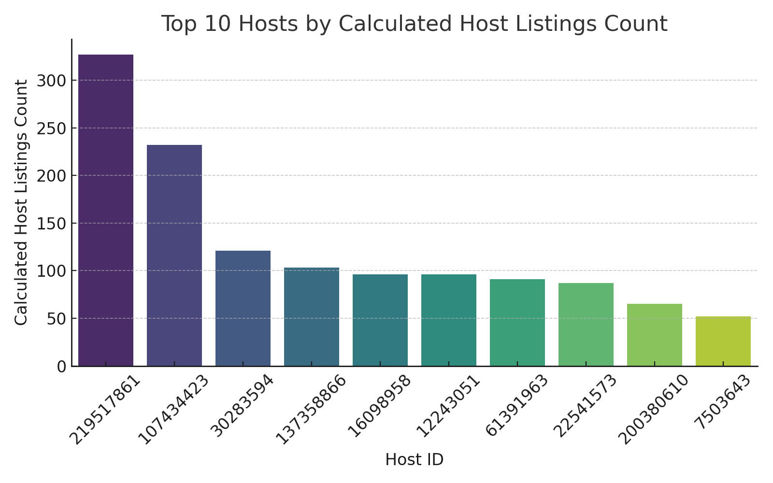
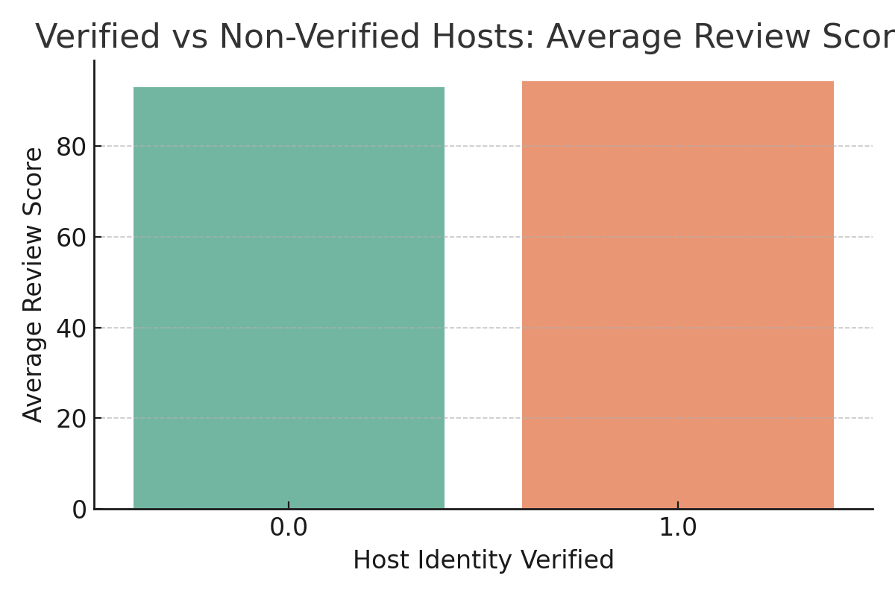
RESULTS1

Slide 7
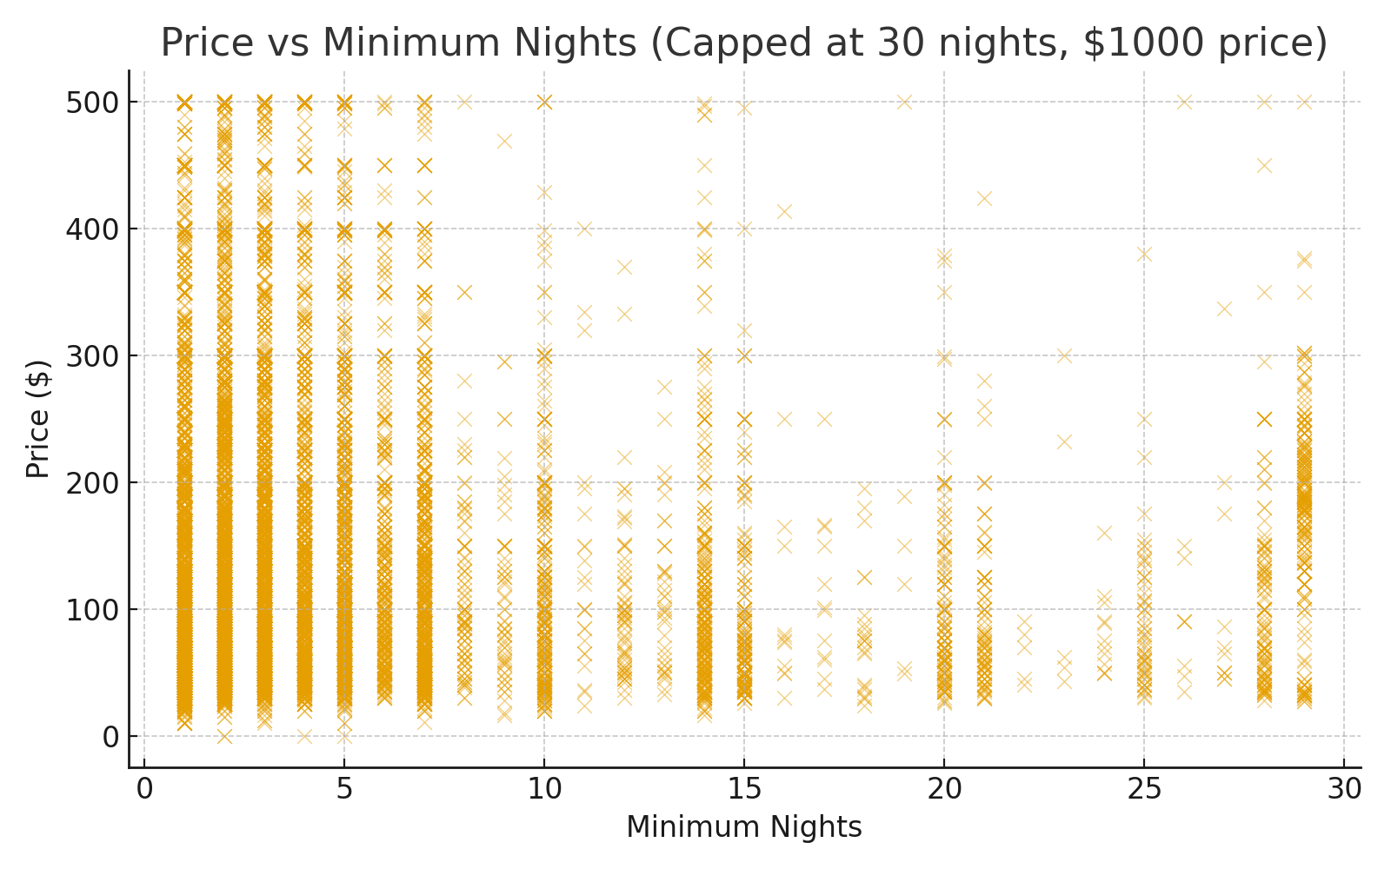

RESULTS2

Slide 8
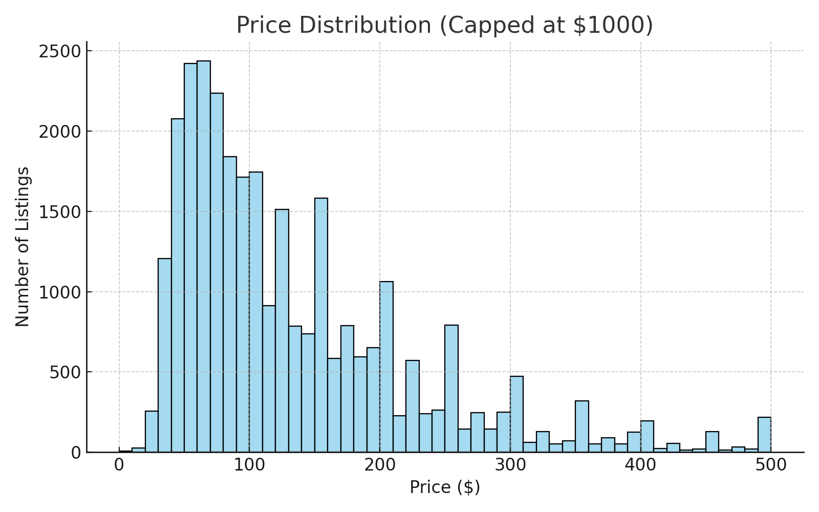
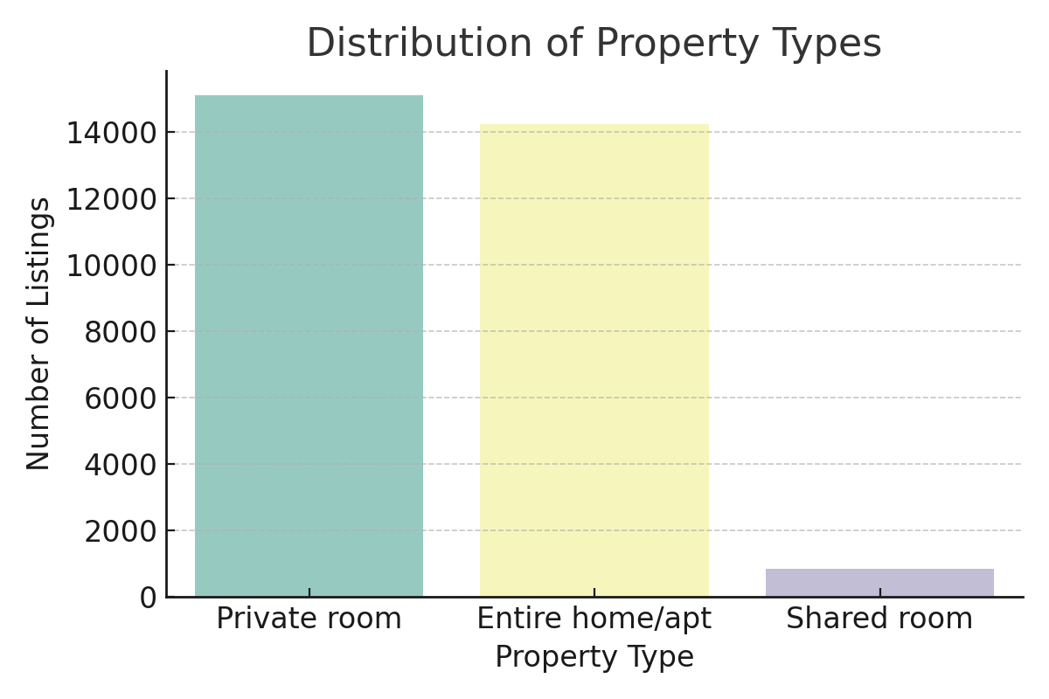
RESULTS3

Slide 9
GitHub repository
https://github.com/RAPALLY-JAYENDRA/VOIS_AICTE_Oct2025_MajorProject_RAPALLY-JAYENDRA.git
Demo Link

Slide 10

Getting started with Basics of Python Certificate

Slide 11
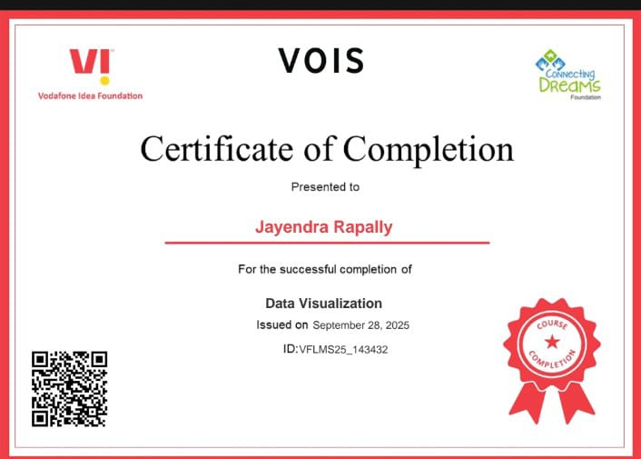
Data Visualization Certificate

Slide 12
Thank you
.
.

