Slide 1

Project Title -Netflix Dataset Analysis
[JAYENDRA RAPALLY]
[RAPALLY_JAYENDRA]

Slide 2

PROBLEM STATEMENT
With the rapid rise of OTT platforms, Netflix faces intense competition from global players like Amazon Prime, Disney+, and regional streaming providers. To maintain its leadership, Netflix must strategically analyze its content catalog to identify strengths, gaps, and emerging opportunities.
The key problem addressed in this project is:
“How has Netflix’s content distribution (Movies vs. TV Shows, genres, and country contributions) evolved over the years, and what insights can be derived to guide future content acquisition and production strategies?”
This problem requires analyzing the dataset to uncover:
The balance between Movies and TV Shows in Netflix’s library.
The most common genres and how their popularity has changed over time.
The contribution of different countries to Netflix’s catalog, highlighting global representation and untapped markets.addressing this problem, the project aims to provide strategic insights that help Netflix refine its content strategy, enhance global audience engagement, and remain competitive in the streaming industry.

Slide 3
Project Description This project, “Content Trends Analysis for Strategic Recommendations – Netflix Dataset”, focuses on exploring and analyzing Netflix’s content library to uncover meaningful trends and patterns. Netflix, being one of the largest global streaming platforms, continuously expands its catalog with a mix of original productions and licensed content. However, with increasing competition from Amazon Prime, Disney+, and regional OTT providers, it is essential for Netflix to adopt a data-driven approach in managing its content strategy. The project leverages a Netflix dataset (CSV format) containing detailed information about movies and TV shows, including release dates, genres, categories, countries of origin, and other attributes. Using data analytics and visualization techniques, the project provides insights into: The distribution of Movies vs. TV Shows over the years.The popularity and evolution of genres across time. The country-wise contributions to Netflix’s global catalog.By analyzing these trends, the project identifies strengths, gaps, and opportunities within Netflix’s library. The findings enable Netflix to refine its content acquisition and production strategy, ensuring that it caters to diverse global audiences while maintaining a competitive edge in the streaming industry. The analysis is performed using Python, Pandas, Matplotlib, and Seaborn in a Jupyter Notebook environment, with the option of extending to interactive dashboards using Tableau or Power BI. Ultimately, this project delivers strategic recommendations that can guide Netflix’s future decisions in content investment, global market expansion, and audience engagement.

Slide 4
WHO ARE THE END USERS?
Netflix Management & Strategy Teams
To make data-driven decisions on content acquisition, production, and licensing.
Helps them identify trending genres, popular countries, and underrepresented markets.
Content Acquisition & Production Teams
To decide which movies/TV shows to invest in.
Supports choosing regional markets (e.g., more K-dramas, Spanish thrillers, or Indian content).
Marketing Teams
To design targeted campaigns based on audience preferences (genres, regions).
Example: Promoting Indian movies in Asian markets, or K-dramas in global youth segments.
Data Analysts & Researchers
To understand trends in OTT platforms.
Provides insights for academic, business, or market research.
Helps investors see growth potential in Netflix’s content library.
Business partners (like production houses) can align with Netflix’s strategy.Competitor Platforms (Amazon Prime, Disney+, etc.) (Indirect End Users)They can benchmark Netflix’s content strategy to adjust their own catalogs.

Slide 5

Technology Used
1. Data Handling & Preprocessing
Python – core language for analysis.
Pandas – for dataset cleaning, transformation, and manipulation.
NumPy – for numerical operations and handling large arrays.
2. Data Visualization
Matplotlib – basic plotting (line charts, bar charts, scatter plots).
Seaborn – advanced statistical plots (heatmaps, distribution plots).
3. Exploratory Data Analysis (EDA)
Jupyter Notebook / Google Colab – interactive coding and visualization.
Excel – quick checks and summaries.

Slide 6
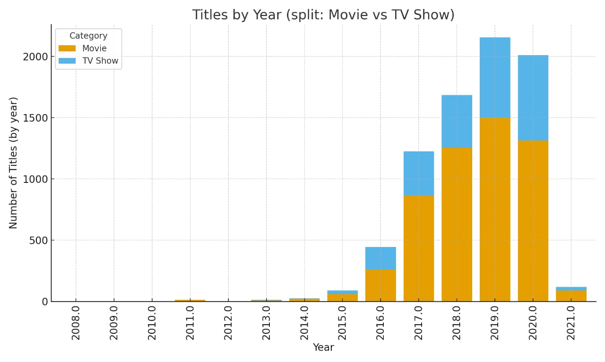
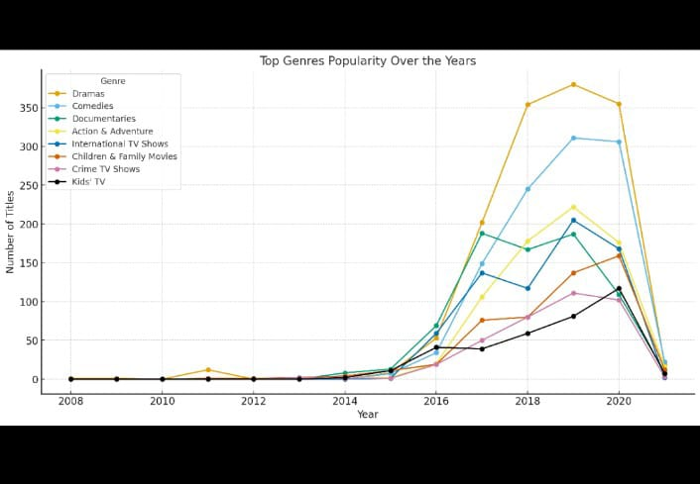
RESULTS2
[Add screen shots of your code or Chart(s) ]

Slide 7
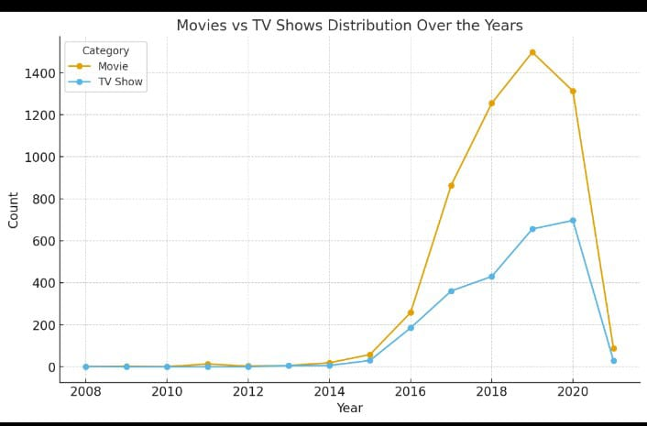
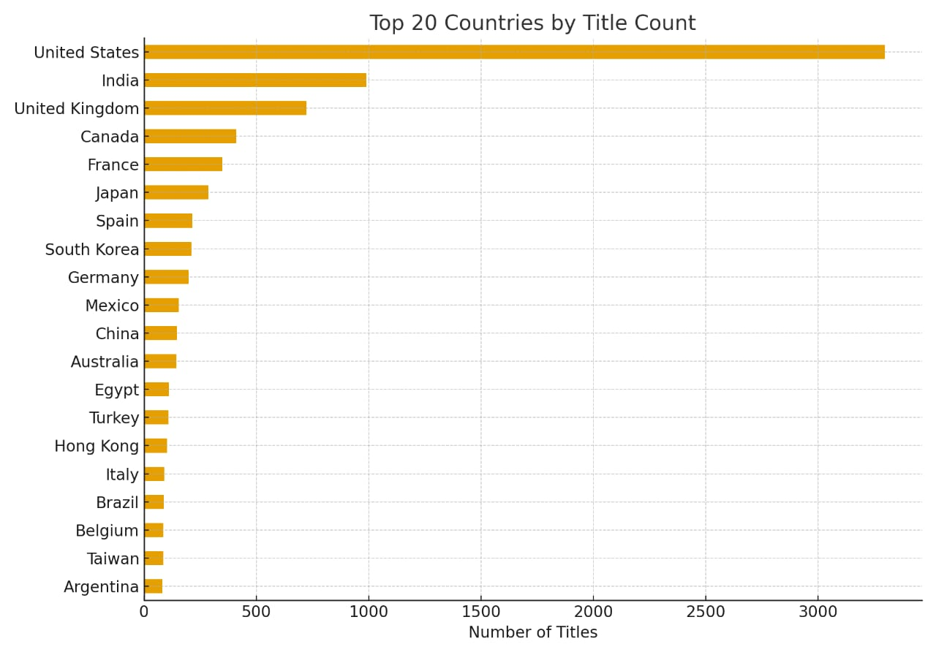
RESULTS1
[Add screen shots of your code or Chart(s) ]

Slide 8
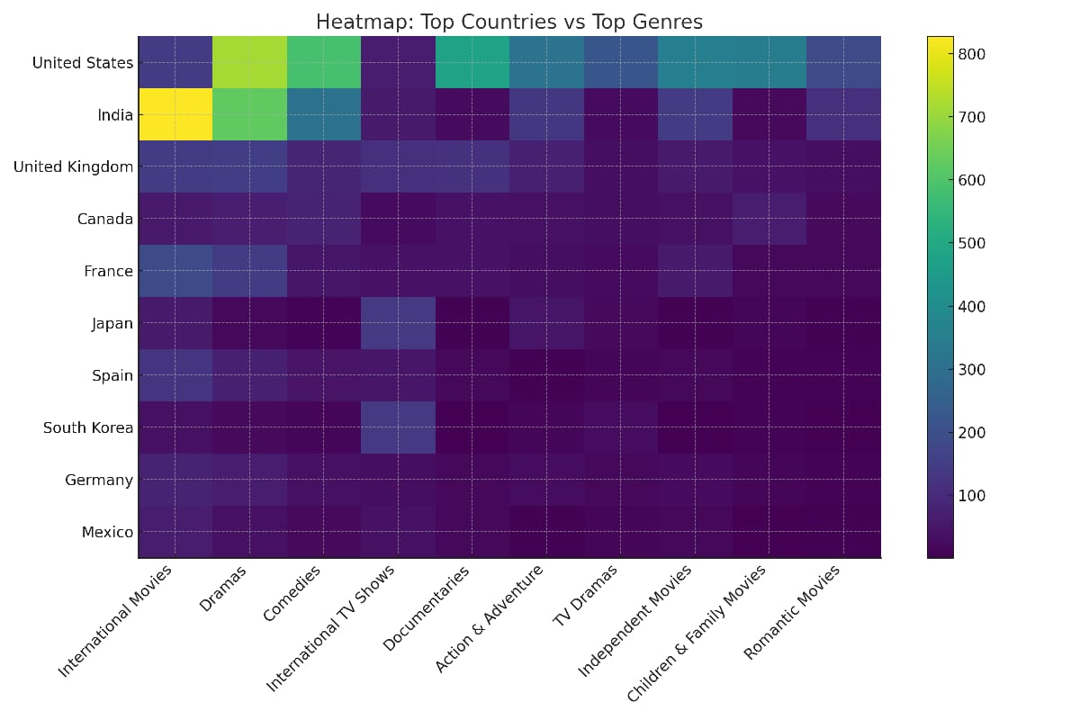
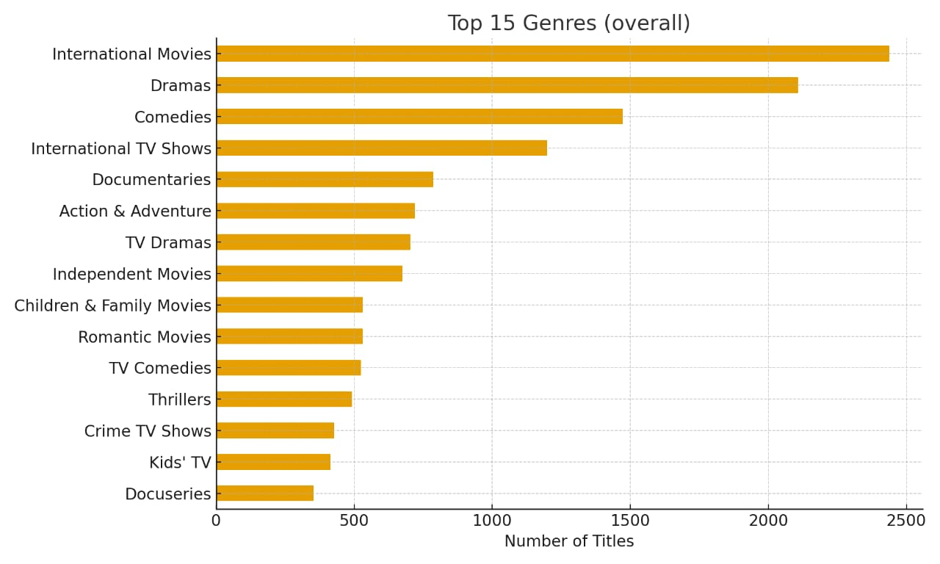
RESULTS3
[Add screen shots of your code or Chart(s) ]

Slide 9
GitHub repository
https://github.com/RAPALLY-JAYENDRA/VOIS_AICTE_Oct2025_MajorProject_RAPALLY-JAYENDRA.git

Slide 10

Getting started with Basics of Python Certificate

Slide 11
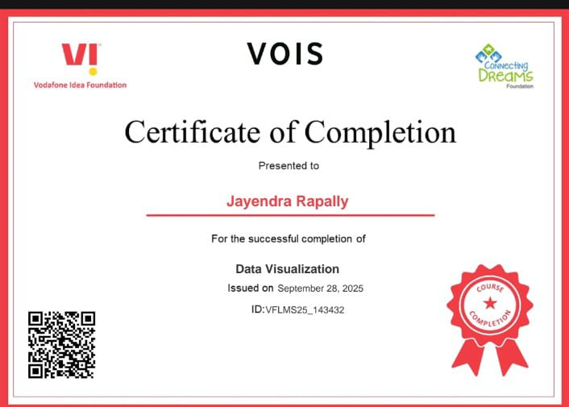
Data Visualization Certificate
[Paste your Certificate Here]

Slide 12
Thank you
.
.

