Slide 1
An Intelligent Bangla Conversational Agent: TUNI
GROUP – 6
Ridah Khurshid – 18101683
Zarin Tasnim Promi - 18101589
Fatin Ishrak - 21301716

Slide 2
content
1 Introduction and Abstract (Ridah)
2 Related Works (ridah)
3 Prerequisite Works (zarin)
4 Corpus Structure (zarin)
5 Methodology (fatin)
6 Experimental Results (fatin)
7 Conclusion (Ridah)

Slide 3

introduction
This research paper represents a method of a man-machine communication system named “TUNI”, where TUNI acts like a psychologist and continuously asks questions based on the response of the user.

Slide 4
introduction
In this paper, a corpus-based method is proposed which establishes a natural language communication system between man and machine in Bangla language. The machine that have implemented in this paper, TUNI, imitates and responses like a psychologist who can communicate with a user through a comfortable terminal-like interface.
Though the machine can mimic like a mock psychologist, the editing capabilities of TUNI “corpus” gives the ability to respond in various context.
Here, a new strategy was approached that included pattern matching with a Bangla POS tagger and very basic sentiment analysis. TUNI may provide natural and syntactically valid responses using this method, overcoming the complications.

Slide 5
Related Works
ELIZA described by Joseph Weizenbaum in January 1966 was a domain-based system that uses some semantic rules that simply matches the keyword from an extensive collection of rules.
ALICE (Artificial Linguistic Internet Computer Entity) was invented by Richard Wallace in 1995, is a knowledge-based natural language processing system that can communicate with a human by processing the user input using some reasoning heuristically pattern matching rules.
PARRY was discussed by psychiatrist Kenneth Colby, at Stanford University in 1972, is used to simulate a paranoid schizophrenia patient.
DOLY is a man and machine communication system that was implemented to give replies to a user query in a human manner for the education system in the Bengali Language.

Slide 6
Prerequisite Works
Bangla pos tagging
Suffix processing
Person mapping
Posneg mapping
Sentence deviation processing

Slide 7
Corpus structure
Keyword
Precedence of the keyword
Decomposition rules
Reassembly rules

Slide 8
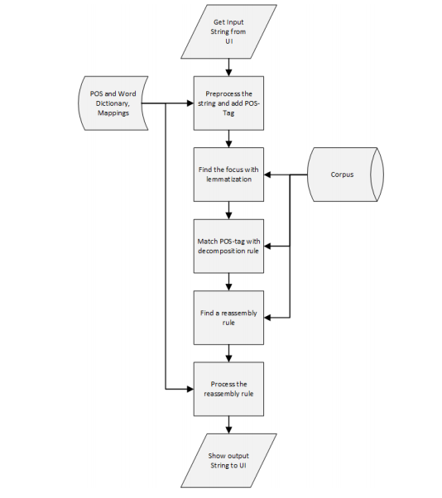
Methodology
Preprocessing
Removing unnecessary spaces
Tokenization
Breaking Into Sub-sentence
Adding Tags
Removing Unnecessary Words
Finding Focus

Slide 9
Methodology
Matching
Parsing
Reassembly Rule Processing
Rule Selection
Placing Token
Evaluating Functions

Slide 10
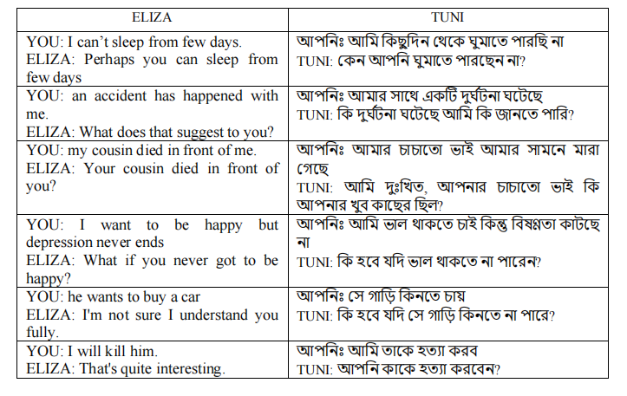
Result

Slide 11
Conclusion
A new method for Bangla sentence processing and meaning parsing is proposed in this paper.
The primary complications of Bangla language, such as diverse person forms, sentence patterns, and suffixes, are solved using this strategy.
The approach was developed using a corpus and a variety of datasets.
The corpus contains certain terms and rules and datasets contain tags or mappings.
The dynamic mappings and keywords are also included in the datasets. It allows users to type and converse using TUNI.
The POS tag, suffix tag, PosNeg tag, and reassembly rules all affect TUNI's correctness.
The more precise the tags and regulations, the more accurate and natural the responses TUNI.

