Slide 1


Synaptic Assimilator
Andreas F. Vermeulen

Slide 2
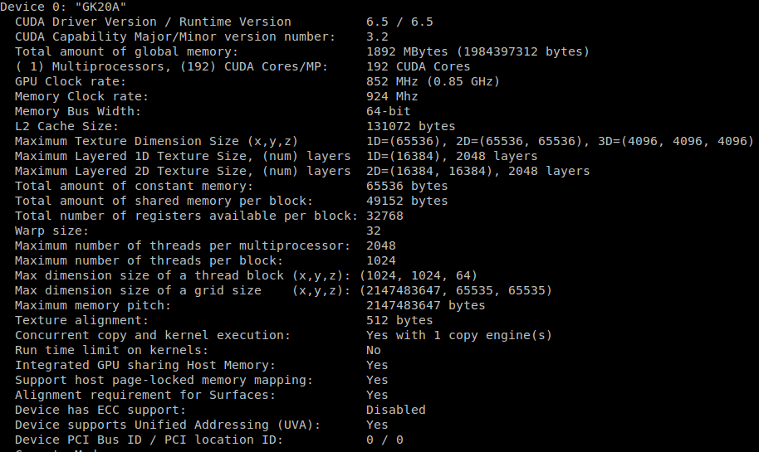
Jetson = CUDA 6.5

Slide 3
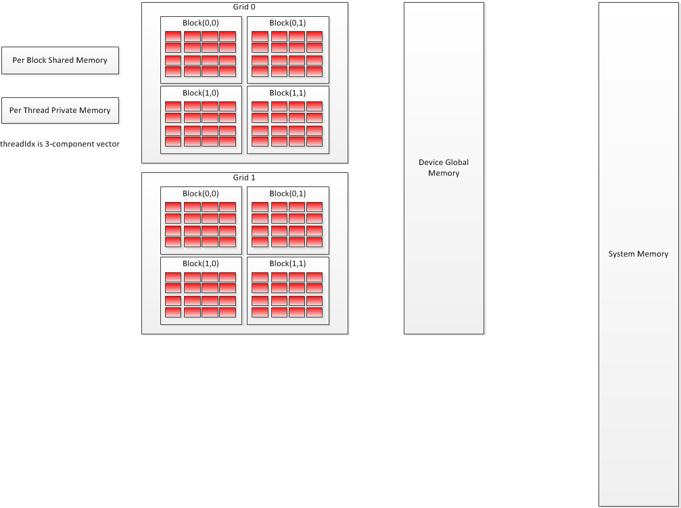
Basic Process

Slide 4
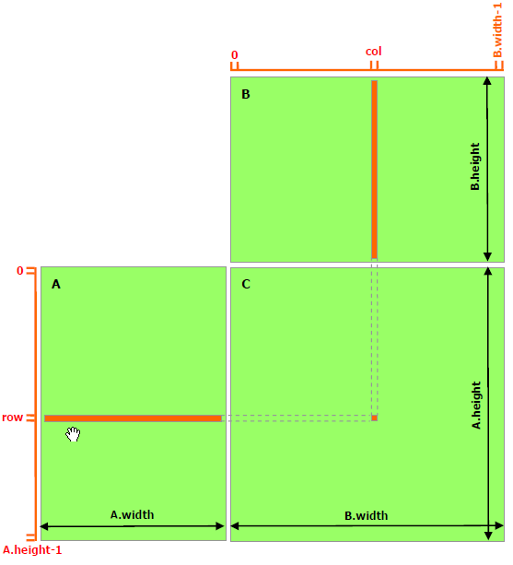
Matching Values

Slide 5

Sorting and matching data bigger than the system

Slide 6
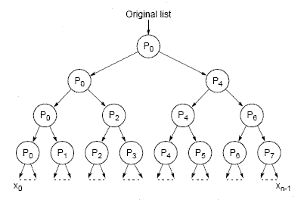
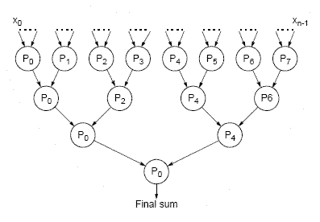
Divide the data set into data sets that fit in processor.

Slide 7
Hash into Prefix and Suffix Keys
A | n | d | r | e |  | V | e | r | m | e | u | l | e | n
65 | 110 | 100 | 114 | 101 | 0 | 86 | 101 | 114 | 109 | 101 | 117 | 108 | 101 | 110 | 0 | 0 | 0 | 0 | 0 | 0
S | t |  | A | n | d | r | e | w | s
83 | 116 | 0 | 65 | 110 | 100 | 114 | 101 | 119 | 115 | 0 | 0 | 0 | 0 | 0 | 0 | 0 | 0 | 0 | 0 | 0
D | u | n | d | e | e
68 | 117 | 110 | 100 | 101 | 101 | 0 | 0 | 0 | 0 | 0 | 0 | 0 | 0 | 0 | 0 | 0 | 0 | 0 | 0 | 0

Slide 8
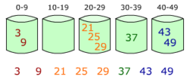
Bucket Sort on Prefix Key

Slide 9
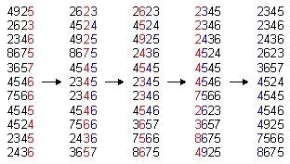
Radix Sort Suffix key fro each Prefix Key

Slide 10
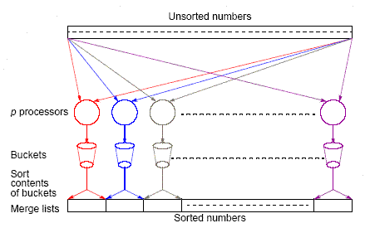
Scale the process out for Many processors

Slide 11
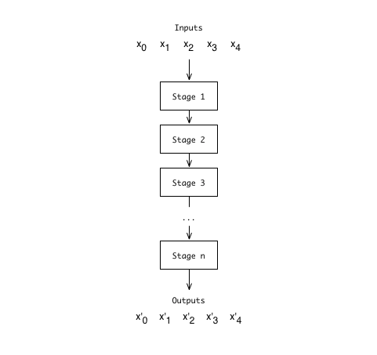
R-A-P-T-O-R Pipeline

Slide 12
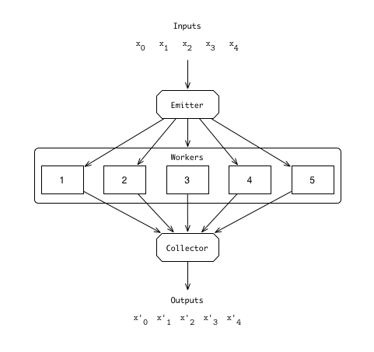
R Farm
A Farm
P Farm
T Farm
O Farm
R Farm

Slide 13
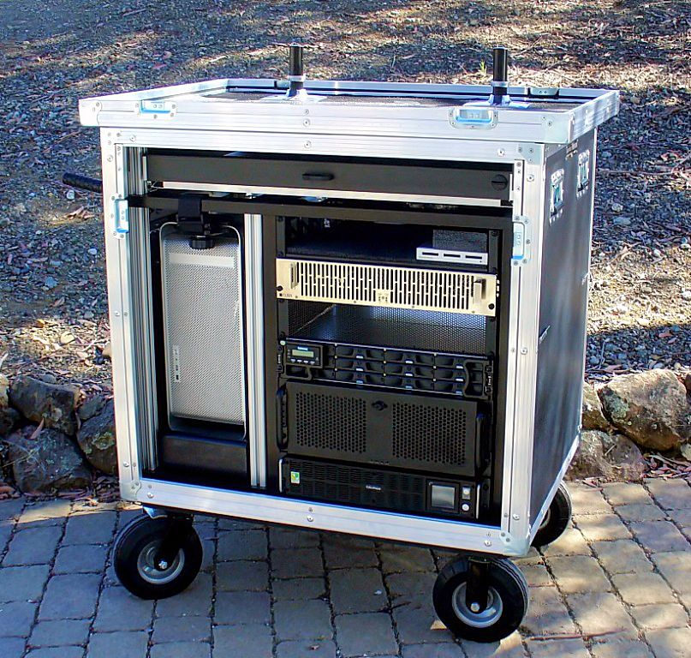
Research Information Framework Cluster

