Slide 1



Synaptic
Assimilator
Andreas F. Vermeulen
3 July 2015

Slide 2
Research Question:
What happens when exascale computing executes data processing and computing solutions uses commodity building block and heterogeneous computing processes to convert data into information?
Notes:
Exascale Solution:
- 1000 000 processors
- 1000 000 CPUs
- 1000 000 GPUs
- 1000 000 FPGAs
- Exabyte of Data (10^18 bytes)

Slide 3
Exascale Computing:
Exascale computing is systems capable to support over one exaFLOPS of data processing.
Notes:
Exascale Solution:
- 1000 000 processors
- 1000 000 CPUs
- 1000 000 GPUs
- 1000 000 FPGAs
- Exabyte of Data (10^18 bytes)

Slide 4
Synaptic Assimilator
The solution is a one million processor ecosystem that processes data sets in the exabyte (10¹⁸) range and the system uses embedded heterogeneous computing that is assembled by an artificial control system from a range of pre-optimised processing building blocks.

Slide 5
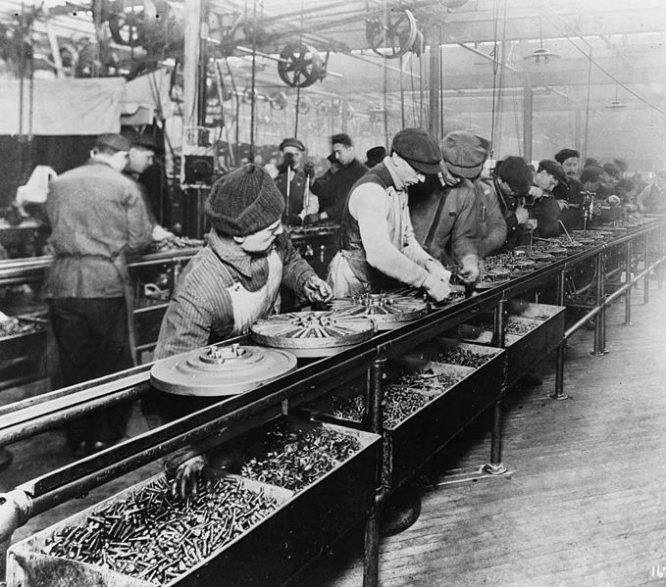
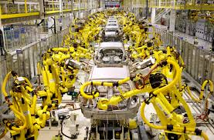
Rapid Information Factory
The concept of a factory is well known to the world of mass production in manufacturing.
The RIF uses the same principals that is used in mass production in the commodity market to guide the processing of the data into information.

Slide 6
Rapid Information Factory
The factory consists of two halves:
Rapid Information Factory Framework
The framework guides the processing of data into information using pre-optimised processes.
Rapid Information Factory Cluster
The cluster is a pre-optimised processing solution that is processing the data into information.
Notes:
The Rapid Information Factory consists of two halves:
1. Rapid Information Factory Framework
The framework is the processing rules of the complete solution.
2. Rapid Information Factory Cluster
The cluster is a exascale solution built out of commodity computer hardware with cloud processing to support any overflow of the processing requirements.

Slide 7
Rapid Information Factory Framework
The framework guides the processing of data into information using pre-optimised processes.

Slide 8
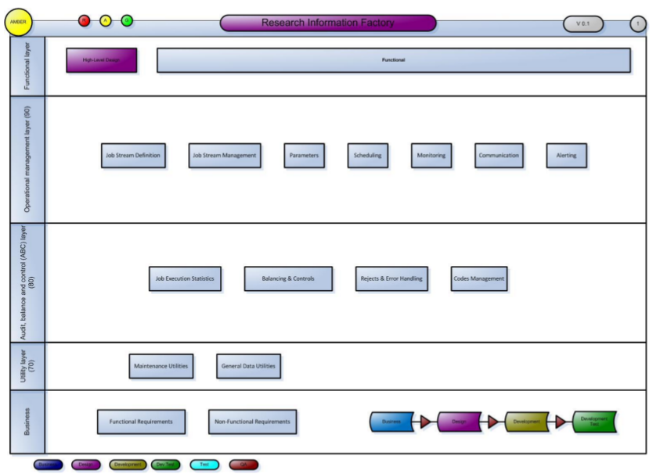
Rapid Information Factory Framework
Notes:
The Rapid Information Factory Framework at a high-level consists for five layers:
1. Functional Layer
2 Operational Management Layer
3. Audit, Balance and Control Layer
4. Utility Layer
5. Business Layer..

Slide 9
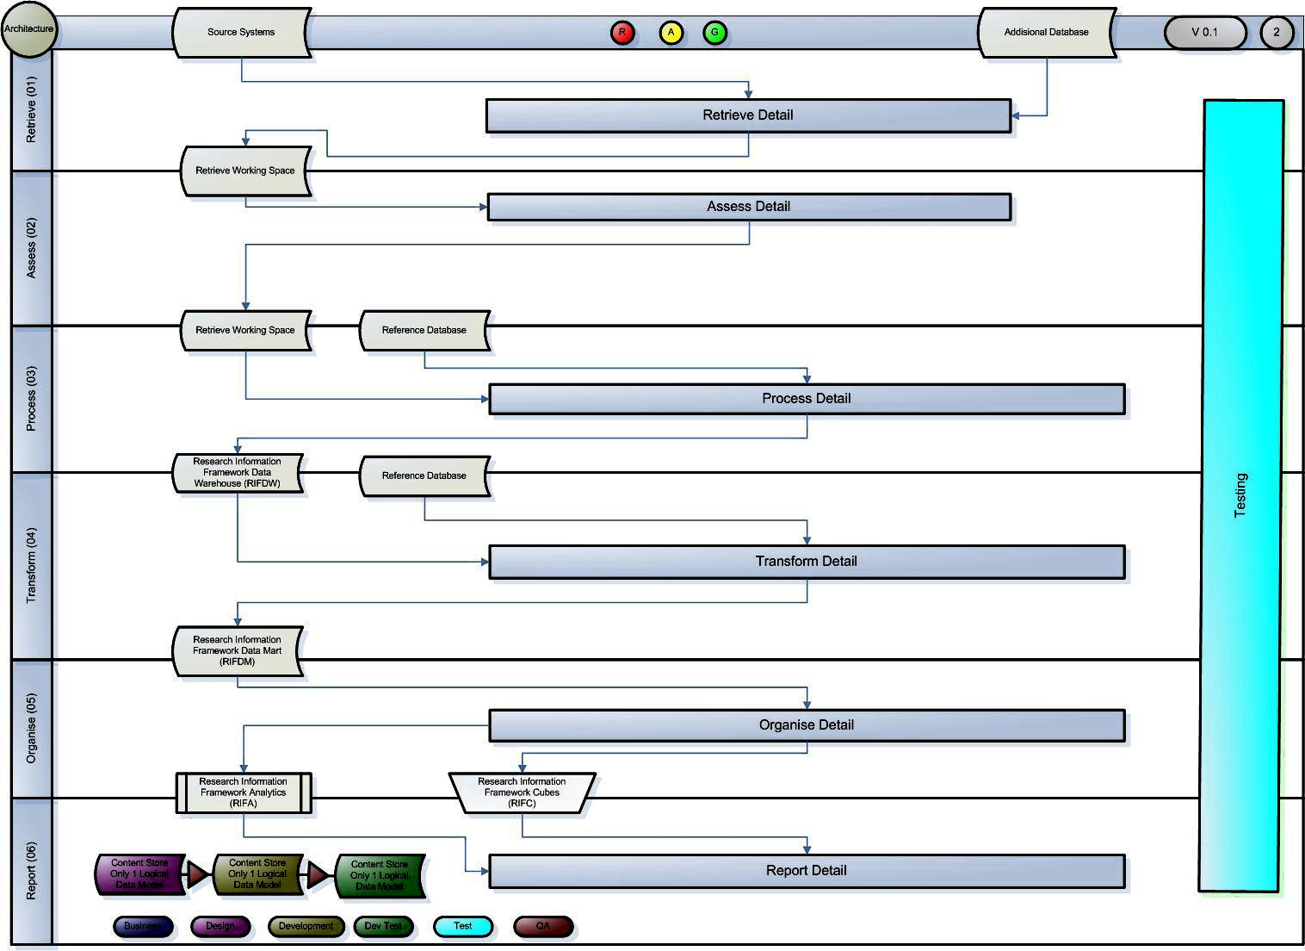
Rapid Information Factory Framework
Notes:
The functional Layer consists of six layer pip-line:
1. Retrieve
The Retrieve layer enables all the processing that specificity retrieves data from other data sources and publishes it to the rest of the Rapid Information Factory.
2. Assess
The assess layer ensures that only “good” data is allowed through to the other layers of the solution.
3. Process
The process layer normalises the data with the purposes of removing duplicates and presenting a model view of the real world the data is describing
4. Transform
The Transform layer extracts specific data structures ready to convert it into information.
5. Organise
The Organise layer groups the approriate groups of information together to enable to correct extraction of the facts.
6. Report
The report layer handles the visualisation of the data for the business users.

Slide 10
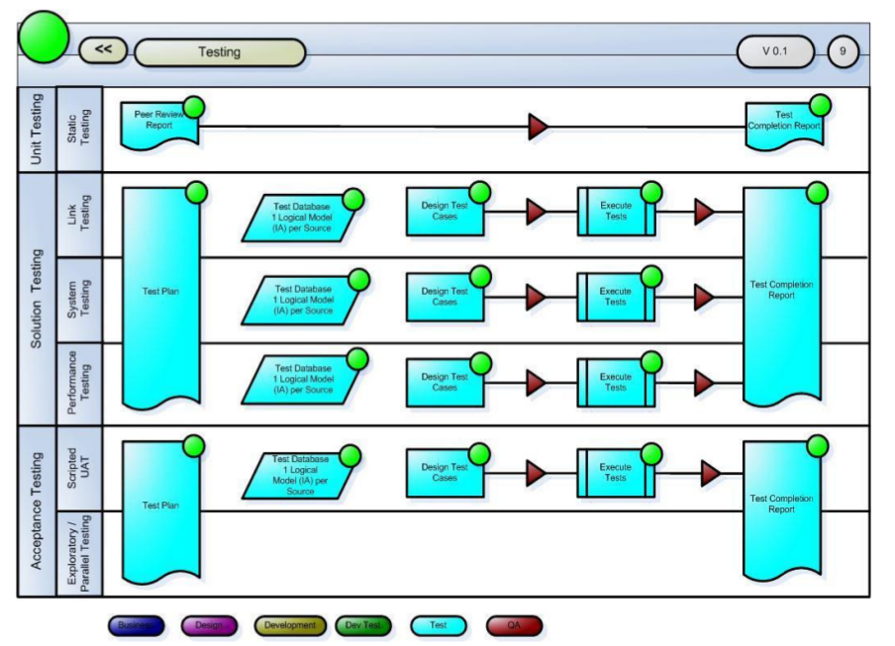
Rapid Information Factory Framework

Slide 11
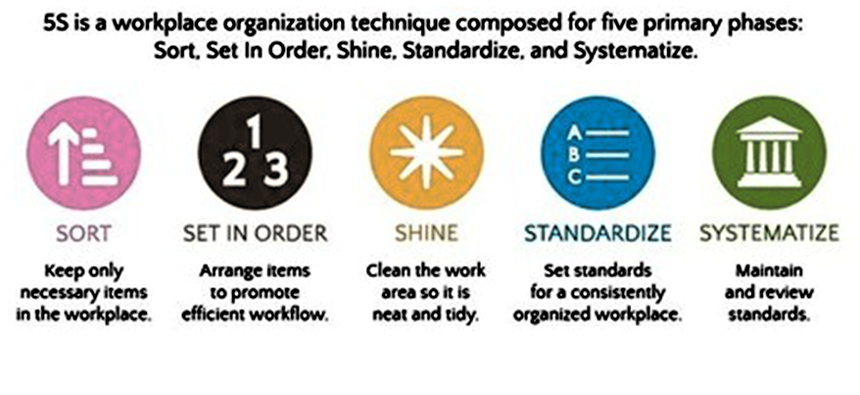
Rapid Information Factory Framework

Slide 12
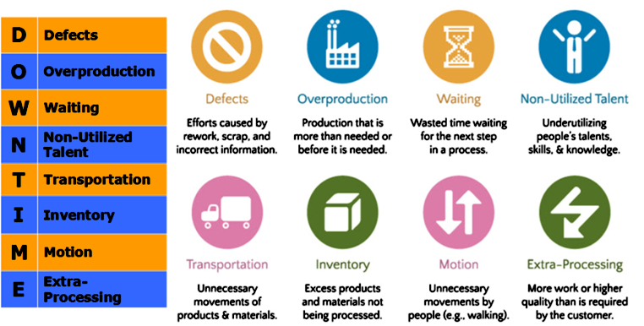
Rapid Information Factory Framework

Slide 13
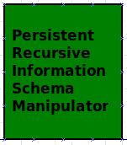
Rapid Information Factory Framework
Persistent Recursive Information Schema Manipulator
The PRISM is the main process that drives a specific chain of processes that together forms the required work cells to convert the data into information by applying the RIFF rules of processing.

Slide 14

Rapid Information Factory Framework
Remote Assessment Yoke
The RAY is a “Poka-yoke” from Lean manufacturing to avoid mistakes in the work cells while conversion of the data into information by applying the RIFF rules of processing.

Slide 15
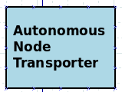
Rapid Information Factory Framework
Autonomous Node Transporter
The ANT is the software stack required to run any predefined hardware process and software combination from the RIFF library of processing configurations.

Slide 16
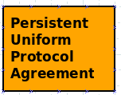
Rapid Information Factory Framework
Persistent Uniform Protocol Agreement
The PUPA is the software stack required to run any predefined Algorithms that is formed from self-contained step-by-step set of operations to be performed.
PUPA performs calculation, data processing, and automated reasoning using uniform processes from the RIFF library of processing configurations.
PUPA can consist of other PUPA to form processing chains.

Slide 17
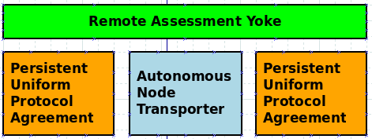
Rapid Information Factory Framework
Remote Work Cell
The RWC is a group of processes that has a singular purpose of work in the same manner than a Lean Work Cell.
The cell consists of four parts:
- RAY
- PUPA (inbound)
- ANT
- PUPA (Outbound)

Slide 18
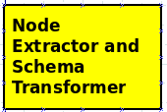
Rapid Information Factory Framework
Node Extractor and Schema Transformer
The NEST is a specialised software stack required to enable a ANT to communicate with a specific type of data source.
NEST will be designed for data sources and published in as uniform processes in the RIFF library.

Slide 19
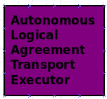
Rapid Information Factory Framework
Autonomous Logical Agreement Transport Executor
The ALATE is a specialised software stack required to enable a ANT to discover which PUPAs will be required to perform the R-A-P-T-O-R process for a new NEST.

Slide 20

Rapid Information Factory Framework
Sequential Converter into Ontology for Uniform Transport
The SCOUT is a specialised software stack required to enable a ANT to convert meta data from a NEST into HORUS PUPA for R-A-P-T-O-R process to use.

Slide 21
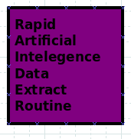
Rapid Information Factory Framework
Rapid Artificial Intelegence Data Extract Routine
The RAIDER is a specialised software stack required to enable a ANT to mine data from a NEST into HORUS PUPA procedures for R-A-P-T-O-R process to use.

Slide 22
Rapid Information Factory Cluster
The cluster is a pre-optimised processing solution that is processing the data into information.

Slide 23
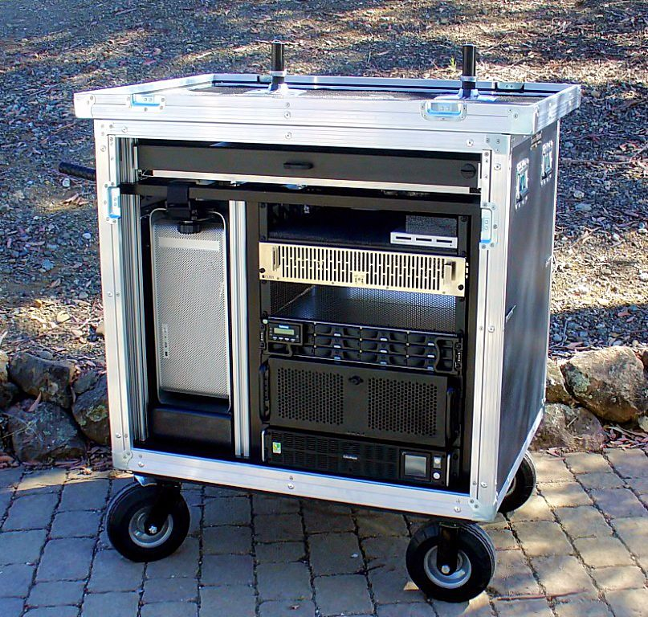
Rapid Information Factory Cluster

Slide 24
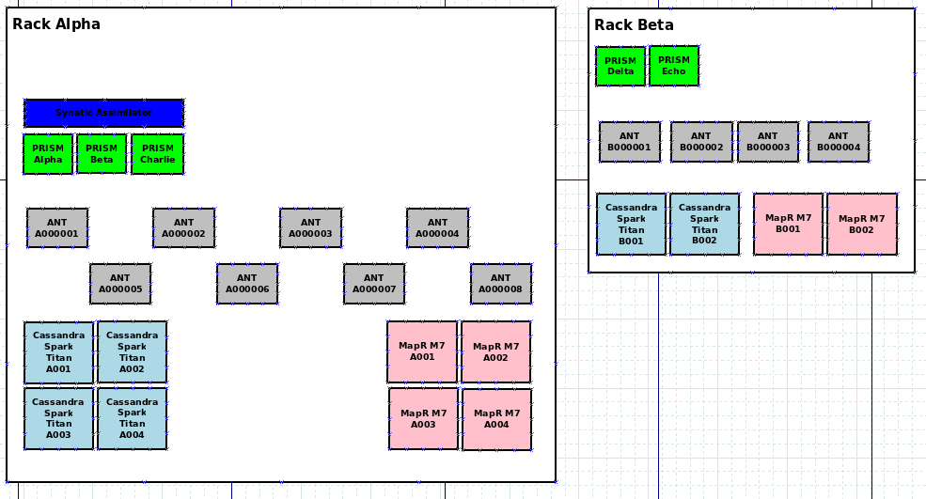
Rapid Information Factory Cluster

Slide 25
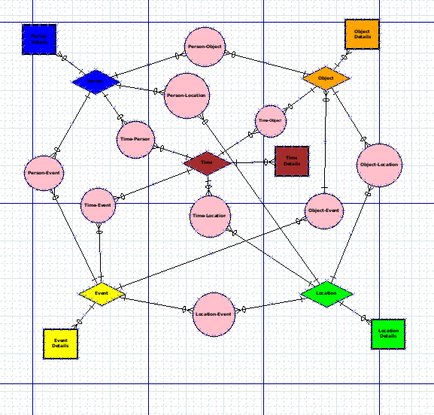
Time
People
Organisation
Location
Event

Slide 26
Thank you
Synaptic Assimilator
Andreas F. Vermeulen
E-mail: afvermeulen@dundee.ac.uk

