Slide 1
Infrastructure as Code (IaC) Bigger Picture
Ryan Russell-Yates

Slide 2
How to build efficient and reliable solutions on Azure?
Notes:
Or on Cloud in general

Slide 3
Pillars of well-architected framework
Azure Well-Architected Framework
Security
Reliability
Cost Optimization
Performance efficiency
Operational excellence
Notes:
Five Pillars of Well-Architected Framework
Use these pillars as a yard stick when developing solutions on cloud
All the pillars are equally important and related to each other.
Not addressing one will have an effect on another.
https://docs.microsoft.com/en-us/learn/paths/azure-well-architected-framework/

Slide 4
What is Operational excellence about?
Visibility
ensuring you have full visibility into how your application is running, and ensuring the best experience for your users
Productivity
making your development and release practices more agile, which allows your business to quickly adjust to changes

Slide 5
How to achieve operational excellence?

Slide 6
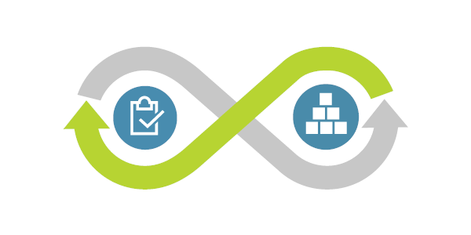
Building a culture to achieve operational excellence
Small, autonomous and multidisciplinary teams
Agile practices and Growth mindset
Ownership and shared responsibility
Mutual accountability
Usually known as DevOps Culture
Notes:
Let’s talk a little bit about cultural aspects - https://docs.microsoft.com/en-us/azure/devops/learn/what-is-devops-culture
Build Small, autonomous and multidisciplinary teams
Apply agile practices
Include operations in the team responsibility
No silos and no blame game, team is mutually accountable.
Apply growth mindset, learn from experience
Think in terms of competencies not roles and share responsibility
Shift your priority from Mean time between failure to Mean time to mitigate (MTTM) and mean time to mean time to remediate

Slide 7
Operational excellence from a technical perspective
Design, build and orchestrate with modern practices
Use monitoring and analytics to gain operational insights
Use automation to reduce effort and error
Test
Notes:
DevOps, CI/CD, IAC
A modern architecture will give you the ability to automate deployments using infrastructure as code, automate application testing, and build new environments as needed. DevOps is as much cultural as it is technical, but can bring many benefits to organizations that embrace it.
Monitoring
Throughout your architecture, you want to have a thorough monitoring, logging, and instrumentation system.
Operationally, it's important to have a robust monitoring strategy. This helps you identify areas of waste, troubleshoot issues, and optimize the performance of your application
Automation
Automate operational activities config management, build and administer resources
Test
A good testing strategy will help you identify issues in your application before it's deployed, and ensure that dependent services can properly communicate with your application.
Unit Testing, Security Testing, Performance Testing, Acceptance Testing – See Test pillar.
https://docs.microsoft.com/en-us/learn/modules/azure-well-architected-introduction/4-operational-excellence

Slide 8
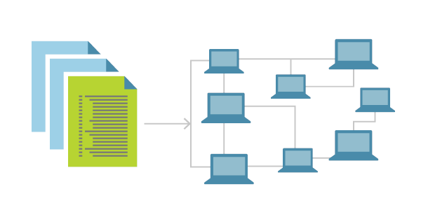
One of the modern practices
Infrastructure as Code (IaC)

Slide 9
IaC -Treat infrastructure like software
Declarative (typically)
Idempotent
Versioning
Reproducible
Distributable
Automated provisioning and configuration
From definition files to working infrastructure
Notes:
IaC is not as same configuration management automation / DSC

Slide 10
Benefits of adopting IaC
Mitigate environment drift and snowflake environments
Enforce Consistency
Better visibility from versioning and well-documented code
Enable testing capabilities on production-like environments
Increase development productivity
Can play a key role in enabling best practices in DevOps
Notes:
DevOps teams can work together with a unified set of practices and tools to deliver applications and their supporting infrastructure rapidly, reliably, and at scale.
Build immutable infrastructure if needed

Slide 11
IaC tooling

Slide 12
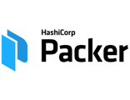
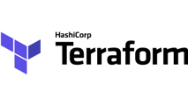
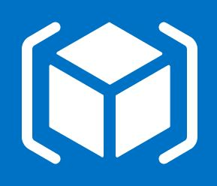
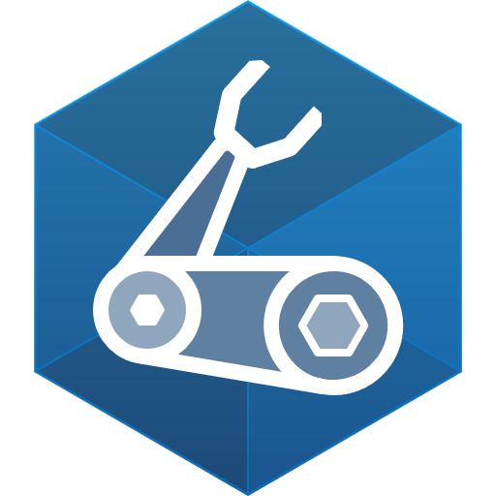

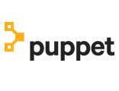



IaC and Configuration tools for Azure
…and more
Notes:
AWS: Cloud formation,
GCP: Google Cloud Deployment Manager
Configuration Orchestration vs Configuration Management
Terraform Provisioners are not intended to maintain desired state and configuration for existing resources. For that purpose, you should use one of the many tools for configuration management, such as Chef, Ansible, or PowerShell Desired State Configuration. (Terraform includes a Chef provisioner.)
For e.g: Provisioners run when a vm or container is created or destroyed. (such as remote-exec or file provisioner)
An imaged-based infrastructure, such as images created with Packer, can eliminate much of the need to configure resources when they are created. In this common scenario, Terraform is used to provision infrastructure based on a custom image. The image is managed as code

Slide 13
Most popular IaC tools for provisioning Azure resources
Notes:
Others: Salt Stack,
AWS: Cloud formation,
GCP: Google Cloud Deployment Manager
Configuration Orchestration vs Configuration Management

Slide 14

Ask
Discuss
Comment

Slide 15
Notes (hidden)
Some speakers at Microsoft like to use this slide for hidden “notes slides”.
Delete it if you don’t want to use it.
NEXT: <next slide title>

