Slide 1
Terraform language, expressions, console and functions
Ryan Russell-Yates

Slide 3
Terraform language, console, expressions and more..
Notes:
Let’s learn terraform / HCL as a programming language.
The idea of IAC is to apply software engineering principles into Infrastructure.

Slide 4
Terraform Language
Terraform uses its own configuration language, designed to allow concise descriptions of infrastructure.
The Terraform language is declarative, describing an intended goal rather than the steps to reach that goal.
Expressions
Expressions are used to refer to or compute values within a configuration.
Simplest example are literals such as “hello” or 5
Terraform language also allows more complex expressions such as references to data exported by resources, arithmetic, conditional evaluation, and a number of built-in functions.
Notes:
Learning the language constructs is vital for writing cleaner code

Slide 5
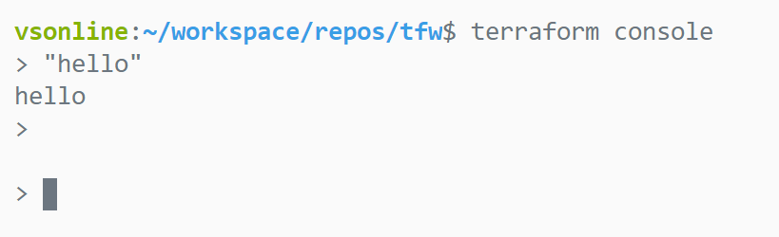
Terraform comes with an interactive console for evaluating expressions
Notes:
Terraform Console
Read, Eval, Print and Loop

Slide 6
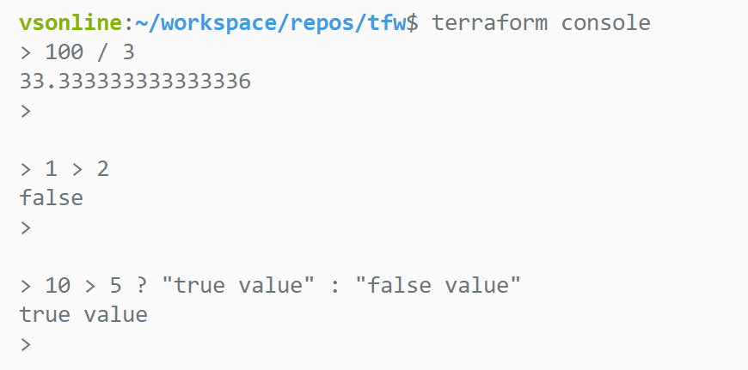
Arithmetic and Logical Operators
An operator is a type of expression that transforms or combines one or more other expressions.
The Terraform language has a set of operators for both arithmetic and logic, which are similar to operators in programming languages such as JavaScript or Ruby.
Notes:
https://www.terraform.io/docs/configuration/expressions.html#arithmetic-and-logical-operators

Slide 7
Type Constraints and values
Allow you to restrict the type of value that will be accepted as the value for a variable.
If no type constraint is set then a value of any type is accepted.
variable "region" {
type = string
default = "UK South"
}
locals {
tags = {
"cost_center" = "contoso research"
}
}
Supported type keywords
Collections and complex-types via type constructors
list(<TYPE>) – Ordered List of Values
set(<TYPE>) – Deduplicated List of Values
map(<TYPE>) – Keys and Values
object({<ATTR NAME> = <TYPE>, ... }) – Schema-Driven Map
tuple([<TYPE>, ...]) – Schema Driven List
string
number
bool
Notes:
Data types
What’s the difference between Map and object?
With Maps, lists and sets, the data should be of same type

Slide 8
count and for_each meta arguments (keeping it DRY)
resource "azurerm_resource_group" "rg" {
count = length(var.rg_names)
name = var.rg_names[count.index]
location = var.region
tags = var.tags
}
resource "azurerm_resource_group" "rg" {
for_each = var.resource_groups
name = each.value.name
location = var.region
tags = var.tags
}
Note: A given resource block cannot use both `count` and `for_each`. We’ll see other meta arguments later
Notes:
https://www.terraform.io/docs/configuration/expressions.html#for-expressions
This was not possible before 0.12
https://www.hashicorp.com/blog/hashicorp-terraform-0-12-preview-for-and-for-each/
https://blog.gruntwork.io/terraform-tips-tricks-loops-if-statements-and-gotchas-f739bbae55f9

Slide 9
Iterating over collections
> [for s in ["hello", "world"]: upper(s)]
[
"HELLO",
"WORLD",
]
output "rg_ids" {
value = [for rg in azurerm_resource_group.rgs : rg.id]
}
Splat expressions
output "rg_ids" {
value = azurerm_resource_group.rgs.*.id
}
Notes:
https://www.terraform.io/docs/configuration/expressions.html#for-expressions
This was not possible before 0.12
https://www.hashicorp.com/blog/hashicorp-terraform-0-12-preview-for-and-for-each/
https://blog.gruntwork.io/terraform-tips-tricks-loops-if-statements-and-gotchas-f739bbae55f9

Slide 10
Interpolations and Directives
A ${ ... } sequence is an interpolation, which evaluates the expression given between the markers, converts the result to a string if necessary, and then inserts it into the final string
name = "${var.prefix}_rg"
A %{ ... } sequence is a directive, which allows for conditional results and iteration over collections, similar to conditional and for expressions.
name = "Hello, %{ if var.name != "" }${var.name}%{ else }unnamed%{ endif }!"

Slide 11
Applying what we’ve learnt to our config
# variables.tf
variable rg_names {
type = list(string)
}
# terraform.tfvars
rg_names = [
"contoso_rg",
"contoso_dev_rg",
"contoso_staging_rg"
]
# main.tf
resource "azurerm_resource_group" "rgs" {
count = length(var.rg_names)
name = var.rg_names[count.index]
location = var.region
tags = var.tags
}
# outputs.tf
output "rg_ids" {
value = azurerm_resource_group.rgs.*.id
}
Notes:
https://www.terraform.io/docs/configuration/expressions.html#arithmetic-and-logical-operators

Slide 12
Terraform Import Command
The terraform import command is used to import existing infrastructure.
The command currently can only import one resource at a time.
resource "azurerm_resource_group" "existing_rg" {
name = "rg_created_via_portal"
location = "UK South"
}
terraform import azurerm_resource_group.existing_rg "/subscriptions/<subscription_id>/resourceGroups/rg_created_via_portal"

Slide 13
Terraform Import Block
The terraform import block is used to import multiple existing infrastructure components.
Requires Terraform CLI >=1.5.0
It can also optionally generate the config for you.
import
{
to = azurerm_resource_group.existing_rg
id = "/subscriptions/<subscription_id>/resourceGroups/rg_created_via_portal"
}
resource "azurerm_resource_group" "existing_rg"{
name = "rg_created_via_portal"
location = "UK South"
}
terraform plan -generate-config-out=generated_resources.tf

Slide 14
Terraform Data Sources
Data sources allow data to be fetched or computed for use elsewhere in Terraform configuration.
data "azurerm_resource_group" “pre_existing_rg" {
name = “demo_rg"
}
# Access data source
data.azurerm_resource_group.pre_existing_rg.id

Slide 15
Expressions and Terraform Console
Demo

Slide 16
Functions
Notes:
The set of files used to describe infrastructure in Terraform is known as a Terraform configuration

Slide 17
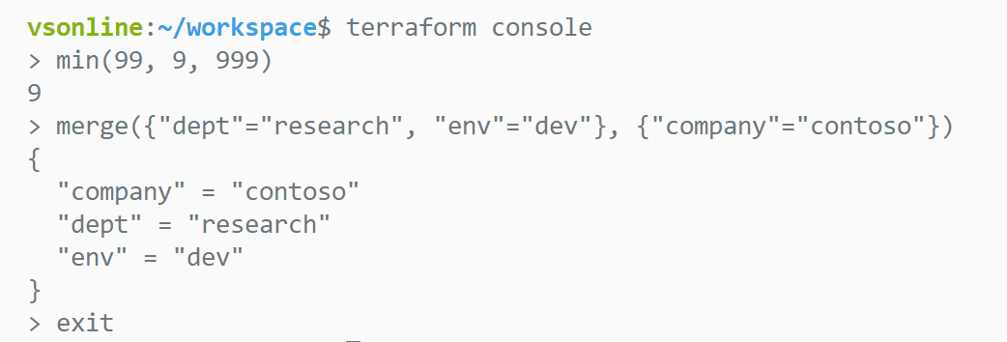
Functions
The Terraform language includes a number of built-in functions that you can call from within expressions to transform and combine values.
The general syntax for function calls is a function name followed by comma-separated arguments in parentheses
Notes:
Terraform Console
Read, Eval, Print and Loop

Slide 18
Terraform Built-in Functions by category
Numeric
String
Collection
Encoding
File System
Date and Time
Hash and Crypto
IP Network
Type Conversion
Notes:
Before 0.12, this was all scattered

Slide 19
Functions on Terraform console
> max(12,54,3)
54
> max([12,54,3]...)
54
> split(",", "foo,bar,baz")
[
"foo",
"bar",
"baz",
]
> join(" ", ["foo", "bar", "baz"])
foo bar baz
> lower("HELLO")
hello
> keys({a=1, c=2, d=3})
[
"a",
"c",
"d",
]
> sort(["e", "d", "a"])
[
"a",
"d",
"e"
]
> toset(["c", "b", "b"])
[
"b",
"c",
]
> base64decode("SGVsbG8gV29ybGQ=")
Hello World
> sha256("hello world")
b94d27b9934d3e08a52e52d7da7dabfac484efe37a5380ee9088f7ace2efcde9
> cidrsubnet("172.16.0.0/16", 8, 0)
172.16.0.0/24
> file("${path.module}/hello.txt")
Hello World
> jsonencode({"hello"="world"})
{"hello":"world"}
...and many more with new ones being added such as `yamlencode`
Notes:
abspath(path.root)
file("${path.root}/hello.txt")
max(12,54,3)
max([12,54,3]...)
split(",", "foo,bar,baz")
join(" ", ["foo", "bar", "baz"])
lower("HELLO")
keys({a=1, c=2, d=3})
sort(["e", "d", "a"])
toset(["c", "b", "b"])
base64decode("SGVsbG8gV29ybGQ=")
sha256("hello world")
cidrsubnet("172.16.0.0/16", 8, 0)
jsonencode({"hello"="world"})

Slide 20
Functions
Demo
Notes:
Terraform console
abspath(path.root)
file("${path.root}/hello.txt")
max(12,54,3)
max([12,54,3]...)
split(",", "foo,bar,baz")
join(" ", ["foo", "bar", "baz"])
lower("HELLO")
keys({a=1, c=2, d=3})
sort(["e", "d", "a"])
toset(["c", "b", "b"])
base64decode("SGVsbG8gV29ybGQ=")
sha256("hello world")
cidrsubnet("172.16.0.0/16", 8, 0)
jsonencode({"hello"="world"})
https://www.terraform.io/docs/configuration/expressions.html

Slide 21

Ask
Discuss
Comment

