Slide 1
Resource Dependencies and Terraform Modules
Ryan Russell-Yates

Slide 3
Dependencies

Slide 4
Resource Dependencies in Terraform
When Terraform changes infrastructure, many of the changes have to be made in a specific order.
This order is determined by resource dependencies.
Implicit Dependencies
Terraform and the Azure provider determine automatically based on the configuration.
Explicit Dependencies
User defines using depends_on meta argument
This is done when terraform can’t detect a dependency and user wants to override the default execution plan
Notes:
Can anyone remember other meta arguments?
For example, if a virtual machine (VM) resource references a network interface (NIC), the provider "knows" to create the NIC before attempting to create the VM.

Slide 5
Implicit Dependency example
resource "azurerm_resource_group" "rgs" {
count = length(var.rg_names)
name = "${var.prefix}_${var.rg_names[count.index]}"
location = var.region
tags = var.tags
}
resource "azurerm_virtual_network" "vnet" {
count = length(var.rg_names)
name = lookup(var.vnets[count.index], "name")
address_space = [lookup(var.vnets[count.index], "address")]
location = var.region
resource_group_name = azurerm_resource_group.rgs[count.index].name
}
Notes:
Swap the blocks and it will still work..
https://learn.hashicorp.com/terraform/azure/dependencies_az

Slide 6
Explicit Dependency example
resource "azurerm_resource_group" "rgs" {
count = length(var.rg_names)
name = "${var.prefix}_${var.rg_names[count.index]}"
location = var.region
tags = var.tags
}
resource "azurerm_virtual_network" "vnet" {
count = length(var.rg_names)
name = lookup(var.vnets[count.index], "name")
address_space = [lookup(var.vnets[count.index], "address")]
location = var.region
resource_group_name = "${var.prefix}_${var.rg_names[count.index]}"
depends_on = [ azurerm_resource_group.rgs ]
}
Notes:
Swap the blocks and it will still work..
https://learn.hashicorp.com/terraform/azure/dependencies_az

Slide 7
Dependencies
Demo
Notes:
Create a vnet inside resource groups

Slide 8
Modules

Slide 9
Modules
Root Module vs Sub Module
Notes:
Explain the difference between a root module and a sub module for clarity moving forward.

Slide 10
Modules
A module is a container for multiple resources that are used together.
Ligthtweight abstractions
Distributable
Can be Nested
Composable
Local or Remote
Better Organization
Encapsulation
Reusability
Notes:
https://www.terraform.io/docs/modules/composition.html
Composition over deep-nesting
Similar to a library or a package
other benefit of using modules is to encapsulate configuration into distinct logical components

Slide 11
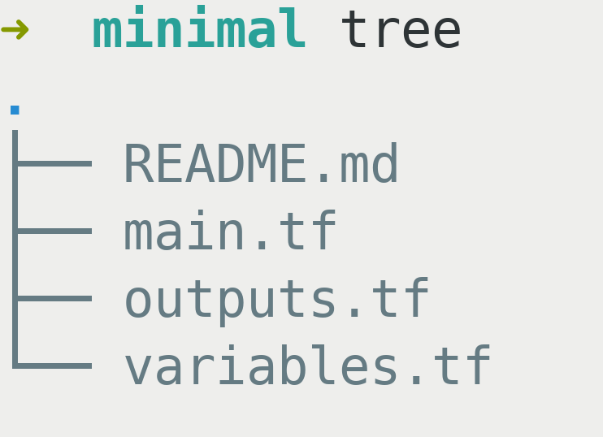
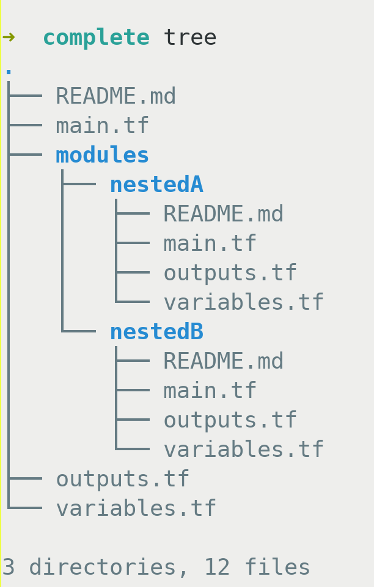
Root Module is the only requirement and acts as the entry point.
Minimal Structure
Nested Example
Notes:
https://learn.hashicorp.com/terraform/modules/creating-modules
There aren’t any .tfvars because we will be passing in the values. Placing data inside makes modules less reusable.

Slide 12
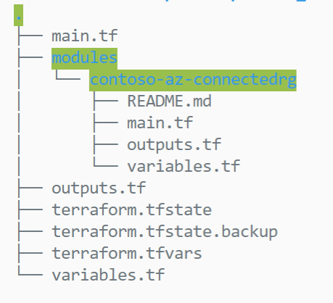
Module block to call a module
# main.tf from calling module
provider "azurerm" {
version = "~>2.0.0"
features {}
}
module "connectedrg" {
# or remote git repo with ?ref=version
source = "./modules/contoso-az-connectedrg"
rg_names = var.rg_names
vnets = var.vnets
}
Notes:
Module sources can be remote git repos, private registries, etc.

Slide 13
Module structuring – Common pattern
Resource Modules
(Opinionated encapsulated wrapper with minimal variables and sensible defaults)
Stack Modules
(Composed of Resource Modules Only)
VNET
1 Tier Web Application with SQL Database
Storage Account
App Service Plan
SQL Database
2 Tier Web Application with SQL Database, Storage and Private Networking
App Service
Front Door

Slide 14









Modules Structuring - Pattern and Policy
Resource Module
Stack Module
Root Module
Managed Identity
SQL Database
Private Endpoint
Resource Module
Stack Module
Managed Identity
Storage Account
Provider Resource
Private Endpoint
Resource Module

Slide 15
Private Module Sharing Options
git repository
http server
cloud blob storage
private registry in Terraform Cloud / Ent
Can be public or private
Private requires an access token
Versioning is static via `ref` on url
Documentation in read me
Serve a zip or tar
Versioning would require custom coding
Authentication would be custom and basic
Documentation separate
Only supports AWS and GCP
Versioning static via url
Token / credentials required
Documentation separate
Authentication built in
Dynamic versioning via `version` attribute
Documentation in registry
Supports providers
Supports authz for admins

Slide 16
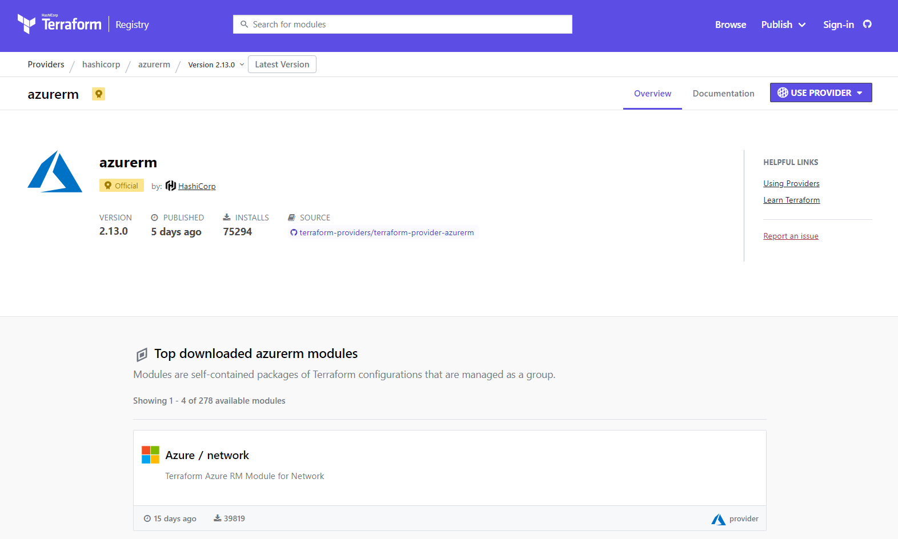
Terraform public registry
Notes:
Don’t mutate the modules from official registry. If planning to do so, then make it custom and manage it separately in your own module source because version upgrades to original module will break changes if you accidentally update them.
It’s best not to mutate community maintained / official modules.

Slide 17
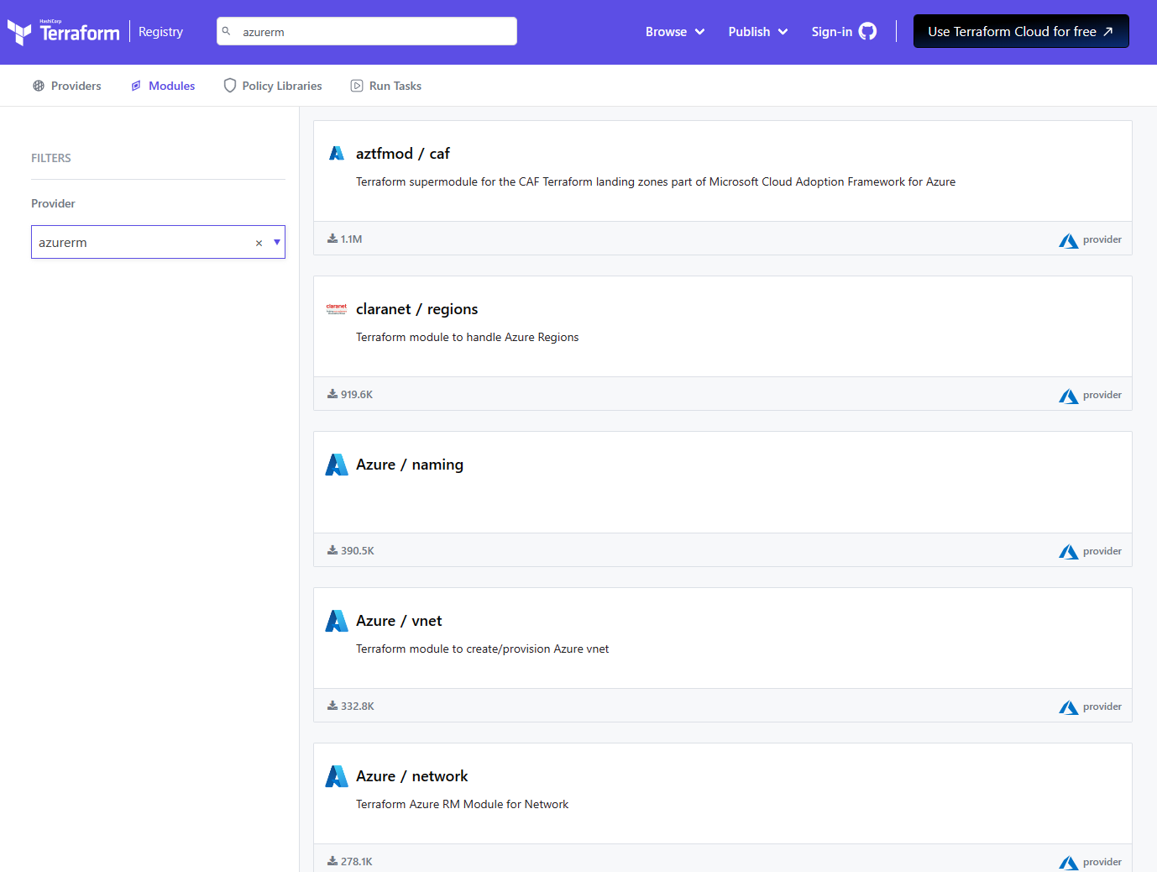
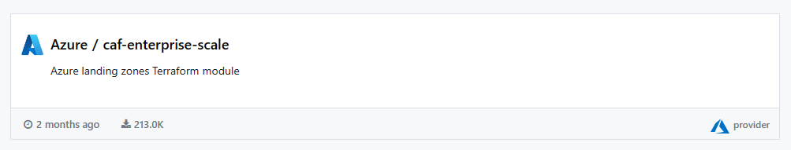
Public Modules and Providers
Terraform public registry
Curated by Microsoft
Reusable best practice
Landing zones

Slide 18
Module and Provider Versioning
Module and Provider version pinning allows teams to work with confidence
Follow SemVer
Major: Incompatible API changes
Minor: New functionality added in a backwards compatible manner
Patch: Backward compatible bug fixes
Use version patterns to accept patch or minor releases
~> 1.1.3
Allows all 1.1.* >=1.1.3
Does not allow >=1.2.0
>= 1.1.3, <2.0.0
Allows all 1.*.* versions >=1.1.3
does not allow >=2.00

Slide 19
Modules - What and Why of Inner Source?
Exactly the same as open source, but private to your organisation
Anyone can branch or fork and raise a pull request
Platform team provides:
Guidance (documentation, training and pairing)
Validation (automated checks when a pull request is raised)
Approval (peer review and merging of pull requests)
Optimised for fast flow and sharing:
Do not hold up teams that need a new module
Easy discovery to promote the use and re-use of modules
No need for a huge central backlog
No need for a cumbersome pre-approval / planning process

Slide 20
Root Module Sizing
Number of resources managed
Refresh time grows linearly
Blast radius
Maintainability
Size of state file
Memory usage
Graph generation
Agent sizing
Plan Time
Plan ahead or refactor later
Split vertical or horizontal
Share outputs or use data sources

Slide 21
Modules
Demo
Notes:
Show both local and remote flow. (re init as needed)

Slide 22

Ask
Discuss
Comment

