Slide 1
Do modelling papers lie to us?
Ramakrishna Suresh
Project-2

Slide 2
Paper background
H1N1 and H5N1 are two flu varieties which modelers are interested in.
H5N1 is much more aggressive and kills the victim quickly.
Fitting a general response model to both and analysis the differences in parameters can be useful

Slide 3
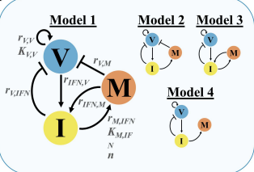
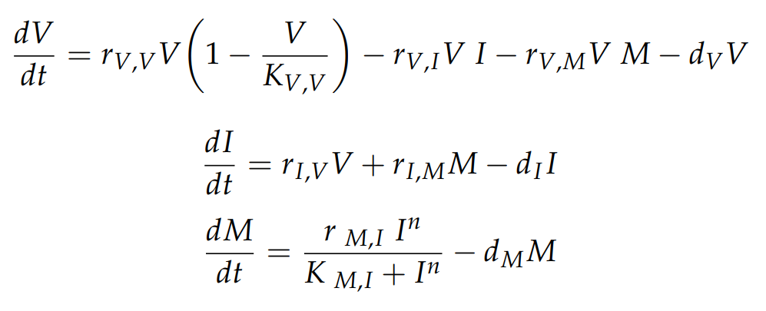
The model used

Slide 4
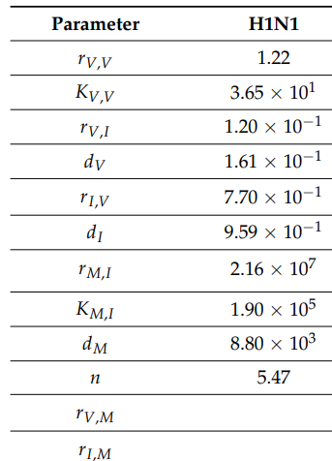
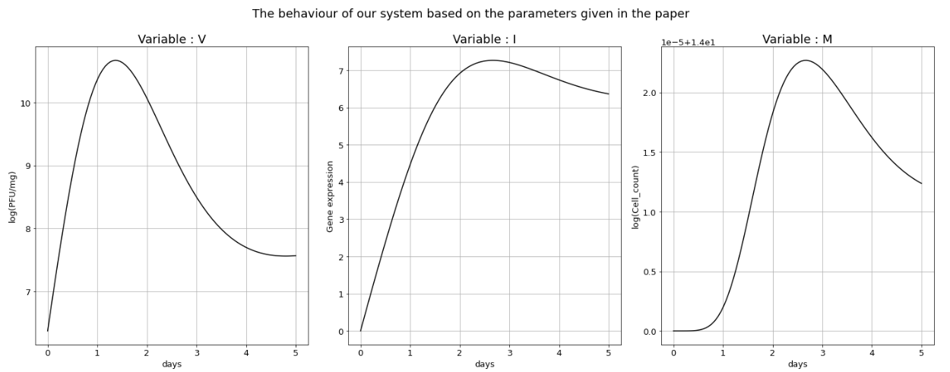
Initial plot

Slide 5
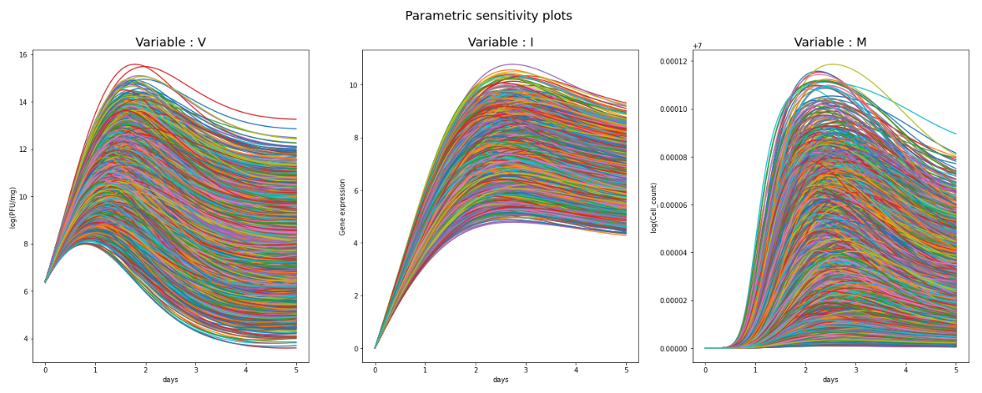
Global parametric sensitivity analysis
We see that the steady state values of our plots shift as we vary our parameters. We do not see a behaviour change in any of the three curves.
Range used: 20% above and below the reported values

Slide 6
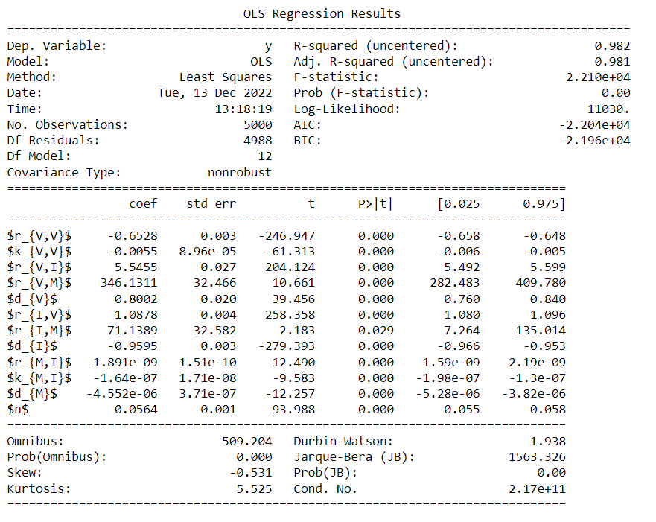
Global parametric sensitivity analysis
The parameter selected for bifurcation analysis
Parameter values which have been set to an arbitrarily low value. Do not have any significance
Extremely insensitive parameters

Slide 7
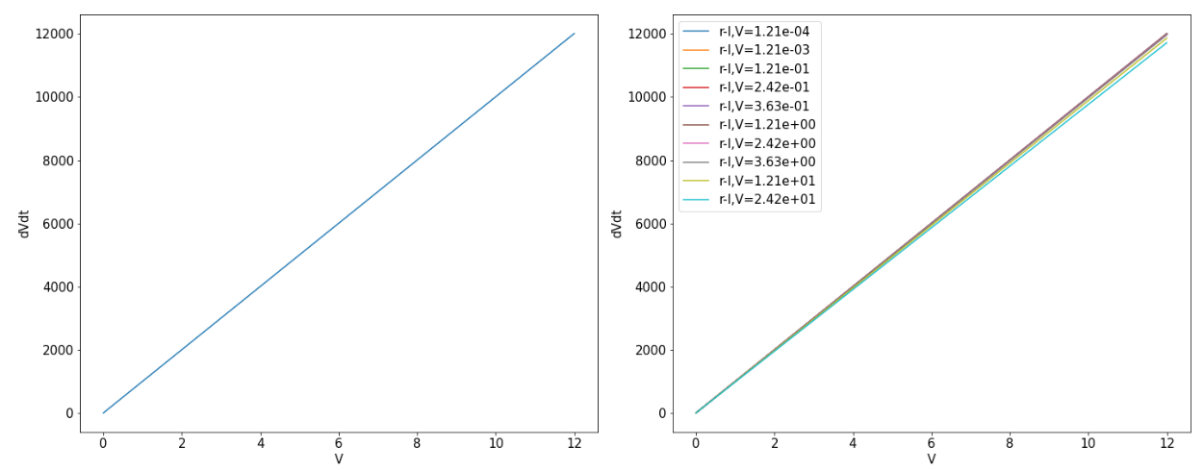
Bifurcation analysis: State - V

Slide 8
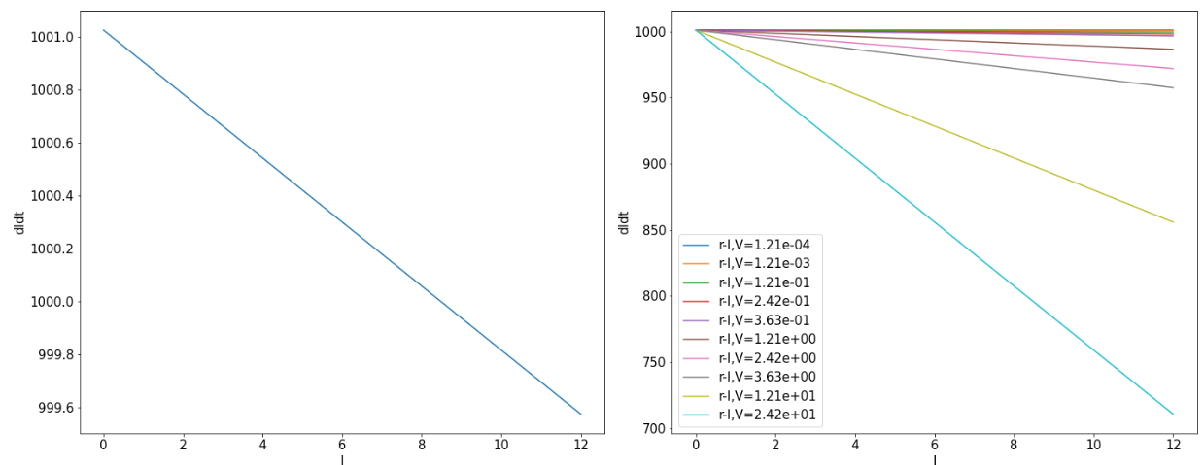
Bifurcation analysis: State - I

Slide 9
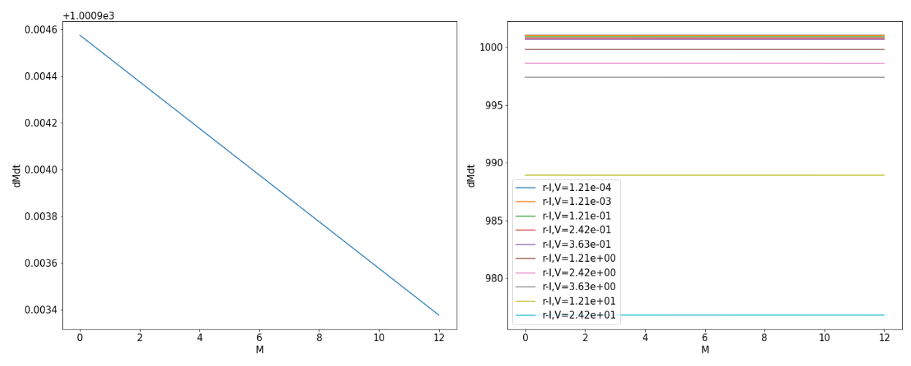
Bifurcation analysis – STATE M

Slide 10
Fitting the data
t in days | Viral load in Log(PFU)/mouse
0 | 5.25
5 | 13.56
8 | 6.87
Data from lin et al.

Slide 11
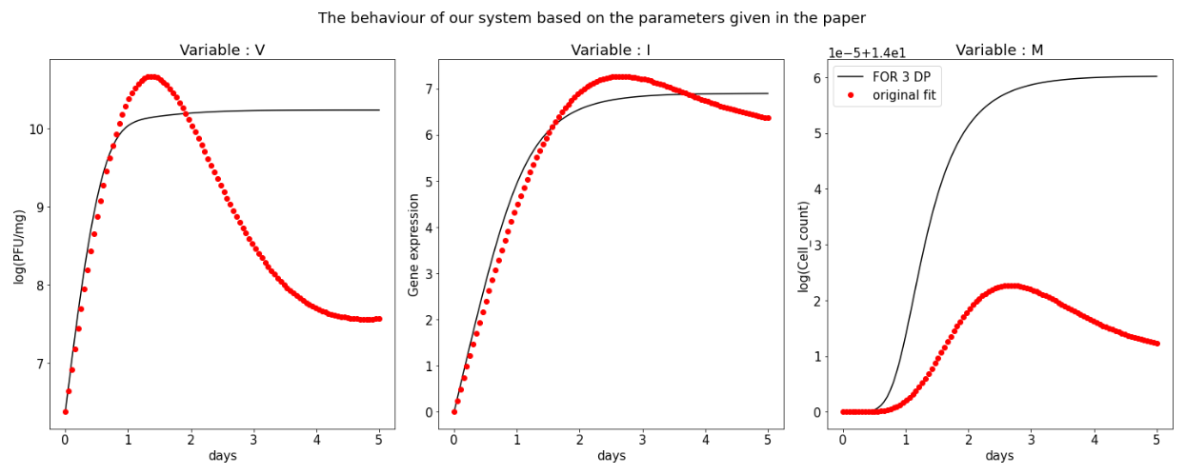
Fitting the data

Slide 12
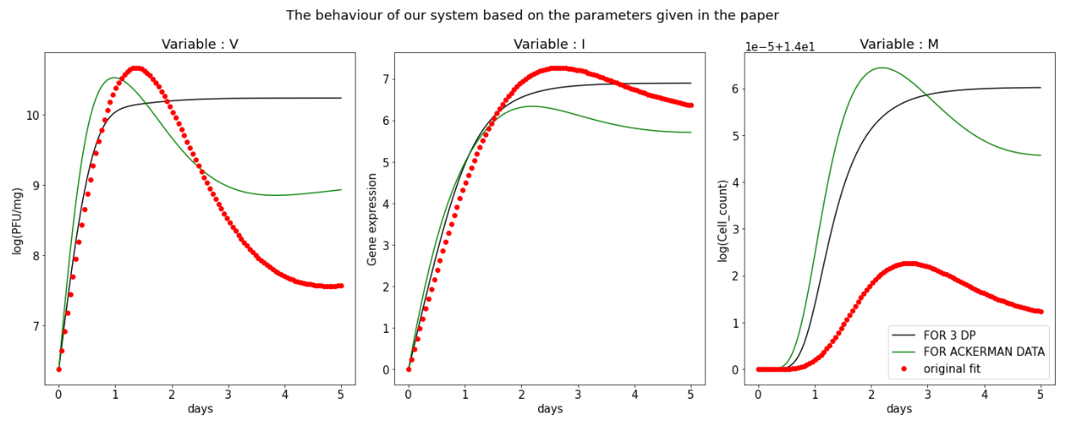
Fitting the data

Slide 13
Conclusions/Take home points
NEVER USE scipy.optimize.solve_ivp for ODE solving, especially when there are iterations involved.
The authors might not have mentioned specific constraints set to the solvers, which results in the fit mismatch.
Authors perform a parametric space analysis by using “MCMC” and “Basin hopping” methods – useful getting more reasonable fits
Sometimes, no matter what we do, the model just refuses to fit. Cheers to 5 years of this!

