Slide 1
ELEVA

Slide 2
ELEVA
RASEEL AL-KHAMEES
AISHA GAMMASH

Slide 3
PROJECT OVERVIEW
An AI platform designed to bridge the gap between job seekers and target technical roles through automated analysis, match scoring, personalized learning plans, and interview preparation.
Key Workflow:
Upload a resume (PDF) and select a target job title.
An advanced cooperating AI agent pipeline analyzes the resume and evaluates role requirements.
Delivers a tailored package including match scores, learning roadmaps or application-ready guides, resume improvements, and interview questions.
2

Slide 4
SYSTEM ARCHITECTURE
┌────────────────────────────────────────────┐
│ LAYER 4: FRONTEND LAYER (HTML / CSS / JS UI) │
│ ┌─────────────────────────────────────────┐ │
│ │ LAYER 3: API GATEWAY LAYER (FASTAPI, REST ENDPOINTS, CORS) │ │
│ │ ┌──────────────────────────────────────┐ │ │
│ │ │ LAYER 2: STORAGE & SECURITY (SQLITE, SQLALCHEMY, AUTH) │ │ │
│ │ │ ┌───────────────────────────────────┐ │ │ │
│ │ │ │ LAYER 1: AI AGENT LAYER (LANGGRAPH MULTI-AGENTS) │ │ │ │
│ │ │ │ ┌────────────────────────────────┐ │ │ │ │
│ │ │ │ │ LAYER 0: CORE LLM (QWEN2.5:7B VIA OLLAMA) │ │ │ │ │
│ │ │ │ └────────────────────────────────┘ │ │ │ │
│ │ │ └───────────────────────────────────┘ │ │ │
│ │ └──────────────────────────────────────┘ │ │
│ └─────────────────────────────────────────┘ │
└────────────────────────────────────────────┘
3

Slide 5
Resume Analysis
resume upload
Job Requirements
Skill Gap
Application Ready
Learning Planner
≥ 80%
< 80%
Resume Improvement
Interview Prep
Agents Roadmap

Slide 6
Resume Analysis
strengths/weaknesses
resume upload
extracts skills, education, experience,
Job Requirements
Skill Gap
Application Ready
Learning Planner
≥ 80%
< 80%
Resume Improvement
Interview Prep
Agents Roadmap

Slide 7
Resume Analysis
resume upload
Job Requirements
generates the target role's expected skill profile
Skill Gap
Application Ready
Learning Planner
≥ 80%
< 80%
Resume Improvement
Interview Prep
Agents Roadmap

Slide 8
Resume Analysis
resume upload
Job Requirements
Skill Gap
compares resume vs. requirements → match score
Application Ready
Learning Planner
≥ 80%
< 80%
Resume Improvement
Interview Prep
Agents Roadmap

Slide 9
Resume Analysis
resume upload
Job Requirements
Learning Planner: generates targeted skills, tasks, and time estimates to bridge the skill gap
Application Ready: confirms qualification and readiness for the role (match score ≥ 80%)
Skill Gap
Application Ready
Learning Planner
≥ 80%
< 80%
Resume Improvement
Interview Prep
Agents Roadmap

Slide 10
Resume Analysis
resume upload
Job Requirements
Skill Gap
Application Ready
Learning Planner
≥ 80%
< 80%
Resume Improvement
rewritten summary, bullet points, keywords
Interview Prep
Agents Roadmap

Slide 11
Resume Analysis
resume upload
Job Requirements
Skill Gap
Application Ready
Learning Planner
≥ 80%
< 80%
Resume Improvement
Interview Prep
technical / project / behavioral Q&A
Agents Roadmap

Slide 12
SECURITY & RELIABILITY CONSID
Reliability: If one AI step fails, we catch the error and return a safe fallback instead of crashing the whole app.
Prompt Injection: We prevent bad instructions hidden in a resume from taking over by forcing the AI to only output structured JSON, not free text.
Cost Explosion: We avoid runaway costs by running our own local AI model instead of a pay-per-use API.
Observability: We track what's happening by logging every AI response, so we can debug issues after the fact.
Org Integration: We control access with password-protected accounts and login tokens.
2

Slide 13
SECURITY & RELIABILITY CONSID
Data Leakage: We protect user data by hashing passwords and giving every uploaded file a random name so files can't be overwritten or guessed.
Evaluation: We check accuracy with rule-based skill matching (not AI) for the one thing that must be precise: comparing skills.
Latency: We're aware sequential AI calls add latency and plan to run independent steps in parallel.
Regulatory: We limit exposure by only storing what's needed (resume data, no extra tracking) and keeping it local rather than sending it to a third party.
2

Slide 14
APP
INTERFACE

Slide 15
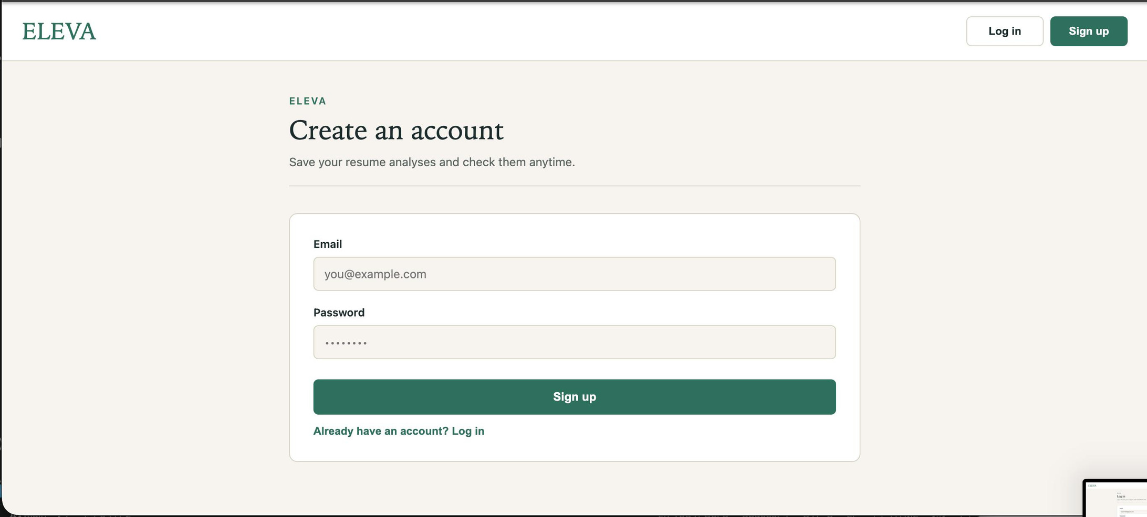

Slide 16
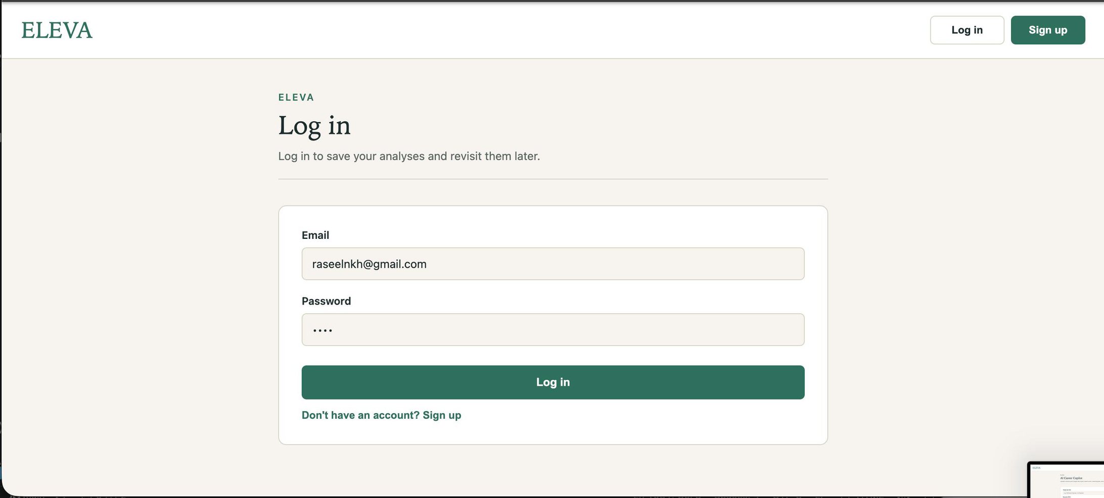

Slide 17
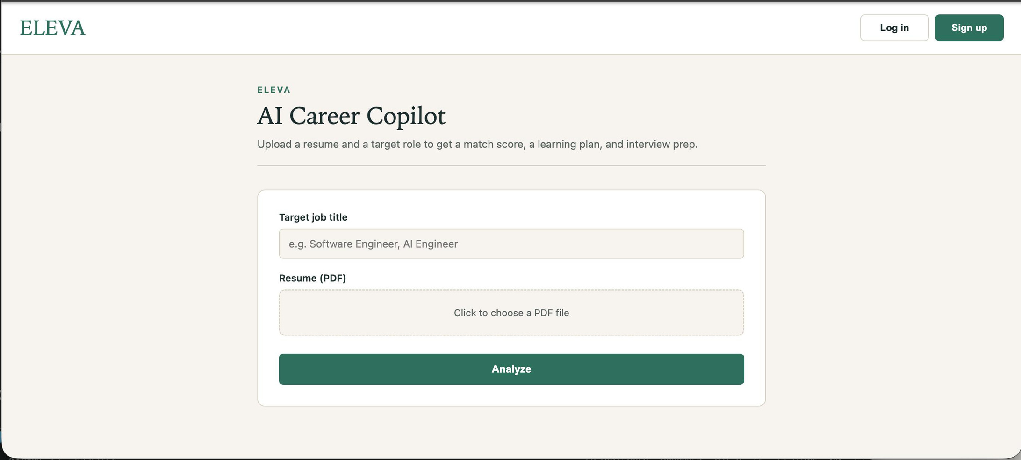

Slide 18
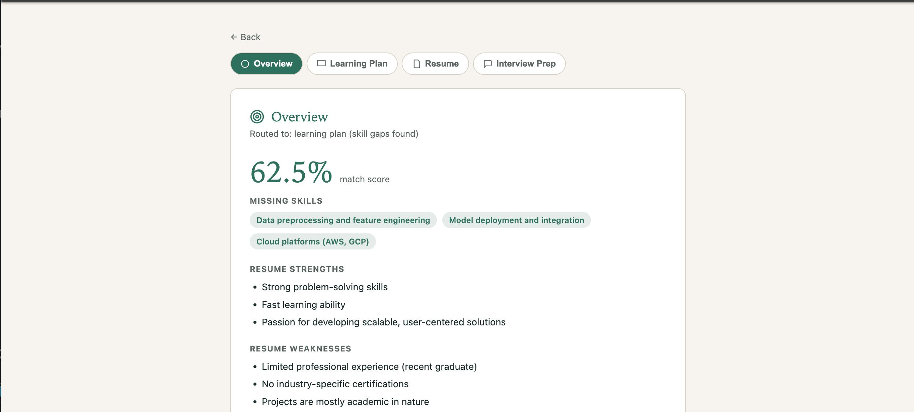

Slide 19
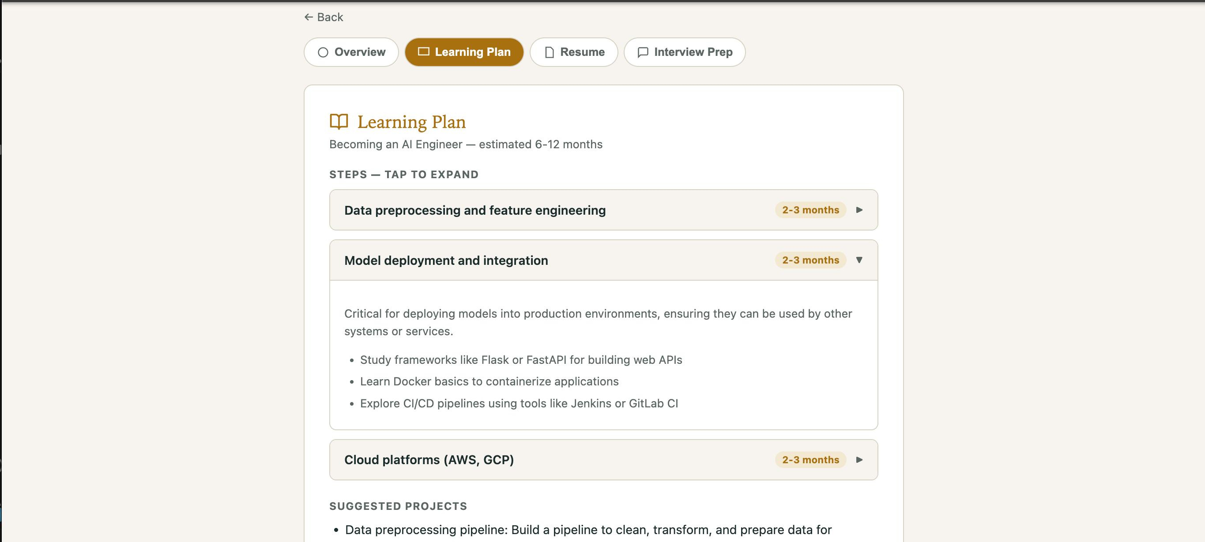

Slide 20
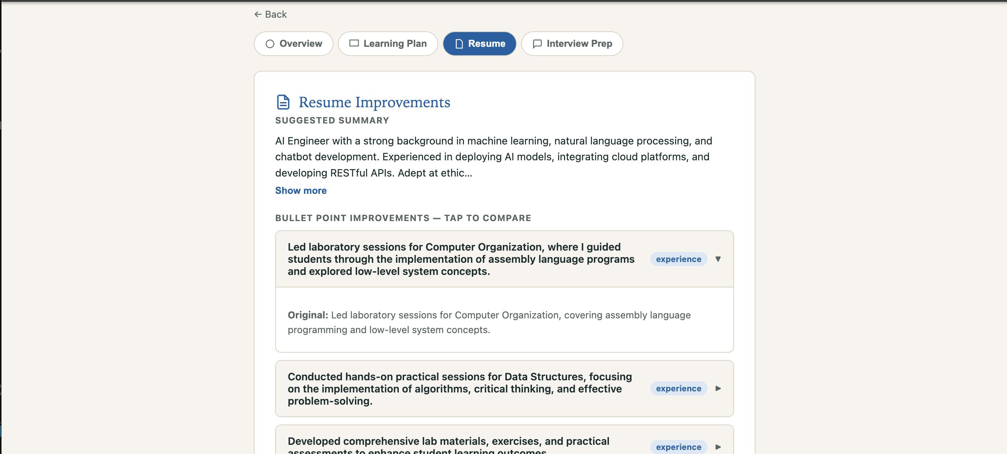

Slide 21
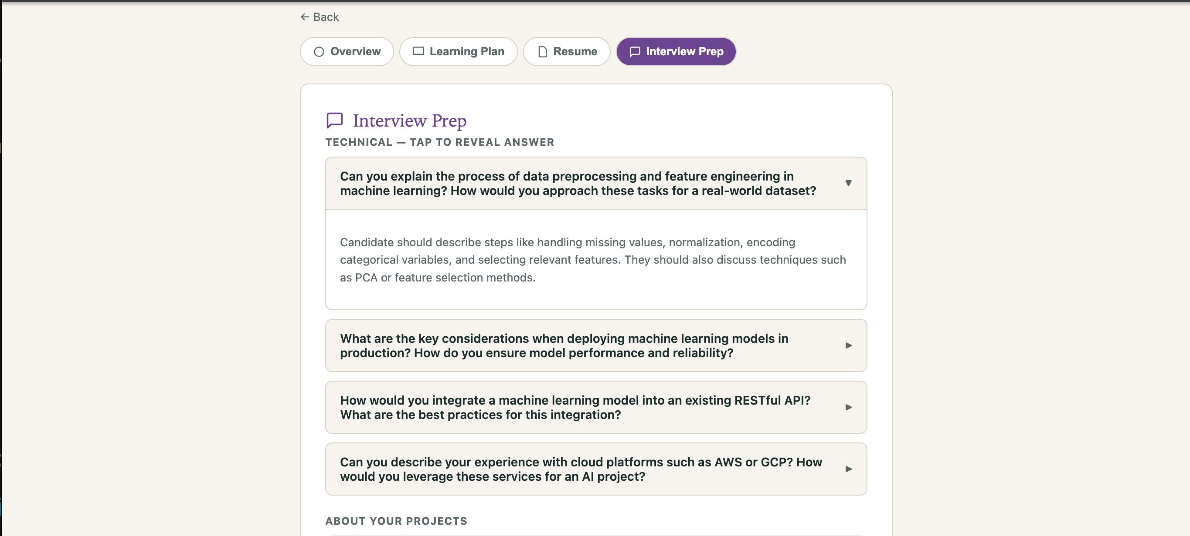

Slide 22

THANK YOU FOR LISTENING
Github Link
2026 February 9
Shawn Garcia
Liceria & Co.

