Slide 1
Assistive Robotics Part 1

Slide 2

Sandesh G. Bhat, Ph.D.
Assistant Professor
Assistive Systems and Robotics Engineering

Slide 3
Agenda
Introduction to Robotics
Workshop Project
Simple Electronics
Simple Coding
Servo Motors
Controlling Servo Motors

Slide 4
Introduction to Robotics
Robotics? Or just Robots?

Slide 5
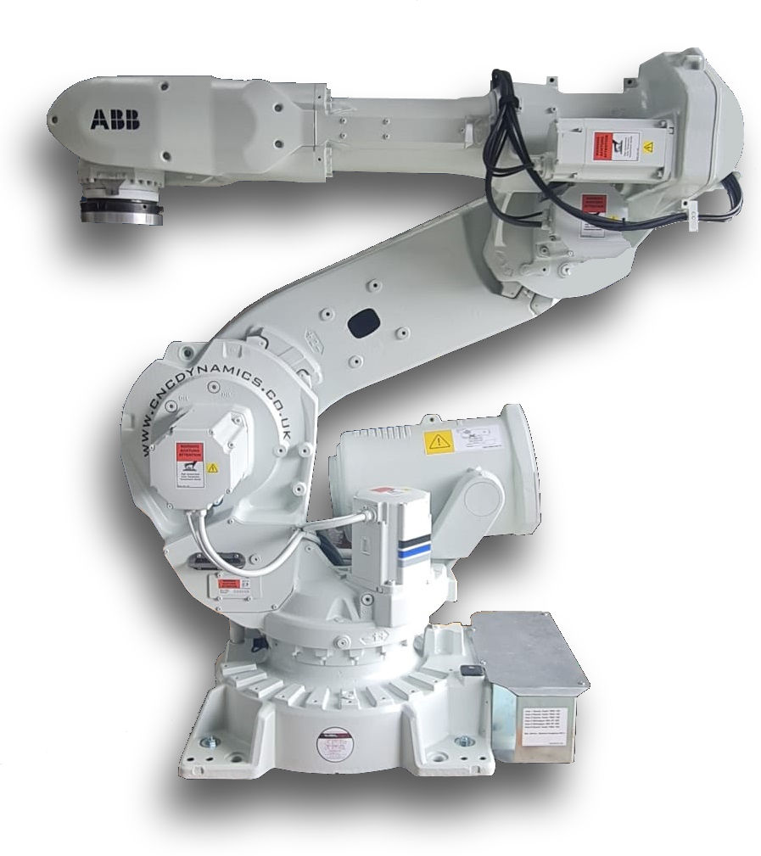

Introduction to Robotics
Robotics:
The field of science and engineering dedicated to designing, building, and programming
Robots:
Machines that perform certain tasks

Slide 6

What Robots have you seen/used/heard of?

Slide 7
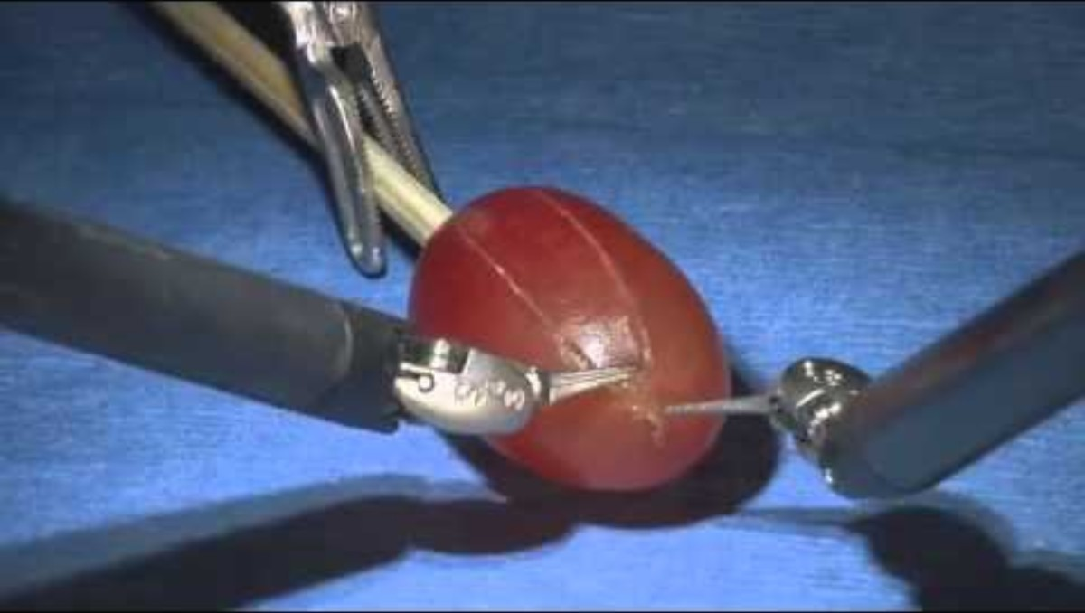

Slide 8
Surgical Robotics
More than 3.15 million robot-assisted surgeries were performed worldwide in 2025
Most Common Procedures:
General surgery: ~1.58 million procedures
Urology: ~708,000 procedures
Gynecology: ~649,000 procedures
Hernia Repair
Joint Replacements

Slide 9
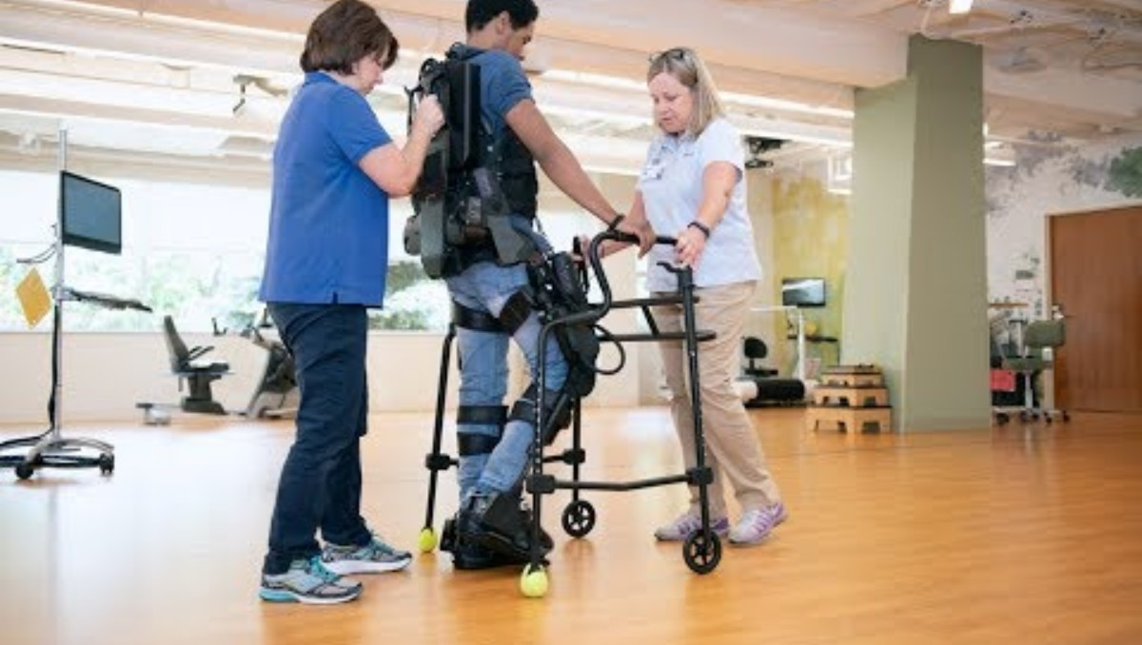

Slide 10
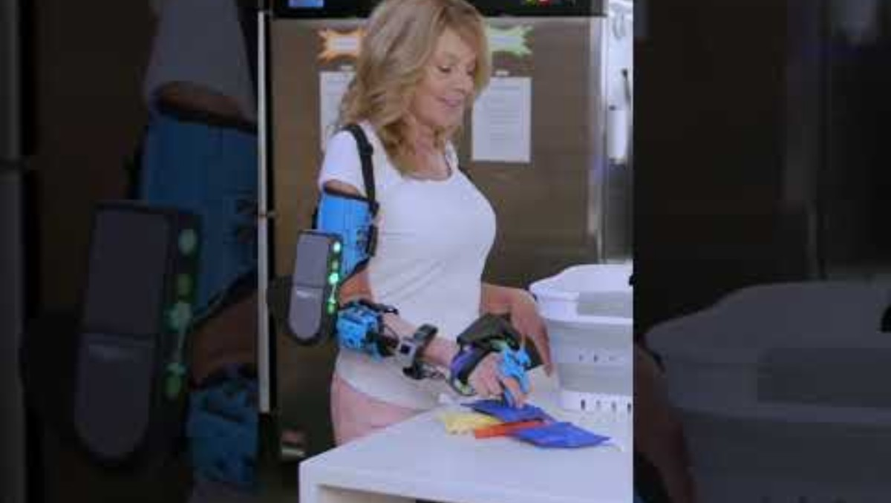

Slide 11
Introduction to Robotics
Skills required:
Mechanical Engineering: To design/build the robot
Electrical Engineering: To wire the motors and sensors
Computer Engineering + Science: To make the robot work as intended

Slide 12
Workshop Project
What are we doing here?

Slide 13
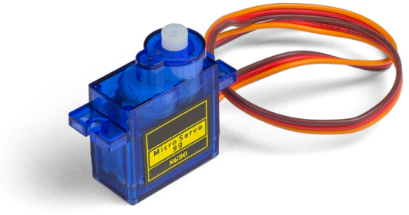
Workshop Project
Control a motor using an input
Connect a motor to a microcontroller
Use an input to move it
The motor returns to original position once the input goes away

Slide 14
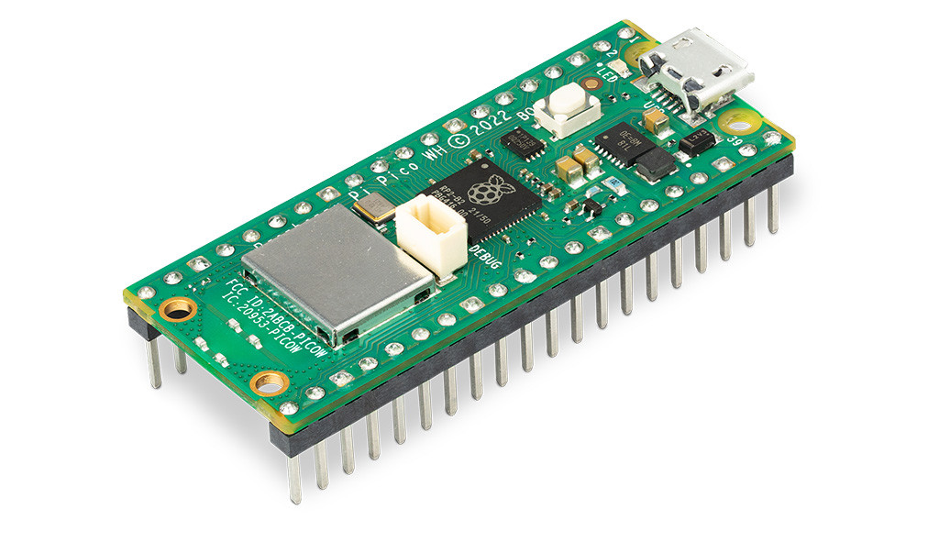
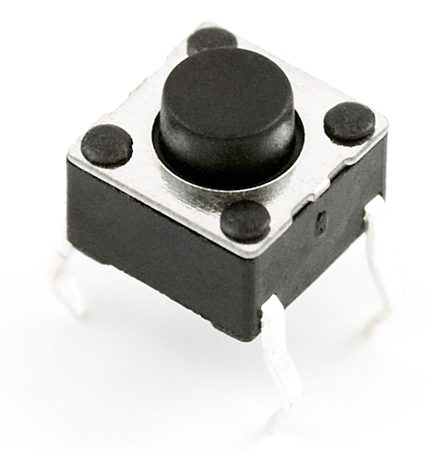
Workshop Project
What you will learn:
Wiring electronics
Programming a microcontroller (Raspberry Pi Pico)
Reading an input
Moving a motor

Slide 15
Simple Electronics
No sparks allowed here!

Slide 16
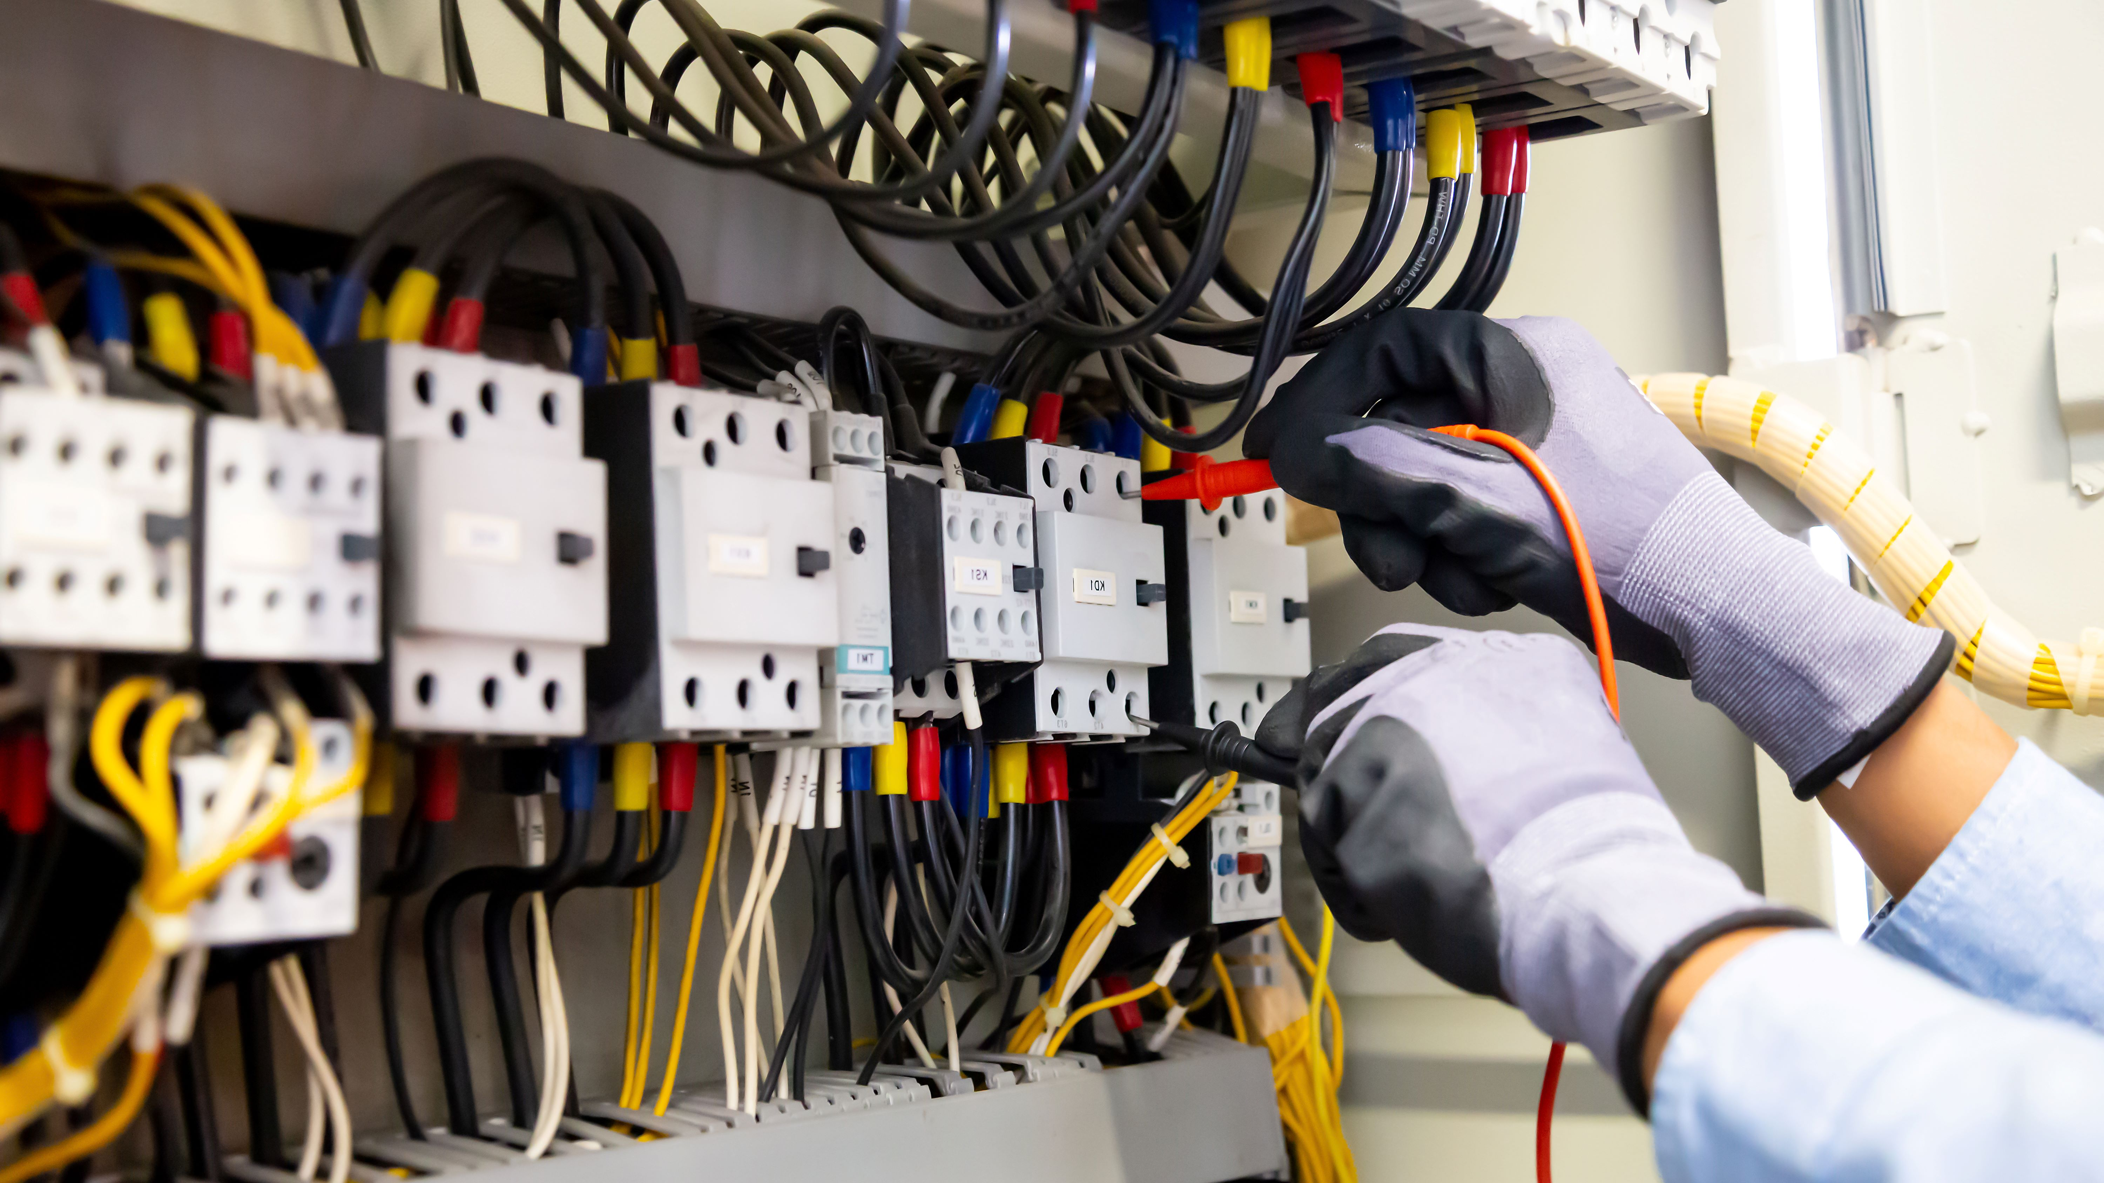

Conductors vs. insulators
Conductors:
Electricity flows through
e.g., Metals
Insulators:
Stops flow of electricity
e.g., Plastic

Slide 17
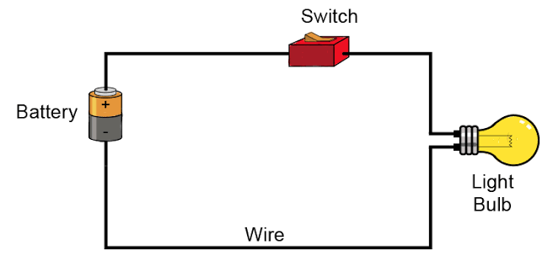
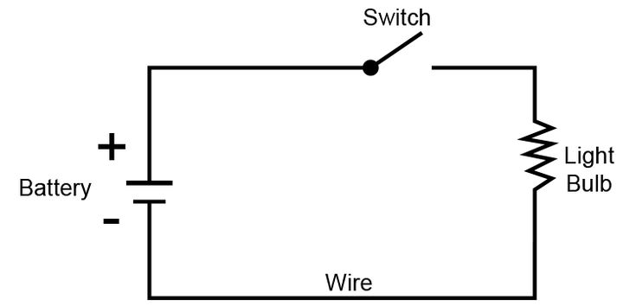
What is a Circuit?
Has all the components involved in the system.
The battery provides power (electricity)
The switch controls the flow of the power
The light bulb converts the power into a different form (light)

Slide 18
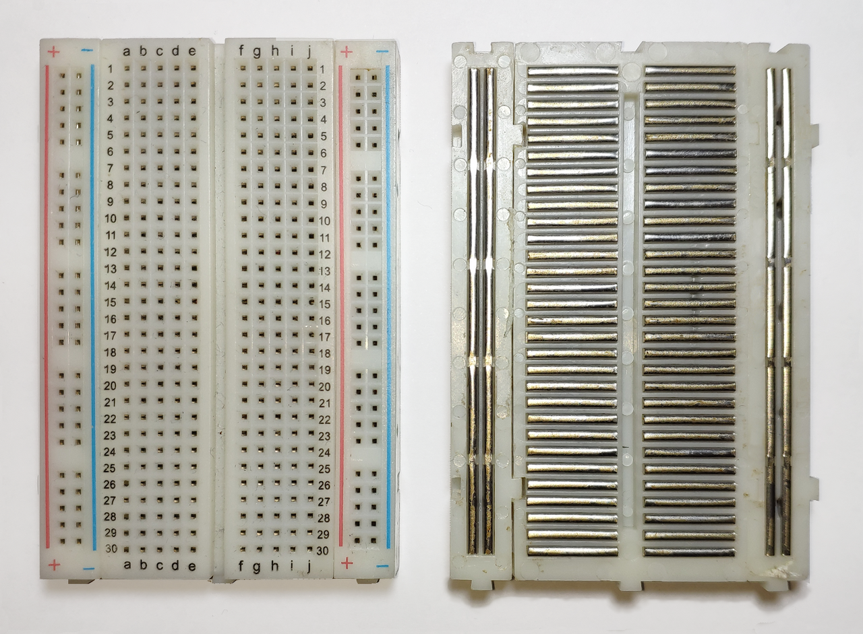
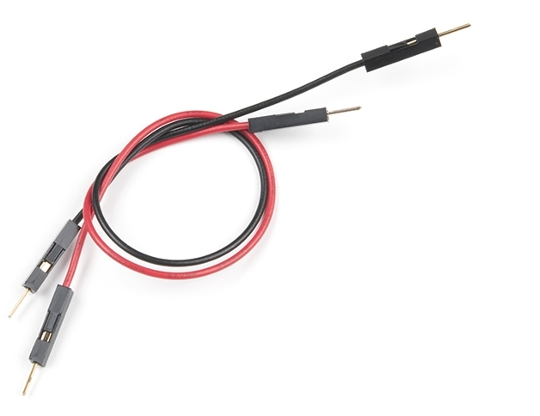
Easy Circuits
Try inserting the wires into the breadboard !
Making a circuit can be difficult!
So we use some components to make it easier
Breadboard
Jumper wires

Slide 19
Microcontroller
Raspberry Pico Pi
Simple tiny computer
It can:
Read sensors
Run programs
Control motors

Slide 20
Wiring Rules
Simple safety tips
Double check your wiring
Do not force components or wires together
Do not connect to power before checking in with me

Slide 21
Simple Coding
Lets keep this simple

Slide 22

Simple Coding
Open Thonny on your computers!
We will use micro python for programming the Pico
Thonny (open-source integrated development environment)
Try to add numbers
Print “Hello World”

Slide 23
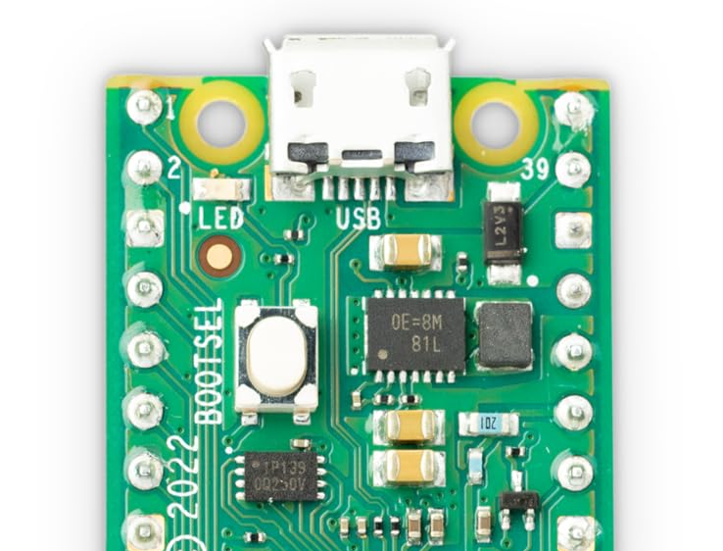
Blink the onboard LED
Activity:
LED
Use a simple program to blink the LED on-off at regular intervals
rasr-lab.github.io/education/
Blink_onboard_LED.py

Slide 24
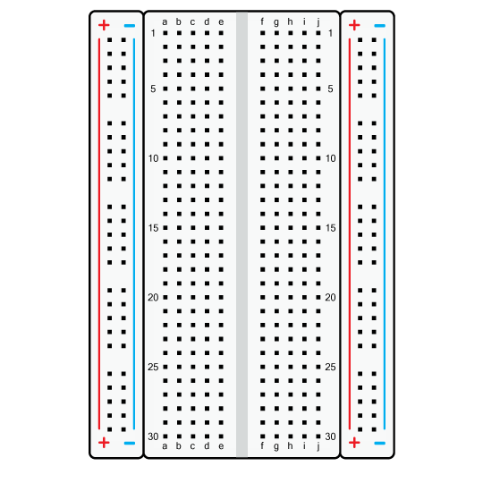
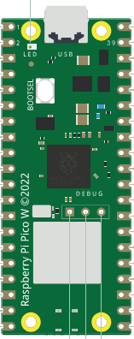

Blink the onboard LED
Activity:
Use a button to turn the LED on/off
rasr-lab.github.io/education/
Blink_LED_button.py

Slide 25
Servo Motors
Not just a motor

Slide 26
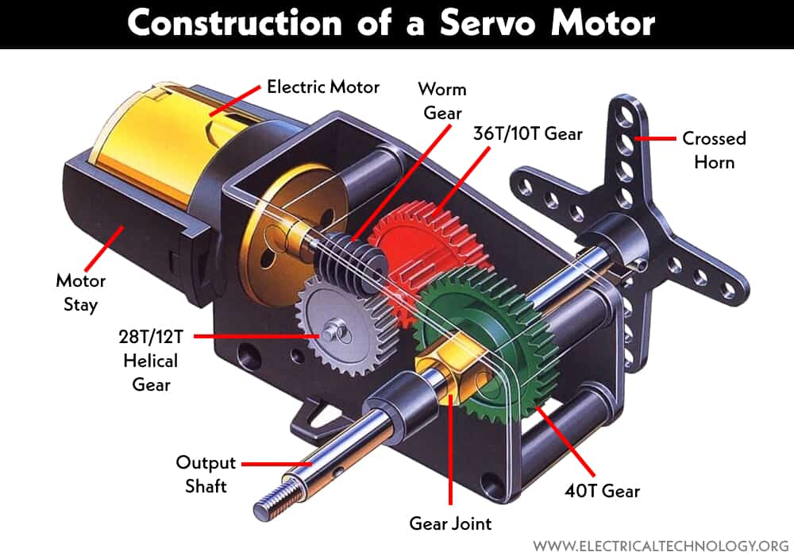
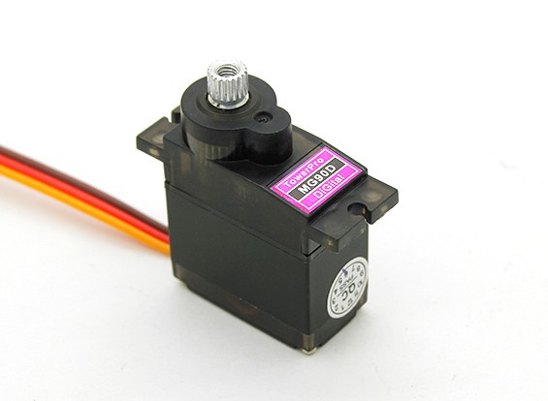
Servo Motors
A motor that moves to a specific angle
Internals are complex

Slide 27
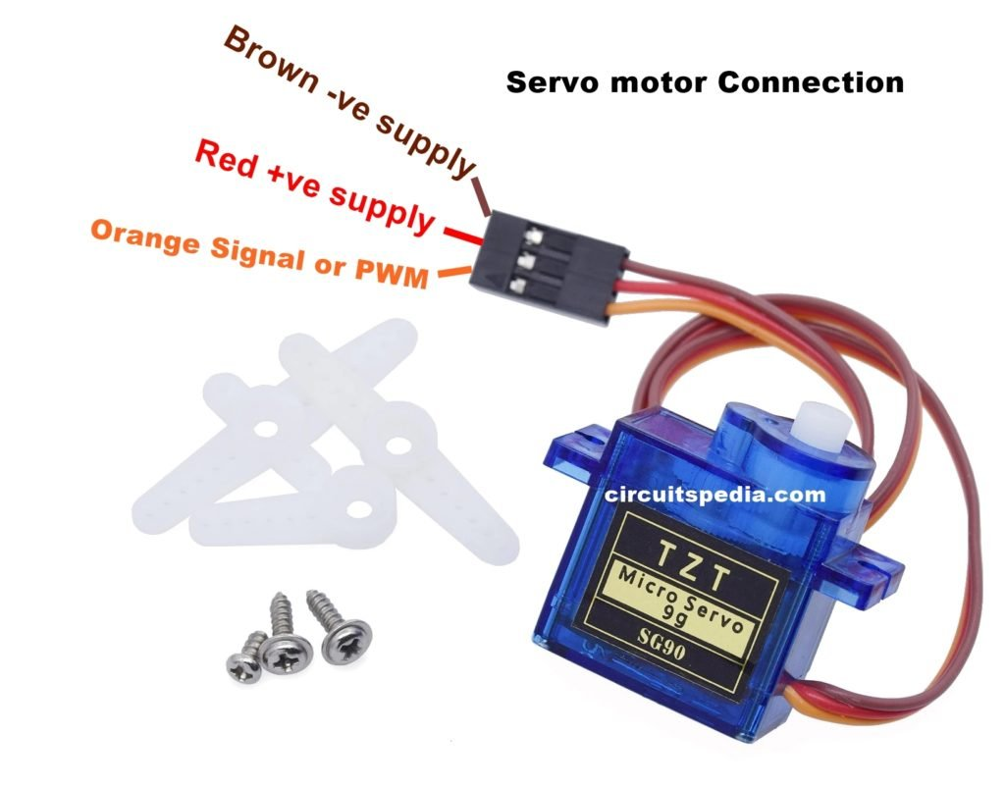
Servo Motors: Connections
3 wires to connect:
Red: + 5 V or VBUS
Black: 0 V or GND
Orange Or Yellow Or White: Control Signal
What is this?

Slide 28
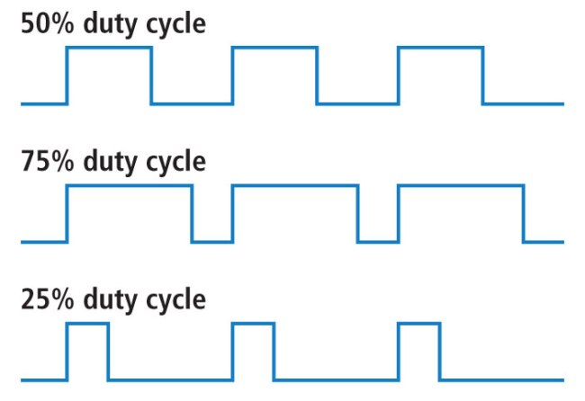
Servo Motors: Control
Pulse Width Modulation (PWM)
Instead of changing voltage, we change how long the voltage is high
This duration is called duty cycle
Voltage High
Voltage Low

Slide 29
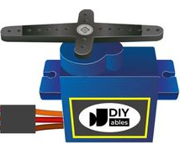
Simple motor control
Activity:
Make the motor rotate from max angle to min angle
rasr-lab.github.io/education/
Simple_servo_control.py

Slide 30
Simple motor control
Activity:
Make the motor rotate from max angle to min angle only on button press
rasr-lab.github.io/education/
Button_servo_control.py

Slide 31
What else can you do with this setup?

Slide 32
Thank you!
Sandesh G. Bhat
Assistive Systems and Robotics Engineering
bhatsg@uwec.edu

