Slide 1
Assistive Robotics Part 2

Slide 2
Agenda
Recap of Assistive Robotics Part 1
Human muscles and signals
Muscle activation as an input
Workshop Project

Slide 3
Recap of Assistive Robotics Part 1
Let’s run it back!

Slide 4
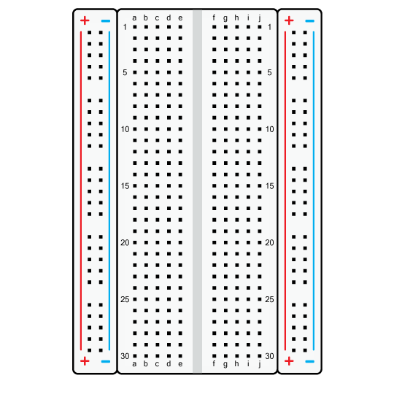
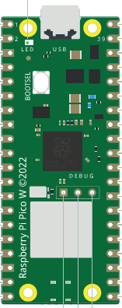
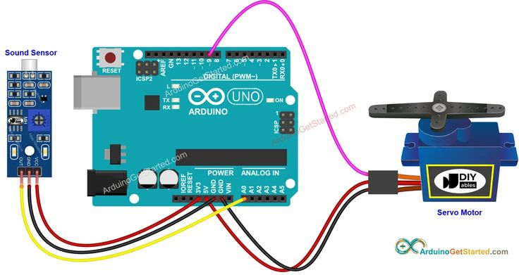

Simple motor control
Activity:
Make the motor rotate from max angle to min angle only on button press
rasr-lab.github.io/education/
Button_servo_control.py

Slide 5
Human muscles and Signals
What makes us move!

Slide 6
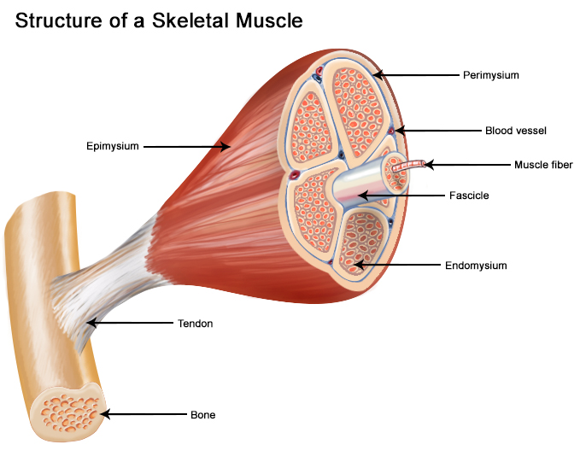
Structure of a muscle
Soft tissue
Muscle fibers bundled together
Blood supply within the muscles
Tendons connect to bones

Slide 7
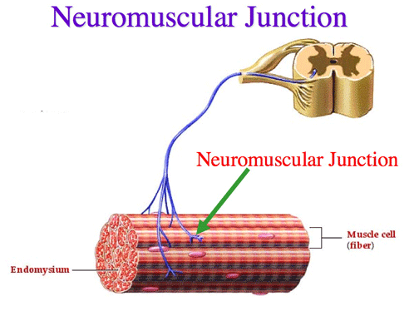
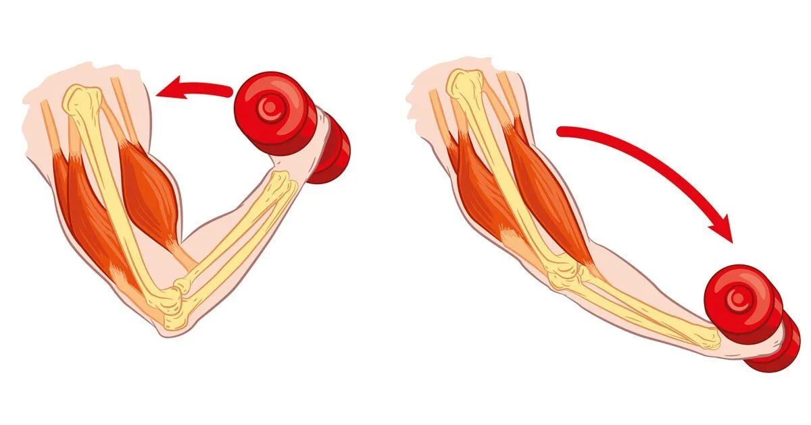
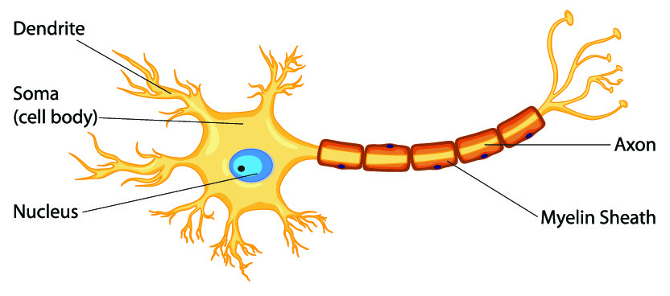
Structure of a muscle
Muscles need electrical activity to contract
Nerves supply electrical stimuli
Human nervous system generates electrical stimuli based on intent

Slide 8
Sensing Muscle Activity
This “electrical stimuli ” can me measured
The tool is called an Electromyograph
Needle EMG
Fine-wire EMG
Surface EMG

Slide 9
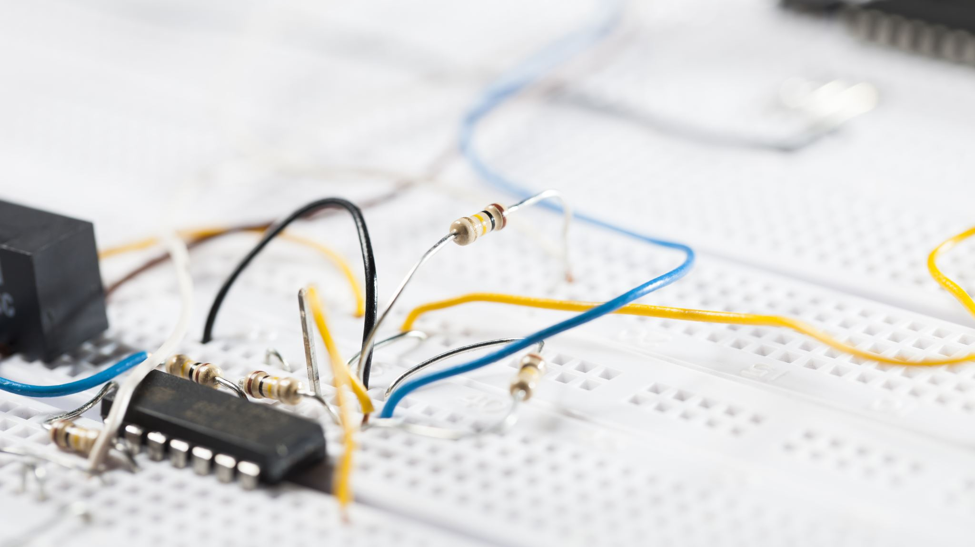
Let’s see an EMG sensor in action!

Slide 10
Muscle Activation As An Input

Slide 11
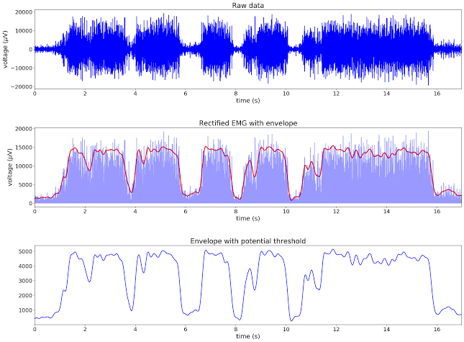

Slide 12
Muscle Activated
100
Muscle Activity (%)
Threshold
0
Time (s)
Muscle Not Activated

Slide 13
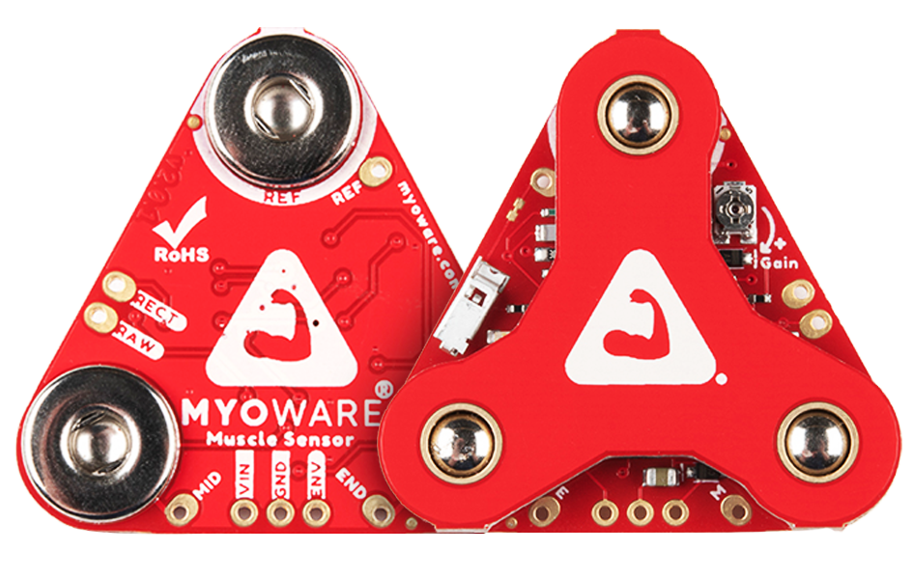
The sensor we will use is
Can be connected to the microcontroller
Cheap and convenient
Readily available
Already provides an Envelope Signal

Slide 14
The sensor we will use is
Red: +5V or Vin
Black/Green: 0V or GND
White: ENV (Envelope)
Let’s attach the sensor to our biceps

Slide 15
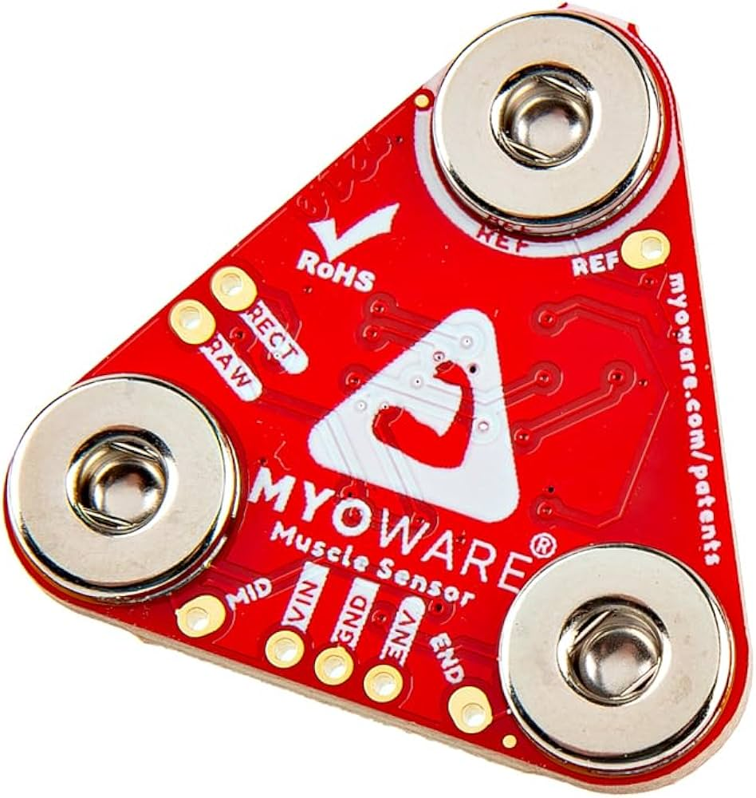
Blink the onboard LED
Activity:
GND
+5V
Use the EMG sensor to turn the LED on/off
rasr-lab.github.io/education/
Blink_LED_EMG.py

Slide 16
Blink the onboard LED
Activity:
GND
+5V
Use the EMG sensor to turn the LED on/off (with a filter)
rasr-lab.github.io/education/
Blink_LED_EMG_
filtered.py

Slide 17
Workshop Project

Slide 18
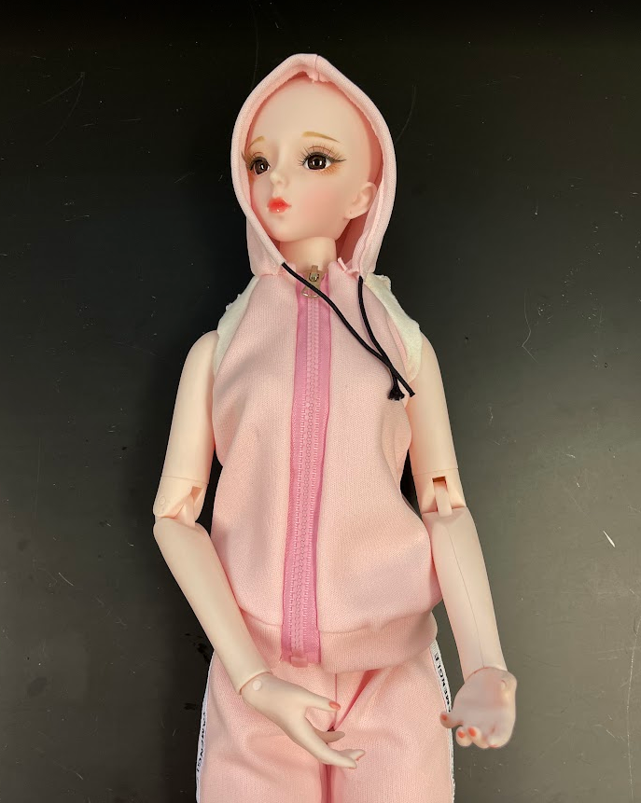
Workshop Project
Control an exoskeleton using your muscles
Connect the exoskeleton to a microcontroller
Attach the exoskeleton to the doll
Use your muscle to move the exoskeleton
The motor returns to original position once the input goes away

Slide 19
Control the Servo with your muscle
Activity:
GND
+5V
Use the EMG sensor to turn the LED on/off (with a filter)
rasr-lab.github.io/education/
Exoskeleton_EMG_Servo.py

Slide 20
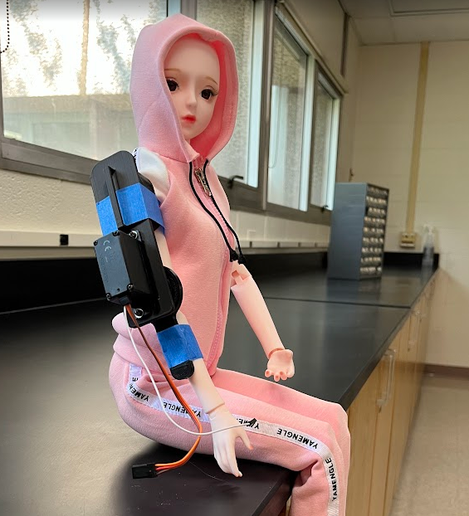
Attach the Exoskeleton to the Doll
Activity:
Make sure the Exoskeleton lines up with the elbow joint
Use masking tape to attach the Exoskeleton to the doll
Make the dolls elbow flex/extend using the Exoskeleton

Slide 21
What else can you do with this setup?

Slide 22
Thank you!
Sandesh G. Bhat
Assistive Systems and Robotics Engineering
bhatsg@uwec.edu

