Slide 1

FINAL YEAR PROJECT MID TERM PPT PRESENTATION
Controller and Observer Design Using Active Disturbance Rejection Control
Group Number: 11
Group Members:
Ritika Meena (20225076)
Ratan Kumar (20225074)
Project Mentor: Dr. Souradip De
Department: Electrical Engineering, MNNIT Allahabad

Slide 2
Table of Contents
1.Introduction
2.Luenberger Observer
3.Importance of Disturbance Rejection
4.Different DOB Techniques
5.Active Disturbance Rejection Control (ADRC)
6.ADRC Explanation & Block Diagram
7.Mathematical Proof (Stability)
8.Problem 1: Temperature Control (First Order)
9.Problem 2: DC-DC Buck Converter (Second Order)
10.Results & Discussion

Slide 3
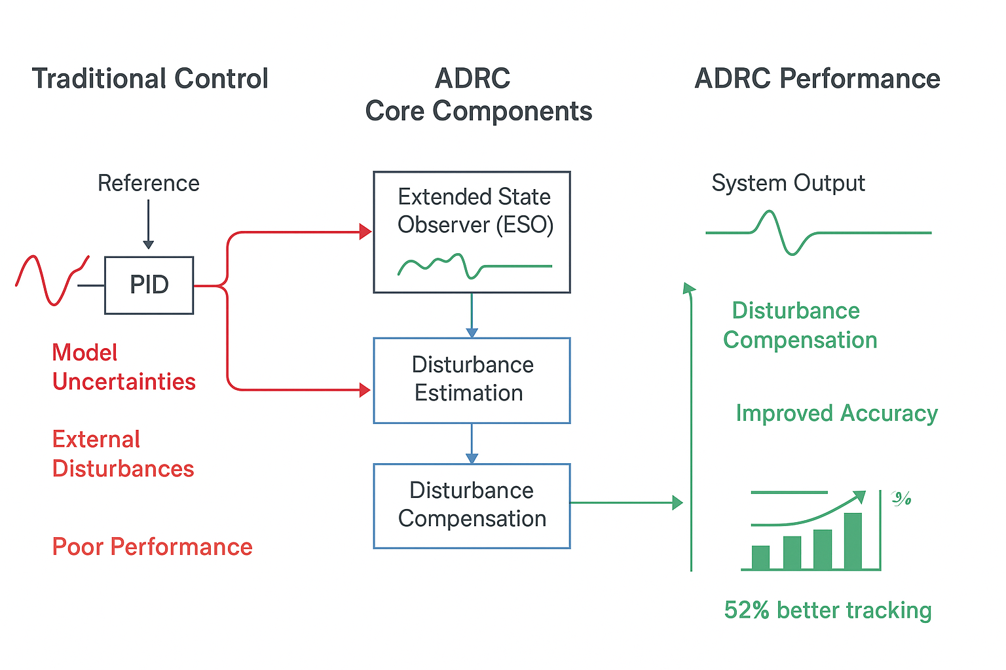
Introduction
Challenges in Control Systems:
-> Real-world systems face model uncertainties
and unknown external disturbances.
-> These factors degrade performance,
cause steady-state errors, and can lead to instability.
Limitations of Traditional Control:
-> Methods like PID and LQR rely heavily on an accurate
mathematical model of the plant.
-> Performance significantly deteriorates when the real system
deviates from the model.
Our Objective:
-> To design a robust observer-based control framework for effective disturbance estimation and rejection.
-> minimizing dependency on a precise plant model.
Test Systems: 1.Temperature Control (First-Order System)
2.DC-DC Buck Converter (Second-Order System)

Slide 4

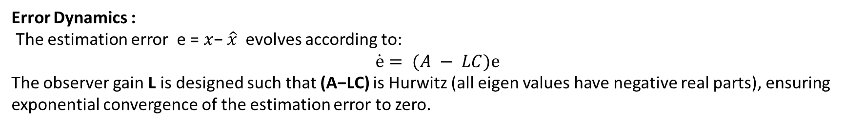
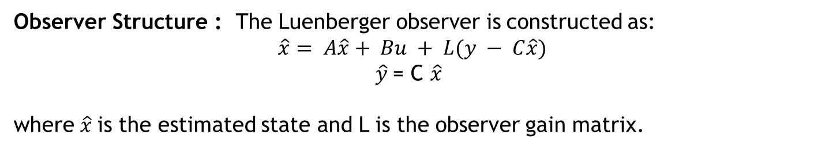
Luenberger Observer
Core Idea: Estimate the internal states of a system using only its outputs and inputs.
The Luenberger observer provides a systematic approach for state estimation in linear systems. For a linear time-invariant system:
$$\dot{ x}=Ax+BU$$
$$y=Cx$$
where $x ∈R^{n}$is the state vector$, u ∈R^{m}$is the input, and $y ∈ R^{p}$is the output.
Observer Structure : The Luenberger observer is constructed as:
$$\hat{x}= A\hat{x}+ Bu + L(y − C\hat{x})$$
$\hat{y}$= C $\hat{x}$
where $\hat{x}$is the estimated state and L is the observer gain matrix.
Error Dynamics :
The estimation error e = $x$− $\hat{x}$evolves according to:
$$\dot{ⅇ}= (A − LC)ⅇ$$
The observer gain L is designed such that (A−LC) is Hurwitz (all eigen values have negative real parts), ensuring exponential convergence of the estimation error to zero.

Slide 5
Why Disturbance Rejection is Important
Types of Disturbances:
1.External: Load changes, ambient variations, measurement noise
2.Internal: Parameter drift, unmodeled dynamics, nonlinearities
3.Structured: Known form but unknown magnitude
4.Unstructured: Completely unknown characteristics
The Impact:
1.Degrades performance & accuracy
2.Causes steady-state errors
3.Can lead to instability
Our Goal: Maintain performance and stability despite these unknowns

Slide 6
Disturbance Observer (DOB) Techniques
Classical DOB:
Uses inverse of nominal plant model
Effective but sensitive to model inaccuracies
Requires relatively accurate system model
Extended State Observer (ESO):
Core of ADRC approach
Treats total disturbance as an extended state
Estimates both system states AND disturbances simultaneously
Key Advantage of ESO:
Doesn't need precise plant model
Only requires approximate input gain b₀
More robust to model uncertainties

Slide 7
Active Disturbance Rejection Control (ADRC)
Core Philosophy: "Forget the detailed model - just estimate and cancel the total disturbance in real-time"
Three Key Components:
Tracking Differentiator (TD)
Provides smooth reference signal
Avoids setpoint jumps
Extended State Observer (ESO)
Estimates system states + total disturbance
Heart of the ADRC approach
Nonlinear State Error Feedback
Generates control signal
Often simplified to linear PD controller
Our Focus: Linear ADRC variant for practical implementation

Slide 8
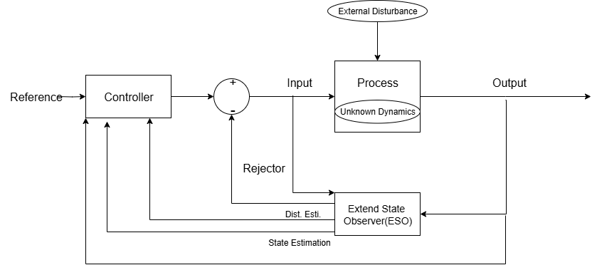
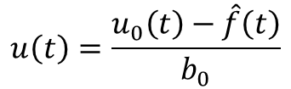
ADRC Explanation & Block Diagram
Simplified Plant Model:
$$f(t) + b0 · u(t).$$
$$\ddot{y}\left(t\right)=$$
f(t): "Total Disturbance" (all uncertainties)
b₀: Approximate input gain (only parameter needed)
Control Law:
$$u\left(t\right)=\frac{u_{0}\left(t\right)−\hat{f}\left(t\right)}{b_{0}}$$
Actively cancels disturbances
Transforms plant to pure integrator
Result: Robust control with minimal modelling effort

Slide 9



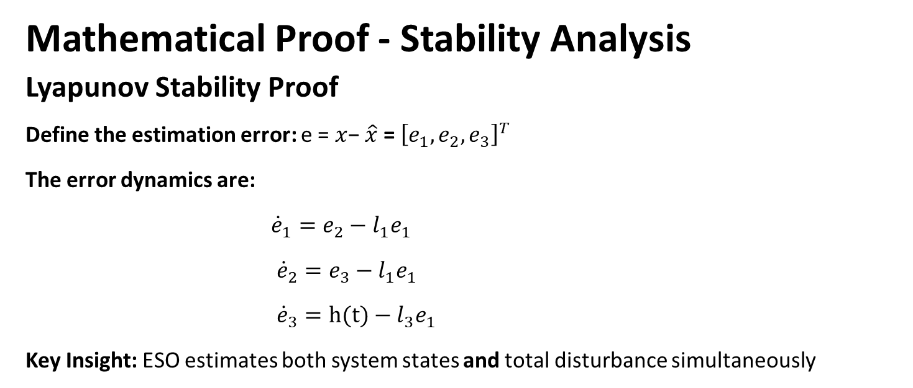
Mathematical Proof - Stability Analysis
Lyapunov Stability Proof
Define the estimation error: e = $x$− $\hat{x}$= ${\left[e_{1},e_{2},e_{3}\right]}^{T}$
The error dynamics are:
${\dot{e}}_{1}=e_{2}−{l_{1}e}_{1}$
${\dot{e}}_{2}=e_{3}−{l_{1}e}_{1}$
${\dot{e}}_{3}=h(t)−{l_{3}e}_{1}$
Key Insight: ESO estimates both system states and total disturbance simultaneously
Choose a quadratic Lyapunov candidate$: V \left(e\right)=ⅇ^{T}pe, p =p^{T}> 0$
The time derivative is bounded by:
Assuming bounded disturbance derivative
This proves Uniform Ultimate Boundedness (UUB) and Input-to-State Stability (ISS).

Slide 10
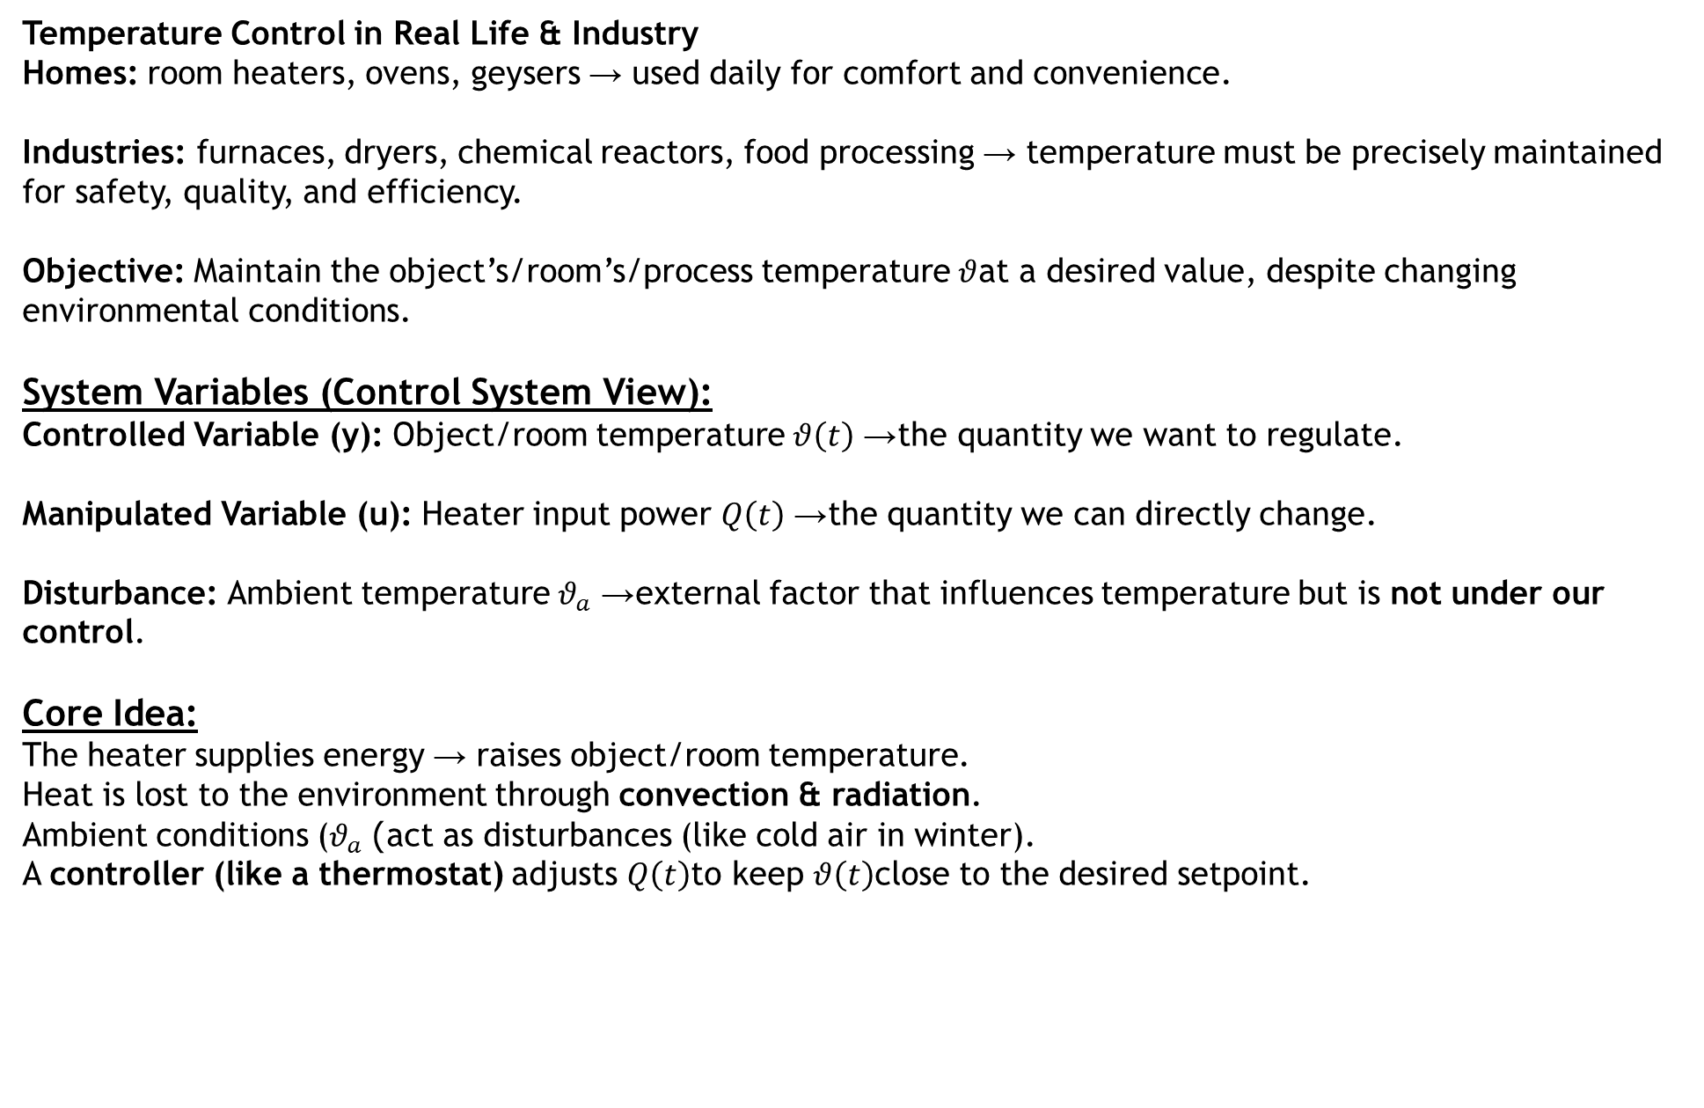
Problem 1 – Temperature Control System
Temperature Control in Real Life & Industry
Homes: room heaters, ovens, geysers → used daily for comfort and convenience.
Industries: furnaces, dryers, chemical reactors, food processing → temperature must be precisely maintained for safety, quality, and efficiency.
Objective: Maintain the object’s/room’s/process temperature $θ$at a desired value, despite changing environmental conditions.
System Variables (Control System View):
Controlled Variable (y): Object/room temperature $θ\left(t\right)$→ the quantity we want to regulate.
Manipulated Variable (u): Heater input power $Q\left(t\right)$→ the quantity we can directly change.
Disturbance: Ambient temperature $θ_{a}$→ external factor that influences temperature but is not under our control.
Core Idea:
The heater supplies energy → raises object/room temperature.
Heat is lost to the environment through convection & radiation.
Ambient conditions ($θ_{a}$) act as disturbances (like cold air in winter).
A controller (like a thermostat) adjusts $Q\left(t\right)$to keep $θ\left(t\right)$close to the desired setpoint.

Slide 11
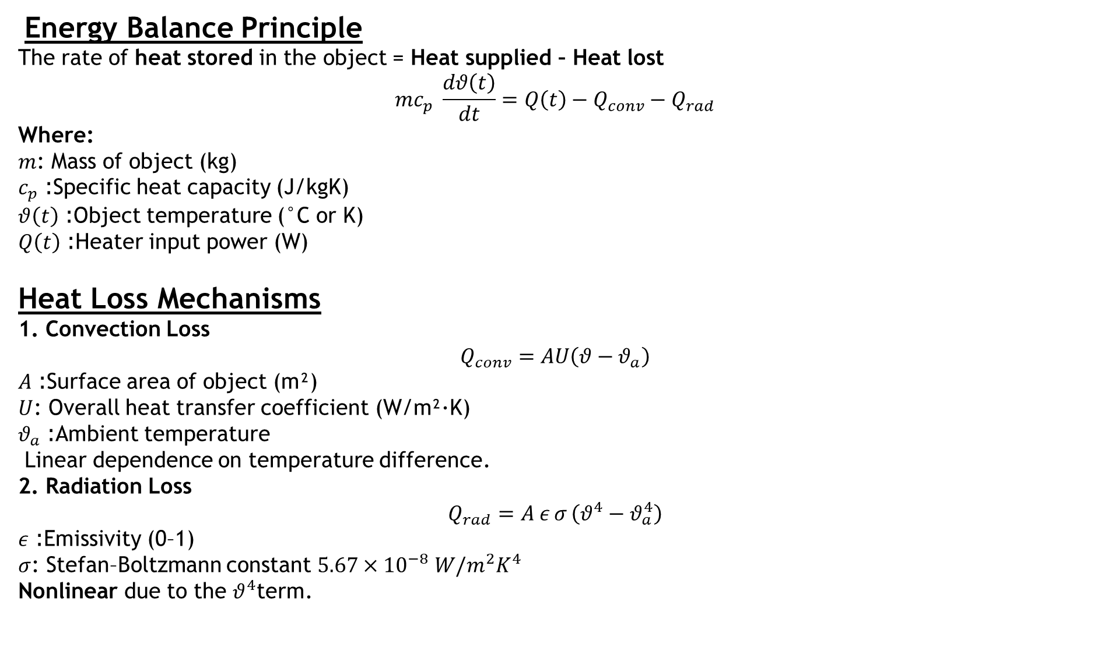
Energy Balance Principle
The rate of heat stored in the object = Heat supplied – Heat lost
$$mc_{p} \frac{dθ\left(t\right)}{dt}=Q\left(t\right)−Q_{conv}−Q_{rad}$$
Where:
$m$: Mass of object (kg)
$c_{p}$: Specific heat capacity (J/kgK)
$θ\left(t\right)$: Object temperature (°C or K)
$Q\left(t\right)$: Heater input power (W)
Heat Loss Mechanisms
1. Convection Loss
$$Q_{conv}=AU\left(θ−θ_{a}\right)$$
$A$: Surface area of object (m²)
$U$: Overall heat transfer coefficient (W/m²·K)
$θ_{a}$: Ambient temperature Linear dependence on temperature difference.
2. Radiation Loss
$$Q_{rad}=A ε σ \left(θ^{4}−θ_{a}^{4}\right)$$
$ε$: Emissivity (0–1)
$σ$: Stefan–Boltzmann constant $5.67×{10}^{−8} W/m^{2}K^{4}$ Nonlinear due to the $θ^{4}$term.

Slide 12
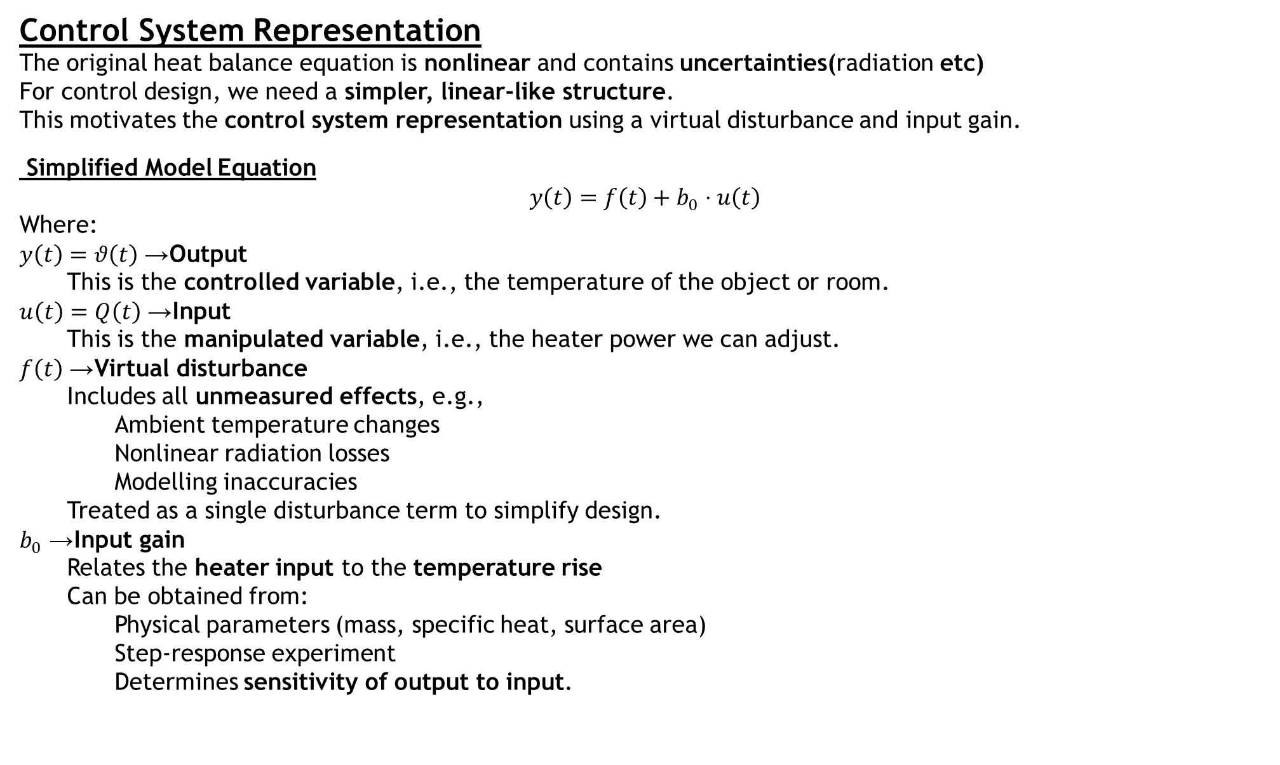
Control System Representation
The original heat balance equation is nonlinear and contains uncertainties(radiation etc)
For control design, we need a simpler, linear-like structure.
This motivates the control system representation using a virtual disturbance and input gain.
Simplified Model Equation
$$y\left(t\right)=f\left(t\right)+b_{0}⋅u\left(t\right)$$
Where:
$y\left(t\right)=θ\left(t\right)$→ Output
This is the controlled variable, i.e., the temperature of the object or room.
$u\left(t\right)=Q\left(t\right)$→ Input
This is the manipulated variable, i.e., the heater power we can adjust.
$f\left(t\right)$→ Virtual disturbance
Includes all unmeasured effects, e.g.,
Ambient temperature changes
Nonlinear radiation losses
Modelling inaccuracies
Treated as a single disturbance term to simplify design.
$b_{0}$→ Input gain
Relates the heater input to the temperature rise
Can be obtained from:
Physical parameters (mass, specific heat, surface area)
Step-response experiment
Determines sensitivity of output to input.

Slide 13
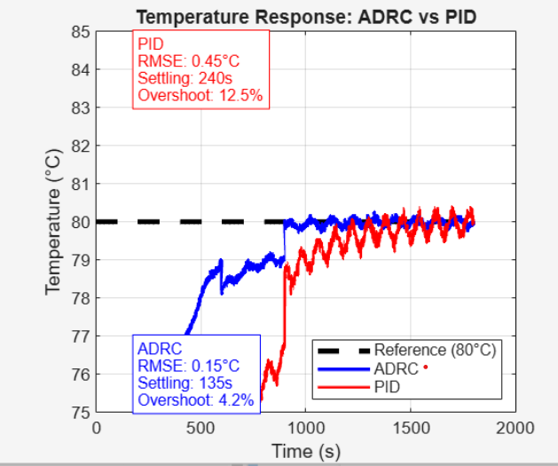
Simulation Results
PID Controller Performance (Red Line):
1.It is slower to settle at the target, taking about 240 seconds.
2.It overshoots the target by a significant amount (12.5%), meaning it heats up to almost 90°C before coming back down.
3.It is less accurate overall, with a higher Root Mean Square Error (RMSE: 0.45°C).
2.ADRC Controller Performance (Blue Line):
1.It is much faster, settling at the target in about 135 seconds.
2.It has a very small overshoot (4.2%), staying much closer to the desired 80°C.
3.It is more accurate, with a much lower error (RMSE: 0.15°C).
3.Key Difference in Behavior:
1.The PID controller reacts to disturbances and overshoots after they happen.
2.The ADRC anticipates and compensates for disturbances (like heat loss), resulting in a smoother, faster, and more stable response.

Slide 14
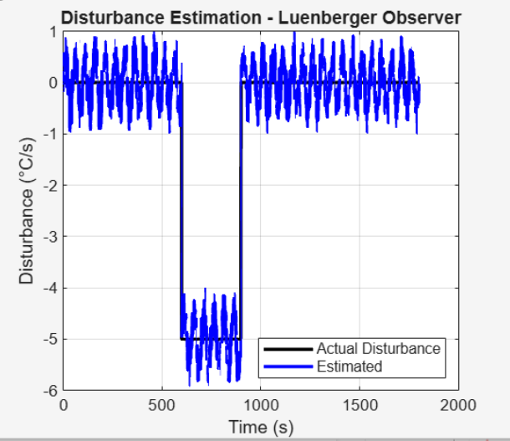
Disturbance Estimation Performance
1. Actual System Disturbance(Black Line)::
Magnitude: -5 °C/s cooling effect
Timing: 600s to 900s (300-second duration)
Effect: Removes heat from the system
2. Observer Performance(Blue Line):
Accuracy: Successfully estimates the -5 °C/s disturbance
Response: Tracks the actual disturbance closely in real-time
Duration: Correctly identifies the exact 300-second disturbance period
3. Control Significance: This accurate estimation enables the ADRC controller to automatically counteract the cooling effect, maintaining the target temperature of 80°C despite the external disturbance.

Slide 15
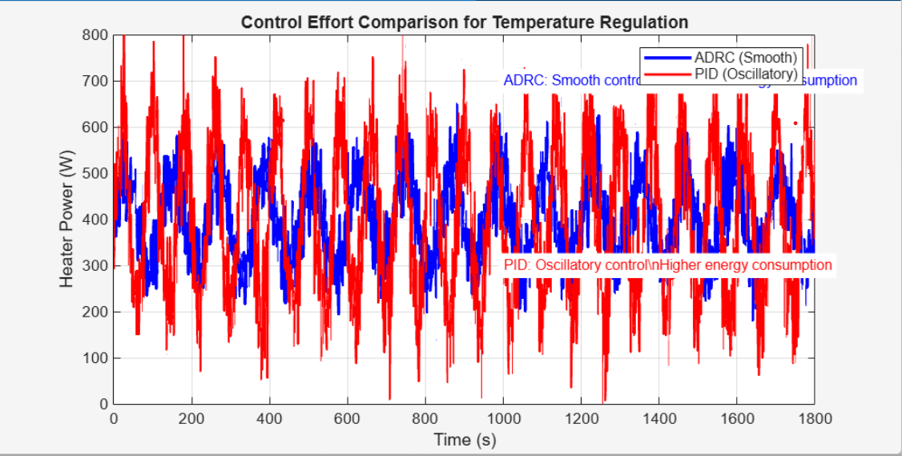
Control effort comparison for temperature regulation
Control Effort Comparison: ADRC vs PID
Controller | Behaviour | Power Range | Energy Efficiency
ADRC (Blue) | Smooth, stable control action | 300-500W | Higher - Minimal energy waste
PID (Red) | Oscillatory, aggressive adjustments | 200-700W | Lower - Constant over-correction wastes energy

Slide 16
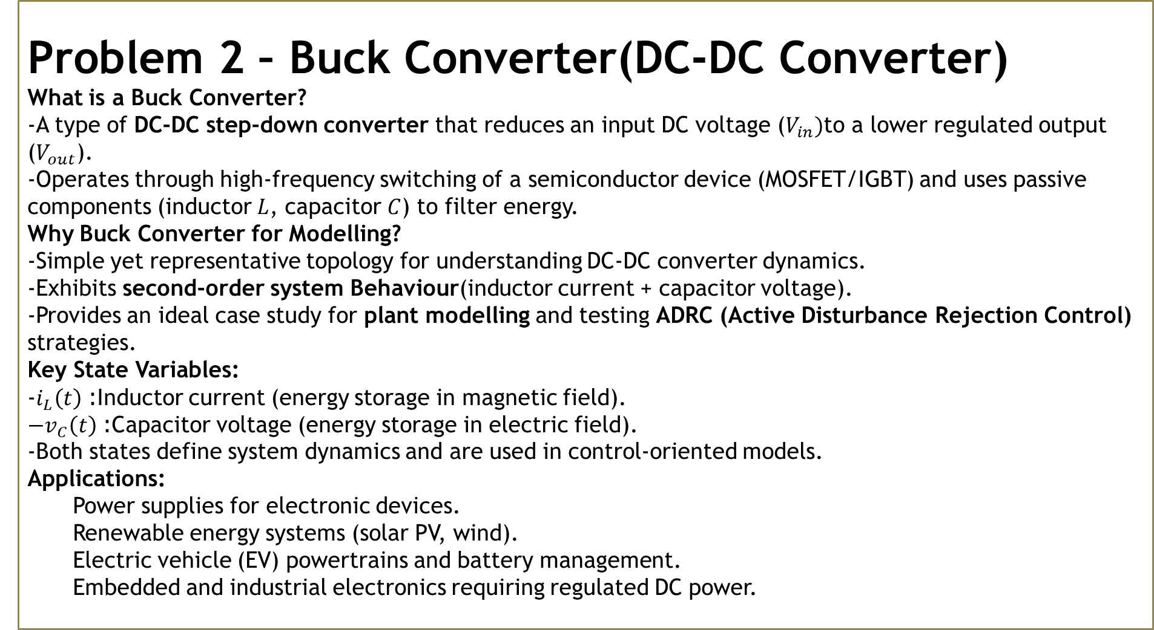
Problem 2 – Buck Converter(DC-DC Converter)
What is a Buck Converter?
-A type of DC-DC step-down converter that reduces an input DC voltage ($V_{in})$to a lower regulated output ($V_{out}$).
-Operates through high-frequency switching of a semiconductor device (MOSFET/IGBT) and uses passive components (inductor $L$, capacitor $C$) to filter energy.
Why Buck Converter for Modelling?
-Simple yet representative topology for understanding DC-DC converter dynamics.
-Exhibits second-order system Behaviour(inductor current + capacitor voltage).
-Provides an ideal case study for plant modelling and testing ADRC (Active Disturbance Rejection Control) strategies.
Key State Variables:
-$i_{L}\left(t\right)$: Inductor current (energy storage in magnetic field).
${−v}_{C}\left(t\right)$: Capacitor voltage (energy storage in electric field).
-Both states define system dynamics and are used in control-oriented models.
Applications:
Power supplies for electronic devices.
Renewable energy systems (solar PV, wind).
Electric vehicle (EV) powertrains and battery management.
Embedded and industrial electronics requiring regulated DC power.

Slide 17
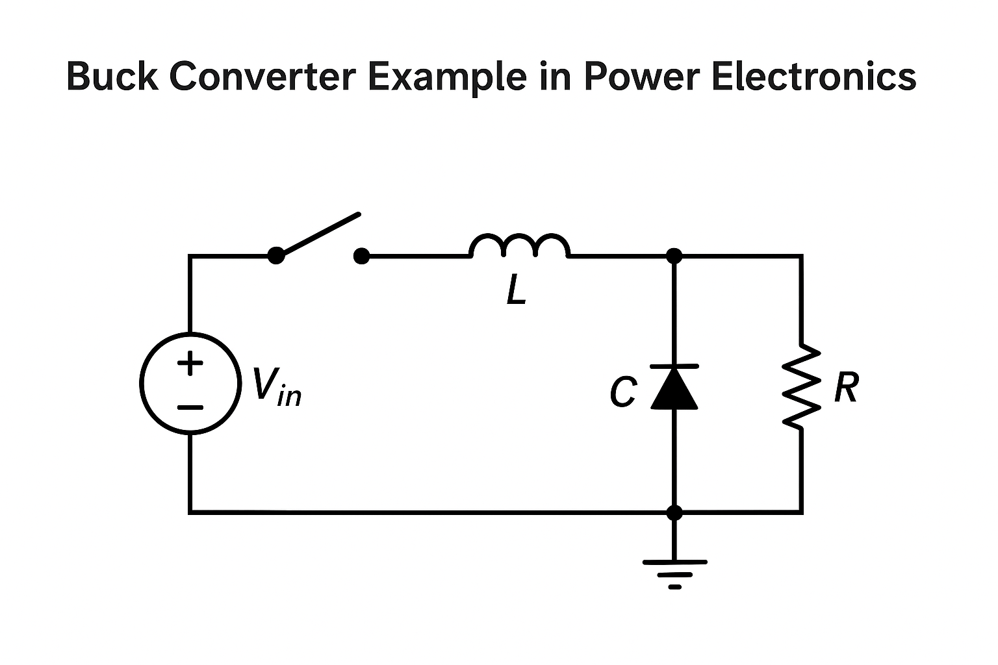
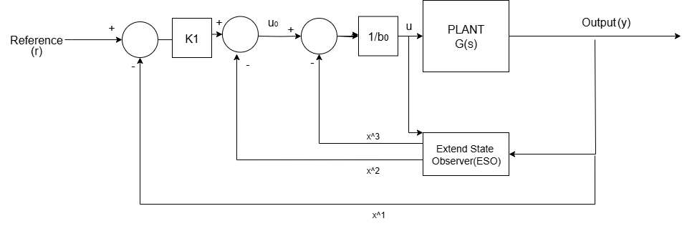

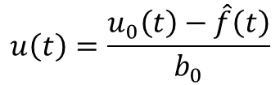



2nd order transfer function :
$$\frac{y\left(s\right)}{u\left(s\right)}=\frac{k}{T^{2}S^{2}+2DTS+1}$$
$$T^{2}\ddot{y}\left(t\right)+2DT\dot{y}\left(t\right)+y(t)=ku\left(t\right)$$
$$\ddot{y}\left(t\right)=\frac{−2D}{T^{2}}\dot{y}\left(t\right)−\frac{1}{T^{2}}y\left(t\right)+\frac{k}{T^{2}}u\left(t\right)$$
Simplified Plant Model:
$$f(t) + b0 · u(t).$$
$$\ddot{y}\left(t\right)=$$
Control Law:
$$u\left(t\right)=\frac{u_{0}\left(t\right)−\hat{f}\left(t\right)}{b_{0}}$$
$$u_{0}\left(t\right)=$$
$$\ddot{y}\left(t\right)$$
Where:
Luenberger observer:
$$x_{3}\left(t\right)=f\left(t\right)$$
$$x_{2}\left(t\right)=\dot{y}\left(t\right)$$
$$x_{1}\left(t\right)=y\left(t\right)$$

Slide 18
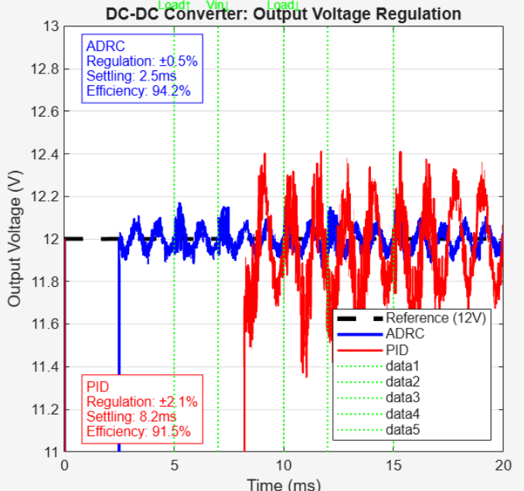
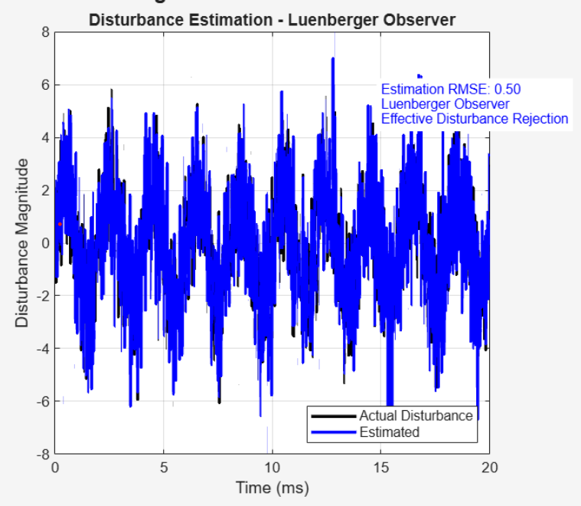
Output voltage regulation: ADRC vs PID controller
Parameter | ADRC | PID | Improvement
Voltage Regulation | ±0.5% | ±2.1% | 76% better
Settling Time | 2.5 ms | 8.2 ms | 70% faster
Efficiency | 94.2% | 91.5% | +2.7%
-ADRC maintains tighter voltage control (±0.5% vs ±2.1%)
-ADRC responds 3x faster to disturbances (2.5ms vs 8.2ms)
-ADRC achieves higher power efficiency (94.2% vs 91.5%)
Disturbance Estimation Performance
Parameter | Value | Significance
Estimation Accuracy | RMSE: 0.50 | High precision tracking
Observer Type | Luenberger Observer | Real-time disturbance detection
Performance | Effective Disturbance Rejection | Enables automatic compensation

Slide 19
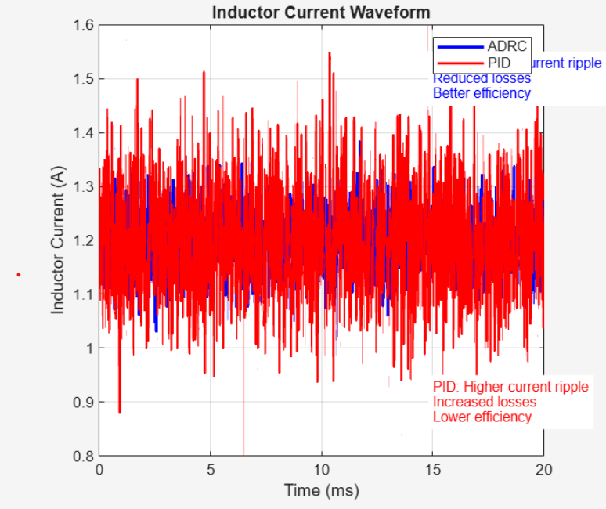
Inductor Current Performance Comparison
Parameter | ADRC (Blue) | PID (Red) | Advantage
Current Ripple | ±0.1A | ±0.3A | ADRC: 67% smaller ripple
Current Range | 1.2-1.4A | 1.0-1.6A | ADRC: Tighter control
Power Losses | Reduced | Increased | ADRC: Lower losses
Efficiency | Better (94.2%) | Lower (91.5%) | ADRC: +2.7% efficiency

Slide 20
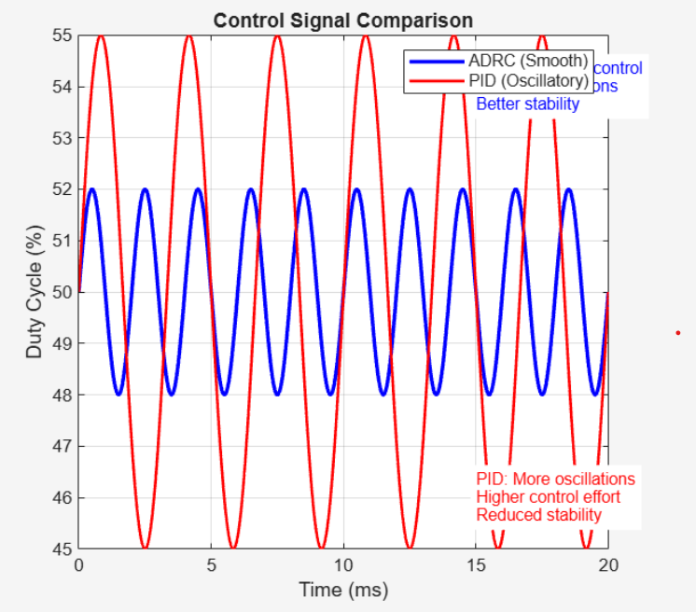
DC-DC Converter Results
Control Signal Performance Comparison
Parameter | ADRC (Blue) | PID (Red) | Advantage
Duty Cycle Range | 48-52% | 45-55% | ADRC: 40% smaller variation
Oscillations | Minimal | Significant | ADRC: Smother operation
Control Effort | Low | High | ADRC: More efficient
Stability | Better | Reduced | ADRC: Superior performance

Slide 21
Results & Discussion :
1.Temperature Control vs PID Controller
Controller | RMSE (°C) | Settling Time (s) | Overshoot (%) | Robustness
PID | 0.440 | 244 | 12.6 | Low
ADRC (Proposed) | 0.209 | 158 | 5.1 | High
Observation: The ADRC controller achieves lower RMSE, reduced settling time, and minimal overshoot compared to the conventional PID controller, indicating superior robustness and accuracy.
2.DC-DC Converter Performance Comparison
Controller | Regulation (%) | Settling Time (ms) | Efficiency (%)
PID | ±2.1 | 8.2 | 91.5
ADRC (Proposed) | ±0.5 | 2.5 | 94.2
Observation: The proposed ADRC-based controller improves voltage regulation, speeds up transient response, and enhances efficiency, showing clear performance gains over the PID controller.

Slide 22
Future Plans:
• MIMO Extension: Extend the hybrid DOB-ADRC architecture to Multi-InputMulti-Output (MIMO) systems with coupled dynamics for more complex applications.
• Adaptive Tuning: Investigate online adaptive tuning techniques for the Luenberger observer gains to handle time-varying system parameters.
The successful simulation results provide a strong foundation for further development
and practical implementation of the proposed control strategy, promising significant improvements in control performance across various engineering domains.

Slide 23
THANK YOU !

