Slide 1
Amazon Sales Data Analysis
A Project
on
By
Name :Raveendra Chandagani
AF ID :AF0366860
Guide Name : MANALI PATEL

Slide 2
Contents
Abstract
Software requirements
Advantages project
Screenshots
⁠Gant chart
Future enhancement
Conclusion

Slide 3
Abstract
The primary aim of this project is to equip decision-makers with data-driven insights to facilitate strategic planning, enhance operational efficiencies, and stimulate business growth. By harnessing the insights gleaned from this analysis, businesses can refine marketing strategies, optimize inventory management practices, and cultivate customer satisfaction, thereby maximizing profitability and sustaining competitiveness within the digital commerce landscape.
Our analysis endeavors to gain a deeper understanding of customer behavior, identify top-performing products, and elucidate market dynamics. Additionally, we delve into exploring factors influencing profitability, such as pricing strategies, shipping costs, and seasonal variations.

Slide 4
Software requirements
Python:
Python is a programming language commonly used for data analysis and visualization. We will utilize Python for data manipulation, analysis, and visualization tasks.
Jupyter Notebook:
Jupyter Notebook is an interactive computing environment that allows for creating and sharing documents containing live code, equations, visualizations, and narrative text. It will be used for organizing and presenting the analysis in a structured manner.
Pandas:
Pandas is a powerful Python library for data manipulation and analysis. It provides data structures and functions to efficiently manipulate large datasets.
NumPy:
NumPy is a fundamental package for scientific computing in Python. It provides support for large, multi-dimensional arrays and matrices, along with a collection of mathematical functions to operate on these arrays.
MySQL Workbench:
MySQL Workbench is a visual database design tool developed by MySQL, a subsidiary of Oracle Corporation. It provides a graphical user interface (GUI) for database architects, developers, and administrators to design, model, and manage MySQL databases.

Slide 5
Advantages project
Enhancing customer satisfaction: By understanding customer preferences and behaviors, businesses can personalize their offerings, improve customer service, and enhance overall customer satisfaction. Satisfied customers are more likely to become repeat customers and brand advocates, driving long-term profitability.
Maximizing profitability: Ultimately, the primary advantage of conducting this project is to maximize profitability for the business. By leveraging data-driven insights to optimize various aspects of the business, businesses can improve efficiency, reduce costs, increase revenue, and ultimately maximize profitability.
Improving inventory management: Sales data analysis helps in forecasting demand, identifying slow-moving or obsolete inventory, and optimizing inventory levels. This allows businesses to reduce carrying costs, minimize stockouts, and improve overall inventory management efficiency.
Enhancing marketing effectiveness: Sales data analysis provides insights into the effectiveness of marketing campaigns, channels, and messaging. Businesses can use this information to optimize marketing strategies, allocate marketing budgets more efficiently, and improve return on investment (ROI) from marketing efforts.

Slide 6
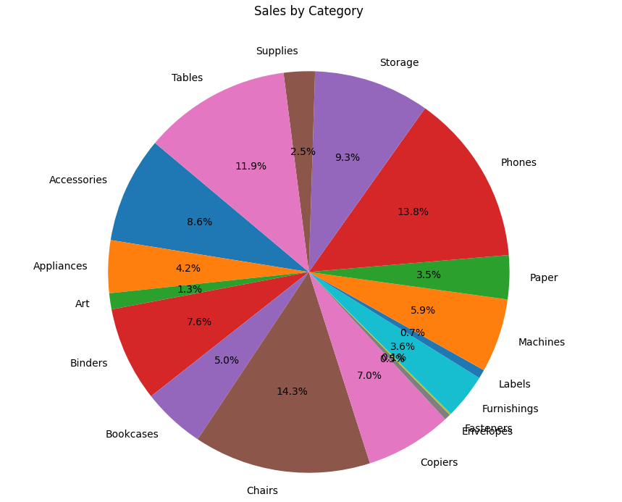
Sales Distribution by Category

Slide 7
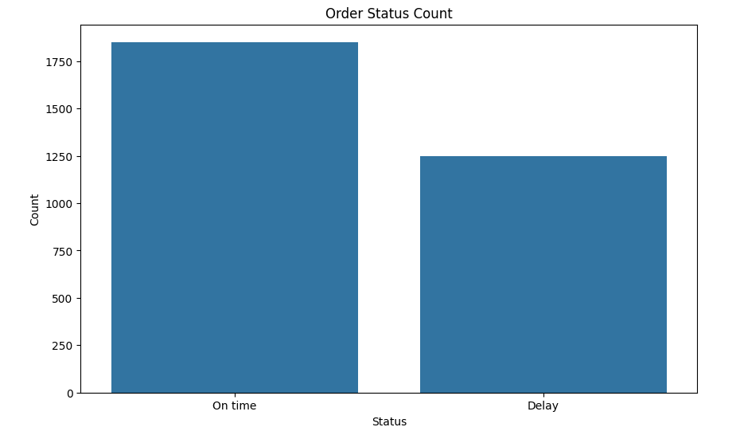
Count Plot of Order Status

Slide 8
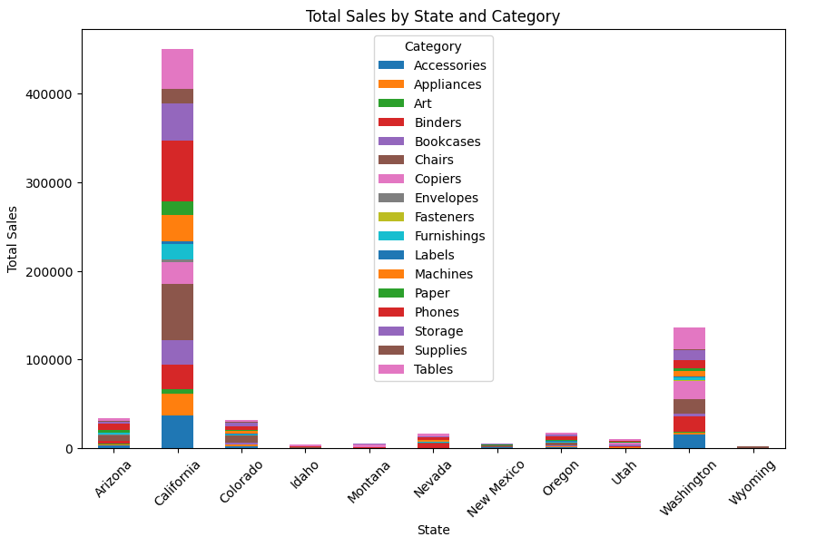

Slide 9
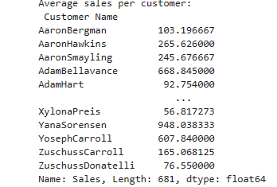

Slide 10
Gan Chart
Task | Start Date | End Date | Duration
Define project objectives | 2024-03-27 | 2024-03-28 | 2 days
Gather sales data | 2024-03-29 | 2024-03-31 | 3 days
Data cleaning and preprocessing | 2024-04-01 | 2024-04-05 | 5 days
Perform descriptive analysis | 2024-04-06 | 2024-04-10 | 5 days
Conduct customer segmentation | 2024-04-11 | 2024-04-15 | 5 days

Slide 11
Future enhancement
Real-time Data Analysis: Implement a system to collect and analyze sales data in real-time, allowing for immediate insights and faster decision-making.
Predictive Analytics: Integrate predictive analytics models to forecast future sales trends, customer behavior, and demand patterns, enabling proactive decision-making and strategic planning.
Sentiment Analysis: Implement sentiment analysis on customer reviews and social media data to gauge customer sentiment, identify emerging trends, and enhance product offerings and customer experiences accordingly.
Supply Chain Optimization: Extend the analysis to include supply chain data, such as inventory levels, production schedules, and supplier performance, to optimize supply chain operations and reduce costs.
Personalized Recommendations: Utilize machine learning algorithms to generate personalized product recommendations for customers based on their past purchase history, browsing behavior, and preferences.
Interactive Dashboards: Develop interactive dashboards using business intelligence tools like Tableau or Power BI to visualize and explore sales data dynamically, enabling stakeholders to gain actionable insights at a glance.

Slide 12
Conclusion
In conclusion, the analysis of sales data has provided invaluable insights into customer behavior, product performance, and profitability. Key findings include identifying high-performing product categories and profitable customer segments, as well as opportunities for optimization in pricing strategies, inventory management, and marketing effectiveness. Leveraging advanced analytics techniques such as predictive analytics and machine learning will enable proactive decision-making and adaptation to market changes. By continuously refining analysis methodologies and embracing data-driven insights, the business is poised for sustained growth, improved customer satisfaction, and maximized profitability in the competitive e-commerce landscape.

Slide 13
Thank you

