Slide 1
Speech Activated Object Detection with Visual Recognition

Slide 2
Problem Statement
Computer Vision is a promising to use state-of-art techniques to help people with vision loss. Through this project, we want to explore the possibility of using the hearing sense to understand visual objects. The sense of sight and hearing share a striking similarity: both visual object and audio sound can be spatially localized. It is not often realized by many people that we are capable at identifying the spatial location of a sound source just by hearing it with two ears. In our idea, we build a real-time object detection and position estimation pipeline, with the goal of informing the user about surrounding object and their spatial position using binaural sound.

Slide 3
Literature Survey
1. J. Redmon, S. Divvala, R. Girshick and A. Farhadi, "You Only Look Once: Unified, Real-Time Object Detection," 2016 IEEE Conference on Computer Vision and Pattern Recognition (CVPR), 2016, pp. 779-788, doi: 10.1109/CVPR.2016.91.
2. H. Gada, V. Gokani, A. Kashyap and A. A. Deshmukh, "Object Recognition for the Visually Impaired," 2019 International Conference on Nascent Technologies in Engineering (ICNTE), 2019, pp. 1-5, doi: 10.1109/ICNTE44896.2019.8946015.
3. Samruddhi Deshpande &Ms.Revathi Shriram ,” Real Time Text Detection and Recognition on Hand Held Objects to Assist Blind People” , International Institute of Information Technology, International Conference on Automatic Control and Dynamic Optimization Techniques (ICACDOT),IEEE ,2016.

Slide 4
Challenges
Real-time Processing: Ensuring that the model can process images and provide feedback in real-time is crucial for usability but can be technically challenging.
Latency: Minimizing the time between user input and system feedback is critical for real-time applications. Latency issues can frustrate users and affect the system's usability.
Scalability: As the model is improved with more data or features, ensuring that it remains efficient and does not require excessive computational resources is a challenge.
User Privacy: Implementing object detection in public or personal spaces raises privacy concerns. Ensuring user data is handled ethically and securely is paramount.

Slide 5
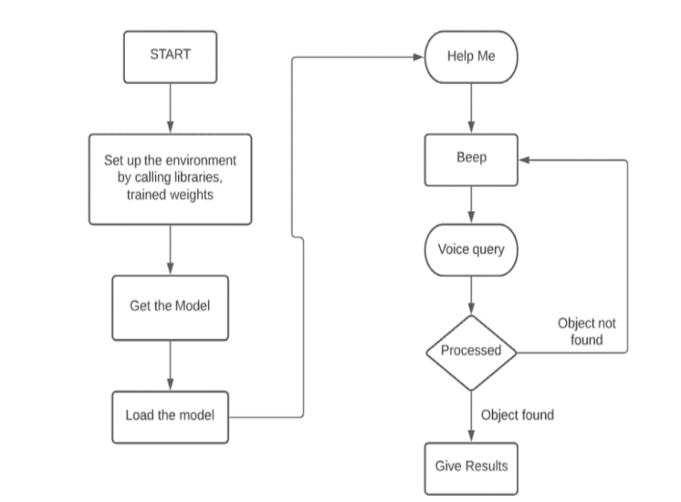
Methodology
The model uses MobileNet-SSD algorithm for object detection and Google Speech Recognition package (gTTS) for audio processing. Pascal Voc dataset is used for object detection; segmentation and captioning which has 20 different classes making it very versatile for object detection.

Slide 6
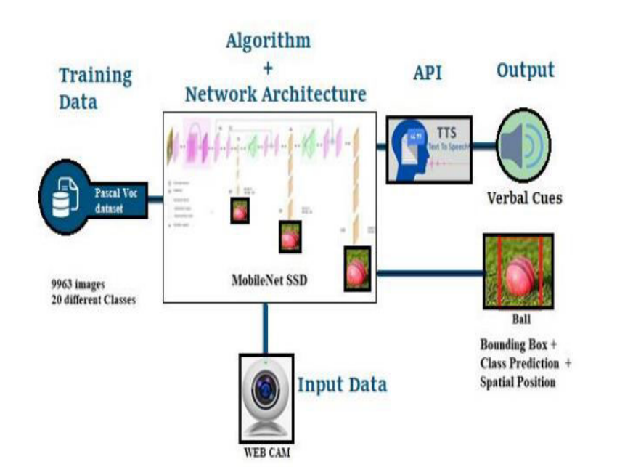
Proposed System

Slide 7


