Slide 1
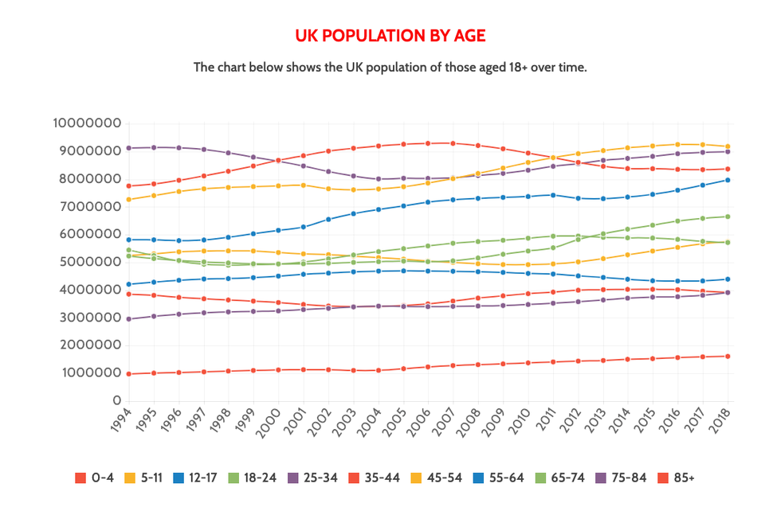
PROMPT
Read Alberto Cairo’s work, Graphics Lies, Misleading Visuals
Locate an example of a misleading visual that uses one or more of the mechanisms for misleading that Cairo outlines in his book chapter: (1) Hiding relevant data; (2) Displaying too much data and obscuring reality; (3) Distorting data through visual forms.
Please upload an image of this visual using a widely accessible graphic format (e.g., PDF, .jpg, .png)
UK POPULATION BY AGE
The chart shows the UK population of those aged 18+ over time

Slide 2
PROMPT
Briefly describe the context for the visual by addressing the following questions:
What is the source of the visual? (e.g., URL or bibliographic citation)
Who is the intended audience (i.e., decoders)? How do you know this?
Source of visual: https://www.agediscrimination.info/current-uk-population
The charts shows the most recent official data on the UK population. It contains data on the UK population by age.
1) This data can be used by the government officials to make/ implement new policies and laws for the benefit of the people.
2) It can be used by the marketers/ product manufactures or service provide to select the audience and aim the service or products accordingly.
3) This is evident from the fact on other relevant studies conducted in the same site.

Slide 3
PROMPT
Identify the specific component(s) of the visual that is/are misleading
For each part(s) of the visualization that is/are misleading, identify the mechanism that is used: hiding relevant data to highlight what benefits us; displaying too much data to obscure reality; using graphic forms in inappropriate ways (distorting the data)
Explain how the mechanisms are used to mislead
1) using graphic forms in inappropriate ways: The graph is not easily understood. The title says population aged 18+, but then are multiple lines for different age groups.
Y-axis can be made simpler by converting it into millions by removing zeros.
2) Displaying too much data to obscure reality: Using 5 colors to represent 11 pieces of data might not be a good choice. Repetition of colors for different age groups, it leads to confusion and observer tends to overlook data. Especially two green age ranges, which float around similar values.
3) hiding relevant data to highlight what benefits us: The focus as per the title is on 18+ year population , but since the information regarding other ages groups is available, it diverts the focus from the relevant data.
PROMPT
Optional: Describe any additional issues you found with visual that did not fall under Cairo's three misleading mechanisms.
This chart might be difficult to be interpreted by the color blind.

