Slide 1
A Web-Based Platform for Tea Production Management
160761
168669
ICS Group: C
Supervisor: Emmanuel Olang’

Slide 2
Background
Many Kenyan tea farmers lack access to their delivery, grading and payment records.
This leads to poor communication between factories and farmers thus limiting transparency
Limited transparency weakens trust in the tea value chain.
Existing systems do not give farmers direct access to their data
A digital solution is therefore needed to improve communication.

Slide 3
Problem Statement
Communication between farmers and tea factories is inefficient
Feedback and communication between farmers is limited.
Existing systems do not provide farmers with visibility into their own records
Farmers are often unaware of tea quality results and payment status/timelines
This leads to frustration, disputes and inefficiencies in the tea value chain

Slide 4
Motivation & Justification
Tea farmers lack access to key records and timely feedback
This creates mistrust and poor communication with factories
The system improves transparency by giving farmers direct access to delivery, quality and payment details
It also helps factories respond faster to farmer concern
Ths solution bridges the gap between tea factories and farmers and thus strengthens trust and supports fair, efficient tea processing

Slide 5
Specific Objectives
AIM: To develop a web-based tea management system that improves transparency and communication between farmers and factories
Identify communication gaps in the tea value chain
Review existing tea management systems
Design a user-friendly platform
Develop and implement the web based system
Test and validate the system for performance and usability

Slide 6
Literature Review (Existing Applications)
Amity Software - focuses on plantation operations. Manages large estates but lacks real-time farmer interaction thus not designed for farmers.
Agrivi - Comprehensive farm management system. Great for crop planning, but not tailored to tea delivery chains
Cropster - Built for coffee grading and quality tracking. It is not directly usable in tea factories.

Slide 7
Methodology
Followed a Waterfall approach guided by SSAD (Structured Systems Analysis Design)
Started with clear functional and non-functional requirements and process modelling using use case diagrams
Created wireframes before development
Used HTML, CSS, JavaScript, Node.js, MySQL, GitHub and VS Code
Organized system functions into role-based modules
Applied Black Box and Regression Testing to validate functionality and ensure changes didn’t break existing features

Slide 8
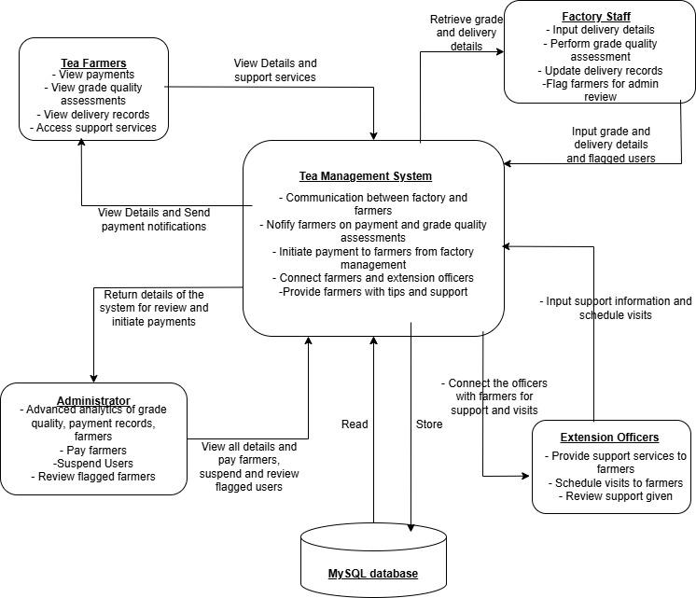
Conceptual Framework

Slide 9
Demonstration: WEB

