Slide 1
GIT

Slide 2
Index:
1)Why version control tools
2)Main problem with centralized version control tool
3)Introduction to Git
4)Why only git
4)Important terminology in Git
5)Git stages
6)Types of repositories
7)Installing and configuring Git
8) Git Commands
9)Git workflow

Slide 3
Git Commands
a)git config
b)git init
c)git add
d)git status
e)git commit
f)git log
g)git show
h).gitignore
i)git branching
j)git conflicts
k)removing files
l)delete all untracked files
m)git stash
n)git reset
o)git revert
p)git remote
q)git clone
r)git fetch
s)git pull
t)git push
u)git tag
v)rebase

Slide 4
Why version control tools:
→Version control system will have the capacity to track all the changes with date and time.
→For each commit it will give commit id. So that you can track file.
→It will create versions.
→By using version control system, we can get back to previous versions.
SCM tools:
1)Git
2)SVN
3)Perforce
Main problem with centralized version control:
→Single point of failure performance issues for complex and very large distributed project environment.

Slide 5
Introduction to Git:
→Git is a storage of code. That’ why we called it as repo.
→It stores developers code, Testing team code, and Devops scripts.
→Different people from different teams can store simultaneously.
→Pipeline between offshore and onsite teams.
→Helps in achieving teamwork.
→Git storages the code that’s why we called it as repo.
→It is secure.
→Track changes.
→Free and open source.
→Fast and small
→Implicit backup: Multiple copy of repos
→Efficiency branching model.
→Developers can clone any repo.
→A repository is a logical space where we have all the objects that needs to be versioned.
→Repo can be initialized by git init
→There are two kinds of repos.
1)Private repo
2)Public repo

Slide 6
Why only Git:
1)Speed:
→it is using snapshot concept.
→snapshot is taking in staging area and snapshot stores the changes only not whole copy.
2)Fully distributed:
→Can share code without any central repo. That’s why we called GIT as DVCS.
3)Parallel Branching:
→We can create multiple branches at a time.
Important terminology:
1)Repository
2)Server
3)Workspace/workdir
4)Branch/trunk/codeline
5)Commit/checkin
5)Version/versioned/commitid

Slide 7
1)Repository:
→Storage related to one product.
→Changes are personal to that repository.
2)Server
→Stores all repos
3)Branch:
→Product is same, so one repo but different features.
→Each feature has one separate branch.
→Finally merge all branches
→Can create any number of branches.
→Can create one branch on the bases of another branch.
→Changes are personal to the particular repo.
→Can place only files on branches not in repo directly.
→Default branch is master
→Files created in workspace will be visible in any of the branch workspace until you commit. Once you commit then that files belongs to the particular branch.
Workspace/Working Directory:
→Where you work
→Where you see all the files physically and do modifications.
Version/Version id/Commit id/Revision Id:
→It is having 40 alphanumeric characters.
→It is used to identify each change and who did that change.
→Even if you change one dot also you will get commit id.

Slide 8
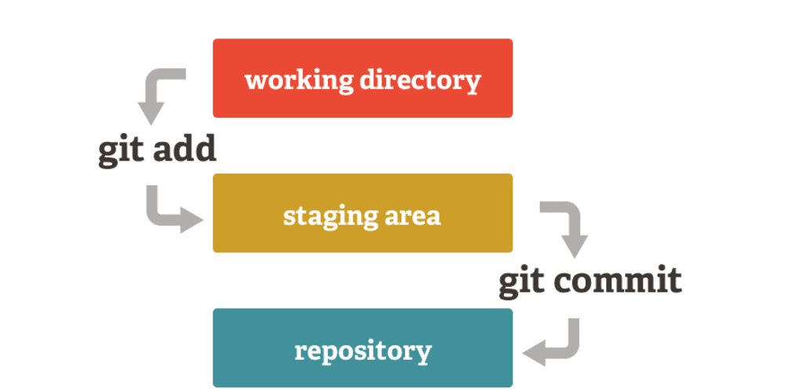
Git Stages:
1)Workspace-Physically see files and modify
2)Staging area-buffer area and we can take snapshots
3)Repository
a) local-stores changes locally
b) central-Stores changes centrally

Slide 9
Types of Repositories:
1)Bare Repository (Central):
→Stores and share only
→All central repositories are bare repos.
2)Non bare Repository (Local):
→Where you can modify the files.
→all local repos are non-bare repos.
Install and configure Git:
[] sudo su
[] yum -y install git
[] git –version
Explanation of each command with Example:
1)git config
→Configuring username and email in git
We must configure username and email in git for tracking purpose
[]git config –list
[] git config –global user.name “pavani”
[]git config –global user.emailpavani@gmail.com

Slide 10
2)git init
→git init command is used to initialize the git repository
[]mkdir pavani
[]cd pavani
[]git init
[]ls -la
3)git add
→Create file and add that file to staging area and check the status
[] vi pavani1
[]git status
[]git add . (or)[]git add pavani1
your files are staged now
4)git status
→To view the state of the working directory.
→Git status is to check the status of files (added or committed)
[]git status
5)git commit
→Commit the changes to local repo.
[] git commit -m “commitmsg”
6)Git log:
→git log will display the commit id and commit msg
[] git log

Slide 11
7)git show
→git show will display commitid, commitmsg and data inside the file.
→Observer the difference between modified file and untracked file see commits id
[] git log
[] git log –online
8).gitignore
→ignore the files while committing.
→purpose is developers are writing the code and once they build .class files also will be generated. In this case we have to eliminate .class files. By using git ignore we can eliminate .class files.
[]vi .gitignore
.java*
:wq!
[]git add .gitignore
[] git commit -m “ignoring .java files”
[]touch.java3 .java4
[]git status
→here you could not see .java4 and .java5 because it is ignored by .gitignore.
→First time only we have to commit .ignorefile. Later if any .java files are generated no need to commit. This is caused by retrospective effect.

Slide 12
9)Branching
→Developers can work on their own feature branches.
→To see list of available branches
[] git branch
→Create a new branch
[] git branch <name of the branch>
→to switch branch
[] git checkout <in which branch you wanna go>
[]vi c1
[]git add .
[]git commit -m "commitmsg"
→You cannot merge branches of diff repos
→To merge branches
To merge from one branch data to another branch and you have to be in destination branch
[] git merge <name of the branch>
→Delete branch
[] git branch -d <name of the branch to delete>
→To rename current branch
[] git branch -m <new name>

Slide 13
10)Git conflicts:
→When same file is having different contents in different branches, if you du merge then conflicts occurs.
→Conflicts occurs in 2 ways.
1)Merging branches
2)Pushing to central repo
11)Removing files after adding to staging
[] git rm –f <filename>
12)Delete all untracked files
[] git clean -n
[] git clean -f
13)git stash
→Removes file from working directory and puts in stashing store and gives clean working directory.
→Developers can save their changes and come back later.
→Later on, you can bring back that stashed items to working directory and can resume your work on that file.
→Stash literally means save up as for future use.
→To stash an item
[]vi pavani1
[]git add .
[] git stash

Slide 14
→Stash will be working before commit.
→To see the stashed items list
[] git stash list
→To apply stashed items.
Get back to your previos commit.
[] git stash apply stash@{number}
→To delete the stash items
[] git stash clear
Practical:
[] mkdir playbooks
[] cd playbooks
[] git init
[] vi web.yml
:wq!
[] git status
[] git add web.yml
[] git commit -m “commit msg”
14)git reset
→To undo commit
→It is used to bring back the file to working area.
[] git reset commitid

Slide 15
15)git revert
→A revert operation will take the specified commit, remove the changes from that commit, and create a new "revert commit".
[] git revert commitid
16)git remote
→This command lets you to create, view and delete connections to other repos
[] git remote -v
[]git remote add origin URL
17)git clone
→It is used to clone the remote repos
[]git clone URL
18)git fetch
→It downloads all commits, files from remote repo but it will not merge.
[] git fetch URL
19)git pull
→It is used to download and merge those changes into your local repo.
Pull=fetch+merge
[]git pull origin master
[]git pull origin master –allow-unrelated-histories
20)git push
→It is used to publish your local changes to your remote repo
[]git push origin master

Slide 16
21)git tag
→Once we have released the code means in production, we are creating tag.
→ A tag is like a branch that doesn't change. Unlike branches, tags, after being created, have no further history of commits.
[]git tag
[]git tag <tagname>
[]git push origin <tagname>
22)git rebase
→rebase differs from merge by rewriting the commit history in order to produce a straight, linear succession of commits.
[] git rebase <branchname>
9)workflow
1)centralized workflow
2)Feature branch workflow
3)Git-flow workflow
4)Forking workflow
1)Centralized workflow
→meaning multiple developers all push to a shared repository.
2) Feature branch workflow
→The core idea behind the Feature Branch Workflow is that all feature development should take place in a dedicated branch instead of the master branch. This encapsulation makes it easy for multiple developers to work on a feature without disturbing the main codebase.

Slide 17
3) Gitflow Workflow
→Master:
In this, code is ready for production. This branch is always ready to be released with everything fully tested and approved.
→Hotfix:
“hotfix” branches are used to quickly patch production releases.As soon as the fix is complete, it should be merged into both master. Hotfix branches are created to fix specific bugs in production environment.
→Develop:
this is the branch to which all feature branches are merged and where all tests are performed. Once testing can be done then we can merge to master.’
→Feature:
Each new feature should be created here.
4)Forking workflow:
when a new developer wants to start working on the project, they do not directly clone the official repository. Instead, they fork the official repository to create a copy of it on the server.

