Slide 1
FLORA CARBON AI · HIRING HACKATHON
ForestLens
Counting tree crowns and bounding canopy area in
high-resolution forest imagery
Ravi Yadav · September 2026
Live demo + source: github.com/RAVIYADAV6522/forestlens
Notes:
Open with the one-sentence pitch:
"ForestLens turns high-resolution forest imagery into individual tree detections and an auditable canopy-area estimate — and it shows you where it fails."
Then say what the deck is about: three findings that constrain what this kind of tool can honestly claim. Don't lead with the technology; lead with the findings.

Slide 2
THE TASK
The brief, and the bar it set
Input. High-resolution satellite imagery of a forest. Source it yourself.
Task 1. Count the individual tree crowns.
Task 2. Estimate the canopy area those crowns cover.
Constraints. Solo, one weekend, any stack.
JUDGED ON THREE THINGS
Criterion | What it demanded
Does it run? | A real application, not a concept
Can a stranger use it? | No developer standing beside it
Honest about limits? | No invented figures
The organiser's stated preference: a rough tool that admits its limits beats a polished tool that invents figures. That sentence shaped every design decision that follows.
ForestLens · tree-crown detection and canopy-area estimation
2
Notes:
Make the point that the third criterion is the hard one. Anyone can get a detector to emit a number; the difficulty is knowing which numbers you're entitled to report.
If asked why canopy area is harder than counting: counting needs the crowns to be separable, area needs them to be complete. Those fail in different conditions — which is slide 8.

Slide 3
DESIGN PRINCIPLE
One rule drove the whole build
If the system cannot justify a number, it does not present that number.
No ground sample distance → no physical area. Pixel counts only, stated as such.
No segmentation masks → area comes from boxes, labelled a proxy everywhere, with the measured 12–22% overestimate shown.
No detector installed → the app refuses to count rather than inventing a number. There is deliberately no synthetic fallback.
Confidence ≠ accuracy. No accuracy figure is published anywhere in the project, because no labelled evaluation set exists.
Cover is an interval. When the two independent estimates disagree by more than 25 points, no single figure is reported at all.
No carbon estimate. Canopy area is geometry. Converting it needs allometry, species and field calibration I don't have.
ForestLens · tree-crown detection and canopy-area estimation
3
Notes:
This is the slide to spend time on. Each line is enforced in code and covered by a test — they are not aspirations.
The last one usually gets a reaction at a carbon company. Be ready to defend it: declining to convert area to carbon is a correctness property, not a missing feature. Offering a carbon number from RGB geometry alone would be the single least defensible thing this tool could do.

Slide 4
DATA
Three scenes, self-sourced, licences verified
Scene | Source | Native GSD | Grid | Extent | Canopy
S1a open | Maxar/Vantor WV-02 | 0.49 m | 0.305 m | 9.77 ha | open pine/fir
S1b dense | Maxar/Vantor WV-02 | 0.49 m | 0.305 m | 9.77 ha | near-closed conifer
S2 closed | swisstopo SWISSIMAGE | 0.10 m | 0.10 m | 4.19 ha | closed mixed
Reproducible, not downloaded. Fetch scripts read only the requested window from the provider's cloud-optimised GeoTIFF, so each crop is 1–10 MB and rebuilds exactly from a scene ID and pixel window.
Provenance is machine-readable. Provider, platform, date, native GSD, grid spacing, CRS, off-nadir, sun elevation, cloud, processing steps and licence — written automatically at fetch time.
Native GSD ≠ grid spacing. Maxar delivers a 0.305 m grid from a 0.49 m sensor. Areas from the grid are correct; detectable detail is capped by the sensor. Tracked separately.
Licensing is an engineering constraint, not paperwork: Maxar Open Data is CC BY-NC — non-commercial. Productising this needs different imagery. SWISSIMAGE permits commercial use with attribution.
ForestLens · tree-crown detection and canopy-area estimation
4
Notes:
Expect: "why not NEON for the 10 cm scene?" Answer: NEON is what DeepForest was trained on, possibly including those very tiles. It would show behaviour at native resolution while testing nothing about generalisation. SWISSIMAGE gives the same resolution over structurally different forest, which separates resolution from familiarity — and that separation is what produced the headline finding.
If asked about the licence: I read the terms for the exact asset, not the programme page, and recorded them. A carbon company will care.

Slide 5
SYSTEM
Pipeline, and the arithmetic behind every area
Imagery
GSD, CRS
Scale match
to 0.10 m/px
Tiled detect
800 px / 0.15
Suppress dup.
IoU 0.40
Crown mask
optional
Count · area
cover interval
Crown area. pixel count × GSD². Total = sum over accepted crowns.
Canopy cover. the UNION of crown footprints ÷ analysed ground area — a union, so overlapping detections are not double counted.
Unknown GSD. physical area withheld entirely; pixel areas reported instead. No default is assumed.
One implementation. the UI, the CSV and the GeoJSON all call the same conversion, so the tests that pin the arithmetic pin the reported numbers.
Counting and area are separate stages on purpose: the count comes from the detector, the area from whatever crown geometry is defensible for that imagery.
ForestLens · tree-crown detection and canopy-area estimation
5
Notes:
Walk left to right, then give the arithmetic. Two details worth volunteering:
1. Boxes found on the resampled copy are mapped back into source-raster pixels, so annotation, area and GeoJSON all share one coordinate frame.
2. Cover uses the union, not the sum. I found the sum double-counting overlaps while building the cover bracket — the sum is still reported, but as crown area, not cover.

Slide 6
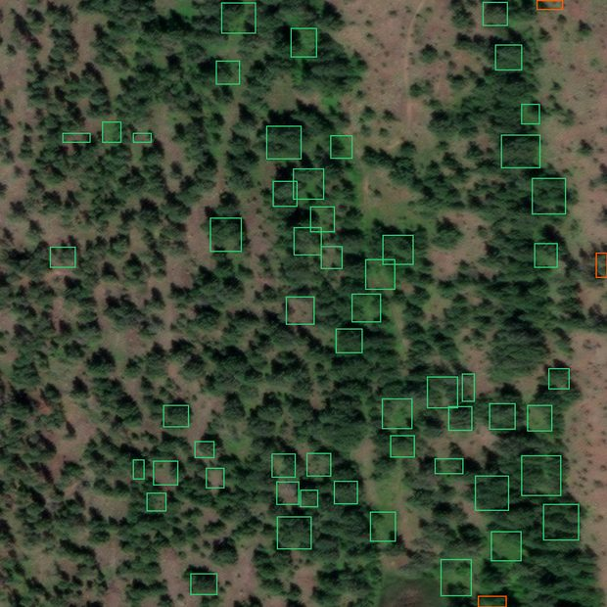
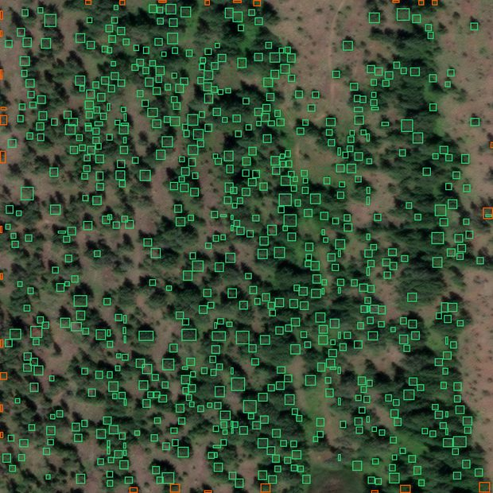
FINDING 1 OF 3
The detector fails on satellite imagery at native scale
Scale | Eff. GSD | Trees | /ha | Mean crown
1× | 0.305 m | 57 | 5.8 | 179 m² (15.1 m)
2× | 0.153 m | 392 | 40.1 | 49.0 m² (7.9 m)
3.05× | 0.100 m | 695 | 71.2 | 21.3 m² (5.2 m)
4× | 0.076 m | 836 | 85.6 | 12.1 m² (3.9 m)
At native scale: 5.8 trees/ha with 15 m “crowns”. Real crowns here are 4–8 m. The model was trained on ~0.10 m imagery.
So the detection input is resampled to the model's training GSD — the same crop then gives 71.2 trees/ha with 5.2 m crowns.
Same scene, same settings. Left: native 0.305 m, 57 crowns. Right: resampled 3.05×, 695 crowns.
3.05× is anchored to the model's documented training GSD — not picked. The count never plateaus, so choosing the nicest number would be tuning to a preferred answer. And resampling adds no information.
ForestLens · tree-crown detection and canopy-area estimation
6
Notes:
The trap on this slide is that 57 → 695 looks like an improvement. It is not a result; it is evidence that the input scale was wrong. Say that before they ask.
"Isn't upsampling cheating?" — It adds no information and the app says so on screen. It presents crowns at the pixel size the model expects. What would be cheating is picking 4× because 836 looked better; since the count rises monotonically and never plateaus, the only defensible anchor is the documented training resolution.
Whether 695 is right is slide 9.

Slide 7
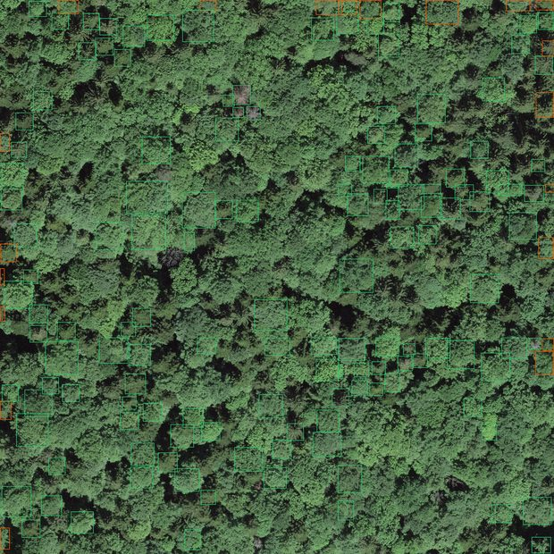
FINDING 2 OF 3
Canopy closure, not resolution, is the binding constraint
Scene | GSD | Trees/ha | Cover (crown union) | Visible cover
S1a open | 0.49 m | 71.2 | 17.0% | consistent
S1b dense | 0.49 m | 72.2 | 15.1% | ~70–90%
S2 closed | 0.10 m | 37.7 | 21.0% | ~95–100%
The finest scene performed worst. At exactly the training resolution it recovers roughly one crown in five.
Counts saturate. 71.2 vs 72.2 trees/ha across two visibly different stand densities — the detector stops separating crowns once they interlock.
Two causes, confounded. Closure removes the separable apexes the detector needs; and DeepForest's training data is largely open North American conifer, not closed European mixed forest.
S2 at native 0.10 m — the detector's own training resolution, no resampling.
This inverts the usual procurement instinct. Buying finer imagery does not fix individual-tree analysis under closed canopy — assess stand structure before commissioning imagery.
ForestLens · tree-crown detection and canopy-area estimation
7
Notes:
This is the strongest slide in the deck and the one to lead with if time is short.
I sourced the Swiss scene specifically to test this, and deliberately avoided NEON so that resolution and familiarity were separable. The result was the opposite of what I expected going in.
If asked what would fix it: fine-tuning on closed-canopy imagery. No threshold setting reaches an 80% miss rate — I tried.

Slide 8
FINDING 3 OF 3
Summed crown boxes are not a canopy-cover measurement
The failure. Detection fires on separable crown apexes, so the union of its boxes cannot tile interlocking canopy. On the closed-canopy scene that reports 21% where cover is visibly near-complete — wrong by a factor of four.
The response. Report cover as two independent estimates and refuse to average them.
WHY EACH BOUND IS WRONG
Lower bound — union of detected crowns.
Too low: every crown the detector missed contributes nothing. Under closed canopy, far too low.
Upper bound — pixels where 2G − R − B > 0.
Too high: grass, shrubs and crops are green too. Deeply shadowed canopy can drop below the threshold and be missed.
Scene | Lower: crown union | Upper: green vegetation | Width
S1a open | 17.0% | 92.6% | 76 pts
S1b dense | 15.1% | 96.3% | 81 pts
S2 closed | 21.0% | 93.9% | 73 pts
Above 25 points apart, the app states the range and refuses a single figure — the midpoint of two estimates that disagree this strongly means nothing. Honest conclusion: this pipeline counts relatively separable trees and cannot measure canopy cover to a useful precision.
ForestLens · tree-crown detection and canopy-area estimation
8
Notes:
Expect: "a 75-point range isn't very useful." Agree — and that is the finding. A useless honest answer beats a useful false one, and it tells you which instrument you actually need.
The right instrument for cover is a canopy-versus-ground segmentation model. Crown detection answers "how many trees"; it is the wrong tool for "how much cover". That's my first recommendation for next steps.

Slide 9
VALIDATION
Counted by eye, before any detections were shown
Crop | Scene | Area | Reference | Detected | Difference
openA | S1a, 3.05× | 0.610 ha | 48 ± 10 | 57 | +19%
openB | S1a, 3.05× | 0.610 ha | 36 ± 8 | 46 | +28%
chA | S2, native | 0.262 ha | 48 ± 14 | 9 | −81%
Method, stated up front. One count per distinguishable crown unit bounded by shadow or texture discontinuity; unresolvable clumps counted by apparent apex; crops quartered and counted cell by cell.
Open canopy runs 19–28% high. At or just beyond the counting uncertainty. Likely clump splitting and shadow detections.
Closed canopy recovers ~1 in 5. Not a borderline result, and no threshold setting changes its character.
The uncertainty is itself a finding. At 0.49 m native GSD even careful manual counting cannot separate clumps reliably — so don't over-read the open-canopy agreement.
These reference counts were made by the AI assistant that built the system — by eye, not by a human expert or field survey. They are independent of the detector but they are not ground truth, and both headline figures inherit that weakness. Stated wherever the numbers appear.
ForestLens · tree-crown detection and canopy-area estimation
9
Notes:
Do not skip the amber box. Volunteering the weakness before being asked is the whole point of the project.
If you have since counted the crops yourself, replace these numbers with yours and say so — that converts the weakest part of the submission into a number you can defend as your own.
"How accurate is it?" — I don't publish an accuracy figure. There's no labelled evaluation set for these scenes, and eyeballing an overlay doesn't give precision or recall. What I have is this table, with its provenance stated.

Slide 10
RIGOUR
Three things I tried, measured, and threw away
OTSU THRESHOLDING — REJECTED
It assumes a bimodal histogram with two real classes. On a uniformly vegetated image it splits within the vegetation distribution — sunlit against shaded crown — and claimed 62% cover on a ~100%-closed scene. Replaced with a fixed, stated threshold; Otsu is still reported as a diagnostic.
TEXTURE FILTERING — REJECTED
The vegetation index reads turbid lake water as 94.3% vegetation. Canopy is rough and water is smooth, so local σ looks like the fix: water 4.8, closed canopy 20.0 — but the open Okanagan stand is 6.3. Any threshold removing the lake also deletes a real forest scene. The app flags the condition instead of shipping a fix that works on one image.
A LIBRARY DOCSTRING — CHECKED, NOT TRUSTED
The detector documents its image argument as BGR. The pipeline passes RGB. Rather than assume, both were tested on the library's own in-distribution crop:
Channel order | Trees | Mean conf. | Conf > 0.5
RGB (what we pass) | 55 | 0.535 | 35
BGR (per the docs) | 29 | 0.389 | 5
RGB is correct; the docstring is stale. Had it gone the other way, every number in this project would have come from transposed colour channels.
NEGATIVE CONTROLS
Open water: 2 detections over 9.77 ha, 0.0% crown union — effectively clean. Urban core: detections land on real street trees, roofs almost entirely clear, a handful of genuine rooftop false positives.
ForestLens · tree-crown detection and canopy-area estimation
10
Notes:
This slide exists to show method rather than results. Interviewers can tell the difference between someone who got a pipeline working and someone who interrogated it.
The channel-order check is the strongest single anecdote in the deck: a stale docstring would have silently invalidated every count, and the only reason it didn't is that I tested the claim instead of trusting it.
The texture rejection is the one that shows judgement: I had a fix that made the demo scene look right and declined to ship it because it would break elsewhere.

Slide 11
ENGINEERING
Reproducibility, tested where it matters
80 tests, no model weights needed. Area arithmetic, GSD precedence, resampling and box remapping, union-vs-sum cover, duplicate suppression, edge flagging, mask acceptance, export shapes — so the measurement logic is verifiable without a GPU.
13 mechanical QA checks. Run against the acceptance criteria, including a grep for accuracy claims that should not exist.
Every run exports its own metadata. Image identity, GSD and its origin, model versions, all thresholds, resampling scale, timings, peak memory. Any count is reproducible from its own export.
Imagery rebuilds from a scene ID. Window-addressed COG reads, not a folder of downloads.
MEMORY — MEASURED, NOT ASSUMED
Inference path | Peak RSS | Detections
In-memory tiling | ~1270 MB | 695
Windowed (default) | ~1100 MB | 695, identical
Windowed inference reads one tile at a time from a temporary raster. Verified bit-identical: same count, same area, same hash of all box coordinates.
Two interventions tested and discarded: disabling gradients changed nothing (the library already does it), and a 400 px tile did not cut memory while changing the result — 1379 trees against 695. Tile size is a far stronger lever on the count than on memory.
Run-to-run variance is ±150 MB and the floor is ~1050 MB even on the small scene, so the cost is the model's forward pass — not the imagery.
ForestLens · tree-crown detection and canopy-area estimation
11
Notes:
Use this slide if the interviewer is technical. Two things to emphasise:
1. The tests cover the arithmetic, not the model. That's deliberate — I can't test DeepForest's weights, but I can guarantee that pixel count × GSD² is right and that an unknown GSD withholds area.
2. I found and fixed a real defect through this: the area formula existed in three places, and the one the tests covered was the one the app never called. Consolidating it meant the tests finally pinned the shipped numbers.

Slide 12
LIMITS AND NEXT STEPS
What I would not claim, and what I'd build next
WHAT I WOULD NOT CLAIM
No accuracy figure. No labelled evaluation set exists for these scenes.
Reference counts aren't ground truth. Made by eye by the assistant that built the tool.
Three scenes, two forest types. Closure is confounded with structural domain shift.
The upper cover bound is approximate. It over-counts green water and under-counts shadowed canopy.
Generalisation is untested. Including — honestly — on Indian forests, which look structurally closer to the failure case.
WHAT I WOULD BUILD NEXT
1. Expert or field reference counts. Converts every “plausible” here into a measurement.
2. Fine-tune on closed canopy. Targets the dominant error — the 80% miss rate no threshold reaches.
3. A canopy-vs-ground segmentation model. Replaces the 75-point cover interval with an actual measurement.
4. Height from lidar or photogrammetry. Separates trees from grass, which RGB greenness cannot.
“Why should you trust the result? Because I can show you every detected crown, where the resolution came from, the arithmetic behind the area, and the scene where it fails worst — none of it hidden behind a single confident number.”
ForestLens · tree-crown detection and canopy-area estimation
12
Notes:
Close on the quote — it is the thesis of the whole project in one sentence.
The ordering of next steps is deliberate and worth saying out loud: reference counts first, because without them every figure in the deck is only plausible. Then fine-tuning, because it attacks the dominant error. The segmentation model third, because it fixes the wrong-instrument problem for cover.
If asked "what would you do differently?" — I'd source the closed-canopy scene on day one. It produced the most important finding and I found it late.

