Slide 1

VERBAL ABILITY v
WELCOME
What this class is about !!!!!

Slide 2
VERBAL ABILITY
What is Verbal Ability?
Verbal Ability is defined as the capability of a person in expressing ideas using words in a clearly understandable manner.
For Verbal Ability, a good vocabulary and sentence-forming skills are vital.
Why are we reading Verbal Ability ?
Verbal Ability is an important component of various competitive exams & assessment tests etc.

Slide 3

VERBAL ABILITY
Verbal Ability or English Aptitude comprises following
Reading Ability
Grammar
Vocabulary

Slide 4
VERBAL ABILITY
GRAMMAR
Parts of Speech
Noun Pronoun Adjective Verb
Adverb Preposition Conjunction Interjection

Slide 5
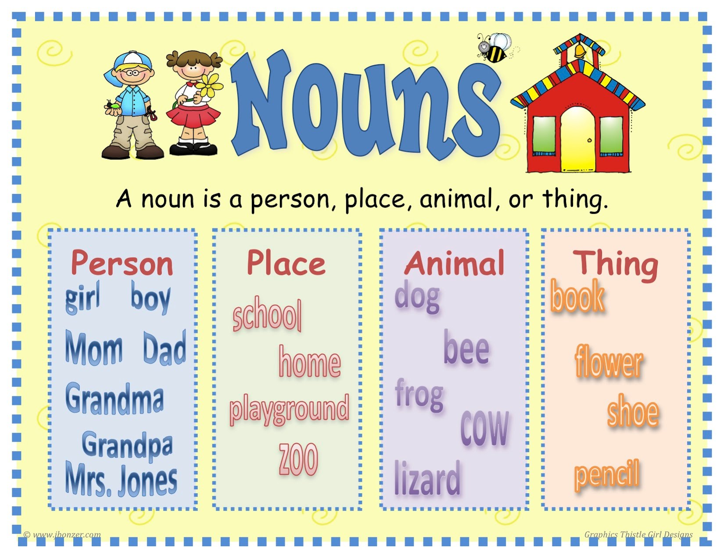
VERBAL ABILITY
NOUN
Noun is the name given to a person, place or thing.
Eg. Kabir, Chandigarh, Gold, Cricket etc.

Slide 6
VERBAL ABILITY
Classification
Proper Noun Common Noun Collective Noun Abstract Noun

Slide 7
VERBAL ABILITY
The train stopped at the station.
A pack of cards is kept on the table.
The Taj Mahal is a beautiful building.
This necklace is made of gold.
The fireman could not put out the fire.
My family is going to Lucknow.
The Ganga is a holy river.
Many new plants have been planted in the garden.
The shepherd took his flock of sheep to the grassland.
A crowd gathered around the injured man.

Slide 8
VERBAL ABILITY
Table, rain, box, mob, tiger, Delhi, car, gold, ground, bat,
football, soldier, Vishnu, England, Shakespeare, silver,
bed, bunch, flock, mountain, bangle, Ox, honesty,
intelligence, Mumbai

Slide 9
VERBAL ABILITY
Let’s Simplify
Countable Uncountable

Slide 10
VERBAL ABILITY
Noun & Number
Singular Plural
Boy Boys
School Schools
City Cities
Mother in law ______
Zone of Caution
Some nouns look singular but Plural in use
Some nouns look Plural but Singular in use

Slide 11
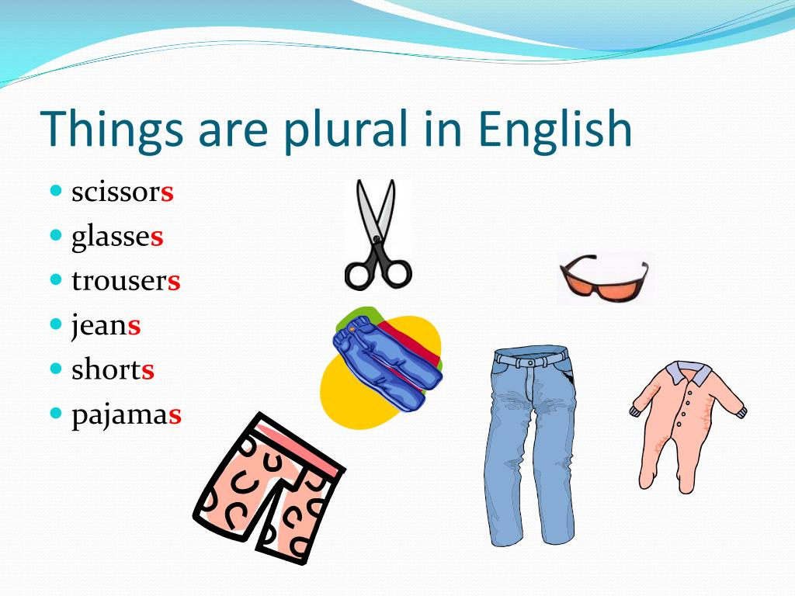
VERBAL ABILITY
Names of certain dress articles
Jeans, trousers, shorts.
Names of some Instruments
Tongs, scissors, spectacles.
Names of some diseases
Rickets, Measles, Diabetes.
Names of some Subjects
Mathematics, Economics, statistics.

Slide 12
VERBAL ABILITY
NOUN & CASE
Nominative Case
Accusative Case
Possessive Case
When we say that something belongs to someone.
Noun Possession
Boy Toy
Boys College

Slide 13
VERBAL ABILITY
How to form possessive nouns ?
Words ending with ‘s’ sound
Words not ending with ‘s’ sound

Slide 14
VERBAL ABILITY
Exercise
I could not buy furnitures when I was in Chandigarh.
I receive many advices from my seniors.
There are many sheeps grazing in the field.
Is your scissors sharp ?
I received hundred hundred-rupees notes.
The sceneries of Masuri are heavenly.
I had two breads in breakfast.
I scored only passing marks in English.
A flock of lions is roaming in the jungle.
Last month, community center's wall fell down due to heavy rain.

Slide 15
VERBAL ABILITY
Answers
I could not buy furnitures when I was in Chandigarh.
I receive many advices from my seniors.
There are many sheeps grazing in the field.
Is your scissors sharp ?
I received hundred hundred-rupees notes.
The sceneries of Masuri are heavenly.
I had two breads in breakfast.
I scored only passing marks in English.
A flock of lions is roaming in the jungle.
Last month, community center's wall fell down due to heavy rain.

Slide 16
VERBAL ABILITY
How many eggs (A)/ and milk (B)/ do you need. (C)/ No error. (D)
These news have (A)/ disturbed the (B)/ peace of my mind (C)/ No error. (D)
All the girls students (A)/ of the college are advised (B)/ to sit in the(C)/ girls’ common room. (D)/ No Error (E)
The Indian team (A)/ defeated the Australian (B)/ by an innings.(C)/ No error (D)
The name of (A)/ Sudhakar’s and (B)/ Abhijeet’s father is Rai bahadur. (C)/ No error.
When they stole (A)/ the money and (B)/ Where did they hide it ? (C)/ No error.(D)

Slide 17
VERBAL ABILITY
How many eggs (A)/ and milk (B)/ do you need. (C)/ No error. (D)
These news have (A)/ disturbed the (B)/ peace of my mind (C)/ No error. (D)
All the girls students (A)/ of the college are advised (B)/ to sit in the(C)/ girls’ common room. (D)/ No Error (E)
The Indian team (A)/ defeated the Australian (B)/ by an innings.(C)/ No error (D)
The name of (A)/ Sudhakar’s and (B)/ Abhijeet’s father is Rai bahadur. (C)/ No error.
When they stole (A)/ the money and (B)/ Where did they hide it ? (C)/ No error.(D)

Slide 18
VERBAL ABILITY
There are four alternatives of underlined part is given below. choose the correct the alternative to improve the sentence. If sentence doesn’t need improvement select ‘no improvement’ option.
Bachelor of Arts is a three-years degree course.
(A) a three-years degree courses.
(B) a three years degree course.
(C) a three-year degree course.
(D) No improvement.

Slide 19
VERBAL ABILITY
There are four alternatives of underlined part is given below. choose the correct the alternative to improve the sentence. If sentence doesn’t need improvement select ‘no improvement’ option.
Bachelor of Arts is a three-years degree course.
(A) a three-years degree courses.
(B) a three years degree course.
(C) a three-year degree course.
(D) No improvement.

Slide 20
VERBAL ABILITY
Somesh gifted his sister many furnitures.
(A) Many furniture.
(B) Many pieces of furniture.
(C) Many pieces of furnitures.
(D) No improvement.

Slide 21
VERBAL ABILITY
Somesh gifted his sister many furnitures.
(A) Many furniture.
(B) Many pieces of furniture.
(C) Many pieces of furnitures.
(D) No improvement.

Slide 22
VERBAL ABILITY
Empire after Empire was destroyed by Alexander.
(A) Empires after empires were
(B) Empire after empires was
(C) Empire after empire was
(D) Empires after empire were
(E) No improvement.

Slide 23
VERBAL ABILITY
Empire after Empire was destroyed by Alexander.
(A) Empires after empires were
(B) Empire after empires was
(C) Empires after empire were
(D) No improvement.

Slide 24
VERBAL ABILITY
Two-third of the member of parliament were agreed on this bill.
(A) Two-thirds of the members of parliament
(B) Two-thirds of the member of parliaments
(C) Two-third of the members of parliament
(D) Two-thirds of the member of parliament

Slide 25
VERBAL ABILITY
Two-third of the member of parliament were agreed on this bill.
(A) Two-thirds of the members of parliament
(B) Two-thirds of the member of parliaments
(C) Two-third of the members of parliament
(D) Two-thirds of the member of parliament

Slide 26
VERBAL ABILITY
He gave his friend a hundred-rupees note.
(A) hundred-rupees notes.
(B) hundred-rupee notes.
(C) hundreds-rupee note.
(D) hundred-rupee note.
(E) No improvement.

Slide 27
VERBAL ABILITY
Stealing is (a)/ a bad (b)/ custom. (c)/no error (d)
My uncle’s secretary’s wife (a)/ is (b)/ very charming. (c)/ no error (d)
A hundred miles (a)/ are a (b)/ long distance. (c)/ no error (d)
There were many (a)/ females (b)/ in the compartment (c)/ no error (d)
There was (a)/ no place (b)/ on the bench for you. (c)/ no error (d)
Please (a)/ put your (b)/sign here (c)/no errors (d)

Slide 28
VERBAL ABILITY
Stealing is (a)/ a bad (b)/ custom. (c)/no error (d)
My uncle’s secretary’s wife (a)/ is (b)/ very charming. (c)/ no error (d)
A hundred mile (a)/ are a (b)/ long distance. (c)/ no error (d)
There were many (a)/ females (b)/ in the compartment (c)/ no error (d)
There was (a)/ no place (b)/ on the bench for you. (c)/ no error (d)
Please (a)/ put your (b)/sign here (c)/no errors (d)

Slide 29
VERBAL ABILITY
Vocabulary
In the following question, out of the four alternatives, choose the one which best expresses the meaning of the given word.
Ineffable
Options:
1) unintelligible 2) illegible 3) inexplicable 4) inexpressible

Slide 30
VERBAL ABILITY
Vocabulary
In the following question, out of the four alternatives, choose the one which best expresses the meaning of the given word.
Ineffable
Options:
1) unintelligible 2) illegible 3) inexplicable 4) inexpressible

Slide 31
VERBAL ABILITY
Vocabulary
In the following question, out of the four alternatives, choose the one which best expresses the meaning of the given word.
Espionage
Options:
1) hypnotism 2) spying 3) perception 4) detente

Slide 32
VERBAL ABILITY
Vocabulary
In the following question, out of the four alternatives, choose the one which best expresses the meaning of the given word.
Espionage
Options:
1) hypnotism 2) spying 3) perception 4) detente

Slide 33
VERBAL ABILITY
Vocabulary
In the following question, choose the word opposite in meaning to the given word.
Theoretical
Options:
1) punctual 2) uncritical 3) emotional 4) practical

Slide 34
VERBAL ABILITY
Vocabulary
In the following question, choose the word opposite in meaning to the given word.
Theoretical
Options:
1) punctual 2) uncritical 3) emotional 4) practical

Slide 35
VERBAL ABILITY
In the following question, choose the word opposite in meaning to the given word.
Mitigate
Options:
1) enlarge 2) reduce 3) increase 4) multiply

Slide 36
VERBAL ABILITY
In the following question, choose the word opposite in meaning to the given word.
Mitigate
Options:
1) enlarge 2) reduce 3) increase 4) multiply

Slide 37
VERBAL ABILITY
In the following question, choose the word opposite in meaning to the given word.
Elegance
Options:
1) vehemence 2) fragrance 3) graceless 4) ostentatious

Slide 38
VERBAL ABILITY
In the following question, choose the word opposite in meaning to the given word.
Elegance
Options:
1) vehemence 2) fragrance 3) graceless 4) ostentatious

Slide 39
VERBAL ABILITY
In the following question the 1st and the last part of the sentence/passage are numbered 1 and 6. The rest of the sentence/ passage is split into four parts and named P, Q, R and S. These four parts are not given in their proper order. Read the sentence/passage and find out which of the four combinations is correct.
1. Why should I tell you again and again? P. They know what they have to do. Q. Don't you know your duties? R. Only you require to be told. S. Other students need not be told. 6. I will not tolerate this anymore.
1) QSPR 2) QRPS 3) SPRQ 4) QPSR

Slide 40
VERBAL ABILITY
1. One evening he lit a large lamp in the bedroom and sat near his wife. P. 'Why not?', was the answer. Q. 'Whatever you like.' R. 'Shall I read you something?', he asked. S. 'What shall I read?', he continued. 6. He was somewhat taken aback by her answer.
1) RPSQ 2) SRQP 3) RQPS 4) SQPR

Slide 41
VERBAL ABILITY
1. Suddenly the man heard the low hum of an engine. P. Instead, it grew louder and louder and seemed to be coming from above. Q. At first he thought that it must be a car travelling along the road he had recently left. R. He looked up quickly and saw an aeroplane cutting a crazy, zigzag path across the sky. S. He expected the noise to fade away in the distance. 6. It disappeared for an instant behind some clouds, then emerged and plunged into the field.
1) QSPR 2) SPRQ 3) RPSQ 4) QPRS

Slide 42
VERBAL ABILITY
1. I got on a colourful bus filled with all kinds of strange people. P. We arrived at a gate like the one in Salvador Dali's paintings. Q. The bus rode across the dirty expanses without roads. R. At first, I wasn't aware that the bus roof was loaded with drugs. S. Everyone was filled with dust and often the wheels would sink into the soft soil. 6. It was a gate neither separated nor connected anything from or to anything.
1) QRSP 2) SPQR 3) RQSP 4) RSPQ

