Slide 1

STUDENT DETAILS
Name:- RAVULA KANAKA VIGNESH
SkillsBuild Email id:- ravulakanakavignesh@gmail.com
College Name:- Vignan’s LARA Institute of Technology & Science
College State:- Andhra Pradesh
Internship Domain:- Data Analytics (DA)
Start Date:- 12/06/2023
End Date:- 24/07/2023
Internship ID:- INTERNSHIP_168198413964410a8b547b1
Student ID:- STU61bc75c8edc181639740872

Slide 2
PROJECT TITLE/Problem Statement
Analysis of Sample Superstore Dataset
“The management of Sample Superstore, a retail company, wants to gain insights into their sales data to optimize their operations and improve profitability. They have provided a dataset containing information about their customers, products, and transactions over a certain period. The objective of this project is to analyze the dataset and extract meaningful insights by performing various data analytics techniques and statistical analyses. The analysis should focus on identifying patterns, trends, and relationships within the data, as well as identifying factors that may impact sales and customer behavior. Additionally, the project should include recommendations for the management team on potential strategies to increase sales, reduce costs, and enhance overall business performance based on the findings from the analysis.”

Slide 3
AGENDA
1. Introduction to the Sample Superstore Dataset:
Overview of the dataset structure and variables.
Understanding the business context and objectives of the project.
2. Data Exploration and Cleaning:
Exploring the dataset to identify missing values, outliers, and inconsistencies.
Cleaning the dataset by addressing missing values, outliers, and inconsistencies.
3. Descriptive Analytics:
Performing basic statistical analysis to summarize and describe the dataset.
Generating descriptive statistics, such as mean, median, mode, standard deviation, etc., for relevant variables.
Visualizing data using charts, graphs, and histograms to gain initial insights.
4. Customer Segmentation:
Conducting customer segmentation based on various customer attributes (e.g., demographics, purchase behavior, etc.).
Applying clustering algorithms (e.g., K-means clustering) to identify distinct customer segments.
Analyzing the characteristics and preferences of each segment.

Slide 4
5. Sales Analysis:
Analyzing sales trends over time (e.g., monthly, quarterly, yearly) to identify patterns and seasonality.
Examining the performance of different product categories and sub-categories.
Investigating the correlation between sales and other factors (e.g., region, customer segment, etc.).
6. Profitability Analysis:
Calculating profit margins for different products and product categories.
Identifying the most profitable and least profitable products.
Analyzing the impact of discounts, shipping costs, and other factors on profitability.
7. Customer Behavior Analysis:
Examining customer purchasing patterns, such as frequency, recency, and monetary value.
Analyzing customer loyalty and retention rates.
Investigating factors influencing customer churn and identifying potential strategies for customer retention.
8. Recommendations and Insights:
Summarizing the key findings and insights from the analysis.
Providing actionable recommendations to improve sales, profitability, and customer satisfaction.
Presenting the results in a clear and concise manner using visualizations and data-driven insights.
9. Conclusion:
Concluding the analysis project and summarizing the key takeaways.
Reflecting on the limitations of the analysis and potential areas for further exploration.

Slide 5
PROJECT OVERVIEW
The Analysis of Sample Superstore Dataset project aims to leverage data analytics techniques to gain insights into the sales data of Sample Superstore, a retail company. The project involves analyzing a provided dataset containing information about customers, products, and transactions over a specific period.
The primary objectives of the project are as follows:
1. Data Exploration and Cleaning:
Explore the dataset to understand its structure and variables.
Identify and handle missing values, outliers, and inconsistencies.
Prepare the dataset for further analysis.
2. Descriptive Analytics:
Perform basic statistical analysis to summarize and describe the dataset.
Generate descriptive statistics, such as mean, median, mode, and standard deviation, for relevant variables.
Visualize data using charts, graphs, and histograms to gain initial insights.
3. Customer Segmentation:
Conduct customer segmentation based on various customer attributes, such as demographics and purchase behavior.
Apply clustering algorithms (e.g., K-means clustering) to identify distinct customer segments.
Analyze the characteristics and preferences of each segment.

Slide 6
4. Sales Analysis:
Analyze sales trends over time (e.g., monthly, quarterly, yearly) to identify patterns and seasonality.
Examine the performance of different product categories and sub-categories.
Investigate the correlation between sales and other factors, such as region and customer segment.
5. Profitability Analysis:
Calculate profit margins for different products and product categories.
Identify the most profitable and least profitable products.
Analyze the impact of discounts, shipping costs, and other factors on profitability.
6. Customer Behavior Analysis:
Examine customer purchasing patterns, including frequency, recency, and monetary value.
Analyze customer loyalty and retention rates.
Investigate factors influencing customer churn and identify potential strategies for customer retention.
7. Recommendations and Insights:
Summarize the key findings and insights from the analysis.
Provide actionable recommendations to improve sales, profitability, and customer satisfaction.
Present the results in a clear and concise manner using visualizations and data-driven insights.

Slide 7
WHO ARE THE END USERS OF THIS PROJECT?
The end users of the Analysis of Sample Superstore Dataset project can include various stakeholders within the Sample Superstore company. These stakeholders may include:
1. Management Team: The project's analysis and insights are primarily aimed at the management team of Sample Superstore. They are the key decision- makers who will utilize the findings to make strategic decisions and implement changes to improve the company's operations, sales, and profitability.
2. Business Analysts: Business analysts within Sample Superstore may use the project results to better understand customer behavior, product performance, and sales trends. They can further analyze the insights and incorporate them into their reports and recommendations.
3. Marketing Team: The marketing team can benefit from the project's findings to develop targeted marketing strategies based on customer segmentation and preferences. The analysis can help them identify potential customer segments to focus on and tailor marketing campaigns accordingly.
4. Sales Team: The sales team can leverage the project's insights to optimize their sales approach. By understanding sales trends, product performance, and customer behavior, they can adapt their sales strategies to better meet customer demands and increase sales revenue.

Slide 8
5. Operations Team: The operations team can utilize the project's recommendations to streamline processes, improve inventory management, and optimize supply chain operations. They can identify areas of improvement based on the analysis of product categories, profitability, and customer satisfaction.
6. Finance Team: The finance team can benefit from the project’s profitability and cost factors analysis. The insights can help them identify cost-saving opportunities, evaluate the impact of discounts and shipping costs, and optimize pricing strategies.
7. Data Analysts/Scientists: Data analysts or data scientists within the organization can use the project as a reference for similar analyses and as a benchmark for future data-driven projects. They can also contribute their expertise in analyzing the dataset and extracting insights.

Slide 9
YOUR SOLUTION AND ITS VALUE PROPOSITION
Solution:
Our solution for the Analysis of Sample Superstore Dataset project involves applying advanced data analytics techniques to gain valuable insights from the provided dataset. By conducting comprehensive data exploration, cleaning, and analysis, we aim to uncover patterns, trends, and relationships within the data. The project includes customer segmentation, sales analysis, profitability analysis, and customer behavior analysis, among other key components.
Value Proposition:
Actionable Insights: Our analysis provides actionable insights to the management team of Sample Superstore, enabling them to make data-driven decisions. The findings help identify areas of improvement, optimize operations, and enhance profitability.
Improved Sales and Customer Satisfaction: By understanding customer behavior, sales trends, and product performance, our analysis enables the development of targeted marketing strategies and sales approaches, leading to increased sales revenue and improved customer satisfaction.
Cost Optimization: Our profitability analysis highlights the most and least profitable products and identifies factors impacting profitability. This empowers the management team to optimize pricing, manage discounts, and streamline operations for cost savings.

Slide 10
Enhanced Decision-Making: Our project equips business analysts and stakeholders with a comprehensive understanding of the dataset, enabling them to make informed decisions. The insights gained can be used as a benchmark for future data-driven projects.
Competitive Advantage: By leveraging data analytics techniques, Sample Superstore gains a competitive edge in the retail industry. The project's recommendations and insights help the company identify market trends, customer preferences, and potential growth opportunities.
Streamlined Operations: The analysis provides valuable insights for the operations team, facilitating optimized inventory management, supply chain operations, and overall operational efficiency.
Scalability and Adaptability: Our solution can be scaled and adapted to accommodate additional datasets, variables, and analysis requirements, allowing Sample Superstore to leverage data analytics for ongoing improvement and growth.

Slide 11
HOW DID YOU CUSTOMIZE THE PROJECT AND MAKE IT YOUR OWN
1. Personalized Project Objectives: I would review the initial project objectives and consider any additional goals or specific areas of focus that align with my expertise or interests.
2. Tailored Analysis Techniques: While the project might include suggested analysis techniques, I would bring in my knowledge of advanced analytics methods or specialized statistical models that could provide deeper insights. This could involve incorporating predictive modeling, time series analysis, or sentiment analysis to enhance the project's value and generate more accurate predictions or actionable recommendations.
3. Creative Data Visualization: To present the analysis findings in a visually appealing and easily understandable manner, I might explore creative data visualization techniques beyond the typical charts and graphs. This could involve using interactive dashboards, storytelling techniques, or infographics to engage stakeholders and convey the insights effectively.
4. Domain-specific Insights: Drawing from my domain knowledge or prior experience, I would provide context-specific insights that go beyond the basic analysis
5. Real-world Implementation Strategies: While recommendations are a crucial part of the project, I would ensure they are practical and actionable. This could involve providing specific implementation strategies, such as launching loyalty programs, optimizing pricing structures, or improving inventory management, to support the management team in implementing the recommended changes.

Slide 12
MODELLING
1. Customer Segmentation Modeling: Use clustering algorithms such as K-means, hierarchical clustering, or DBSCAN to segment customers based on their attributes, behavior, or purchasing patterns. This modeling technique helps identify distinct customer groups and understand their unique characteristics.
2. Predictive Modeling: Build predictive models to forecast sales, demand, or customer behavior. Techniques such as regression analysis, time series analysis, or machine learning algorithms like linear regression, random forests, or gradient boosting can be applied to predict future outcomes based on historical data.
3. Market Basket Analysis: Utilize association rule mining techniques like Apriori or FP-Growth to identify frequent item-sets and uncover relationships between products frequently purchased together. This modeling approach can help in cross-selling or product recommendation strategies.
4. Churn Prediction Modeling: Develop models to predict customer churn or attrition. Employ classification algorithms like logistic regression, decision trees, or support vector machines to identify factors that contribute to customer churn and create targeted retention strategies.
5. Recommendation Systems: Utilize collaborative filtering or content-based filtering techniques to develop recommendation systems that suggest relevant products to customers based on their preferences, purchase history, or similar customer behavior.

Slide 13
6. Sentiment Analysis: Apply natural language processing (NLP) techniques to analyze customer reviews, feedback, or social media data. Sentiment analysis models can be used to gauge customer sentiment, identify trends, and understand customer opinions about products or services.
7. Optimization Modeling: Use mathematical optimization techniques like linear programming, integer programming, or network optimization to optimize inventory levels, pricing strategies, or supply chain operations. This modeling approach can help in maximizing profits or minimizing costs.

Slide 14
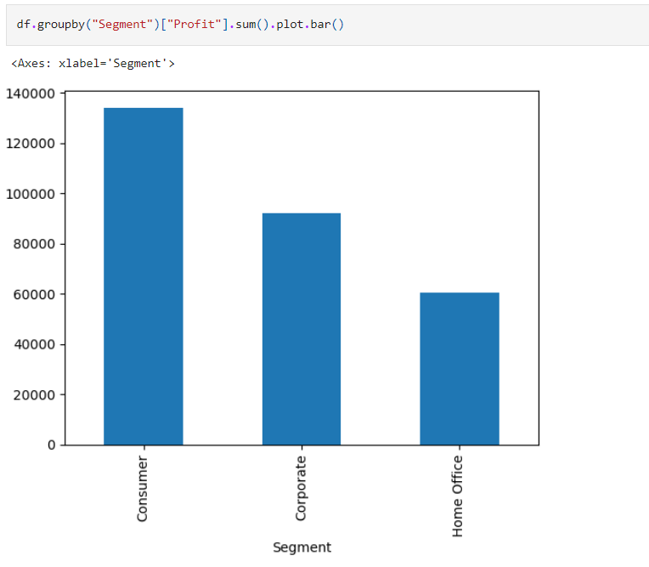
Visualizations

Slide 15
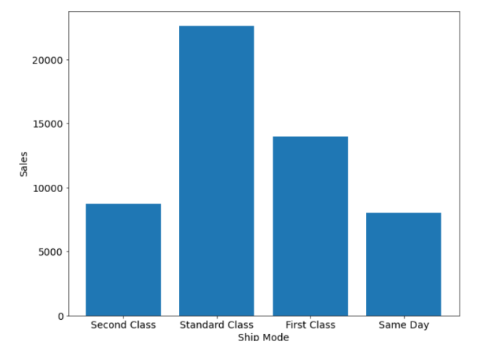
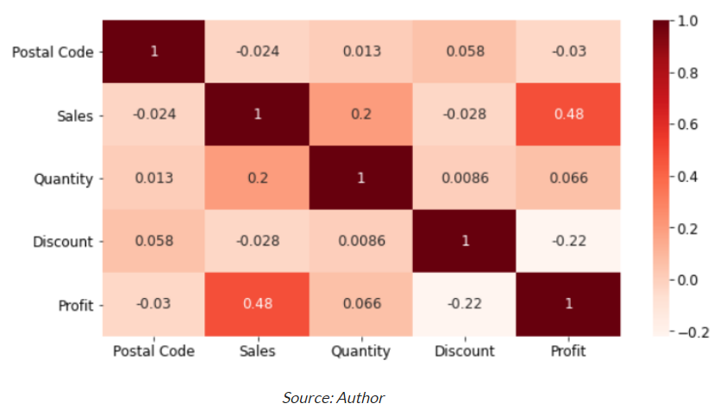

Slide 16
Results
1. Customer Segmentation Results:
- Identified distinct customer segments based on demographics, purchasing behavior, or geographic location.
- Analyzed the characteristics and preferences of each segment, such as high-value customers, frequent purchasers, or price-sensitive customers.
2. Sales Analysis Results:
- Identified sales trends over time (monthly, quarterly, yearly) and identified peak seasons or periods of high demand.
- Analyzed the performance of different product categories and identified top-selling and underperforming products.
- Explored correlations between sales and factors like region, customer segment, or product attributes.
3. Profitability Analysis Results:
- Calculated profit margins for different products and product categories to identify the most profitable and least profitable items.
- Analyzed the impact of discounts, shipping costs, or other factors on profitability.
- Identified opportunities to optimize pricing strategies, reduce costs, or improve overall profitability.
4. Customer Behavior Analysis Results:
- Analyzed customer purchasing patterns, such as frequency, recency, and monetary value, to understand customer loyalty and lifetime value.
- Identified factors influencing customer churn and developed strategies for customer retention.
- Explored cross-selling and upselling opportunities based on market basket analysis and product association.
5. Recommendations and Insights:
- Provided actionable recommendations to improve sales, profitability, and customer satisfaction based on the analysis results.
- Proposed strategies for targeted marketing campaigns, product promotions, or customer retention initiatives.
- Highlighted potential areas for process optimization, inventory management, or supply chain efficiency improvements.

Slide 17
links
Drive:- https://drive.google.com/drive/folders/1UlhtU9-L_q-4JcVCdd6lbWjxP_j3s0tI?usp=drive_link
Github Repo:- https://github.com/RAVULAKANAKAVIGNESH1/IBM_Project_Superstore_DataAnalytics
Google Colab:- https://colab.research.google.com/drive/1tw30TZrVZECmR85c49kpSLmGmkQedvDA
Research and Analysis:-
www.wikipedia.com
www.researchgate.com
www.academia.edu
https://www.kaggle.com/datasets/vivek468/superstore-dataset-final
https://skills.yourlearning.ibm.com/

Slide 18
THANK YOU

