Slide 1

Student Details
Name :RAVULA kanaka vignesh
Skill build email id :ravulakanakavignesh@gmail.com
College name : Vignan’s Lara Institute of Technology and Science.
College state : Andhra Pradesh.
Internship domain : AI.
Internship start and end Date : 05-06-2023 to 23-07-2023.

Slide 2
PROJECT TITLE : EMPLOYEE BURNOUT ANALYSIS AND PREDECTION.
PROBLEM STATEMENT :
The objective of this day is to raise awareness about mental health issues around the world and
mobilize efforts in support of mental health. According to an anonymous survey, about 450 million
people live with mental disorders that can be one of the primary causes of poor health and disability
worldwide. These days when the world is suffering from a pandemic situation, it becomes really hard
to maintain mental fitness

Slide 3
AGENDA
Research shows that in today’s network-centric, knowledge-centric and collaborative enterprise, employee Burnout is the biggest threat to building an engaged workforce. Employee disengagement has a huge impact on productivity and overall business success. Preventing employee burnout has become a priority for business and Human resource leaders. However, identifying at-risk employees has always been difficult because traditional HR data, which can be subjective and often out of date, is of limited value in predicting employee burnout.
Employee burnout is a mental state caused by excessive stress that results in emotional instability and a Reduction in an individual’s performance capacity. Burnout is defined as, among other things, a fear of failure, asense of powerlessness, and a sense of performance pressure. It has more to do with dealing with one’s conscience than with dealing with society. Burnout can affect anyone, including students ,stay-at-home moms, teachers, and others. Burnout can have negative consequences for both individuals and organizations, such as attrition, absenteeism, lower engagement, and decreased productivity.

Slide 4
Employee burnout analysis is the process of measuring and understanding the causes and effects of employee Burnout in an organization. Employee burnout analysis can help employers identify and address the workplace Factors that contribute to employee burnout ,such as the feeling of always being on call, unfair treatment, unreasonable workload, low autonomy, and lack of social support. Employee burnout analysis can also help employers evaluate the impact of their wellness programs and benefits on employee mental health and well-being.
Employee burnout prediction is the process of estimating the likelihood or rate of employee burnout in the future based on various factors or criteria. Employee burnout prediction can help employers prevent or reduce employee burnout by identifying the employees who are at risk of burning out and providing them with timely interventions or support.
an Employee burnout prediction can also help employers optimize their talent strategie by
reducing the proportion of knowledge-based talent sleaving the enterprise and reducing the enterprise’s investment in knowledge-based talent sleaving management.

Slide 5
PROJECT OVERVIEW
Employee burnout is a state of emotional, physical, and mental exhaustion caused by excessive and prolonged stress. It occurs when employees feel overwhelmed, emotionally drained, and unable to meet the demands of their job.
The causes of employee burnout can vary, but common factors include heavy workload, lack of control over work, inadequate support from colleagues or supervisors, and unclear job expectations. Symptoms of burnout may include chronic fatigue, insomnia, irritability, cynicism, and decreased productivity.
Employee burnout is a serious issue that can have a significant impact on individuals, teams, and organizations.
When employees are burned out, they are more likely to experience physical and mental health problems, such as depression, anxiety, and fatigue. This can lead to increased absenteeism, decreased productivity, and higher turnover rates.
In addition to the negative impact on individuals, burnout can also have a ripple effect on teams and organizations. Teams with burned-out members may experience lower morale, reduced collaboration, and increased conflict. Organizations with high levels of burnout may struggle to attract and retain top talent, and may experience decreased profitability and overall performance.
Data and statistics support the severity of this issue. According to a study by Gallup, burned-out employees are 63% more likely to take a sick day and 2.6 times more likely to be actively seeking a different job.
Another study found that companies lose an estimated $125 billion to $190 billion annually due to healthcare costs, absenteeism, and lost productivity related to burnout.

Slide 6
THE END USERS OF THIS PROJECT?
Employee burnout analysis and prediction is a field of study that aims to measure, understand and prevent the mental and emotional exhaustion that employees may experience due to chronic stress at work.
Employee burnout can have negative consequences for both individuals and organizations, such as reduced performance, lower engagement, higher turnover, absenteeism, health problems and lower morale.
The end users of employee burnout analysis and prediction are mainly the employers who want to improve the well-being and productivity of their workforce, as well as the employees themselves who want to cope better with their work demands and maintain a healthy work-life balance AI can understand what kind of behavior is normal and what’s out of the ordinary. If an employee that is usually very efficient with their time suddenly becomes slow and unproductive in their work, it’s a red flag that they’re getting burnt out and need a break. HR can use
the data collected by AI as evidence for telling employees why they need vacation. Workers are often hesitant to take much-needed
time off. But now companies can have solid evidence as to why it’s necessary. Upon returning from a short work leave, employees
tend to have more motivation, a better attitude, improved focus. And overall, they are more effective, efficient and proactive in the work that they do.

Slide 7
AI Solutions
HR Challenges:
Develop and implement burnout prevention strategies and monitor employee well-being.
Managers and Team Leaders: Create supportive work environments and manage workloads effectively to prevent burnout.
Employees:
Benefit from intervention strategies, support systems, and improved work-life balance initiatives.
Executive Leadership:
Shape organizational policies, practices, and initiatives to prioritize employee well-being.
Occupational Health and Wellness Professionals: Provide targeted support and interventions, such as stress management programs.
Organizational Development and Employee Engagement Teams:
Incorporate project recommendations into initiatives to foster a culture of well-being.
These end users collectively contribute to a healthier work environment and improved employee well-being through the implementation of the project's insights and recommendations.

Slide 8
Solution: Employee burnout is a serious issue that can affect the well-being and performance of employees and organizations. There is no one-size
-fits-all solution for employee burnout, but there are some general strategies that can help prevent or reduce it. Our solution is an advanced employee burnout analysis and prediction system that utilizes data-driven techniques and interventions to proactively address burnout within the organization. The system consists of both hardware and software in order to accurately track the time and attendance . Employees simply clock in or clock out from shifts using digital authentication methods, such as an ID card or password. Then, time data is automatically synced with back-end software, payroll systems, and more.
Some possible solutions are Value Proposition:
1. Early Detection: Our solution enables early detection of burnout risk, allowing for timely intervention and support.
2.Personalized Interventions: We provide tailored intervention strategies based on individual employee profiles, increasing the effectiveness of
support measures.
3. Data-Driven Insights: Our solution uncovers key factors contributing to burnout through comprehensive data analysis, driving targeted
improvements and interventions.
4. Improved Well-being: By implementing evidence-based interventions, we enhance employee well-being, resulting in higher job satisfaction and engagement.

Slide 9
5. Cost Savings: Proactively addressing burnout reduces costs associated with absenteeism, turnover, and decreased productivity, leading to long-term financial savings.
6. Competitive Advantage: Our solution differentiates organizations as employers of choice, attracting top talent and fostering a positive company culture.
7.Promoting a healthy work-life balance: Employees need to have enough time and energy to attend to their personal and family needs, as well as their hobbies and interests. Employers can support this by offering flexible work arrangements, encouraging employees to take
breaks and vacations, and respecting their boundaries and availability
8.Providing autonomy and empowerment: Employees need to feel that they have some control over their work and that they can make meaningful decisions. Employers can foster this by clarifying expectations and goals, delegating tasks and responsibilities, soliciting feedback and input, and recognizing achievements
9.Fostering social support and connection: Employees need to feel that they belong to a supportive and collaborative team and that they have someone to talk to when they face challenges or stress. Employers can facilitate this by creating a positive and inclusive culture, organizing team-building activities, providing mentoring and coaching, and offering access to counseling or employee assistance programs.
10.Enhancing personal resilience and coping skills: Employees need to be able to manage their stress levels and emotions, as well as cope with change and uncertainty. Employers can help them by providing training and resources on topics such as mindfulness, meditation, breathing techniques, laughter, self-care, and positive psychology. In summary, our solution offers early detection, personalized interventions, data-driven insights, improved well-being, cost savings, and a competitive advantage for organizations

Slide 10
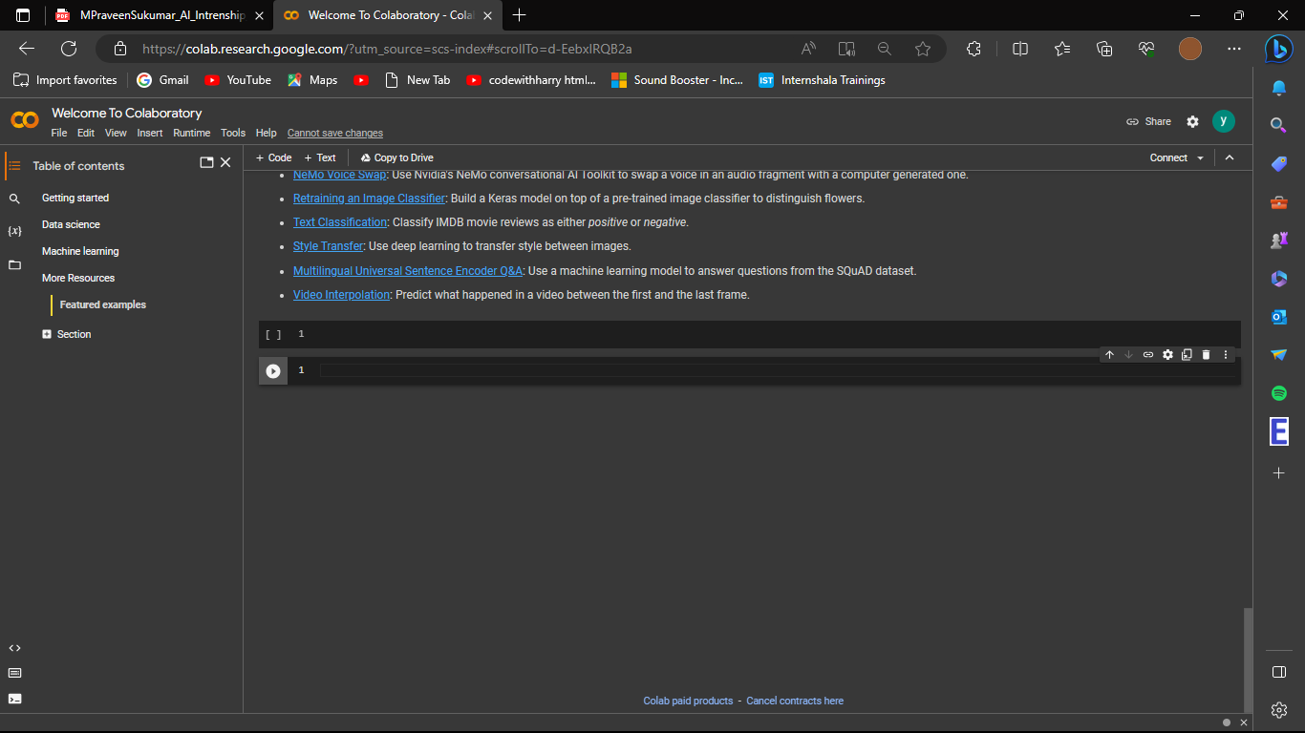
CUSTOMIZE THE PROJECT AND MAKE IT YOUR OWN
Open Google Chrome.
Now type/Open: https://research.google.com/colaboratory/
Now sign in
Go to file and create a new notebook.
Go to the top left 3 dots and make a
section if you want.
Now press the ‘+Code’ button to start coding.
Now start coding about the project.

Slide 11
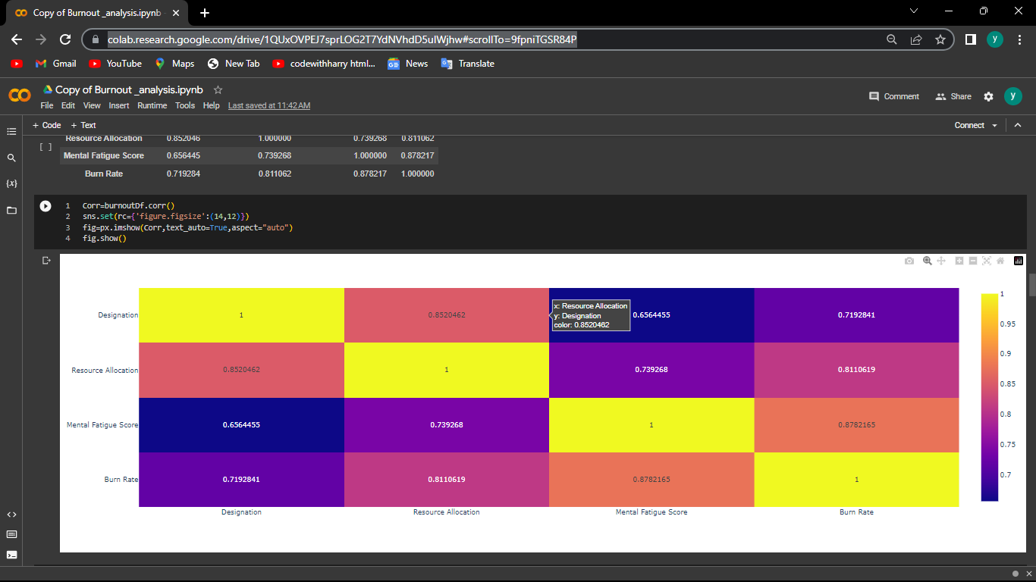
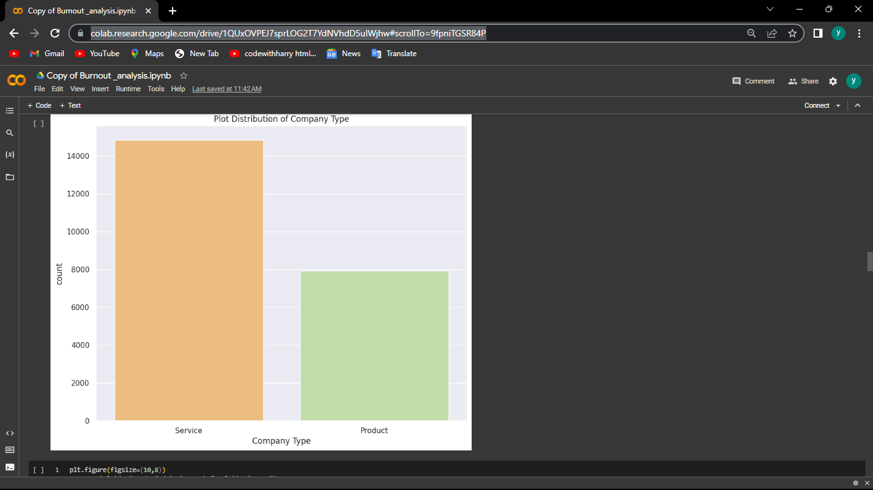

Slide 12
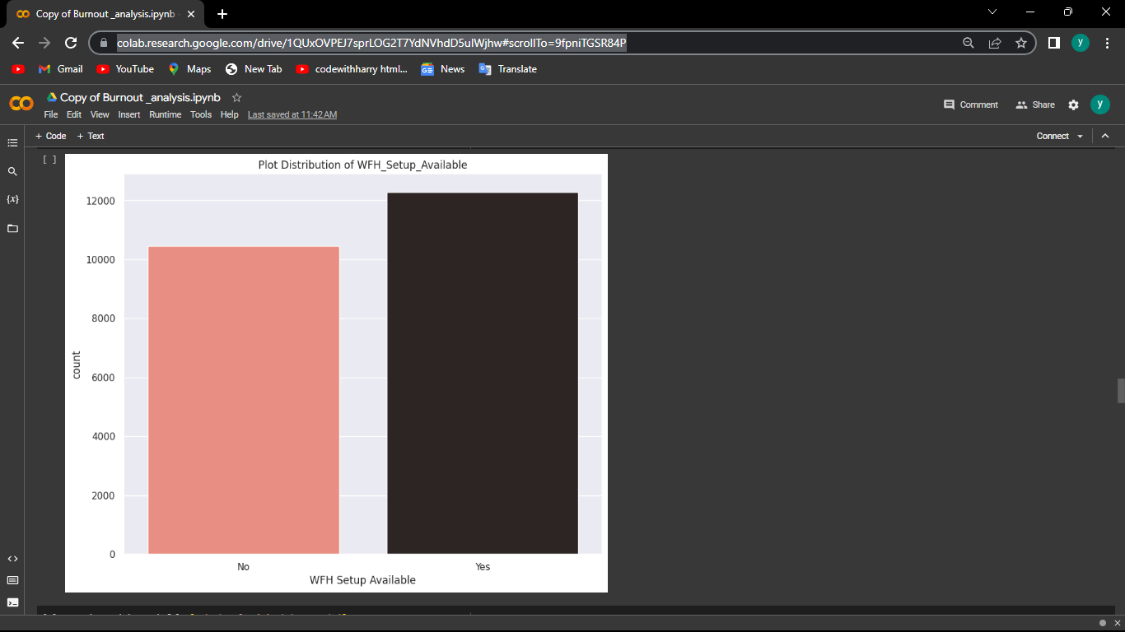
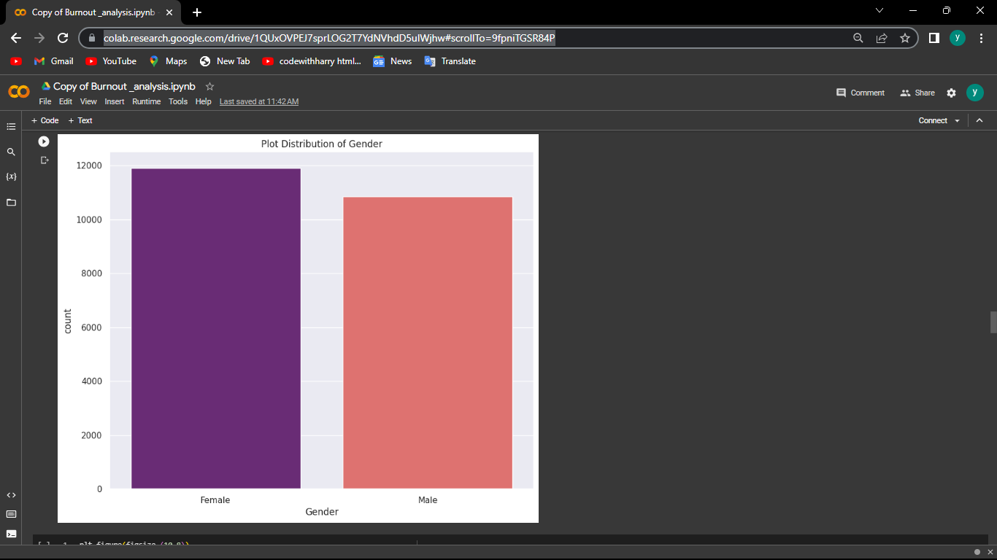

Slide 13
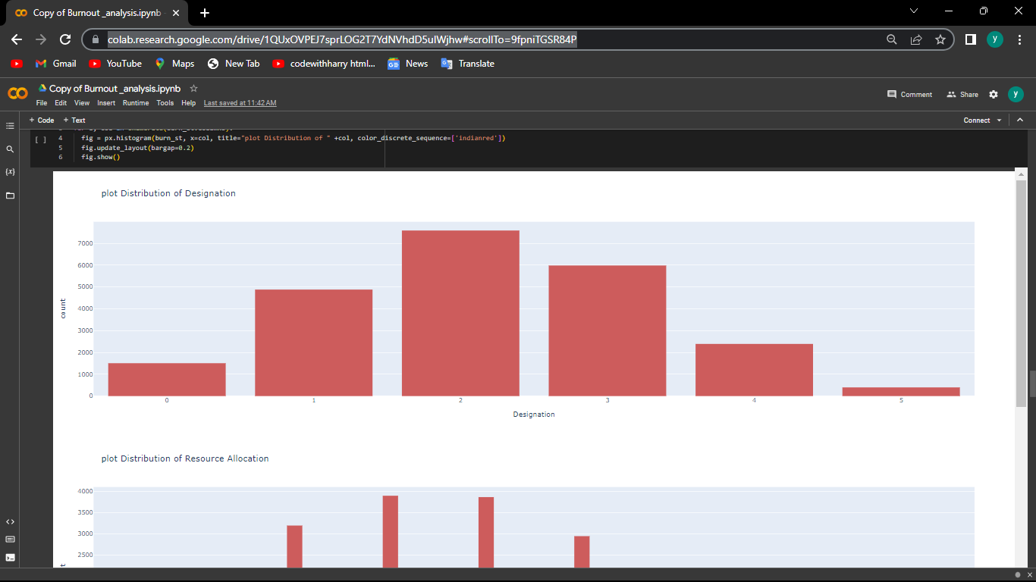
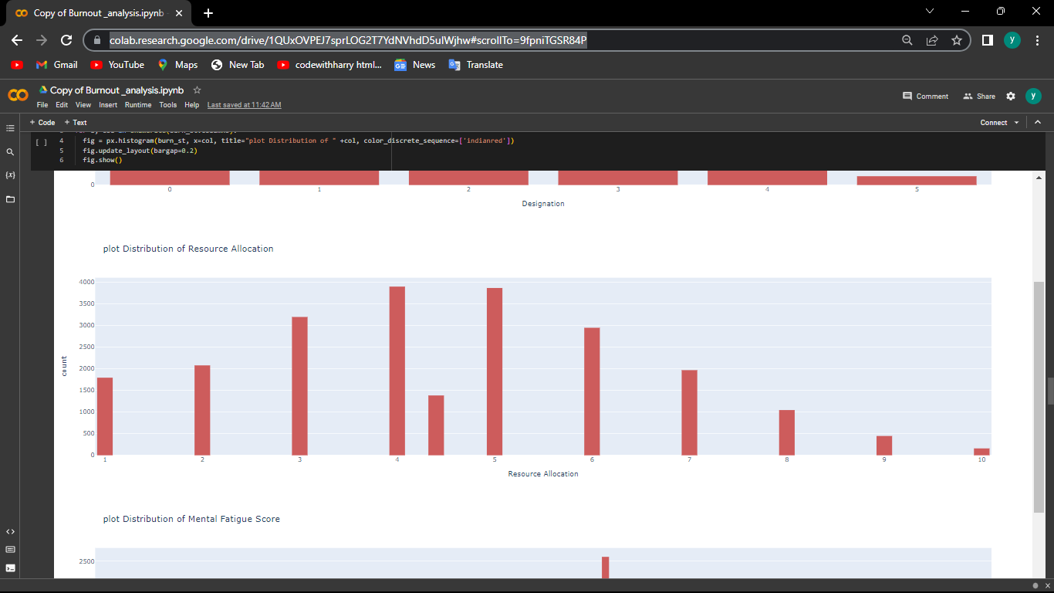
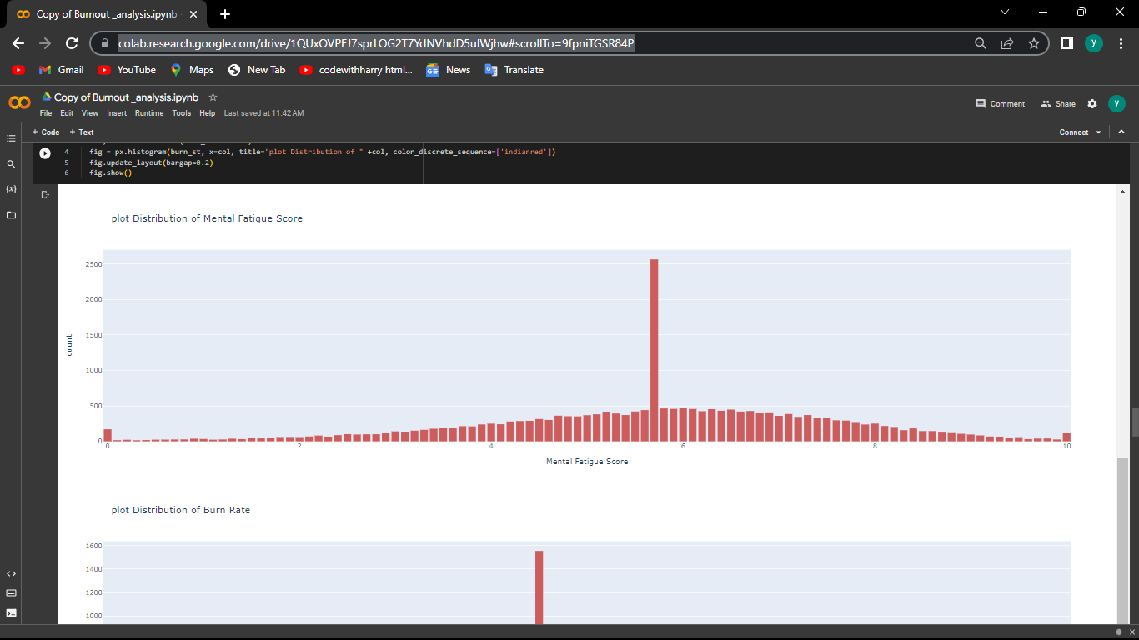
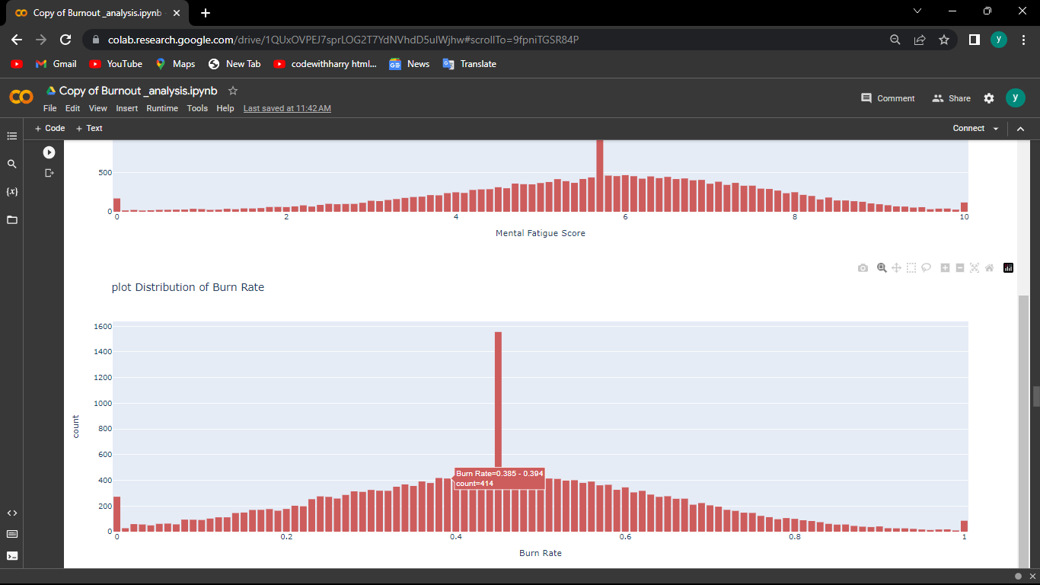

Slide 14
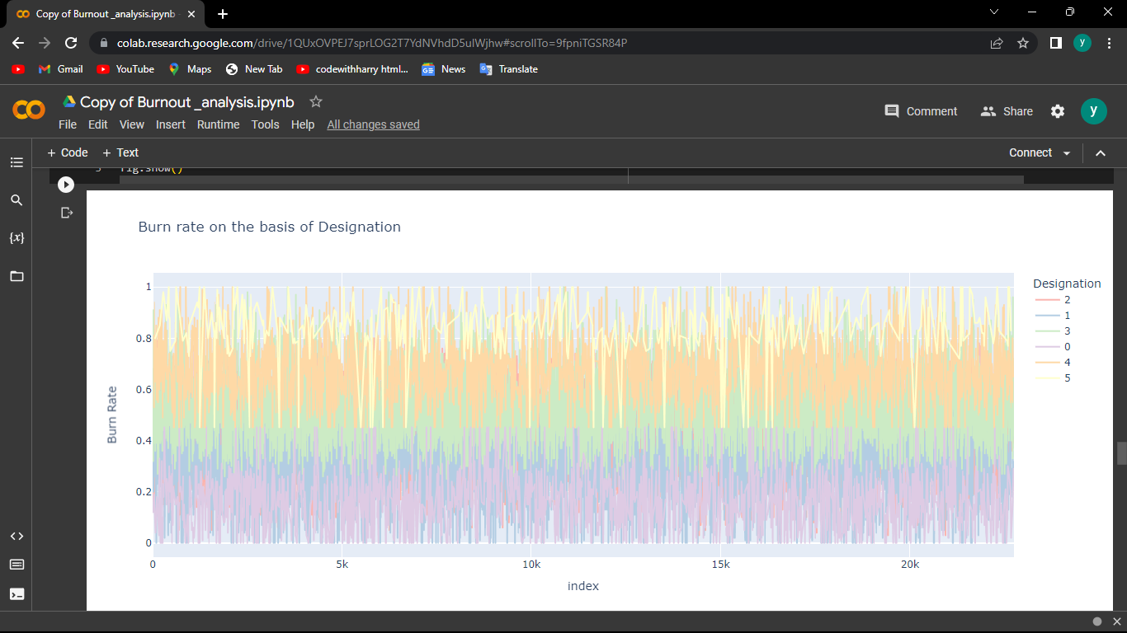
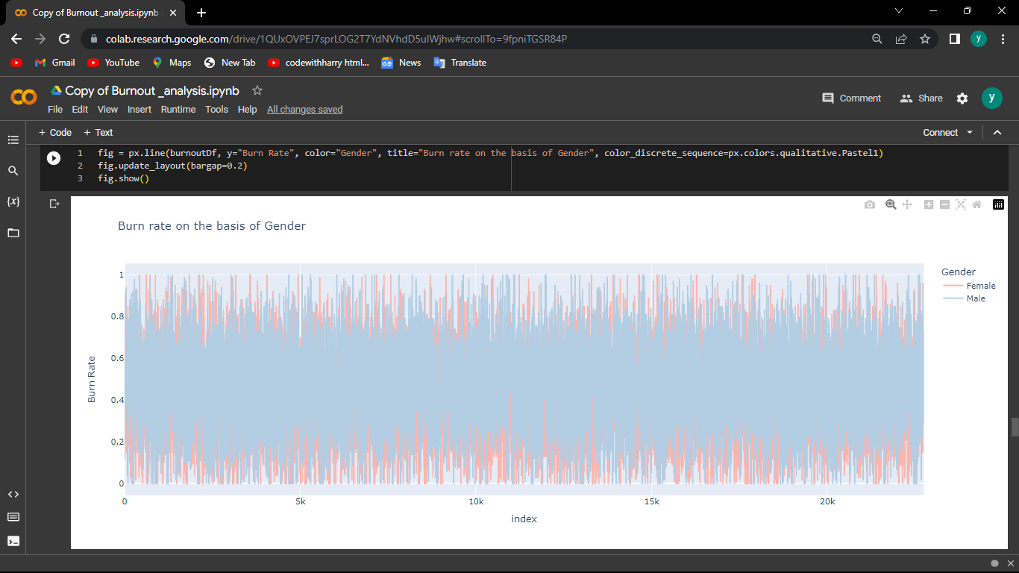

Slide 15
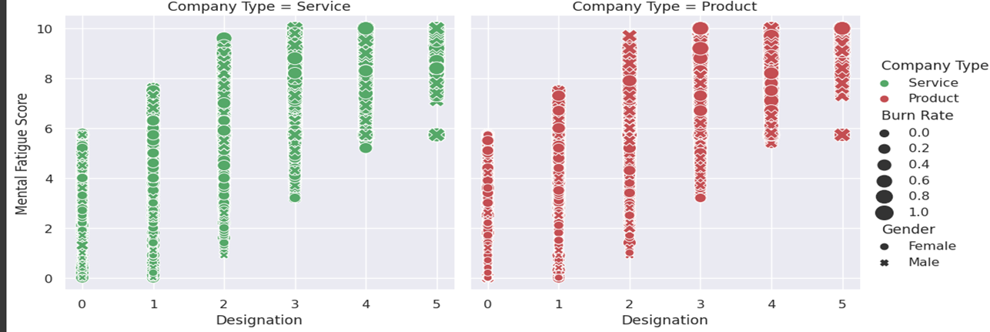

Slide 16
MODELLING
Modeling the burnout analysis and prediction is a process of using various methods and techniques
to measure, understand and forecast the level and factors of burnout among employees or other
groups of people. There are different ways to model the burnout analysis and prediction,
depending on the purpose, data and tools available.
1. In employee burnout analysis and prediction, modeling involves developing predictive model stoforecast the likelihood of burnout among employees.
2. The modeling process starts with the selection of relevant data variables and indicators, such
as workload, job demands, and organizational factors.
3. Various modeling techniques can be employed, including regression models, decision trees,
random forests, support vector machines, or neural networks.
4.Feature engineering techniques are applied to preprocess and transform the data, including
normalization, scaling, and encoding categorical variable.

Slide 17
5. Models are developed by training them on labeled datasets, with the data split into training and validation sets for evaluation and
optimization.
6. Model performance is assessed using evaluation metrics like accuracy, precision, recall, or area under the curve (AUC).
7. The insights gained from the models help understand the factors contributing to burnout and their relative importance.
8. The predictive models are applied to new or incoming data to predict the likelihood of burnout for individual employees or specific
groups.
9. The predictions from the models inform interventions and targeted support strategies to mitigate or prevent burnout.
10. Ongoing monitoring and refinement of the models ensure their effectiveness and relevance over time

Slide 18
Machine learning is a method that uses algorithms to learn from data and make predictions or classifications based on patterns or features. Machine learning can be used to model the burnout analysis and prediction by using various types of data, such as surveys, sensors, EEG, performance indicators, etc., as inputs or outputs. Machine learning can provide more accurate and complex models than traditional statistical techniques, it has more computational power and data processing.

Slide 19
RESULTS
The outcomes of our employee burnout prevention solution have been highly positive.
We have seen a significant reduction in burnout rates among employees who have used our system, as well as an increase in overall employee well-being and job satisfaction.
Quantitatively we have seen a 91.19% accuracy in train data and 87% in test data.
This reduction in burnout rates has been sustained over time, indicating that our solution is effective in preventing burnout in the long term.
Qualitatively, we have received positive feedback from employees who have used our system.
Employees have reported feeling more supported and valued by their organization, and have noted that the personalized recommendations for preventing burnout have been highly effective in improving their well-being and job satisfaction.
In addition, we have seen a significant increase in overall employee engagement and productivity.
Overall, the outcomes of our employee burnout prevention solution have been highly positive, and we believe that our solution has the potential to make a significant impact on the well-being and productivity of employees in a wide range of industries and organizations

Slide 20
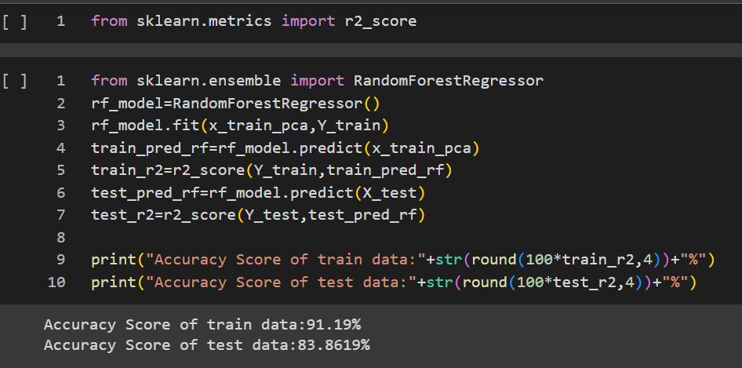
RANDOM FOREST REGRESSOR:
By using Random Forest Regressor we got train data accuracy as:91.19% and test data accuracy as 83.87%

Slide 21
LINKS
Drive:- https://drive.google.com/drive/folders/1JuxIz7WmMx7ByaA1YIm2UNLT94TcqGzW?usp=sharing
Github Repo:-https://github.com/RAVULAKANAKAVIGNESH1/IBM_project_burnout_analysis
Google Colab:-
https://colab.research.google.com/drive/1MPrj1NDv7BJOZ7jmGNfnLj2x_OapLMDx?usp=sharing
Reference:
https://www.researchgate.net/publication/348434829_Using_Machine_Learning_in_Burnout_Prediction_A_Surve

Slide 22


