Slide 1
INDOOR AIR QUALITY
TEAM NAME: FUSION BRAINS
TEAM MEMBERS: R. TEJA SRI
V. VARSHITHA NAGA SRI
K. VARSHITHA

Slide 2
Why Monitor Indoor Air
People spend 90% of their time indoors
Poor indoor air causes headaches, asthma, fatigue, respiratory issues
No real-time, low-cost solutions for home/small spaces
Lack of awareness and action in day-to-day life

Slide 3
Our Smart Solution
IoT-based system using ESP32
Measures temperature, humidity, and air quality
Sends data to ThingSpeak Cloud
Live dashboard built using HTML + CSS
Buzzer alert system for harmful air conditions

Slide 4
Core Components Used:
ESP32 – Wi-Fi-enabled microcontroller for data transmission
DHT11 Sensor – Measures temperature & humidity
MQ2 Sensor – Detects smoke, LPG, CO
Buzzer – Alerts when harmful gas levels are high
Breadboard & Jumper Wires – For hardware connections
Software used:
Arduino IDE (C++) – For writing and uploading code
ThingSpeak – IoT cloud platform to store and visualize sensor data
HTML, CSS, JavaScript – For designing a custom web-based dashboard

Slide 5
System Overview
Steps:
User logs into HTML page
ESP32 reads sensor values
Sends data to ThingSpeak every few seconds
Web dashboard displays live data
Buzzer alerts when air quality is bad

Slide 6
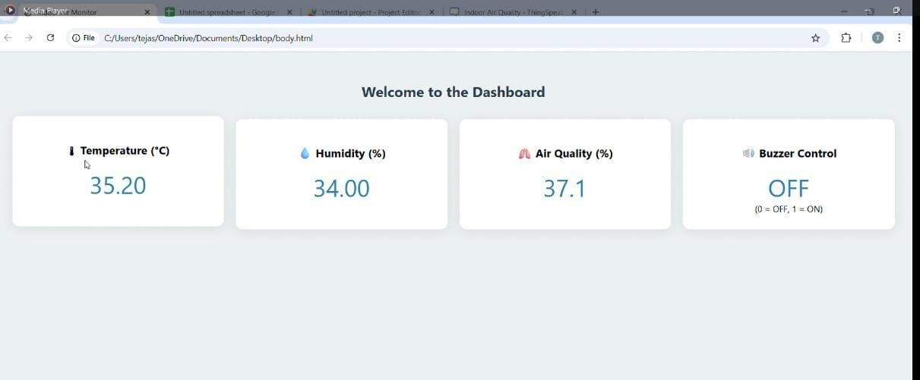

Slide 7
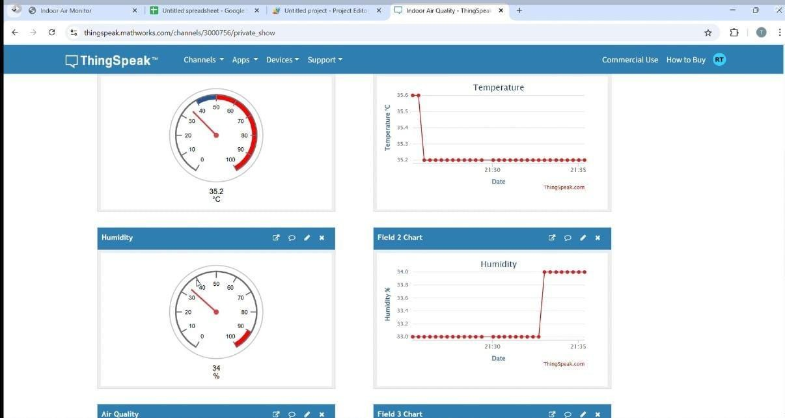

Slide 8
Conclusion
We developed a smart, affordable, and real-time air quality monitoring system using IoT.
Our solution helps create awareness about indoor pollution and encourages people to take action for a healthier lifestyle.
With live data, alerts, and a simple dashboard, anyone can use it — even in homes, hostels, or classrooms.
We’ve gained hands-on experience in sensors, cloud platforms, and frontend development.
This project shows how technology can solve real-world health problems.

