Slide 1


AIClub

Slide 2
AI Project Cycle

Slide 3
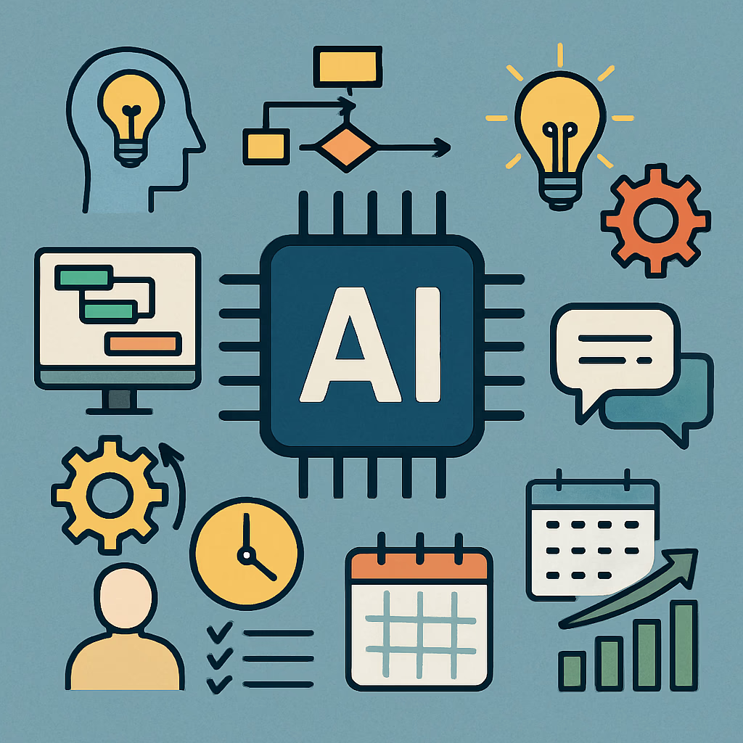
What is AI Project Cycle?
AI Project Cycle is a step-by-step process used to build an AI-based solution. It helps us:
Solve real-world problems
Use data effectively
Build intelligent systems

Slide 4
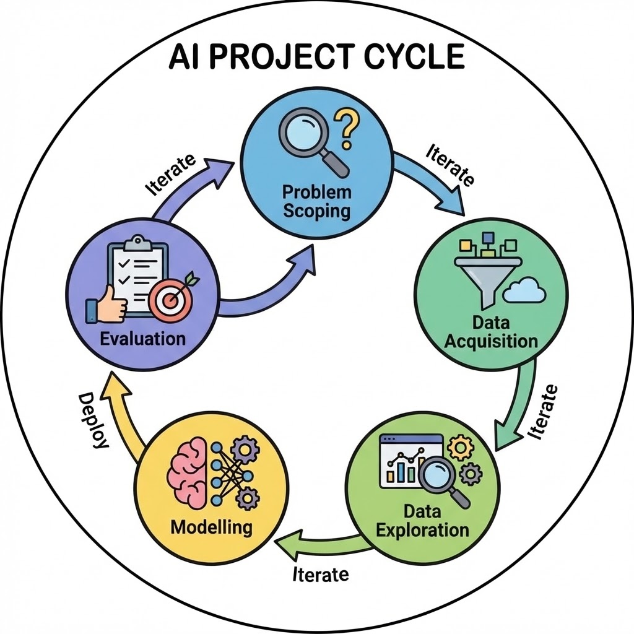
The 5 Stages of AI Project Cycle
AI Project Cycle has 5 stages:
1. Problem Scoping 2. Data Acquisition 3. Data Exploration 4. Modelling 5. Evaluation
Each stage is connected and important.

Slide 5

Stage 1 – Problem Scoping
Problem Scoping means clearly defining the problem. Before building AI, we must understand:
What is the problem?
Who is affected?
Why is it important?

Slide 6
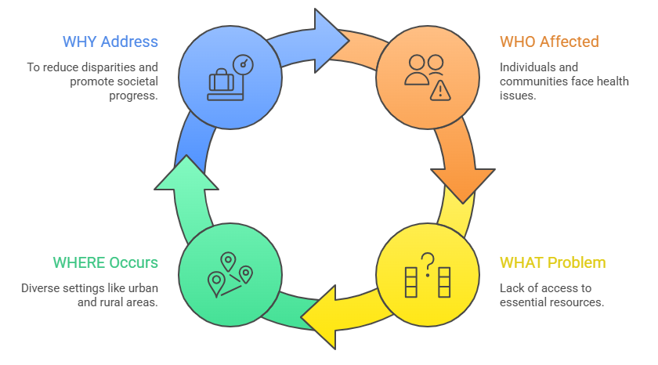
4Ws Framework
WHO – Who is affected?
WHAT – What is the problem?
WHERE – Where does it occur?
WHY – Why is it important?
A clear problem leads to a better solution.

Slide 7

Stage 2 – Data Acquisition
Data Acquisition means collecting relevant data related to the problem.
AI systems learn from data.
Without data, AI cannot work.

Slide 8
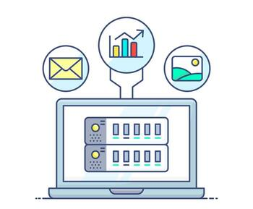
Types & Sources of Data
Types:
Structured (tables, numbers)
Unstructured (images, videos, text)
Sources:
Surveys
Sensors
Cameras
Websites
Databases

Slide 9

Stage 3 – Data Exploration
Data Exploration means analyzing the collected data to find patterns and trends.
We check:
Missing values
Error
Trends
Relationships

Slide 10
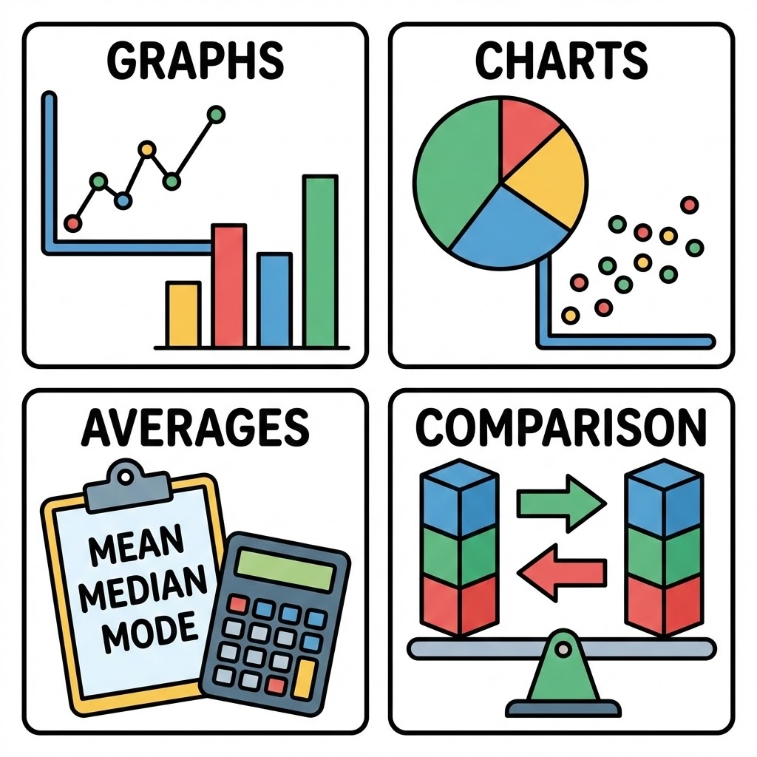
Tools Used in Data Exploration
Graphs
Charts
Averages
Comparison.
Goal: Understand data before building model.

Slide 11
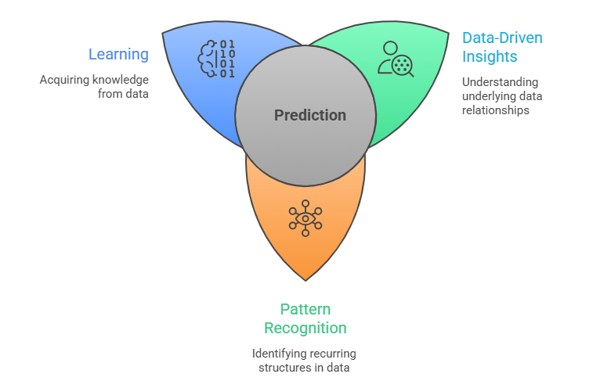
Stage 4 – Modelling
Modelling means building an AI model using Machine Learning.
The model:
Learns from data
Finds patterns
Makes predictions

Slide 12

Training & Testing
Training:
AI learns from past data.
Testing:
AI is tested using new data.
If performance is poor, improve model.

Slide 13

Stage 5 – Evaluation
Evaluation means checking whether the AI model works correctly.
We measure:
Accuracy
Efficiency
Reliability

Slide 14

Improving the Model
If model is not accurate:
Collect more data
Improve data quality
Change algorithm
AI Project Cycle is iterative (repeats until improvement).

Slide 15
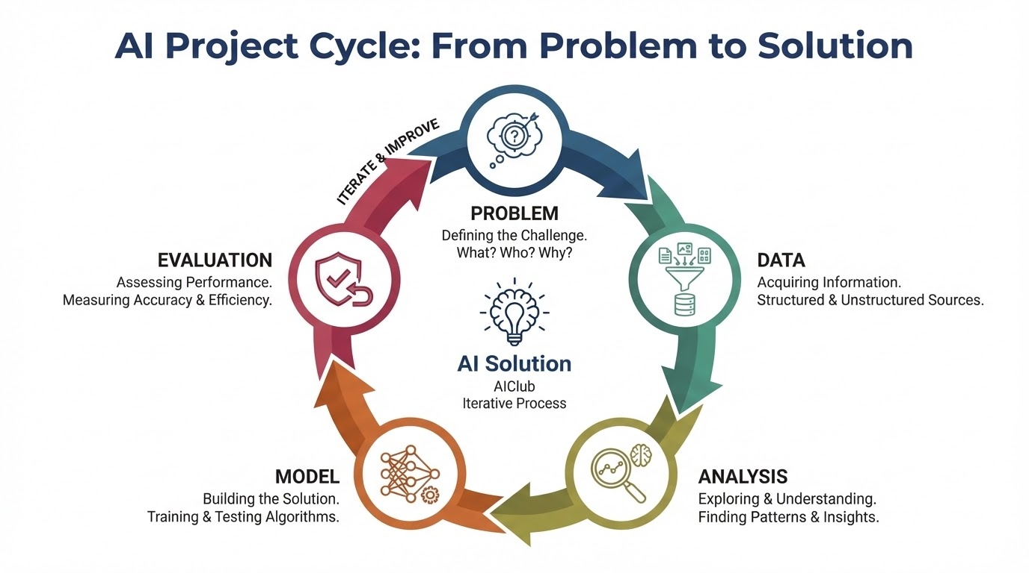
Complete Flow Diagram

Slide 16
Key Takeaways
✅ AI Project Cycle has 5 stages
✅ Each stage is important
✅ Data is central to AI
✅ The process is iterative

Slide 17



THANK YOU
info@pyxeda.ai
https://aiclub.world

