Slide 1


AIClub

Slide 2
Introduction to Artificial Intelligence and Machine Learning

Slide 3
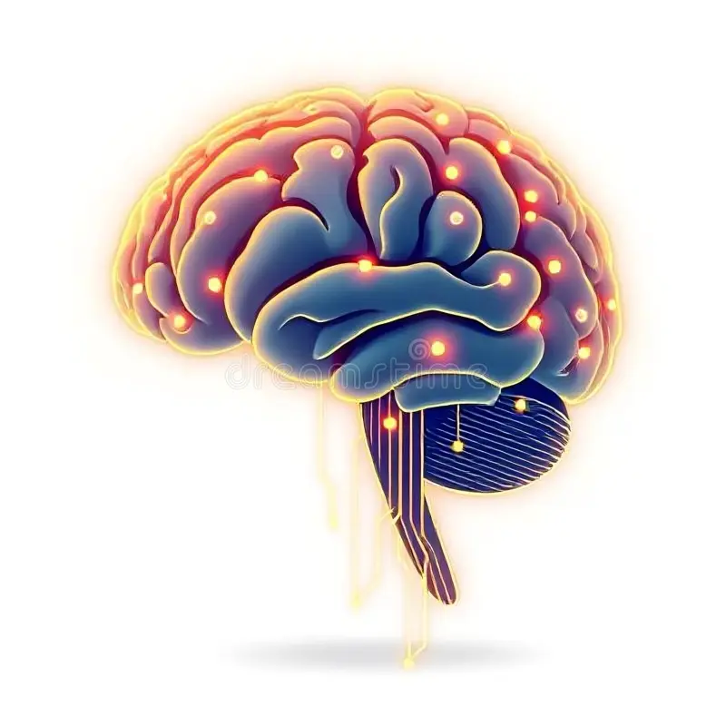
What is Intelligence?
Ability to learn
Ability to reason
Ability to solve problems
Ability to adapt

Slide 4
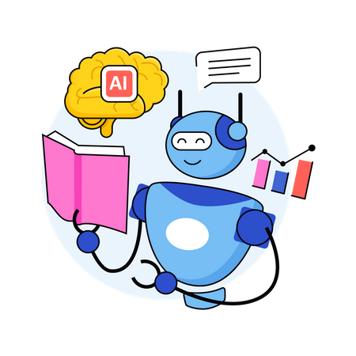
What is Artificial Intelligence (AI)?
Artificial Intelligence is the ability of machines to perform tasks that normally require human intelligence.

Slide 5
What is Artificial Intelligence (AI)?
Artificial Intelligence is the ability of machines to perform tasks that normally require human intelligence.
Examples:
Face unlock
Google Maps
Chatbots
Recommendation systems

Slide 6
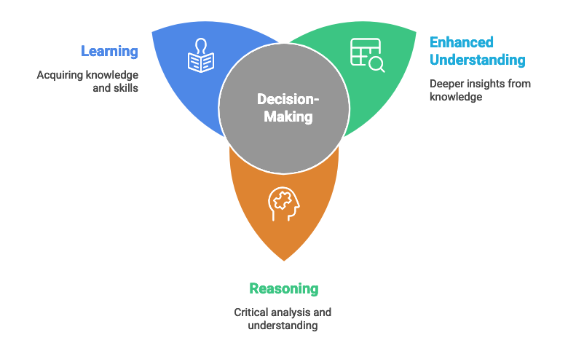
Formal Definition of AI
Artificial Intelligence is a branch of computer science that enables machines to mimic human intelligence such as learning, reasoning, and decision-making.
Key Words Highlighted: ✔ Learning ✔ Reasoning ✔ Decision-making

Slide 7
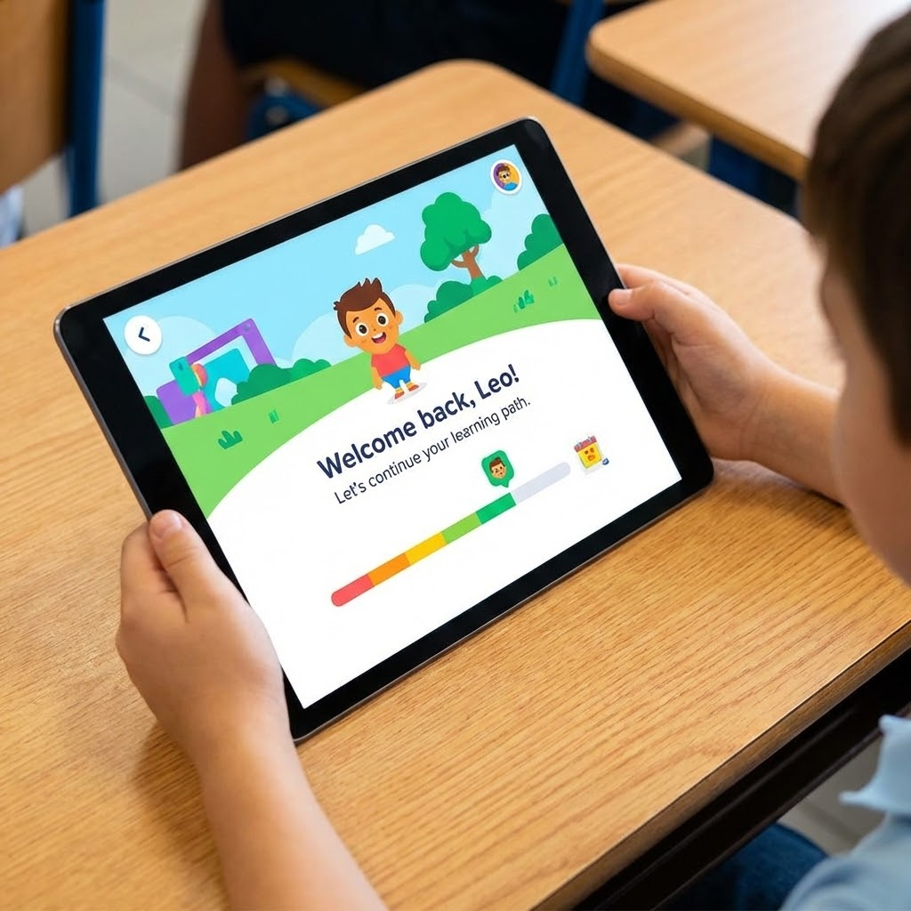
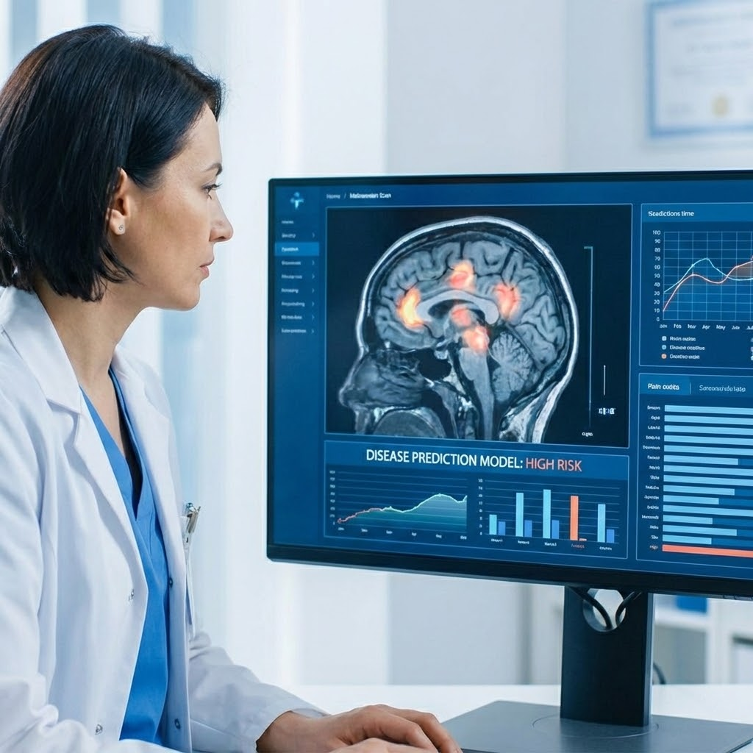
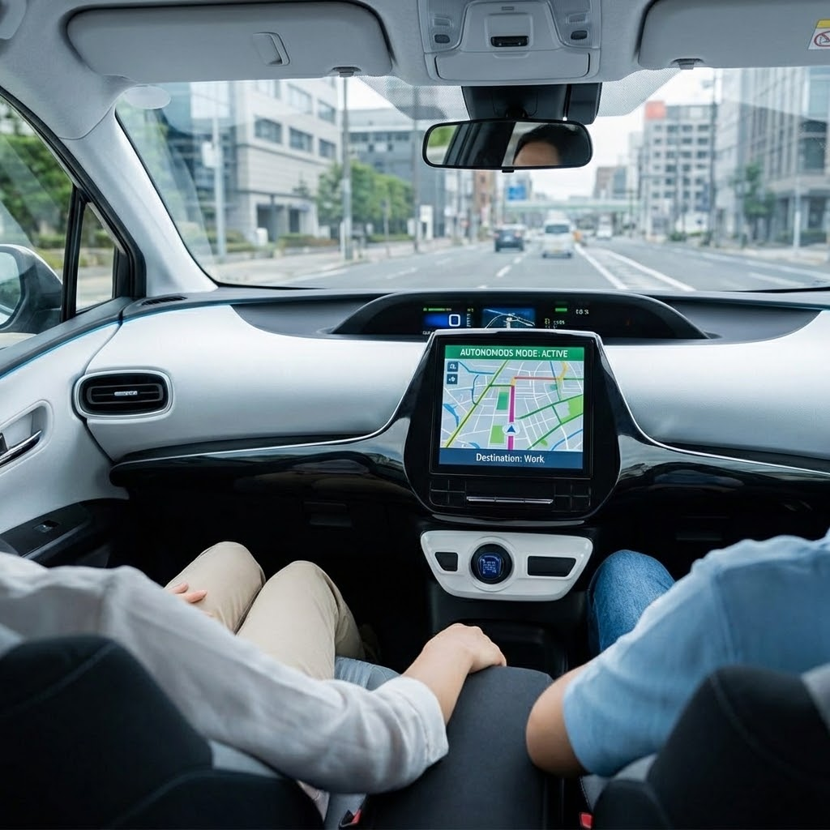
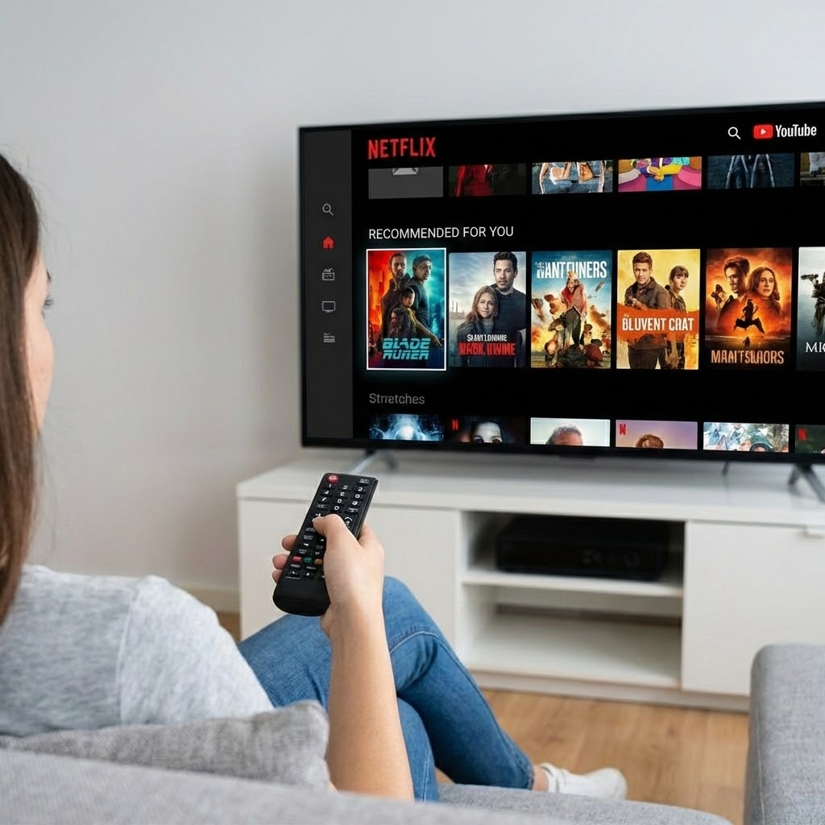
Real-Life Applications of AI
Education (Personalized learning apps)
Healthcare (Disease prediction)
Transportation (Self-driving cars)
Entertainment (Netflix/YouTube recommendations)

Slide 8
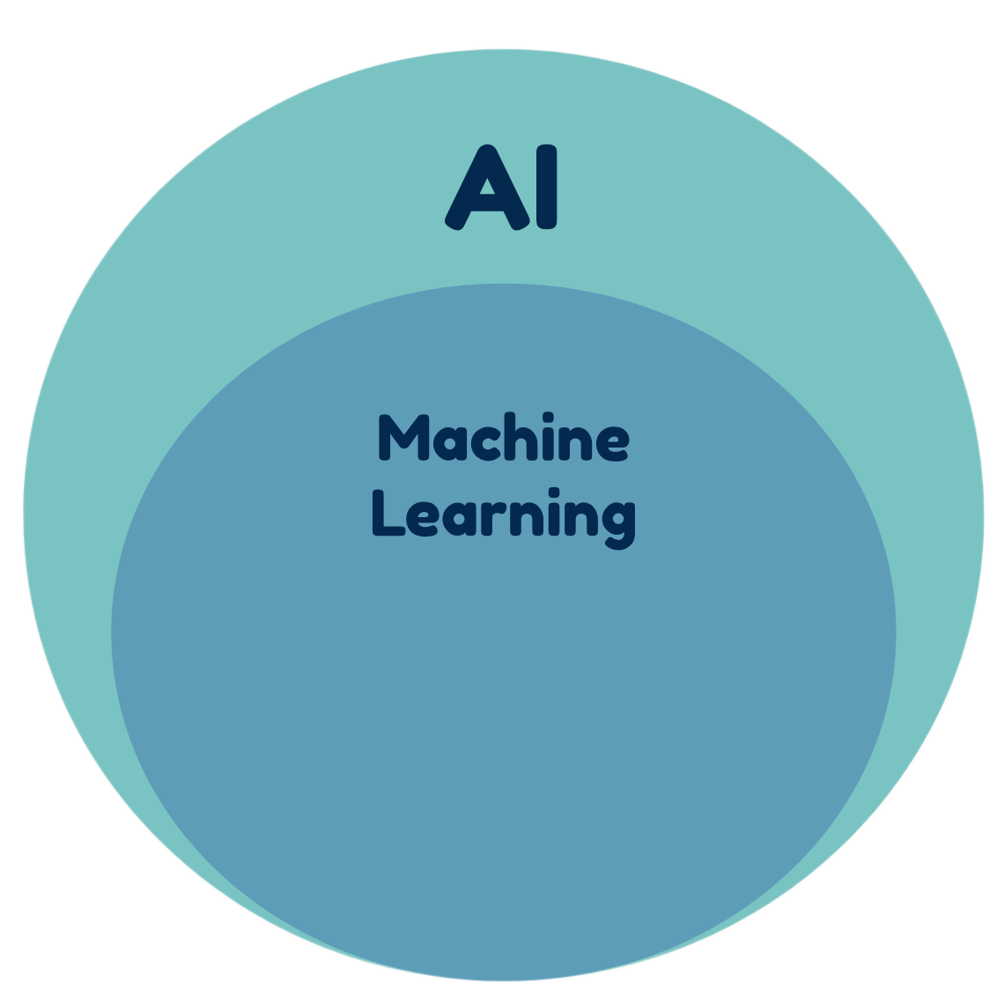
What is Machine Learning (ML)?
Machine Learning is a subset of AI that allows machines to learn from data and improve without being explicitly programmed.
Important Point:
AI is a big concept
ML is one way to achieve AI

Slide 9
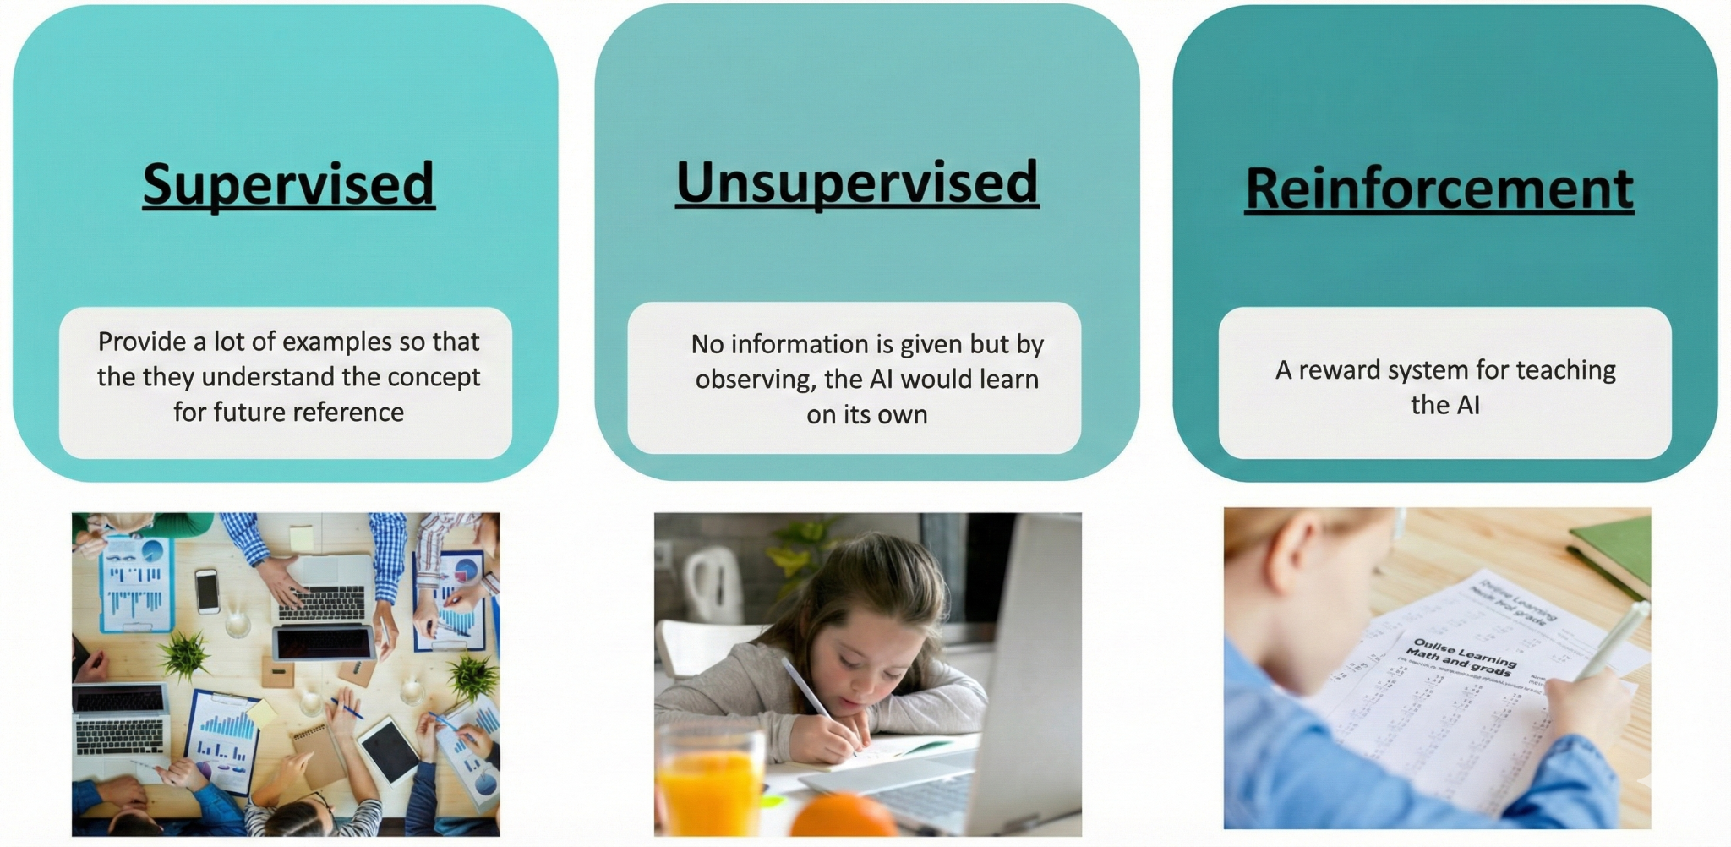
Types of Machine Learning

Slide 10
AI vs Machine Learning
Artificial Intelligence
Broad concept
Makes machines intelligent
Can be rule-based
Machine Learning
Subset of AI
Helps machines learn from data
Always data-driven

Slide 11
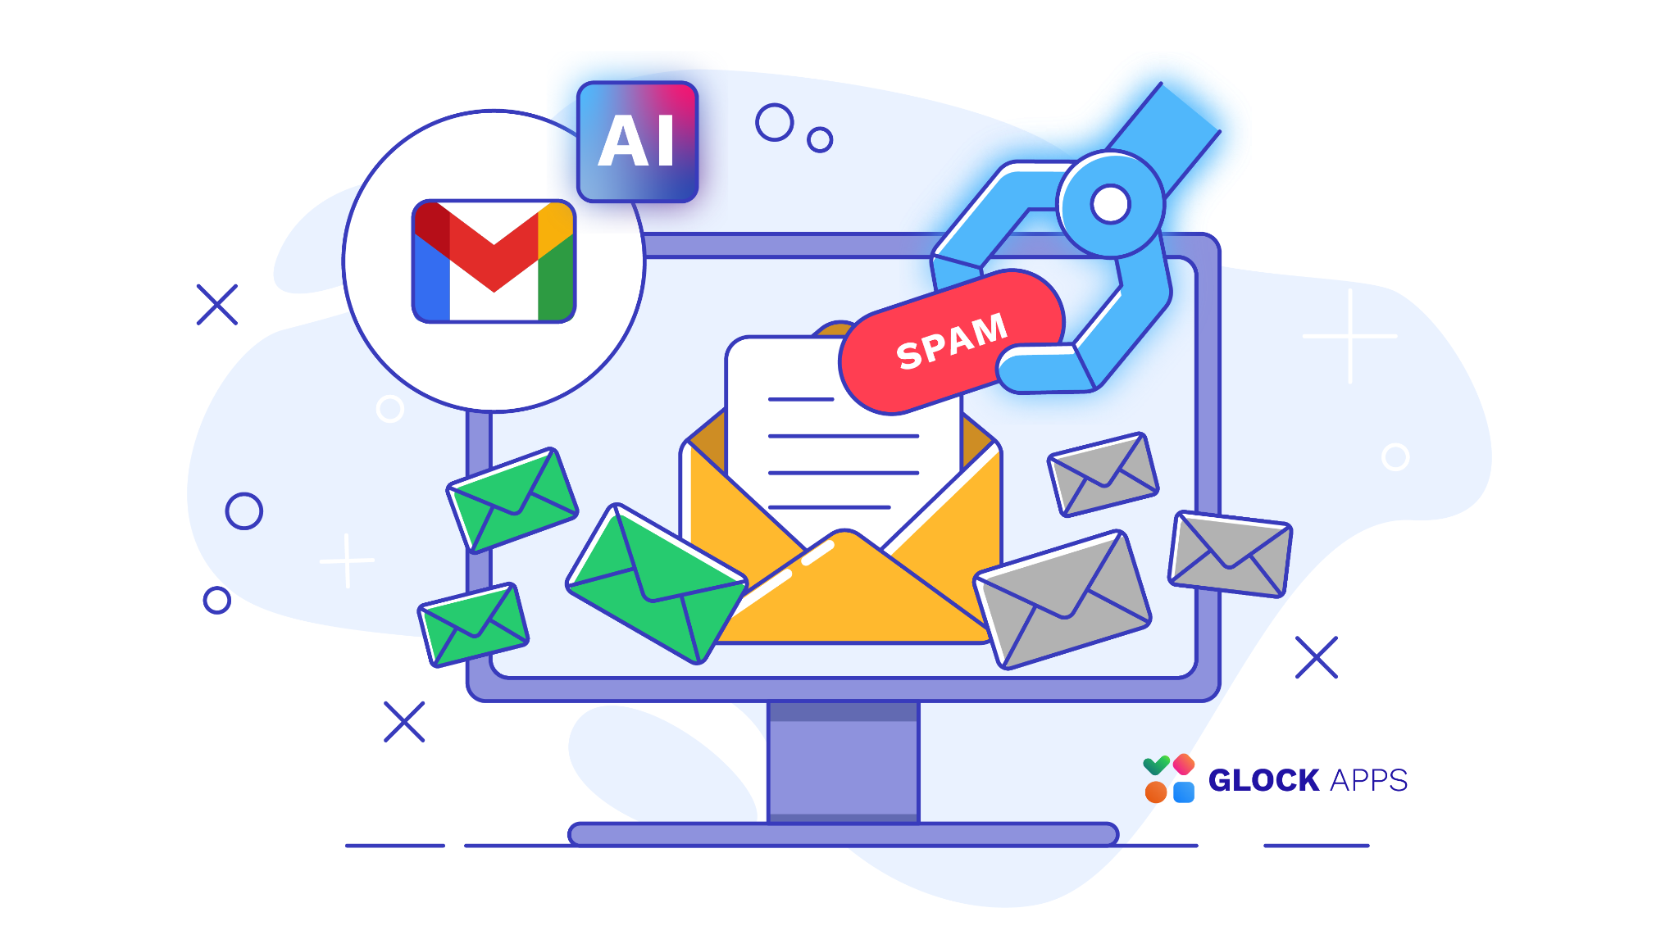
Example to Understand ML
Example: Spam Email Filter
Instead of manually writing rules, the system learns from thousands of spam emails.
It improves over time.
Working flow:
Data → Pattern → Prediction

Slide 12
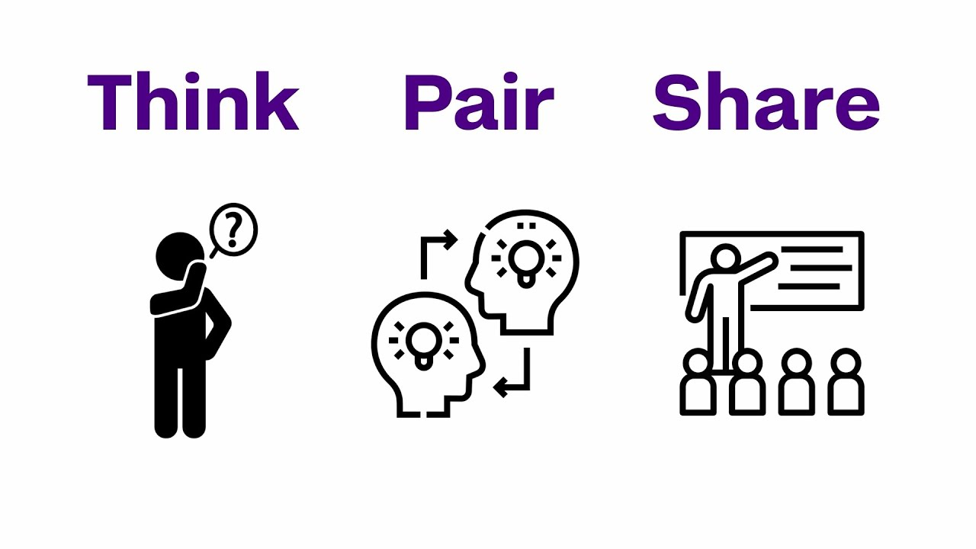
Quick Classroom Activity
Think–Pair–Share
Identify whether the example is:
AI
ML
Both

Slide 13
Quick Classroom Activity
Think–Pair–Share
Identify whether the example is:
AI
ML
Both
None
Examples:
Calculator
Face Recognition
Auto-correct
Netflix Recommendation
Chess-playing computer

Slide 14



THANK YOU
info@pyxeda.ai
https://aiclub.world

