Slide 1


Welcome to
AI Introduction
Level -1

Slide 2
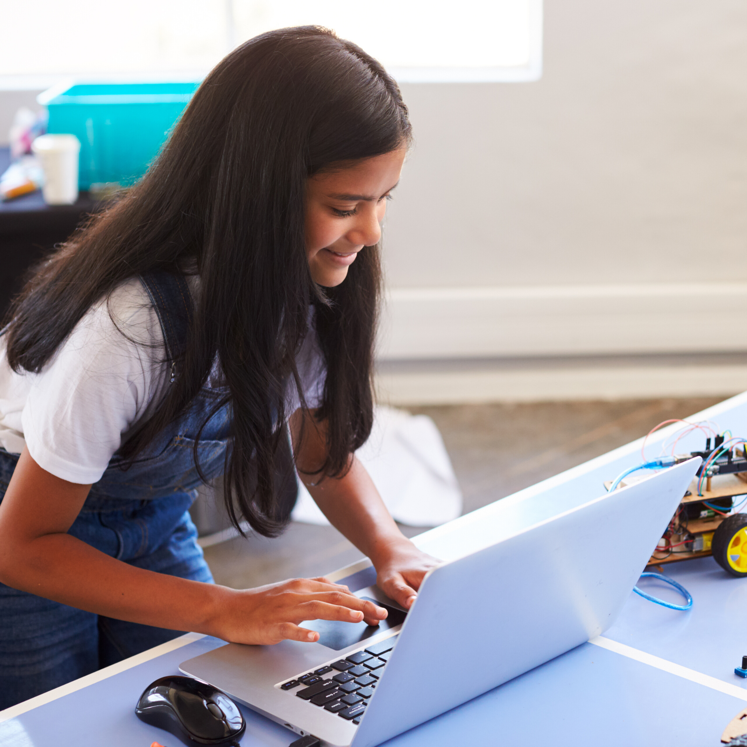
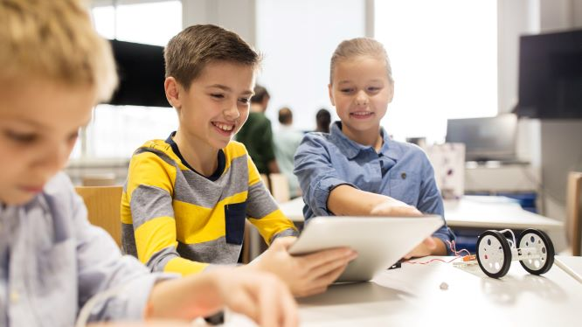
What is AI?

Slide 3

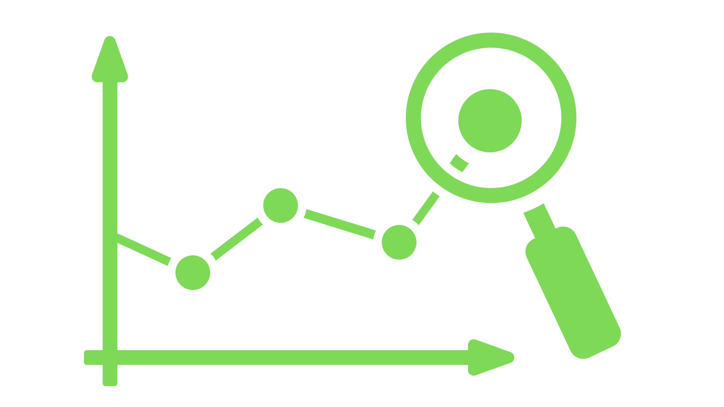





Make decisions and other things that human brains do
Recognize sound
Predict futures
Detect anomalies
Recognize images
Decide strategies
Classify types
Play games

Slide 4
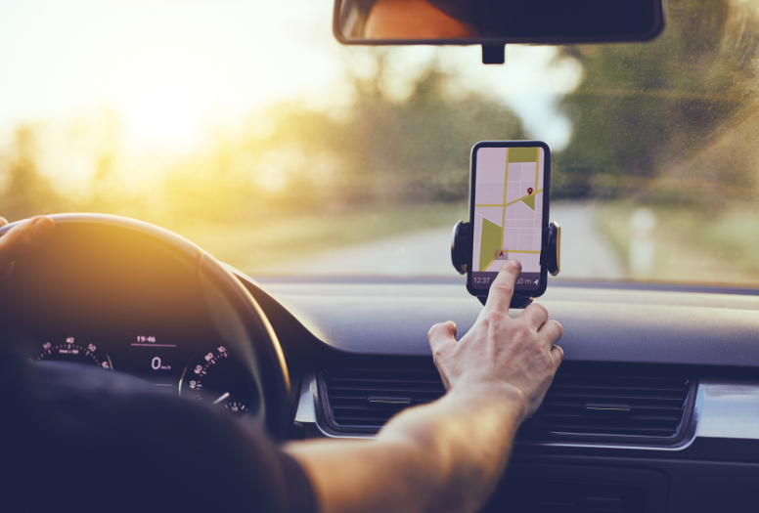
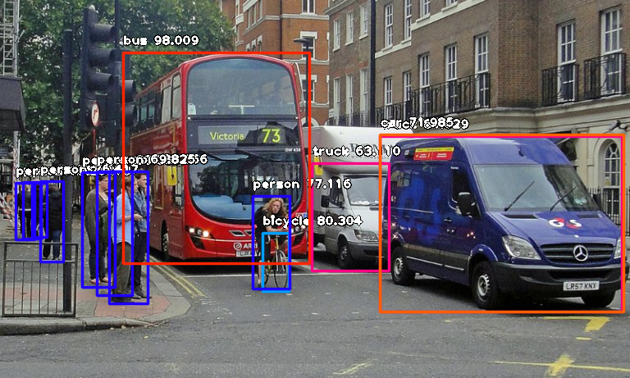
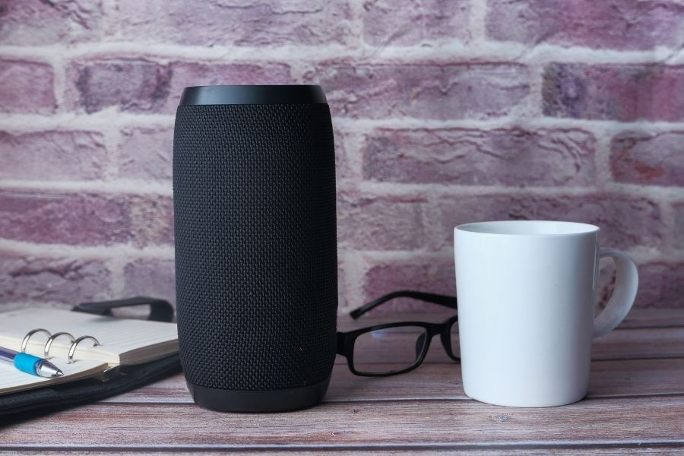

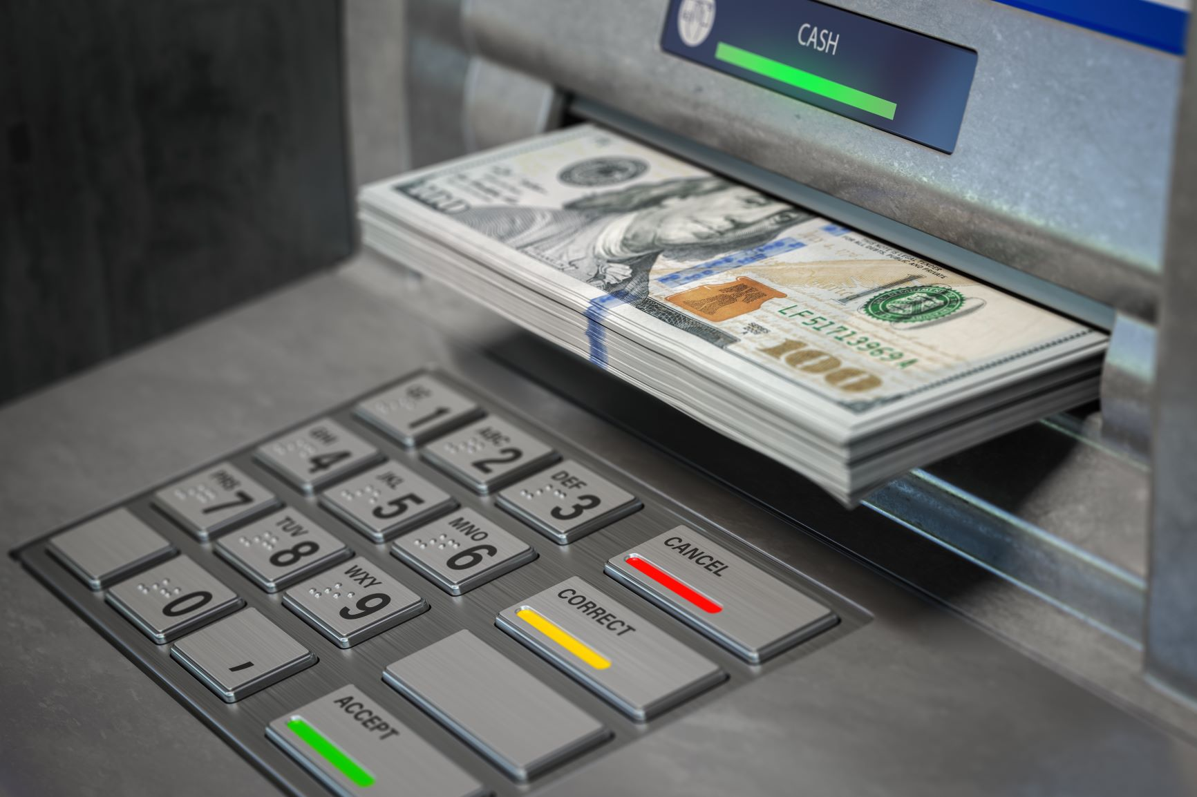

AI in real life

Slide 5

Thank you!
aiclub.world

