Slide 1


Welcome to
Types of AI Learning

Slide 2

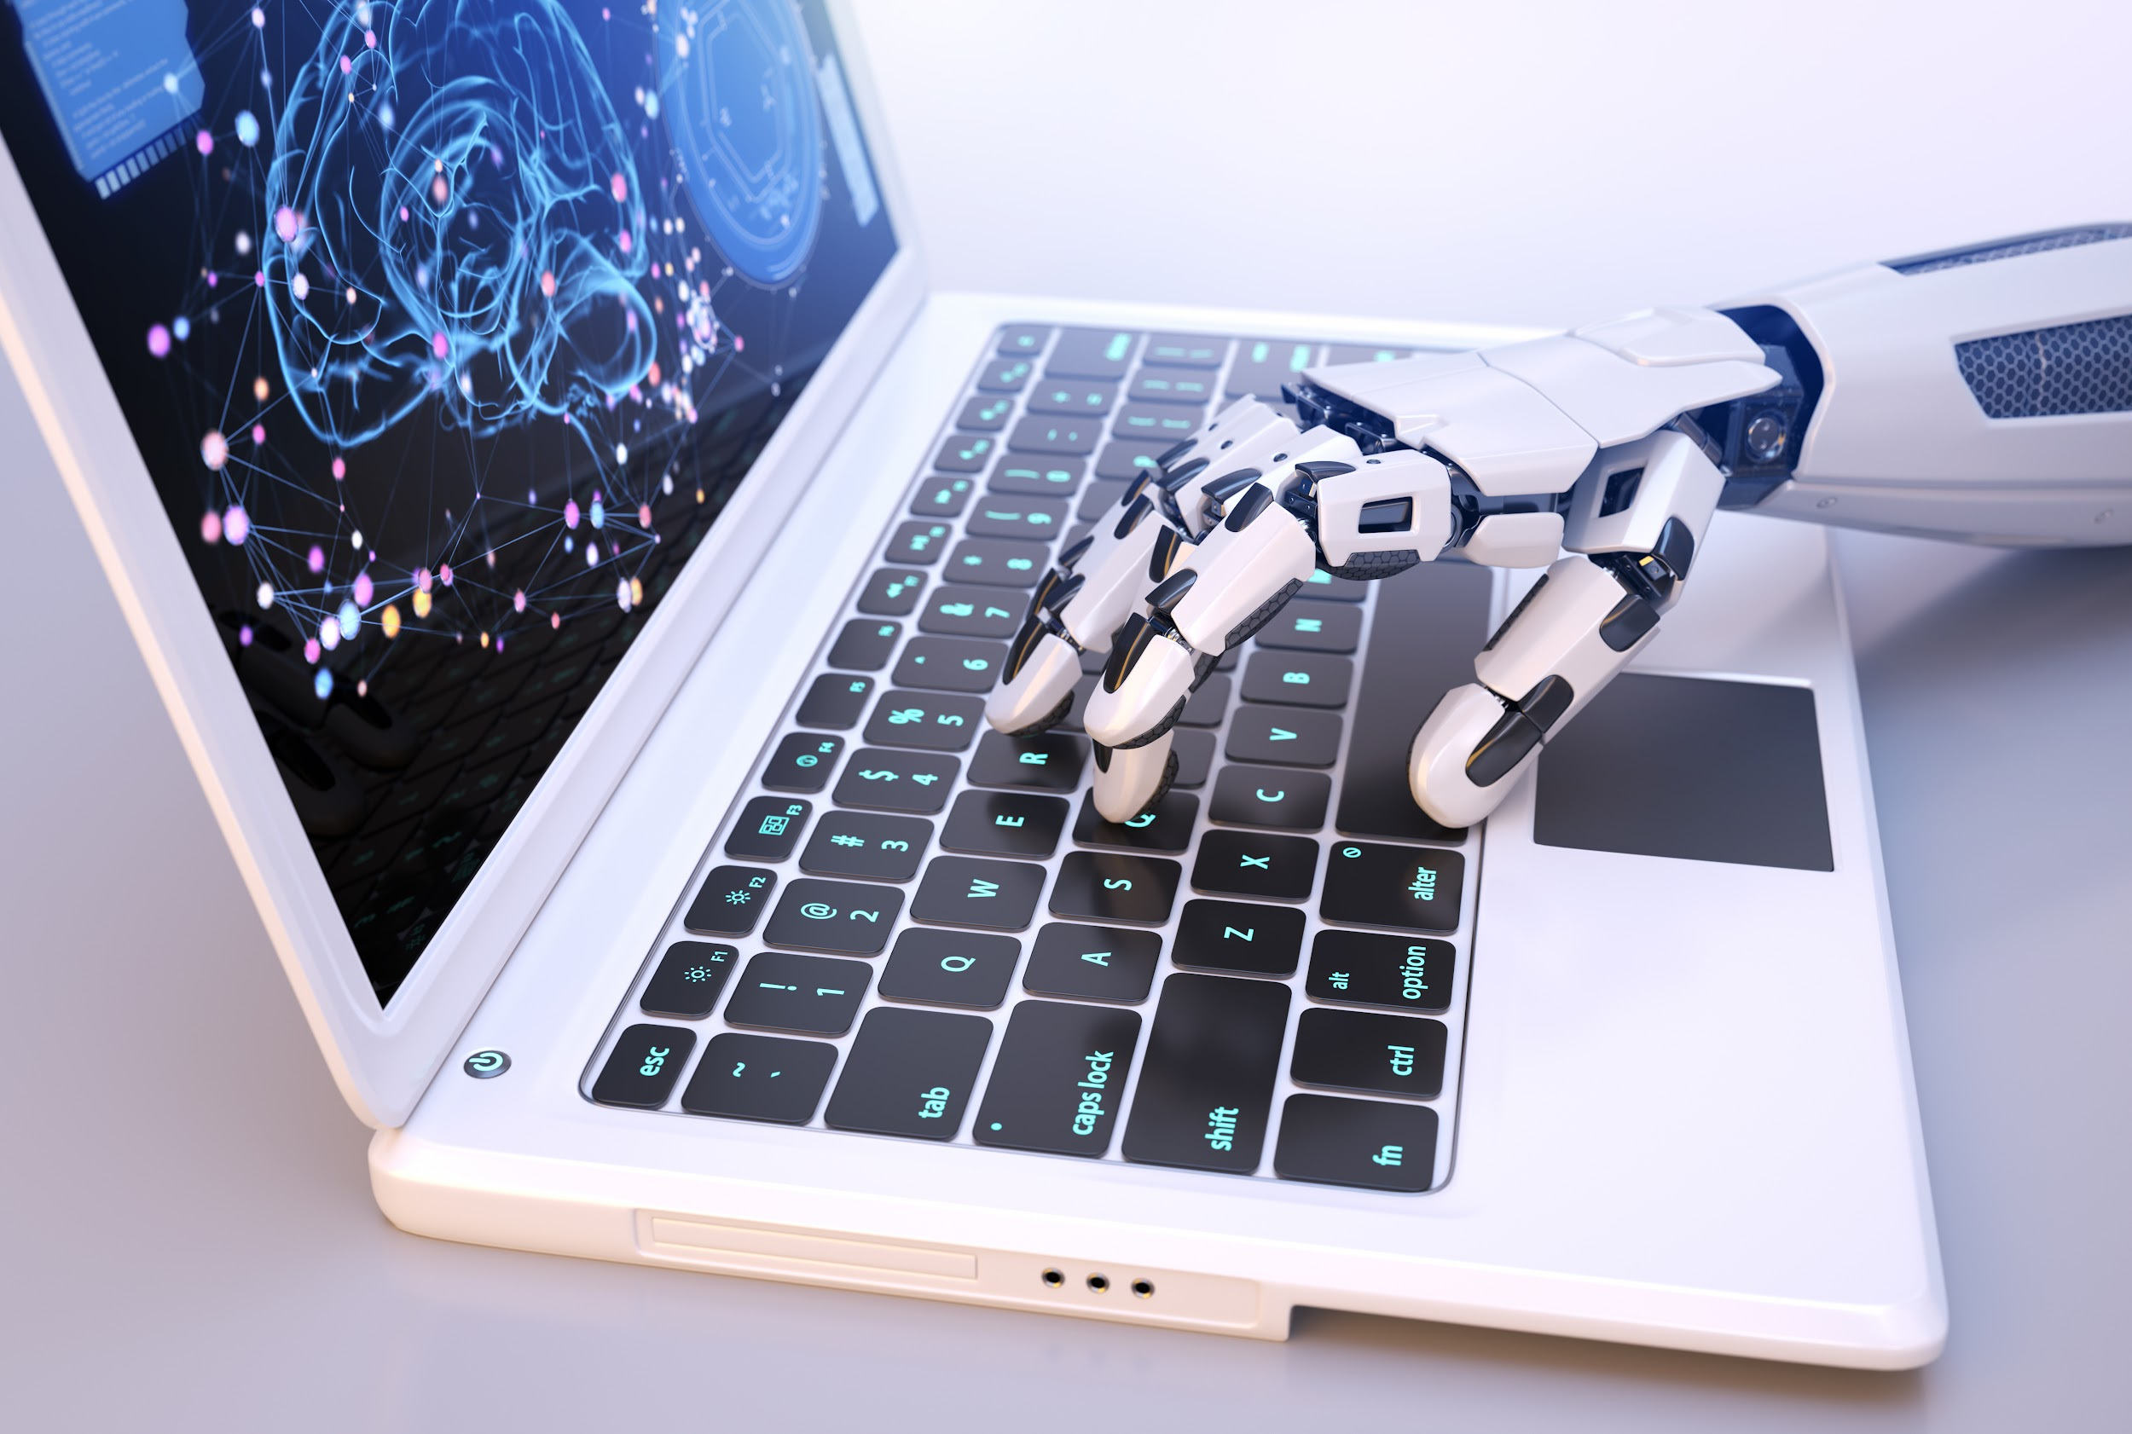
Types of Learning

Slide 3
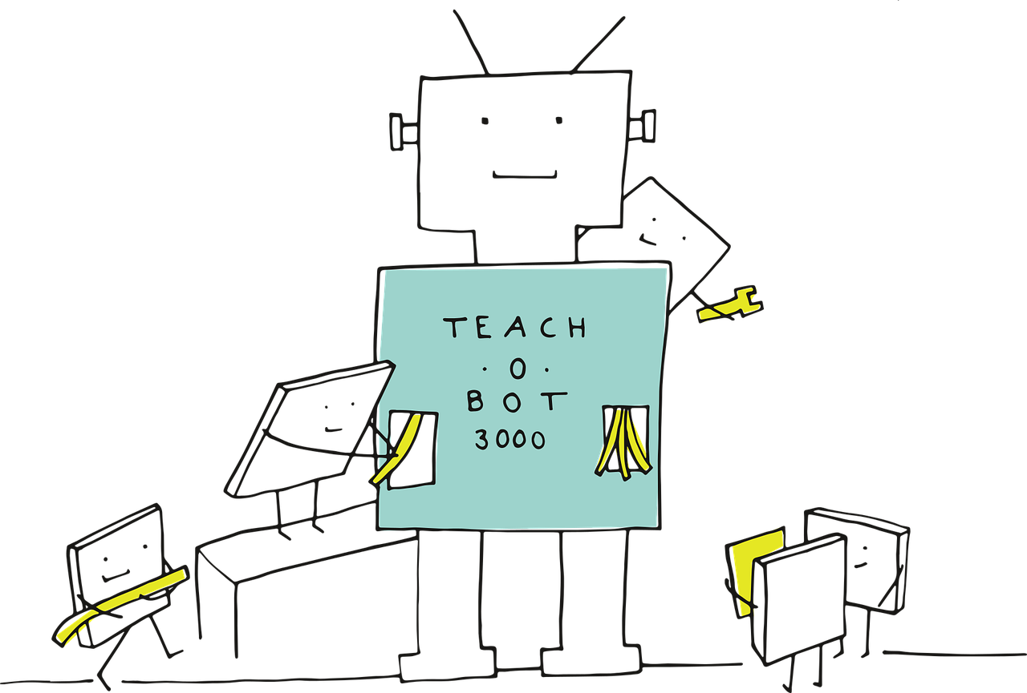
AIs learn in different ways

Slide 4
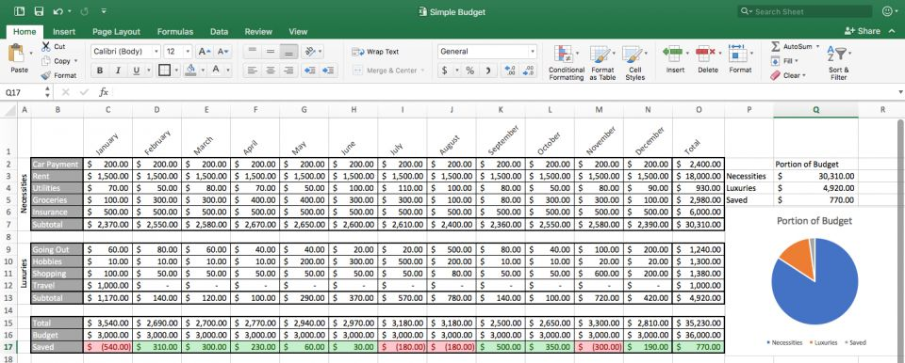


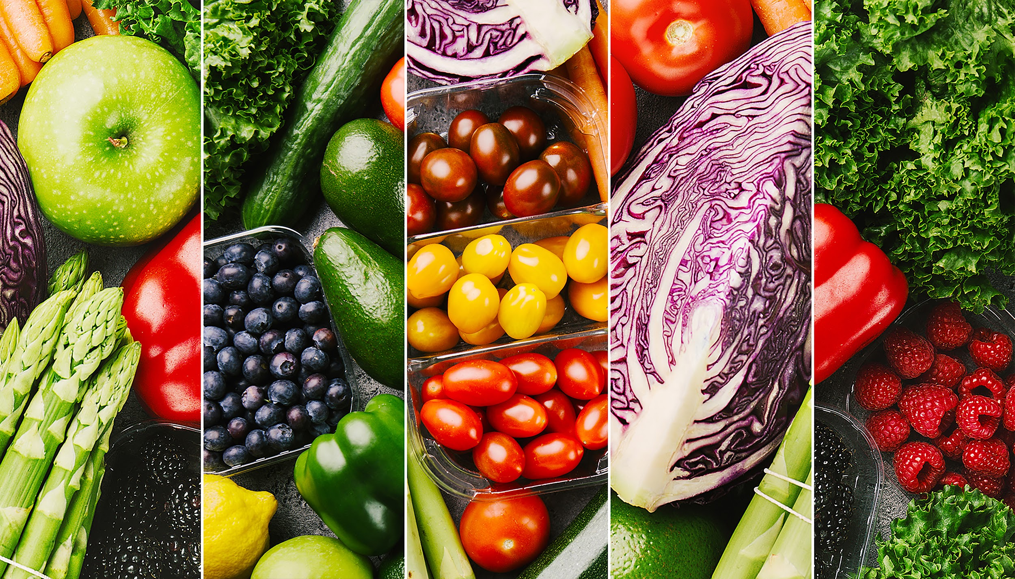



All AIs learn from data

Slide 5



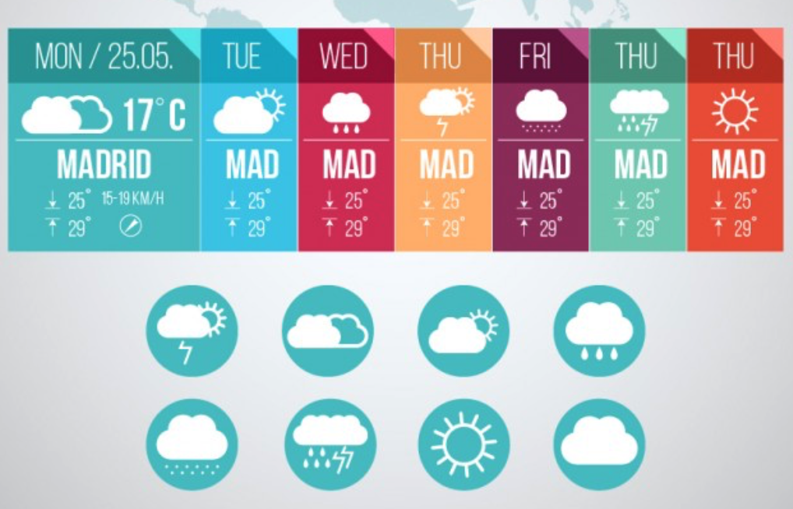

Supervised
Learning
Predict futures
Learn from
the right
answer.
Detect anomalies
Classify types

Slide 6
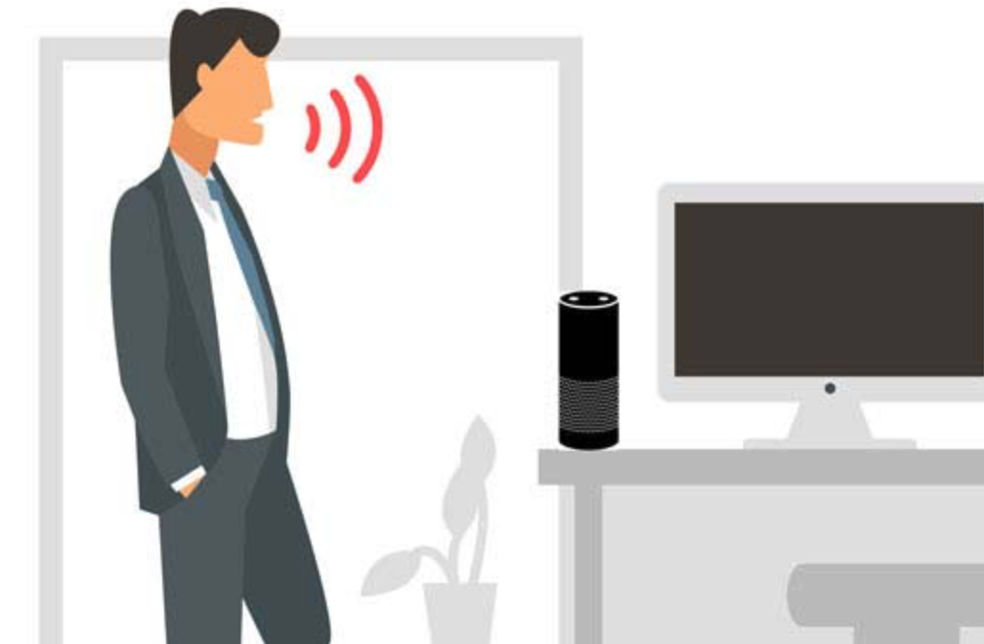

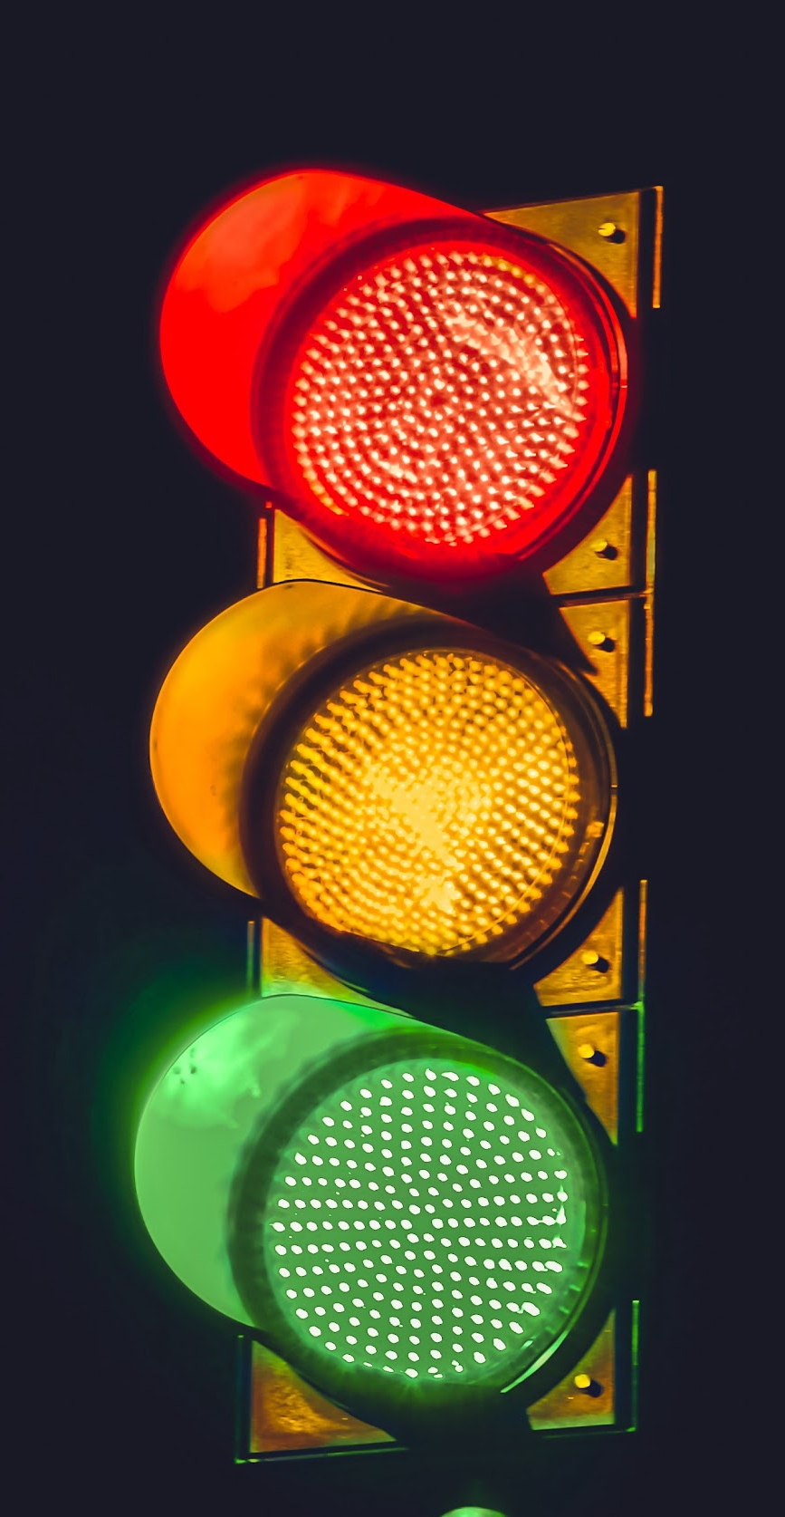
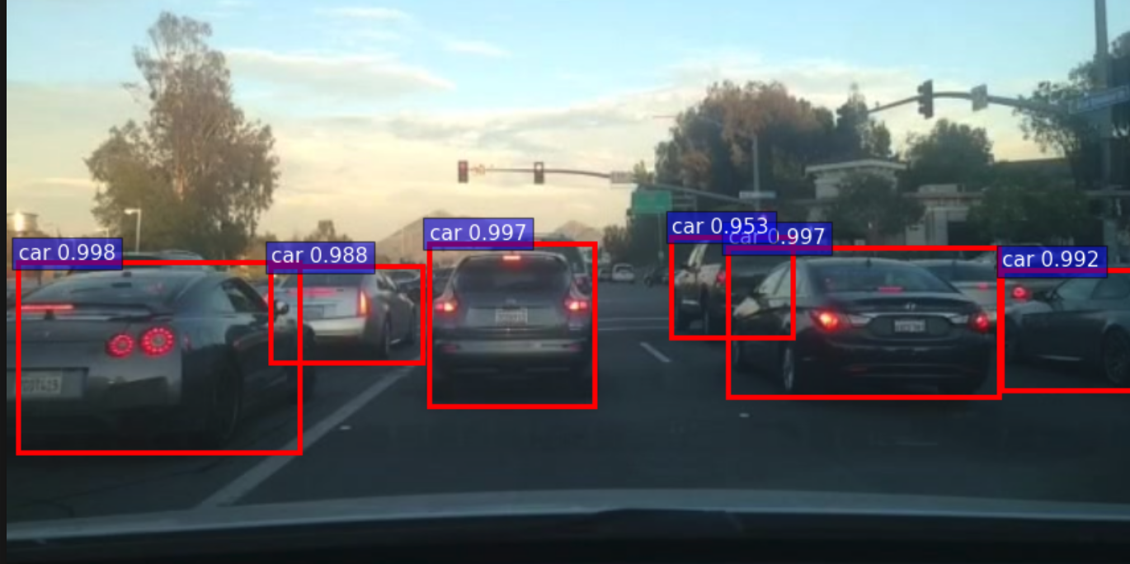

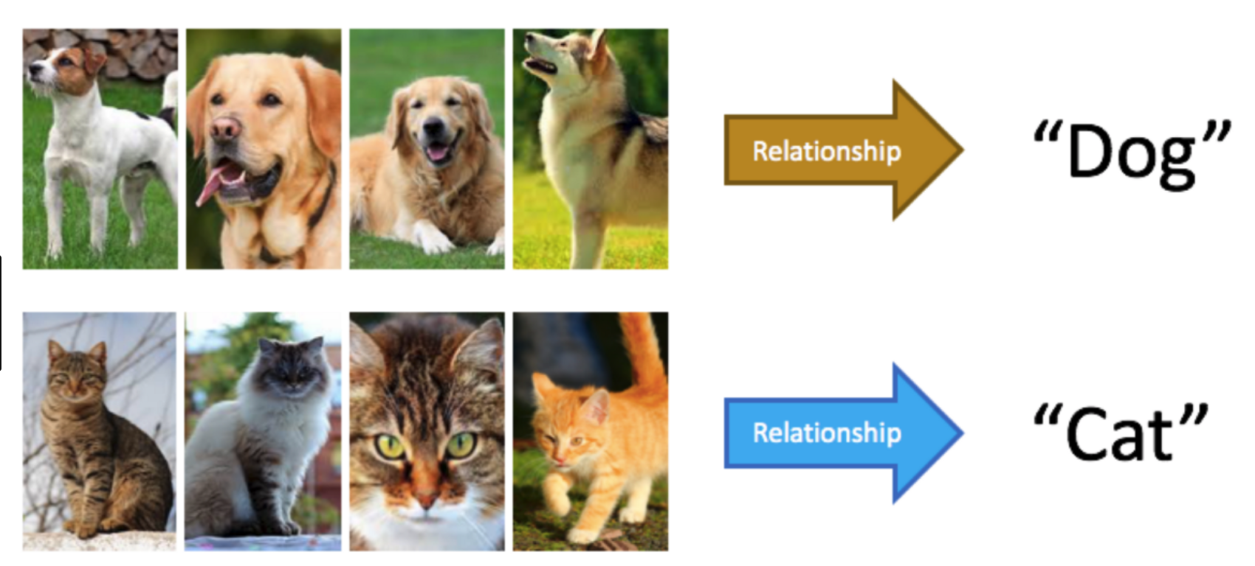
Unsupervised
Learning
Languages
Figure out patterns.
Videos

Slide 7
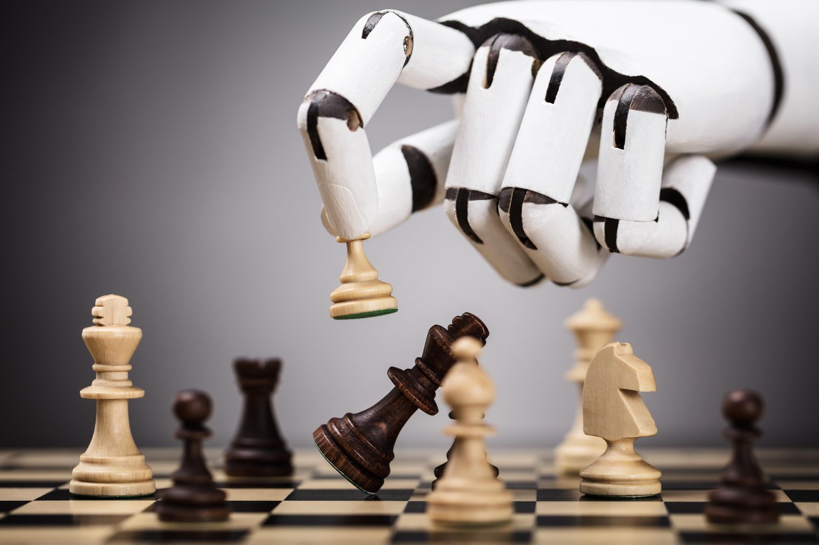
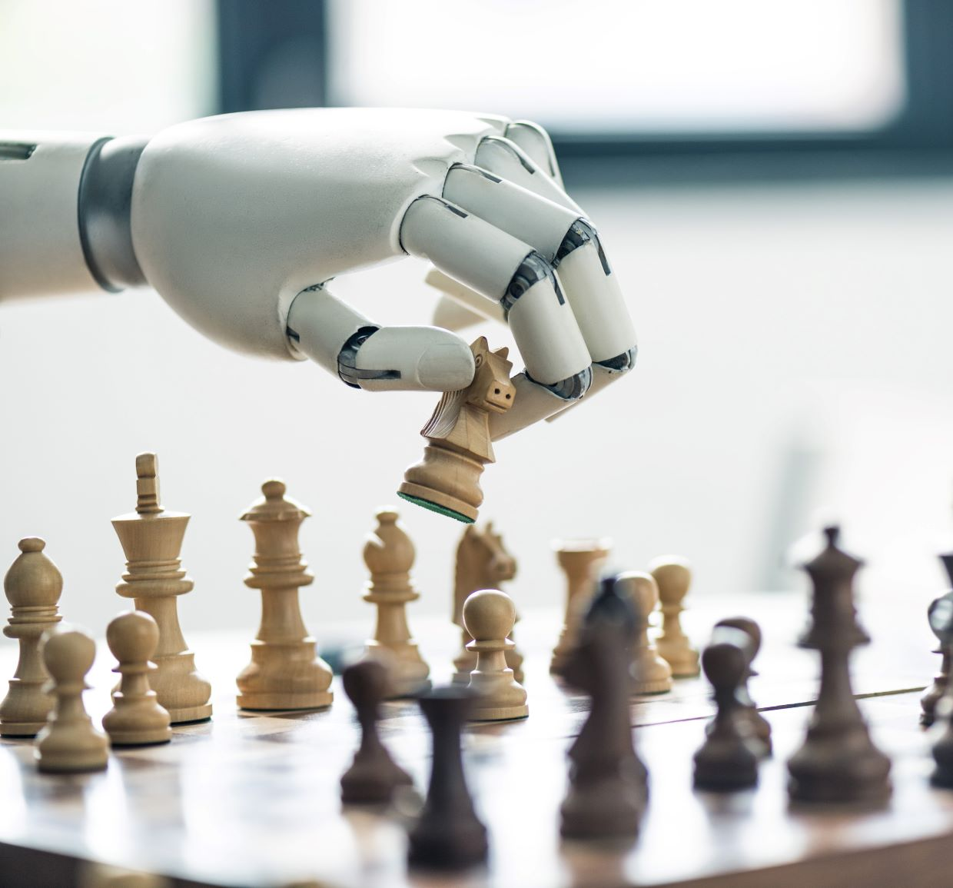

Reinforcement
Learning
Learn by trying.

Slide 8

Thank you!
https://www.corp.aiclub.world/

