Slide 1
EchoStick -
Smart Blind stick
Internet of Things - Domain Analyst Project
Maithreyi A – 21BAI1548
Arshiyaa Bhambri – 21BAI1281
Muralidharan V – 21BAI1406
Rahan S – 21BAI1444
Shaik Ahmed Rayyan – 21BAI1686
Rahul kevin Raghu – 21BAI1813
FACULTY Dr. Manigandan M

Slide 2
ABSTRACT
The Smart Blind Stick is an assistive device designed for the visually impaired, integrating innovative sensor technologies and also Fall Detection to enhance mobility and safety. The Ultrasonic sensor utilizes echolocation principles to detect obstacles in the user's path and provide audible alerts. The IMU sensor Module is used to calculate the Inertia of the stick and can detect if the stick has fallen. Then, a SMS message is promptly sent to an aide informing of the fall. The Smart Blind Stick represents a cutting-edge solution, harnessing technology to empower the visually impaired in navigating their surroundings independently.

Slide 3
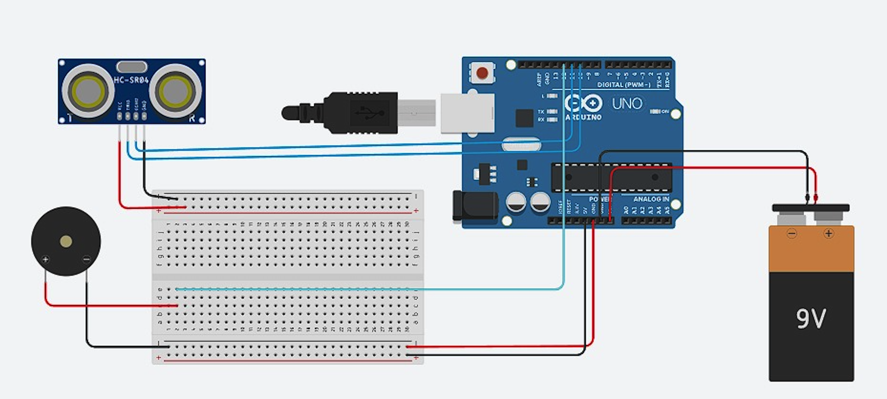
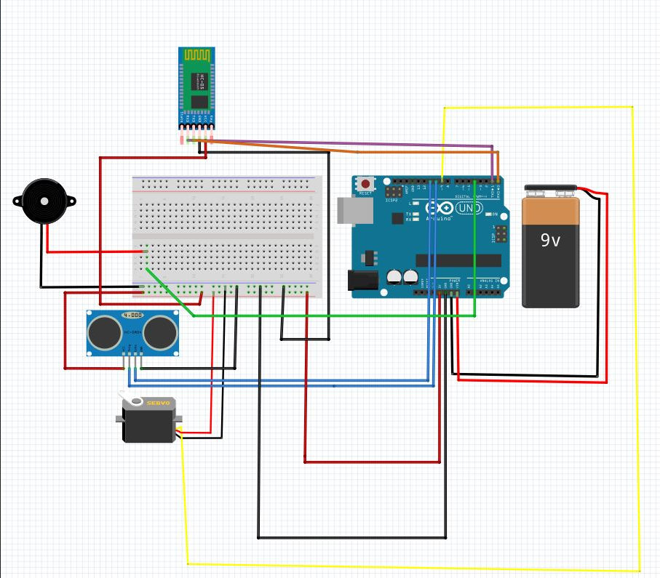

Slide 4
WORK DONE
The project has been divided into 2 modules
Module - 1:
Arduino: Microcontroller that controls the echo-stick.
Ultrasonic Sensor: Emits sound waves and measures their bounce-back time to calculate distances.
Buzzer: Produces audible alerts based on data from the ultrasonic sensor.
Functionality:
Ultrasonic sensor detects obstacles or objects in the environment.
Arduino processes distance measurements and determines if obstacles are present.
Buzzer emits alerts if obstacles are detected within a certain range.
Demonstration:
Showcasing real-time distance measurements and obstacle detection using the ultrasonic sensor.
Demonstrating the buzzer's response to approaching obstacles or objects.

Slide 5
WORK DONE
Module 2 (Fault Detection System):
IMU Sensor (MPU-6050): Detects motion and orientation changes by measuring acceleration and rotation.
Functionality:
IMU sensor monitors the orientation and movement of the echo-stick.
Detects sudden falls or impacts by measuring changes in acceleration.
Triggers an alert mechanism via SMS in response to a fall or impact.

Slide 6
COMPONENTS
Arduino Uno
Buzzer Module
Ultrasonic sensor (HC-SR04)
MPU 6050 Sensor
ESP 32 Microcontroller
Batteries and power supply
Jumper wires and connectors
Circuit board and soldering tools
Enclosure for the stick
Blind Stick

Slide 7
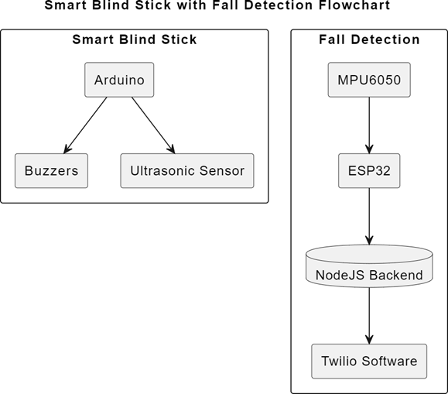
FLOWCHART:

Slide 8
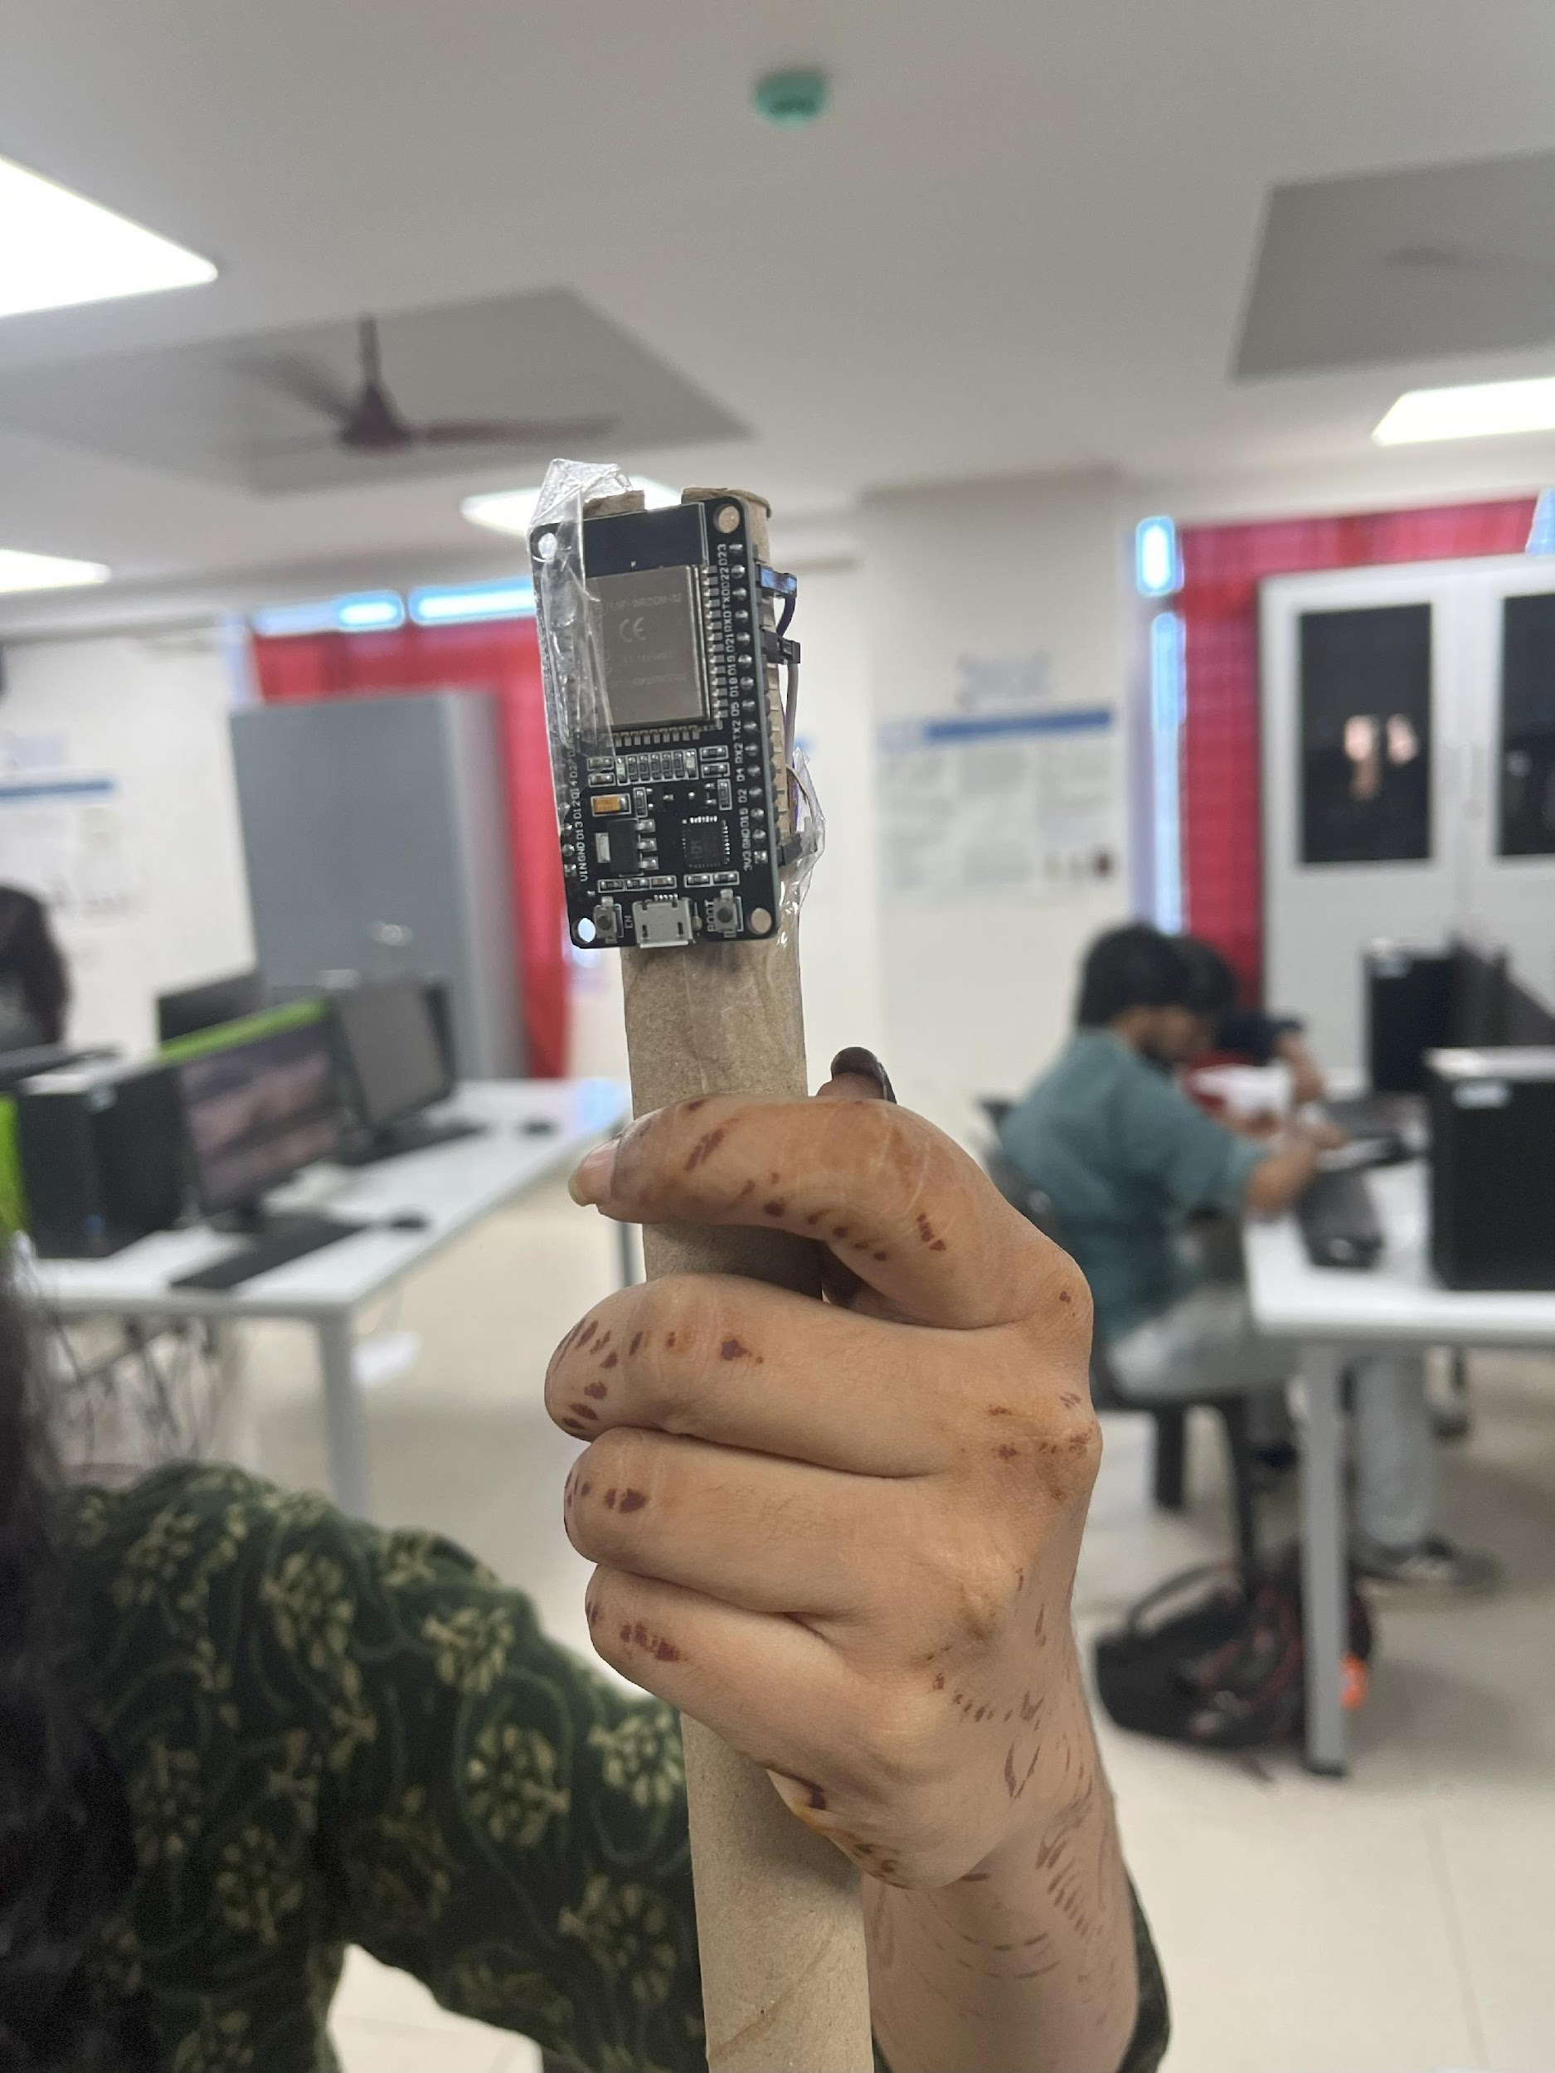
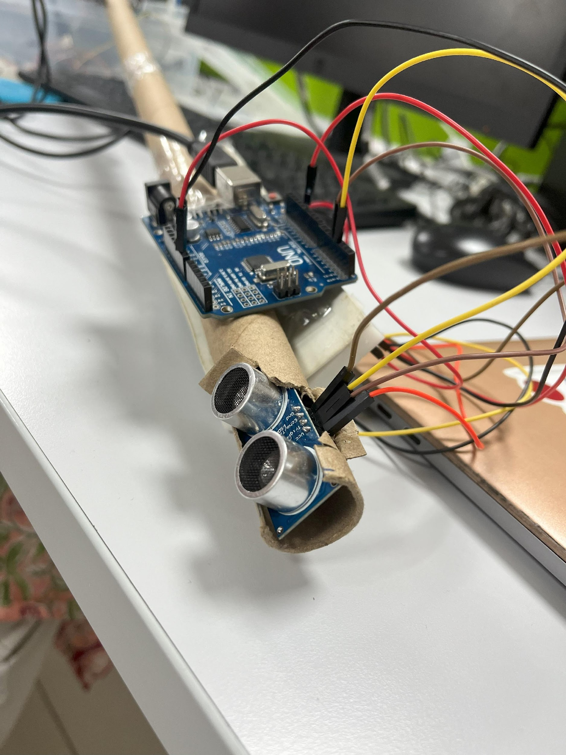
Experimental Results

Slide 9
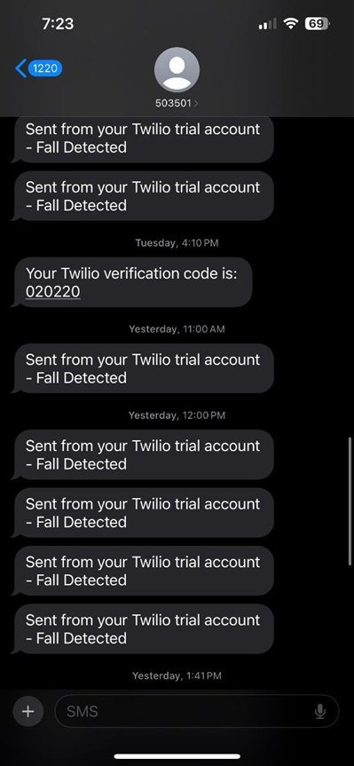
EXPERIMENTAL RESULTS:

Slide 10
FUTURE IMPROVEMENTS AND DEVELOPMENT:
Future improvements and developments for blind stick technology encompass several key areas. Firstly, enhancing object detection involves implementing machine learning algorithms for better obstacle recognition and integrating multiple sensors like infrared sensors or cameras for comprehensive detection. Advanced fall detection could benefit from real-time analysis using machine learning models and exploring additional sensors or technologies for varied fall detection angles. Communication and alerting systems can be improved with a dedicated mobile app for remote monitoring and integration with voice assistants or wearable devices. Accessibility and user interface enhancements may include intuitive interfaces with voice commands and haptic feedback for navigation guidance. Data analytics tools can provide insights for optimizing sensor configurations and system settings based on usage patterns. Integration with smart city infrastructure, such as traffic signals and environmental data, can further enhance navigation and safety. Continuous testing, user feedback, and agile development methodologies will ensure ongoing iteration and incorporation of new technologies for improved functionality and user experience.

Slide 11
THANK YOU!

