Slide 1

Face Emotion Recognition Using Deep Learning
Detecting and Classifying Human Emotions with AI

Slide 2
Introduction
What is Face Emotion Recognition?
A technology that detects human emotions using facial expressions.Uses AI and deep learning models to analyze emotions from images or videos.
Key Problems:Difficulty in real-time detection.Variations in emotion due to cultural differences

Slide 3

Applications of Emotion Recognition
Healthcare: Mental health monitoring, stress detection.
Education: Enhancing e-learning by recognizing student engagement.Retail & Marketing: Analyzing customer responses to products.Security: Detecting suspicious behavior in public places.

Slide 4
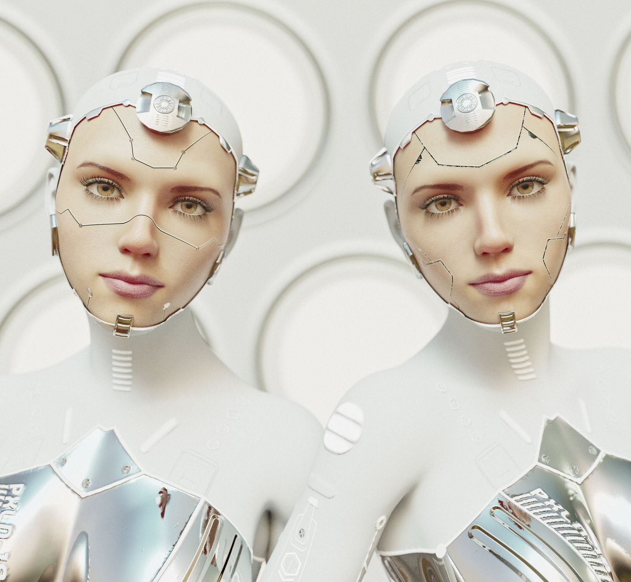
How Face Emotion Recognition Works
Step-by-Step Process:Face Detection: Identifying the face in an image.Feature Extraction: Identifying key facial features (eyes, eyebrows, mouth).Emotion Classification: Assigning emotions based on extracted features.

Slide 5
Dataset Used
Common datasets used for training:FER-2013: 35,887 images with seven emotions.CK+: Ideal for real-world emotion detection.JAFFE: Includes Japanese female expressions.

Slide 6

Preprocessing of Data
Why Preprocessing is Important:Improves model accuracy and performance.Techniques Used:Resizing images to a fixed size.Normalization for better learning.Data Augmentation: Flipping, rotating, adding noise.

Slide 7
Model Selection (Deep Learning Approach)
Why CNNs?They automatically extract facial features.Reduce manual feature engineering efforts.
Alternative Methods:Traditional Machine Learning (SVM, Random Forest)

Slide 8
Architecture of the CNN Model
Layers Used:Convolutional Layer – Extracts features.Pooling Layer – Reduces dimensions.Fully Connected Layer – Final classification.
Activation Functions: ReLU, Softmax

Slide 9

Training the Model
Training Process:Dataset split: Training (80%) | Validation (10%) | Testing (10%)Optimizer: AdamLoss function: Categorical Cross-Entropy

Slide 10
Evaluation Metrics
Used to measure model performance:Accuracy – Overall correctness.Precision & Recall – Quality of predictions.F1-Score – Balance of precision and recall.
Confusion Matrix: Helps analyze misclassifications.

Slide 11
Evaluation Metrics
Your title here
Your title here
01
04
Presentations are communication tools
Presentations are communication tools
Your title here
Your title here
02
05
Presentations are communication tools
Presentations are communication tools
Your title here
Your title here
03
06
Presentations are communication tools
Presentations are communication tools

Slide 12

Results and Performance Analysis
Accuracy achieved: 85-90% on test data.Performance improves with data augmentation and fine-tuning.
Challenges:Lower accuracy for subtle emotions (neutral vs. sad).Real-time performance is computationally expensive.

Slide 13

Challenges and Limitations
Data Bias: Some datasets lack diverse faces.Lighting Conditions: Poor lighting affects accuracy.Real-time Recognition: Requires high computing power.

Slide 14
Future Enhancements
Improving Accuracy:Using more advanced deep learning models.Combining facial expressions with speech for better analysis.
Real-time Processing:Deploying on Edge AI devices for faster recognition.Ethical Considerations:Ensuring unbiased AI models.

Slide 15

Live Demo or Screenshots
Live Demo: Show a video or GIF of your model in action.Screenshots:Model correctly predicting emotions on different faces.Sample test images with predicted labels.

Slide 16

Conclusion
Summary of Key Takeaways:Emotion recognition has vast applications.CNN-based models provide high accuracy.Still challenges in real-world scenarios.Final Thought:AI is making computers more human-like but still needs improvement.

Slide 17
THANK YOU

