Slide 1

SCM Strategy for T24

Slide 2
Agenda
AS-IS State
SCM Introduction
SCM Benefits
SCM Tools
SCM Process & Procedures
Artifact Management
SCM Dashboard
Automation CI/CD
SVN to Bitbucket Migration
SVN to GitLab Migration
SCM Backup and Restore strategy
SCM Integration with Jira and Jenkins
Assumptions
Appendix

Slide 3
AS-IS State
T24 Environment Build
T24 Development
T24 Build
L1 & L2 (Global & Australian Core banking changes)
L1 & L2 Code Build
DEV Env Build/Refresh
Developed and delivered by Temenos. Sources are managed by Temenos and only library files are shared
These patches are stored in the server and deployed into environments by NPE team, are tracked in a spread sheet.
These patches are deployed to test environments by NPE team
Base code is maintained as Golden copy(initial build done by Temenos) and gets updated as and when the patches are tested and deployed in production
Developed by Capgemini team & are not dependent on L1 & L2 for their development
SVN is used for maintaining L3 source code
L4 code is more of configurations, versions & values & L3 source codes are updated from SVN to Dev environment and start the development. Post unit testing in Dev environments, sources are checked in to SVN
Limited usage of SVN Tool. Branching strategy is not matured and only dev branch is created for new development.
Compiled sources are delivered as a patch by Temenos
These patches are stored in server and tracked by NPE team
These patches are tracked in spread sheet
Golden Copy Env
Dev Env
L1 & L2 Patch deployments
L3 & L4 Code deployments
L3 & L4 Code Build
Code
Code
L3 & L4 (ME Bank customizations)
L3 sources are checked out from SVN and updated in dev environment
Capgemini Dev team develops the code and test the code and then check-in the code
Capgemini Dev team builds the code into components
L3 code are compiled using T24 internal tools
L4 code is configurations, versions, values etc and these codes are compiled into Data records
Capgemini Dev team creates the package with these L3 components & L4 Data records and hands over the package to NPE team
NPE teams stores these packages in the server and deploys the code to other test environments using T24 utility
Seed Database(no customer data)
Database
Test Env Build/Refresh
Production Env
Test /New Env
Code
Code
Prod DB
Database

Slide 4
AS-IS State: Identified SCM Gaps
Lack of secured & Tool repository for sources and packages
Release and its configuration items are not mapped in SCM Tool
No information on Change traffic/breakage & reworks
Lack of SCM Tool administration
Manual Reporting & metrics
Artefacts/packages are not version controlled
SCM Tool usage is very limited
No Source traceability and status accounting
Ineffective tracking & control mechanism
Audit process not in place
Weak release process to test environments
Insignificant Branching, Merging & Baseline strategy
Limited Governance process
Indefinite Roles & responsibilities

Slide 5
Software Configuration Management - Introduction
Software Configuration Management:
SCM is to manage and control all the elements produced during software development, to ensure the version of the product and its components are always known.SCM is the process of managing the code in a systematic fashion throughout its lifecycle. CM implements the policies, procedures, techniques, tools that manage, evaluate proposed changes, track the status changes, and maintain an inventory of an system and support documents as the system changes.
SCM comprises of five principles
SCM Plan
Configuration Identification
Configuration Control
Configuration Status Accounting
SCM Audits
Notes:
SCM Plan:
Formal document and plan to guide CM programs that includes
SCM Tools strategy
Manage source code
Baselining procedures
Branching & Merging strategy
Roles & Responsibilities, resources
Configuration Control & status reporting
Naming conventions
SCM Audits
Artefact Management
Deployment Automation
Normal change process
Emergency change process
Configuration Identification:
Consists of setting and maintaining baselines, which define the system or subsystem architecture, components, and any developments at any point in time
Manage Source code
Source naming convention
Baseline & Branching strategy
Artefact Management
Asset naming convention
Deployment Automation
Configuration Control:
Baseline control procedure
Changes via review process
Change via Change Management process
Vendor changes control
Normal Change process
Emergency Change process
Configuration Status Accounting:
Process of recording and reporting configuration items
Tracking from design phase to production
Release status
Configuration Management Report (Code changes, revisions, Baselines, branches etc)
SCM Audits:
Conduct Internal and External Audit review to assess the maturity of the SCM Process
Produce the Audit report and target to close the identified noncompliance with a target date
Provide the scope for improvement

Slide 6
SCM Benefits
Control
Standardized & measurable process for the change are tracked through SCM Tool
Cost
Savings
Accurate and repeatable release control is produced in a repeated fashion and reduce reworks
Quality
Through SCM Automation process and track the changes through out its life cycle.
Enhanced system reliability through more rapid detection and correction of improper configurations
Faster restoration of service
More transparent process which allows the changes to be less error prone & faster to implement
Increased efficiencies, stability and control by improving visibility and tracking
Cost Reduction through maintaining change integrity through defined, tracked & review CI’s
Decreased risk and greater levels of security, greater agility and faster problem resolution, thus giving better quality of service.
The ability to define and enforce formal policies and procedures that govern asset identification, status monitoring, and auditing
Tool based Metrics & Reporting of change details
Identifying & guiding the configuration Item through a unique naming conventions allows version, release, update & full change tracking
Management
Control
Cost Savings
Management
Quality
Notes:
Control:
Track/Review & Approve/Reject the changes. Deploy & test the changes in the environment post the changes are approved
SCM Tool to be one set of source which permits only controlled changes to be baselined
Standardized & measurable process for the change are tracked through SCM Tool
Increased efficiencies, stability and control by improving visibility and tracking
More transparent process which allows the changes to be less error prone & faster to implement
Cost Savings:
Cost reduction by having detailed knowledge of all the elements of the configuration which allows for unnecessary duplication to be avoided
Maintaining changes integrity through defined, tracked & review CI’s provides the managed bill of materials for the changes
Accurate and repeatable release control is produced in a repeated fashion
Reduces the rework(code reviews, package creation, package deployment etc) & ability to reproduce the code at any point
Faster restoration of service. If you know the desired state of the configuration and how they are interrelated, recovering the live configuration will be much easier and quicker.
Management:
Identifying & guiding the configuration Item through a unique naming conventions allows version, release, update & full change tracking
Tool based Metrics & Reporting
Change details & status of the changes in the environment
SCM Audits provides the maturity & delivers the scope for the improvement
The ability to define and enforce formal policies and procedures that govern asset identification, status monitoring, and auditing
Quality:
Through SCM Automation process managing and building the software that improves the quality
Measuring the high quality is done through tracking the changes through out its life cycle
Repeated management and change control in a systematic fashion allows the accurate estimation of the future efforts
Enhanced system reliability through more rapid detection and correction of improper configurations that could negatively impact performance
Decreased risk and greater levels of security
Greater agility and faster problem resolution, thus giving better quality of service.

Slide 7
Recommended SCM Tools
Tools vs Costs
Tools
Bitbucket (Licensed) or
GitLab (Community Edition – Open Source)
Features
Pull request
Code review
Inline editing
Issue tracking
Online Dashboarding
Markdown support
Advanced access control management
Hosted static web pages
Clone repositories
Snippets
3rd party integrations
Cost/Tools | Bitbucket | GitLab
Infrastructure | Linux or Windows Machine with 8GB RAM,4 Core processor, 1 TB Storage space | Linux or Windows Machine with 8GB RAM,4 Core processor, 1 TB Storage space
License | 3600 $ per year for 50 users for Bitbucket 3500 $ per year for 25 users for JIRA | Community Edition - Open Source
Note:
The above prerequisites to be provisioned by ME bank
GitLab Security assessment from Capgemini is in progress
The above server specifications are for standalone not for High Availability.

Slide 8
SCM Tools : Bitbucket Vs GitLab
Features | Bitbucket | GitLab | Comments
Purpose built for cloud | ü | û
Jira Integration | ü | û | Built in issues Boards are available with in GitLab
Built-in Continuous Delivery and Integration | ü | ü
Granular Branching Permissions | ü | ü
Git Large File Storage | ü | ü
Secured and authentications | ü | ü
Built-in custom Git hooks | û | ü
Innersourcing & Group Milestones | û | ü | InnerSource - Faster development, Code reuse, Documentation, Cross-team collaboration Inner Source takes the lessons learned from developing Open Source software and applies them to the process that the companies follow to develop the software internally.
Issue Boards & trackers | û | ü
Move issue between the projects | û | ü
Dashboarding & Analytics | ü | ü
Code reviews & multiple approvals in code reviews | û | ü

Slide 9
Recommended SCM Process & Procedures
Manage Source code
L3 sources will be migrated from SVN to Bitbucket/GitLab
All the data records will be copied from production & configuration management is done to those records
Master is like a trunk in SVN which will be always in sync with the production sources
Tag is the terminology to do the baselines in Bitbucket which helps in baselining the code as per the release
Baseline & Tags
Tags are technical name for baselining the code in Bitbucket
Tags mark a specific commit at a point in Bitbucket repository. When tag a commit, all the changes are included before it
Difference between two points in history can be compared using tags
Tags are commonly used to mark release versions, with the release name as the tag name
Example:
- Release Name – RLS1.0
- Tag Names can be RLS1.0
- Bug fixes, delta releases can be RlS1.0.1, RLS1.0.2
Note:- Changes between the two releases can be identified by filtering between the two tags
Repository
Master
L3_SOURCES
Baseline the master post every production release
L4_DATARECORDS
Tags
L3_SOURCES
Tag Name <RLS Name>
L4_DATARECORDS

Slide 10
Recommended SCM Process & Procedures
Branching Strategy
Code Repository
L3_SOURCES
Master
L4_DATARECORDS
L3_SOURCES
Tags
Tag Name <delta Release Name>
L4_DATARECORDS
Branch Name<RLS Name>
L3_SOURCES
Branch
L4_DATARECORDS
Branch Name<Project >
L3_SOURCES
L4_DATARECORDS

Slide 11
Artifactory– Recommended Package Management Tool
Build the package
Artifactory
(Package Repo)
Golden copy env to be updated post every production release with new version and store the artifacts in Artifactory
SCM Repository
Artifactory
Artifactory is the tool to store the software artifacts(Packages & executable) of any technology or language
Integrating with all major CI/CD and DevOps tools, Artifactory provides an end-to-end, automated solution for tracking artifacts from development to production
Versioning in the Artifactory:
<RLS Number>.<build number>
Example:
-1.0.1
- 2014.01.1
- 2014.1.0.1
Note:
ME Bank needs to fund licenses for Artifactory. Artifactory Pro estimated license cost is $3K per year
ME Bank needs to provision Infra structure for Artifactory with below prerequisites
2 TB Storage space
8 GB RAM
4 core processor
64 bit OS/JVM
Golden Copy
L1_PATCHES
Update & Maintain the L1 & L2 patches in Artifactory
L2_PATCHES
Home loan
Burger
CUSTOMIZATION_PACKAGES
S&T
Update & Maintain the L3 & L4 packages in the appropriate Value stream folder
Customer Servicing
Ultrax

Slide 12
Configuration Management – Dashboards
Dashboard has the view on the following
Repository
Change Request Tracker
Baseline, number of pull requests and commits
Branch and Merge
Coding languages
Issue logged
CI/CD statistics
Code review
Contributors
Analysis on productive hours/commits/contributions and priorities to concentrate

Slide 13
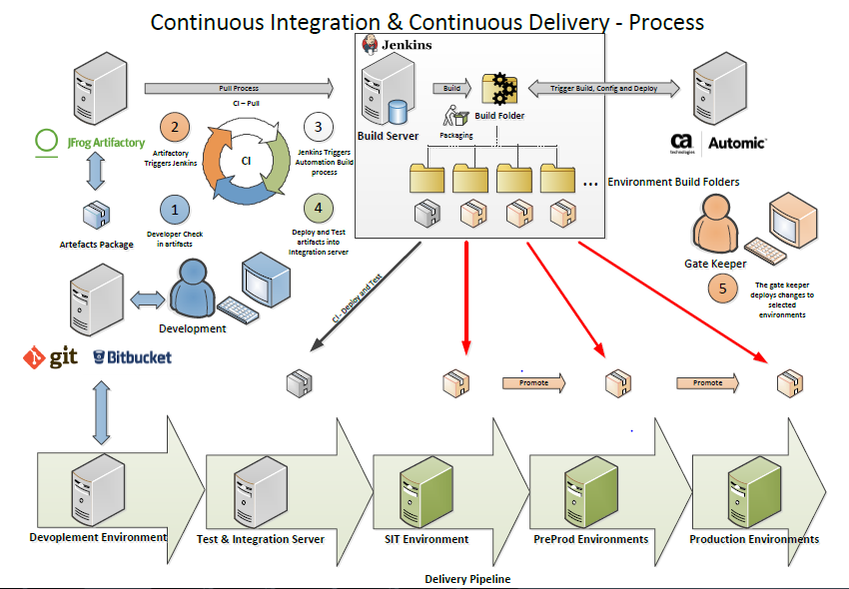
Automation – CI/CDs
We proposed the Bitbucket on premises but strategy will be adopted to Bitbucket cloud as per ME bank solution
Continuous Integration is the practice of testing each change done to your codebase automatically and as early as possible.
Continuous Deployment follows the testing that happens during Continuous Integration and pushes changes to a staging or production system. This makes sure a version of your code is accessible at all times.

Slide 14



SVN to Bitbucket Migration
We proposed the Bitbucket on premises but strategy will be adopted to Bitbucket cloud as per ME bank solution
Migration Strategy: Migration Procedure:
1. Prepare the environment for migration
Migration from SVN Prod to Bitbucket QA
2. Convert SVN repository to a local Git Repository
3. Synchronize the local Git Repository when the SVN repository changes
SVN Central Repository
SVN Prod Repo
Bitbucket QA Repo
SVN Central Repository
Migration from SVN Prod to Bitbucket Prod
Git Local Repository
Git Local Repository
5. Start using Git repository
4. Share git repository with developers
SVN Prod Repo
Bitbucket Prod Repo
Baseline the code in SVN Production server
Migrate the SVN repo to Bitbucket QA repo
Validate the sources in Bitbucket QA repo
Baseline the code in SVN Production
Migrate the SVN repo to Bitbucket Production repo
Validate the Sources in Bitbucket Production repository
SVN Central Repository(inactive)
Bitbucket Git Remote Repository
SVN Central Repository
Bitbucket Git Remote repository
Git Local Repository

Slide 15
SVN to Bitbucket Migration – Implementation Plan
Task | Duration | Accountability
Install the Bitbucket Git software in ME Server | 1 week | SCM Manager
Verification of Bitbucket Git in ME Server | 1 week | SCM Manager
Training on Bitbucket to Development team | 3 days | SCM Manager
Discuss and agree on the baseline history to be taken from SVN Repo to Bitbucket Repo | 1 day | Migration Lead
Communicate to the stakeholders on baseline tag and migration date |  | Migration Lead
Copy the SVN baseline history repository to local |  | Migration Lead
Create git repository locally | 2 days | Migration Lead
Share the local git repository with other developers by pushing it to Bitbucket | 1 day | Migration Lead
Validate the sources and its history in local Git repository | 1 day | Developers/Migration Lead
Post successful verification, sync up the latest version from SVN to Bitbucket Git | 1 day | Migration Lead
Push the code from local Git repository to Centralised | 3 days | Migration Lead
Clone the central repository to the local | 1 day | Developers
Validate the sources and its history |  | Developers
Confirm on the migration status (Go/No Go) |  | Migration Lead
Convert SVN into retire mode |  | Migration Lead
Bitbucket Git Tool Support | 4 weeks | SCM Manager
Over all Effort for migration & Support : 43 days
SCM Manager Effort including support post migration: 33 days
Migration Lead Effort : 10 days

Slide 16
SVN to GitLab Migration
We proposed the Bitbucket on premises but strategy will be adopted to Bitbucket cloud as per ME bank solution
Migration Strategy: Migration Procedure:
1. Prepare the environment for migration
Migration from SVN Prod to GitLab QA
2. Convert SVN repository to a local Git Repository
3. Synchronize the local Git Repository when the SVN repository changes
SVN Central Repository
SVN Prod Repo
GitLab QA Repo
SVN Central Repository
Migration from SVN Prod to GitLab Prod
Git Local Repository
Git Local Repository
5. Start using Git repository
4. Share git repository with developers
SVN Prod Repo
GitLab Prod Repo
Baseline the code in SVN Production server
Migrate the SVN repo to GitLab QA repo
Validate the sources in GitLab QA repo
Baseline the code in SVN Production
Migrate the SVN repo to GitLab Production repo
Validate the Sources in GitLab Production repository
SVN Central Repository(inactive)
GitLab Git Remote Repository
SVN Central Repository
GitLab Git Remote repository
Git Local Repository

Slide 17
SVN to GitLab Migration – Implementation Plan
Task | Duration | Accountability
Install the GitLab software in ME Server | 1 week | SCM Manager
Verification of GitLab in ME Server | 1 week | SCM Manager
Training on GitLab to Development team | 3 days | SCM Manager
Discuss and agree on the baseline history to be taken from SVN Repo to Bitbucket Repo | 1 day | Migration Lead
Communicate to the stakeholders on baseline tag and migration date |  | Migration Lead
Copy the SVN baseline history repository to local |  | Migration Lead
Create git repository locally | 2 days | Migration Lead
Share the local git repository with other developers by pushing it to Bitbucket | 1 day | Migration Lead
Validate the sources and its history in local Git repository | 1 day | Developers/Migration Lead
Post successful verification, sync up the latest version from SVN to GitLab | 1 day | Migration Lead
Push the code from local Git repository to Centralised | 3 days | Migration Lead
Clone the central repository to the local | 1 day | Developers
Validate the sources and its history |  | Developers
Confirm on the migration status (Go/No Go) |  | Migration Lead
Convert SVN into retire mode |  | Migration Lead
GitLab Tool Support | 4 weeks | SCM Manager
Over all Effort for migration & Support : 43 days
SCM Manager Effort including support post migration: 33 days
Migration Lead Effort : 10 days

Slide 18
SCM Tool Backup strategy
GitLab/Bitbucket Server
Backup Server
Repositories
Backup location
Copying daily backup
Builds & artifacts
Daily
Daily
Weekly
Copying weekly backups
Weekly
Plugins
Monthly
Copying monthly backups
Monthly
Database
Logs and events
Stop Git services and restore the backup in the Git server backup location

Slide 19
SCM – Backup and Restore strategy
Bitbucket
Backup contains:
the database the instance is connected to (either the internal or external DB),managed Git repositories, the Bitbucket Server logs, installed plugins and their data
Backup Strategies:
Using Bitbucket Server DIY Backup(bitbucket.diy-backup.sh or js)
Restoring a Backup:
When restoring Bitbucket Server, you must run the bitbucket.diy-restore.sh script on the machine that Bitbucket Server should be restored to. In order to ensure accidental restores do not delete existing data, you should never restore into an existing home directory.
GitLab
Backup contains:
db (database),uploads (attachments),repositories (Git repositories data),builds (CI job output logs),artifacts (CI job artifacts),lfs (LFS objects),registry (Container Registry images),pages (Pages content)
Backup strategies:
The default backup strategy is to essentially stream data from the respective data locations to the backup using the Linux command tar and gzip. This works fine in most cases, but can cause problems when data is rapidly changing.
GitLab-rake GitLab:backup:create
GitLab-rake GitLab:backup:create DIRECTORY=daily
GitLab-rake GitLab:backup:create DIRECTORY=weekly
GitLab-rake GitLab:backup:create DIRECTORY=monthly
Restoring a backup:
sudo GitLab-rake GitLab:backup:restore
Copy the required backup to the backup location in GitLab server and execute the above command to restore

Slide 20


SCM Tools – High Availability
https
Load Balancer
Shared file system
Bitbucket/GitLab server1(Active)
Bitbucket/GitLab server2(standby)
Database(Standalone or HA)
ME bank to provision Additional servers (3) for Tool server and DB HA.
This can be made active-active or active-passive.
Developer license to be installed in passive server for Tool server if in case active passive is opted.
HA set up can be done with only two servers or with multiple server at multi-site. In case of multi site additional servers needs to be provisioned.

Slide 21






SCM – Integration with Jira
Bitbucket Integration
GitLab Integration
1.Version Control and Project tracking
2. Release Automation
3. Package Management
Stakeholders
4. Release Automation
QA
UAT
PRD
GitLab
Project Tracking
PRD
UAT
Developers
Stakeholders
1.Developers
2.Version Control
3. Package Management
QA
Environments

Slide 22
SCM – Scope for Improvement at Enterprise level
Extend the SCM strategy to Enterprise level (Bankfast, cadencie, java components, pega origination, pega customer service) with detailed understanding on each application
Environment configurations to be maintained in SCM tool
Reduce match to production activities in non prod environments
Get the sources from SCM tool for any Environment refresh activities
Strengthen Release process and package delivery
Enhanced code review and management process
Advanced SCM metrics and dashboards
Release traceability matrix
Cost savings on release reworks and implementations
Faster time to market

Slide 23
Assumptions
For better source control and artefact management, ME bank will be providing required support to onboard source code to Bitbucket tools
ME bank will be providing the required infrastructure to implement the SCM strategy
SCM Strategy post approval warrants the change in AS-IS process and project team will be adopting to the SCM strategy
All application artefacts delivered by the application development teams have gone through sufficient level of unit and system testing
The development teams understand the SCM process, and are responsible for identifying the CI items requiring to be packaged for deployment
SCM Tools infrastructure will be in production zone so that back ups of the repositories are enabled
SCM Team will be part of NPE team
Infrastructure & Network layer configuration management is taken care by the respective teams
Data is out of scope and test data related configuration management is taken care in CA TDM tool
ME bank is responsible for Bitbucket tool sign off to roll out in ME servers
ME bank will be funding & provisioning the Bitbucket & Atlassian licenses
ME bank will be obtaining approval from Cyber Security architect and project Managers sign off to implement Bitbucket & Atlassian in ME servers
ME bank will be running SCM Strategy implementation as a separate project
Bitbucket & Artifactory tool support will be channelized through ME bank
ME bank provides the server for storing the Git repository on daily, weekly and monthly basis

Slide 24

Q&A

Slide 25
Appendix

Slide 26
SCM Tools in Market
Tools in the market
GitLab*
Bitbucket(Atlassian)
Github*
Mercurial*
Rational clear case
Perforce
Subversion
Rational Team concert
Artifactory
Nexus
Rational Asset Manager

Slide 27
SCM Tools – Open Source Vs Licensed Tools
Open Source:
Free and Economical
Easy availability
Low cost for enterprise version
Wider compatibility & convenient usability
Distributed, peer to peer model
Increase in operation speed
Lack of Security & enhancement
Tool Support issues
Licensed:
Secure and superior technology
Easy availability of support and enhancements
Technologically evolving
Convenient support
High Cost and license fees
Permitted and restricted usability

Slide 28
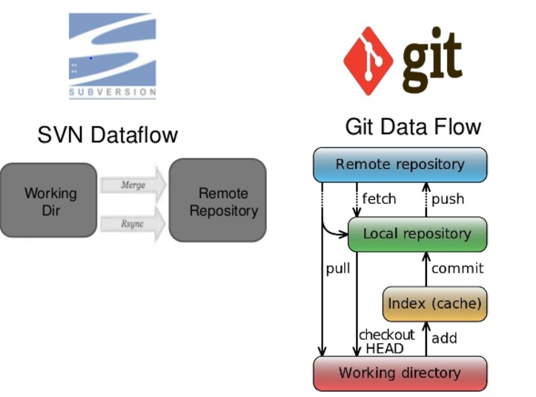
SCM Tools - Workflow
Subversion:
SVN has been around longer. There are tons of tools available which make using it easier for non-technical users. SVN error messages make more sense. If the version control system will be used by managers, graphic designers or other non-developers, SVN is a better choice. With Tortoise SVN anybody tech-savvy enough to browse for files can easily use SVN
Bitbucket Git:
Bitbucket is a web based hosting service that is owned by Atlassian, used for code and development projects that use either Mercurial or Git revision control systems.
Bitbucket Git is fast & excellent for managing large open source projects with many collaborators. While branching is possible with SVN, branching and merging is what Bitbucket Git was built to do. Bitbucket Git has many rich features and are functional. Bitbucket Git makes the programming a social activity and lets you connects with and follow other developers .It makes coding more fun, and even makes it possible for less technical people to take part in the development process.

Slide 29
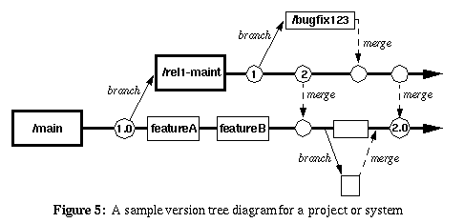
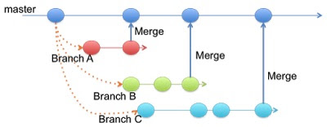
Recommended SCM Process & Procedures
Branching & Merging
Branching is done in the Bitbucket when there are parallel development
Branching is derived from the trunk(either full trunk can be copied or only required sources from trunk can be copied) and can be created for each release
Post the development is completed in branch and deployed into production, branch code is merged into trunk
If there are any source conflicts, Bitbucket tool alerts on the conflict to the developers
Note: The big difference is that the commit a branch points to changes as you add new commits, and a tag is frozen to a particular commit to mark a point in time as having a certain significance

Slide 30
SCM Trainings
30 developers are to be trained on
Software configuration Management
SCM Tools usage
Configuration control
Baselines, Branching & Merging
Package Management
Status Accounting & Reporting
Estimated effort is 10 days of effort to train the 30 developers in batches

Slide 31
Roles & Responsibilities for T24
Role | Responsibilities | Owner
Release Manager | Owner of the value stream Provides coordination, resource & funding Part of Change control board steering committee Review/Approve the changes for the releases to be put in to the non-prod environments | ME Bank
Software Configuration Manager | Responsible for setting overall Code Management Strategy at an Enterprise level Ensures Teams full compliance with Process and Audit requirementsW Maintains the project repository for the project team Responsible for core SCM activities Maintains the project’s SCM Plan SCM Tool Admin Governance on the source code across all the branches & trunk Provide reporting & traceability of the source code and packages Define the SCM Strategies & conduct training on SCM Tools & process Perform SCM Audits to assess the maturity and ensure the quality deliverables | Capgemini

Slide 32
Roles & Responsibilities for T24
Role | Responsibilities | Owner
Environment Manager | Manages All Environment Streams providing delivery expertise and guidance Responsible for setting overall Environment Strategy and Direction at an Overall Program Level Single point of Ownership for all Environment teams Environment provisioning Responsible for the standardization of Environment services and Processes across the Enterprise Work with Project team at a management level for all Environment related issues Responsible for the raising and managing of all Environments related Risks/Issues Execute the deployments in the environments Change control board member | Capgemini
Developer | Develop the L3 & L4 customization codes Responsible to stick to the SCM Principles & adhere to SCM Check out/in process Build the code package and unit test the package Provide estimates for the code development Upload the code packages to Artifactory Provide the release notes for the releases & version number to pick from artifactory | Capgemini

Slide 33
Roles & Responsibilities for T24
Role | Responsibilities | Owner
Vendor software integrator | Develop & deliver the L1 & L2 patches Provide the unit test results for L1 & L2 patches Deliver the release notes along with the patches | Temenos
Test Manager | Analyze the requirements Come up with the Test strategy & Test cases Execute the test cases Conduct the defect meetings Change control board member Participate in release plan meetings and help to schedule the deployments into the environments | Capgemini
Infrastructure Manager | Performs analysis of network needs and contributes to design of network architecture, integration and installation. Maintains network hardware and software, including servers, voice, PDA's, peripherals, network nodes, terminals and wiring. Works with consultants to that the computer system platform provides sufficient computing resources to deliver the desired level of business performance. Infra provisioning and build Develops, maintains and tests disaster recovery plans Manages computer operation scheduling, backup, storage and retrieval functions | Capgemini

