Slide 1

FINAL YEAR PROJECT PROPOSAL
Agent-Based Game Analysis in Unity Based Upon Curiosity and RND Exploration Using PPO and SAC
Raza Ullah khan NUM-BSCS23-28
Supervisor: Dr. Malik M Ali Shahid Co-supervisor: Mr. Abdul Rafay Industrial partner: Inspired Square
NAMAL UNIVERSITY
Department of Computer Science • FYP Proposal
01
Notes:
Open with the broad aim: train game agents in a controlled Unity scene, compare two learning methods, and test whether curiosity helps exploration. Student: RazaUllah. Supervisor and registration number are intentionally left for editing. Target talk length: about ten minutes.

Slide 2
Outline
01
Why learning agents matter
02
What we will compare
03
How we will measure results
04
What we will deliver
NAMAL UNIVERSITY
Department of Computer Science • FYP Proposal
02
Notes:
This proposal moves from the game-learning idea to the research comparison, then explains how the experiments and work plan will be carried out.

Slide 3
Introduction
An agent learns through trial and feedback
01
02
03
04
Observe
Act
Reward
Improve
What is happening?
Choose a move
Was it useful?
Update the policy
Game 1: Hummingbirds • Game 2(SUGGESTION): TBD (likely a Mario-style platformer)
NAMAL UNIVERSITY
Department of Computer Science • FYP Proposal
03
Notes:
Reinforcement learning means an agent learns by trying actions and receiving rewards. In our project, the agent will act in a simple Unity training scenario. The example should be intentionally small so that results are understandable and repeatable.

Slide 4
Literature Review:
Study / Work | PPO | SAC | Curiosity / Intrinsic Reward | PPO vs SAC | Exploration Comparison
Unity: A General Platform for Intelligent Agents (2018) | ✓ | ✓ | ✗ | ✗ | ✗
Automatic Intrinsic Reward Shaping for Exploration in Deep RL (2023) | ✓ | ✗ | ✓ | ✗ | ✓
RLeXplore: Accelerating Research in Intrinsically-Motivated RL (2023) | ✓ | ✓ | ✓ | ✓ | ✓
RL in a Virtual World: PPO and SAC within Unity ML-Agents (2024) | ✓ | ✓ | ✗ | ✓ | ✗
Proposed FYP (2026) | ✓ | ✓ | ✓ | ✓ | ✓
Study / Work | PPO | SAC | Curiosity / Exploration | PPO VS SAC
Unity: A General Platform for Intelligent Agents (2018) | ✓ | ✓ | ✗ | ✓
Curiosity-driven Exploration in Sparse-reward Multi-agent RL (2023) | ✓ | ✗ | ✓ | ✗
Automatic Intrinsic Reward Shaping for Exploration in Deep RL (Yuan et al., 2023) | ✓ | ✗ | ✓ | ✗
Our FYP | ✓ | ✓ | ✓ | ✓
04

Slide 5
Literature Review:
Study / Work | PPO | SAC | Curiosity / Intrinsic Reward | PPO vs SAC | Exploration Comparison
Unity: A General Platform for Intelligent Agents (2018) | ✓ | ✓ | ✗ | ✗ | ✗
Automatic Intrinsic Reward Shaping for Exploration in Deep RL (2023) | ✓ | ✗ | ✓ | ✗ | ✓
RLeXplore: Accelerating Research in Intrinsically-Motivated RL (2023) | ✓ | ✓ | ✓ | ✓ | ✓
RL in a Virtual World: PPO and SAC within Unity ML-Agents (2024) | ✓ | ✓ | ✗ | ✓ | ✗
Proposed FYP (2026) | ✓ | ✓ | ✓ | ✓ | ✓
Study | PPO | SAC | Curiosity / Exploration | PPO vs SAC | Exploration Comparison
Using Unity to Help Solve RL (2024) | ✓ | ✓ | ✗ | ✓ | ✗
RL in a Virtual World: PPO and SAC within Unity ML-Agents (2025) | ✓ | ✓ | ✗ | ✓ | ✗
Proposed FYP | ✓ | ✓ | ✓ | ✓ | ✓
Our FYP brings these comparisons together to study how different learning and exploration
approaches affect AI training.
04

Slide 6
Problem statement and objectives
Problem statement
Developers don't know which RL algorithm and exploration method to choose for training game agents. A method that works well in one game may fail in another. Without a fair, controlled comparison, they rely on guesswork, wasting time and training resources.
Objectives
1
Compare learning algorithms : PPO(Proximal Policy Optimization) vs SAC(Soft Actor-Critic)
2
Test two exploration methods : curiosity(next state prediction) and RND(random network distillation)
3
Tune exploration settings : entropy and intrinsic reward strength
NAMAL UNIVERSITY
Department of Computer Science • FYP Proposal
05
Notes:
RND stands for Random Network Distillation. It gives the agent a bonus for reaching situations it hasn't seen before.“
Curiosity rewards surprising outcomes.
RND rewards new places
PPO: Proximal Policy Optimization
A stable algorithm that improves the agent's policy in small, safe steps, learning from fresh experience.
SAC: Soft Actor-Critic
An algorithm that reuses past experience and rewards the agent for staying a bit random, which helps it explore and learn efficiently.
To say out loud: "PPO learns carefully from new experience, while SAC reuses old experience and encourages exploration. I compare both to see which works better in my games."
Quick tags for your slide:
PPO: on-policy, stable
SAC: off-policy, entropy-based

Slide 7
Use cases
Where trained RL agents help in games
1
Level Testing
AI agents automatically test game levels for difficulty, playability, and possible issues
2
Human vs. Computer
RL agents can be trained to act as computer-controlled opponents .
3
Level Generation & Testing
AI agents explore and evaluate newly generated game levels.
NAMAL UNIVERSITY
Department of Computer Science • FYP Proposal
06

Slide 8
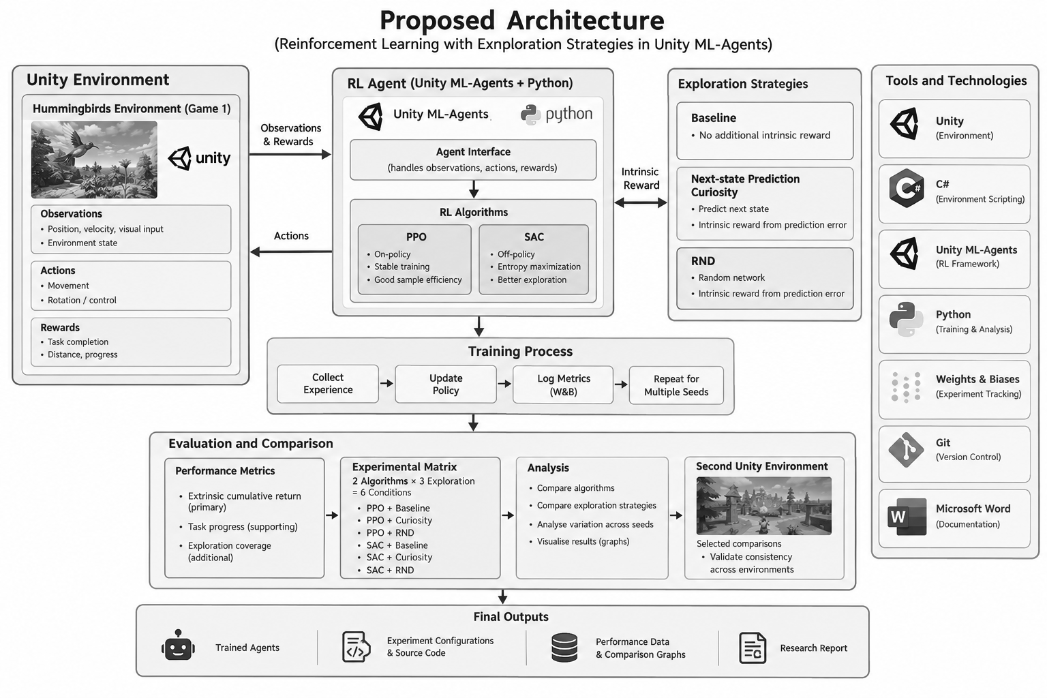
Methodology/Architecture
NAMAL UNIVERSITY
Department of Computer Science • FYP Proposal
07
Notes:
Build Hummingbirds first and define observations, actions and external rewards. Compare candidate algorithms under matched budgets, then test next-state prediction curiosity and RND. Use a second platform game for selected follow-up comparisons. Log runs in Weights & Biases. The pipeline is editable in PowerPoint.

Slide 9
Experiment matrix
Exploration tries new actions. Exploitation repeats actions that work.
No extra reward
Next-state prediction
RND
Algorithm 1(PPO)
Baseline
With curiosity
With RND
Algorithm 2(SAC)
Baseline
With curiosity
With RND
STAGED TEST
RND
Hummingbirds: full matrix • Second game(TBD): selected comparisons
NAMAL UNIVERSITY
Department of Computer Science • FYP Proposal
08
Notes:
Cross each selected learning algorithm with three exploration conditions: no intrinsic reward, next-state prediction curiosity, and RND. Candidate algorithms include PPO and SAC. Run the full six-condition matrix in Hummingbirds, then carry selected comparisons into the second game to keep the project feasible. Tune entropy and intrinsic reward strength only after establishing baselines. Do not directly compare raw returns between games because their reward scales may differ. Sources: https://unity-technologies.github.io/ml-agents/Training-Configuration-File/ ; https://unity-technologies.github.io/ml-agents/ML-Agents-Overview/

Slide 10
Evaluation metrics
What does “better” mean?
01
Extrinsic return
How much game reward did it earn?
02
Task progress
How far did it get in the game?
03
Exploration coverage
Which parts of the game did it reach?
NAMAL UNIVERSITY
Department of Computer Science • FYP Proposal
09
Notes:
The primary measure is extrinsic cumulative return: only the game reward, excluding curiosity or RND bonuses. A second measure is game-specific success or progress, such as obstacles passed in Hummingbirds and checkpoints or level completion in the second game. Exploration coverage can be an optional diagnostic if a meaningful state partition can be defined. Repeat each condition with multiple random seeds and report variation. Do not compare raw return values across games with different reward scales.

Slide 11
software tools
Unity , C#
Build both game environments
ML-Agents , Python
Train and evaluate agents
Weights & Biases
Log runs and inspect curves
Git
Track code and configurations
Required skills: basic Unity/C#, Python, and interest in AI/ML
NAMAL UNIVERSITY
Department of Computer Science • FYP Proposal
10
Notes:
Unity and C sharp create the training environments. ML-Agents connects them to Python training. Weights & Biases, or W&B, will organize experiment runs, configurations, and learning curves. Git keeps source code reproducible. The student needs basic Unity and C sharp, Python, and an interest in AI and machine learning. Specific training hardware should be selected after the scene is scoped. Source: https://unity-technologies.github.io/ml-agents/ML-Agents-Overview/

Slide 12
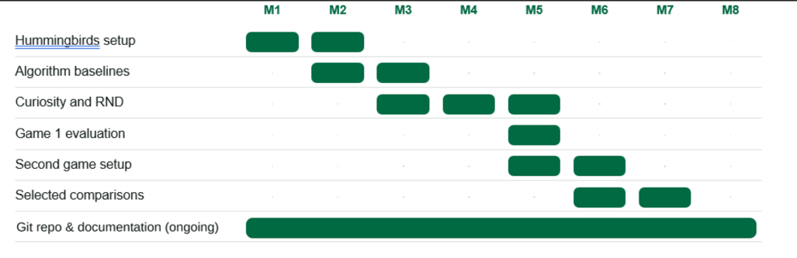
Proposed work plan
Six to eight months, with regular reviews from Inspired Square
M1
M2
M3
M4
M5
M6
M7
M8
Hummingbirds setup
Algorithm baselines
Curiosity and RND
Game 1 evaluation
Second game setup
Selected comparisons
Report and presentation
Technical guidance and review meetings throughout
NAMAL UNIVERSITY
Department of Computer Science • FYP Proposal
11
Notes:
This eight month plan fits the proposed six to eight month duration. First build Hummingbirds, then develop algorithm baselines and compare next-state prediction curiosity and RND. Build a second platform game during months five and six, then repeat selected conditions there. Final months cover analysis and the research report. Inspired Square provides technical guidance and regular reviews throughout.

Slide 13
Expected deliverables
Unity project
Git repository
Two games with trained agents
Code and experiment settings
Results package
Research outputs
Return and progress comparisons
Report and final presentation
FUTURE SCOPE
Explore use in Inspired Square games after reviewing the evidence
NAMAL UNIVERSITY
Department of Computer Science • FYP Proposal
12
Notes:
The final outputs are Unity projects for Hummingbirds and a second selected game with trained agents, a Git repository containing source and configurations, return and game-progress data with comparison graphs, and a research report and presentation. The findings may later inform experiments in Inspired Square games. That application is future scope, not a promised deployment.

Slide 14

Dr. Aaron Chen
Research profile: https://people.wgtn.ac.nz/Aaron.Chen
Paper: https://www.ijcai.org/proceedings/2023/0391.pdf
ACADEMIC POSITIONS:
Victoria University of Wellington, School of Engineering and Computer Science, Wellington, New Zealand
NAMAL UNIVERSITY
Department of Computer Science • FYP Proposal
13

Slide 15
Thank you
Any Suggestions !
Raza Ullah Khan • Inspired Square • Namal University
NAMAL UNIVERSITY
Department of Computer Science • FYP Proposal
14
Notes:
Thank the faculty for considering the proposal. Invite questions about the Unity task, research design, student supervision, or industrial support. Confirm that supervisor name and student registration number will be finalized before submission.

