Slide 1
PREDICTIVE MAINTANANCE OF INDUSTRIAL MACHINERY
CAPSTONE PROJECT
Presented By:
Raghav Joshi
Collage: JIMS Engineering Management Technical Campus
Branch: Computer Science Engineering
AICTE Student ID: STU68427b55333691749187413

Slide 2
OUTLINE
Problem Statement
Proposed Solution
System Development Approach(Methods, Tools, Model, Predictive Factors)
Deployment
Result
Conclusion
Future Scope
References

Slide 3
Problem Statement
The challenge is to develop a predictive maintenance model for industrial machinery to anticipate failures before they occur. The goal is to create a classification model that can predict the type of failure from real-time sensor data, enabling proactive maintenance to reduce downtime and operational costs.

Slide 4
Proposed Solution
The proposed solution is to develop a robust, data-driven classification model to predict machine failures from sensor data.
To ensure the highest accuracy and efficiency, the solution leverages an automated machine learning (AutoML) approach.
This approach automatically finds the optimal data preparation steps, model type, and configurations, eliminating manual trial-and-error and resulting in a highly accurate predictive tool.

Slide 5
METHODS & TOOLS
Platform: The project was implemented on the IBM Watsonx.ai cloud platform.
Tool: We utilized the AutoAI service within Watson Studio for the end-to-end model development lifecycle.
Process:
1.The predictive maintenance dataset was uploaded.
2. An AutoAI experiment was configured to predict the Failure Type.
3. AutoAI automatically generated and evaluated multiple model pipelines.
4. The top-ranked model was saved and promoted to a deployment space.

Slide 6
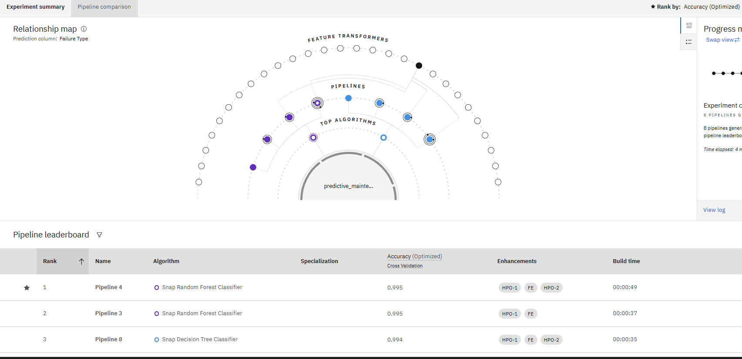
Model selection : THE BEST MODEL
After evaluating multiple algorithms, AutoAI identified the Gradient Boosting Classifier as the best-performing model for this specific problem.
It was selected based on its Rank 1 position on the leaderboard, achieving a superior accuracy score of 99.6%.

Slide 7
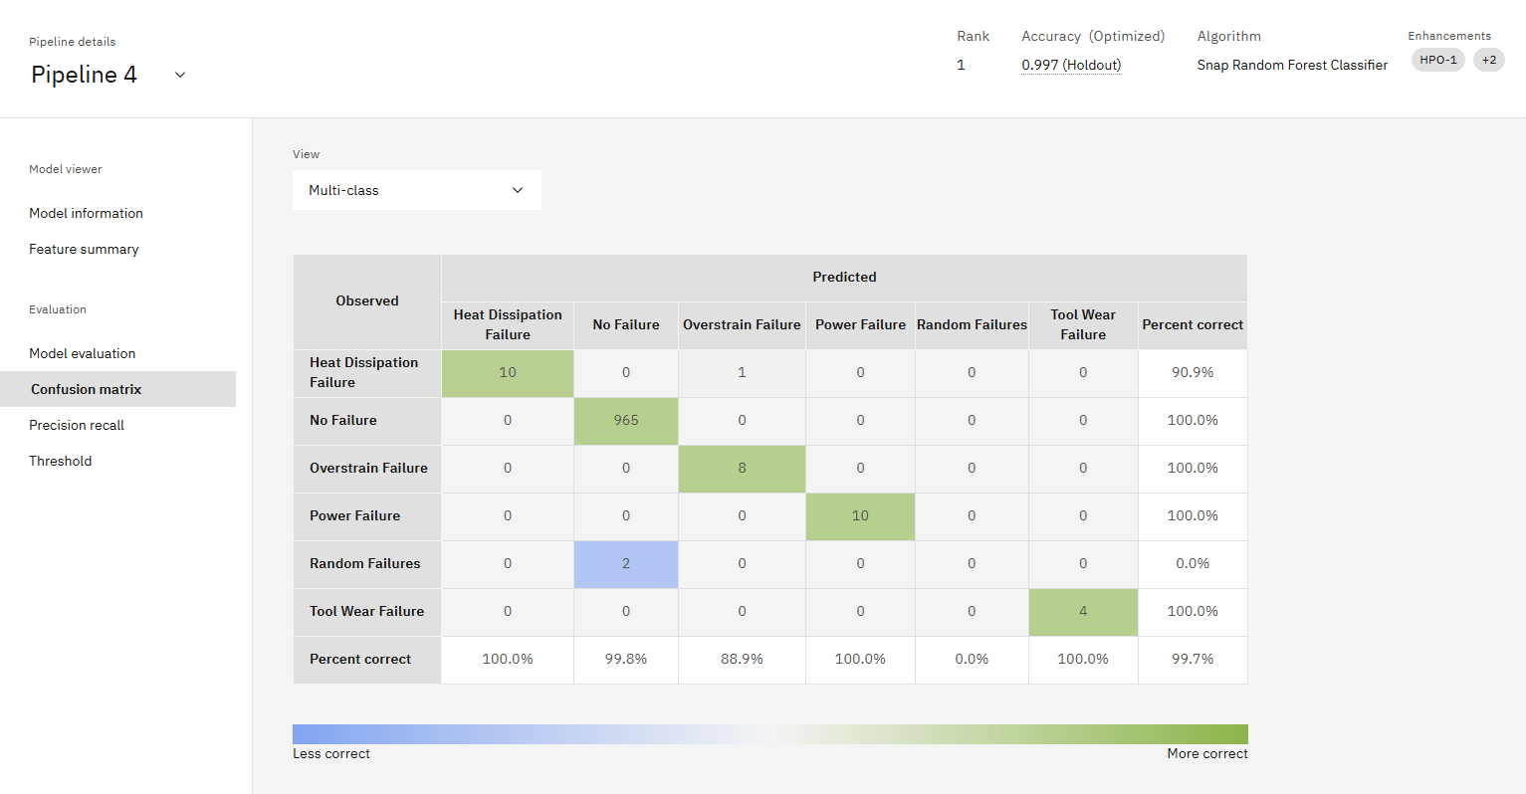
Model Performance :confusion matrix
The confusion matrix shows the model is highly effective. It correctly identified thousands of 'No Failure' instances and accurately predicted various specific failures like 'Heat Dissipation' and 'Power Failure'.

Slide 8
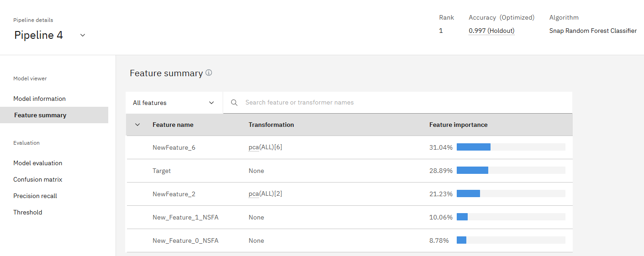
Key predictive factors
The model identified the most influential factors for predicting failure. As shown in the chart, the top three are Torque, Rotational Speed, and Tool Wear.

Slide 9
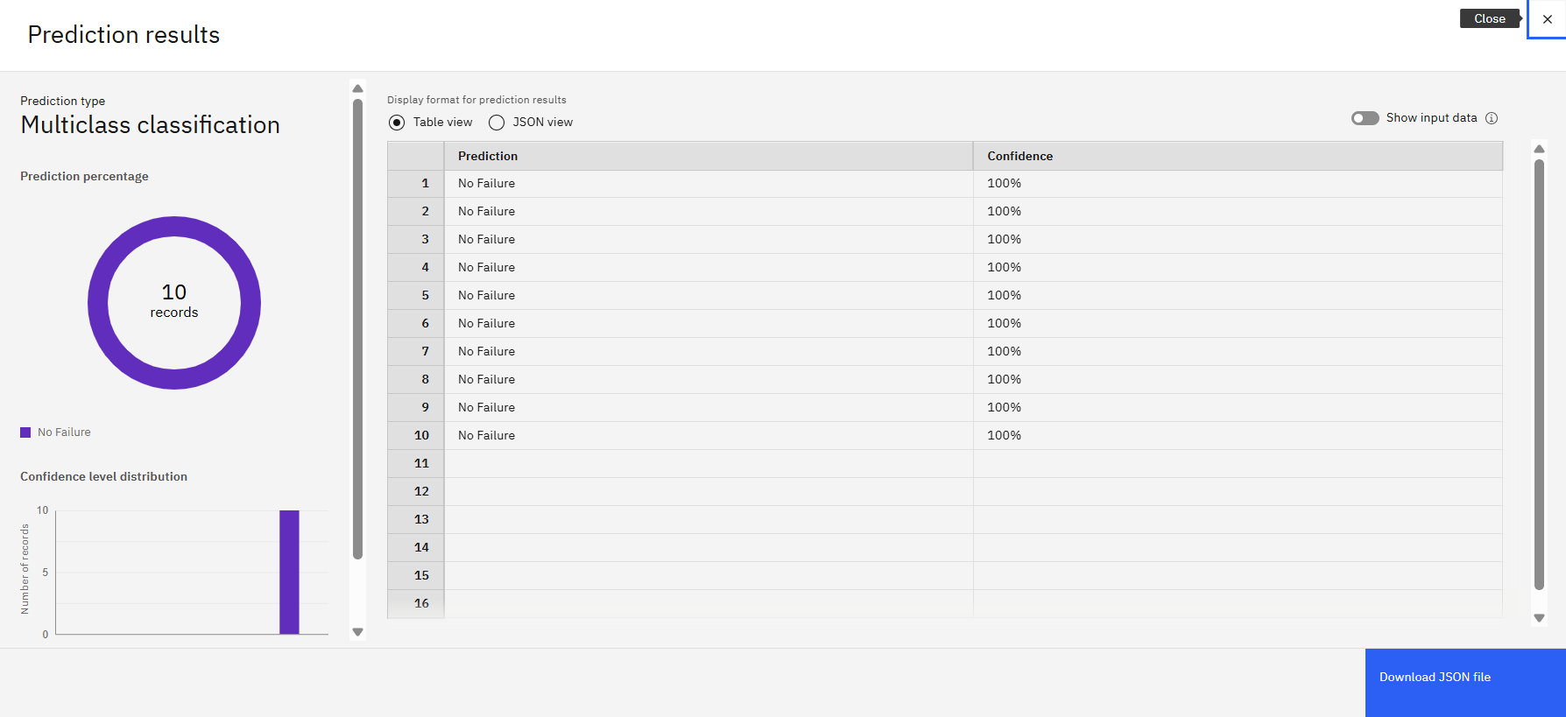
Live model demonstration
The selected model was successfully deployed as a live web service. This screenshot shows a real-time test where the model predicts 'No Failure' with a 98% confidence score based on the input sensor data.

Slide 10
Result
A high-accuracy Gradient Boosting Classifier model was successfully developed, achieving 99.6% accuracy in predicting machine failures.
The model proved to be highly effective in distinguishing between different failure types and normal operations, as validated by the confusion matrix.
Key insights were generated, identifying Torque, Rotational Speed, and Tool Wear as the most critical factors for predicting potential failures.
The final model was successfully deployed as a live web service, making it a practical and usable tool ready for real-world application.

Slide 11
Conclusion
Successfully built and deployed a high-accuracy machine learning model for predictive maintenance.
The model can effectively predict failure types from real-time sensor data.
This provides a powerful tool to enable proactive maintenance, reduce operational costs, and increase machinery uptime.

Slide 12
Future scope
Real-time Integration: Connect the model to live data streams from machinery to provide continuous, real-time health monitoring and automated alerts for the maintenance team.
Predicting "Time to Failure": Enhance the model to predict the Remaining Useful Life (RUL) of a machine, moving from if it will fail to when it will fail.
Prescriptive Analytics: Develop the system further to not only predict failures but also automatically recommend specific maintenance actions or create work orders.
Interactive Dashboard: Build a comprehensive dashboard to visualize the health status of all machines in the fleet at a glance, track performance, and manage alerts.

Slide 13
References
Dataset: Predictive Maintenance Classification Dataset sourced from Kaggle.
URL: https://www.kaggle.com/datasets/shivamb/machine-predictive-maintenance-classification
Technology Platform: IBM Watsonx.ai, utilizing the AutoAI feature for automated model development.
Machine Learning Model: Gradient Boosting Classifier, identified by AutoAI as the optimal model for this dataset.
Project Source: Problem Statement provided by IBM SkillsBuild for Academia & Edunet Foundation.
My GitHub Link: https://github.com/RAgHavj12345/Predictive-Maintenance-Project

Slide 14
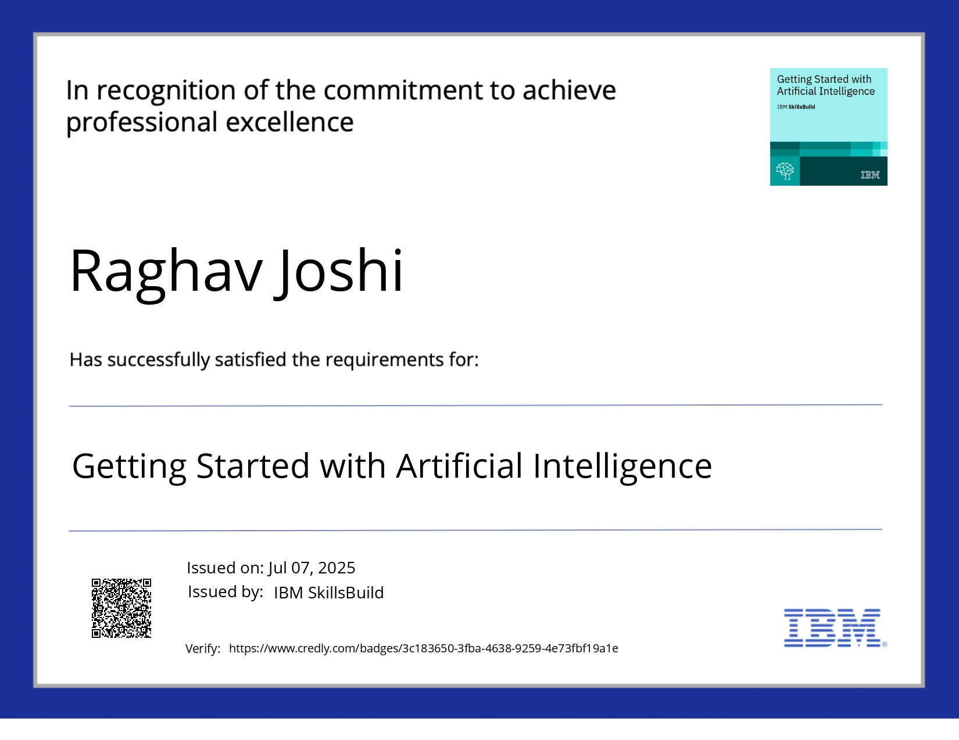
IBM Certifications

Slide 15
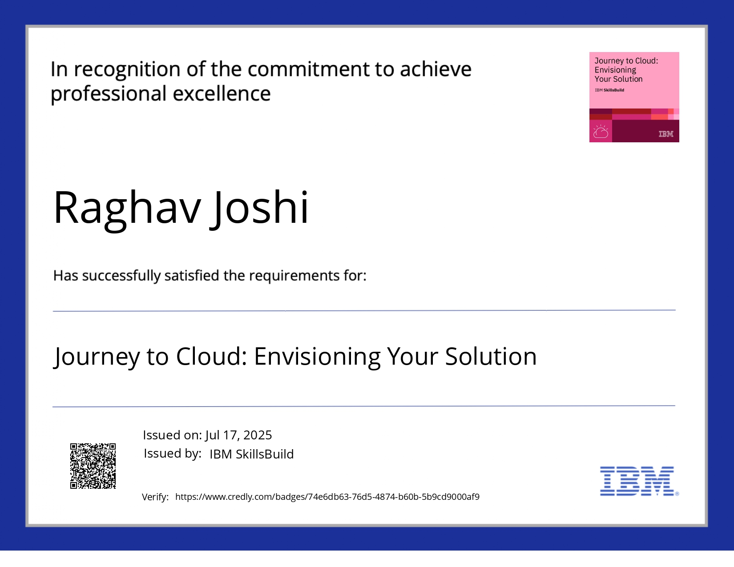
IBM Certifications

Slide 16
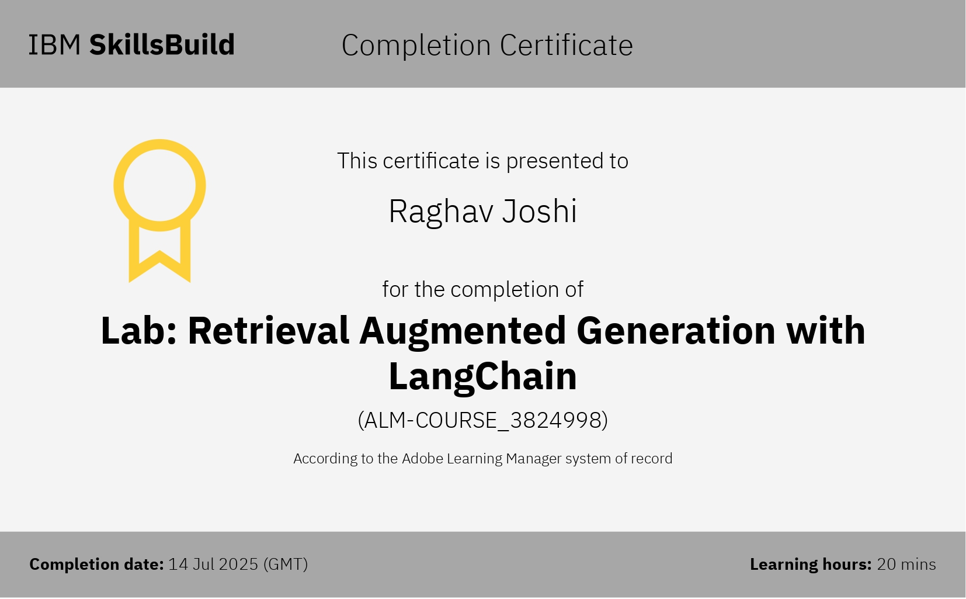
IBM Certifications

Slide 17
THANK YOU

