Slide 1
Grade performace prediction
r. Antonio Vazquez Rodriguez
Data set: https://archive.ics.uci.edu/ml/datasets/Student+Performance

Slide 2

Implementations
Exploratory Data Analysis notebook (students.ipynb)
Transformation of categorical values using sklearn one hot encoder
Multiple Linear Regression Model (regressionByHandMultipleVariables.py)
Comparison with LR model from sklearn (frameworkLR.py)
Decission tree regression performance comparison
Variables
Independent term: G3 (final grade)
Dependent terms : ?

Slide 3
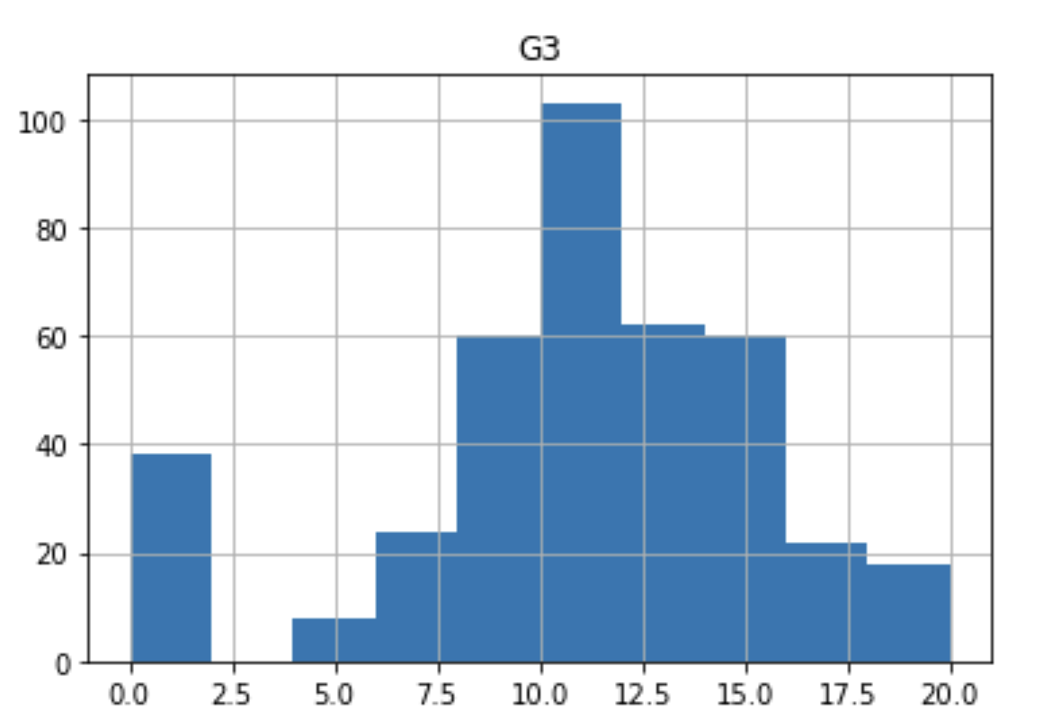
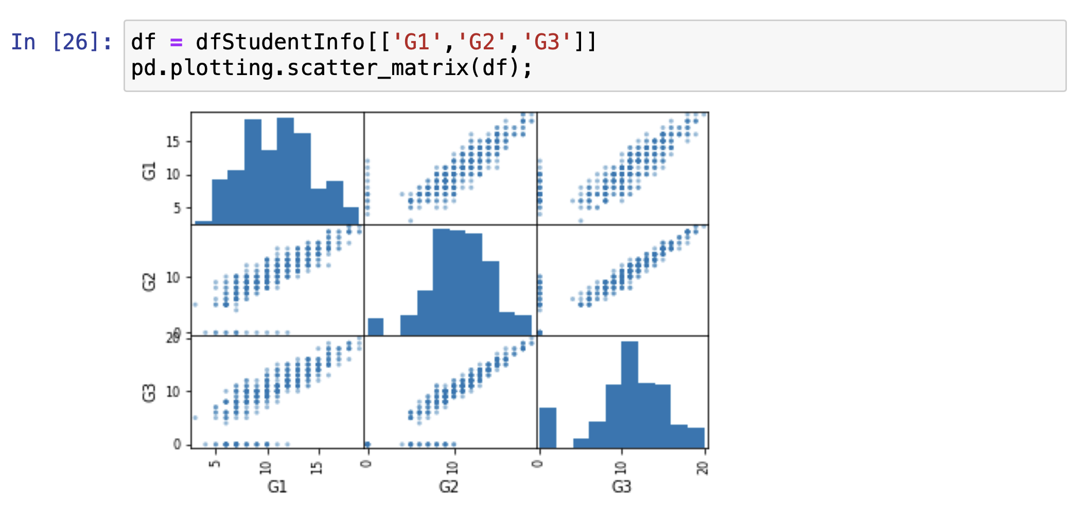
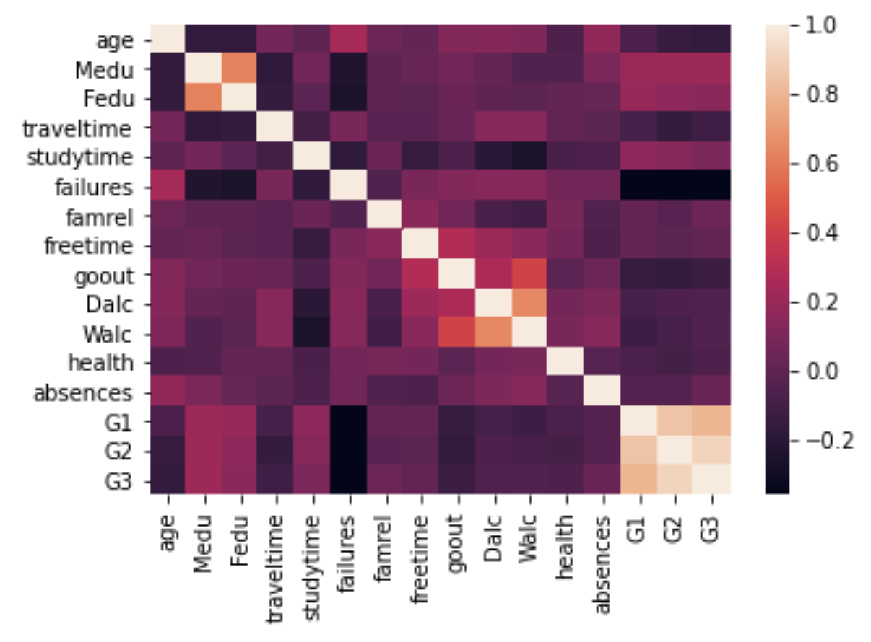
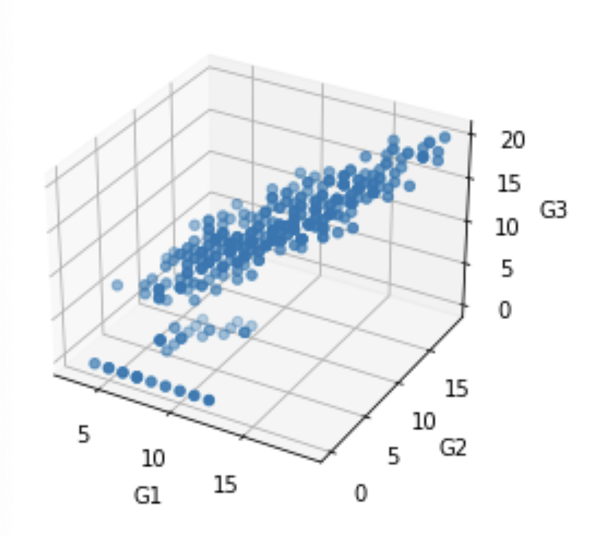
Exploratory Data Analysis
Histogram (target variable)
Linear relationships (scatterplot matrix)
Normal
Distribution!
Outliers!
😮
Correlations
Big
correlation
😎
3D Visualizations (New Matplotlib 3D plots!)
Note: Correlation != causation

Slide 4
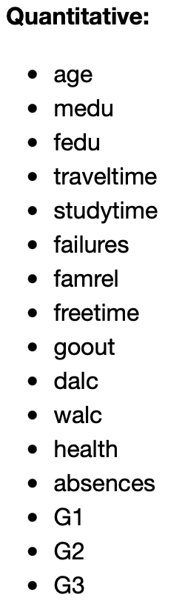
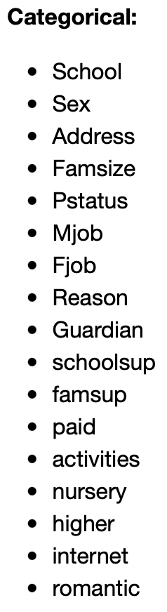

Continuous(16)
Categorical (17)

Slide 5

Feature engineering
Goal: Avoid overfitting or underfitting
Hypothesis 1 features:
G1: first period grade (continuous: from 0 to 20)
G2: second period grade (continuous : from 0 to 20)
Hypothesis 2 features:
absences - number of school absences (continuous : from 0 to 93)
study time - weekly study time (continuous : 1 -<2 hours, 2 - 2 to 5 hours)
Hypothesis 3 features (highly correlated between them):
Mom education - mother's education (continuous)
Father education - father's education
Hypothesis 4 additional categorical feature:
school - student's school (binary: 'GP' - Gabriel Pereira or 'MS' - Mousinho da Silveira) One hot encoding

Slide 6
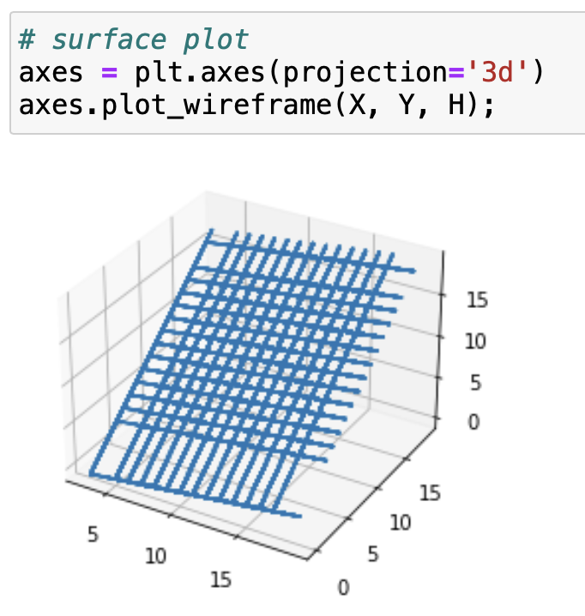
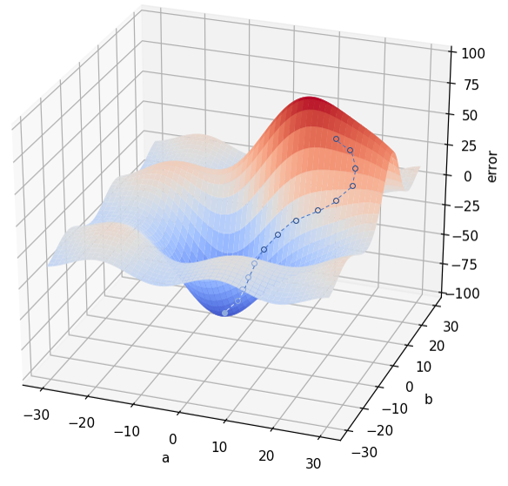
Hand Gradient descent result (hypothesis 1)
$$y=G1 \left(x1\right)+G2\left(x2\right)+yIntercept$$
training
$$y=0.1863 \left(x1\right)+0.9252\left(x2\right)−1.4915$$
Gradient descent
vs
$$y=0.106 \left(x1\right)+1.0260\left(x2\right)−1.7707$$
LR framework

Slide 7
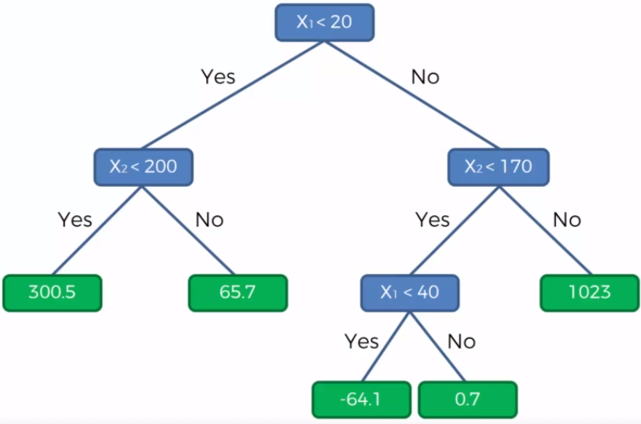
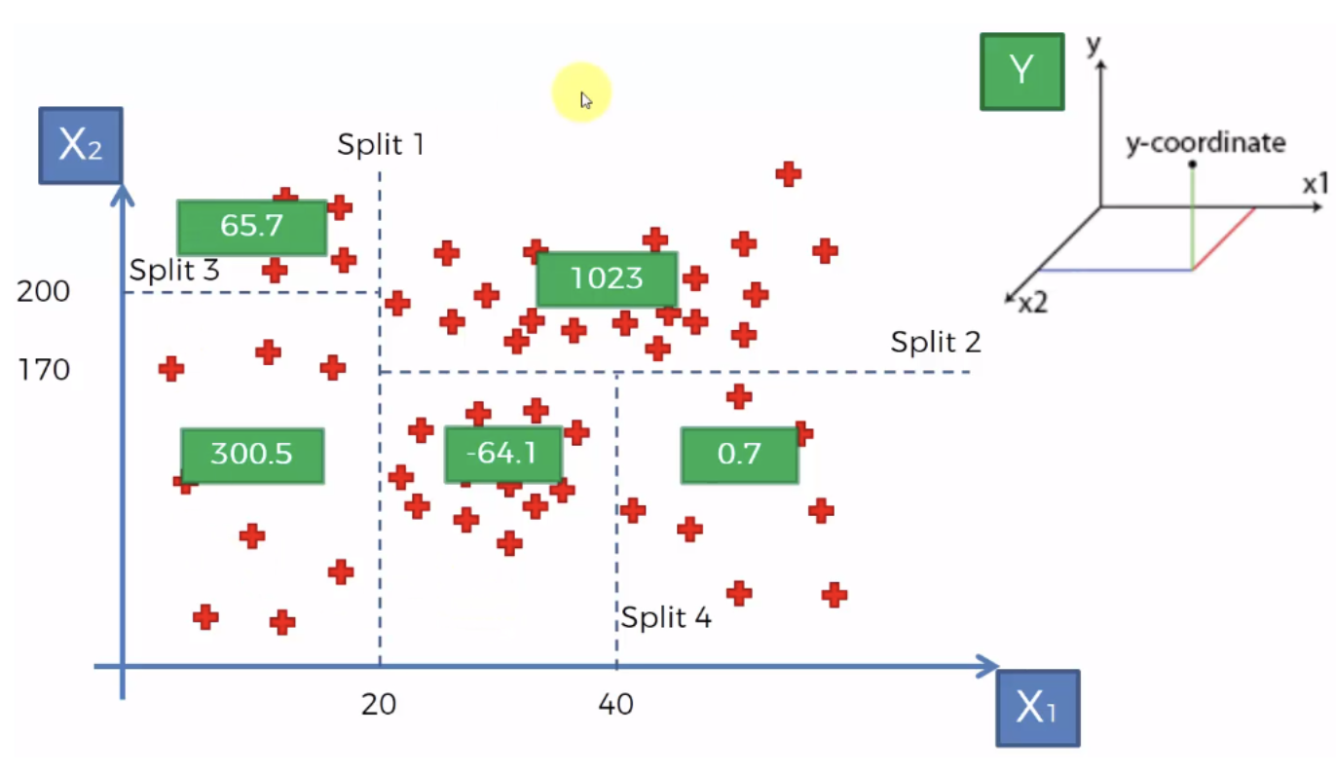
Decision tree regression
Root
Decision node
(x1, x2, ...)
Leafs
How to split
optimally?
Entropy!
Average
of ys
HUGE advantage: no feature scaling needed!

Slide 8
Framework models comparison Results MSE
Feature set | Gradient Descent (Hypothesis 1) | Framework LR (Hypothesis 2) | Decision Tree (Hypothesis 3)
1 | 6.62088 | 6.6451 | 7.6364
2 | 6.3001 | 6.3217 | 6.9525
3 | 6.2844 | 6.5213 | 6.6835
4 | 6.2759 | 6.3923 | 6.5569

Slide 9
Results

Slide 10
References
Szabo, B. (2020, May 26). How to create a seaborn correlation heatmap in python? Medium. Retrieved September 22, 2021, from https://medium.com/@szabo.bibor/how-to-create-a-seaborn-correlation-heatmap-in-python-834c0686b88e.
YouTube. (2021, April 19). MATPLOTLIB 3D plots including Scatter 3D and surface plots for matplotlib Python || Matplotlib Tips. YouTube. Retrieved September 22, 2021, from https://www.youtube.com/watch?v=gqoLLGgbeAE.
sklearn.preprocessing.onehotencoder. scikit. (n.d.). Retrieved September 22, 2021, from https://scikit-learn.org/stable/modules/generated/sklearn.preprocessing.OneHotEncoder.html.
Girgin, S. (2019, July 2). Decision tree regression in 6 steps with python. Medium. Retrieved September 22, 2021, from https://medium.com/pursuitnotes/decision-tree-regression-in-6-steps-with-python-1a1c5aa2ee16.

