Slide 1


Deep learning for quantum chemistry using density functional tight-binding method - Raghav Arora Supervisors: Dr. Alexandre Tkatchenko Dr. Ram Kinkar Roy Under the guidance of: Dr Leonardo Medrano Sandonas

Slide 2
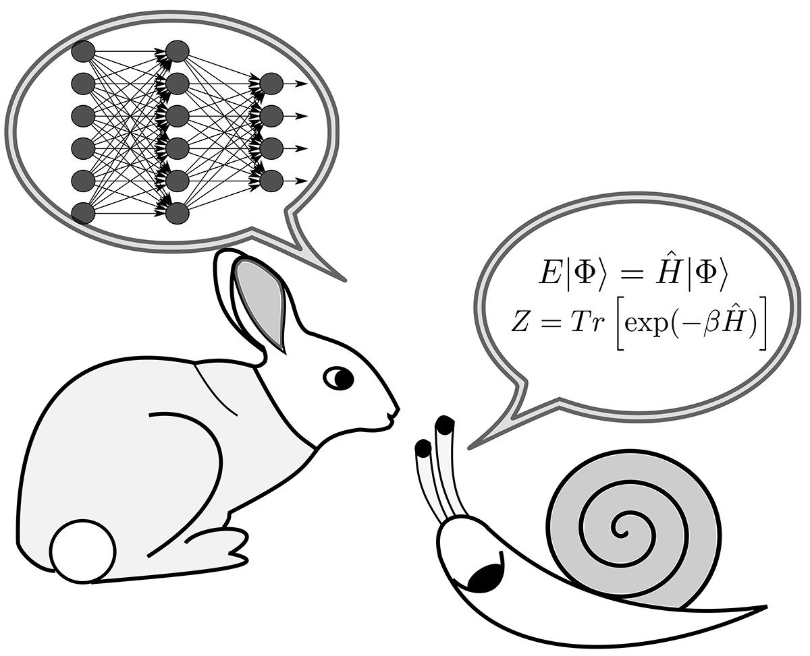
Introduction
Traditional chemical methods for discovery and characterization of compounds are
Time-consuming
Costly
Computational Chemistry methods:
Design and analyse molecules virtually using simulations and quantum-chemical methods.

Slide 3
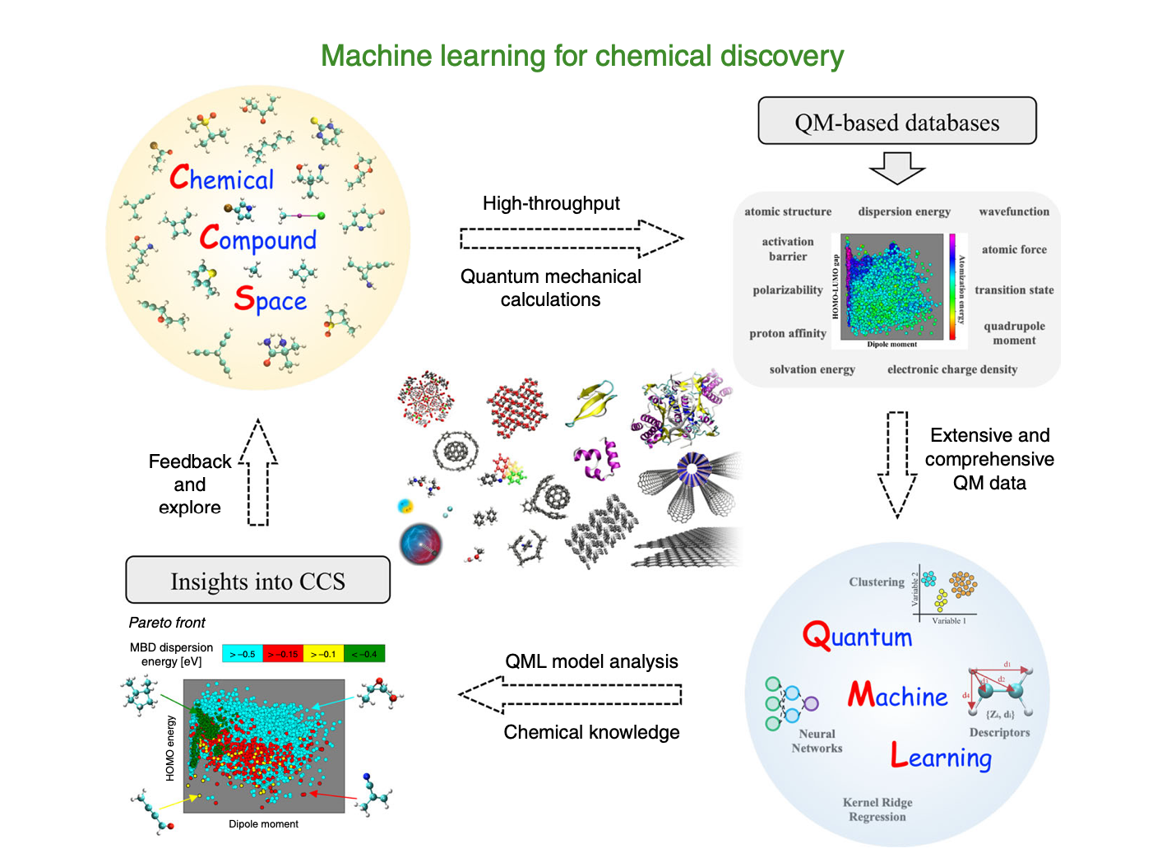
Introduction
Machine Learning (ML) for Chemical Discovery
Challenges in the use of Machine Learning:
Black Box
Difficult to know the best method for a particular application
Quality of Dataset influences the results

Slide 4
Problems at hand
Computational design and discovery of molecules
Molecular Dynamics Simulations
Obtaining efficient force fields
Creation of datasets of molecular structures and properties
Property Prediction
Extending the Chemical Compound Space.

Slide 5
The Use of Machine Learning?
Molecular Dynamics – gives an estimate of the thermodynamic and kinetic properties – accurate only around the equilibrium
Force fields based on solutions to the SE – Time consuming
QM simulations (Kohn Sham DFT) – Too time consuming – not too practical
With ML – obtain the efficiency of QM in practically possible time limit.

Slide 6
QML to explore CCS
CCS – set of all feasible metastable atomic configurations
QML – applying modern statistical learning theory to predict electronic and atomistic properties.
Feedback mechanism between QM(and SM) and statistical ML
How to obtain reference data?
DFT
CCSD(T)
Ex – QM7, QM9, MD17, ANI-1

Slide 7
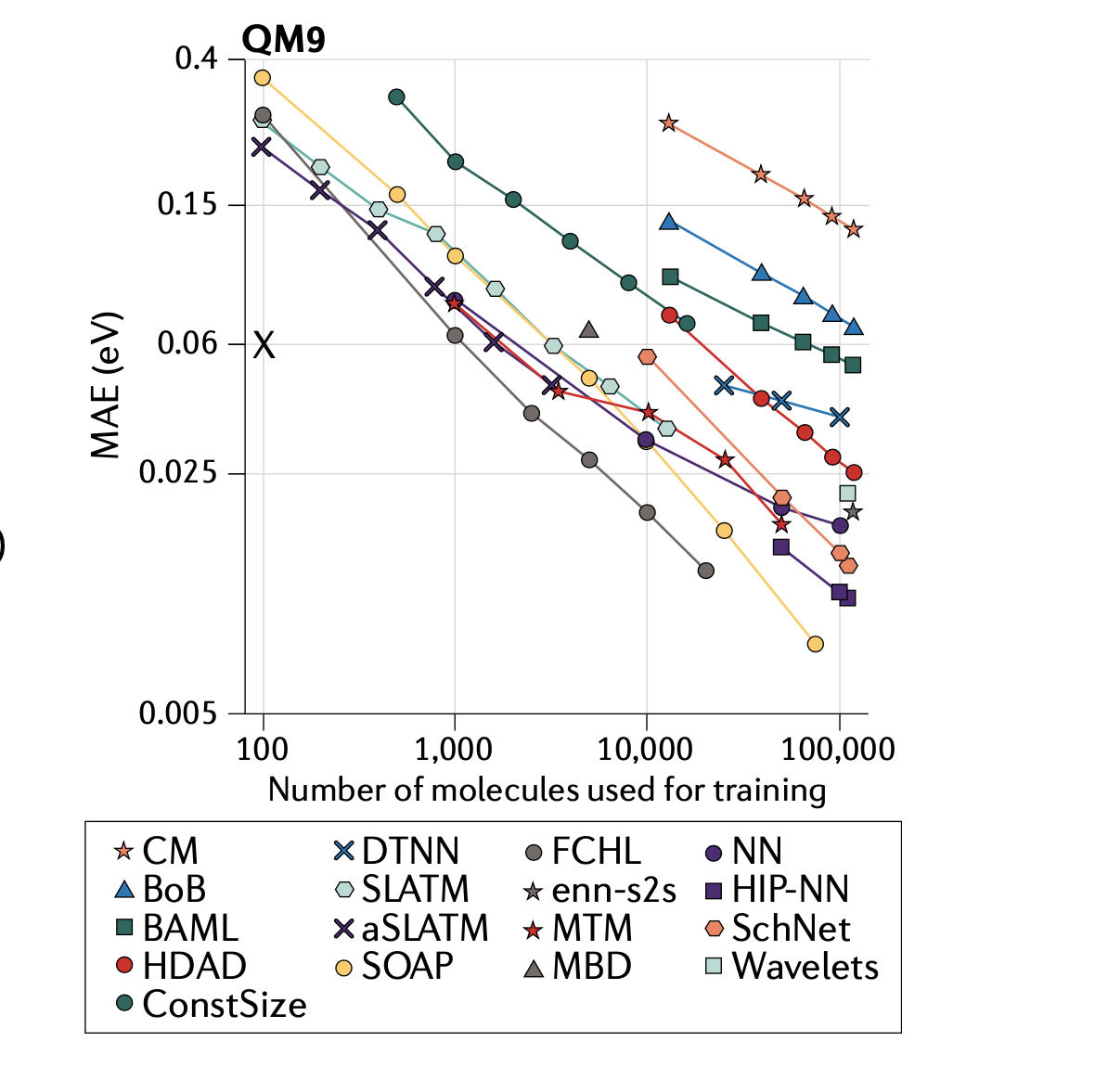
QML to explore CCS
Machine Learning method?
Kernel Ridge Regression
Neural Network
The progress of QML models of atomization energies of molecules over the past few years.
QML prediction errors have decreased by 4—fold – from 8 kcal/mol to 0.2 kcal/mol in 2018

Slide 8
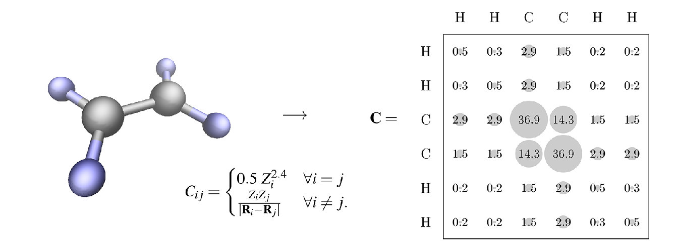
Representation of Molecules - Coulomb Matrix

Slide 9
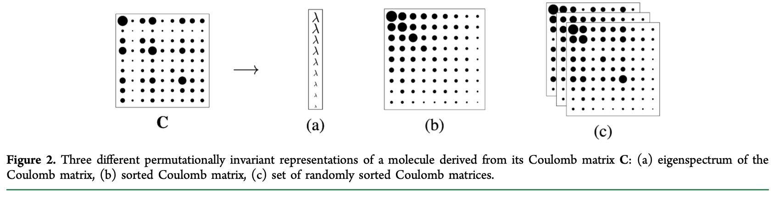
Representation of Molecules - Coulomb Matrix

Slide 10
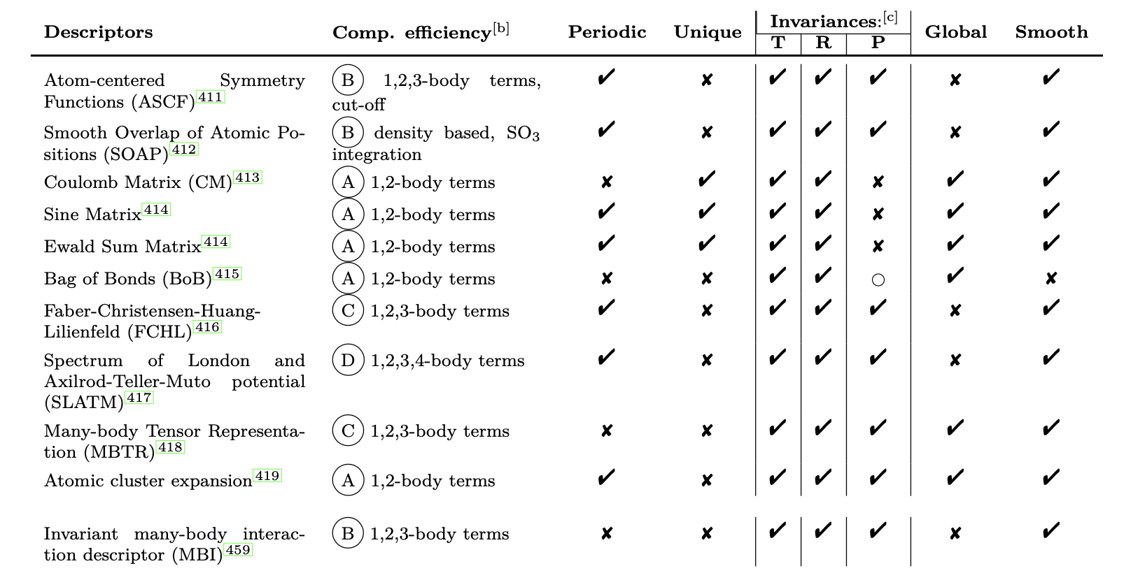
Other Descriptors

Slide 11
Goal of the Thesis
Property Prediction:
Crucial for compound design
Helps to understand the CCS better
Combination of Machine Learning Techniques with quantum mechanical calculations for property prediction.
Studying and Defining novel Molecular Descriptors,
Using the electronic properties obtained from the density functional tight-binding method.
Notes:
The accurate prediction of molecular properties in chemical compound space (CCS) is a crucial ingredient toward rational compound design in chemical and pharmaceutical industries.
Therefore, more efficient algorithms that can predict properties of molecules quickly and reliably would be a powerful tool in order to sample and better understand CCS.

Slide 12
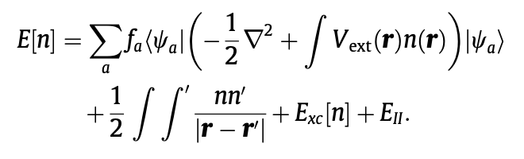
Density Functional Tight Binding Approximation
n(r) = n₀(r) + ∂n(r)
n(r) that minimizes the energy is the ground state density.

Slide 13
Density Functional Tight Binding Approximation
E[δ⍴0] = E_{rep} + E_{Coul}[δ⍴₀] + E_{BS}[δ⍴₀].
E_{BS} - ‘band structure’ term - contains contributions from
T_{ni -} kinetic energy of the non-interacting electrons
V_{eN} - exact nuclear- electron potential, and the
exchange correlation functional

Slide 14
Machine Learning Methods
Using Efficient Coulomb Matrices and tight-binding properties as inputs, machine learning models can be implemented for property prediction
Linear Ridge Regression
Kernel Ridge Regression.
Support Vector Regression.
Multilayer Neural Networks.

Slide 15
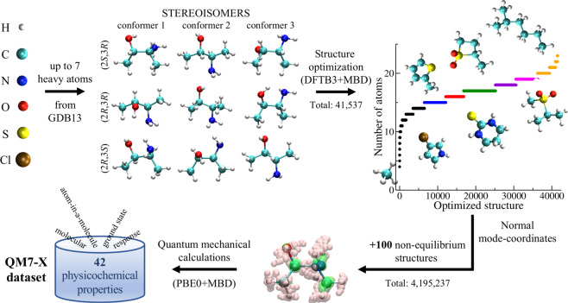
Methodology – Data Preparation
Using QM7-x dataset, for the DFTB properties and information for computing molecular descriptors.
Dataset contains 42 physicochemical properties for
Equilibrium structures
Distorted Structures

Slide 16
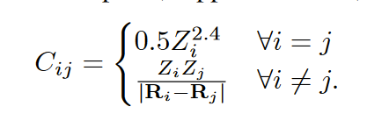
Methodology – Molecular Descriptors Used
Molecular Descriptors considered:
Coulomb Matrix:
Bag of Bonds: an extension to the Coulomb matrix
SLATM
Notes:
The diagonal elements of the Coulomb matrix correspond to a polynomial fit of the potential ener- gies of the free atoms, while the off-diagonal elements encode the Coulomb repulsion between all possible pairs of nuclei in the molecule. As such, the Coulomb matrix is invariant to translations and rotations of the molecule in 3D space; both transformations must keep the potential energy of the molecule constant by definition.

Slide 17
Properties used:
Fermi Energy,
Band Energy,
Number of Electron,
H0Ene – 0th DFTB Energy,
SccEne – Second DFTB Energy,
3rdEne – 3rd DFTB Energy,
Repulsive Energy,
mbdEne,
Tbdip – Dipole Moment,
Tbeig – Eigen Value,
TBchg – Electronic Charge
Notes:
Property Predicted: Atomization Energy
Total feature size of DFTB properties: 40
Total feature size of molecular descriptors:
Coulomb Matrix: 276
BOB: 528
SLATM: 17935

Slide 18
Neural Networks
Property Predicted: Atomization Energy
Total feature size of DFTB properties: 40
Total feature size of molecular descriptors:
Coulomb Matrix: 276
BOB: 528
SLATM: 17935
Architectures used:
Using only geometric molecular descriptors.
Using Geometric Descriptors and DFTB properties concatenated for input layer
Using separate models for Geometric Descriptors and DFTB properties
Feature Selection was done to select the most relevant properties for training the model

Slide 19
Results

Slide 20
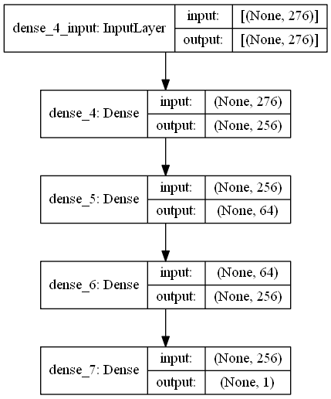
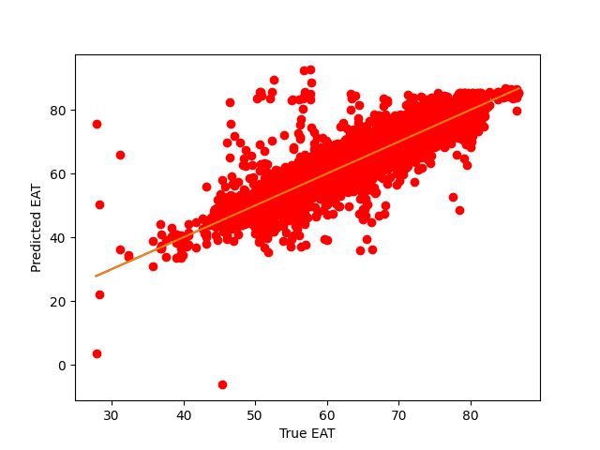
Architecture-1
Sequential Neural Network with only molecular descriptors (Coulomb Matrix)
Output with training size of 30,000, validation size 1,000, test size of 10,000
Test error: 0.711 eV = 16.39 kcal/mol
Using Non -Equilibrium Molecules

Slide 21
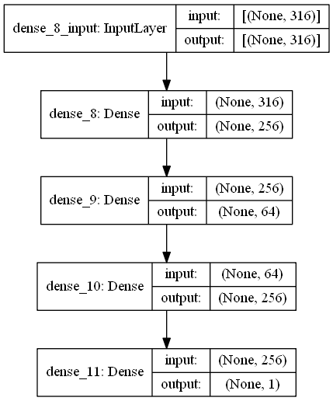
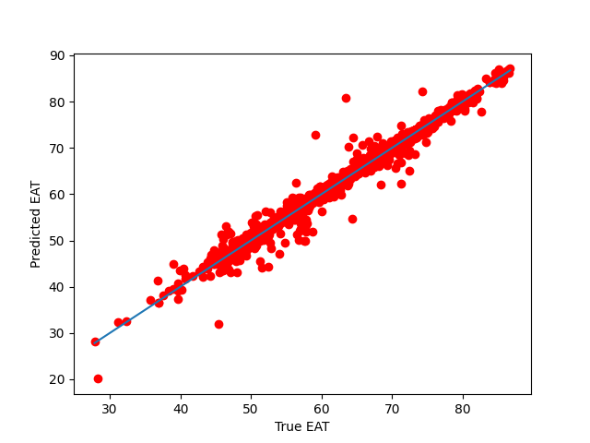
Architecture-2
Sequential Neural Network with Coulomb Matrix and DFTB properties concatenated for the input layer.
Output with training size of 30,000, validation size 1,000, test size of 10,000
Test error = 0.39 eV = 9 kcal/mol
Using Non -Equilibrium Molecules
Notes:
Mention that funnel based approach did not give better results

Slide 22
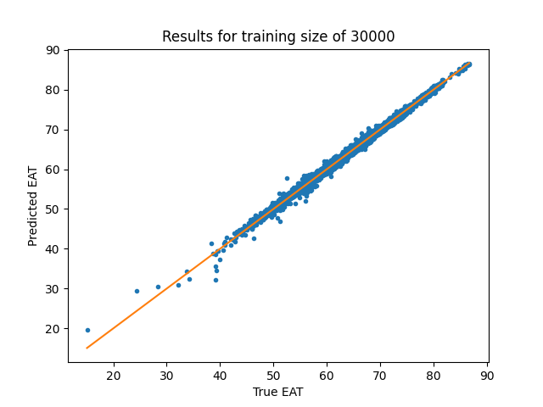
Architecture-2 – With Standardization
Sequential Neural Network with Molecular Descriptors and DFTB properties concatenated for the input layer
Training size: 30,000; validation size: 1,000; test size: 10,000 – Non-Equilibrium dataset
Test error = 0.35 eV = 8.07 kcal/mol
Data standardization of DFTB properties.
Notes:
Using funnel based approach

Slide 23
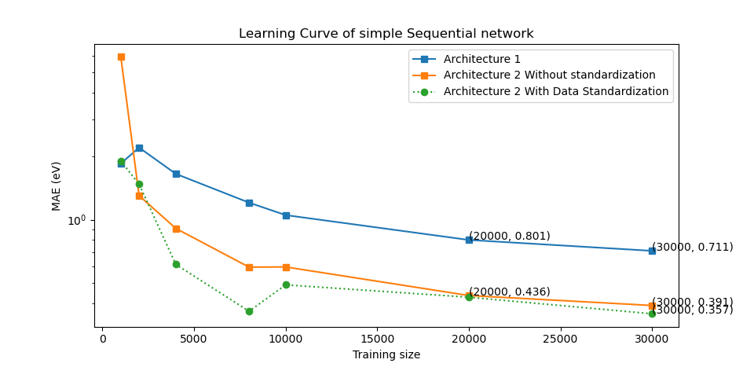
Y-axis is in logarithmic scale

Slide 24
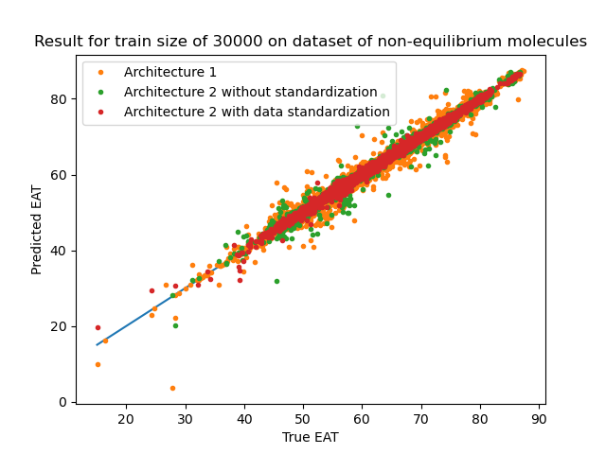

Slide 25
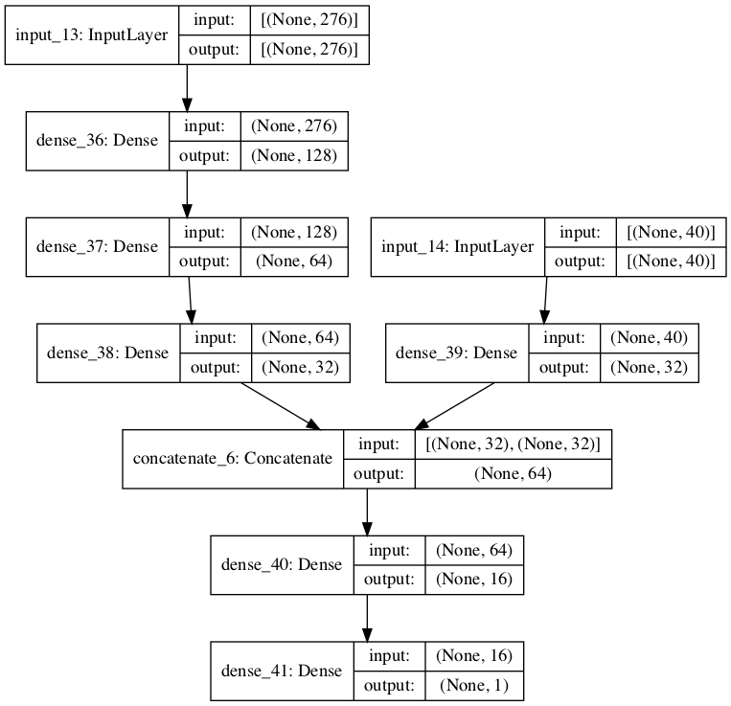
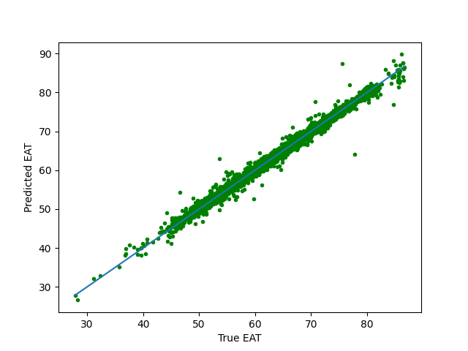
Architecture 3: Using 2 separate models followed by concatenation Final error: 0.4132 eV = 9.53 kcal/mol

Slide 26
Sequential Model Using BOB (Bag of Bonds)
Shape of input layer: 528+40 = 568
Output with training size of 30,000, validation size 1,000, test size of 10,000
Non-Equilibrium molecules
Test error = 0.302 eV = 6.96 kcal/mol

Slide 27
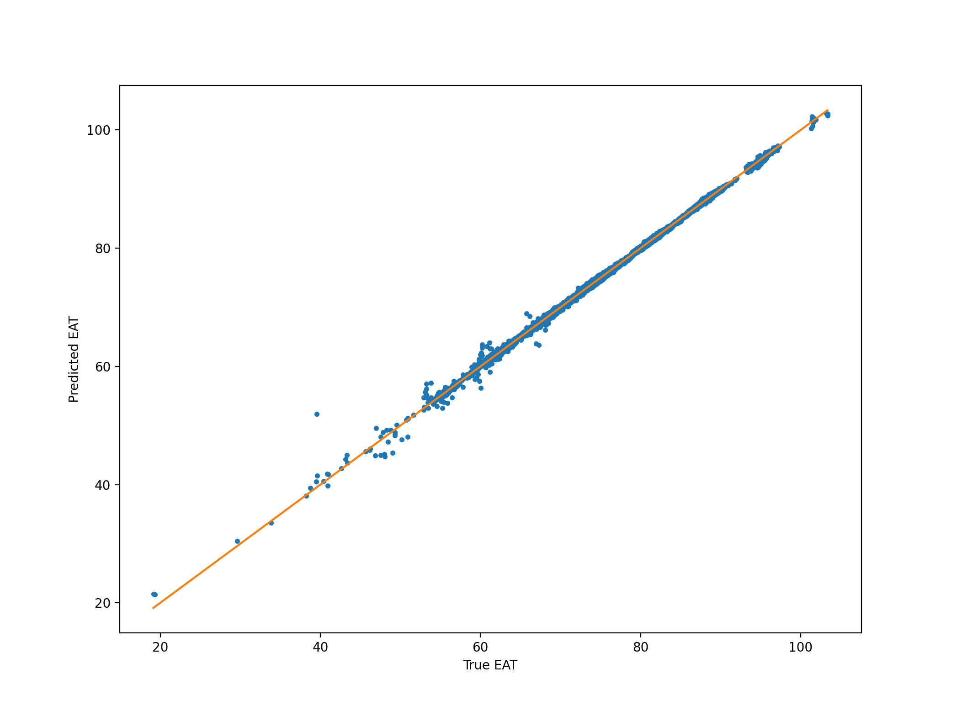
Architecture 2 on Dataset of Using slightly distorted molecules
Output with training size of 50,000, validation size 5,000, test size of 200000
Test error = 0.1712 eV = 3.94 kcal/mol

Slide 28
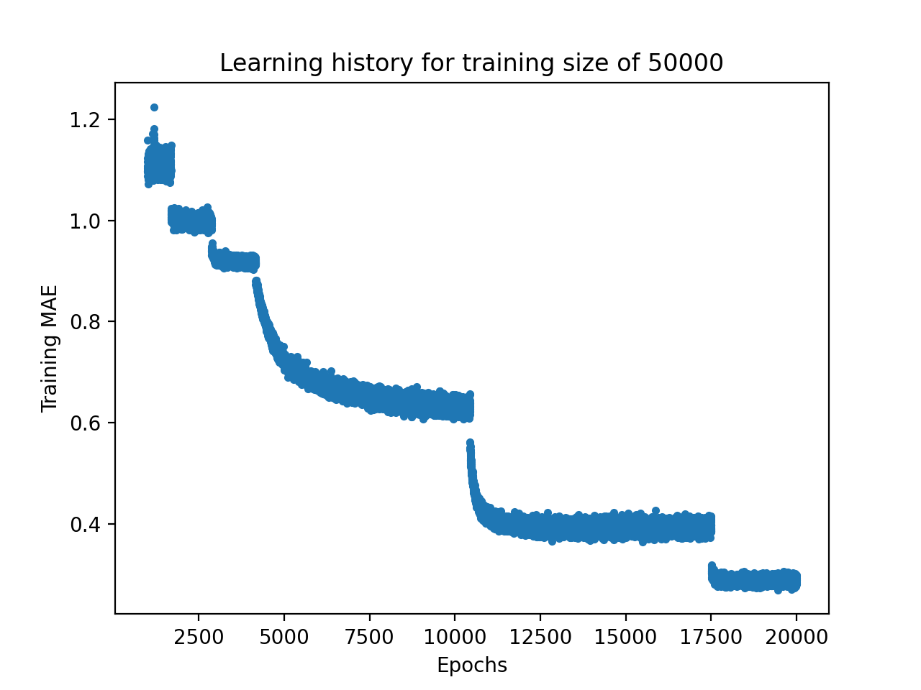

Slide 29
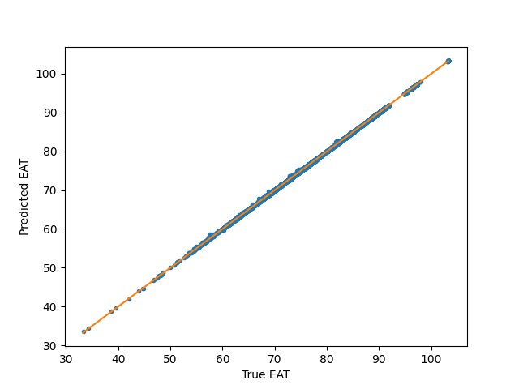
SLATM
Equilibrium Dataset:
Train_set=30000
Val_set=1000
Test_set=200000
MAE = 0.0498 eV = 1.148 kcal/mol

Slide 30
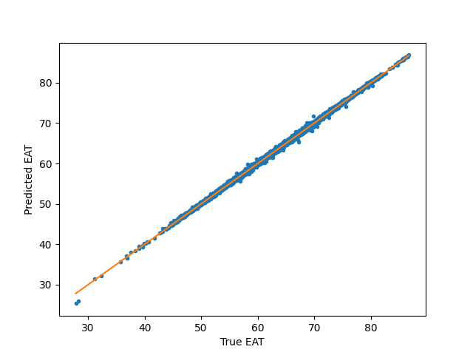
SLATM
Distorted Dataset:
Train_set=30000
Val_set=1000
Test_set=200000
MAE = 0.16494 eV = 3.803 kcal/mol

Slide 31
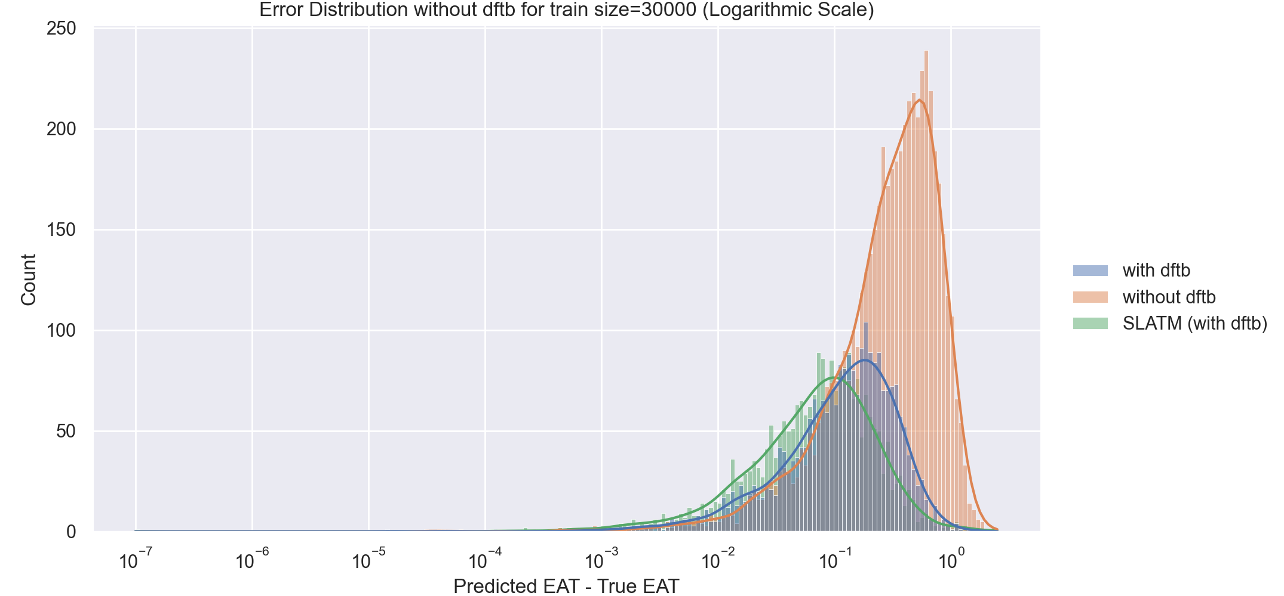

Slide 32
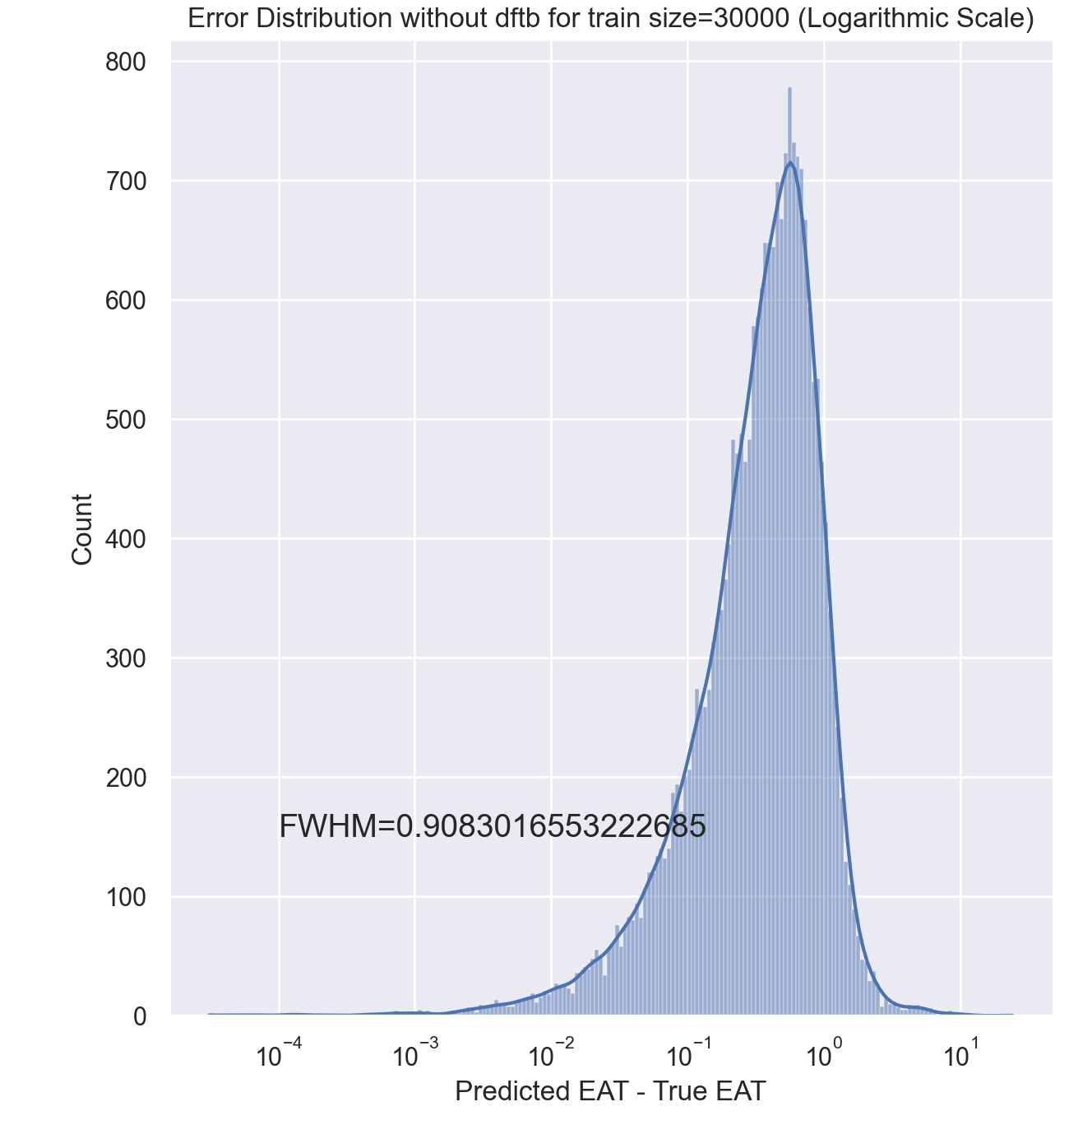
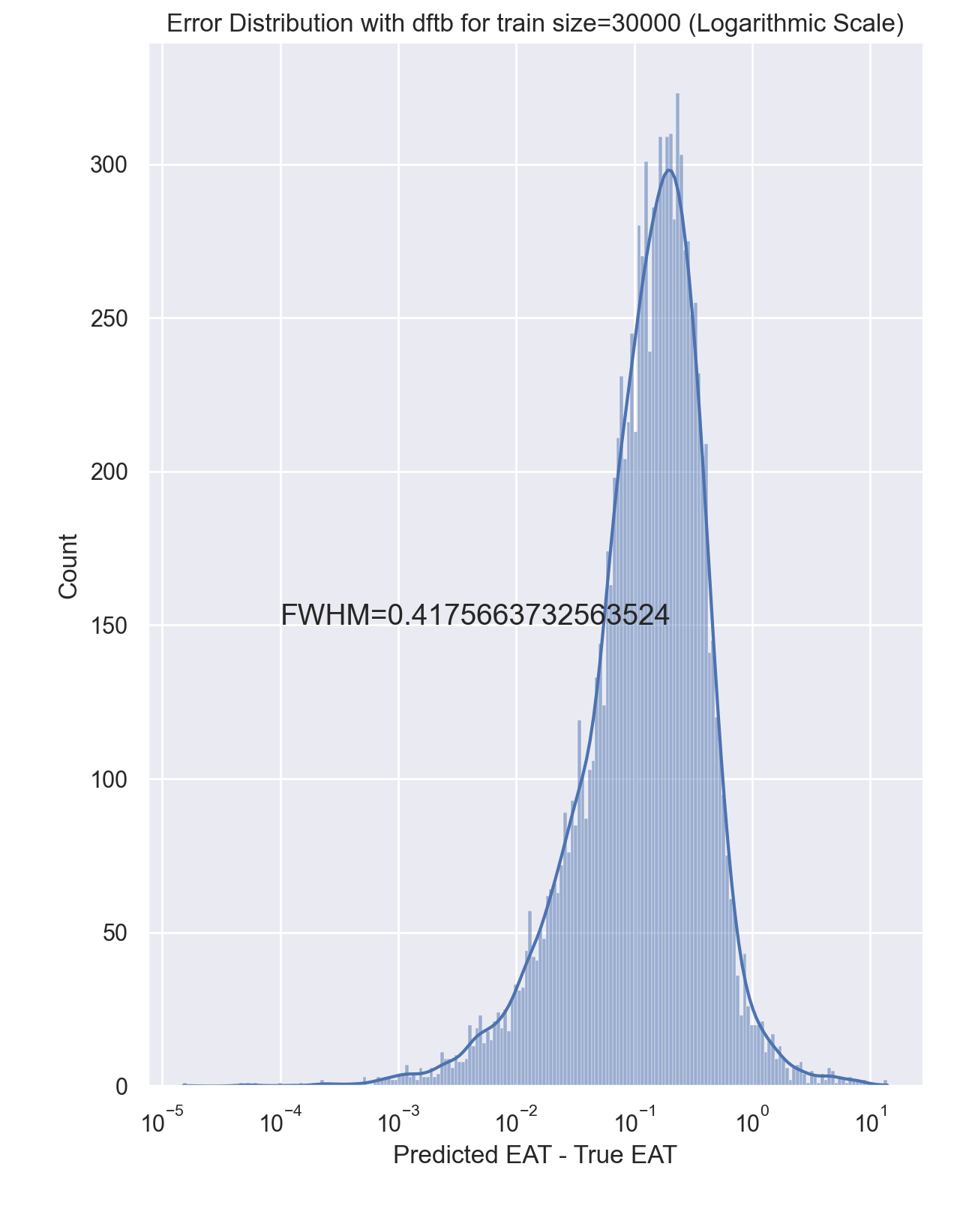
 | With DFTB | Without DFTB | BOB | SLATM (Distorted) | SLATM (Eq)
Std Dev: | 0.4492 | 0.7048 | 0.384 | 0.195 | 0.0706

Slide 33
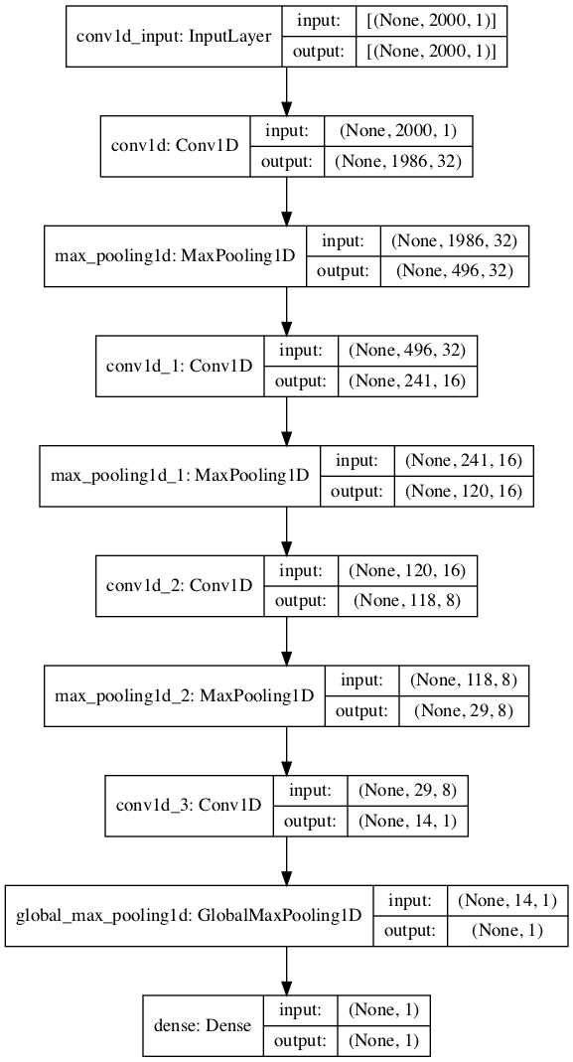
Using Kernel
Test error (with the train kernel)= 5.82 eV
Test error (after using alpha) = 4.56 eV

Slide 34
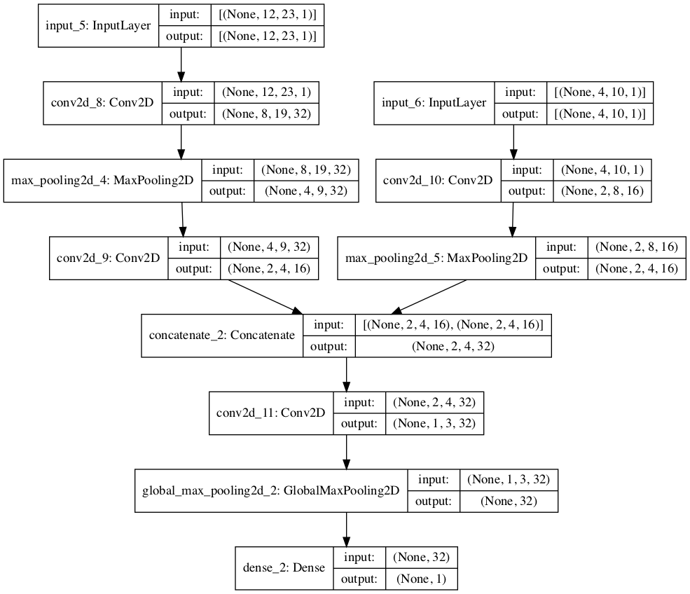
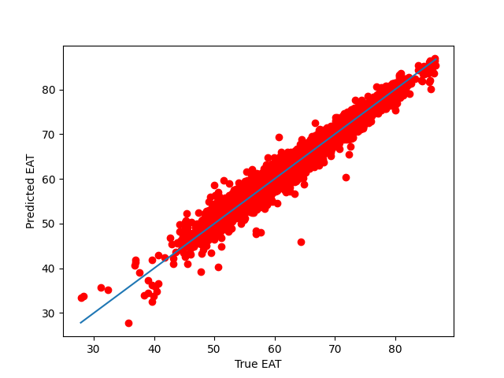
CNN – Failed Model Final error: 6.88 eV

Slide 35
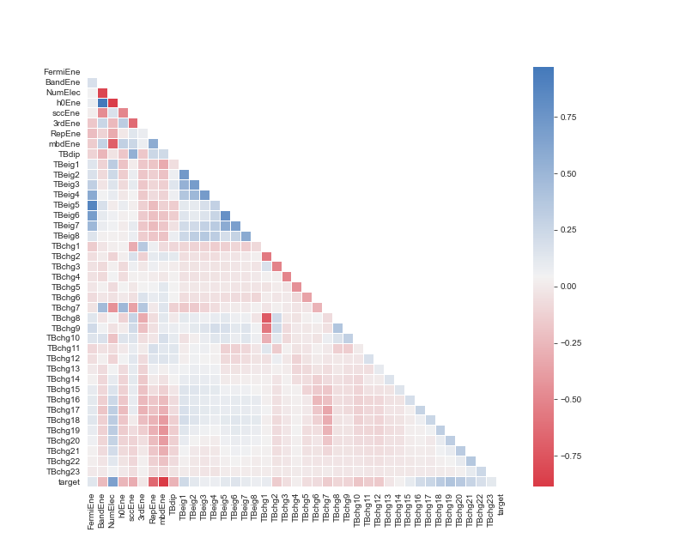
Feature Extraction

Slide 36
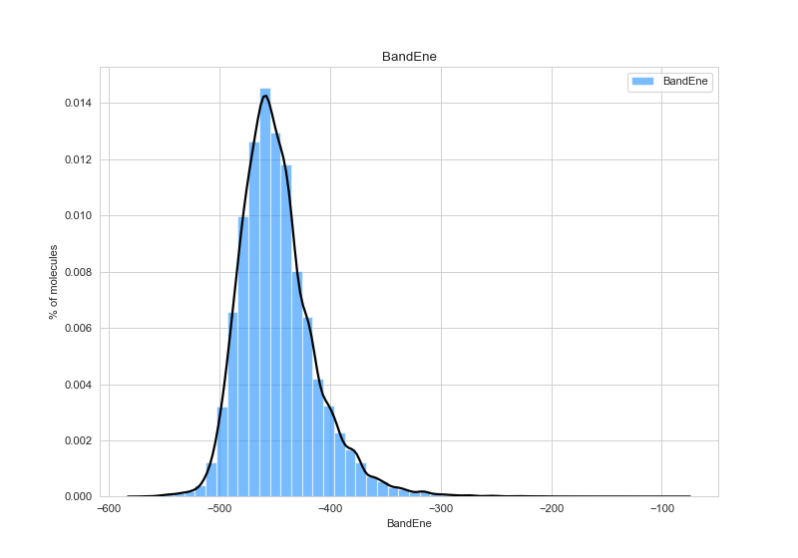
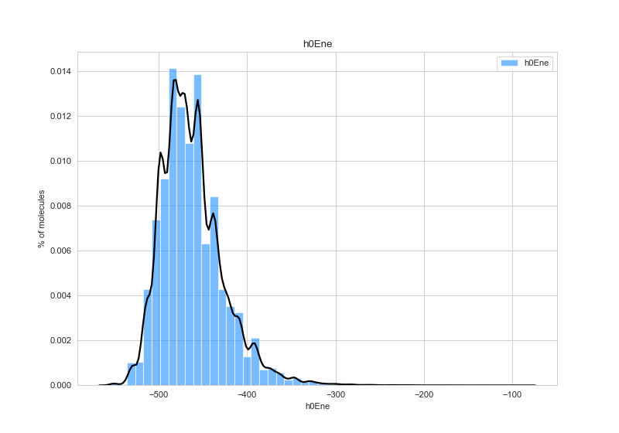
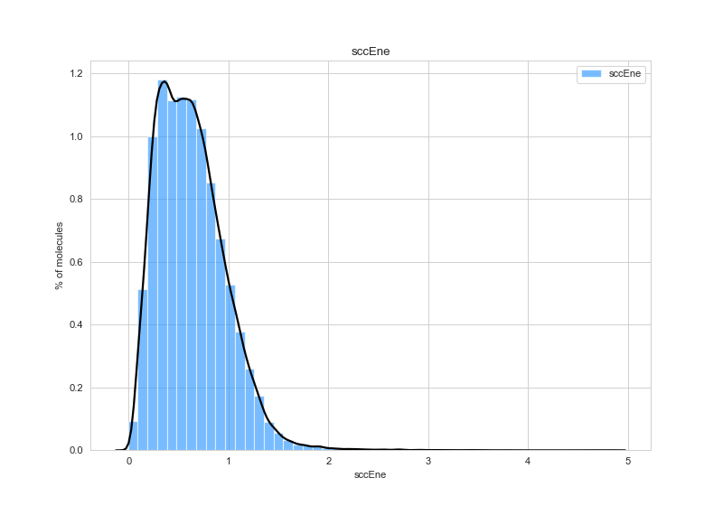
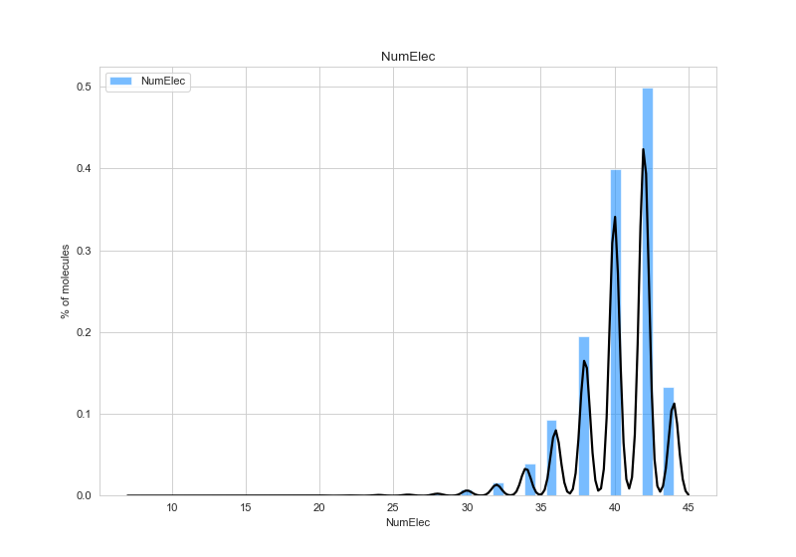

Slide 37
Train set | None | FermiEne | BandEne | NumElec | h0Ene | sccEne | 3rdEne | RepEne | mbdEne | TBdip
1000 | 1.882 | 1.885 | 2.047 | 5.810 | 2.412 | 1.999 | 1.891 | 3.08 | 1.924 | 1.895
2000 | 1.462 | 1.479 | 2.276 | 11.120 | 4.71 | 1.517 | 1.471 | 2.53 | 2.294 | 1.481
4000 | 0.59 | 0.702 | 0.687 | 22.34 | 23.614 | 0.738 | 0.624 | 3.606 | 1.022 | 0.595
8000 | 0.348 | 0.5416 | 0.4004 | 24.352 | 19.983 | 0.530 | 0.370 | 3.016 | 0.578 | 0.350
10000 | 0.4738 | 0.6052 | 0.682 | 12.93 | 15.837 | 0.648 | 0.480 | 4.314 | 0.956 | 0.483
20000 | 0.4224 | 0.579 | 0.599 | 13.63 | 16.91 | 0.616 | 0.425 | 4.33 | 0.620 | 0.431
30000 | 0.3425 | 0.451 | 0.717 | 22.87 | 25.98 | 0.509 | 0.347 | 4.42 | 0.644 | 0.349
Property Removed->

Slide 38
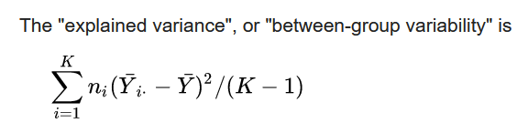
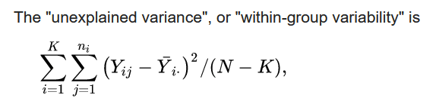
Correlation Scores
 | FermiEne | BandEne | NumElec | h0Ene | SccEne | 3rd Ene | Rep Ene | Mbd Ene | TbDip
 | 1.728 | 2.039 | 3.92 | 2.353 | 2.37 | 2.002 | 4.796 | 8.813 | 1.561
F-classif -> ANOVA f-values: Denoting the correlation of these properties with Atomization Energy
F = (Explained Variance)/(Unexplained Variance)
Yi = Samples of ith group
n_{i} = is the number of observations in the i-th group
K = Number of groups

Slide 39
RFE – Recursive Feature Elimination
Select 4 features: NumElec, h0Ene, Rep Ene, MbdEne
Rank of Remaining features:
SccEne– 2nd
FermiEne – 3rd
Band Ene – 4th
3rd Ene– 5th
Using: DecisionTreeRegressor
To-do: Using keras model for better understanding

Slide 40
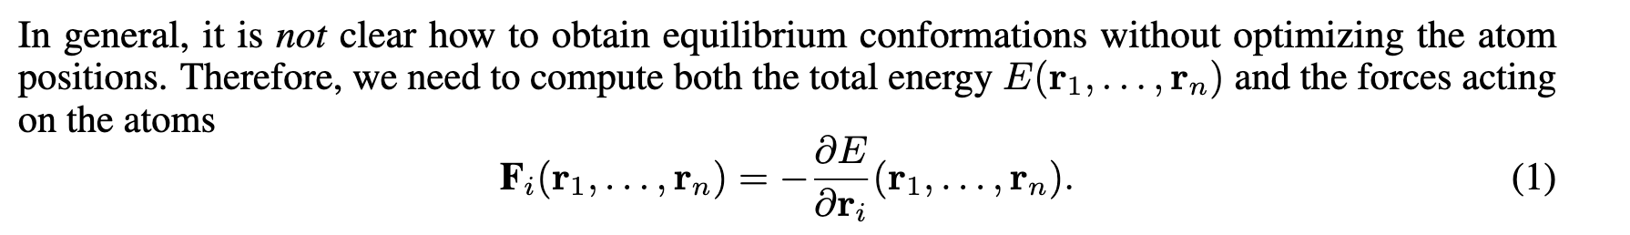
Forces
Fp = -tf.gradients(tf.reduce_sum(Ep), atoms_input[1])[0]

Slide 41
Challenges?
Improved quantum chemistry methods which can reliably cope with reaction barriers, d- and f-elements, magnetic and excited states, as well as redox properties of systems in any aggregation state.
Extensive high- quality data sets covering many properties over wide swaths of structural and compositional degrees of freedom
The removal of hidden and unconscious biases

