Slide 1
Using deep learning to non-iteratively conduct palette generation in class specific color quantization
Russel Arbore and Ezra Tock
Los Altos High School

Slide 2
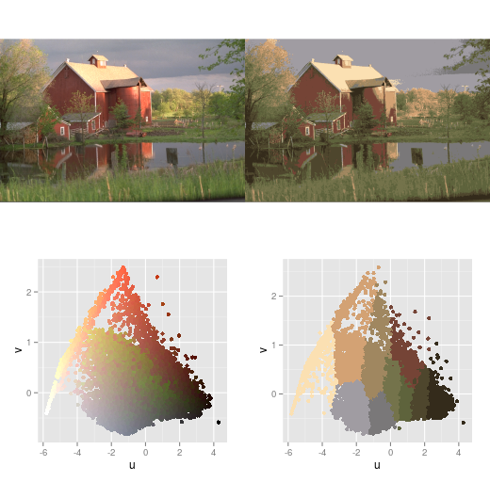
What is Color Quantization (CQ)?
Original image
Quantized image
“Representing an image with high color-depth as accurately as possible with a smaller color palette”
Palette generation (least trivial part): finding 𝙆 colors that can best represent the image
Pixel mapping: mapping each pixel to the closest color in the palette to create the “quantized” image
Extract
Colors
Original palette
Generated palette
Pixel Mapping
Palette Generation
Walker, Ryan. “Color Quantization in R.” R, 3 Jan. 2016, www.r-bloggers.com/2016/01/color-quantization-in-r/.
Notes:
The process of changing high resolution images into the most accurate representation of them with less colors in order to save memory/space *JUST REDUCES COLORS
Used to be absolutely necessary for pre-processing data for image manipulation algorithms because high resolution images were too big

Slide 3
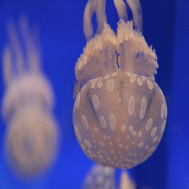
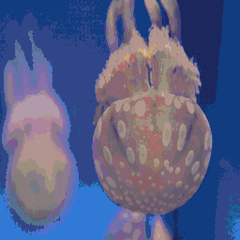
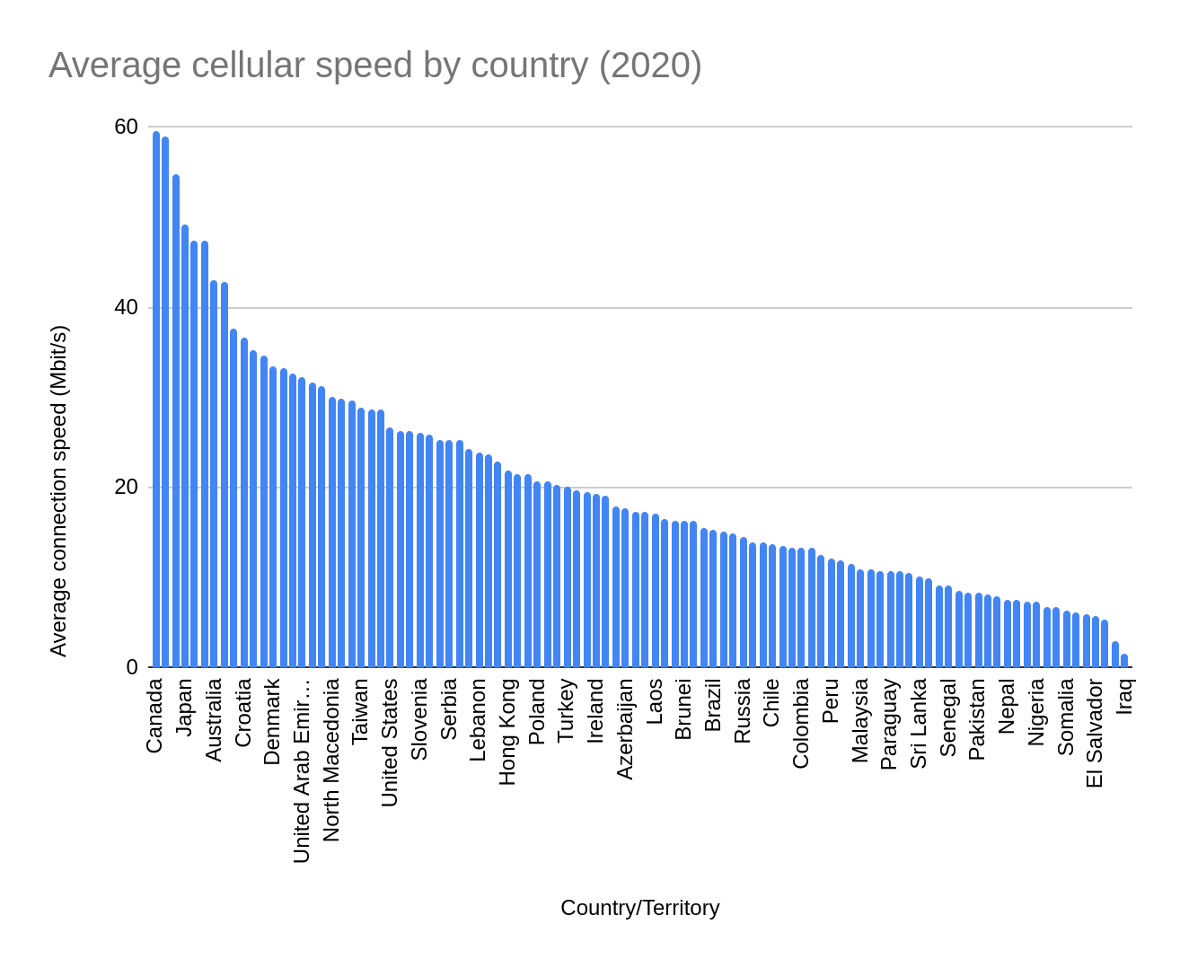
Applications of CQ
Image compression
  For Bitmaps
    Fewer bits needed per pixel with fewer colors
    24-bit color requires 3 bytes per pixel
    A quantized image w/ 64 colors requires 6 bits (¾ of a byte) per pixel + 𝙆 * 24 bits (192 bytes for 𝙆 = 64) to store the palette
  Conventional Formats (i.e. .png)
    Example: 1920x1080 image
      Uncompressed: 5.93 MiB
      Quantized: 1.48 MiB
    CQ can help reduce size of .png, .jpg, etc. since these formats often compress repeat colors automatically (.png uses DEFLATE -> LZSS)
    Content retrieval - individuals with low bandwidth internet can more easily enter the digital world if basic function of the internet are optimized for low bandwidth clients
Original .png Image:
88.22 KiB
Quantized .png Image:
23.94 KiB
B. Zhou, A. Lapedriza, J. Xiao, A. Torralba, and A. Oliva. “Learning Deep Features for Scene Recognition using Places Database.” Advances in Neural Information Processing Systems 27 (NIPS), 2014.
Storer, James A., and Thomas G. Szymanski. “Data Compression via Textual Substitution.” Journal of the ACM, vol. 29, no. 4, 1982, pp. 928–951., doi:10.1145/322344.322346., Fenwick, Sam, and Hardik Khatri. n.d., The State of Mobile Network Experience 2020: One Year Into the 5G Era., B. Zhou, A. Lapedriza, J. Xiao, A. Torralba, and A. Oliva. Learning Deep Features for Scene Recognition using Places Database. Advances in Neural Information Processing Systems 27 (NIPS), 2014.
Notes:
Now it is used for compression, segmentation, text detection, color/texture analysis, watermarking, non-photorealistic rendering, content-based retrieval (probably don’t need to present all)
Content retrieval = low-bandwidth retrieval of images

Slide 4


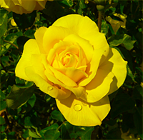
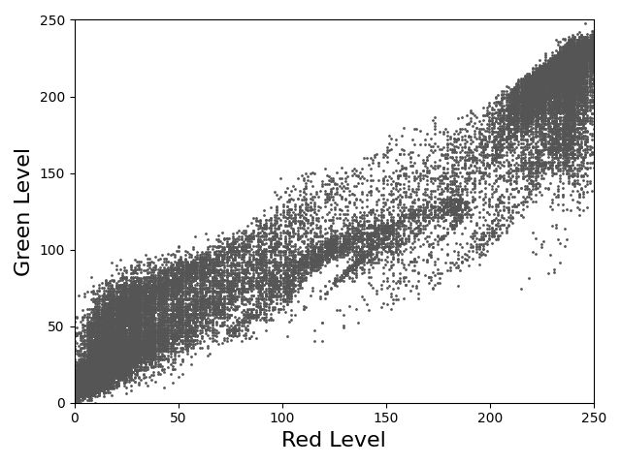
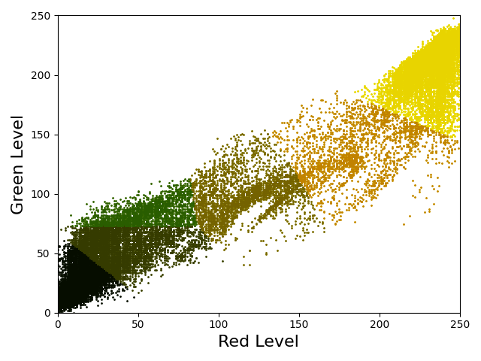
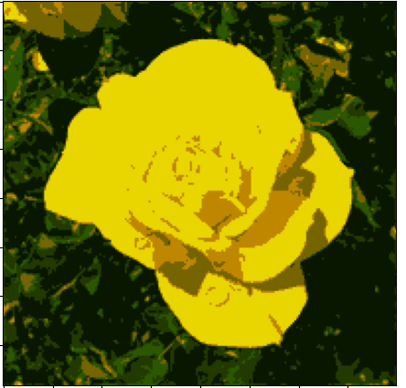
Original method: K-Means Clustering
Finds clusters ( ) to best represent the set of colors, ( )
Create random initial palette:
Map all pixels to closest color in the palette:
Recalculate each color in the palette to the average of the corresponding pixels:
Repeat steps 2 and 3 until palette stops changing
repeat
Input
1)
2)
3)
Result
Major drawbacks:
Non-deterministic - sensitive to the random initial palette
Possible forever loop - need either iteration limit or minimum center-shift threshold to fix “cycling” clusters
Iterative - necessarily stuck on CPU control logic
In general, not easy to deploy on large scale for conducting lots of CQ
Piech, Chris. “K Means.” Stanford, 201AD, stanford.edu/~cpiech/cs221/handouts/kmeans.html., Larsson, Stefan, and Filip Mellqvist. “Automatic Number Plate Recognition for Android.” DIVA, 26 June 2019, kau.diva-portal.org/smash/record.jsf?pid=diva2%3A1325108.

Slide 5
Can we achieve the high quality results of K-Means without the implementation problems?

Slide 6
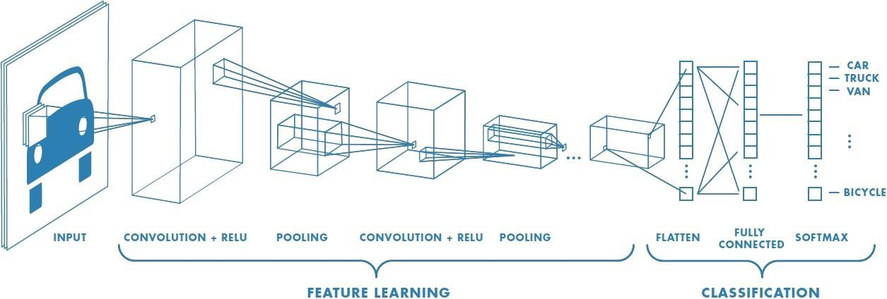
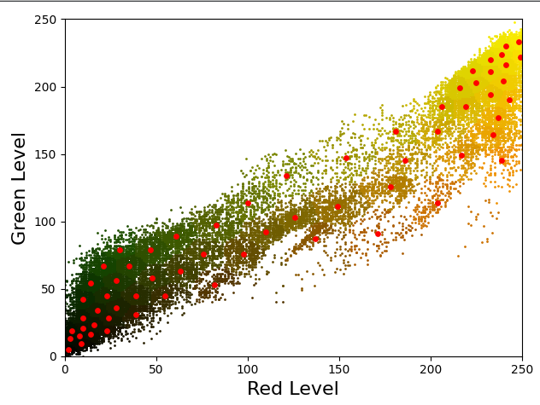
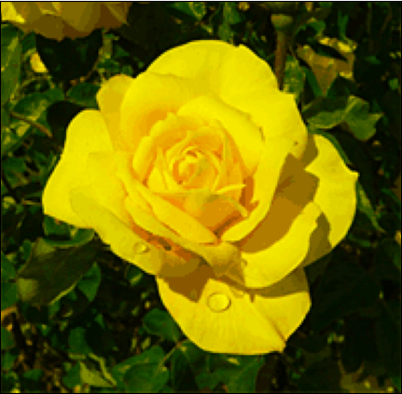

Convolutional Neural Network (CNN)
Benefits:
Always deterministic
Most commonly used with image data - good at classification tasks
Original Image
Quantized Image
Palette
Pixel Mapping*
Aquarium subset of the Places205 dataset used (15000 images for training & 100 images for validation)
*To allow for gradient propagation, the pixel mapping during training uses Softmax to map from a palette to a quantized image continuously rather than a normal piecewise minimum euclidean distance mapping
Saha, Sumit. “A Comprehensive Guide to Convolutional Neural Networks - the ELI5 Way.” Medium, Towards Data Science, 17 Dec. 2018, towardsdatascience.com/a-comprehensive-guide-to-convolutional-neural-networks-the-eli5-way-3bd2b1164a53., Celebi, M. Emre. “Improving the Performance of k-Means for Color Quantization.” Image and Vision Computing, vol. 29, no. 4, 2011, pp. 260–271., doi:10.1016/j.imavis.2010.10.002., B. Zhou, A. Lapedriza, J. Xiao, A. Torralba, and A. Oliva. Learning Deep Features for Scene Recognition using Places Database. Advances in Neural Information Processing Systems 27 (NIPS), 2014.

Slide 7
Architecture
3x3
16
3x3
32
3x3
64
3x3
128
Linear
128, 64
Linear
64, 3𝙆
MaxPool (4)
MaxPool (4)
MaxPool (4)
3𝙆 (palette size) vector
MaxPool (4)
Leaky ReLU (0.2)
Leaky ReLU (0.2)
Leaky ReLU (0.2)
Leaky ReLU (0.2)
Leaky ReLU (0.2)
(Tanh + 1) / 2
3x256x256
100 training epochs, batch size of 10
Palette size of 64 colors
Learning rate of 10^-4 w/ Adam optimizer
Implemented in PyTorch
Input size is 3x256x256
  Colors x Height x Width
Output size is 3𝙆
  R, G, & B values for each color (𝙆 colors)
Larsson, Stefan, and Filip Mellqvist. “Automatic Number Plate Recognition for Android.” DIVA, 26 June 2019, kau.diva-portal.org/smash/record.jsf?pid=diva2%3A1325108.

Slide 8
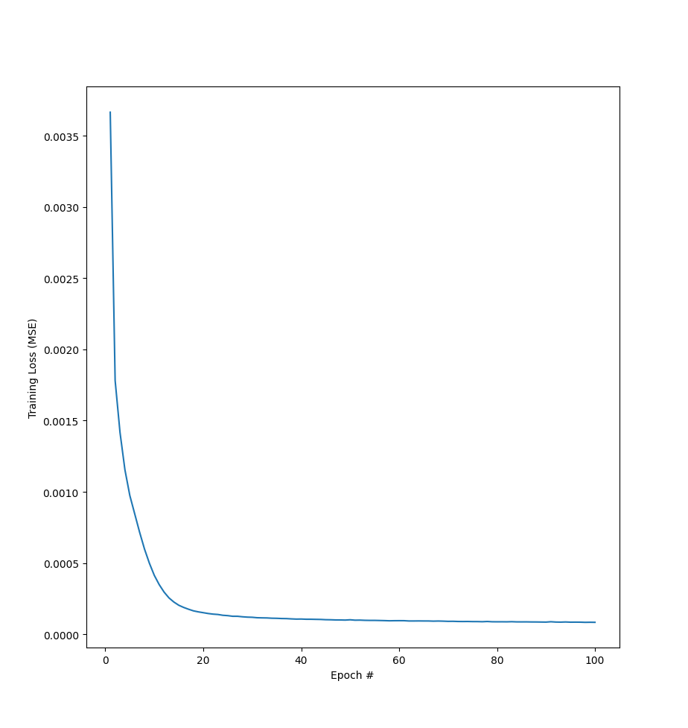
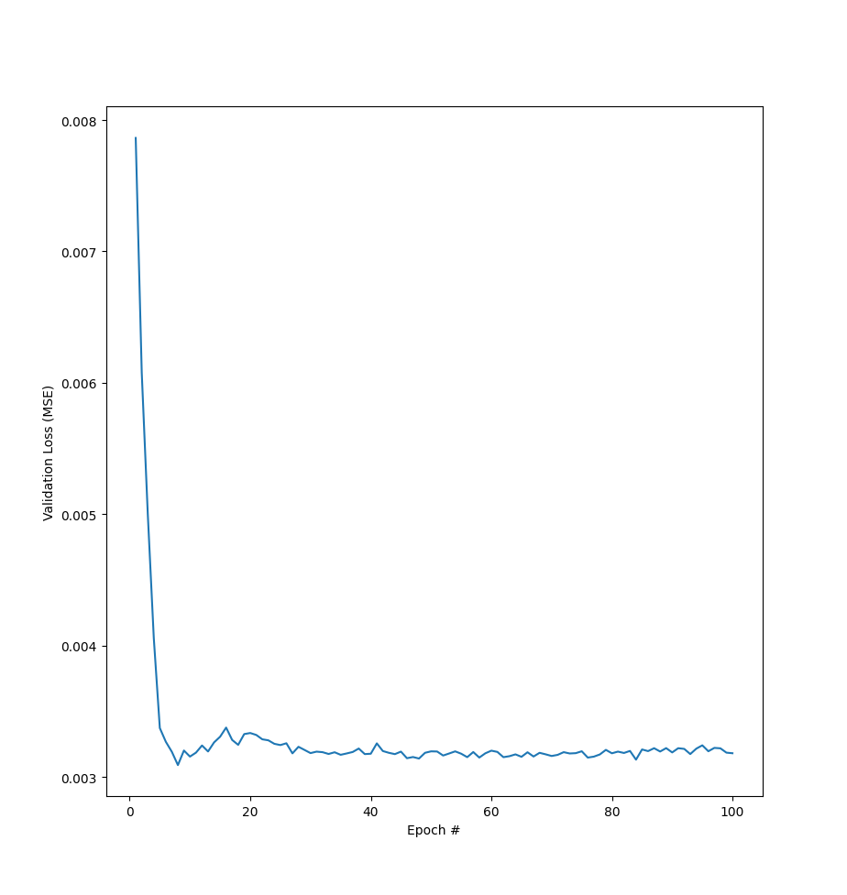
Results
Model minimum validation loss: 0.00309
K-Means validation loss: 0.00486
K-Means is 57.28% worse than CNN
Minimum validation loss occurs at epoch 8
Training loss continues to decrease after validation loss starts to climb up
Classic case of overfitting
Standard solution to overfitting is to train on a larger dataset
Training Loss
Validation Loss

Slide 9
Discussion & Conclusions
Our CNN model achieved comparable results to K-Means
CNNs have been shown to perform well on classification tasks, palette generation has similar output structure as classification output, this example just requires swapping out last Softmax for classification models with a Tanh to achieve a range limited vector instead of a probability distribution vector
Our CNN was “sloppily” trained (simple architecture, overfitted)
Model has predictable runtime, written in PyTorch, can be easily run on GPU
CNNs are a viable method of performing palette generation for CQ (could be used by large visual content distributors)

Slide 10
Can CNNs perform color quantization faster than K-Means?
Is CNN color quantization really class specific?
Can more complex convolutional models outperform the standard CNN on this task?

Slide 11
Runtime Comparison
Hardware does matter!
All tests run on 2x Intel Xeon E5-2650 v2s (16 cores total) and 1x NVidia Tesla M40 GPU, indicative of a modest server
All written in PyTorch (for k-means, this means vectorizing operations)
Minimal control logic in Python (slow)
The code on the right runs faster: uses PyTorch to optimize operation rather than using Python control logic
 | CPU | GPU
CNN | 9.38ms | 5.18ms
K-Means | 4.95s | 6.30s
a = torch.zeros(10**7)
for i in range(10**7):
a[i] += 1
a = torch.zeros(10**7)
a += 1
Average runtime on 50 images from the Places205 dataset

Slide 12
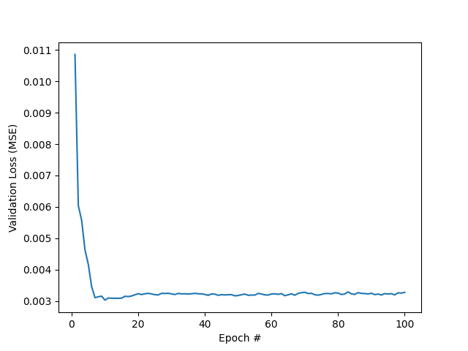
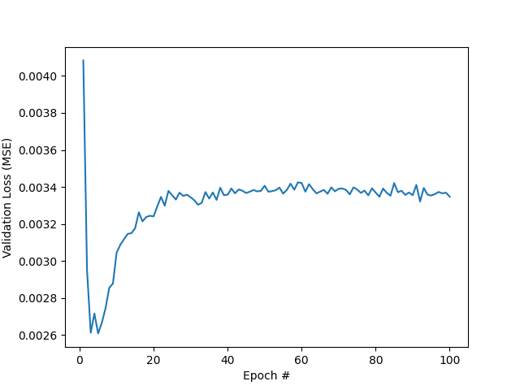
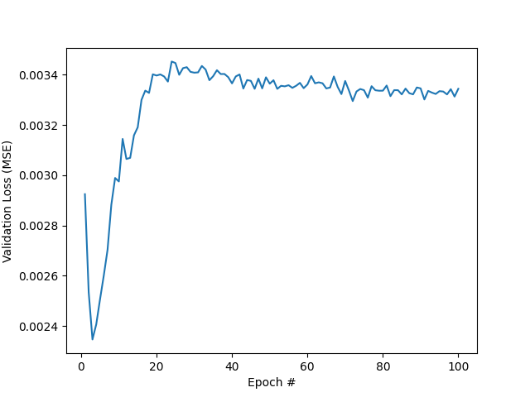
Class Specificity
Trial 1
Trial 2
Trial 1: aquarium subset of Places205
Trial 2: all “a” subsets of Places205
Trial 3: all of Places 205
For each trial, 15100 images were randomly sampled from the corresponding subset of Places205, 15000 were used for training and 100 were used for validation
Trial 3
B. Zhou, A. Lapedriza, J. Xiao, A. Torralba, and A. Oliva. Learning Deep Features for Scene Recognition using Places Database. Advances in Neural Information Processing Systems 27 (NIPS), 2014.

Slide 13
Class Specificity
Lower minimum validation loss with higher variability in data
CNN is not class specific in color quantization
Overfitting occurs when there is low variability in data / too little data, increasing variability appears to have curbed the effects of overfitting (better minimum validation loss)
Model is still able to overfit as validation loss spikes back up by epoch 10 - increasing data size would likely solve this, model can perform general color quantization

Slide 14
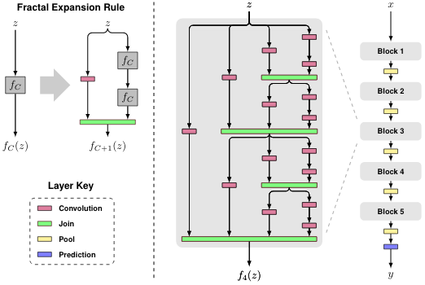
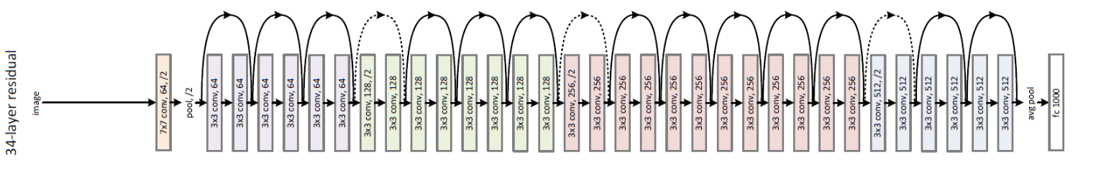
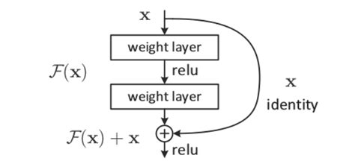
More Complex Models
Fractalnet
Resnet
Maxout
C * nf x H x W
Take maximum value among C channels at each position
nf x H x W
Tsang, Sik-Ho. “Review: ResNet - Winner of ILSVRC 2015 (Image Classification, Localization, Detection).” Medium, Towards Data Science, 20 Mar. 2019, towardsdatascience.com/review-resnet-winner-of-ilsvrc-2015-image-classification-localization-detection-e39402bfa5d8., Larsson, G., Maire, M., & Shakhnarovich, G. (2017). FractalNet: Ultra-Deep Neural Networks without Residuals. In ICLR.

Slide 15
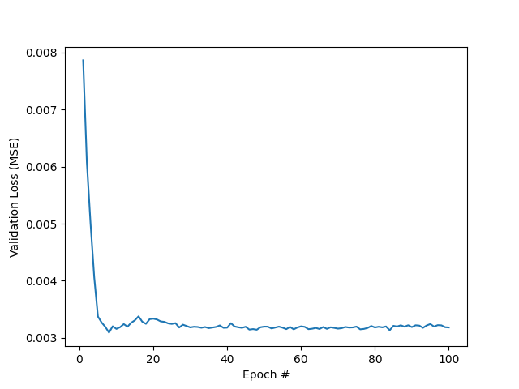
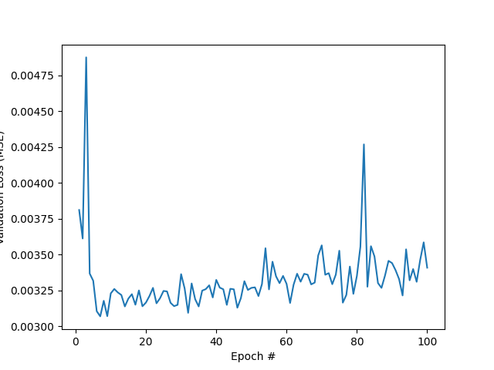
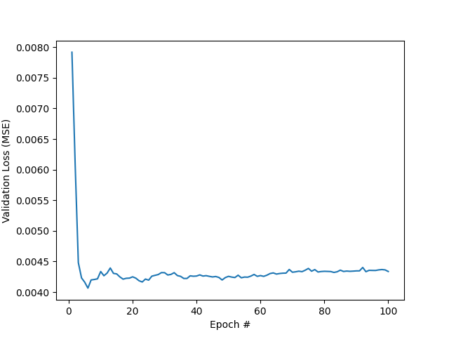
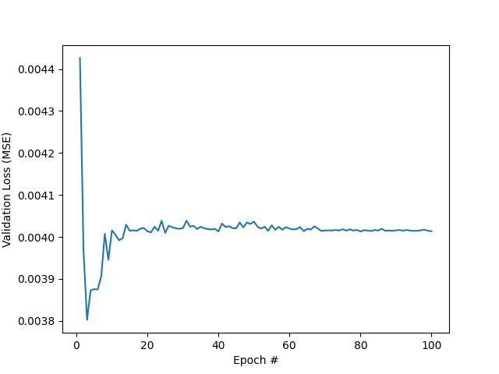
More Complex Models (aquarium subset)
Standard CNN
Resnet
Maxout
Fractalnet

Slide 16
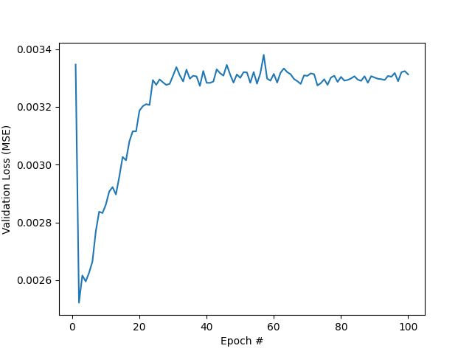
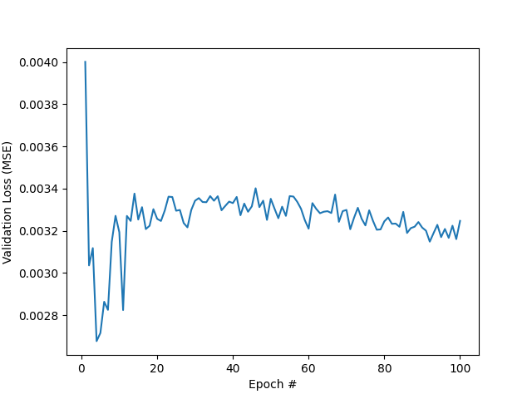
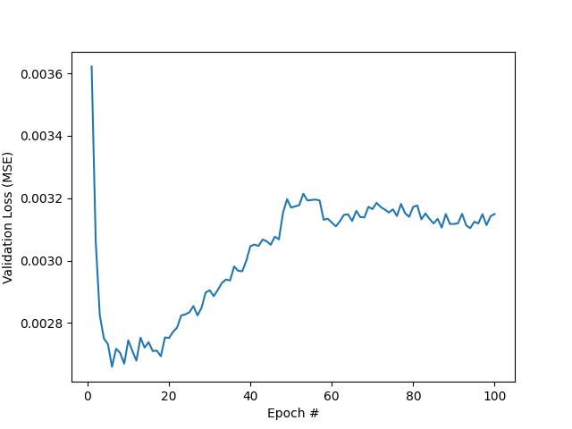
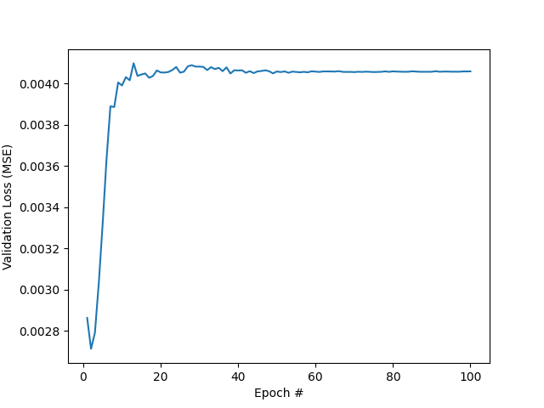
More Complex Models (whole Places205)
Standard CNN
Resnet
Maxout
Fractalnet

Slide 17
Takeaways for deployment
Overfitting likely would be solved by training on entire Places205 dataset (2.5 million images)
Testing with the entire dataset would have to be done to verify, but more complex architectures in classification don’t seem to translate to better CQ performance
More research needed to conclude what architectures translate to better CQ performance
2 possibilities
  Models shown to perform better in classification are not inherently better in color quantization as well
  Models shown to perform better in classification are also better in color quantization, but are just overfitting faster than the standard CNN, so their minimum validation losses are worse
B. Zhou, A. Lapedriza, J. Xiao, A. Torralba, and A. Oliva. Learning Deep Features for Scene Recognition using Places Database. Advances in Neural Information Processing Systems 27 (NIPS), 2014.

Slide 18
Acknowledgements
Mr. Dressen
Dr. Emre Celebi

Slide 19
References
Walker, Ryan. “Color Quantization in R.” R, 3 Jan. 2016, www.r-bloggers.com/2016/01/color-quantization-in-r/.
Celebi, M. Emre. “Improving the Performance of k-Means for Color Quantization.” Image and Vision Computing, vol. 29, no. 4, 2011, pp. 260–271., doi:10.1016/j.imavis.2010.10.002.
Burger, Wilhelm, and Mark J. Burge. Digital Image Processing An Algorithmic Introduction Using Java. Springer, 2016.
B. Zhou, A. Lapedriza, J. Xiao, A. Torralba, and A. Oliva. “Learning Deep Features for Scene Recognition using Places Database.” Advances in Neural Information Processing Systems 27 (NIPS), 2014.
Storer, James A., and Thomas G. Szymanski. “Data Compression via Textual Substitution.” Journal of the ACM, vol. 29, no. 4, 1982, pp. 928–951., doi:10.1145/322344.322346.
Larsson, G., Maire, M., & Shakhnarovich, G. (2017). FractalNet: Ultra-Deep Neural Networks without Residuals. In ICLR.
Fenwick, Sam, and Hardik Khatri. n.d., The State of Mobile Network Experience 2020: One Year Into the 5G Era.
B. Zhou, A. Lapedriza, J. Xiao, A. Torralba, and A. Oliva. Learning Deep Features for Scene Recognition using Places Database. Advances in Neural Information Processing Systems 27 (NIPS), 2014.

