Slide 1
Parallel Computing
Humerus Analysis with MPI.NET
by
Rattanaphan Boonbutra,
Tom E. Delaney
Computer Science, Hood college
2013

Slide 2
Abstract
In image processing, the time consumed to analyze every pixel of an image is a big problem. Even with a multi-core computer, sequential programming is not effective for image processing. Parallel programming using MPI reduces the time consumed by image processing therefore programs are more efficient on multi-core chips. MPI.NET is a high-level binding for the C# programming language to the MPI interface for distributed-memory parallel computing. The performance of the C# bindings is helpful for image processing using C#.NET, especially as time spent analyzing each pixel of an image will decrease thus increasing the efficiency of the program

Slide 3
Goal
Improve the speed up of the Humerus Analysis project
To be able to implement MPI.NET in C# programming.
To understand how MPI.NET run on HPC Pack 2008 R2

Slide 4

The Origianal Program

Slide 5
Basic information about the computer running program
System
Processor:
Intel® Core™, i3-2370M CPU
@ 2.40GH
Memory(RAM): 6 GB
System type: 64-bit Operating system
Operating System
Operating System: Windows 7 Home Premium Service Pack 1
Excecute program
Windows HPC pack 2008 R2

Slide 6
Code Example
using (new MPI.Environment(ref args))
{
Intracommunicator comm = Communicator.world;
…
Bitmap New_Bitmap = new Bitmap(width, heigh / comm.Size);
…
int m = 0;
for (int i = (heigh / comm.Size) * comm.Rank; i < (heigh / comm.Size) * (comm.Rank+1); i++)
{
for (int j = 0; j < width; j++)
{
bitmap.SetPixel(a, b, Vector_Color); // color new vector with Red
New_Bitmap.SetPixel(j,m, Color.Red);
Find_Boundary_List(a, b, New_Bitmap, comm,m); // find boundary area
…
}

Slide 7
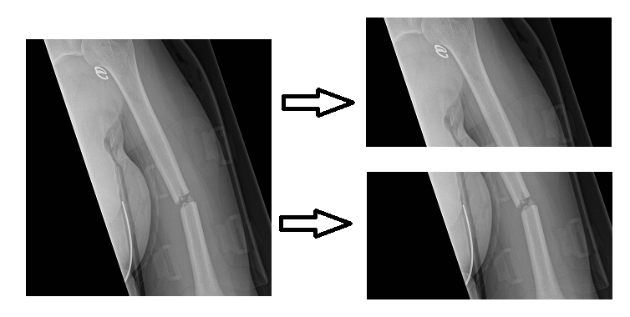
Parallel computing Implementation
Sequential
Parallelism

Slide 8
Boundary Scan for slop in sequential
1
0
0
1
0
0
0
0
0
0
1
1
0
0
0
1
0
0
0
0
0
0
1
0
0
0

Slide 9
Boundary Scan for slop in parallel
1
0
0
1
0
0
0
0
0
0
1
1
0
0
1
0
0
0
0
0
0
0
1
0
0
0

Slide 10
Execution Statement
(HPC Pack 2008 R2)
> mpiexec -cores 2 -n 2 file.exe

Slide 11
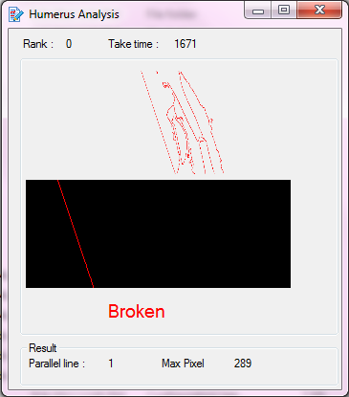
Result: Cores = 0, n = 0

Slide 12
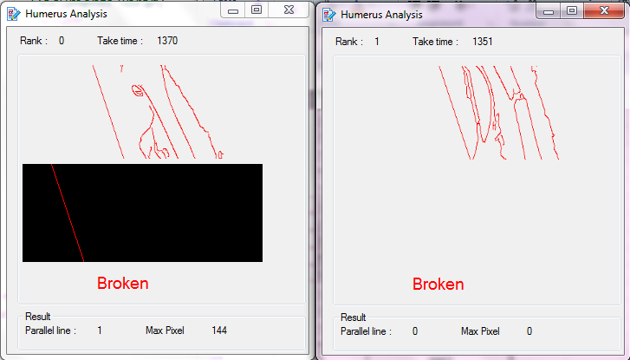
Result: Cores = 2, n = 2

Slide 13
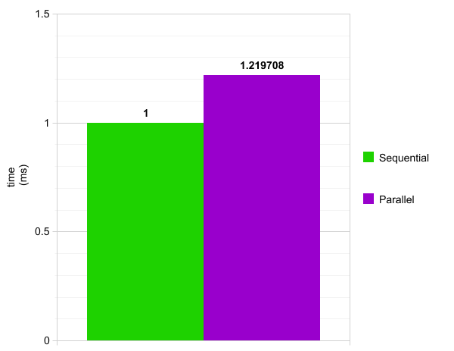
Improvement 1.2

Slide 14
Result
core | n | time | Speed up
1 | 1 | 1671 | 1
 | 2 | 1444 | 1.157202
2 | 1 | 1611 | 1.037244
 | 2 | 1370 | 1.219708
3 | 1 | 1550 | 1.078065
 | 2 | 1418 | 1.17842
4 | 1 | 1678 | 0.995828
 | 2 | 1409 | 1.185947

Slide 15
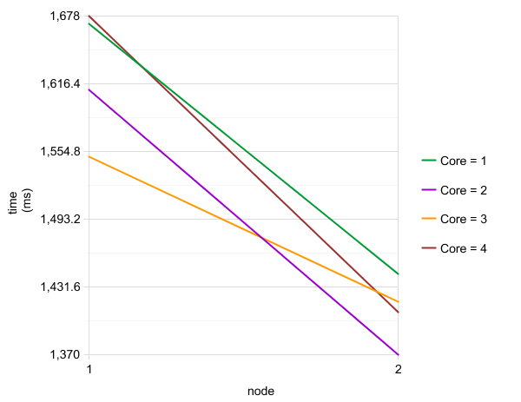
Time Consumed

Slide 16
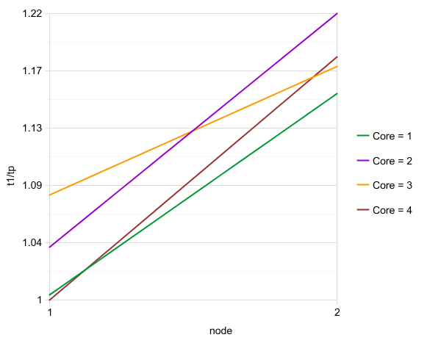
Speed Up

Slide 17

MPI Trace
>mpiexec –trace –cores 2 –n 2 file.exe

Slide 18
Future Work
Implement HPC cluster server 2008 R2 cluster to further accelerate the performance gains and take full advantage of parallel computing. HPC permits running the program through the head node, and can assign the job to run across multiple nodes among all available machines.

Slide 19
Conclusion
In a 2-core 2-node configuration, the program runs the fastest and consumes less time. Increasing either the number of cores or nodes, the program runs slower. Having more cores or nodes does not directly translate into a more efficient execution of the program. In fact, execution efficiency also depends on things like the size of the program, the complexity of the program and the configuration of the executing computer.

Slide 20
References
[1] J.Wilcock, A.Lumsdaine, A.Robison, Using MPI with C# and the Common Language Infrastructure. [Online]. Available: ftp://www.cs.indiana.edu/pub/techreports/TR570.pdf
[2] J.Malik, S.Belongie, T.Leung and J.Shi, Contour and Texture Anlysis for Image Segmentation. [Online]. Available: http://www.eng.utah.edu/~bresee/compvision/files/MalikBLS.pdf
[3] The Trustees of Indiana University, (2004-2013), MPI.NET High-Perfomance c# Library for Message Passing. [Online]. Available: http://www.osl.iu.edu/research/mpi.net/
[4] P.Torgashov, Contour Analysis for Image Recognition in C#. [Online]. Available: http://www.codeproject.com/Articles/196168/Contour-Analysis-for-Image-Recognition-in-C
[5] S.Chatzichristofis, C# Tutorials. [Online]. Available: http://savvash.blogspot.com/p/c-tutorials.html
[6] D.Gregor, A.Lumsdaine, MPI.NET High-Performance Message Passing in C# and .NET. [Online]. Available: http://research.ihost.com/ppopp08/presentations/gregor-mpi-net.pdf
[7] M.Podwysocki, Concurrency with MPI.NET. [Online]. Available: http://weblogs.asp.net/podwysocki/archive/2008/05/15/concurrency-with-mpi-in-net.aspx
[8] A.Jackson, A Parallel Algorithm For Fast Edge Detection On The Graphics Processing Unit. [online]. Available : http://wwwx.cs.unc.edu/~jacksona/doc/thesis.pdf
[9] J.Squyres, A.Lumsdaine, R.Stevenson, A cluster-based parallel image processing toolkit. [Online]. Available: http://www.osl.iu.edu/publications/prints/1998/squyres98:_pipt.pdf
[10] W.Caarls, Parallel Image Processing. [Online]. Available: http://wouter.caarls.org/publications.html

Slide 21

Demo

