Slide 1

DS II SEMINAR
Marcel Ochsendorf
FINAL
PRESENTATION

Slide 2




RESEARCH QUESTION
Is it possible to identify Covid SpreadS Due to
public transportation SERVICE?*
* ASSUMING 100% RAILWAY TRAFFIC [NO CARS,…]

Slide 3
RESEARCH QUESTION
not possible with the current used datasets
Is it possible to identify Covid SpreadS Due to
public transportation SERVICE?*
* ASSUMING 100% RAILWAY TRAFFIC [NO CARS,…]

Slide 4


TIMELINE
COMBINE PROCESSED DATA
GENERATE HEATMAPS
PREPARE DATA [DB | RKI]
BUILD MAINSTATION AND DEPATURE DATASET
FETCH TRAIN DATA FOR SPECIFIED INTERVALS
BUILD AN INTERACTIVE MAP
INITIAL
INTERMEDIATE
FINAL

Slide 5

PREPROCESSING
DB API
[RAILWAY STATIONS]
DISTRICTS
[GEOJSON POLYGONS AND AGS]
STATIONS INSIDE DISTRICTS
FILTERED STATIONS (DB EVU ONLY)
GEOJSON WITH STATION FEATURES [POI]
SEVERAL LOOKUP-TABLES PERFORMANT FOR VISUALISATION
[TRAIN LIST, DISTRICTS,]

Slide 6
CONVERTING COORDINATES
DISTRICT, DB AND RKI DATA ARE USING DIFFERENT COODINATE SYSTEMS
LAYERS ARE NOT MATCHING [OFFSET, SCALE]
REFORMAT THESE WITH QGIS AND GEOPANDAS
QGIS IS QUITE COMPLEX TO USE

Slide 7
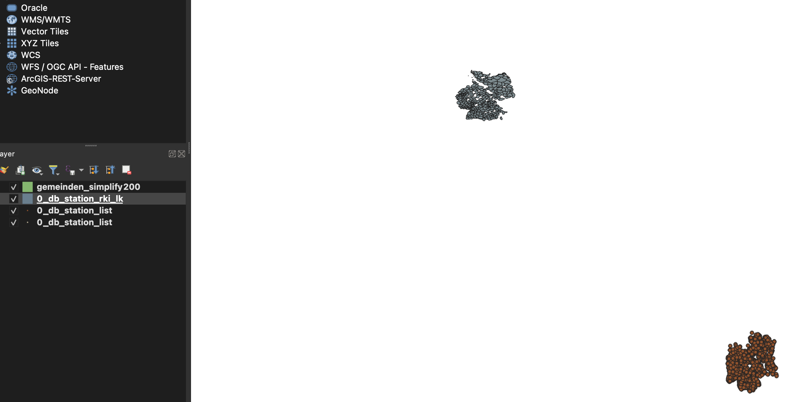
CONVERTING COORDINATES

Slide 8
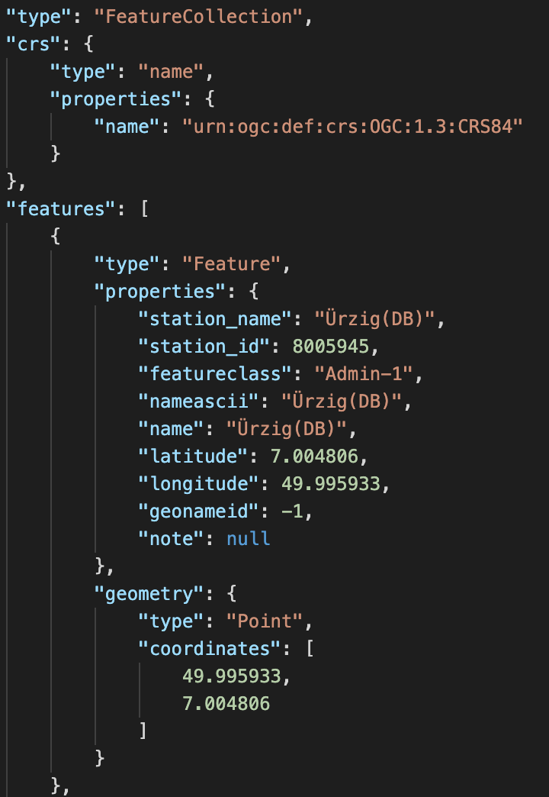
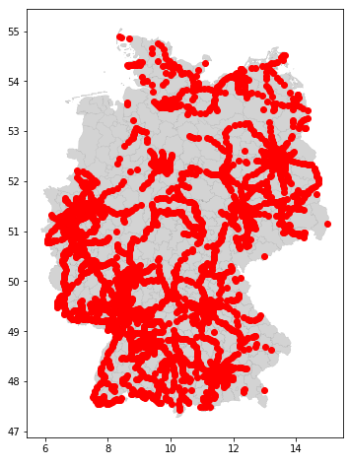
CUSTOM GEOJSON

Slide 9
CUSTOM TRAIN DATASET
DB API
[DEPARTURE TABLE]
5GB Custom Dataset CREATED for All DB TRAINS [01.11.2021 – 16.01.2022]
INCLUDING ARRIVAL | DEPARTURE DELAYS
USEFUL FOR FURTHER USAGE
MERGE SMALL DEPARTURE SNIPPETS INTO A LARGE SET
RECONSTRUCTION OF THE TRAIN drive course

Slide 10
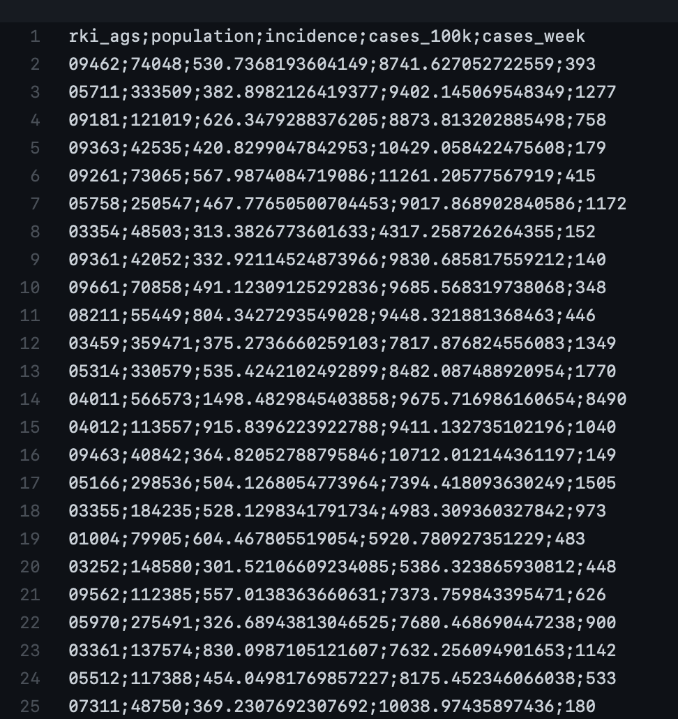
PROCESS RKI DATA
ONE DOWNLOAD OF DISTRIC DATA AT THE END OF EACH DAY
INCIDENCE AND AGS_ID USED

Slide 11
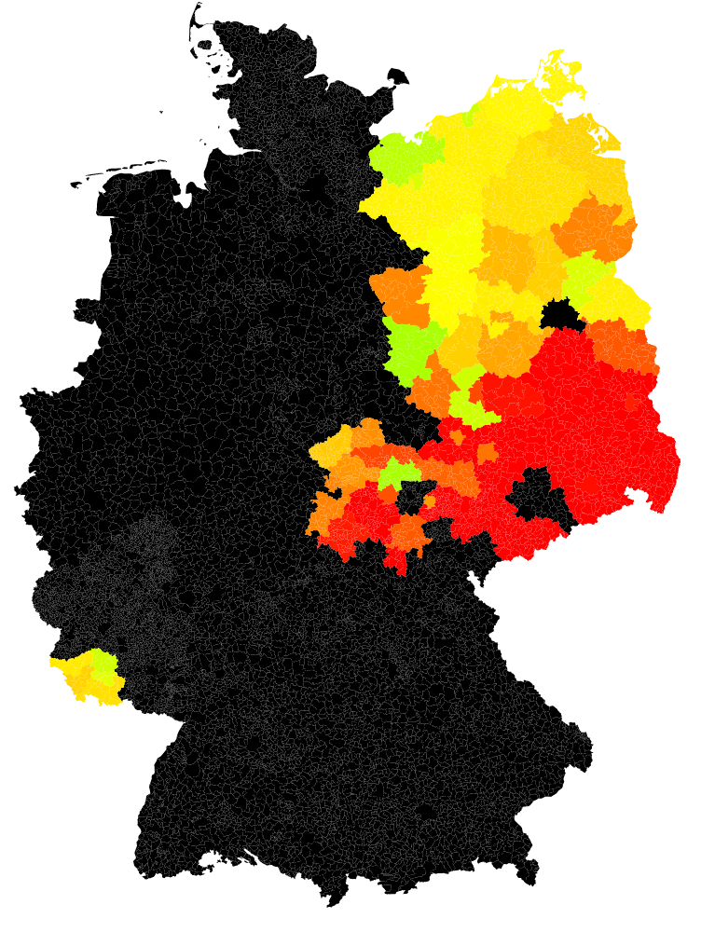
CHECK YOUR DATASETS!
USED https://api.corona-zahlen.org/docs/endpoints/districts.html FOR COVID DISTRICT DATA
CSV RESPONSES LOOKED GOOD
SEVERAL DISTRICTS ARE MISSING
Data apparently lookedgooD
a sporadic test of this data was successful
only noticed after working visualization

Slide 12
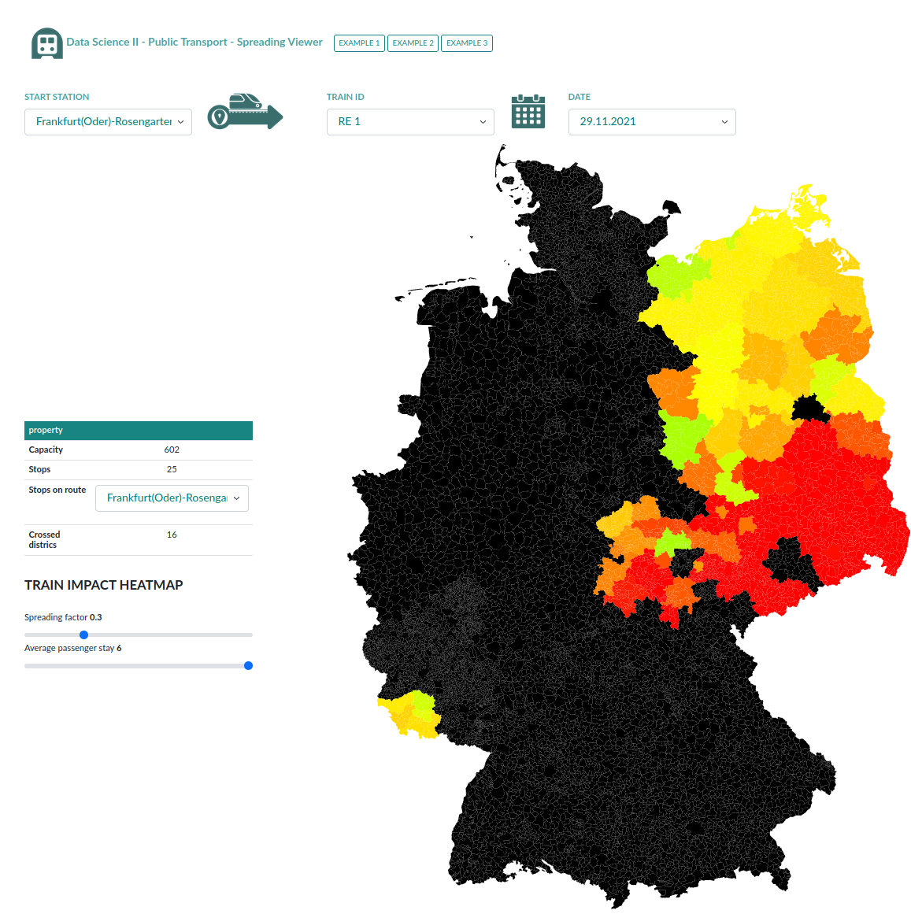
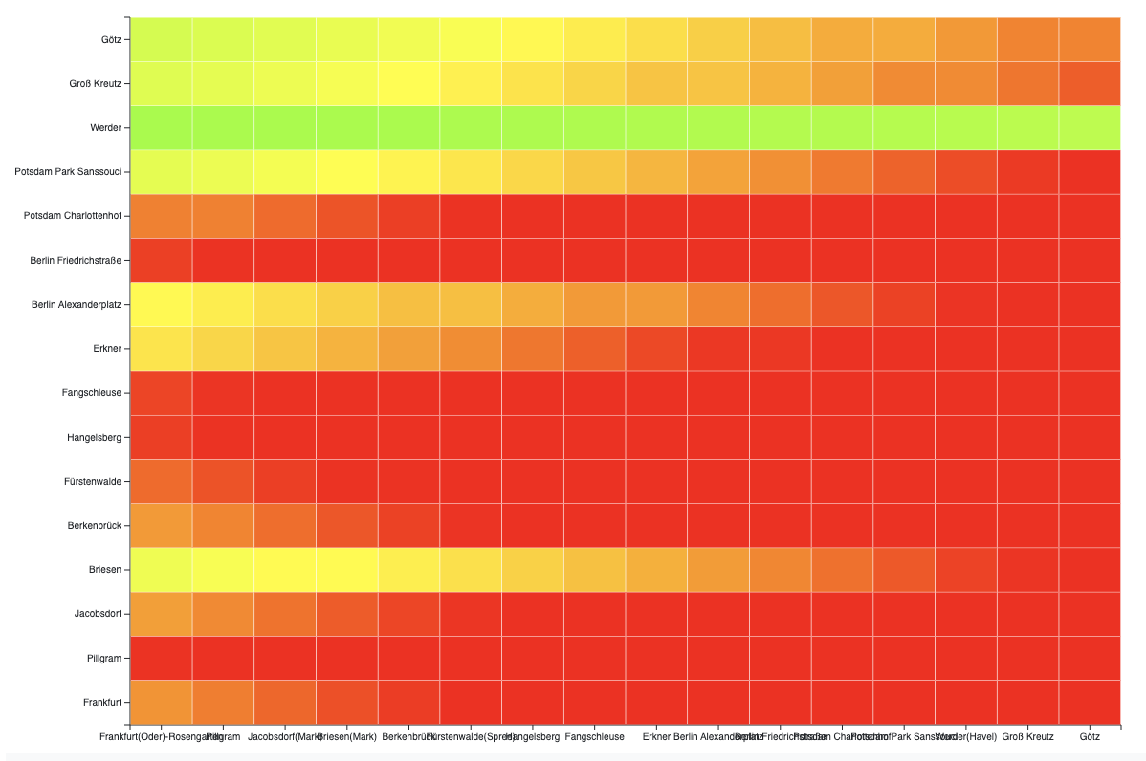
VISUALISATION

Slide 13
Future Work
Fixing COVID DISTRICTDATA
ADD PASSENGER COUNTS
INCLUDE LONG DISTANCE TRAINS INSTEAD OF REGIONAL
RUN OTHER VISUALISATION TASKS ON DELAY TRAIN DATA

Slide 14
QUESTIONS ?
https://github.com/RBEGamer/DataScienceIISeminar

