Slide 1

DS II SEMINAR
Marcel Ochsendorf
INTERMEDIATE PRESENTATION

Slide 2




RESEARCH QUESTION
Is it possible to identify Covid SpreadS Due to
public transportation SERVICE?*
* ASSUMING 100% RAILWAY TRAFFIC [NO CARS,…]

Slide 3


TIMELINE
PREPARE DATA [DB | RKI]
BUILD MAINSTATION AND DEPATURE DATASET
COMBINE PROCESSED DATA
GENERATE HEATMAPS
FETCH TRAIN DATA FOR SPECIFIED INTERVALS
BUILD AN INTERACTIVE MAP
INITIAL
INTERMEDIATE
FINAL

Slide 4
TRAIN DATA
acquisition
HAVAS | IRIS | DB API
[RAILWAY CONNECTIONS, CAPACITY, FILL RATE, DEPARTURE TABLE]
Difficult data extraction
Manual PDF PARSING OF TRAIN TYPES
GERMAN CSV/EXCEL FILES
ENCODING ISSUES
NOT MATCHING GEO COORDINATE SYSTEMS
NO DB HISTORY DATA

Slide 5
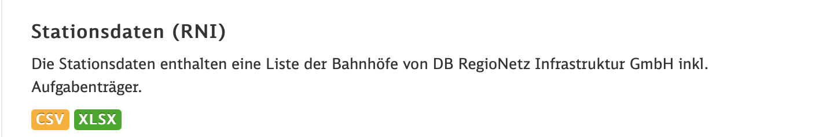

STATION DATA
DB API
[RAILWAY STATIONS, CAPACITY]

Slide 6
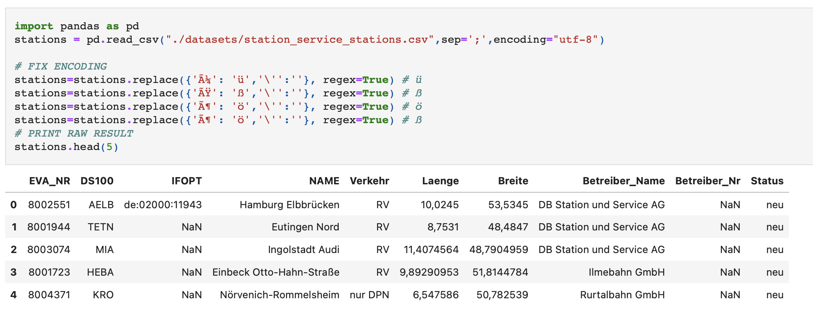
STATION DATA
DB API
[RAILWAY STATIONS]

Slide 7
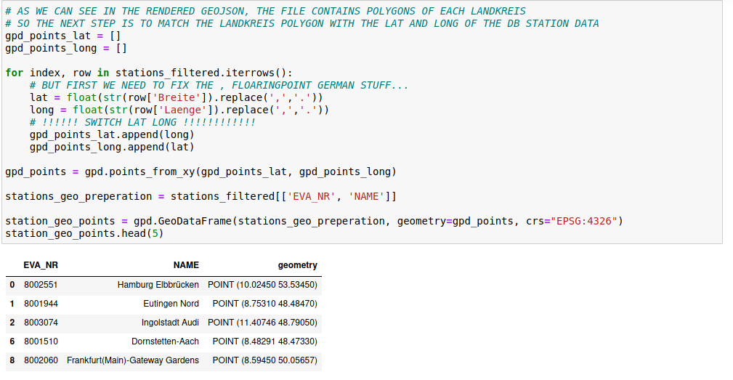
STATION DATA
DB API
[RAILWAY STATIONS]
PANDAS
GEOPANDAS
GEOPLOT

Slide 8
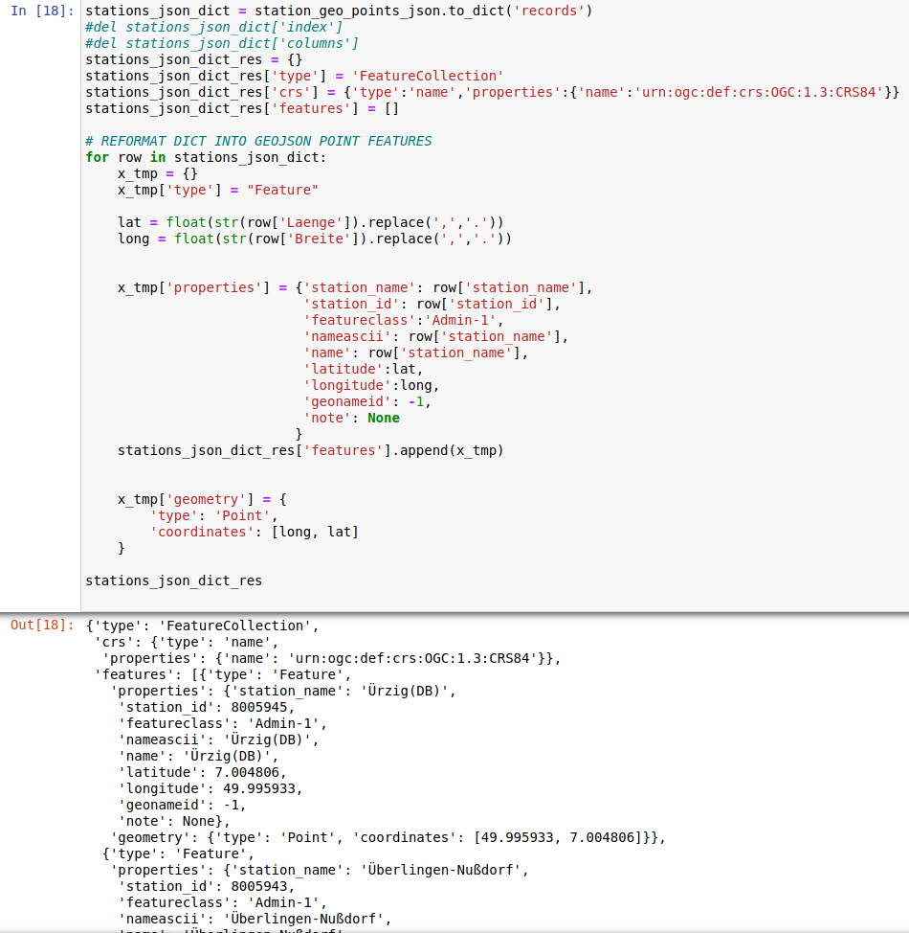
STATION DATA
DB API
[RAILWAY STATIONS]

Slide 9
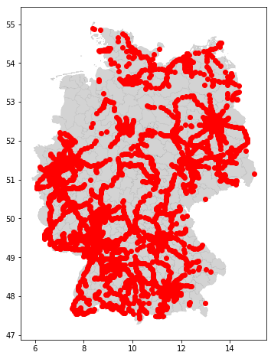

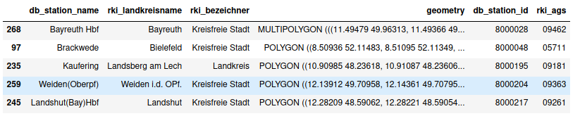
STATION DATA
DB API
[RAILWAY STATIONS]
ONLY DB STATIONS
NO S-BAHN
NO 3rd PARTY COMPANIES

Slide 10

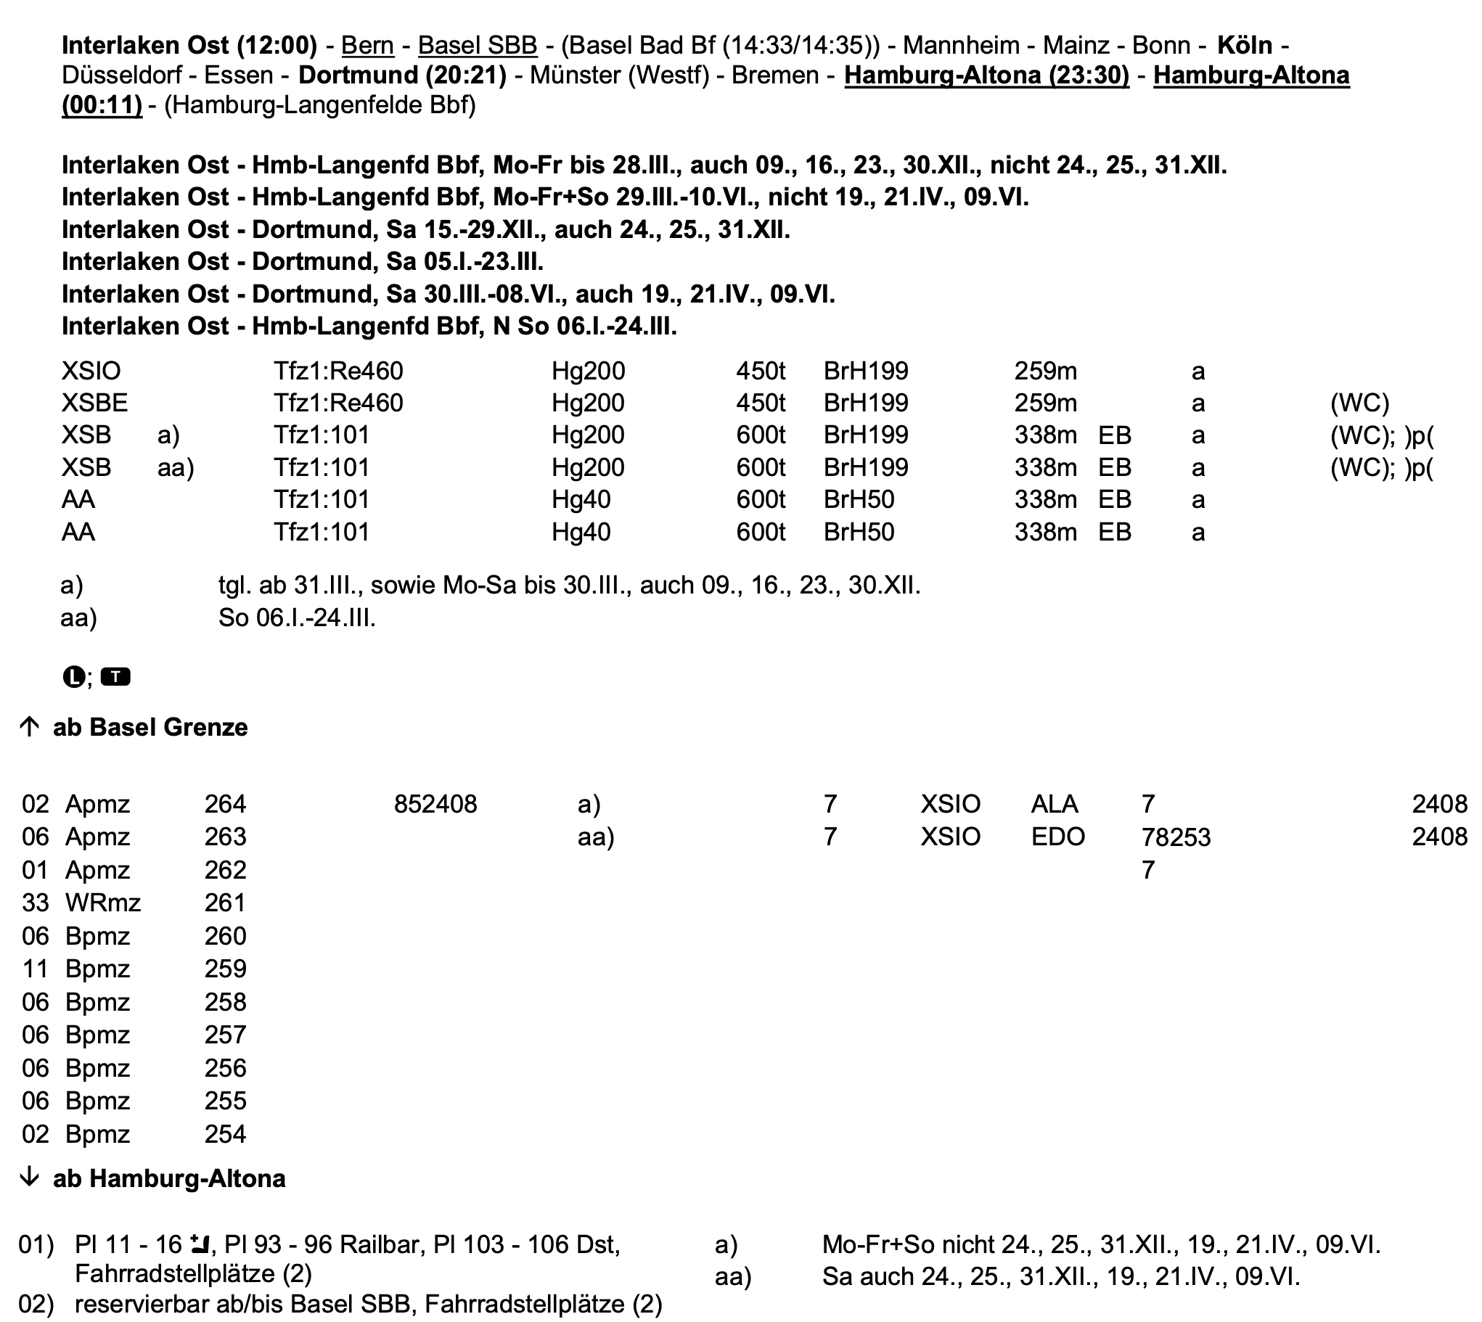
TRAIN CAPACITY DATA
DB API
[CAPACITY]

Slide 11
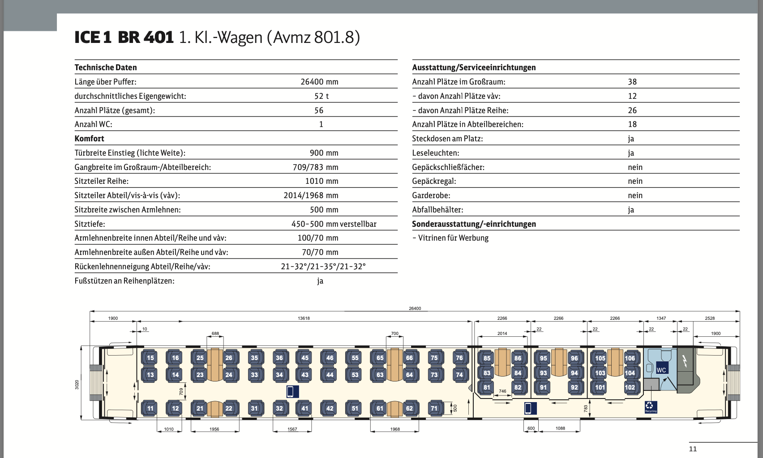
TRAIN CAPACITY DATA
DB API
[CAPACITY]

Slide 12
TRAIN DATA
HAVAS | DB API
[DEPARTURE TABLE]
official data providers do not offer historical data on train departures that goes back more than one day.
And it is possible to get an IP ban already after a few requests per minute.

Slide 13
TRAIN DATA
DB API
[DEPARTURE TABLE]
The goal is to automatically store all required stations and their departure boards by USING of several separate OUTBOUND IP addresses.
AWS INSTANZ WITH 10 DIFFERENT ADRESSES

Slide 14
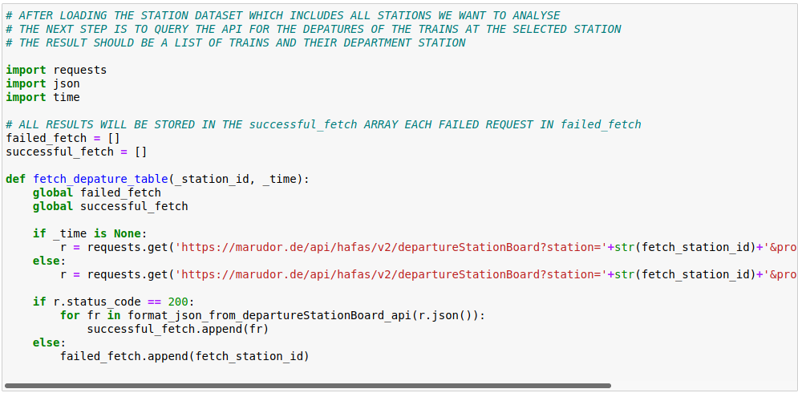
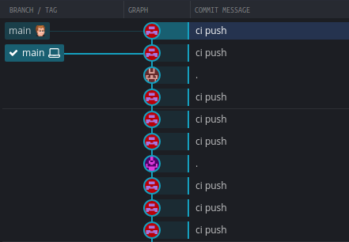
TRAIN DATA
DB API
[DEPARTURE TABLE]

Slide 15
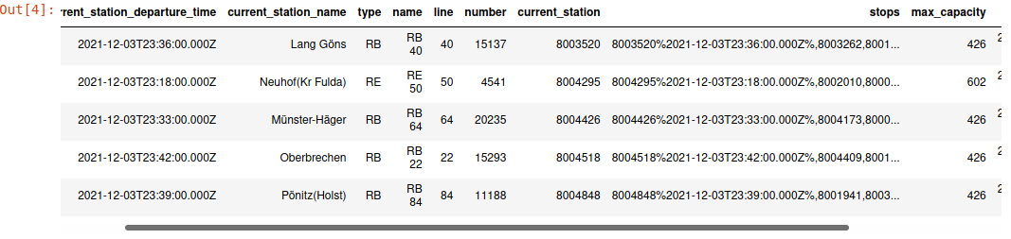
TRAIN DATA
DB API
[DEPARTURE TABLE]
Custom Dataset for All DB TRAINS
10 Minute SNAPSHOT INTERVAL
INCLUDING ARRIVAL | DEPARTURE DELAYS

Slide 16
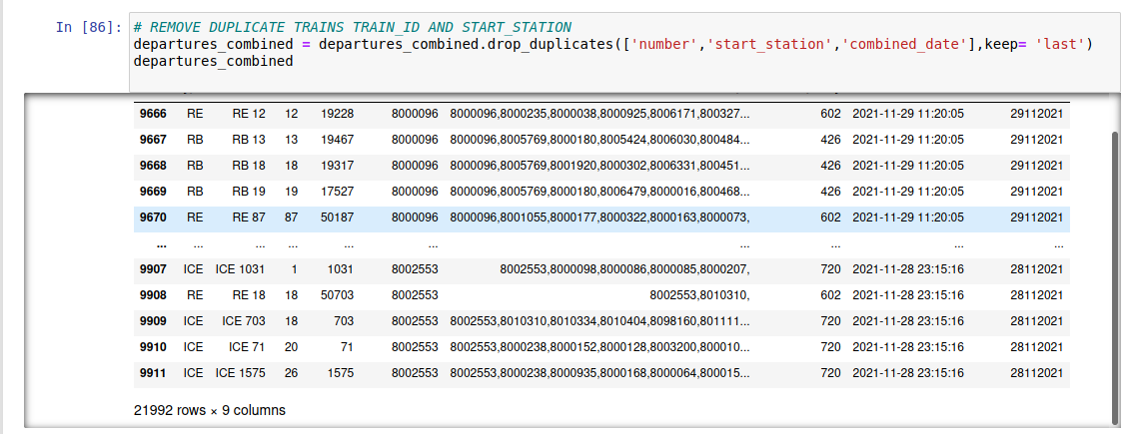
TRAIN DATA
DB API
[DEPARTURE TABLE]

Slide 17
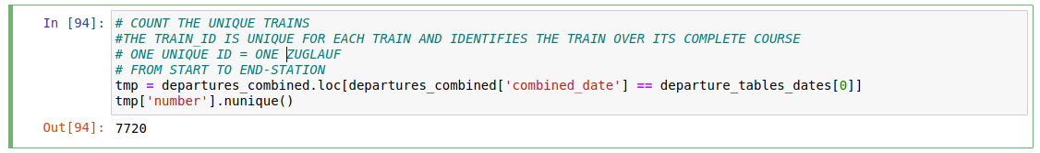
TRAIN DATA
DB API
[DEPARTURE TABLE]

Slide 18
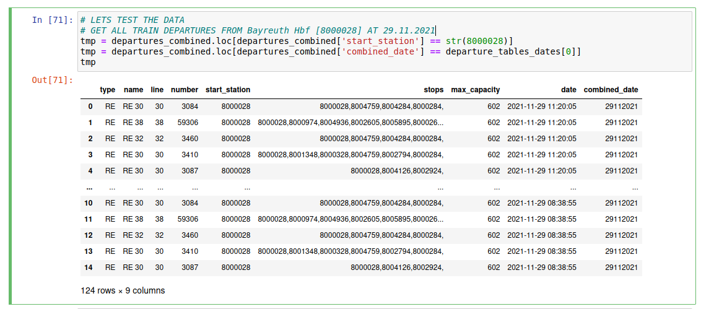
TRAIN DATA
DB API
[DEPARTURE TABLE]

Slide 19
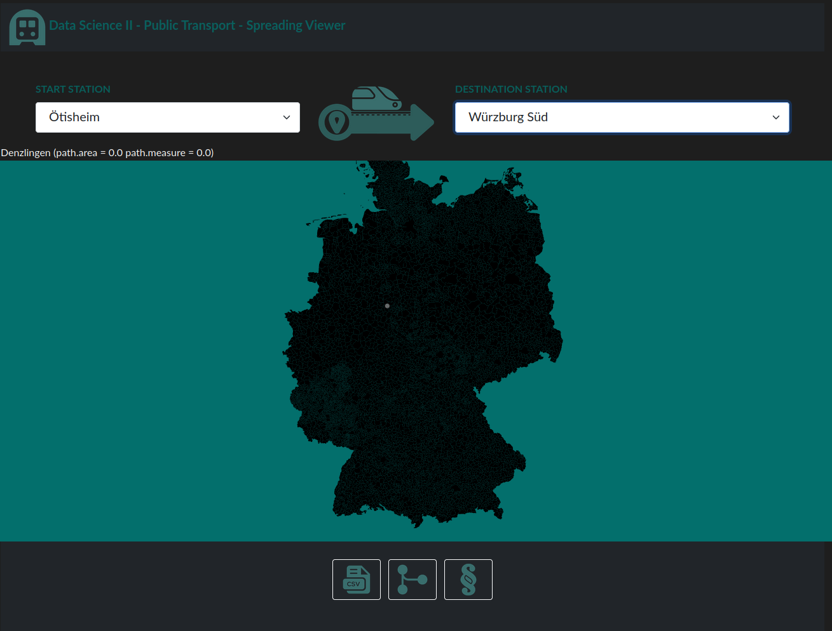
VISUALISATION
TS + NodeJS BACKEND
D3 Map rendering
WebsockeTS FOR REALTIME UPDATES

Slide 20
TIMELINE
GENERATE HEATMAPS FOR EACH DAY IN HISTORY
BUILD AN INTERACTIVE MAP
CREATE VIRUS SPREAD ANIMATION
INITIAL
INTERMEDIATE
FINAL

Slide 21
QUESTIONS ?

