Slide 1

DS II SEMINAR
Marcel Ochsendorf
INTERME PRESENTATION

Slide 2




RESEARCH QUESTION
Is it possible to identify Covid SpreadS Due to
public transportation SERVICE?*
* ASSUMING 100% RAILWAY TRAFFIC [NO CARS,…]

Slide 3


TIMELINE
PREPARE DATA [DB | RKI]
BUILD MAINSTATION AND DEPATURE DATASET
COMBINE PROCESSED DATA
GENERATE HEATMAPS
FETCH CORONA DATASET FOR SPECIFIED INTERVALS
BUILD AN INTERACTIVE MAP LIKE GMAPS
FOR SELECTED CONNECTIONS
INITIAL
INTERMEDIATE
FINAL

Slide 4
TRAIN DATA
acquisition
HAVAS | IRIS | DB API
[RAILWAY CONNECTIONS, CAPACITY, FILL RATE, DEPARTURE TABLE]

Slide 5
TRAIN DATA
acquisition
HAVAS | IRIS | DB API
[RAILWAY CONNECTIONS, CAPACITY, FILL RATE, DEPARTURE TABLE]
Difficult data extraction due not very user friendly DATA SOURCES
Manual PDF PARSING
GERMAN CSV/EXCEL FILES
ENCODING ISSUES
NO HISTORY DATA

Slide 6
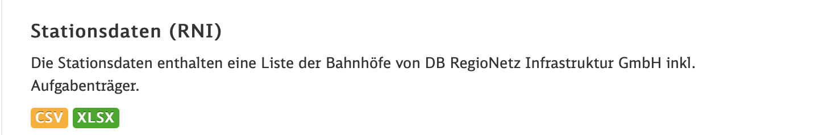
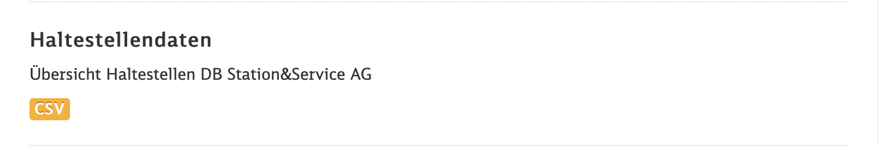
STATION DATA
DB API
[RAILWAY STATIONS, CAPACITY]

Slide 7
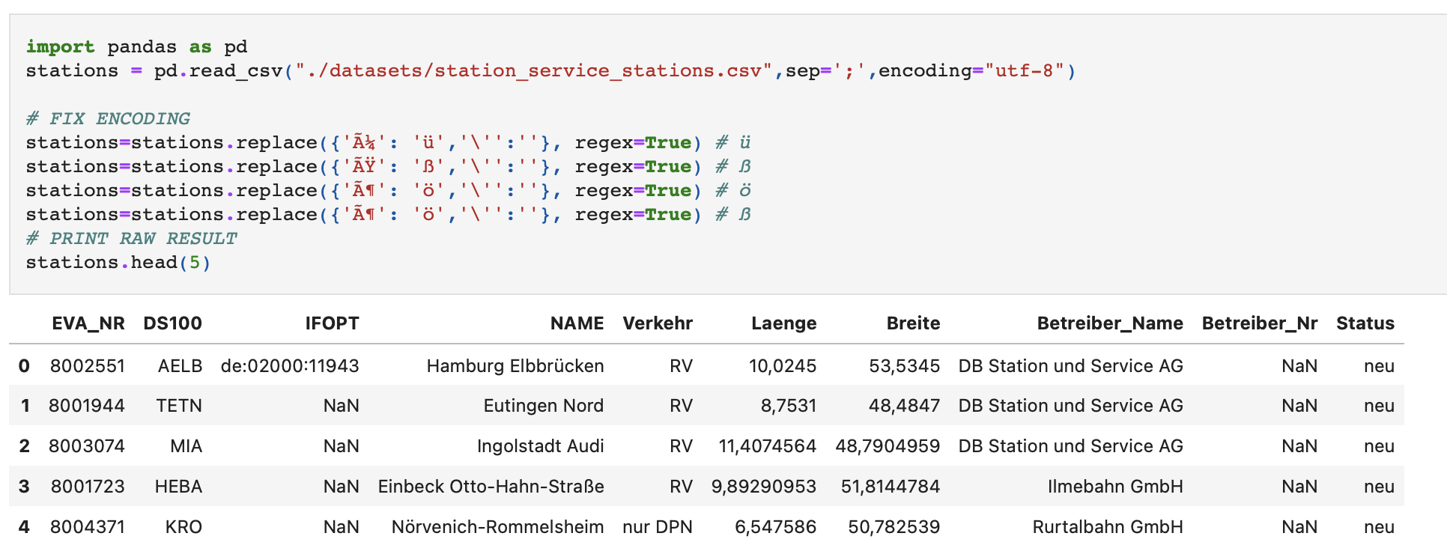
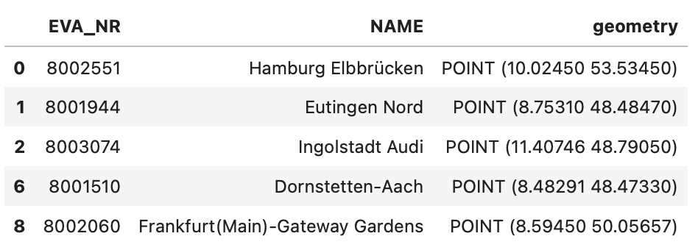
STATION DATA
DB API
[RAILWAY STATIONS, CAPACITY]

Slide 8
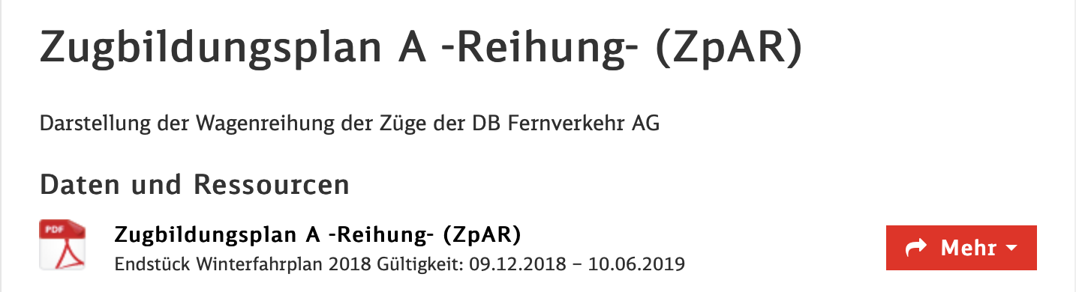
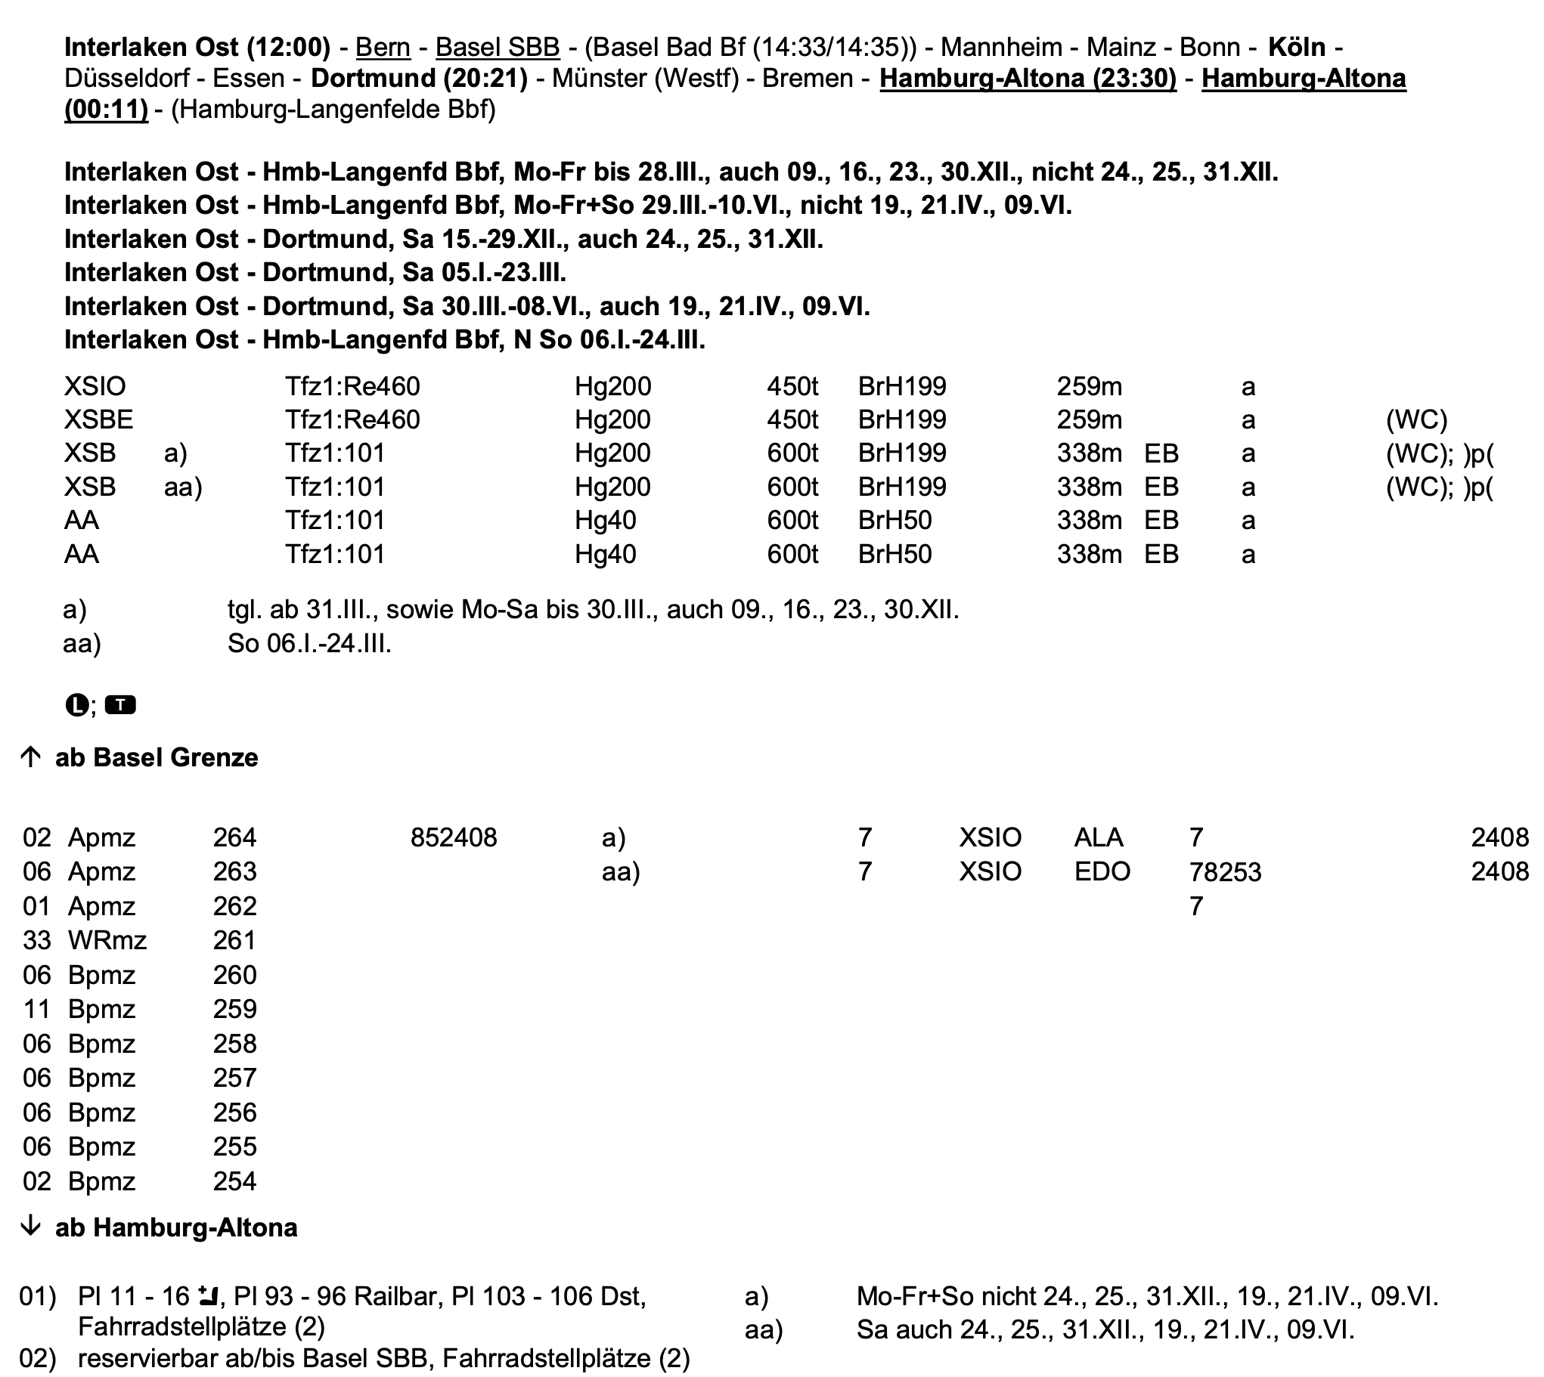
TRAIN CAPACITY DATA
DB API
[RAILWAY STATIONS, CAPACITY]

Slide 9
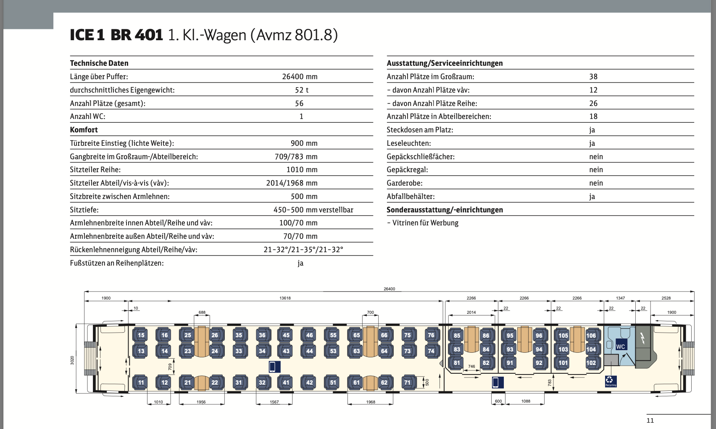
TRAIN CAPACITY DATA
DB API
[RAILWAY STATIONS, CAPACITY]

Slide 10
TRAIN DATA
DB API
[RAILWAY CONNECTIONS, CAPACITY, FILL RATE, DEPARTURE TABLE]

Slide 11



THEORETICALEXAMPLE
MARCH 2020
Nürnberg
RE10 <=>24times/Day
APPROX 30 PASSENGERS/RIDE
EMSKIRCHEN
111 CORONA CASES
7 CORONA CASES

Slide 12
THEORETICALEXAMPLE
NOVEMBER 2020
Nürnberg
RE10 <=>24times/Day
EMSKIRCHEN
768 CORONA CASES
RISK_FACTOR = 10%
20 CORONA CASES
SPREAD_FACTOR = 20%
is it possible to find out railroad connections through which the Corona virus spread?

Slide 13
QUESTIONS ?

