Slide 1
Principal Coordinate Analysis, Correspondence Analysis and Multidimensional Scaling:
Multivariate Analysis of Association Matrices
BIOL4062/5062
Hal Whitehead

Slide 2
Association matrices
Principal Coordinates Analysis (PCO)
Correspondence Analysis (COA)
Multidimensional Scaling (MDS)

Slide 3
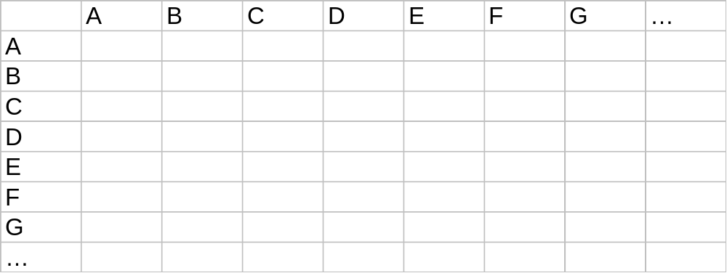
The Association Matrix
Units:
Units:

Slide 4
Association matrices
Similarity
Dissimilarity
Social structure
  association between individuals
Community ecology
  similarity between species, sites
  dissimilarities between species sites
Genetic distances
Correlation matrices
Covariance matrices
Distance matrices
  Euclidean, Penrose, Mahalanobis

Slide 5
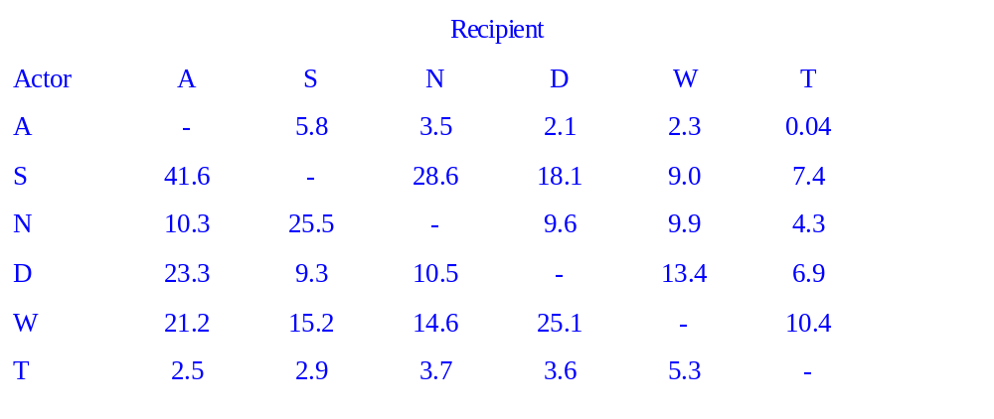
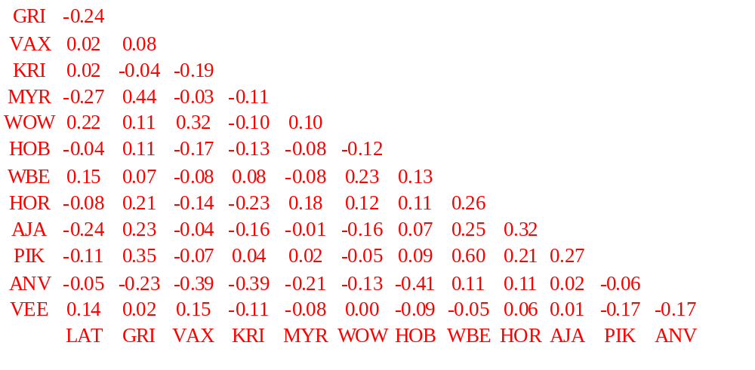
Association matrices
Symmetric/Asymmetric
Grooming rates
of capuchin
monkeys
(Perry 1996)
Genetic relatedness among
bottlenose dolphins (Krutzen et
al. 2003)

Slide 6
Principal Coordinates Analysis
Consider a symmetric dissimilarity matrix
  B 5
  C 3 7
  D 5 4 4
  A B C
As a distance matrix
And then plot it

Slide 7
Principal Coordinates Analysis
  B 5
  C 3 7
  D 5 4 4
  A B C
D
4
C
4
  7
5
3
B
5
A
Can represent:
distances between 2 points in 1 dimension
distances between 3 points in 2 dimensions
distances between 4 points in 3 dimensions
…
distances between k points in k-1dimensions

Slide 8
Principal Coordinates Analysis
HOWEVER!
  B 5
  C 3 7
  D 5 4 4
  A B C
C ??
10
B
5
A
Triangle inequality violated if:
AB + AC < BC
No representation possible

Slide 9
Principal Coordinates Analysis
Take distance (dissimilarity) matrix with k units
Represent as k points in k-1 dimensional space
  if triangle inequality holds throughout
Find direction of greatest variability
  1st Principal Coordinate
Find direction of next greatest variability (orthogonal)
  2nd Principal Coordinate
…
k-1 Principal Coordinates
Reduces
dimensionality
of
representation

Slide 10
Principal Coordinates Analysis
Eigenvectors of distance matrix give principal coordinates
Eigenvalues give proportion of variance accounted for
Triangle inequality equivalent to:
  matrix is positive semi-definite
  no unreal eigenvectors
  no negative eigenvalues
  analysis probably OK if few small, negative eigenvalues

Slide 11
Principal Coordinates Analysis (PCO)
& Principal Coomponents Analysis (PCA)
PCO is equivalent to PCA on covariance matrix of transposed data matrix if distance matrix is Euclidean
PCO is equivalent to PCA on correlation matrix of transposed data matrix if distance matrix is Penrose
PCO only gives information on units or variables not both
Axes (principal coordinates) rarely interpretable in PCO

Slide 12
Principal Coordinates Analysis
Proportion of time chickadees seen together at feeder
SCAO 1.00
AOPR 0.18 1.00
ARPO 0.07 0.27 1.00
YOSA 0.26 0.12 0.12 1.00
ROAY 0.21 0.19 0.18 0.31 1.00
SORA 0.06 0.02 0.03 0.15 0.04 1.00
BJAO 0.19 0.17 0.09 0.16 0.21 0.28 1.00
SCAO AOPR ARPO YOSA ROAY SORA BJAO
Ficken et al. Behav. Ecol. Sociobiol. 1981

Slide 13
Principal Coordinates Analysis
Proportion of time chickadees seen together at feeder
Transformed to distance matrix √(1-X)
SCAO 0.00
AOPR 0.91 0.00
ARPO 0.96 0.85 0.00
YOSA 0.86 0.94 0.94 0.00
ROAY 0.89 0.90 0.91 0.83 0.00
SORA 0.97 0.99 0.98 0.92 0.98 0.00
BJAO 0.90 0.91 0.95 0.92 0.89 0.85 0.00
SCAO AOPR ARPO YOSA ROAY SORA BJAO

Slide 14
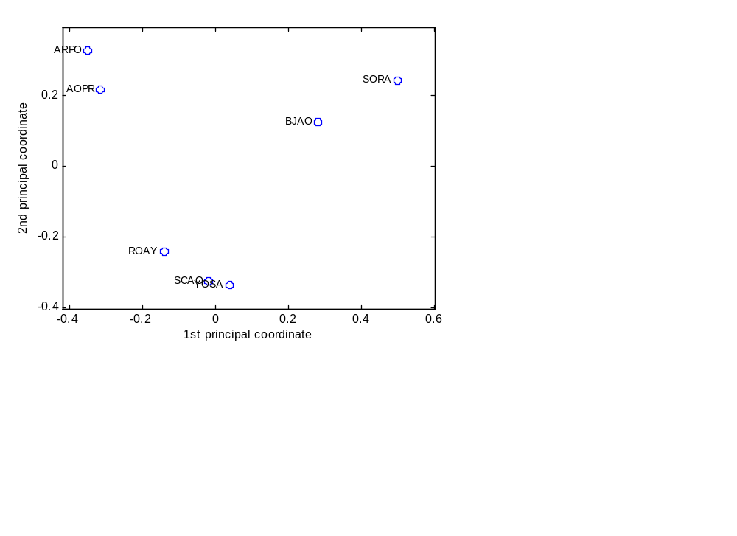
Principal
Coordinates
Analysis:
Chickadees at Feeder
Prin Coord % explained Cumulative Eigenvalue
1 22.77 22.77 0.575
2 20.05 42.82 0.507
3 16.63 59.45 0.420
4 15.17 74.62 0.383
5 13.37 87.98 0.338
6 12.02 100.00 0.304
SCAO 1.00
AOPR 0.18 1.00
ARPO 0.07 0.27 1.00
YOSA 0.26 0.12 0.12 1.00
ROAY 0.21 0.19 0.18 0.31 1.00
SORA 0.06 0.02 0.03 0.15 0.04 1.00
BJAO 0.19 0.17 0.09 0.16 0.21 0.28 1.00
SCAO AOPR ARPO YOSA ROAY SORA BJAO

Slide 15
Correspondence Analysis
Uses incidence matrix
  counts indexed by two factors
  e.g., Archaeology: tombs X artifacts
  e.g., Community ecology: sites X species
Data matrix with counts and many zeros

Slide 16
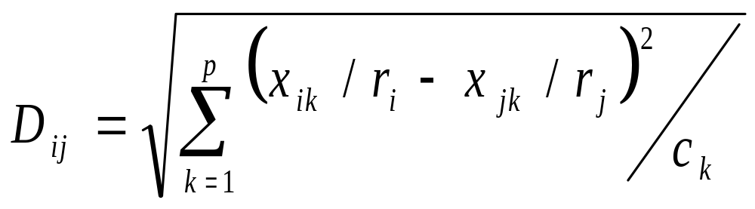
Correspondence Analysis
Distance between two species, i and j, over sites k=1,…,p is (“Chi-squared” measure):
  r_{i} species totals
  c_{k} site totals
{Difference in proportions of each species at each site}
Then do Principal Coordinates Analysis

Slide 17
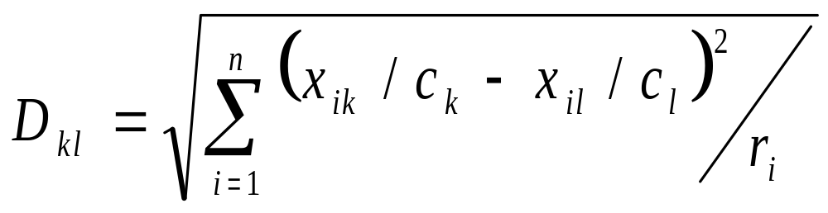
Correspondence Analysis
Distance between two species, i and j, over sites k=1,…,p is (“Chi-squared” measure):
Distance between two sites, k and l, over species i=1,…,n is:

Slide 18
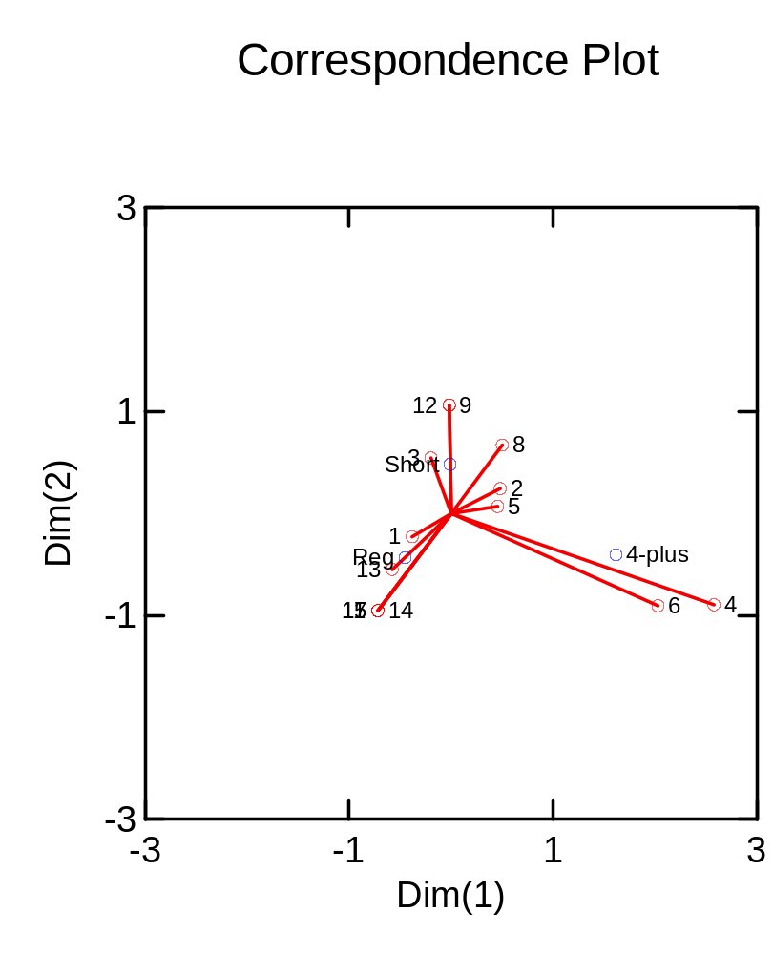
Correspondence Analysis Example:
Sperm Whale Haplotypes by Clan
Reg Short 4-plus
#1 48 28 2
#2 8 27 11
#3 9 26 0
#4 0 0 3
#5 1 2 1
#6 1 0 5
#7 4 0 0
#8 0 4 1
#9 0 2 0
#11 3 0 0
#12 0 1 0
#13 4 1 0
#14 1 0 0
#15 1 0 0
mtDNA haplotype
Eigenvalue 0.205
Eigenvalue 0.394

Slide 19
Multidimensional Scaling
“Non-parametric version of principal coordinates analysis”
Given an association matrix between units:
  tries to find a representation of the units in a given number of dimensions
  preserving the pattern/ordering in the association matrix

Slide 20
Multidimensional Scaling
How it works:
  1 Provide association matrix (similarity/dissimilarity)
  2 Provide number of dimensions
  3 Produce initial plot, perhaps using Principal Coordinates
  4 Orders distances on plot, compares them with ordering of association matrix
  5 Computes STRESS
  6 Juggles points to reduce STRESS
  7 Go to 4, until STRESS is stabilized
  8 Output plot, STRESS
  9 Perhaps repeat with new starting conditions

Slide 21
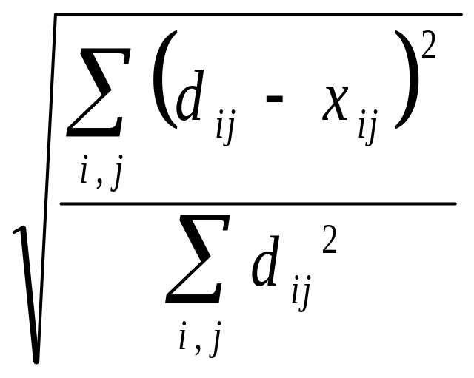
Multidimensional Scaling
STRESS:
d_{ij} associations between i and j
x_{ij} associations between i and j predicted using distances on plot (by regression)

Slide 22
Multidimensional Scaling
Iterative
  No unique solution
  Try with different starting positions
Different possible definitions of STRESS

Slide 23
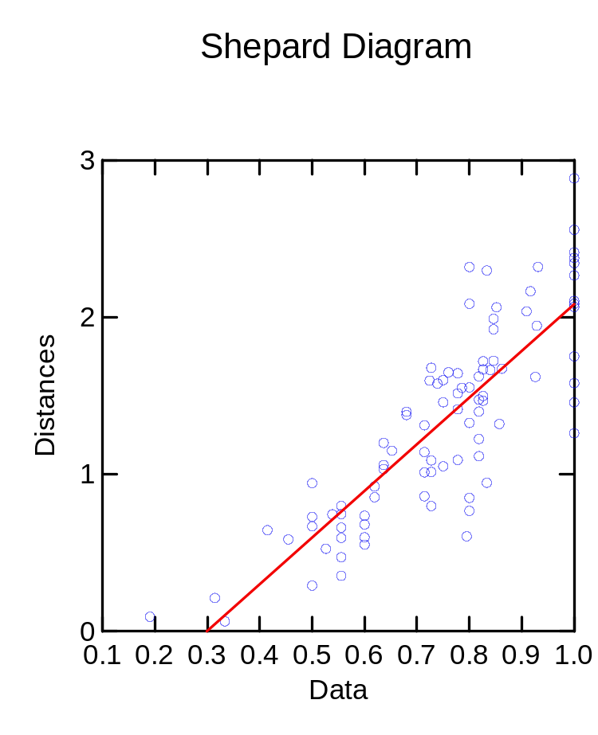
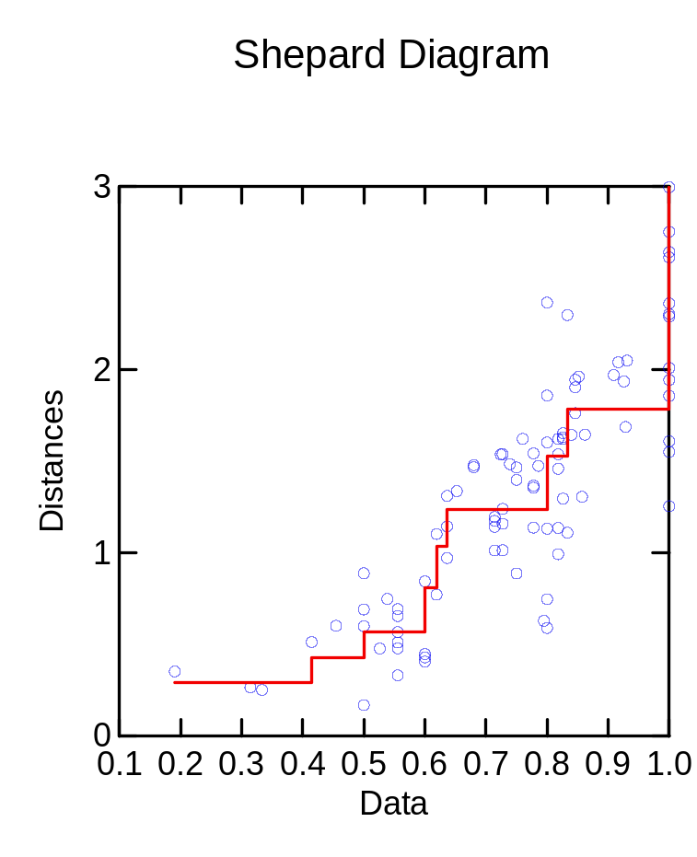
Multidimensional Scaling
Shepard Diagrams
Metric Scaling Non-metric Scaling
Stress 23%
Stress 16%
Association values
Association values
Similar plots to Principal Coordinates
Easier to fit

Slide 24
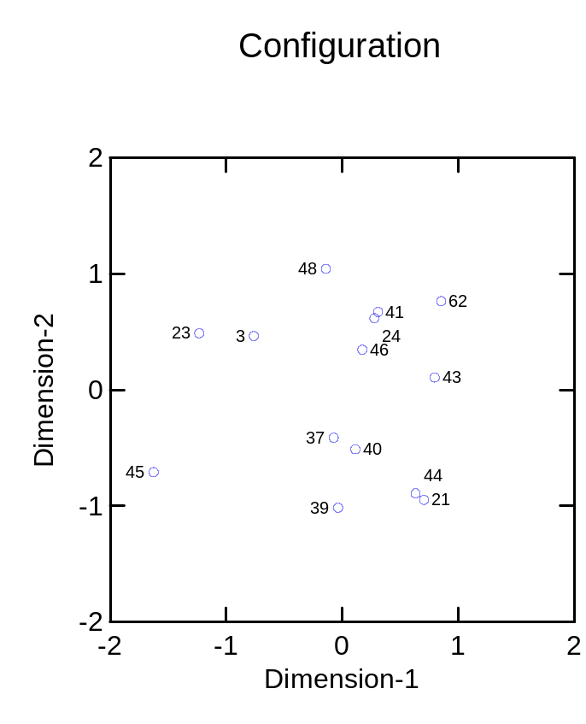
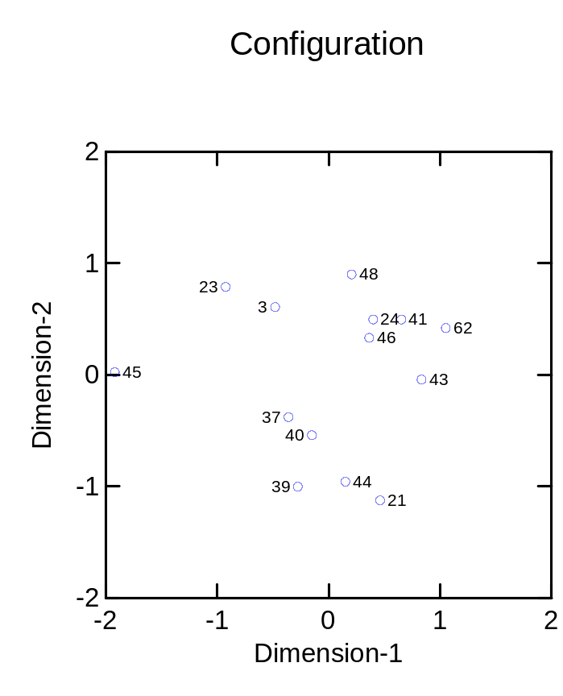
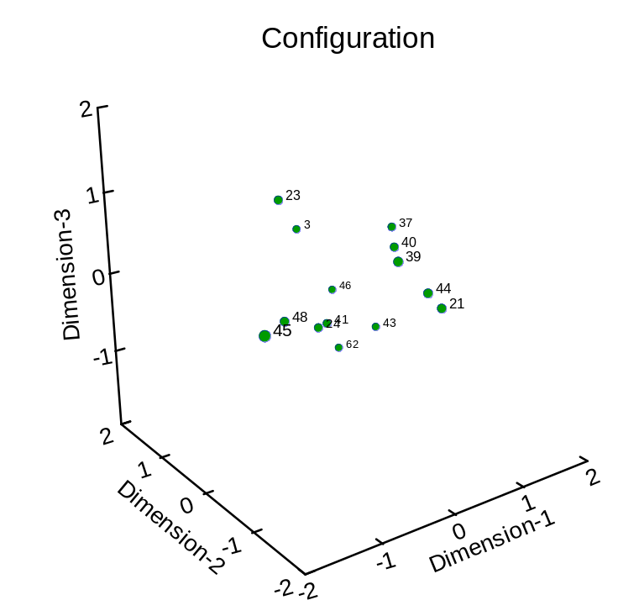
Genetic distances between
sperm whale groups
Metric MDS
Principal coordinates
13/14 eigenvalues negative
-not a good representation
Stress 23%
Non-Metric 2-D MDS
Non-Metric 3-D MDS
Stress 16%
Stress 8%

Slide 25
Multidimensional Scaling
How many dimensions?
  STRESS <10% is “good representation”
  Scree diagram
  two (or three) dimensions for visual ease
Metric or non-metric?
  Metric has few advantages over Principal Coordinates Analysis (unless many negative eigenvalues)
  Non-metric does better with fewer dimensions

Slide 26
Non-metric Multidimensional Scaling vs. Principal Coordinates Analysis
Principal Coordinates MDSCAL
Scaling: Metric Non-metric
Input: Distance matrix Association matrix
Matrix: Pos. Semi-Def. -
Solution: Unique Iterative
Max. Units: 100's 25-100
Dimensions: More Less
Choose no. of
dimensions: Afterwards Before

