Slide 1

Shooting Incidents Trends In NYC
Data Analysis from Historic NYPD Shooting Records
By: Reem B
Notes:
Every day in New York City, families worry about their loved ones' safety. Behind every statistic is a human story. Today, I'm going to take you through a data-driven analysis of shooting incidents in NYC that reveals surprising patterns - patterns that could help save lives

Slide 2
These Data Points are Stories
Each data point represents a family, a community, and a life that was taken from them.
27,000
20
5
Shooting Incidents
NYC Boroughs
Years of historical data
Today, let's uncover patterns that could help prevent a life lost
Notes:
My name is [Your Name], and over the next 10 minutes, we'll uncover three critical insights from over 27,000 shooting incidents that challenge what you might think you know about gun violence in America's largest city.

Slide 3
Questions of Interest
Who are the victims of shooting incidents?
When do these incidents usually occur?
Can we prevent incidents by predicting their occurrence?
How would you answer these questions?
Keep your predictions in mind as we explore and analyze this data…
Notes:
When do you think most shootings occur? Your gut might say late nights or early mornings. What about victims - who's most at risk? Keep those assumptions in mind as we explore what the data tells us.
1. Who are the victims of gun violence in NYC?
2. When do these incidents typically occur?
3. Can we predict future trends to help prevent them?

Slide 4
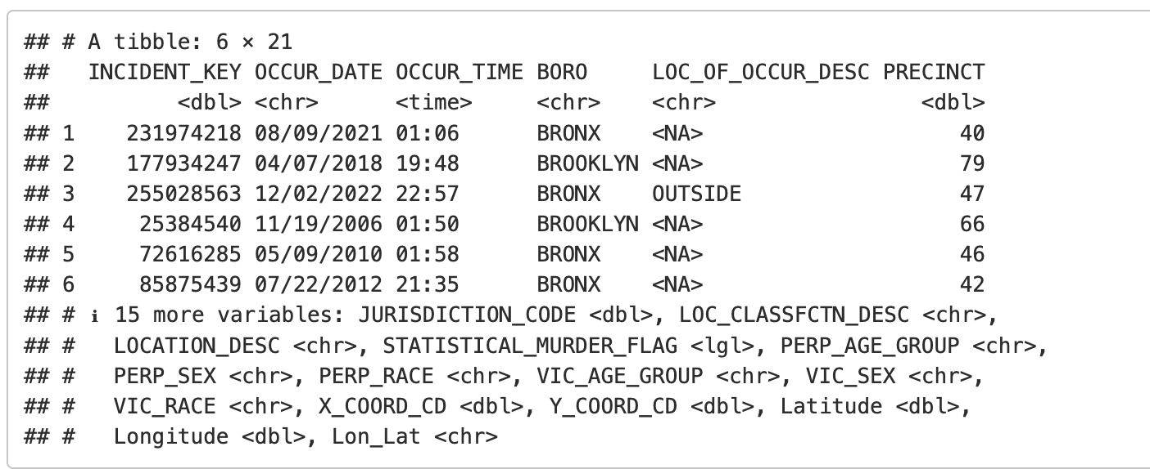
Glimpse of Raw Data
Raw data does not reveal any useful information; it’s the patterns we can extract from it that are useful.
Notes:
The dataset includes incident timing, location, and demographic information. But raw data tells us nothing - it's the patterns we discover that save lives

Slide 5
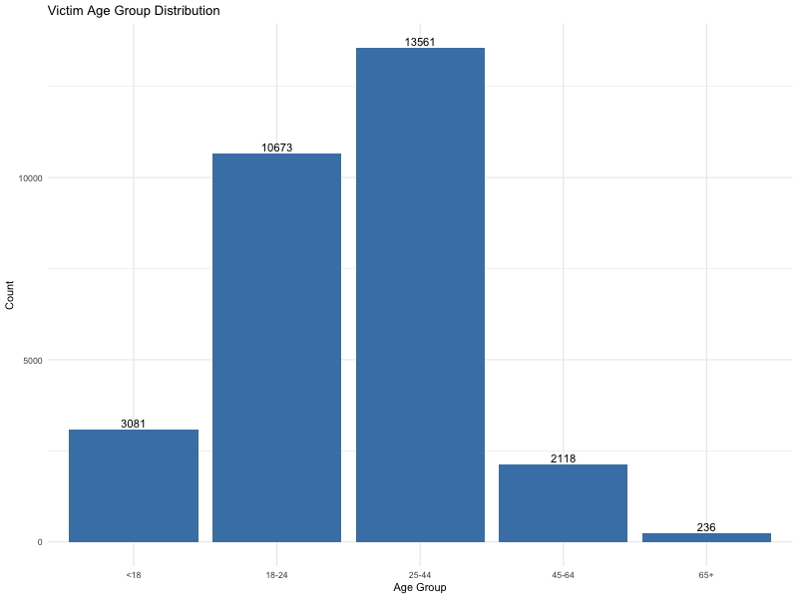
Figure1: Age Factor
60 %
Ages18-44
Prime
Life lost
Mostly young adults starting out their lives and adults in their prime years.
Notes:
Let's start with our first major finding: the demographics of victims paint a clear picture.”
Look at this age distribution. The highest bar represents victims aged 25-44, followed closely by 18-24 year-olds. Combined, these two groups - young adults in their prime - account for nearly 60% of all victims.
hink about that. We're talking about people who should be building careers, starting families, and contributing to their communities. Instead, they're becoming statistics in a dataset.

Slide 6
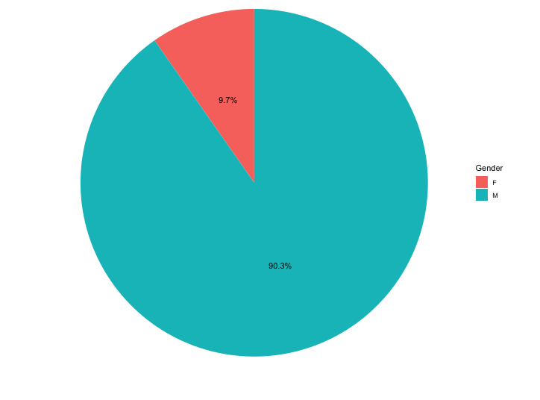
Figure 2 : Victim Gender Distribution
Victims of gun violence in NYC are primarily men
Insight #1: Most victims affected by shooting incidents are Men in their prime years (18-44).
Victim demographics suggest that targeted intervention programs could aid in preventing more incidents.
Notes:
Now here's where the data becomes even more striking. This pie chart shows gender distribution, and the disparity is overwhelming.”
Men represent 89% of shooting victims. That's nearly 9 out of every 10 victims. This isn't just a statistic - it points to deeper social patterns we need to understand.”
So our first key insight: Gun violence in NYC primarily affects men between 18-44. This focused demographic suggests that targeted intervention programs could have maximum impact."

Slide 7
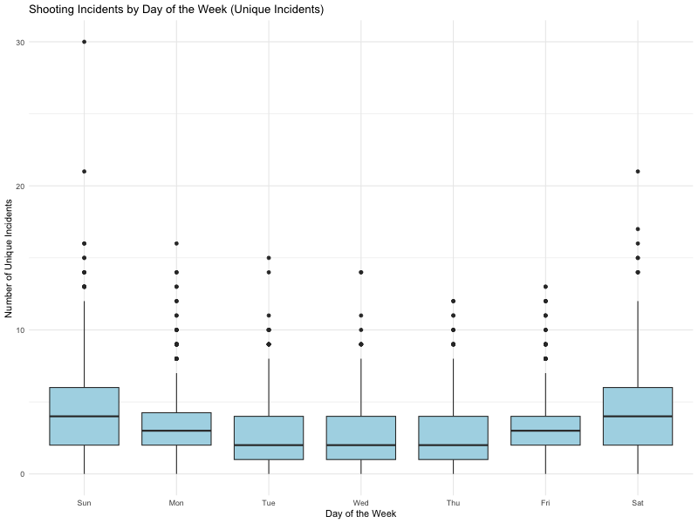
Figure 3: Weekend Vs Weekdays
Shooting incidents occur more on Weekends (Sat/Sun).
Notes:
Our second major finding challenges common assumptions about when violence occurs.

Slide 8
Statistically Significant
Not random – Weekends pose a higher risk of shooting incidents occurring.
ANOVA Statistical Test
P-value < 0.05
Statistically Significant Difference
Insight #2: Weekend days have a significantly higher chance of a shooting incident occurring.
This insight may help city officials and the NYPD to be more vigilant on weekends.
Notes:
But I didn't want to rely on visual patterns alone, so I ran statistical tests.
Using ANOVA analysis, I confirmed this pattern is statistically significant with a p-value less than 0.05. This isn't random variation - weekends genuinely pose higher risk."

Slide 9
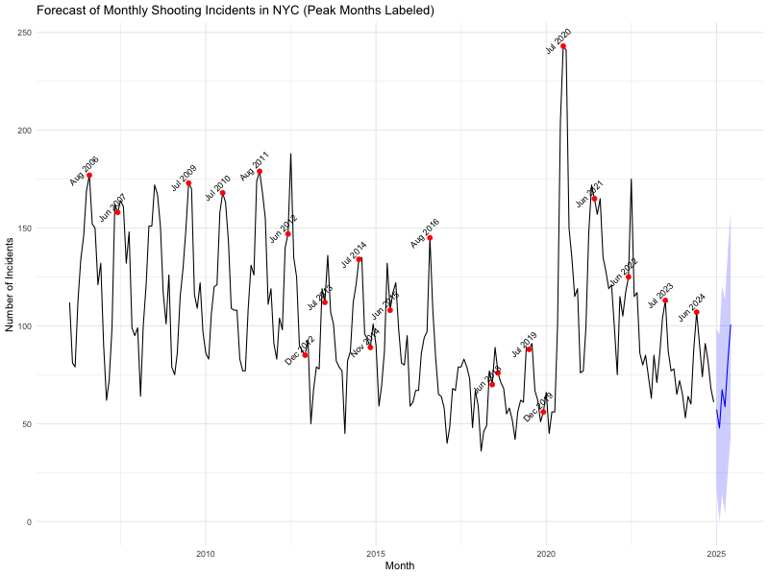
Figure 4: Forecasting
Historical shooting incidents are spiking up during the Summer Months.
Insight #3: Gun violence clearly follows a temporal pattern where incidents occur more in the summer months.
This forecasting model can aid the NYPD with resource allocations to prevent future incidents
Notes:
Using ANOVA analysis, I confirmed this pattern is statistically significant with a p-value less than 0.05. This isn't random variation - weekends genuinely pose higher risk.”
"This time series model reveals something crucial. See these red dots? They mark historical peak months - notice the summer pattern. July, August, and June consistently show the highest incident rates.”
The blue line shows our six-month forecast. If historical patterns continue, we can expect incidents to rise heading into summer months

Slide 10
Three Useful Insights
Who
Young men 18-
When
Weekends and
Predict
Statistical
Model
Summer
44 years old
These patterns revealed insights that are actionable to aid in limiting lives lost to shooting incidents.
Notes:
Let me bring this together with our third insight: These patterns aren't just academic - they're actionable
We know WHO is most at risk: young men aged 18-44. We know WHEN risk peaks: weekends and summer months. We can PREDICT future trends with statistical confidence

Slide 11
We Can Take Action
Some examples:
Assign more patrols on weekends
Summer Youth Programs for job training or internships
Intervention programs for men on conflict resolution and gun violence
The patterns show insights into where our resources and effort are best focused for maximum impact.

Slide 12
Limitations, but We Can Dig Deeper
Time
Location
Weather
Perpetrator
Notes:
Now, I want to be transparent about limitations. This analysis assumes historical patterns continue, and it can't account for policy changes or external factors. There are also data quality issues with unknown demographics that could introduce bias.

Slide 13
Thank You
Notes:
"I started by saying every statistic represents a human story. What this analysis shows us is that these stories follow patterns - patterns we can interrupt.”
Thank you. The data has spoken - now it's time for us to listen and act."

