Slide 1


Shooting Incidents Trends In NYC
Data Analysis from Historic NYPD Shooting Records
By: Reem B

Slide 2
These Data Points are Stories
Each data point represents a family, a community, and a life that was taken from them.
27,000
20
5
Shooting Incidents
NYC Boroughs
Years of historical data
Today, let's uncover patterns that could help prevent a life lost

Slide 3
Questions of Interest
Who are the victims of shooting incidents?
When do these incidents usually occur?
Can we prevent incidents by predicting their occurrence?
How would you answer these questions?
Keep your predictions in mind as we explore and analyze this data…

Slide 4
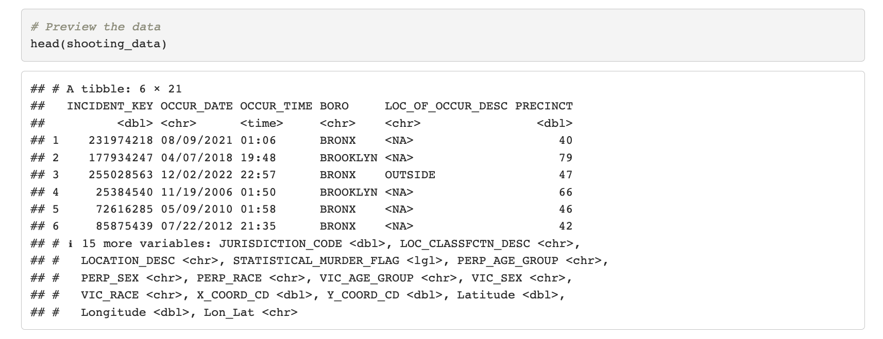
Glimpse of Raw Data
Raw data does not reveal any useful information; it’s the patterns we can extract from it that are useful.

Slide 5
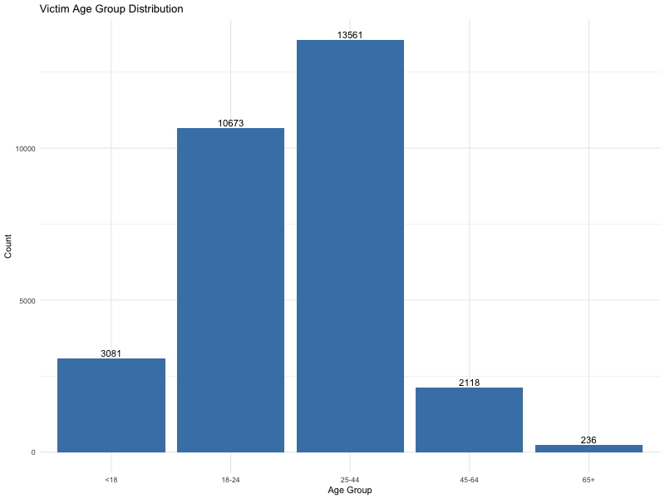
Figure1: Age Factor
60 %
Ages18-44
Prime
Life lost
Mostly young adults starting out their lives and adults in their prime years.

Slide 6
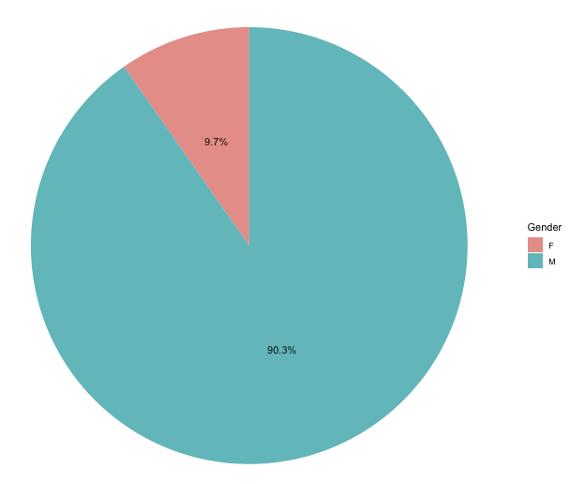
Figure 2 : Victim Gender Distribution
Victims of gun violence in NYC are primarily men
Insight #1: Most victims affected by shooting incidents are Men in their prime years (18-44).
Victim demographics suggest that targeted intervention programs could aid in preventing more incidents.

Slide 7
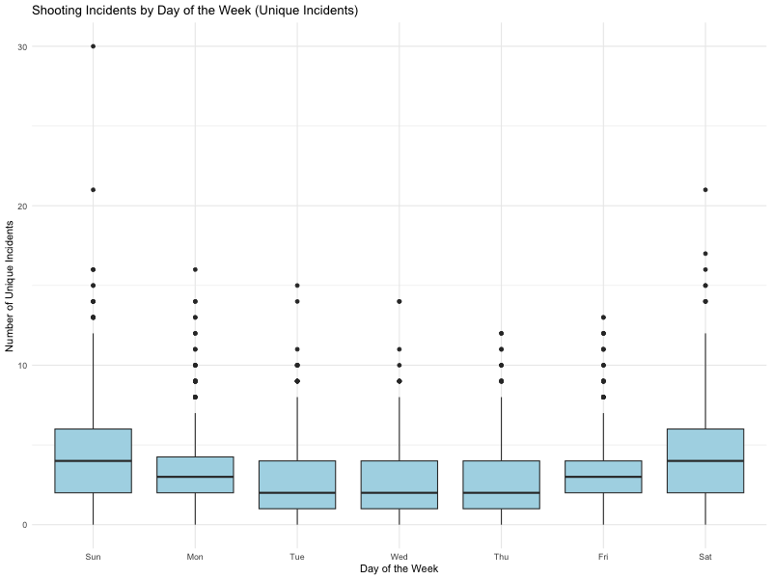
Figure 3: Weekend Vs Weekdays
Shooting incidents occur more on Weekends (Sat/Sun).

Slide 8
Statistically Significant
Not random – Weekends pose a higher risk of shooting incidents occurring.
ANOVA Statistical Test
P-value < 0.05
Statistically Significant Difference
Insight #2: Weekend days have a significantly higher chance of a shooting incident occurring.
This insight may help city officials and the NYPD to be more vigilant on weekends.

Slide 9
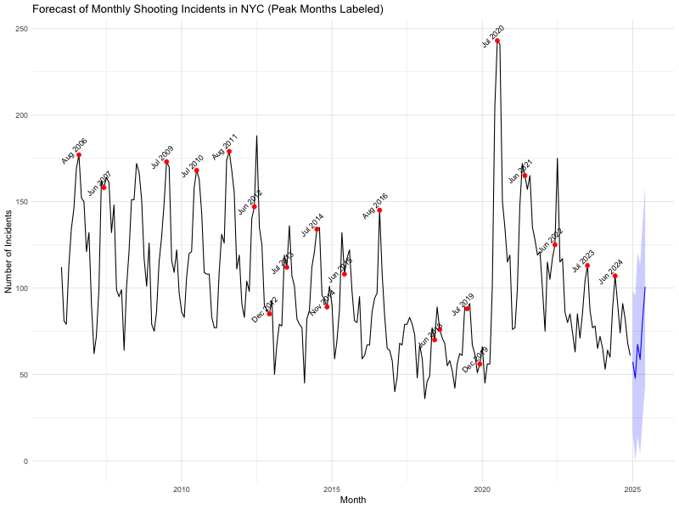
Figure 4: Forecasting
Historical shooting incidents are spiking up during the Summer Months.
Insight #3: Gun violence clearly follows a temporal pattern where incidents occur more in the summer months.
This forecasting model can aid the NYPD with resource allocations to prevent future incidents

Slide 10
Three Useful Insights
Who
Young men 18-
When
Weekends and
Predict
Statistical
Model
Summer
44 years old
These patterns revealed insights that are actionable to aid in limiting lives lost to shooting incidents.

Slide 11
We Can Take Action
Some examples:
Assign more patrols on weekends
Summer Youth Programs for job training or internships
Intervention programs for men on conflict resolution and gun violence
The patterns show insights into where our resources and effort are best focused for maximum impact.

Slide 12
We Can Dig Deeper
Time
Location
Weather
Perpetrator

Slide 13
Thank You

