Slide 1

AllLife Bank
Supervised Learning Classification
Logistic Regression vs. Decision Tree
Renato Barroco

Slide 2

This is an exploratory data analysis and a supervised learning (classification) analysis using a dataset provided by great learning at the Post Graduate program of Data Science and Business Analytics.
The main objective is to build a model applying supervised learning classification to predict if a customer is going to do a Personal Loan or not, explore client dataset and understand AllLife client’s behavior

Slide 3

Data Dictionary
Data Dictionary
ID: Customer ID
Age: Customer’s age in completed years
Experience: years of professional experience
Income: Annual income of the customer (in thousand dollars)
ZIP Code: Home Address ZIP code.
Family: the Family size of the customer
CCAvg: Avg. spending on credit cards per month (in thousand dollars)
Education: Education Level. 1: Undergrad; 2: Graduate;3: Advanced/Professional
Mortgage: Value of house mortgage if any. (in thousand dollars)
Personal_Loan: Did this customer accept the personal loan offered in the last campaign?
Securities_Account: Does the customer have securities account with the bank?
CD_Account: Does the customer have a certificate of deposit (CD) account with the bank?
Online: Do customers use internet banking facilities?
CreditCard: Does the customer use a credit card issued by Bank?

Slide 4

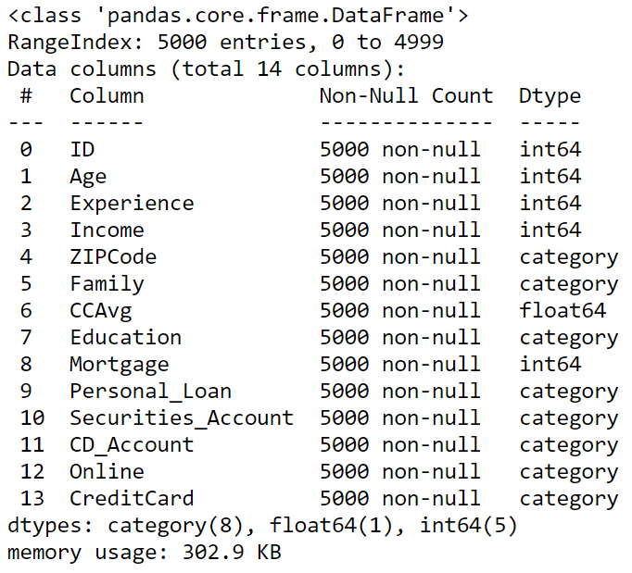
Data description

Slide 5
1. Perform exploratory data analysis.

Slide 6
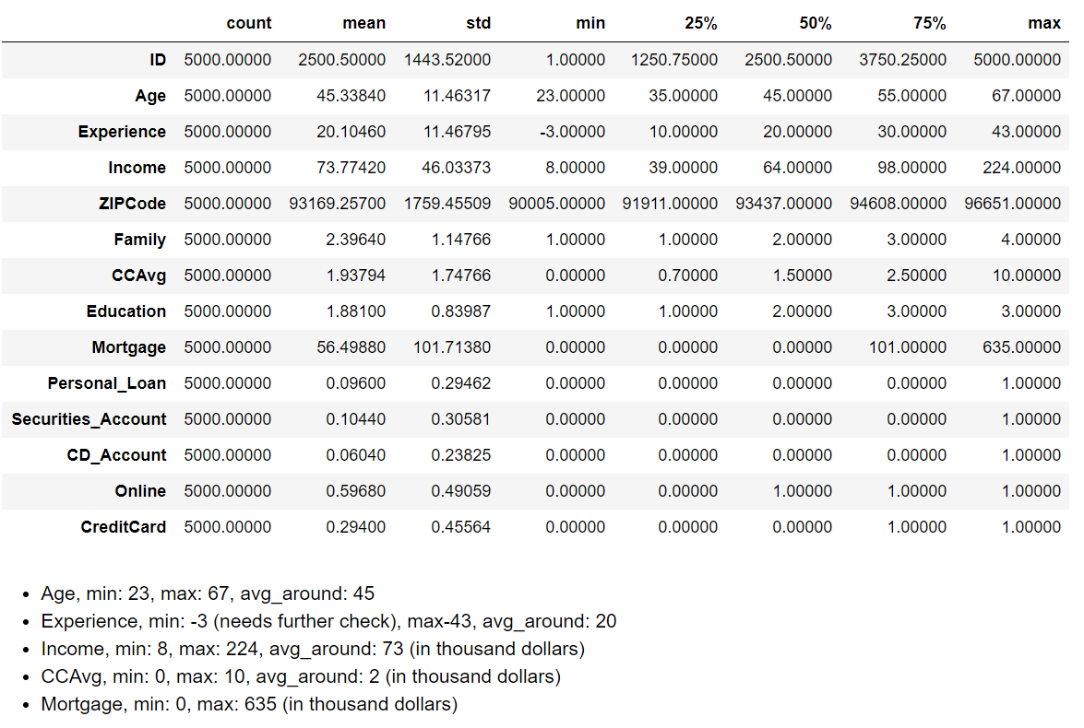
Univariate analysis

Slide 7
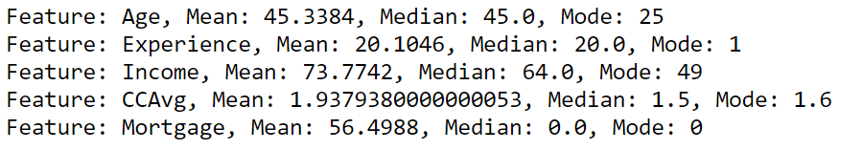
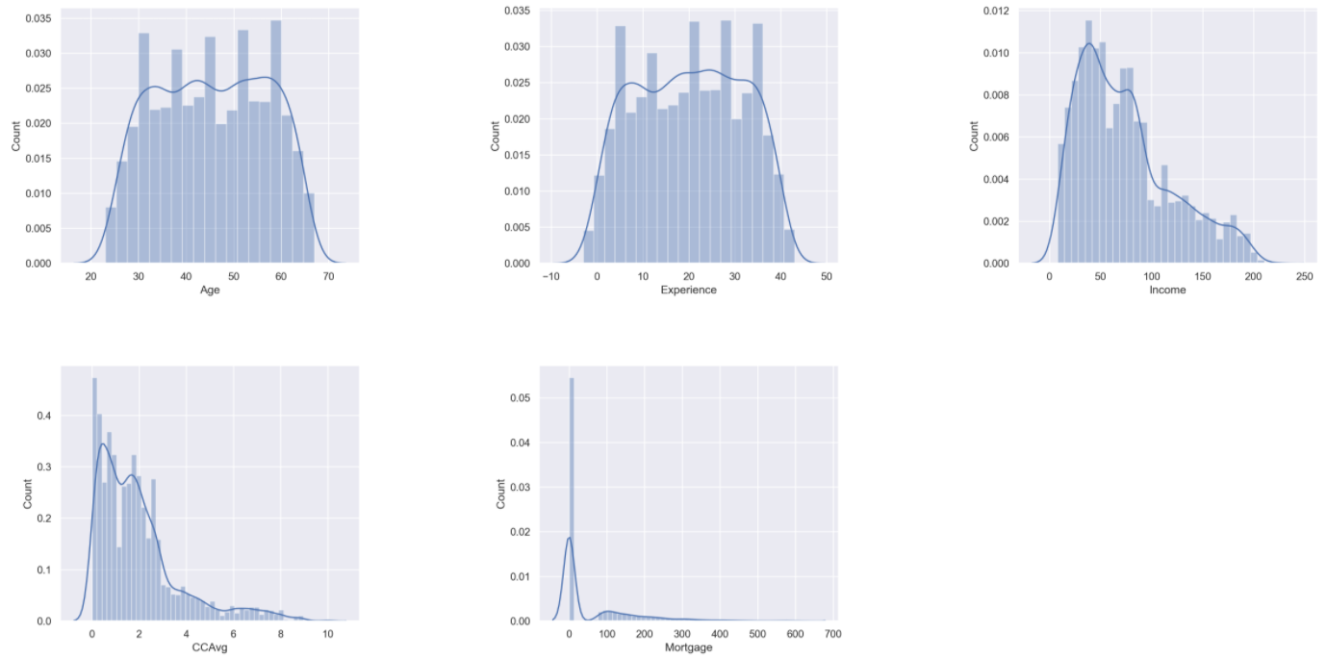
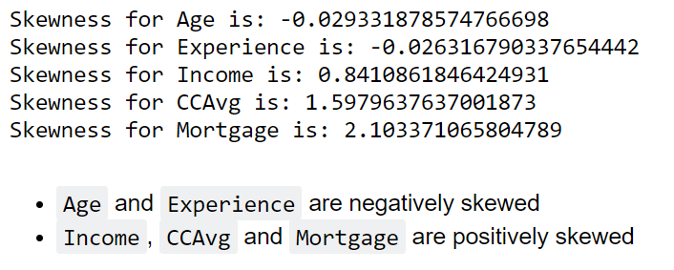
Univariate analysis

Slide 8
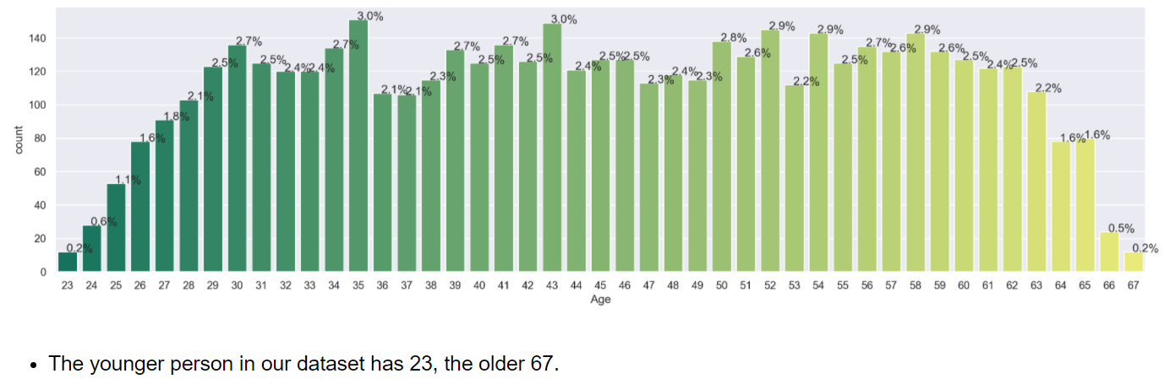
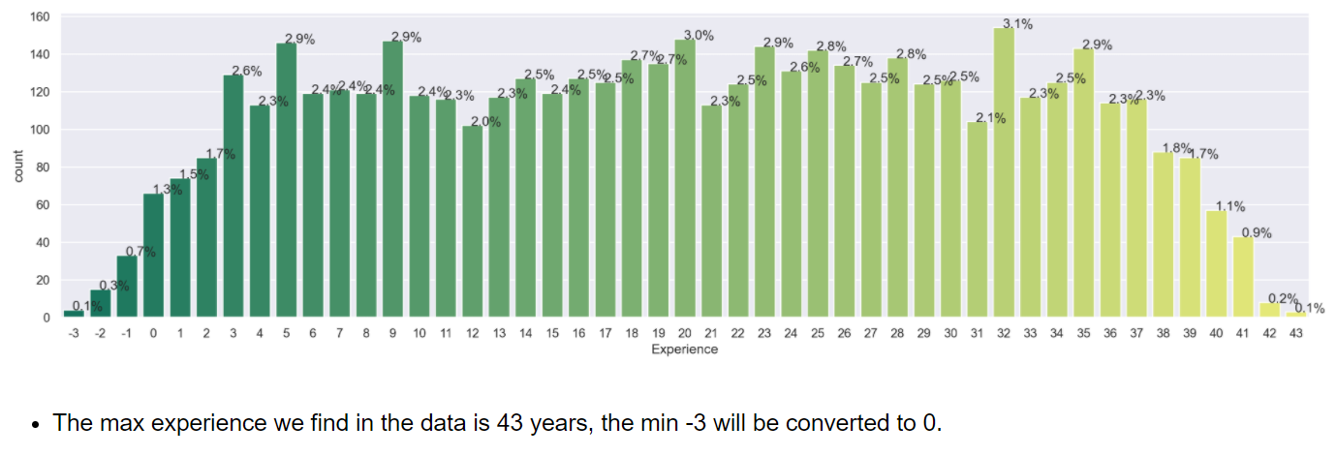
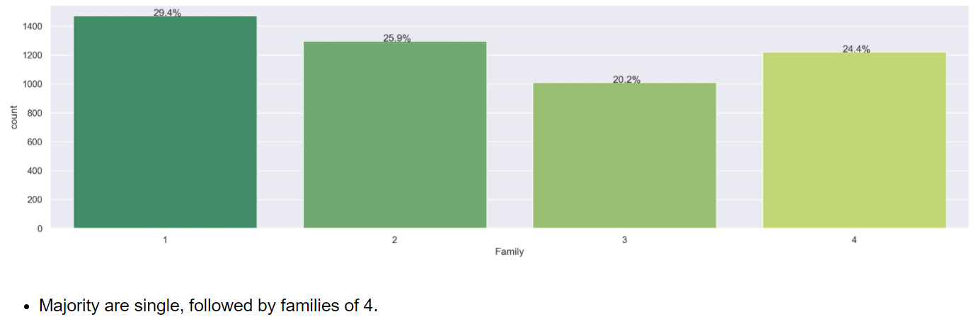
Univariate analysis

Slide 9
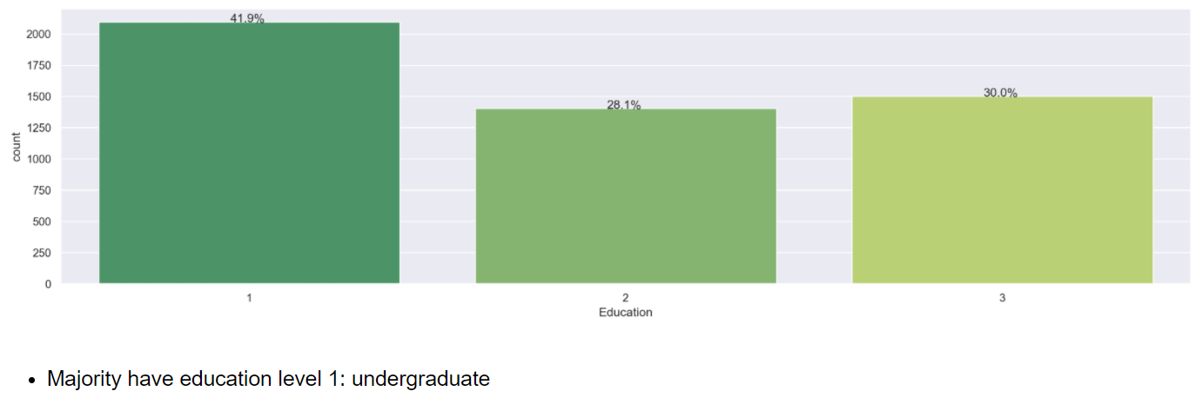
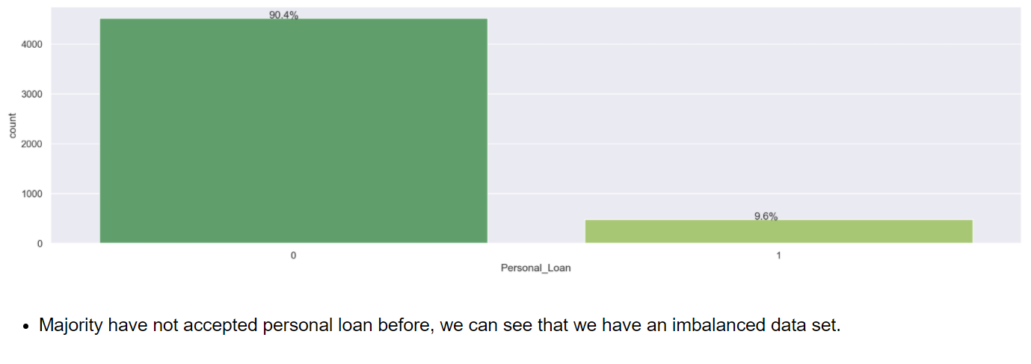
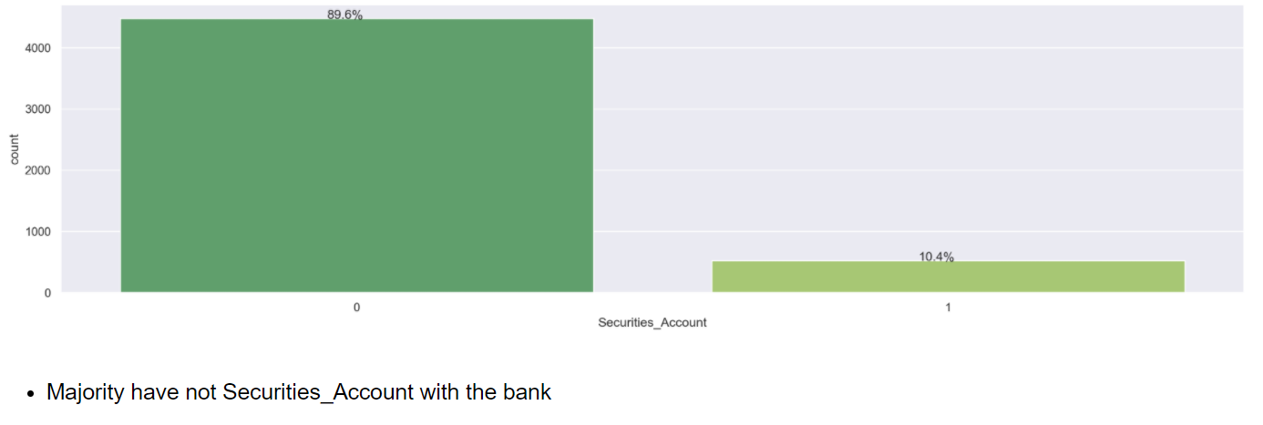
Univariate analysis

Slide 10
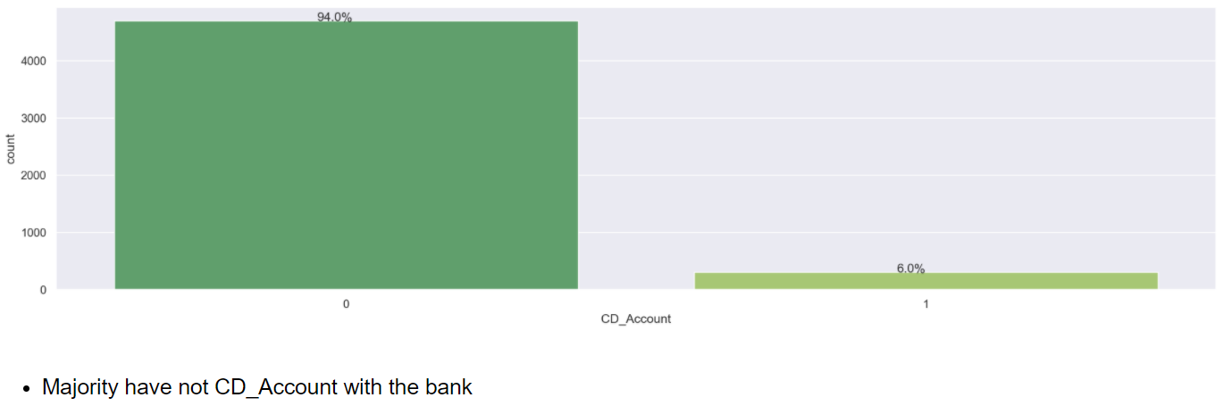
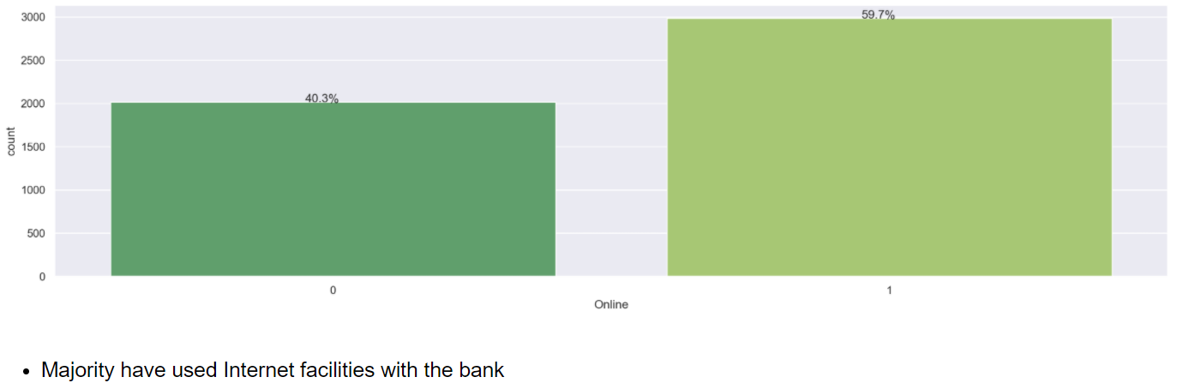
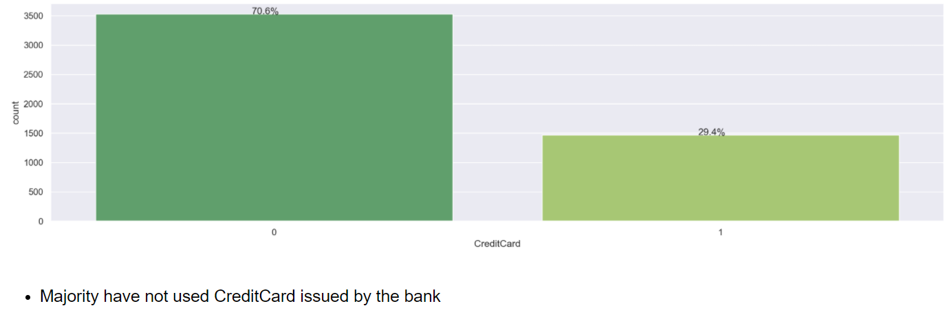
Univariate analysis

Slide 11
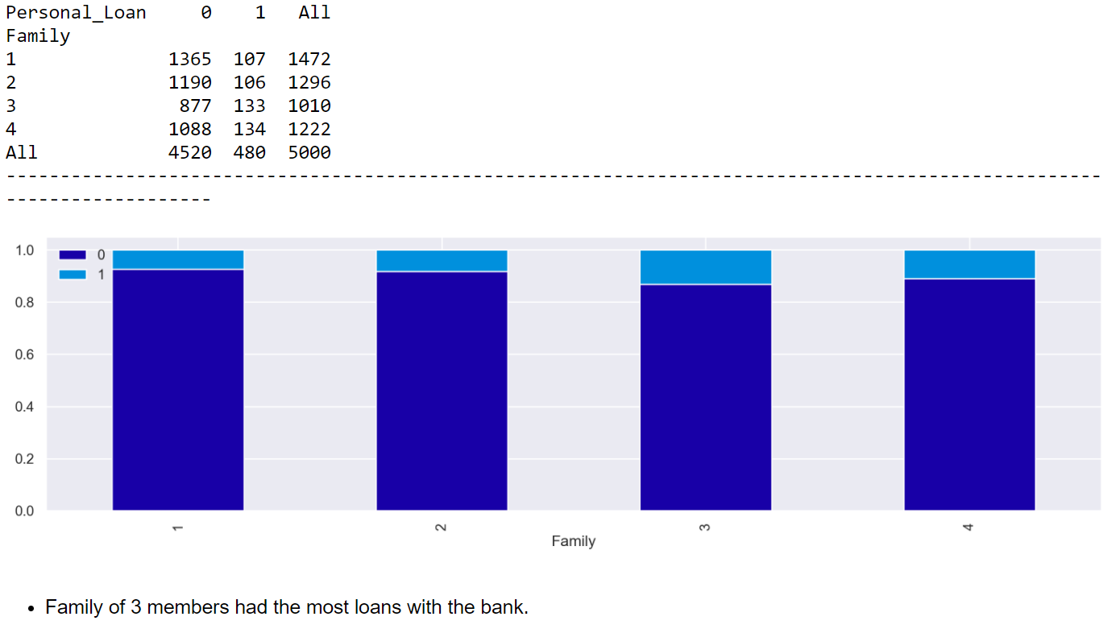
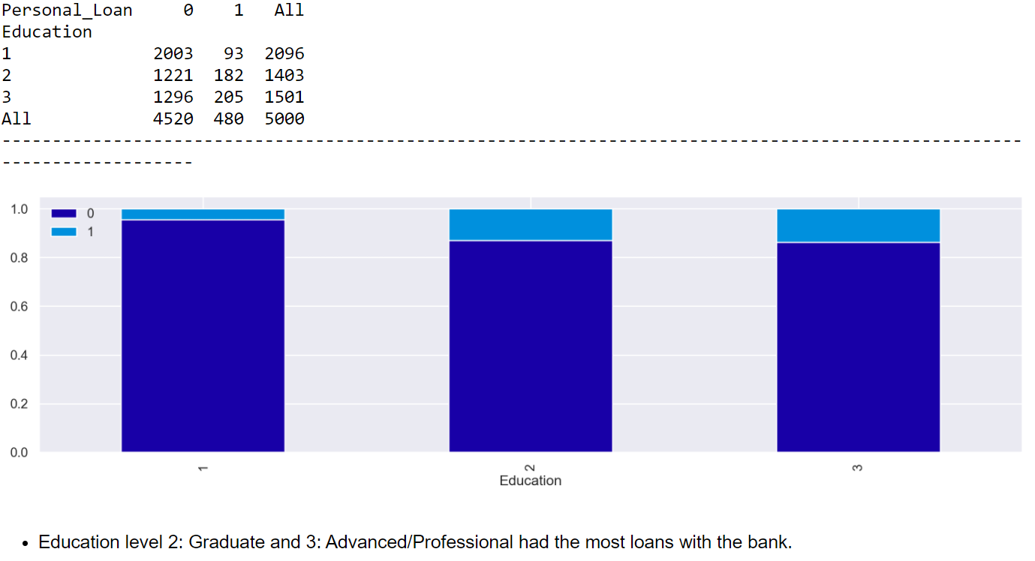
Bivariate analysis

Slide 12
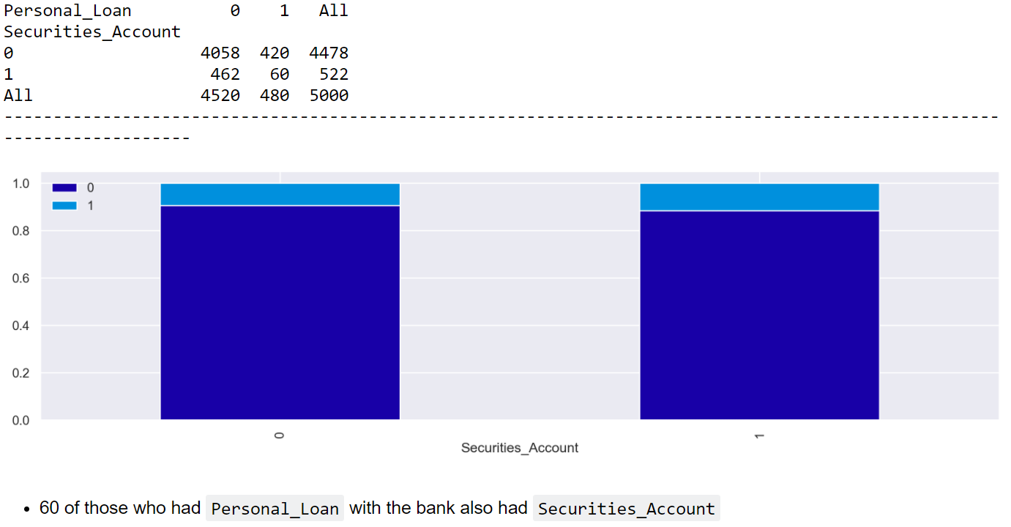
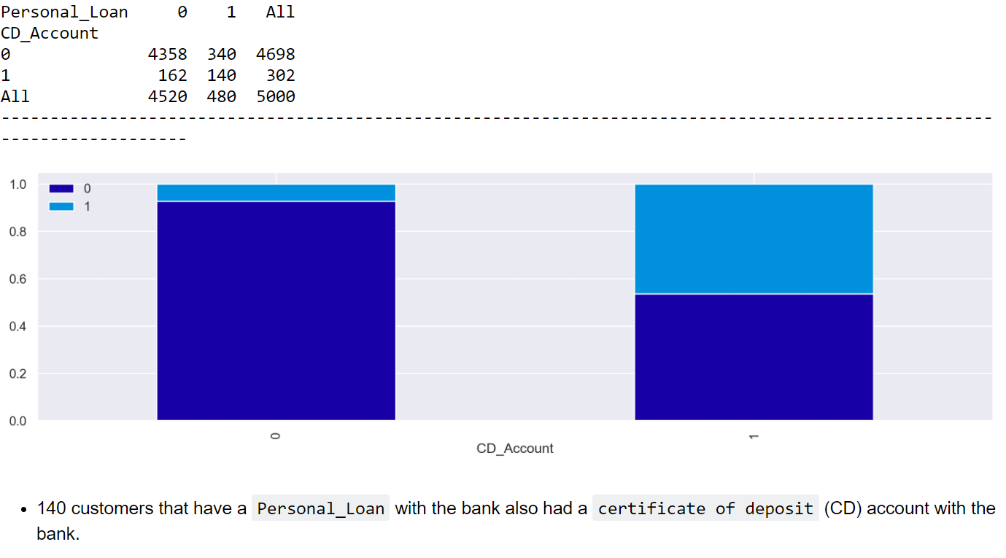
Bivariate analysis

Slide 13
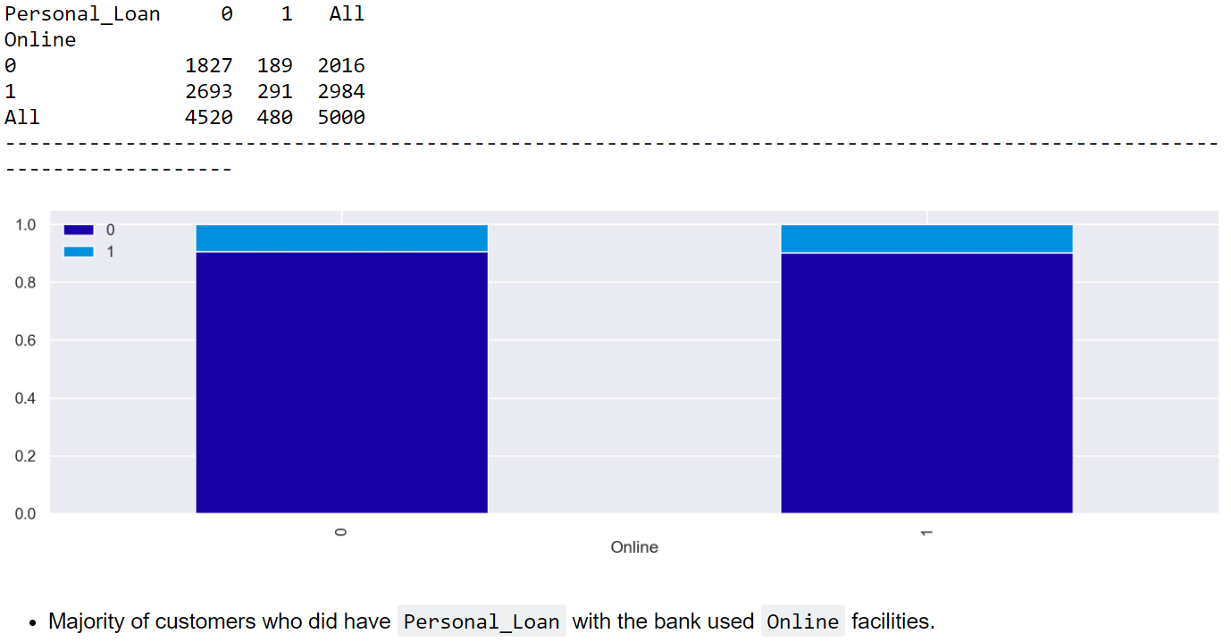
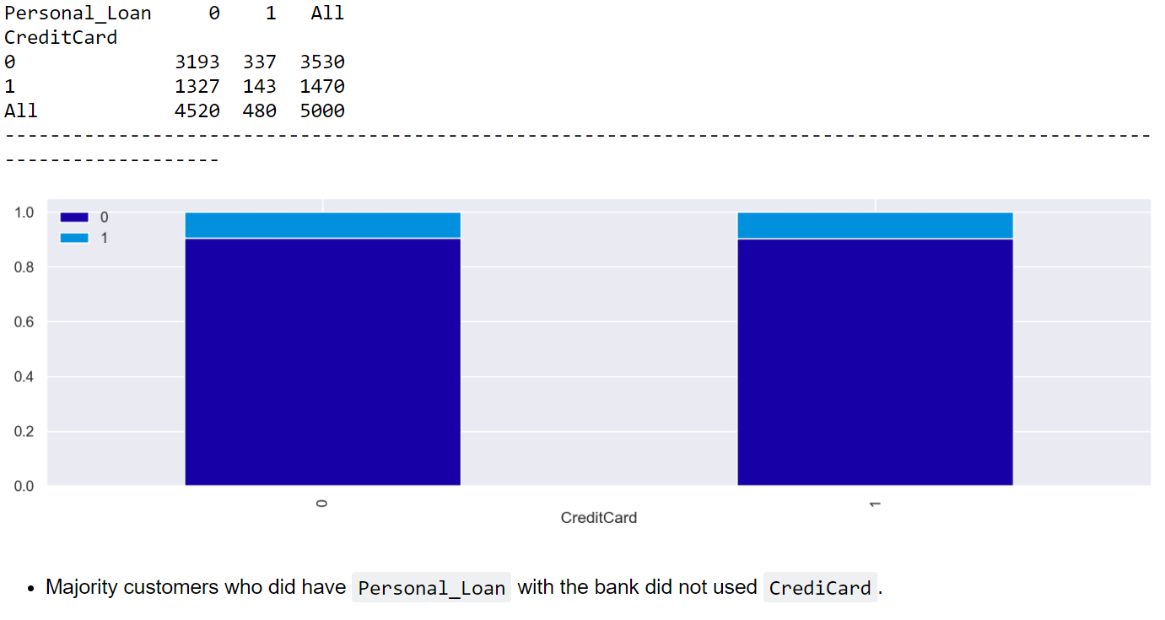
Bivariate analysis

Slide 14
Bivariate analysis

Slide 15
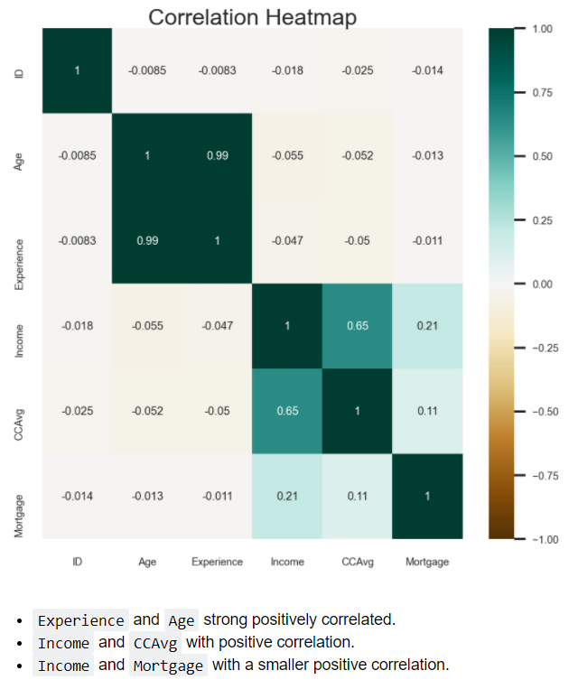
Multivariate analysis

Slide 16
2. Illustrate the insights based on EDA.

Slide 17
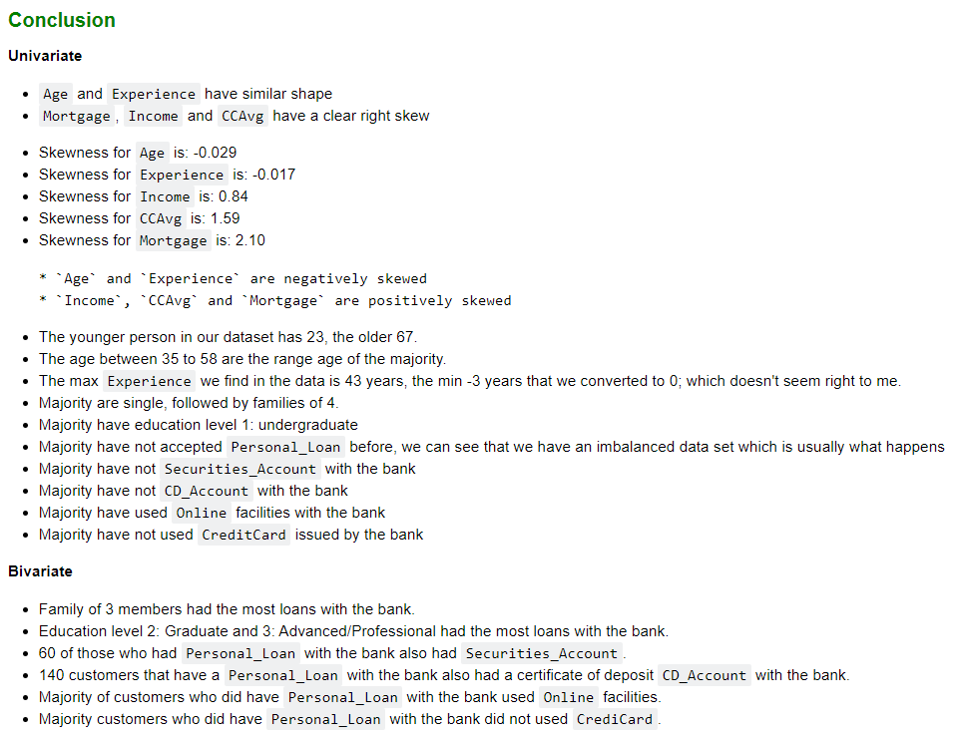
EDA conclusions

Slide 18
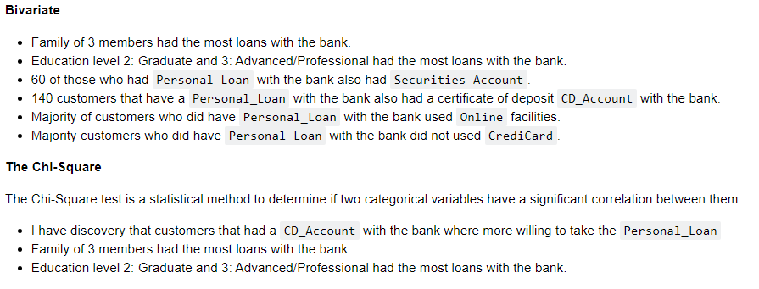
EDA conclusions

Slide 19
3. Data Pre-processing.

Slide 20
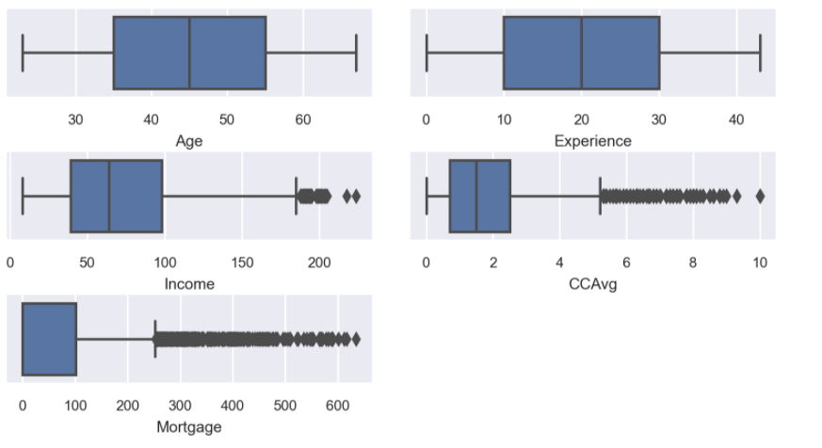
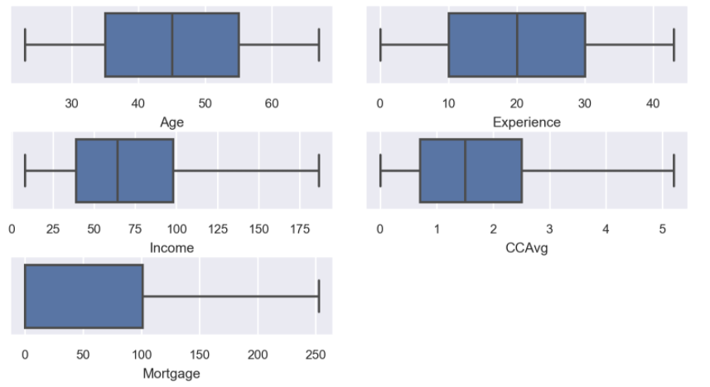
Outliers treatment only for Logistic Regression application

Slide 21
4. Model building – Logistic Regression.

Slide 22
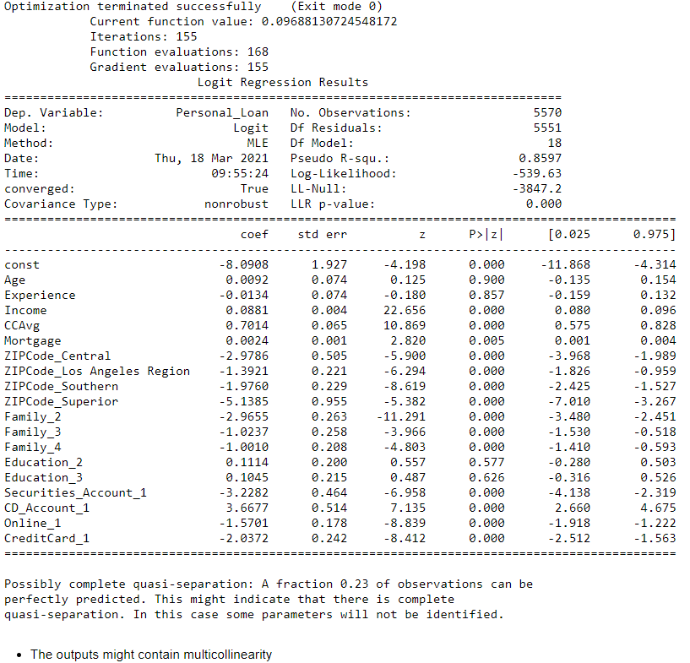
Logistic Regression

Slide 23
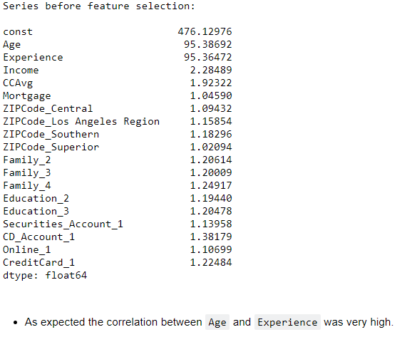
Logistic Regression Solving multicollinearity

Slide 24
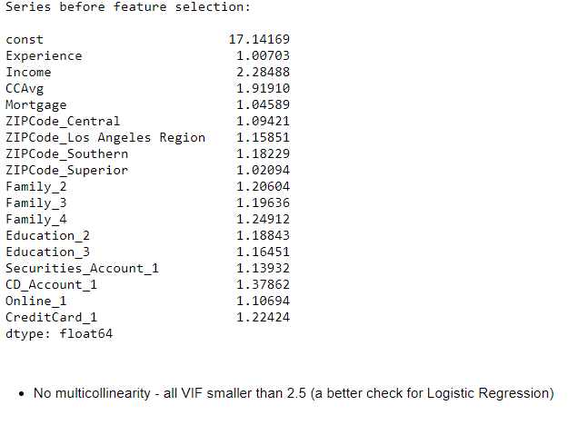
Logistic Regression Solving multicollinearity

Slide 25
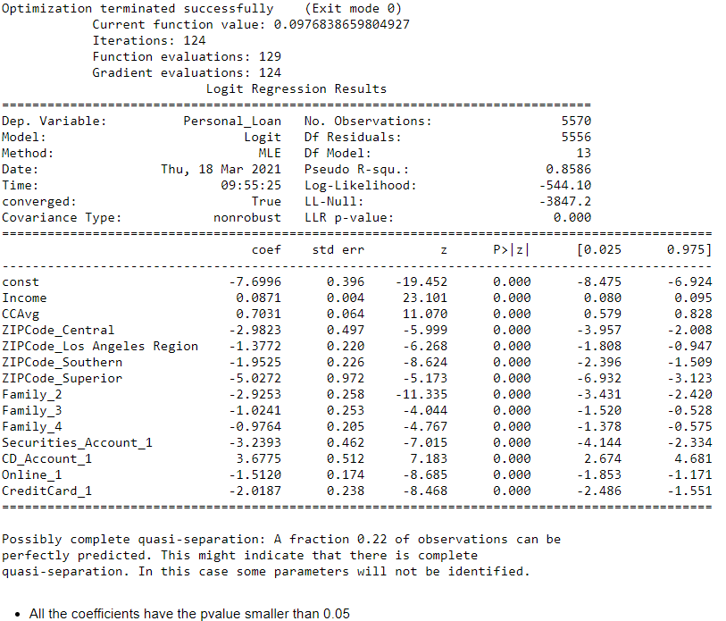
Logistic Regression After removing Education, Mortgage, Experience based on higher p-value than 0.05

Slide 26
5. Model performance evaluation and improvement
Logistic Regression

Slide 27
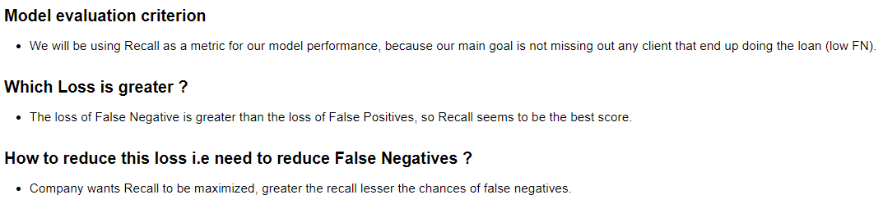
Model Performance

Slide 28
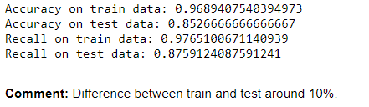
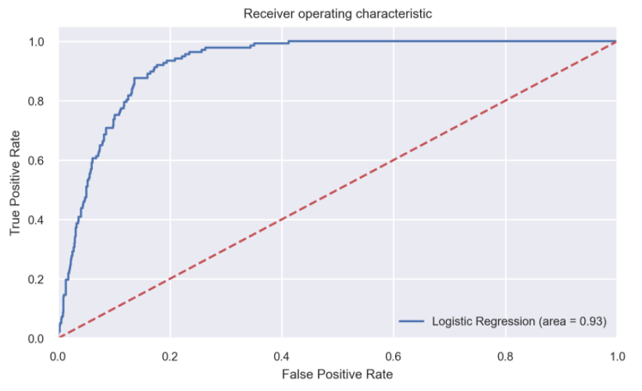
Model Performance Logistic Regression

Slide 29
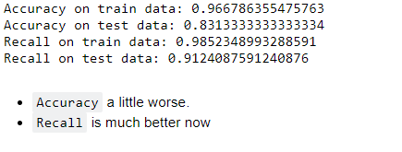
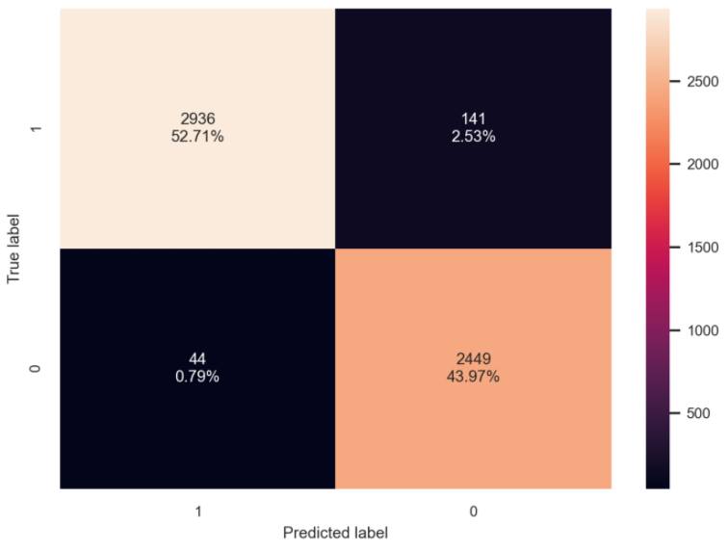
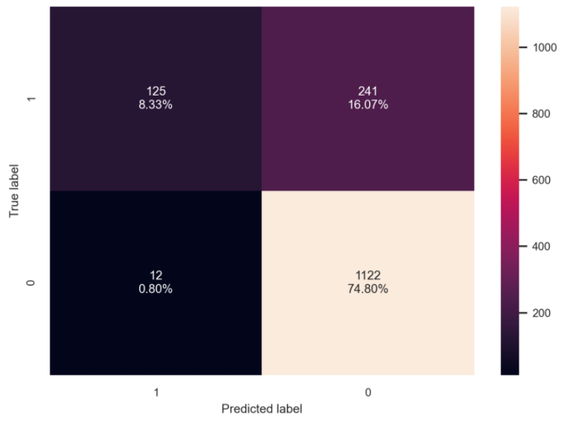
Model Performance Logistic Regression optimal threshold

Slide 30
Model Performance Logistic Regression optimal threshold

Slide 31
6. Model performance evaluation and improvement
Decistion Tree

Slide 32
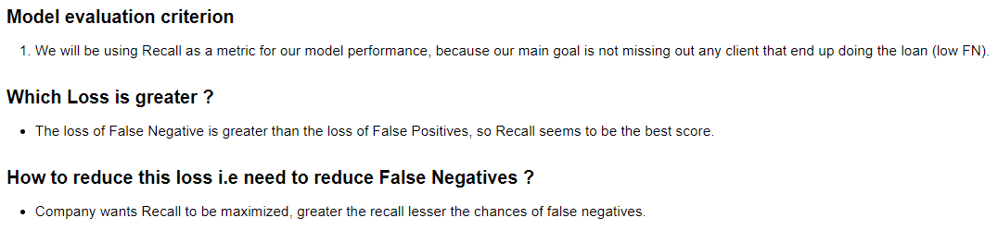
Model Performance Decistion Tree initial

Slide 33
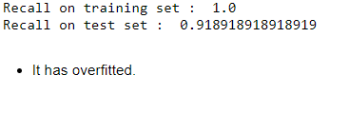
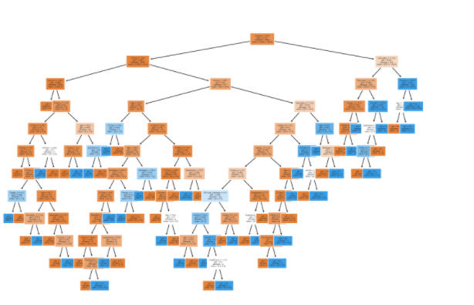
Model Performance Decistion Tree initial

Slide 34
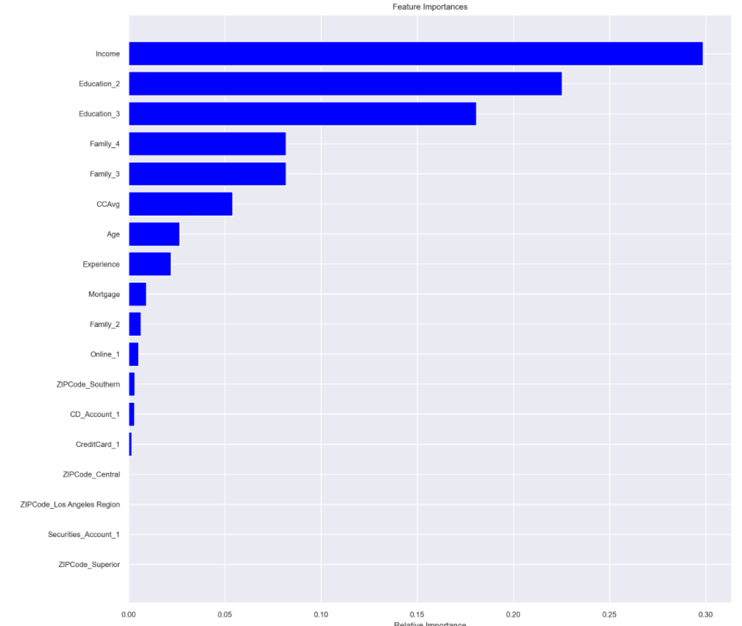
Model Performance Decistion Tree initial Most important features in this model: Income, Education and Family

Slide 35
7. Model performance evaluation and improvement
Decistion Tree

Slide 36
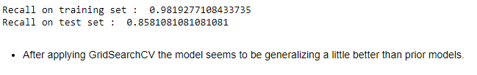
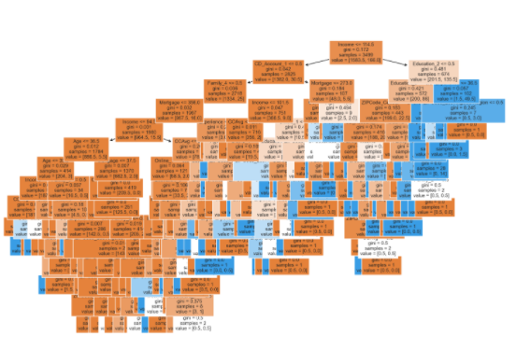
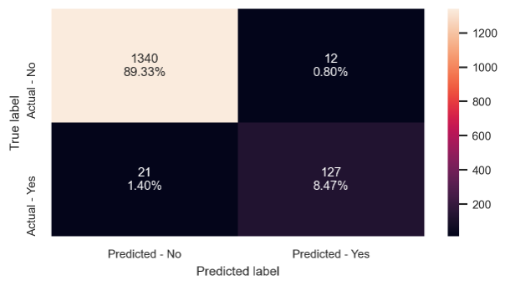
Model Performance Decistion Tree Hyperparameter Tuning, GridSearchCV and class_weight argument

Slide 37
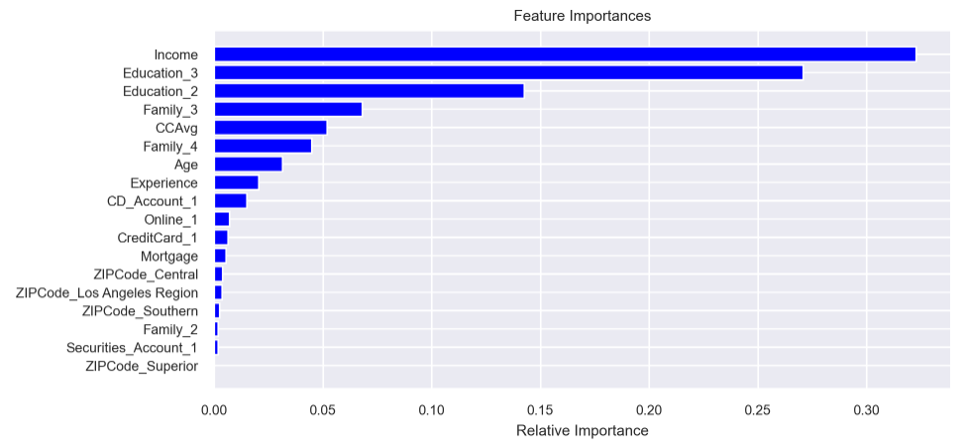
Model Performance Decistion Tree Hyperparameter Tuning, GridSearchCV and class_weight argument

Slide 38
7b. Model performance evaluation and improvement
Decistion Tree – Cost Complexity Prunning

Slide 39
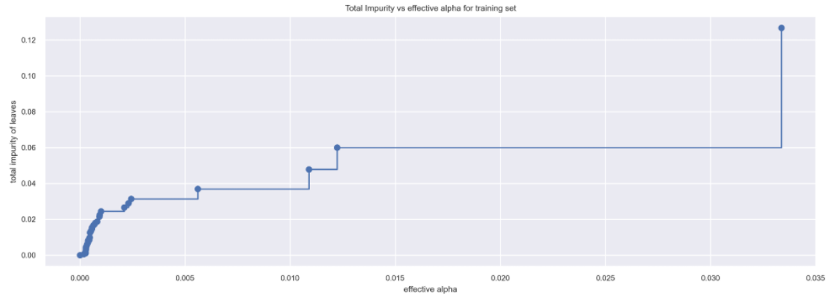
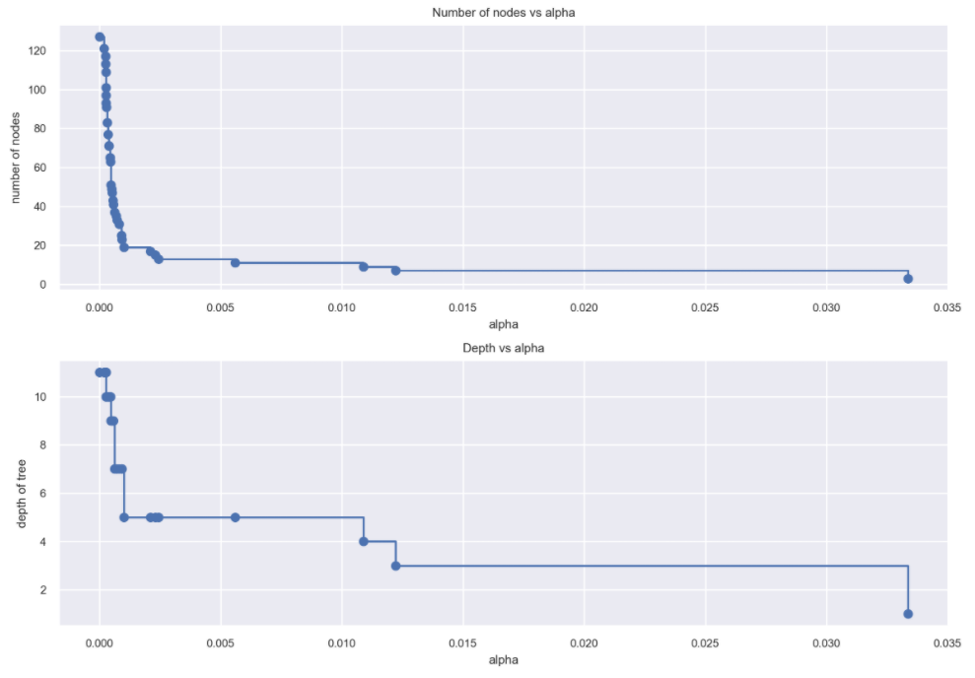
Model Performance Decistion Tree Cost Complexity Pruning

Slide 40
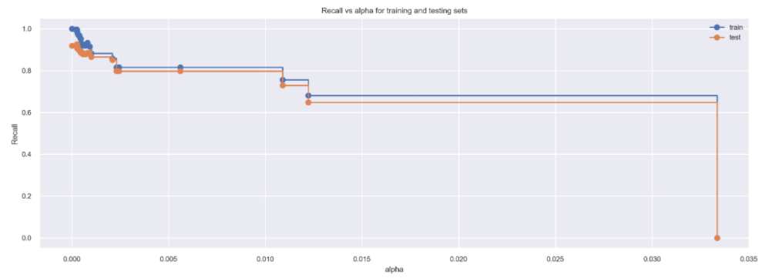
Model Performance Decistion Tree Cost Complexity Pruning

Slide 41
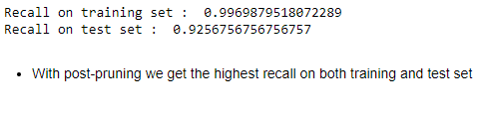
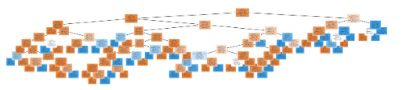

Model Performance Decistion Tree Cost Complexity Pruning

Slide 42
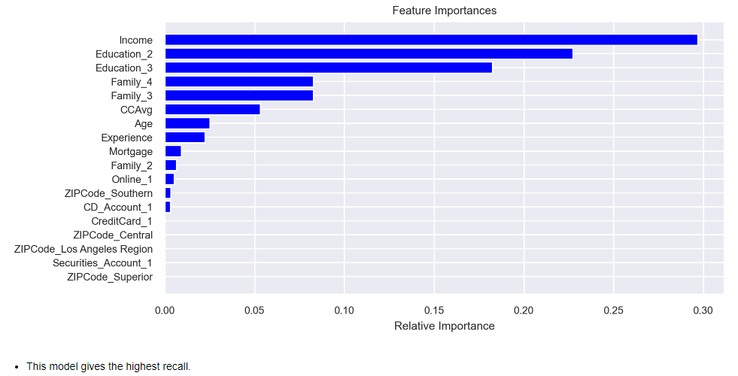
Model Performance Decistion Tree Cost Complexity Pruning

Slide 43
8. Actionable Insights & Recommendations

Slide 44
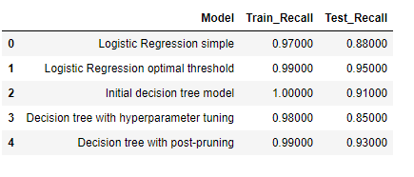
wrap-up

Slide 45

Conclusions

Slide 46
9. Misclassification Analysis

Slide 47

Misclassification Analysis

Slide 48
Thank you!

