Slide 1

Cardio good fitness
Exploratory data analysis
Renato Barroco

Slide 2

This is an exploratory data analysis using a dataset provided by great learning at the Post Graduate program of Data Science and Business Analytics.
Univariate and multivariate data analysis.
The main goal is to identify the type of customer for each one of the three products the company has and produce insights to improve sales.

Slide 3

Dataset
In our dataset we have 104 males and 76 females. Males have an average income of approximately $56.500,00 and female have an average income of approximately $50.000,00.
The product TM195 has 40 males’ customers and 40 females’ customers, 48 are partnered and 32 are single, the average income for women customers is $46.020,075 and the average income for men customers is $46.815,975.
The TM498 has 29 females’ customers and 31 males’ customers, 36 are partnered and 24 are single, the average income for women customers is $49.336,448 and the average income for men customers is $48.634,258.
The TM798 have only 7 females’ customers and 33 males’ customers, 23 are partnered and 17 are single, the average income for women customers is $73.633,857 and the average income for men customers is $75.825,030.
The average age of our customers is 28.78, the average education level is 15.57 years, the average usage expected is 3.45 days, the average fitness score is 3.31, the average income is $53.719,577, and the average miles expected to run is 103.19.
The dataset has all the numerical values positively skewed, and some unordered categorical features.

Slide 4

Data description
Product: Categorical unordered
Age: Numeric ordinal, continuous
Gender: Categorical unordered
Education: Numeric ordinal, discrete
MaritalStatus: Categorical unordered
Usage: Numeric ordinal, discrete
Fitness: Numeric ordinal, discrete
Income: Numeric ordinal, continuous

Slide 5
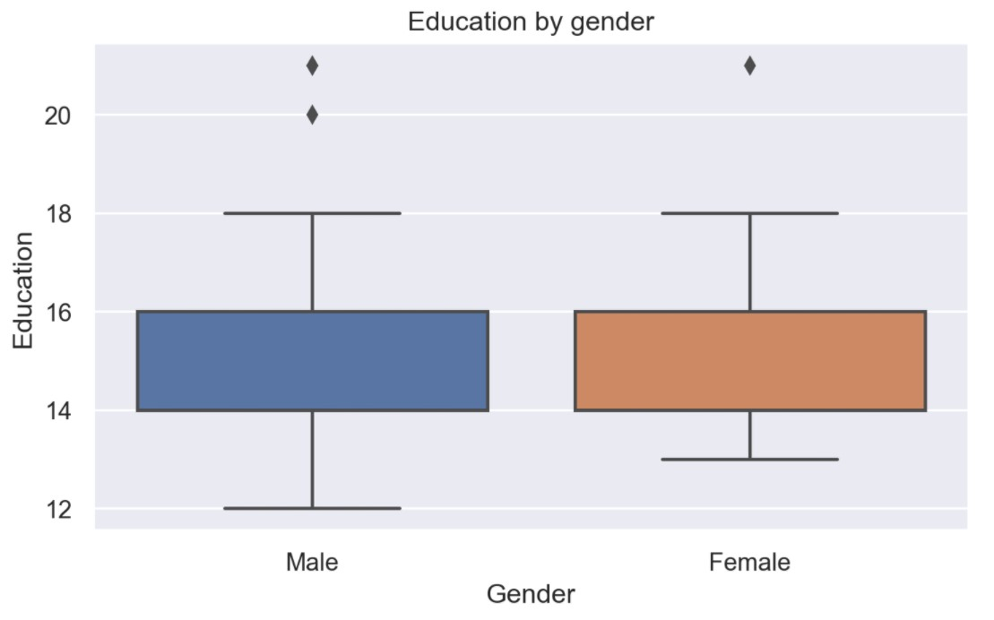
The level of education that the Male clients have is a range minimum of 12 years and a maximum of 18 years with the Q3 being 16 years and Q1 being 14 years. We also see outliers above 18 years.
The level of education that Female clients have is a range minimum of 13 years and a maximum of 18 years with the Q3 being 16 years and Q1 being 14 years. We also see outliers above the 18 years.

Slide 6
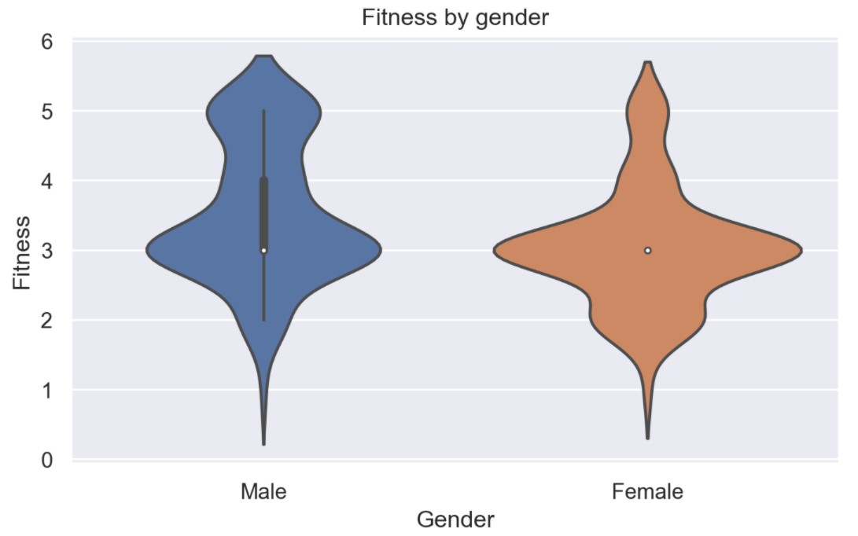
Men self-rated themselves a little more in terms of fitness score.

Slide 7
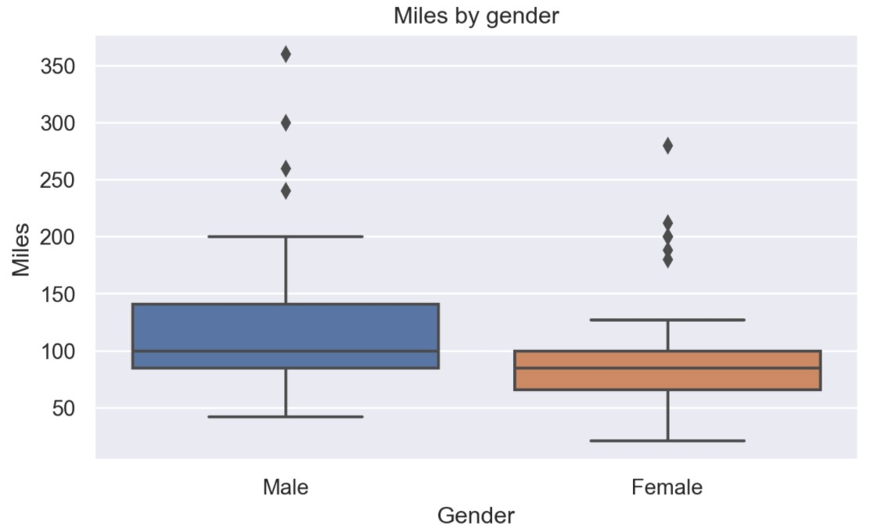
Men believe themselves will run more miles, on average, than woman believe themselves running.

Slide 8
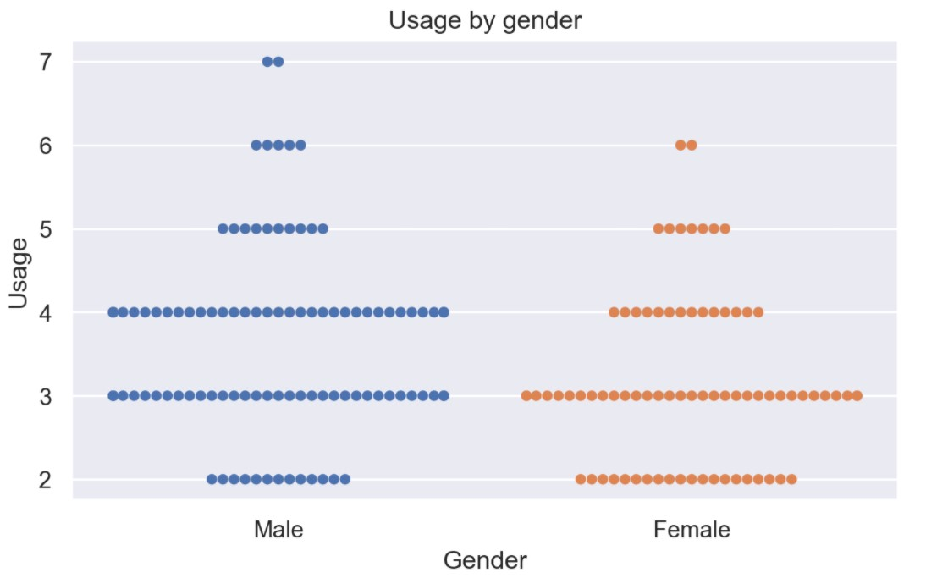
Men believe themselves will use the product more times, on average, than woman believe themselves using it.

Slide 9
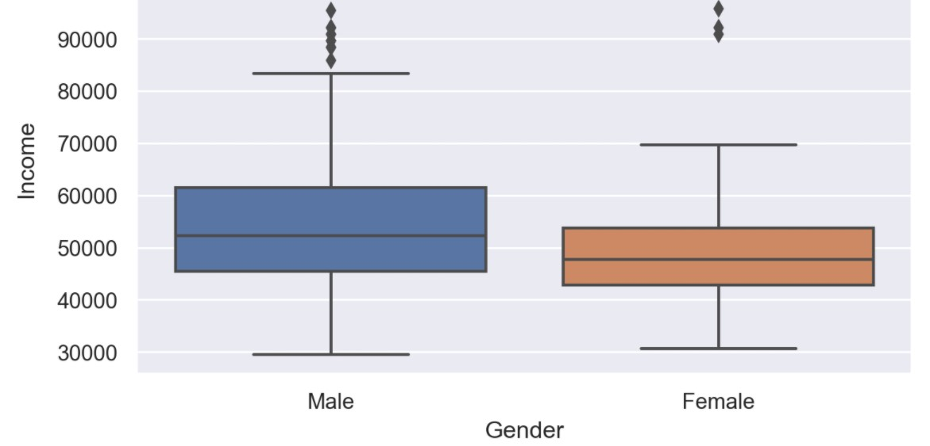
Men has a higher income, on average, than women

Slide 10
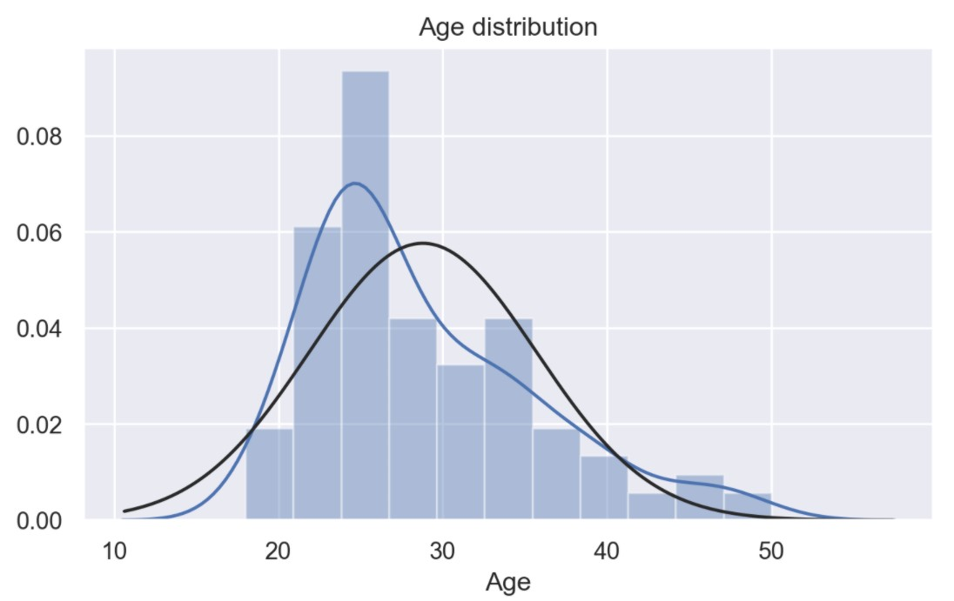
The age of our customers are positively skewed with a higher concentration between 35 years old and 18 years old.

Slide 11
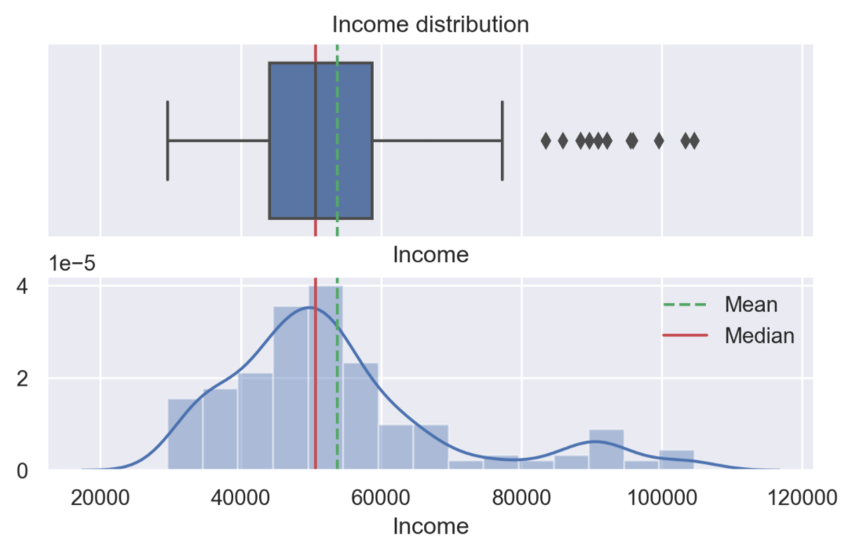
The income of our costumers are positively skewed with a higher concentration under $60,000.00.

Slide 12
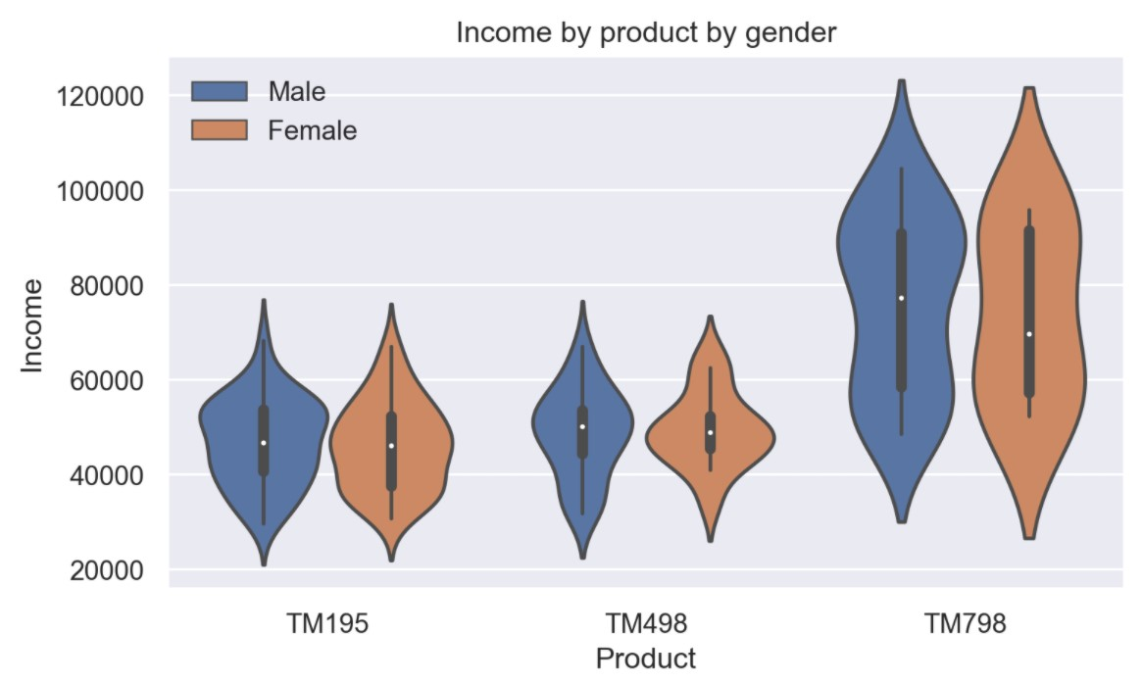
Customers that have a higher income level usually buy TM798.

Slide 13
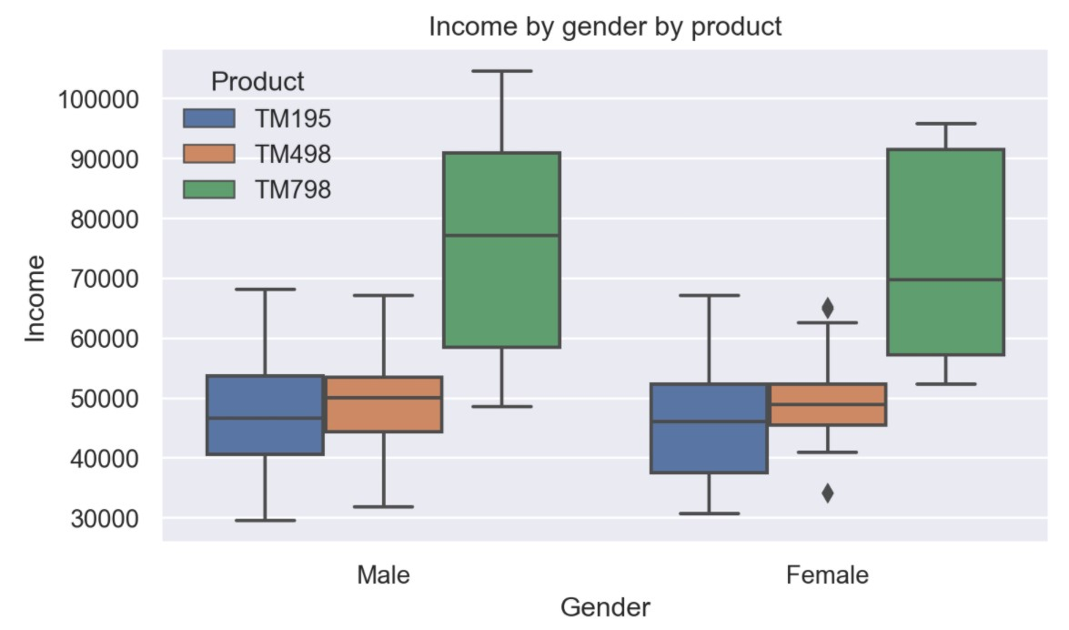
Customers that have a higher income level usually buy TM798.

Slide 14
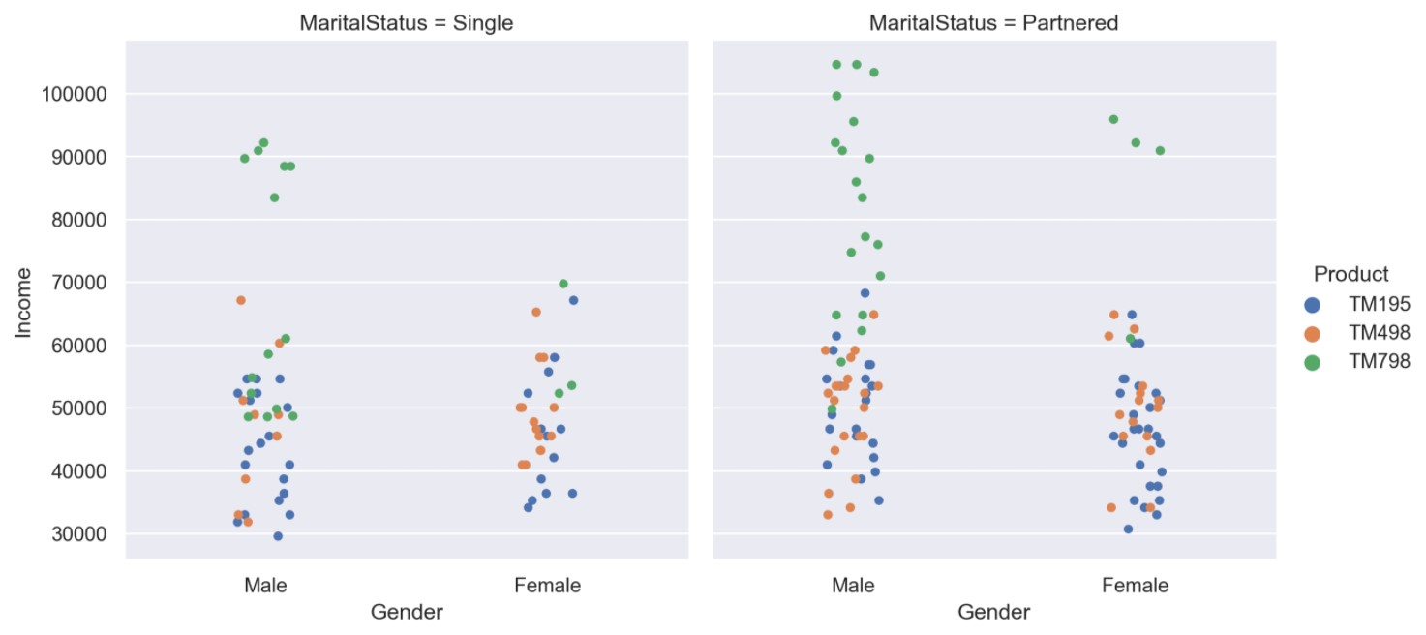
Products TM195 and TM498 are bought by people with lower than $70K as income, single or partnered.
We also see that most people who buys the TM798 are man, partnered.
Most of our buyers are men.

Slide 15
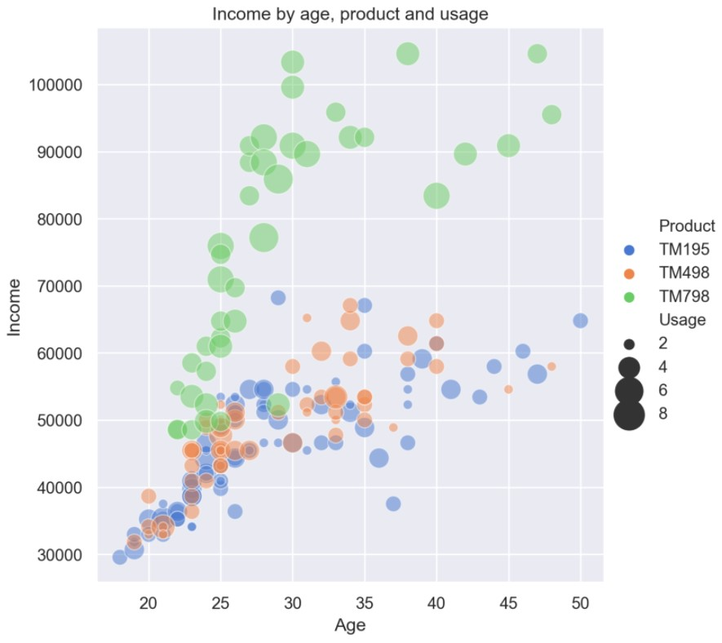
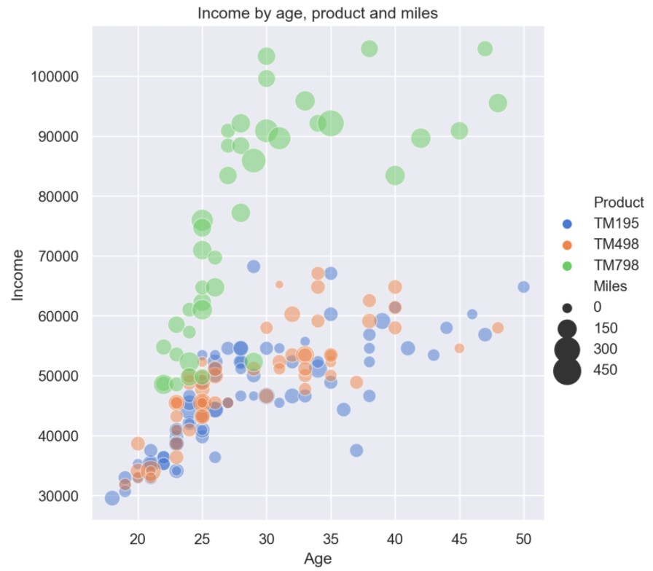
Products TM195 and TM498 are bought by people with lower than 70K as income.
Product TM798 is mainly bought by people with higher than 70K income.
We also see that most people who buys the TM798 think they will be able to run more
than customers of the other two products, on average.

Slide 16
Customers Insights

Slide 17
Insights
From our data, we have found that men self-rated themselves higher in fitness score than women, men believe themselves will run more miles, on average, than women believe themselves running, men believe themselves will use the product more times than women believe themselves using it, and men have a higher income, on average, than women in our dataset. Also, customers that are partnered have a higher income level. The main range of age who buy our products have between 35 and 20 years old, if we decide to approach a new market-share we should do field research on men and women older than 40 years old.

Slide 18
Insights
The income of our customers is positively skewed with a higher concentration of under $60,000.00. We know the clients who have a higher income level usually buy TM798 products. We might be able to divide our basket of products into two types. Class A and Classes B/C. The TM798 product is mainly bought by customers that are Class A, partnered, and male. It could be positioned as a prime product. We might be able to increase the price of the product which would bring a higher margin since the customer who buys that product has higher income level.

Slide 19
Conclusion
All that we find so far in our data allows us to think of creating marketing towards pushing limits to both, male and female, together as a couple since partnered people have a higher income. Since male have a higher income and higher confidence in their physical capability, we might have a possibility of creating marketing campaign towards men to buy the TM798 for a higher price, probably, they will be more willing to spend some amount of money on our products and would be the one who takes the decision to buy it.
The other two products the TM195 and TM498 our approach should be less specific and broader since both men and women with lower income level buys it. We would apply a standard merchandizing approach focusing on low price instead of branding and quality, as we might do with TM798 product.

