Slide 1

Axis Insurance
Business Statistics
Renato Barroco

Slide 2

This is an exploratory data analysis and business statistics analysis using a dataset provided by great learning at the Post Graduate program of Data Science and Business Analytics.
Business Statistics
The main goal is to apply hypothesis testing in order to arrive to statistically significant conclusions based on the test of Null hypothesis vs. alternate Hypothesis

Slide 3

Dataset
1. Age - This is an integer indicating the age of the primary beneficiary (excluding those above 64 years, since they are generally covered by the government).
2. Sex - This is the policy holder's gender, either male or female.
3. BMI - This is the body mass index (BMI), which provides a sense of how over or under-weight a person is relative to their height. BMI is equal to weight (in kilograms) divided by height (in meters) squared. An ideal BMI is within the range of 18.5 to 24.9.
4. Children - This is an integer indicating the number of children / dependents covered by the insurance plan.
5. Smoker - This is yes or no depending on whether the insured regularly smokes tobacco.
6. Region - This is the beneficiary's place of residence in the U.S., divided into four geographic regions - northeast, southeast, southwest, or northwest.
7. Charges - Individual medical costs billed to health insurance

Slide 4

Data description
Numerical:
- age: Average age is 39.20 years old, max age is 64 and min age is 18, and std is 14.04;
- bmi: Average bmi is 30.66 above the ideal range between 18.5 and 24.9, min is 15.96, max is 53.13 (super high), and std is 6.09;
- children: Average children (count) 1.09, min is 0.0, max is 5.0, and std is 1.20;
- charges: Average charges 13270.42, min is 1121.87, max is 63770.42, and std is 12110.01;
Categorical:
- sex: male and female;
- smoker: yes or no;
- regions: northeast, southeast, southwest, or northwest;

Slide 5
1) Explore the dataset and extract insights using Exploratory Data Analysis

Slide 6
Univariate analysis
Skewness for age is: 0.055
Skewness for bmi is: 0.283
Skewness for children is: 0.937
Skewness for charges is: 1.514
- We can see that all our numerical variables have a positive "skewness", which means that the "average" is greater than the "median".
- We can also see many outliers in the "charges" and "bmi" features.
the company has and produce insights to improve sales.

Slide 7
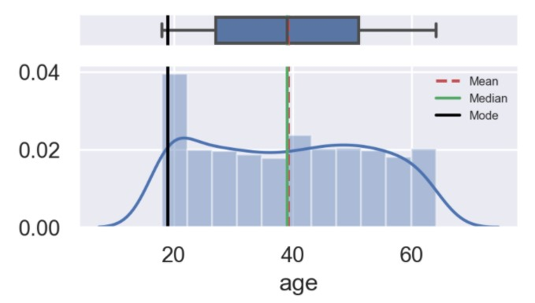
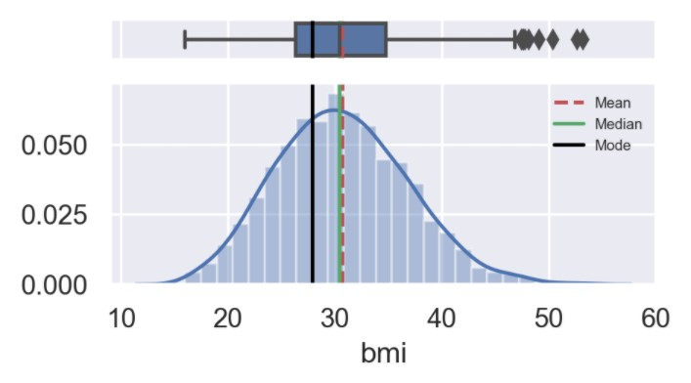
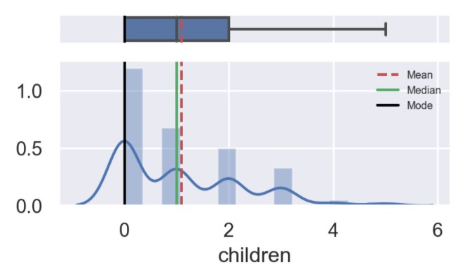
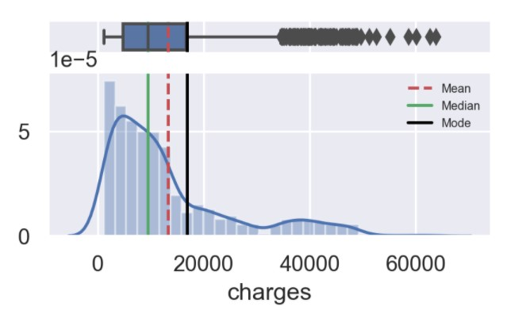

Slide 8
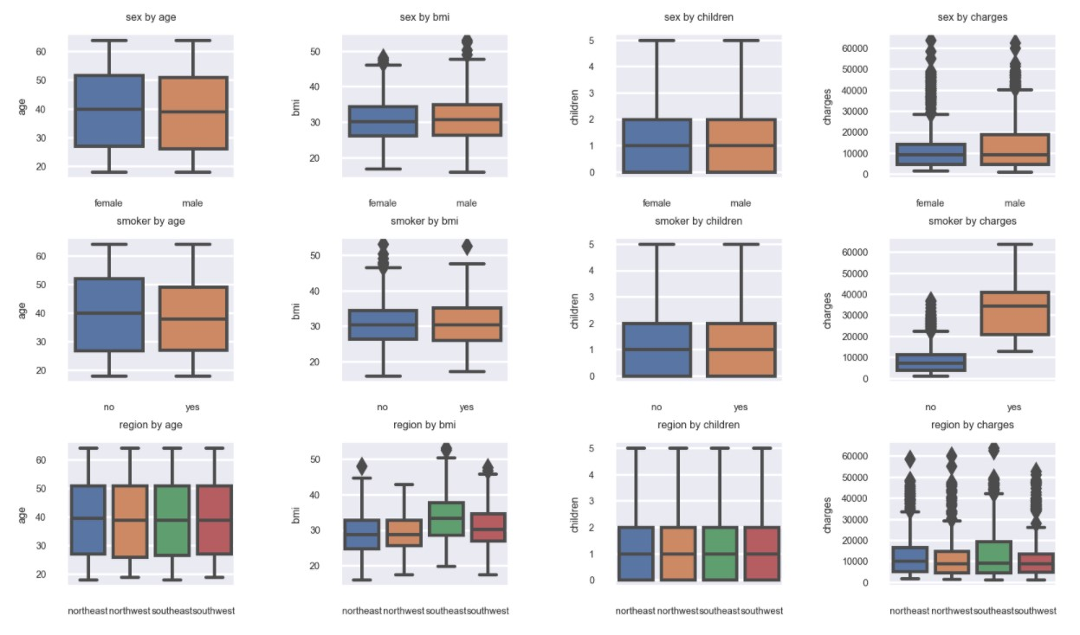
Bivariate Analysis

Slide 9
Categorical sex:
sex by age: age is similar between male and female.
sex by bmi: we can see a higher average BMI among men and a greater number of outliers, compared to women.
sex by children: children is similar between male and female.
sex by charges: we can see a greater number of outliers for charges in women than in men. (graph 1)
Categorical smoker:
smoker by age: nonsmokers has a slightly higher average age than smokers.
smoker by bmi: higher number of outliers for bmi in nonsmoke; however, the average for smokers and nonsmokers is almost the same level.
smoker by children: the profile of smokers and nonsmokers who have children is similar.
smoker by charges: smokers have higher charges than nonsmokers. (graph 2)
Categorical region:
region by age: age pattern is similar between different regions.
region by bmi: southeast has the higher level of bmi. Average and absolute. (graph 3)
region by children: children pattern is similar between different regions.
region by charges: southeast seems to be the most skewed data with the highest value for charges. (graph 4)

Slide 10
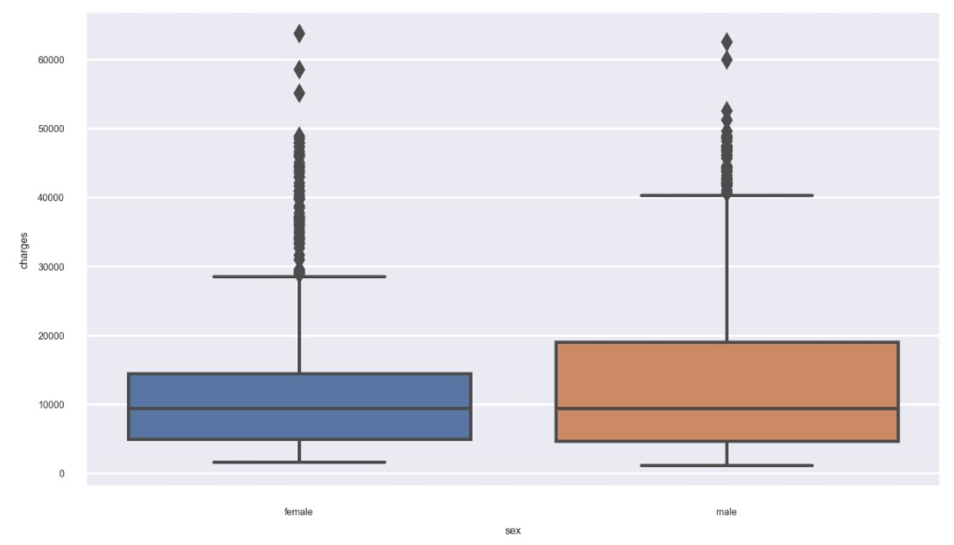
Sex by charges
Sex by charges: we can see a greater number of outliers for charges in women than in men.

Slide 11
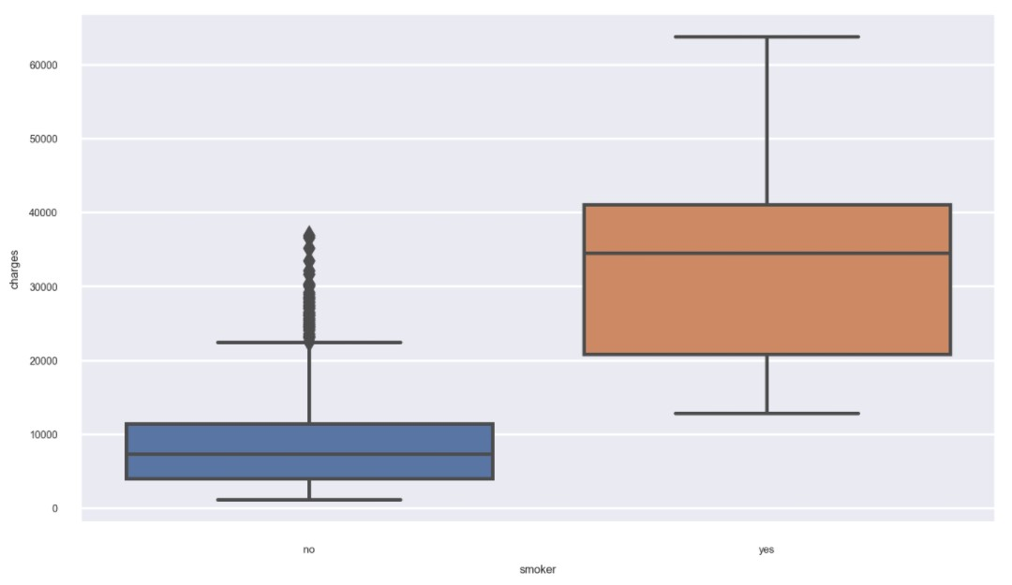
Smoker by charges
smoker by charges: smokers have higher charges than nonsmokers.

Slide 12
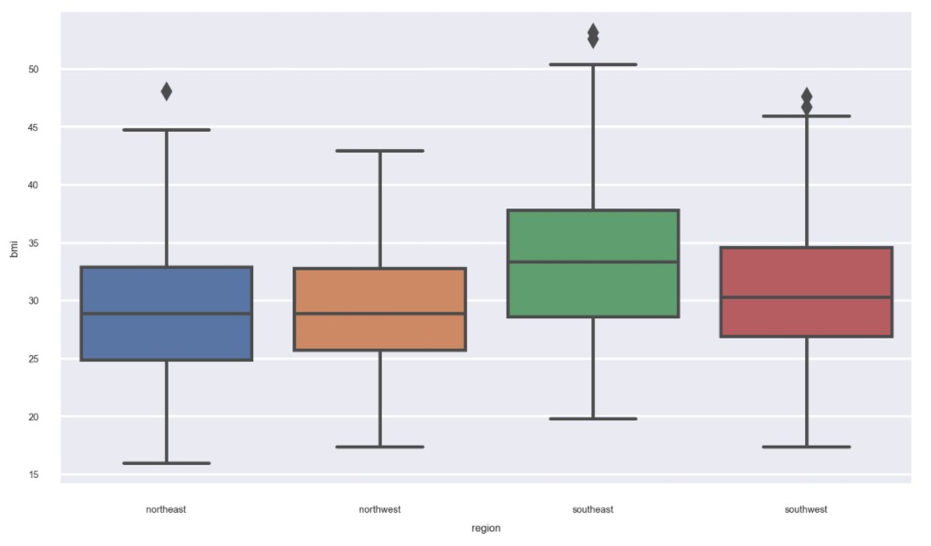
Region by bmi
region by bmi: southeast has the higher level of bmi. Average and absolute.

Slide 13
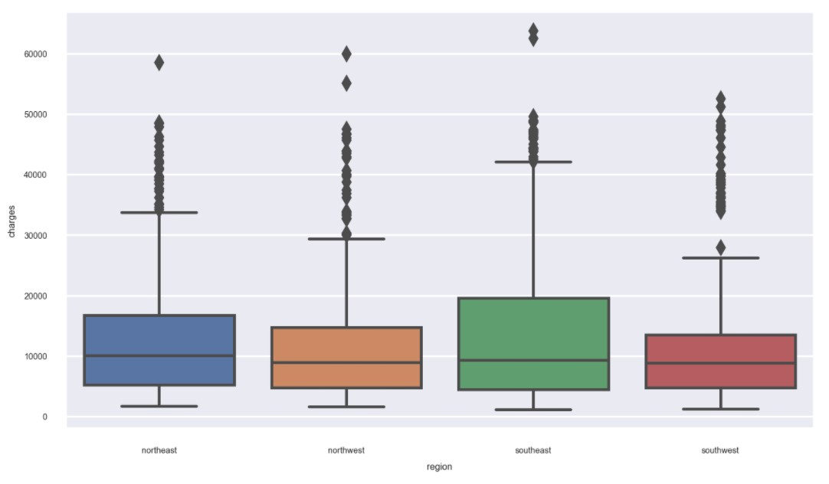
Region by charges
region by charges: southeast seems to be the most skewed data with the highest value for charges.

Slide 14
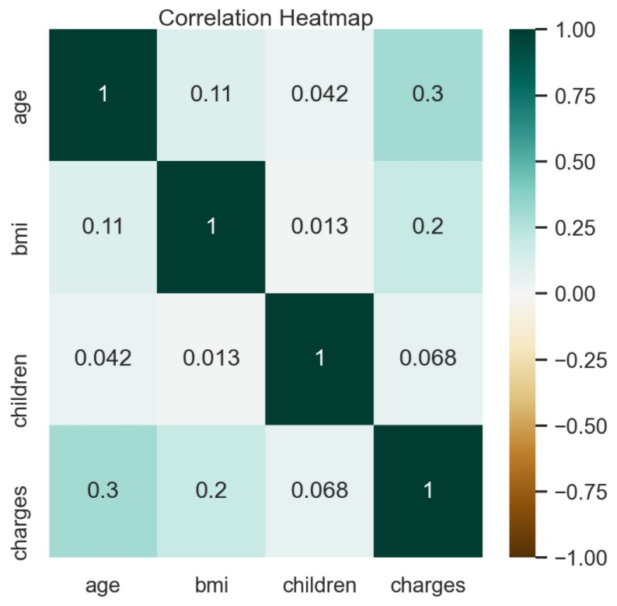
Multivariate analysis
- age and changes: have the highest correlation among our features.
- bmi and charges: have the second highest correlation among our features.

Slide 15
2) Prove (or disprove) that the medical claims made by the people who smoke is greater than those who don't?

Slide 16
Step 1: Define null and alternative hypotheses;
H0: μ1 <= μ2 The average charges of smokers is smaller or equal than nonsmokers
Ha: μ1 > μ2 The average charges of smokers is greater than nonsmokers
Step 2: Decide the significance level;
α = 0.05
Step 3: Identify the test;
We don't know the standard deviation of the population, so we should use a t-test two samples.
Step 4: Calculate the test-statistics and p-value
tstats = 30.168…,
p_value onetail = 1.08e-118
Step 5: Decide to reject or accept null hypothesis
This is a one tail test, since P-value is less than 0.05, we reject the null hypothesis and can conclude that people who smoke have an average larger medical claim. Furthermore, when we compare the result of our bivariate analysis between smokers and charges with the result of our p_value, we come to a similar conclusion graphically.

Slide 17
3) Prove (or disprove) with statistical evidence that the BMI of females is different from that of males.

Slide 18
Step 1: Define null and alternative hypotheses;
H₀: x̄₁ = x̄₂, There is no difference between the males BMI and female BMI means.
H_{A}: x̄₁ != x̄₂, There is difference between the males BMI and female BMI means.
Step 2: Decide the significance level;
α = 0.05
Step 3: Identify the test;
We don't know the standard deviation of the populations, so we should use a t-test two-sample.
Step 4: Calculate the test-statistics and p-value¶
tstats = 1.696…. ,
p_value = 0.0899…
Step 5: Decide to reject or accept null hypothesis
This is a two tailed test. As the P value (0.089) > 0.05 (confidence level) we fail to reject the null hypothesis and we can conclude that there is no a difference in the two averages.

Slide 19
4) Is the proportion of smokers significantly different across different regions?

Slide 20
Step 1: Define null and alternative hypotheses;
H₀: Smokers proportions are independent across different regions
H₁: Smokers proportions are dependent across different regions
Step 2: Decide the significance level;
α = 0.05
Step 3: Identify the test;
We will use two different categorical variables, smoker and region. I am planning to convert smoker into numeric variable so that I can use the raw frequencies of "yes" equal to 1 and "no" equal to zero in a contingency table. This is a Chi-sq Test where categorical data has been reported in raw frequencies.
Step 4: Calculate the test-statistics and p-value
pval = 0.0617
Step 5: Decide to reject or accept null hypothesis
Since the p-value is greater than 0.05 (0.0617…), greater than (alpha), we fail to reject the null hypothesis, which means that smokers proportions are not independent of the region.

Slide 21
5) Is the mean BMI of women with no children, one child, and two children the same? Explain your answer with statistical evidence.

Slide 22

Step 1: Define null and alternative hypotheses;
H₀: The means of BMI with respect to women with no children, one child, and two children is equal.
H₁: At least one of the means of BMI with respect to women with no children, one child, and two children is unequal.
Step 2: Decide the significance level;
α = 0.05
Step 3: Identify the test;
One-way ANOVA - Equality of population through variances of samples.
Step 4: Calculate the test-statistics and p-value
Step 5: Decide to reject or accept null hypothesis
We fail to reject the null hypothesis which states that the means of BMI with respect to women with no children, one child, and two children is equal, p_value (> 0.05)

