Slide 1
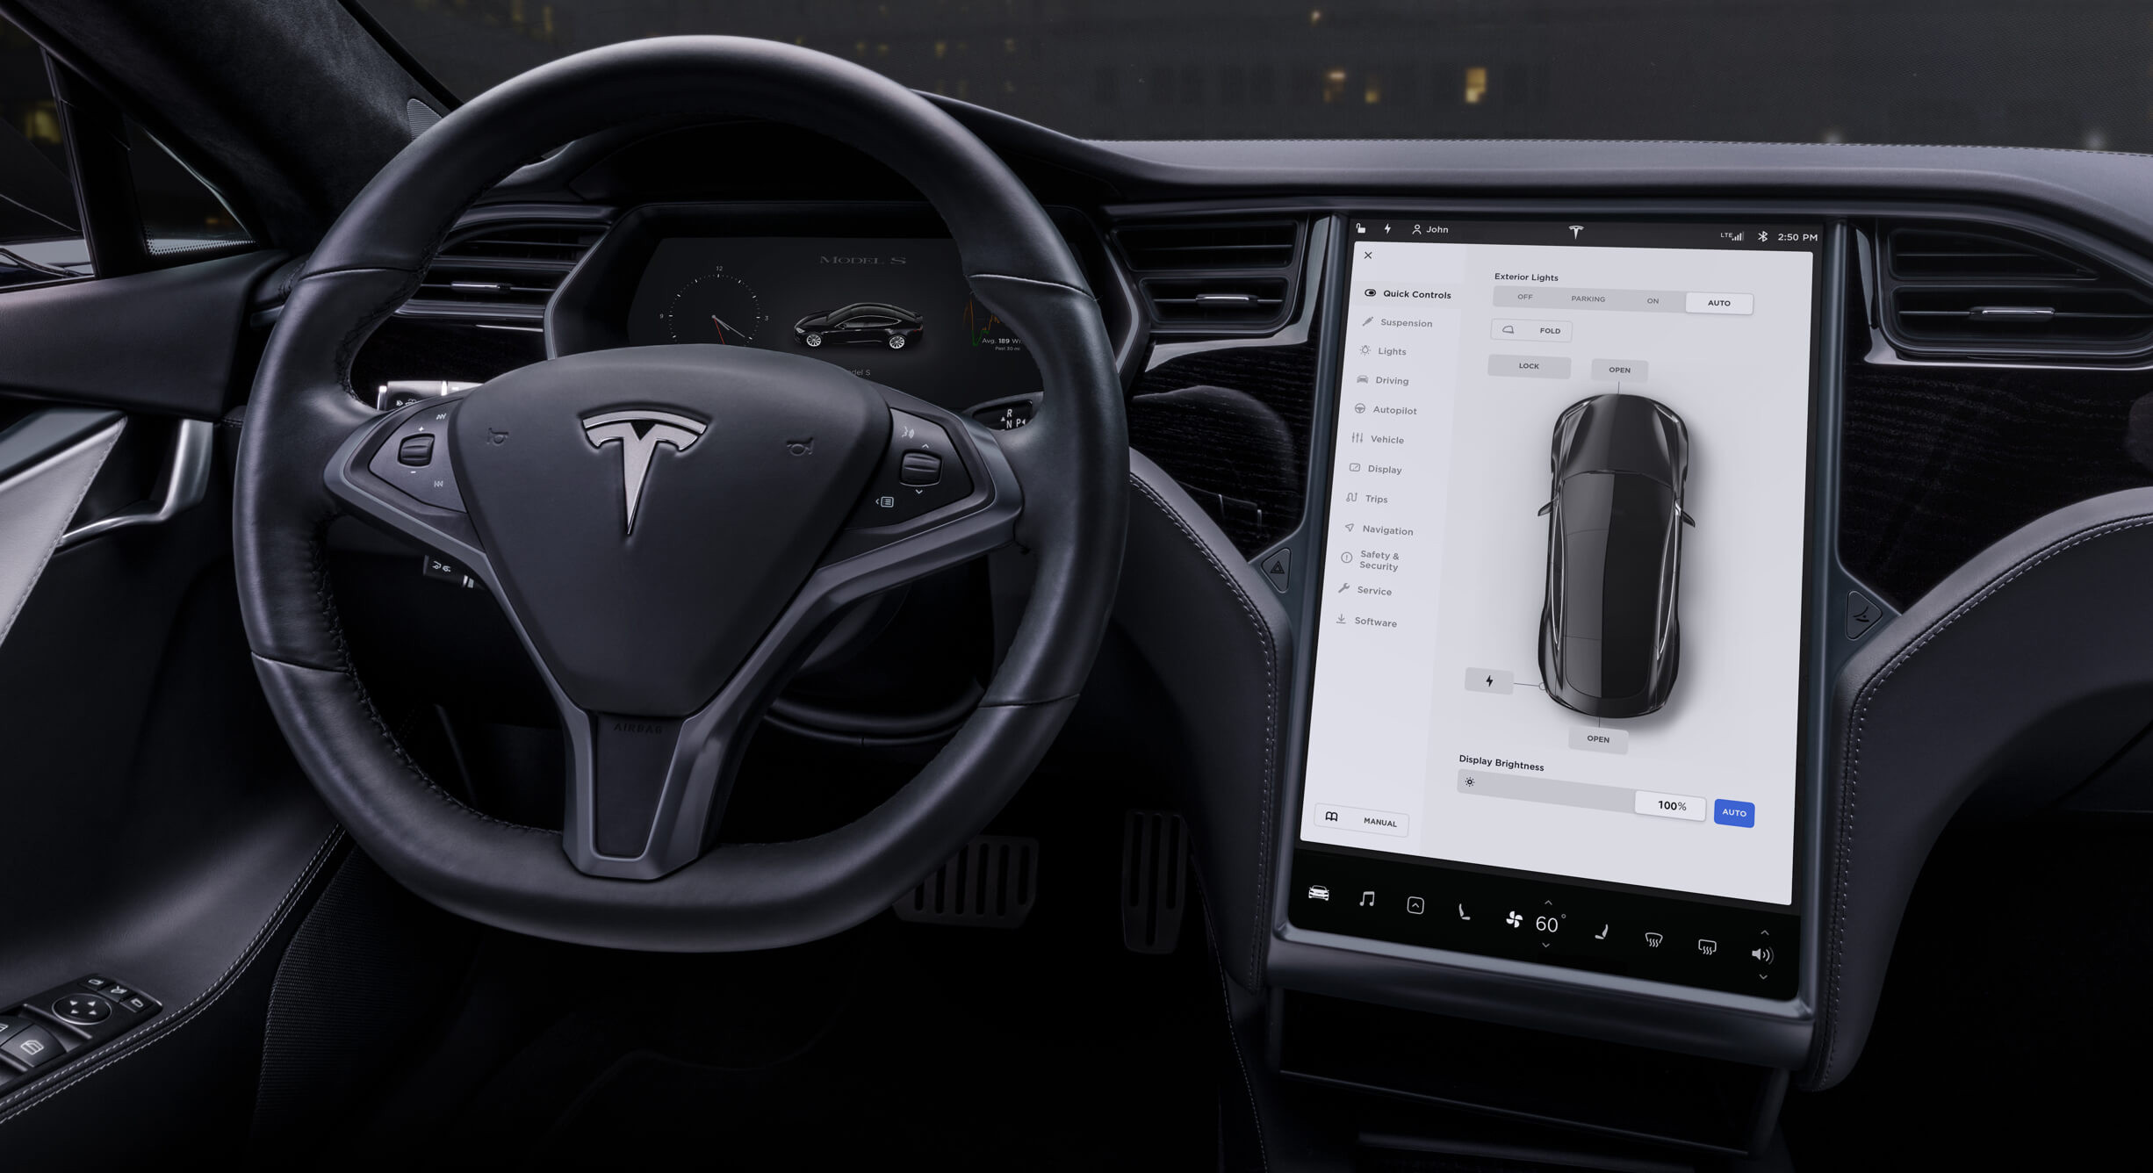
Tesla Company Analysis

Slide 2
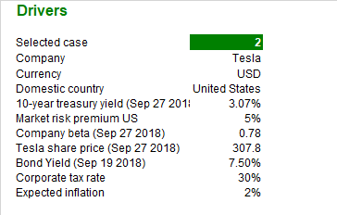
Drivers
Select provides a flexible model.
This is an Analysis about Tesla company.
The model currency is USD.
UST10 is our yield on September 27, 2018.
The market risk premium is 5%.
The beta on September 27, 2018 is 0.78
Tesla’s price on September 27, 2018 is 307.8
Bond yield on September 19, 2018 is 7.5%.
The corporate tax rate is 30%, estimated.
Expected inflation of 2%.

Slide 3
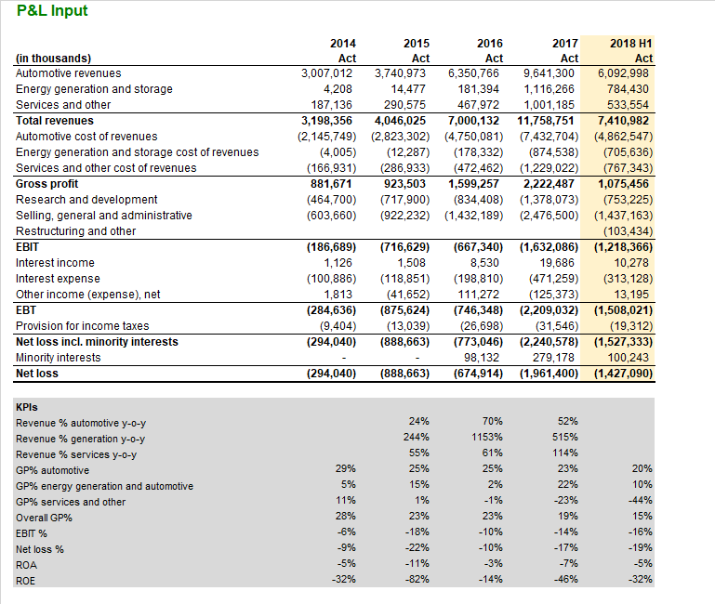
P&L Input
KPIs are calculated on year-to-year validation.

Slide 4
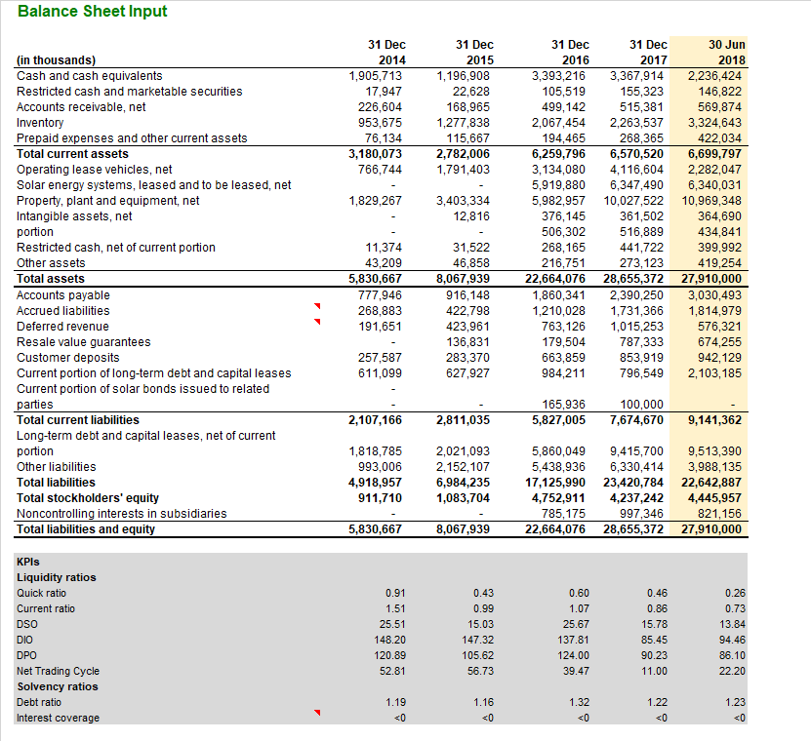
Inputs →
Balance Sheet Input
Here we have measures on liquidity and solvency ratios.
Liquidity ratios above 1 and, Solvency ratios to prove a company's long-term financial health.

Slide 5
Income Statements Items

Slide 6
Automotive 1st business line
More than 80% of Tesla revenues in 2017.

Slide 7
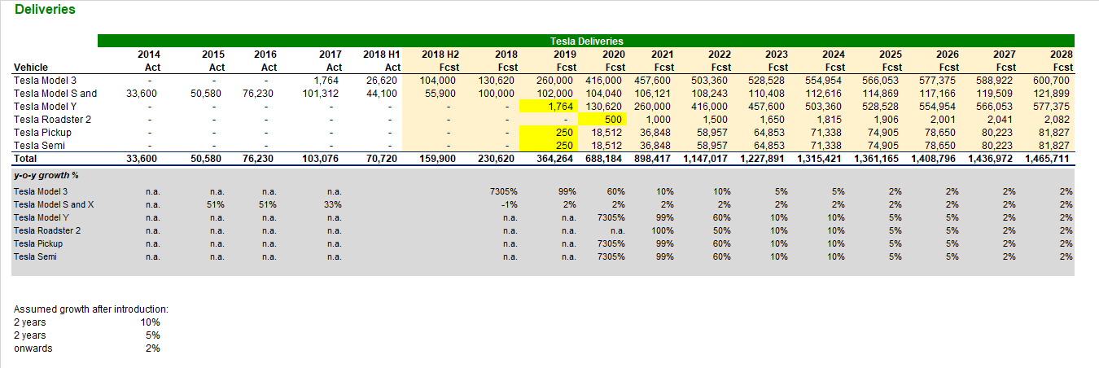
Automotive
Deliveries
Revenue = Number of vehicles delivered X Average price
The Model Y, Roadster 2, Pickup, and Semi models are new models and should start to be delivered after 2018, we need to forecast those deliveries and we do it based on similar industry numbers, and Tesla actual numbers up to this date.

Slide 8
Automotive
Deliveries
The forecast for Model 3, 2018 H2 is based on 26 weeks 4000 deliveries per week, in 2019 the estimate was based on 5000 deliveries per week, in 2020 forecast is based on 52 weeks and 8000 deliveries per week, then 2 years of 10% growth, 2 years of 5% and onwards 2% (which corresponds to long-term inflation). It is reasonable estimate if consider the growth that the company has in deliveries up to this date.

Slide 9
Automotive
Deliveries
The Model S and X are being analyzed together; the Model Y is estimated replicating the Model 3. The Roadster 2 is a fancier car, so it starts with 500 deliveries, increases by 100%, then 50%, afterwards it grows as model 3. Pickup and Semi reflect the same type of growth in our model.
NOTE: Deliveries reflect revenue, which is the basis of a financial model.

Slide 10
Deliveries development

Slide 11
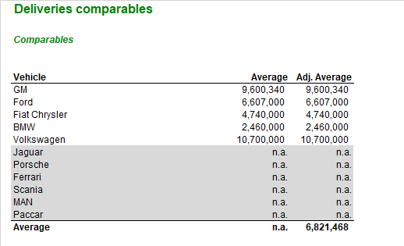
Deliveries comparable
It is important to cross-check our estimate with actual market data, “sanity check”.
In these comparable deliveries, we find an average delivery for companies like GM, Ford, Fiat, BMW and Volkswagen.
We do not take other listed companies into consideration just because we want to make sure that we are comparing the general companies' deliveries with the Tesla company deliveries, not model by model.

Slide 12
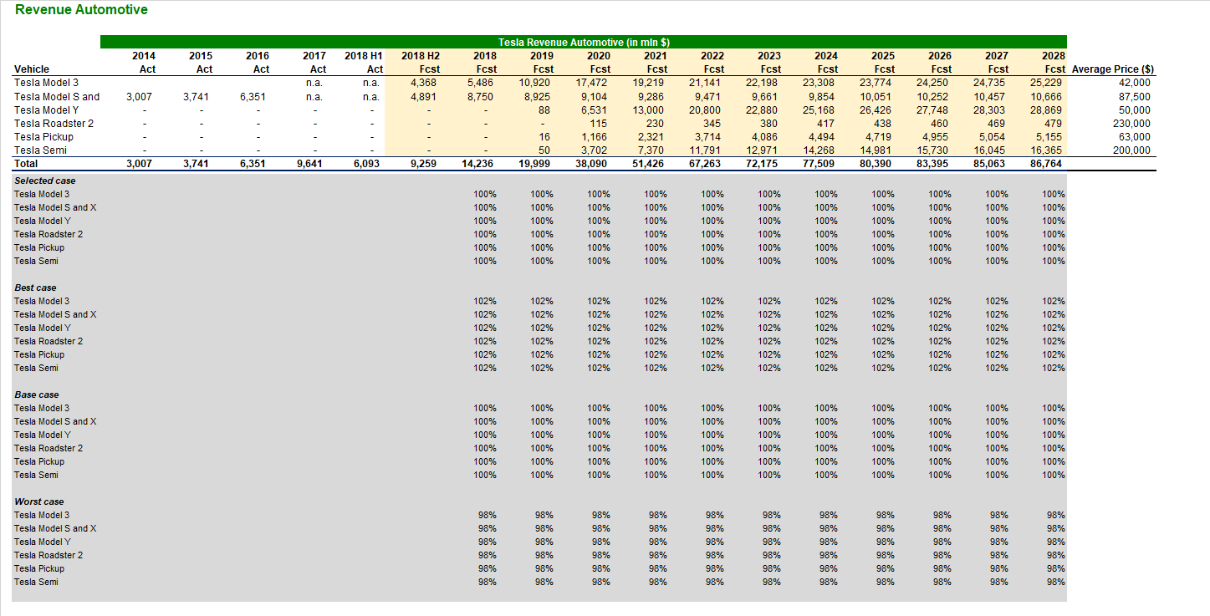
Revenue Automotive
Average prices based on: https://cleantechnica.com/2017/12/25/tesla-vehicle-revenue-2022-73-7-billion/

Slide 13
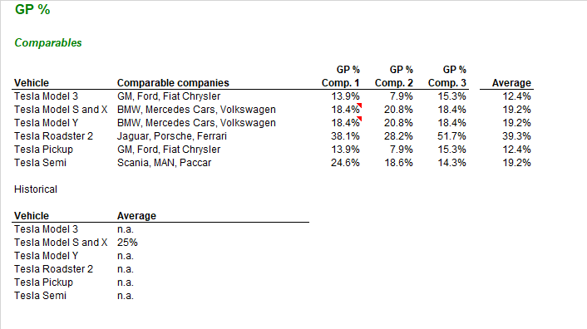
Gross Profit (%)
Gross Profit % divided by Model.
Estimating is based on available public information, taking similar models and averaging is a great way to make a forecast.

Slide 14
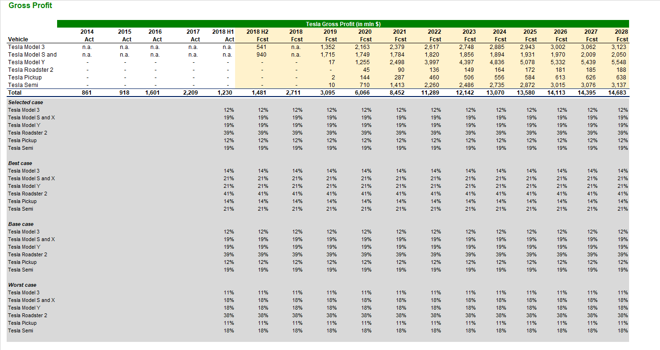
Gross Profit
The best and worst cases are done by adding or subtracting 1.5% of the base case.

Slide 15
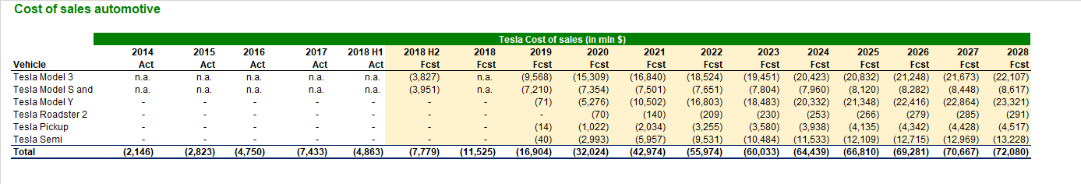
Cost of sales automotive
Gross Profit = Revenues – Cost of sales, easy to calculate with the data we have.
NOTE: Until now we had estimates of delivery, average price of each model, gross profit of each model and now we reach the cost of sales using the formula above.

Slide 16
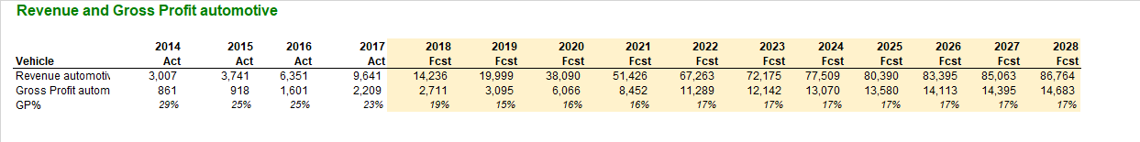
Revenue and GP automotive
We can see that the GP% decreases as the company starts selling more cars with a smaller margin, for example, the Model 3.

Slide 17
Energy & Other 2nd business line

Slide 18
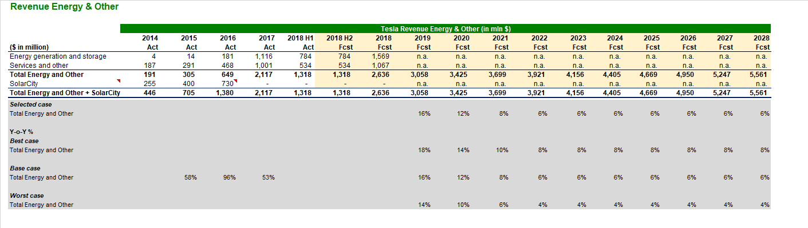
Revenue Energy & Other
The data for 2018 H2 is estimated to be equal 2018 H1. SolarCity is integrated to Tesla.
The estimated growth in our base case is conservative and goes as follows: 16%, 12%, 8%, and 6% onwards. The best and worst case we add or subtract 2%.

Slide 19
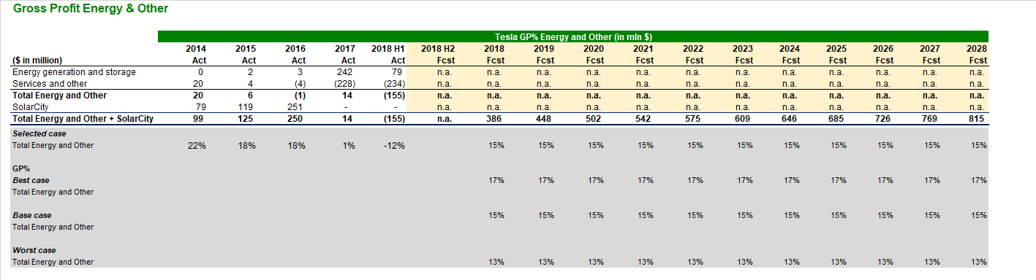
Gross Profit Energy & Other
The gross profit was calculated based on the average of 2014, 2015, 2016, and 2017. The best and worst case we add or subtract 2%.

Slide 20
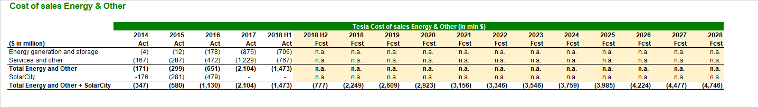
Cost of sales Energy & Other
Gross Profit = Revenues – Cost of sales, easy to calculate with the data we have.

Slide 21
Operating expenses

Slide 22
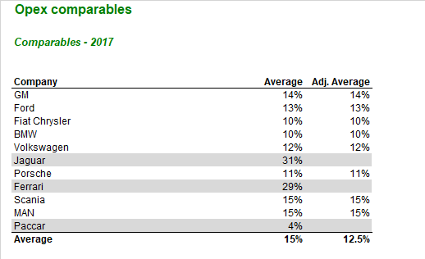
Opex
Tesla is not a young or mature company. The benefits of the scale do not yet apply to it in the year 2018. It is important to check that operating expenses will decrease as soon as the company is able to take advantage of the economy of scale.
The best approach to calculate Opex was to find information from competitors and average them, not considering companies with outlier’s values as an Opex margin (%), instead the average of the market.

Slide 23
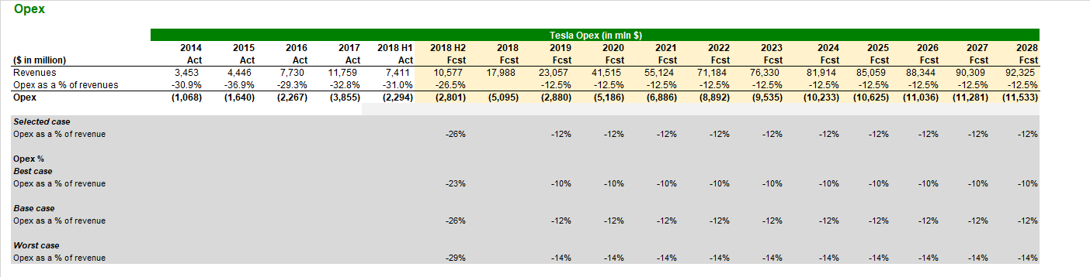
Opex
Opex as a % of revenues.
Opex to the 2018 H2 is based on average for the past years. The best and worst case we add or subtract 3%.
Opex to the others forecasted periods are based on average of competitors. The best and worst case we add or subtract 2%.

Slide 24
Balance Sheet

Slide 25
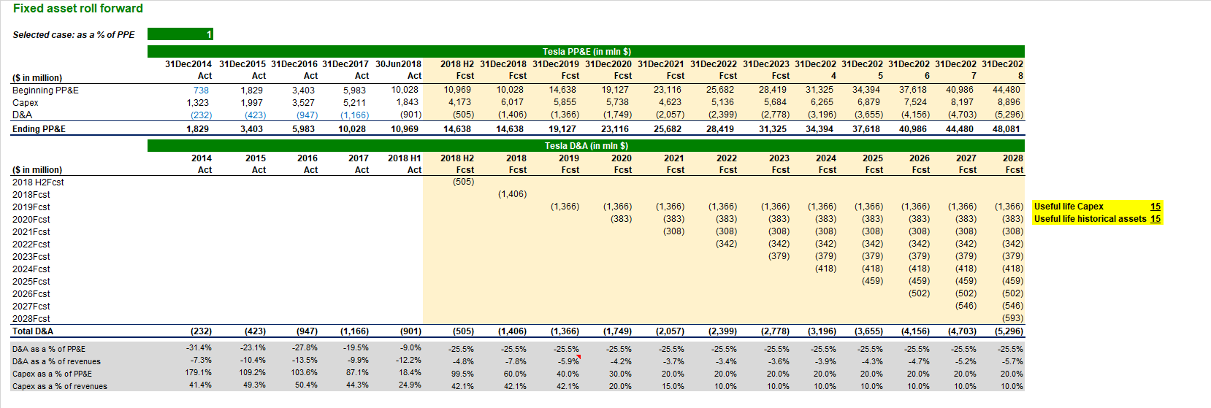
Property, Plant & Equipment
Ending PP&E = Beginning PP&E + Capex – D&A
Capex can be modeled in two approaches:
Model as a % of Beginning PP&E (2018 H2 average applied, 2019 60%, 2020 40%, 2021 30%, 20% onwards).
Model as a % of revenues (2018 H2, 2019 average applied, 2020 20%, 2021 15%, 10% onwards).

Slide 26
Property, Plant & Equipment
It is possible to do a sanity check of D&A as a % of revenues of other companies in the industry.
We can’t do it with Capex, because it is difficult to find Capex data.
NOTE: D&A H2 2018 -> D&A of historical assets + D&A of Capex H2 2018

Slide 27
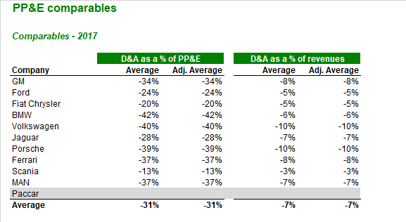
PP&E
With D&A forecasted we can calculate:
1. D&A as a % of PP&E 2. D&A as a % of revenues.
We can do a sanity check since D&A is easier to find public information than capex.
NOTE: It is better to use Capex as a percentage of revenue in growing business, as the business will need improvements as it grows. PP&E is important to verify the historical information of how much CAPEX represented for PP&E.

Slide 28
Working capital

Slide 29
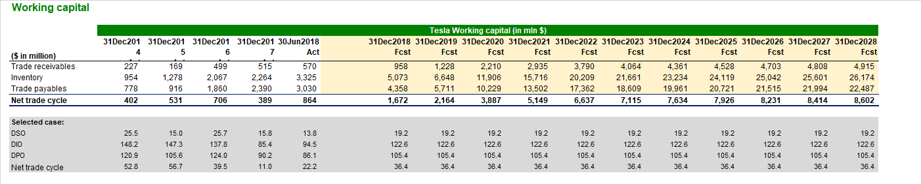
Working Capital
Net trade cycle = DSO + DIO - DPO.
Using the average to forecast the future, from it we can calculate Trade receivables, Inventory and Trade payables.
Trade receivables = (DSO * Revenue) / 360
Trade receivables = (DIO * Cogs) / 360
Trade payables = (DPO * Cogs) / 360

Slide 30
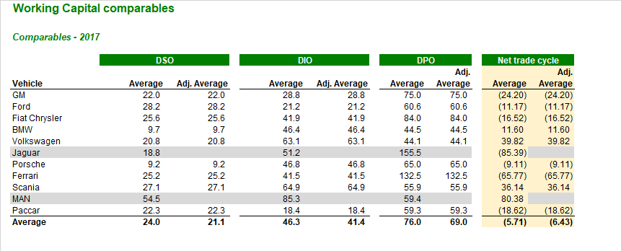
Net trade cycle
It is closer to the Porsche production than anything else. Perhaps a revision of that number should be relevant to futures models.

Slide 31
Financing

Slide 32
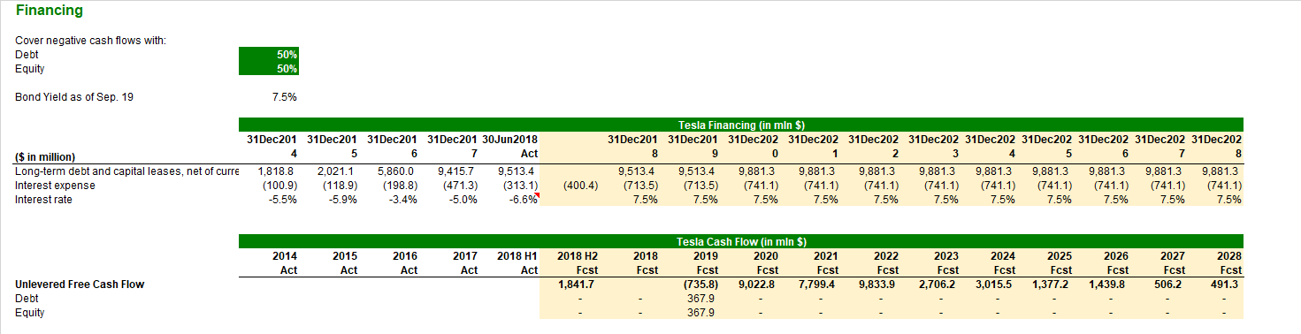
Financing
Assumption #1:
UFCF<0, The company will raise financing on the first day of the following year.
Assumption #2:
The capital structure of the company if 50% debt and 50% equity
Assumption #3:
Cost of debt is constant (unreal assumption but easier to calculate),
7,5% Tesla bonds yield at the time.

Slide 33
Financing
Outstanding debt (end of 2018) = Outstanding debt (end of 2017) + newly raised debt (2018)
Interest expense = Outstanding debt * Interest rate

Slide 34
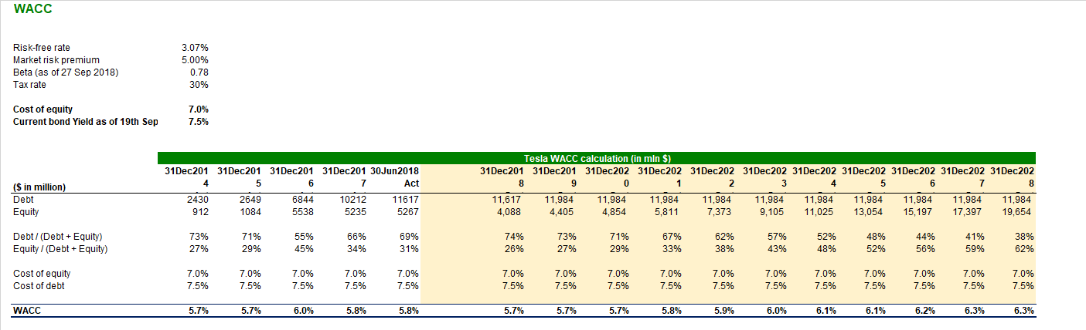
WACC
CAPM Formula:
Cost of equity = Risk-Free Rate of Return + Beta * (Market Rate of Return – Risk free Rate of Return)

Slide 35
Output

Slide 36
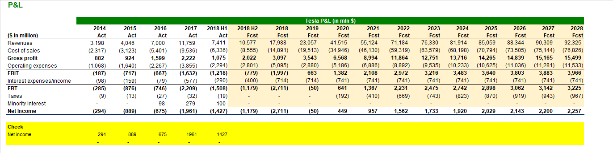
P & L
Revenues = Automotive revenue + Energy & Other revenue.

Slide 37
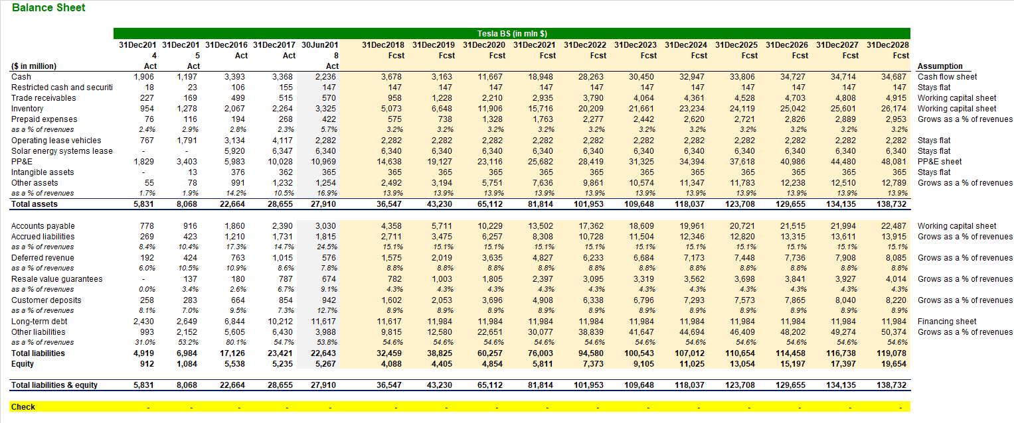
Balance Sheet
Ending cash = Beginning cash + Net cash flow
NOTE: Assumption of growth of assets and liabilities are made on the right column.

Slide 38
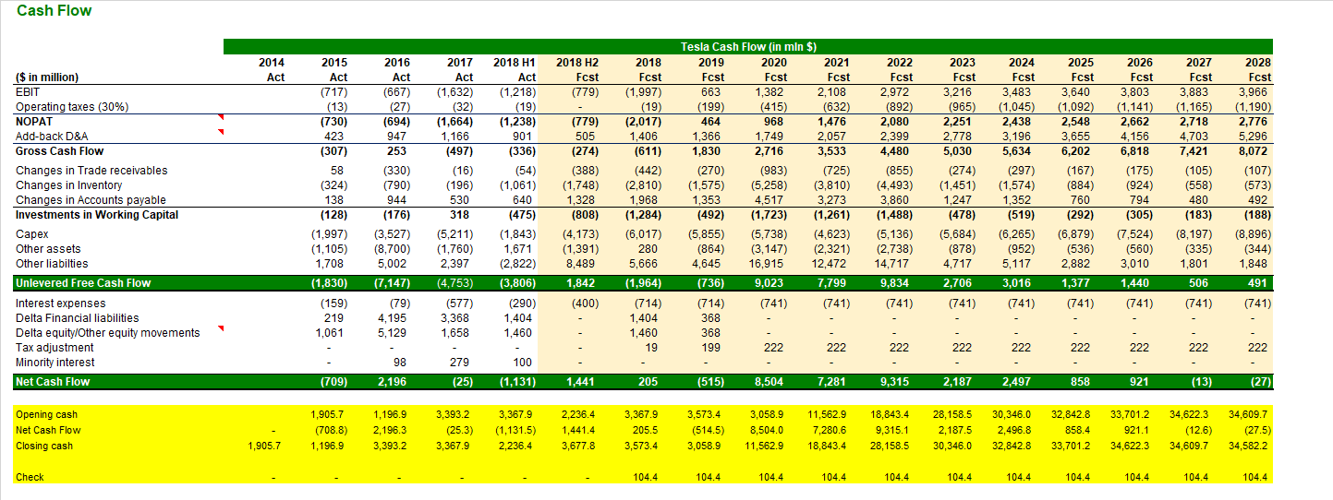
Cash Flow
Unlevered free cash flow, which helps the company to figure out the need for financing in the future.
NOTE: Other assets = Restricted Cash and Securities, Prepaid expenses, Operating Lease vehicles, Solar Energy system leased, Intangible assets, and Other assets.

Slide 39
Cash Flow
NOTE: Operating taxes are different from cash taxes. D&A is a non-monetary expenses.
To calculate WC: when assets increase cash outflow (-), when assets decrease cash inflow (+). For liabilities, when liabilities increase cash inflow (+), when liabilities decrease cash outflow (-). Capex is money that the company spends (-).

Slide 40
Cash Flow
1. Other assets = Restricted Cash and Securities, Prepaid expenses, Operating Lease vehicles, Solar Energy system leased, Intangible assets, and Other assets.
2. Other Liabilities = Accrued Liabilities, Deferred revenue, Resale value guarantees, Customer deposits, and other liabilities.

Slide 41
Cash Flow
Unlevered Free Cash Flow = Gross Cash Flow + Investment in Working Capital + Capex + Other assets + Other liabilities
NOTE: Unlevered Free Cash Flow (debt free company)

Slide 42
Cash Flow
Net Cash Flow = Interest Expense
+ Delta Financial Liabilities = (Debt current period – Debt previous period)
+ Delta equity = (Ending equity – Beginning equity +/- Net income/loss +/- Other equity movement (dividends or any increase of Capital))
+ Tax adjustment = Taxes (P&L) – Operating taxes (Cash Flow)
+ Minority interest (in the P&L)

Slide 43
Thank you

